Slide 2
DAM-Alarming
Data Analytics from Monitoring, for alarming
Summer Student Project 2015
A. Martin, C. Cristovao, G. Domenico
thanks to Luca Magnoni
IT-SDC-MI
31/08/2015

Slide 3
Introduction
Evaluation and implementation of CEP mechanisms
to act upon infrastructure metrics monitored by Ganglia
WLCG is integrating cloud technologies providing an additional approach for delivering computing capacity
Ganglia is being adopted as monitoring system for clouds
Re-purposing raw monitoring data in order to detect anomalies

Slide 4
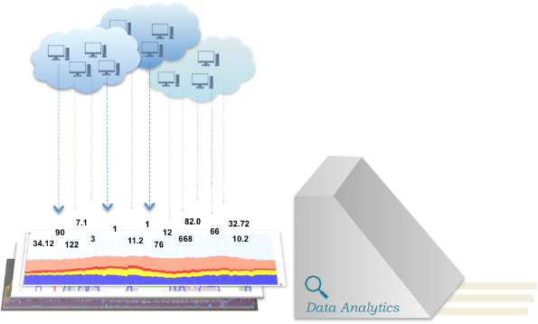
DAM Overview
Resource profiling
Accounting
Alarming

Slide 5




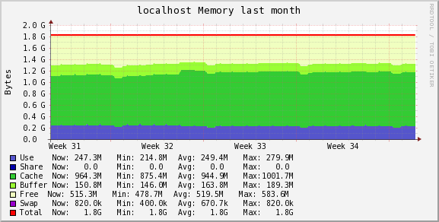
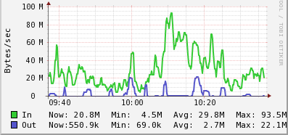
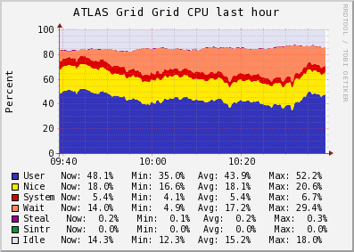
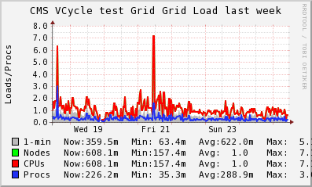
DAM-Alarming
architecture
DAM-Alarming
@
H
H
ESPER
S
S
UDP
TCP
X
M
L
OU
T
P
U
T
◆
◆
◆
◆
◆
◆
Event Processing statements
H
: host event. Contains last metrics’ values per host
S
: status event. Contains current host status
◆
: intermediate events

Slide 6

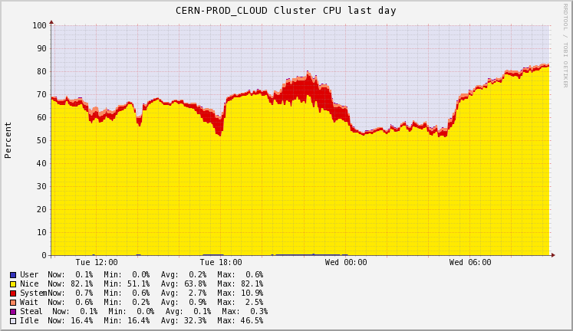
Ganglia
introducing the distributed monitoring system
Scalable distributed monitoring system
“Designed for high-performance computing systems such as clusters and Grids”
Open source project
Collecting a standard set of monitoring metrics (cpu, memory, disk, …)
Providing web interface for visualizing host performance

Slide 7


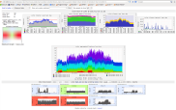
Expected deployment use case
Multiple gmonds on server, one per cluster
GMETAD
UDP
GMOND
GMOND
GMOND
VM
VM

Slide 8
Fitting DAM-Alarming in deployment
Contacting each gmond on a server to retrieve monitoring data
TCP
DAM-Alarming
UDP
GMOND
GMOND
GMOND
VM
VM
Notes:
Gmetad still providing web interface

Slide 9

Complex Event Processing (CEP)
Set of technologies to process events and discover complex patterns among their streams
Goal: identify meaningful events and promptly respond to them
Query
Query
Query
Events
Continuous processing
Notifications

Slide 10

ESPER
introducing the event processing engine
Open source CEP solution
Strong performance, in memory computation
Strong community and support
In use at IT-SDC: Metis monitoring system
Simple Java API
Event types compliant with several input formats (including POJO and Map objects)
Event Processing language (EPL): SQL-like statements
Notes:
500 000 events/ s on a dual CPU 2GHz Intel based hardware

Slide 11
Examples of EPL statements
Filtering events
Aggregation functions
Pattern matching
select * from ReportEvent where cpu_idle > 85;
select avg(cpu_idle) from ReportEvent.win:time(20 minutes);
select * from pattern [
every s=Status(state=State.OK) -> (
timer:interval(5 minutes) and not s_update=Status(hostname=s.hostname, cluster=s.cluster))
];

Slide 12
GANGLIA
Monitoring model
from events describing raw data
GangliaReport
All parsed metrics
Raw data parsed into GangliaReport events

Slide 13
GANGLIA
Monitoring model
first layer of EPL statements
GangliaReport
All parsed metrics
Raw data parsed into GangliaReport events
First EPL statement determines the host state based on cpu_idle
  Possibility to correlate
  metrics
EPL
select hostname, VO, cluster, monitor, reported,
avg(cpu_idle) as ave, cpu_idle as lastVal,
'cpu_idle' as metricName, 'high cpu_idle' as problem
case
when avg(cpu_idle) > 85 then State.ERROR
when avg(cpu_idle) > 70 then State.WARNING
when cpu_idle is null then State.UNKNOWN
else State.OK
end as state
from GangliaReport.win:time(var_timeWindowLength min)
group by hostname,cluster;

Slide 14
GANGLIA
Monitoring model
events describing host state
GangliaReport
All parsed metrics
Raw data parsed into GangliaReport events
First EPL statement determines the host state
based on cpu_idle
Check Events describe the hosts state at current time
EPL
Check
State, relevant metric, average

Slide 15
GANGLIA
Monitoring model
second level of EPL statements
GangliaReport
All parsed metrics
Raw data parsed into GangliaReport events
First EPL statement determines the host state
based on cpu_idle
Check Events describe the hosts state at current time
Second EPL keeps only Check events indicating state transitions: new event Status
EPL
Check
State, relevant metric, average
EPL
Status
State, relevant metric, average
select * from Check.std:groupwin(hostname, cluster).win:length(2)
where state is not prev(1, state) and prev(1, state) is not null;

Slide 16
GANGLIA
Monitoring model
alarming on status change
GangliaReport
All parsed metrics
Raw data parsed into GangliaReport events
First EPL statement determines the host state
based on cpu_idle
Check Events describe the hosts state at current time
Second EPL keeps only Check events indicating state transitions: new event Status
State transitions trigger alarms
EPL
Check
State, relevant metric, average
EPL
Status
State, relevant metric, average
ALARM

Slide 17
GANGLIA
Monitoring model v1.1
lessons learnt
GangliaReport
All parsed metrics
Filtering notifications became crucial for email alarming
Third statement was added
All status events still inserted into ES
EPL
Check
State, relevant metric, average
EPL
Status
State, relevant metric, average
ALARM
Notes:
Identify new

Slide 18
GANGLIA
Upgrading monitoring model
filtering email notifications
GangliaReport
All parsed metrics
Filtering notifications became crucial for email alarming
Third statement was added
All status events
inserted into ES
EPL
Check
State, relevant metric, average
EPL
ElasticSearch
Status
State, relevant metric, average
EPL
EMAIL
Notification
State, relevant metric, average

Slide 19
Ganglia Information System ?
Current deployment details
Querying all 5 production Ganglia servers
  Used by ATLAS, CMS and LHCb
Poll interval: 15 seconds
1.5 seconds timeout for
retrieving from one server
JSON
XML
DAM-Alarming
XML
XML
Notes:
Talk about JSON with info about servers
Polling interval same as GMETAD
ATLAS CMS and LHCb including activities in EGI and Azure, among others

Slide 20
Parsing the Retrieved Data
understanding the monitoring data
<GANGLIA_XML VERSION="3.6.0" SOURCE="gmond">
<CLUSTER NAME="VAC.UKI-LT2-UCL-HEP.uk" LOCALTIME="1436969801" OWNER="unspecified" LATLONG="unspecified" URL="unspecified">
<HOST NAME="lcg-wn02-02.hep.ucl.ac.uk" IP="lcg-wn02-02.hep.ucl.ac.uk" TAGS="" REPORTED="1436969544" TN="257" TMAX="20" DMAX="1800" LOCATION="unspecified" GMOND_STARTED="1436969444">
<METRIC NAME="load_one" VAL="1.41" TYPE="float" UNITS=" " TN="267" TMAX="70" DMAX="0" SLOPE="both">
<EXTRA_DATA>
<EXTRA_ELEMENT NAME="GROUP" VAL="load"/>
<EXTRA_ELEMENT NAME="DESC" VAL="One minute load average"/>
<EXTRA_ELEMENT NAME="TITLE" VAL="One Minute Load Average"/>
</EXTRA_DATA>
</METRIC>
...... # total of 29 metrics per host (default)
<METRIC NAME="swap_free" VAL="4194300" TYPE="float" UNITS="KB" TN="293" TMAX="180" DMAX="0" SLOPE="both">
<EXTRA_DATA>
<EXTRA_ELEMENT NAME="GROUP" VAL="memory"/>
<EXTRA_ELEMENT NAME="DESC" VAL="Amount of available swap memory"/>
<EXTRA_ELEMENT NAME="TITLE" VAL="Free Swap Space"/>
</EXTRA_DATA>
</METRIC>
</HOST>
</CLUSTER>
</GANGLIA_XML>
snippet

Slide 21
Parsing the Retrieved Data
from XML to ESPER Event
Parsing into a Map object using SAX library
  Metrics describing gmond and report (timestamp, TN, hostname, cluster,...)
  Metrics describing host status (cpu_idle, mem_free, cpu_num, proc_total)
...
<HOST NAME="lcg-wn02-02.hep.ucl.ac.uk" IP="lcg-wn02-02.hep.ucl.ac.uk" TAGS="" REPORTED="1436969544" TN="257" TMAX="20" DMAX="1800" LOCATION="unspecified" GMOND_STARTED="1436969444">
<METRIC NAME="load_one" VAL="1.41" TYPE="float" UNITS=" " TN="267" TMAX="70" DMAX="0" SLOPE="both">
...
Map<String, Object> event = new HashMap<String, Object>();
event.put("hostname", "lcg-wn02-02.hep.ucl.ac.uk");
event.put(“tn", 257);
event.put(“reported", 1436969544);
event.put("cpu_idle", 85.0f);
event.put("cpu_num", 5);
event.put("proc_total", 4);
event.put("mem_free", 456123);
event.put(“gmondStarted", 1436969444);
event.put(“location", "unspecified");

Slide 22
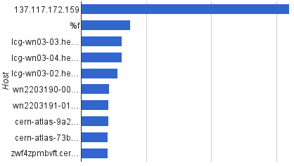
First statistics from live deployment
analyzing output of first two runs connected to production servers
Notifications per host in first run
  First run
    17 hours, produced 21 000 emails,
    more than 1200 emails/hour
    Averaged over 2 minutes,
  Second run
    16 hours, 500 email/hour
    Averaged over 15 minutes,
    tweaked first statement
100
799

Slide 23
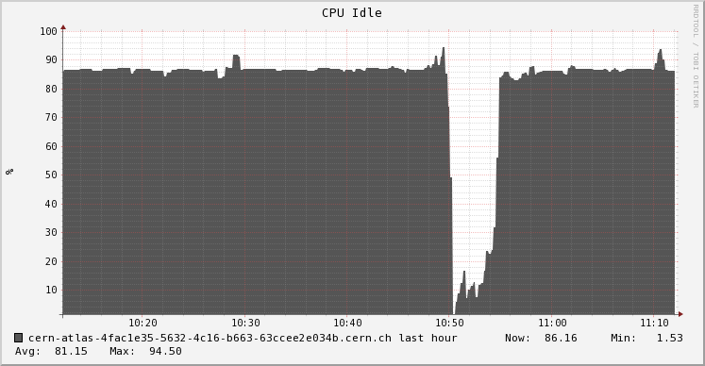
Filtering email notifications
hosts oscillating around fixed threshold
  Need to get rid of
  false positives
  6 mails in 40 minutes
ERROR
WARNING
OK
85
70

Slide 24
Filtering email notifications
hosts oscillating around fixed threshold
  Filtering out the notifications
  Combining states WARNING
  and ERROR into one
ERROR
WARNING
OK
85
70

Slide 25
Filtering email notifications
hosts oscillating around fixed threshold
  Filtering out the notifications
  Combining states WARNING
  and ERROR into one
  Reporting only long lasting
  OK state
ERROR
WARNING
OK
85
70

Slide 26
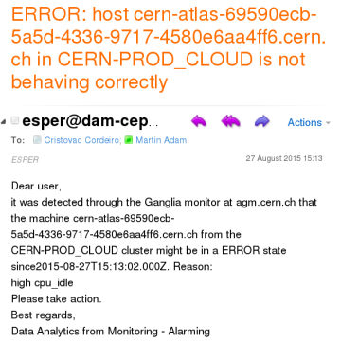
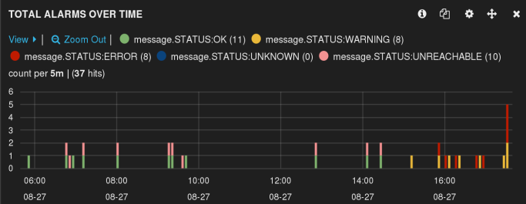
Filtering email notifications
successful example

Slide 27
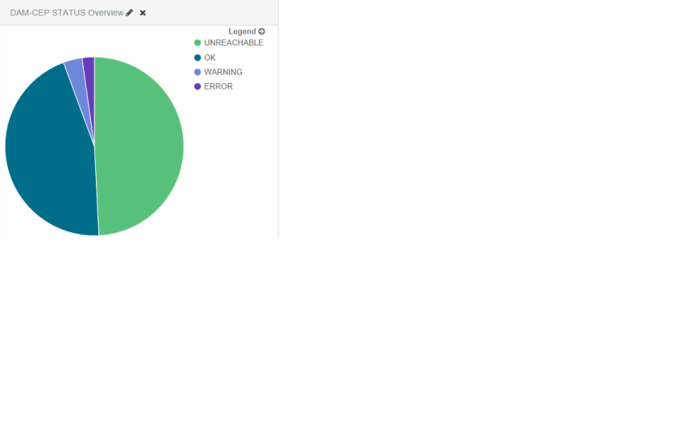
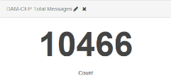
Evaluating statistics
during development
  Connected to ElasticSearch
  Sending messages via log4j
  to Logstash
  Visualizing using Kibana 3
  and Kibana 4
  Improved statistics evaluation efficiency

Slide 28
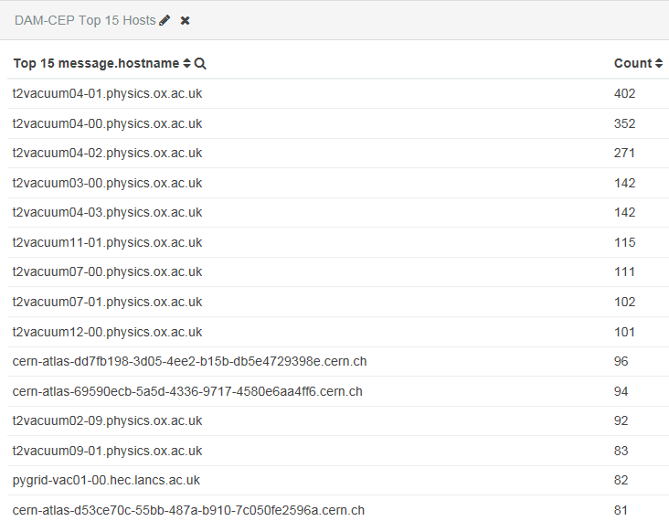
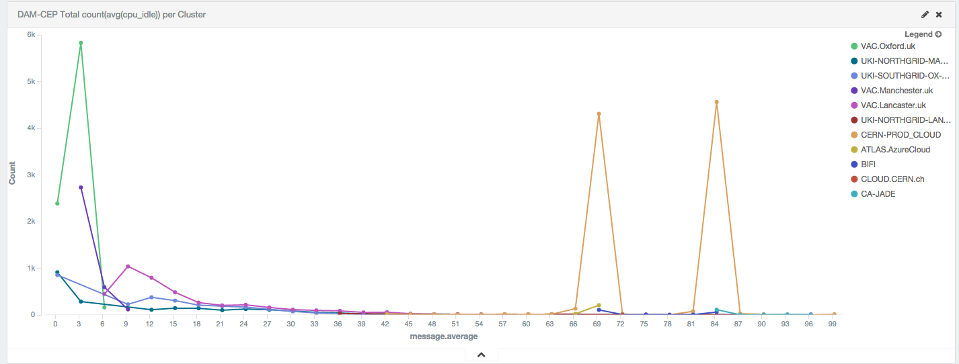
Kibana 4
more examples
  Simplifying aggregations

Slide 29
Concept proven!
Performance example after introducing mail notification filtering
  Real run statistics:
    Time: 27.08. 12:00 – 28.08. 12:00
    4417 machines
    8737 Status updates in ES
    106 emails

Slide 30
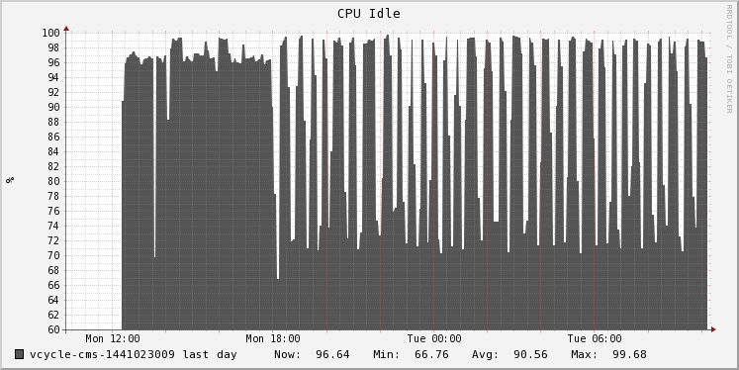
Challenges in alarming
hosts flapping at different rates
  Flapping
    Oscillating between states
    Difficult to detect
    Multiple kinds
    Variable period

Slide 31
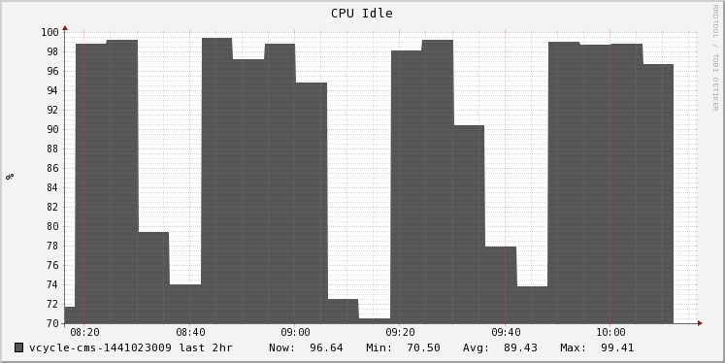
Challenges in alarming
hosts flapping at different rates
  Flapping
    Oscillating between states
    Difficult to detect
    Multiple kinds
    Variable period
  Detection based on fixed
  values
    Number of status changes in a fixed time window

Slide 32
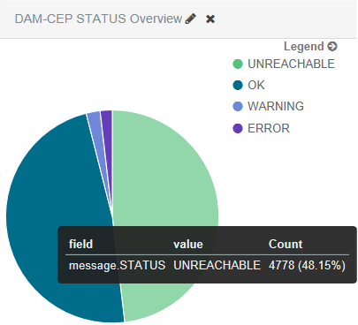
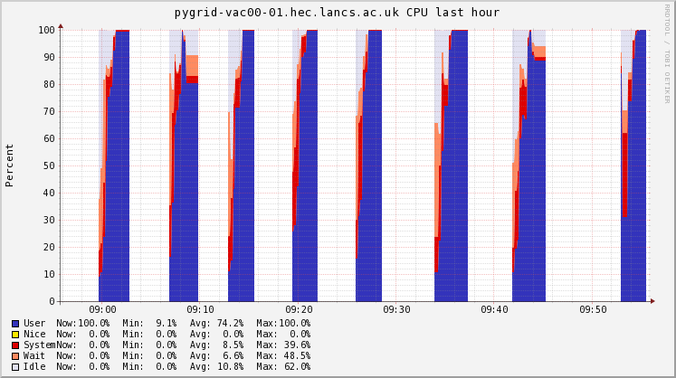
Challenges in alarming
unreachable hosts
  Detecting Unreachable status by checking
  the freshness of the report

Slide 33

Future Work
Improve classification
Flapping detection
Revision of alarming model (aggregate alarms per cluster)

Slide 34
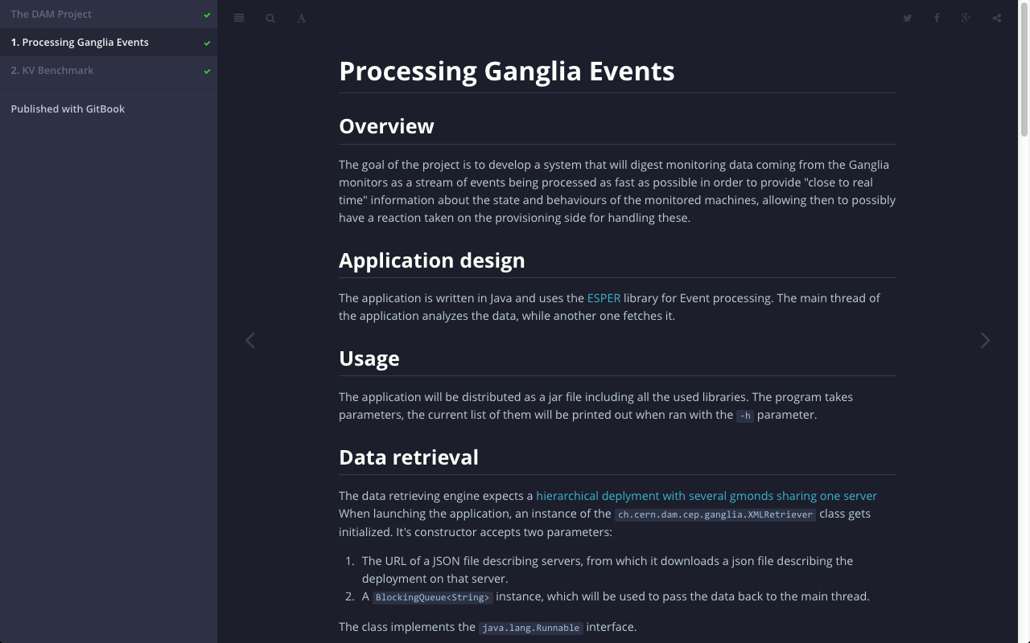
Project documentation
GitBook documentation with link to JavaDoc
https://sdcdam.web.cern.ch/sdcdam/DAM-CEP/index.html

Slide 35
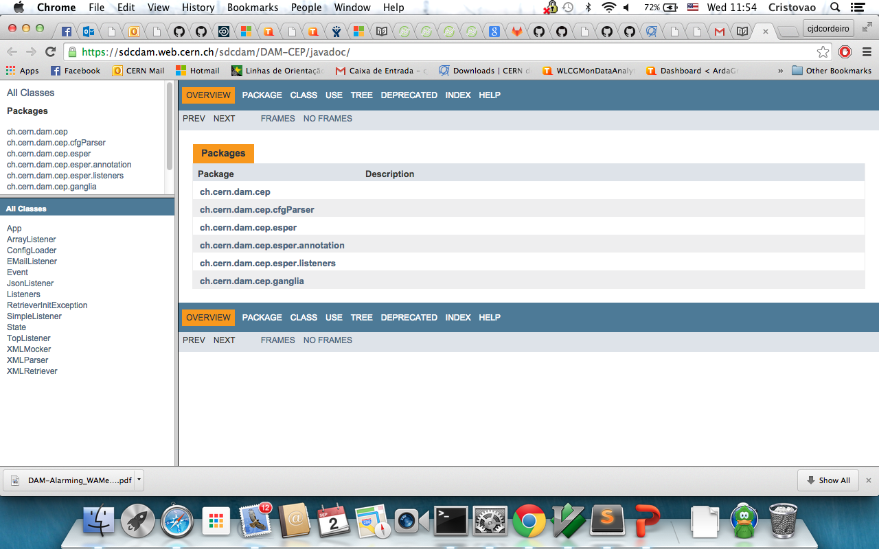
Project documentation
GitBook documentation with link to JavaDoc
https://sdcdam.web.cern.ch/sdcdam/DAM-CEP/javadoc/

Slide 36
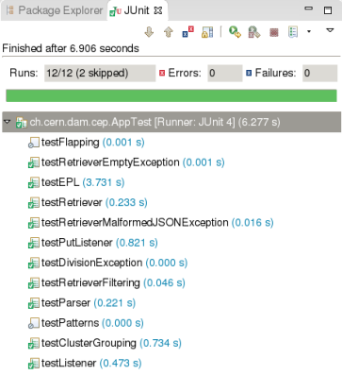
Testing applications components
  Testing all components
  Using JUnit testing suite to implement Unit test

Slide 37
Testing EPL statements
// initializing ESPER engine and load EPL modules
EPRuntime cepRT = initEsper("test");
// creating test event
Map<String, Object> eventOK = new HashMap<String, Object>();
eventOK.put("hostname", "lhcb-cloud.cern.ch"); eventOK.put("reported", 1435924725);
eventOK.put("state", State.OK);
// sending first event
cepRT.sendEvent(eventOK, EVENT_TYPE);
// shifting time
long timeInMillis = System.currentTimeMillis();
timeInMillis += 15000;
timeEvent = new CurrentTimeEvent(timeInMillis); cepRT.sendEvent(timeEvent);
// sending second event
cepRT.sendEvent(eventOK, EVENT_TYPE);
  Using JUnit testing suite
  Help when developing statements
  Could control time to test time windows and time based patterns

Slide 38
Conclusion
Successfully implemented an anomaly detection and alarming system based on raw monitoring data coming from Ganglia
Tested on 5 production cloud monitoring Ganglia servers
Detecting anomalies based on cpu_idle and reporting them without spamming
Injecting all status transitions into ES
Processing more than 65 000 events/hour and can scale up
Notes:
Average from 31.8 – 2.9.

Slide 40
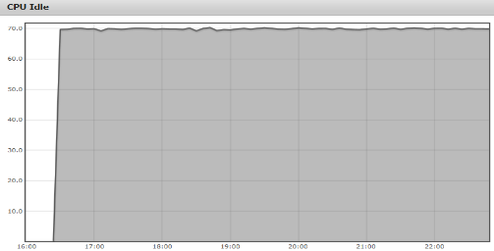
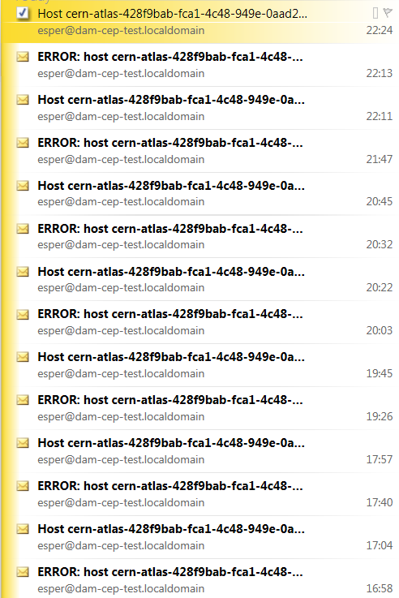
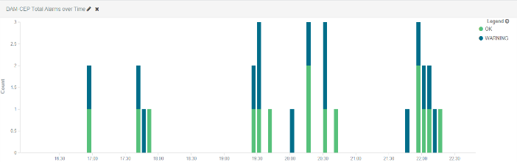
Challenges in alarming
host flapping and spamming

Slide 41
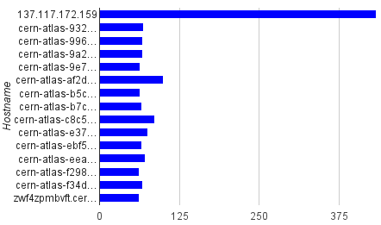
First statistics from live deployment
analyzing output of first two runs connected to production servers
Notifications per host in first run
Notifications per host in second run
100
799

Slide 42
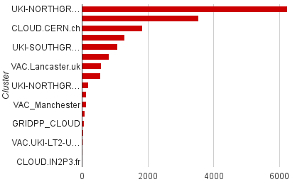
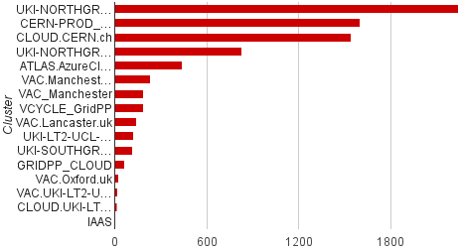
First statistics from live deployment
analyzing output of first two runs connected to production servers
Notifications per cluster in first run
Notifications per cluster in second run

Slide 43
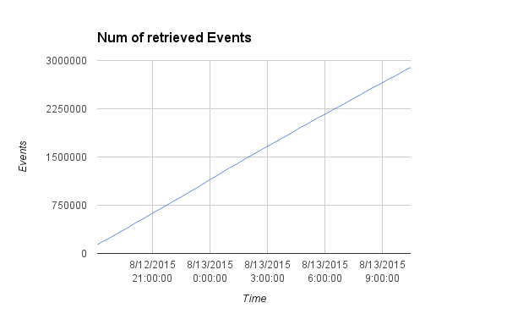
First statistics from live deployment
analyzing output of first two runs connected to production servers

