Slide 1

Hunting for Dark Particles with Gravitational Waves
3rd NPKI Workshop
Korea University
June 14th 2016
Matthew McCullough
with Gian Giudice and Alfredo Urbano

Slide 2
Our Universe
All the evidence for these components is purely gravitational!
Effects on CMB
Expansion / SN redshift
Large scale structure
Rotation curves
Velocity dispersions
Gravitational lensing…
Approximately
vacuum energy
Each new gravitational probe leads to precious new information on the possible particle nature and make up of these different components.
Approximately
cold, collisionless,
matter
Baryons
Notes:
This is an importantoperator:

Slide 3

These are some of the biggest questions we face.
Answering them will require big experiments.
Notes:
This is an importantoperator:

Slide 4
What did LIGO detect?
The gravitational wave signal emitted in the merger of a binary black hole system:
Total energy emitted was significant fraction of total mass. Why? Crudely:
So expect:
Significant fraction of mass energy carried off.
Notes:
This is an importantoperator:

Slide 5
What can LIGO detect?
The gravitational wave signal emitted in the merger of compact objects with mass in the range of 10’s solar masses, and compactness comparable to a BH.
Which objects fit this bill?
?
?
Notes:
This is an importantoperator:

Slide 6
SM Compact Objects
Black Holes
Need no introduction.
Formation scenarios suggest:
Compactness maximal:
Neutron Stars
Need no introduction.
Theoretical upper bound on mass:
Less compact than a BH:
Notes:
This is an importantoperator:
----- Meeting Notes (09/06/16 23:05) -----
Spin?

Slide 7
BSM Compact Objects
Boson Stars
If a light scalar field has weak self interactions, can condense.
Supported from collapse by uncertainty principle: cannot be localized below inverse mass. Total mass:
Compactness:
Interacting Boson
Stars
Self-interaction can increase repulsion:
Total mass:
Compactness:
Notes:
This is an importantoperator:

Slide 8
BSM Compact Objects
Fermion Stars
Supported from collapse by fermion degeneracy pressure. Chandrasekhar mass
Thus:
Compactness
Dark Matter
Stars
Perhaps the light bosons could be axion-like DM. Formation of compact objects unclear, but may occur due to primordial density spikes
Or the
scalars or fermions could be WIMP-like dark matter. Formation through cooling with light force carrier, perhaps suggested by anomalies?
Notes:
This is an importantoperator:

Slide 9
BSM Compact Objects
Fermion Stars
Supported from collapse by fermion degeneracy pressure. Chandrasekhar mass
Thus:
Compactness
Dark Matter
Stars
Perhaps the light bosons could be axion-like DM. Formation of compact objects unclear, but may occur due to primordial density spikes
Or the
scalars or fermions could be WIMP-like dark matter. Formation through cooling with light force carrier, perhaps suggested by anomalies?
Will return to
this possibility
later
Notes:
This is an importantoperator:

Slide 10
What can LIGO detect?
Well-motivated BSM scenarios furnish exotic compact objects (hereafter ECOs) with mass and compactness in the right ballpark!
GW Primer
GW frequency is twice rotational period, thus
Merger onset begins when orbit smaller than “Innermost Stable Circular Orbit”
ECO
ECO
ISCO orbit at
Notes:
This is an importantoperator:
----- Meeting Notes (09/06/16 23:05) -----
Why twice? Also radius here?
----- Meeting Notes (12/06/16 23:29) -----
If you want to see merger.

Slide 11
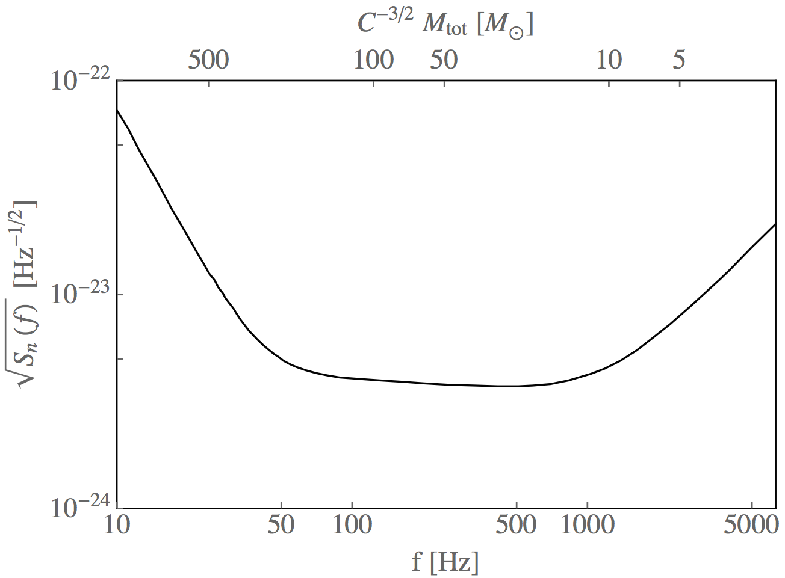
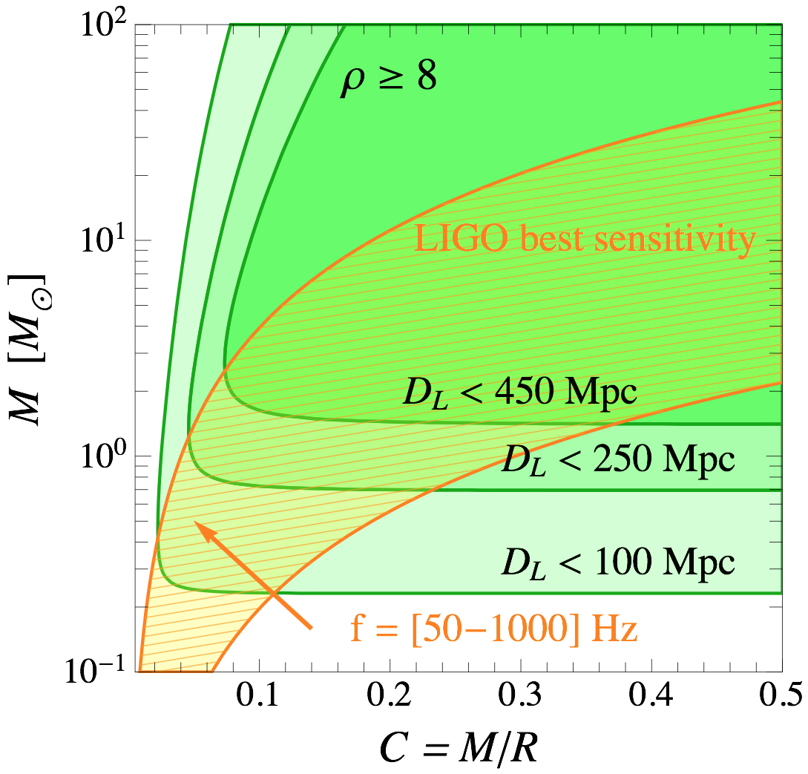
What can LIGO detect?
Can determine the detectable ECO properties by considering the LIGO frequency range:
This demonstrates LIGO has sensitivity to ECOs. However, could you tell they aren’t NS or BHs?
Notes:
This is an importantoperator:
----- Meeting Notes (09/06/16 23:05) -----
What is y-axes?
----- Meeting Notes (12/06/16 23:29) -----
Change this footnote.

Slide 12
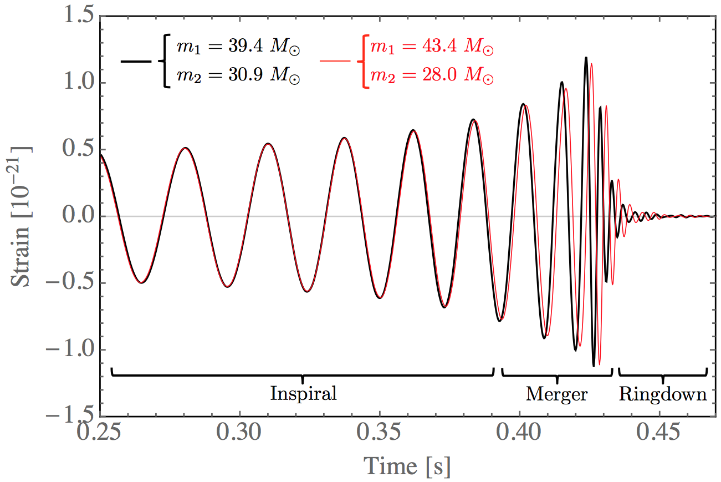
Distinguishing BH from BH
LIGO has already demonstrated extraordinary ability to distinguish:
When an event is observed with large enough amplitude, discriminating power substantial!
This line is
disfavoured
at 90%
This line is
the best-fit.
Params: B. P. Abbott et al.
1602.03840
Wave Formulae: P. Ajith et al.
Phys. Rev. Lett. 106 (2011) 241101
Notes:
This is an importantoperator:

Slide 13
Distinguishing ECO from BH
Can BHs mimic ECOs?
Could we reproduce both for ECOs with BHs?
Where the “symmetric mass ratio” is
This part of the waveform, especially rate of change of frequency, determined by “Chirp Mass”
The frequency at this part of the waveform is the ISCO frequency.
Notes:
This is an importantoperator:

Slide 14
Distinguishing ECO from BH
Thus, by choosing appropriate mass ratio, can have the same Chirp Mass and same ISCO frequency with BHs as with ECOs!
Practically speaking, for the compactness of the ECOs considered here, both reproduced for a BH symmetric mass ratio of:
Does this mean we cannot distinguish?
Notes:
This is an importantoperator:

Slide 15
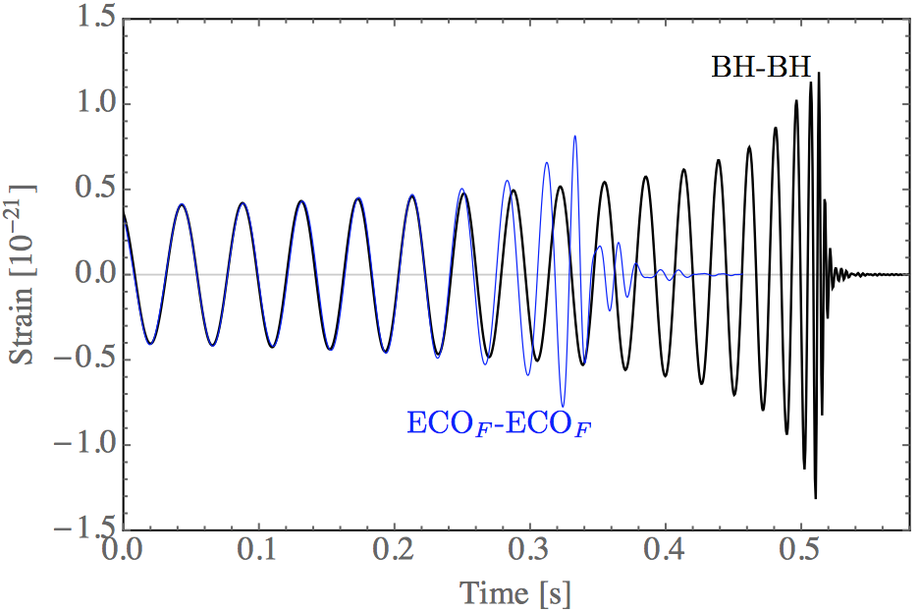
Distinguishing ECO from BH
a) Are waveforms the same?
Equal mass ECOs clearly distinguishable from equal mass BHs
Can estimate fermion ECO waveform directly from NS-NS waveform. Both are degenerate fermion stars, with similar EOS and compactness.
Thus, for larger mass ECOs just rescale time and amplitude axes accordingly. (See e.g. http://astrogravs.gsfc.nasa.gov)
J. A. Faber and F. A. Rasio,
Phys. Rev. D 65 (2002) 084042
Notes:
This is an importantoperator:

Slide 16
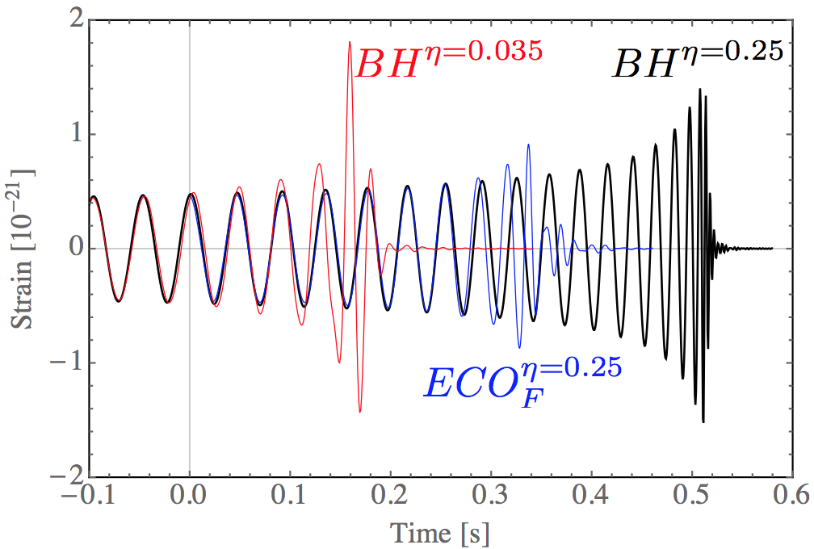
Distinguishing ECO from BH
Are waveforms the same?
Equal mass ECOs distinguishable from unequal mass BHs.
When BH mass ratio tuned to give same chirp and ISCO?
Clearly merger and especially ringdown different. In amplitude and form.
Relation to chirp also different.
Notes:
This is an importantoperator:

Slide 17
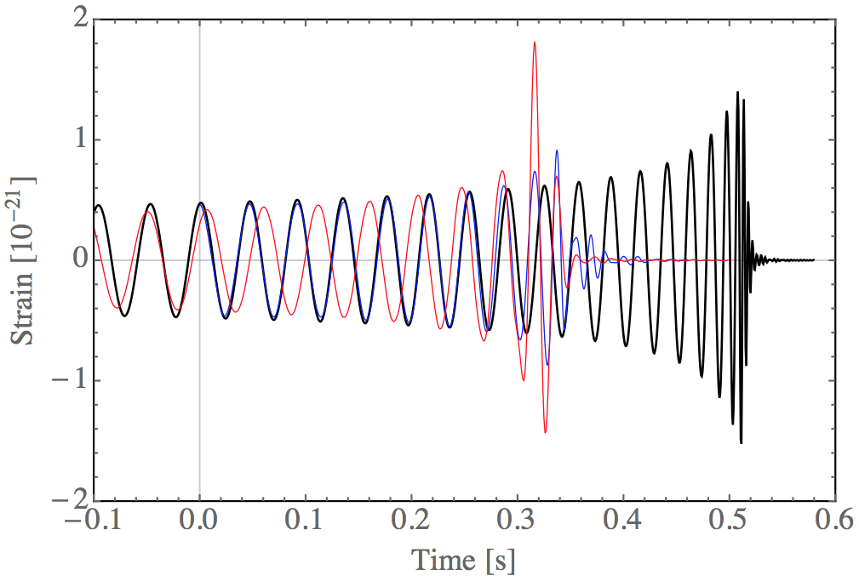
Distinguishing ECO from BH
Are waveforms the same?
Equal mass ECOs distinguishable from unequal mass BHs.
Overlaying BH merger onto ECO merger can see that ISCO can be matched well, but other aspects of waveform distinguishable.
Notes:
This is an importantoperator:

Slide 18
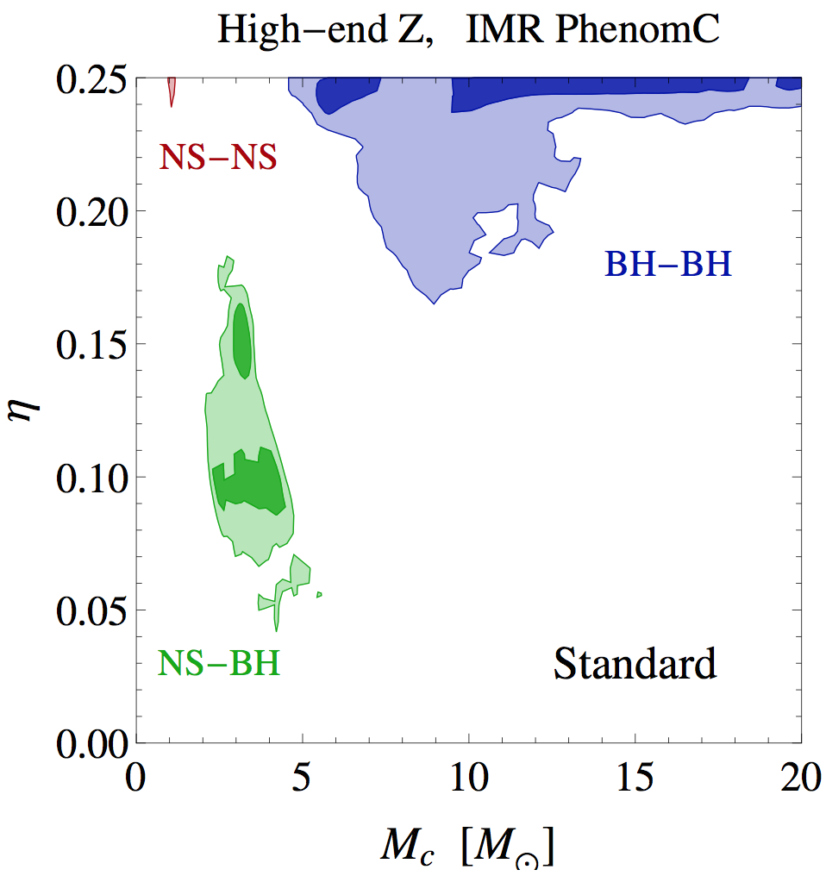
Distinguishing ECO from BH
b) Is this mass ratio likely?
BH binary merger models suggest it is very unlikely to have a BH-BH system with the mass range which could mimic an ECO.
Notes:
This is an importantoperator:

Slide 19
Distinguishing ECO from BH
Mini-Summary:
Only known COs of mass are BHs:
BSM ECOs could lie in this mass range
Their gravitational wave signature could be distinguished from BHs!
ECO
ECO
Notes:
This is an importantoperator:

Slide 20
DM Targets
How does the LIGO reach compare to BSM models?
Lets consider DM candidates with self interactions motivated by the CDM puzzles:
Too big to fail:
Core-cusp problem:
Notes:
This is an importantoperator:

Slide 21
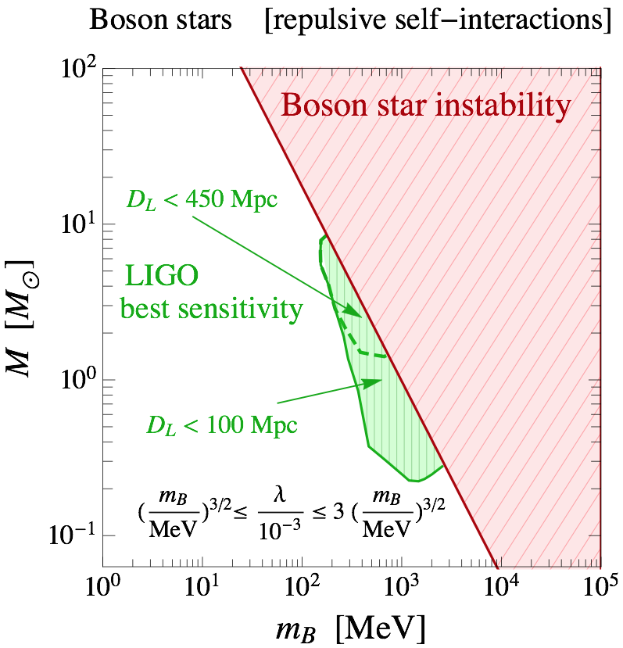
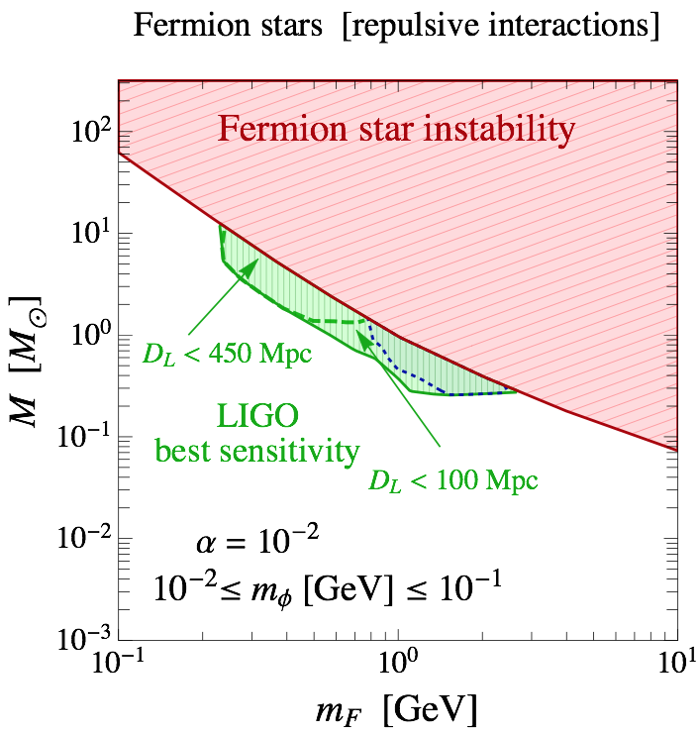
What can LIGO detect?
Interacting Boson Stars
Fermion
Stars
Health warning: It has been established that stable solutions exist for these scenarios, but formation is still an open question.
Notes:
This is an importantoperator:

Slide 22
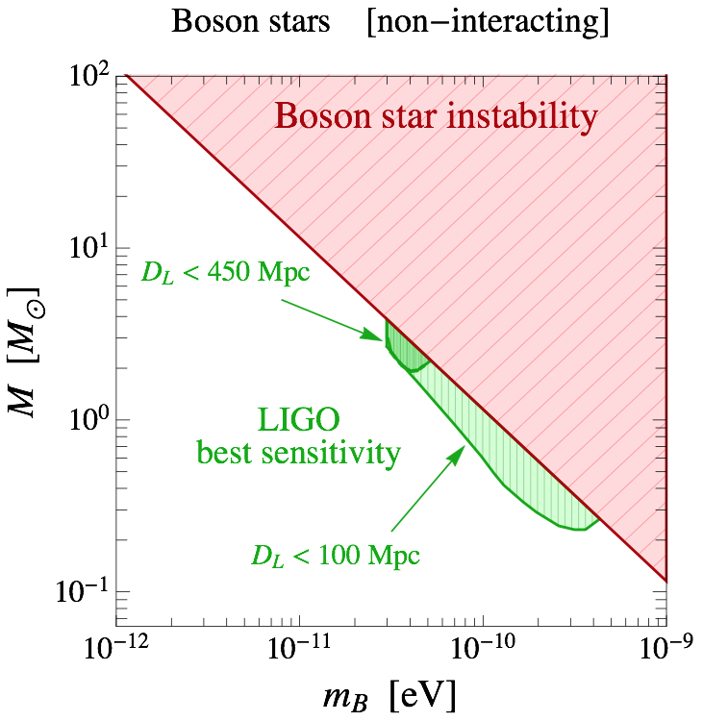
What can LIGO detect?
Non-Interacting Boson Stars
Clearly no connection to self-
interacting DM puzzles. However,
motivation could come from ALPs,
such as the QCD axion.
Expected mass range:
Health warning: It has been established that stable solutions exist for these scenarios, but formation is still an open question.
Notes:
This is an importantoperator:

Slide 23
Summary
The detection of GWs from a binary merger has opened a new window into the dark sector!
Dark sector compact objects (ECOs) are plausible, and in well-motivated parameter ranges, mergers are detectable.
If the ECO masses exceed a few solar masses, and the waveform is sufficiently exotic, it could be discriminated from a BH-BH merger.
Notes:
This is an importantoperator:
----- Meeting Notes (12/06/16 23:29) -----
Cut down to one summary slide.

Slide 24
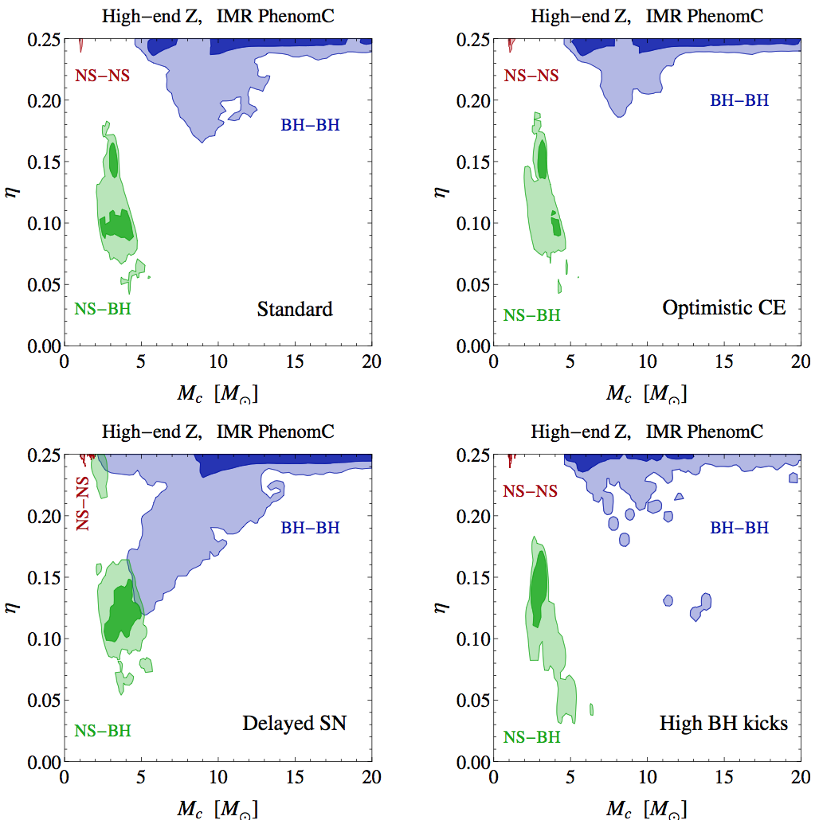
Waveform not Distinguished?
Although there are still very significant uncertainties, studies of population of binaries have been performed:
In terms of the binary mass parameters, there are different models which give similar expectations.
These numerical results are available at “The Synthetic Universe”
http://www.syntheticuniverse.org
Including references therein.
Notes:
This is an importantoperator:
----- Meeting Notes (09/06/16 23:05) -----
What percentage?

Slide 25
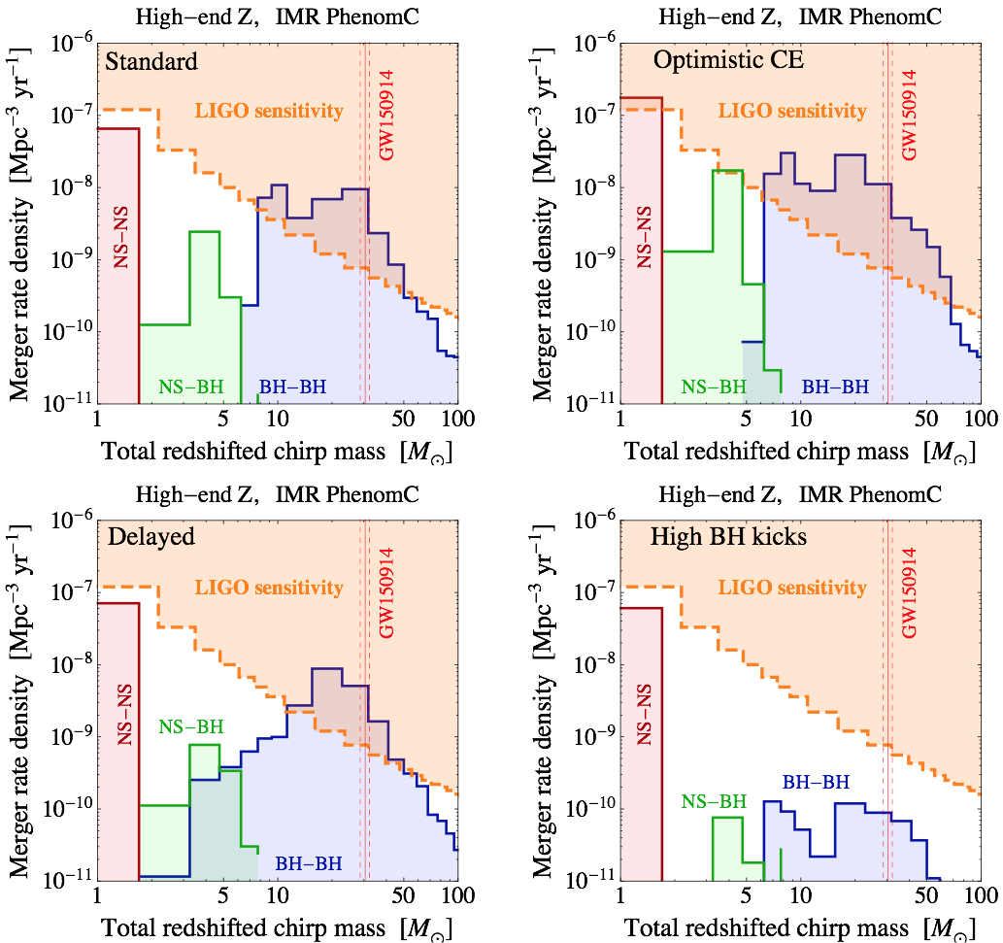
Waveform not Distinguished?
Although there are still very significant uncertainties, studies of population of binaries have been performed:
In terms of the observable quantity, which is the redshifted chirp mass, these distributions show a clear gap between NS-NS and BH-BH, although this is still up for debate.
There is no reason to expect new physics populations to have the same mass gap, so with better understanding of populations ECOs may show up as a new population in this distribution.
Notes:
This is an importantoperator:

Slide 26
DM Targets
Too big to fail:
Core-cusp problem:
Interacting Boson Stars
To resolve these puzzles require parameters in the range
Fermion
Stars
For a coupling
Require mediator masses:
Notes:
This is an importantoperator:
----- Meeting Notes (09/06/16 23:05) -----
Which equations do you solve to calculate this?

Slide 27
Our Universe
Approximately
vacuum energy
Approximately
cold, collisionless,
matter
Maybe even a rich cocktail of stable states, of which our sector is simply one component?
Baryons
Notes:
This is an importantoperator:

