Slide 1

FuturE circular collider MAGNETS TECHNOLOGIES
Wound Conductor Test Facilities
(TASK 2)
(Short status…)
Friedrich Lackner
2nd of September 2015

Slide 2
Task 2.1
Characterization of Cable Processing and Splicing
Description
Review of existing instrumentation and tools presently in use at CERN and at partner institutes to characterize the electromechanical performance of Nb3Sn cables
September 2015: FNAL, UNIGE, TU-Wien – Atominstitut;
2015 - 2016: TWENTE, PSI, NHMFL;
Design and set-up of a tool to characterize the cable wind-ability;
Design and set-up a tool to test splices under different mechanical constraints.
Deliverables
D1: Critical review of existing tools, instrumentation and splicing methods, 3 months;
D2: Proposal tools and test program including internal review, 6 months;
D3: Procurement/fabrication, commissioning, 6 months;
D4: Test campaigns, 36 months.

Slide 3
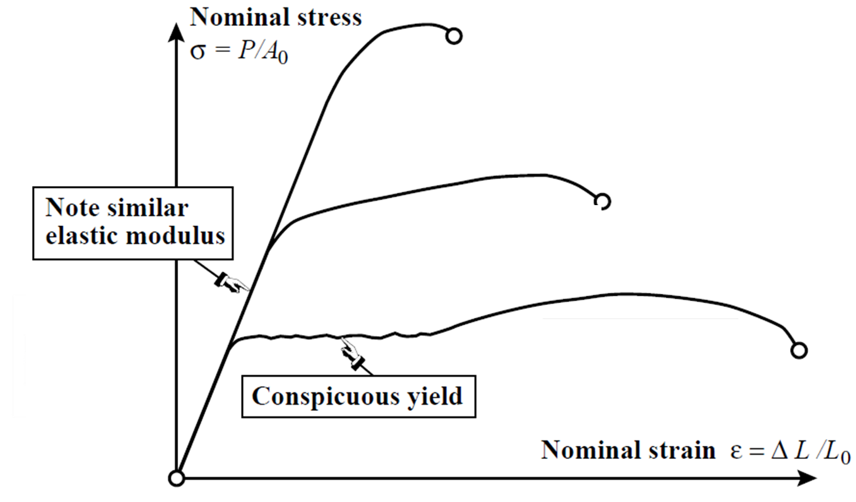
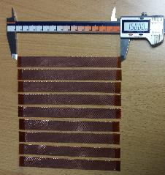
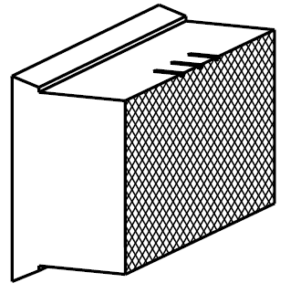
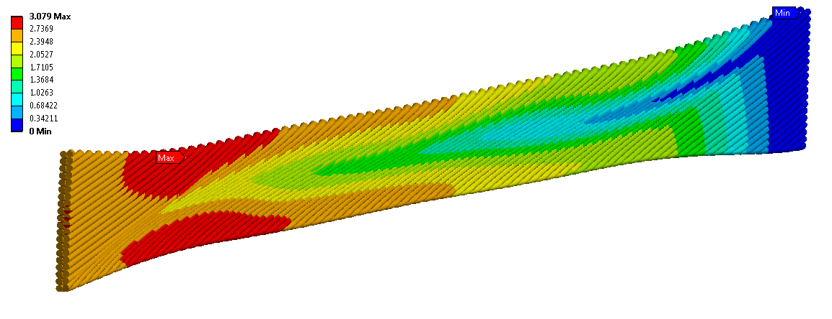
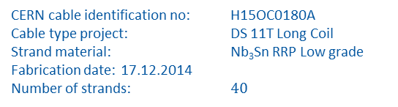
Task 2.1
Mechanical characterization for winding process “wind-ability”:
σxx = E (1 − 2ν)(1 + ν) (1 − ν) xx + ν yy + ν zz,
σyy = E (1 − 2ν)(1 + ν) ν xx + (1 − ν) yy + ν zz,
σzz = E (1 − 2ν)(1 + ν) ν xx + ν yy + (1 − ν) zz,
τxy = G γxy, τyz = G γyz, τzx = G γzx .
Preparation of tensile test in collaboration with EN-MME:
Input parameter for further improvment of numerical models…
Clamping tool…
CERN cable identification no: H15OC0180A
Cable type project: DS 11T Long Coil
Strand material: Nb₃Sn RRP Low grade
Fabrication date: 17.12.2014
Number of strands: $40$
Preparation of test samples

Slide 4
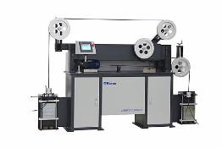
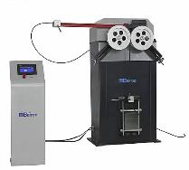

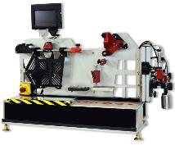
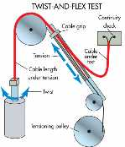
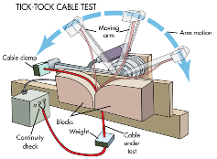
Task 2.1
Cable testing methods & industrial standards:
Flexure test
Bending test
Torsion test
Multi purpose test
And also…
… Shear, Wear, Abrasion, Flexibility
… «Inner friction»
Important source for understanding methods, improving knowledge on standard instrumentation.
… monitoring cable resistance for evidence of shorts or cold hardening

Slide 5
Task 2.2
Impregnated wound conductor insert
Description
Review of existing instrumentation and tools presently in use at CERN and at partner institutes to characterize the electromechanical performance of Nb₃Sn superconductors;
Enhancement of an existing tool or design and manufacture of a new tool capable of exploring the electromechanical behavior of impregnated wound conductors as a function of different parameters, in particular the superconductor itself, the insulation schemes, the heat treatment, the impregnation, the role and possible transformation of the binder. It is important that the tool allows to explore different configurations (different samples and different testing conditions, load, magnetic field, current) with a short lead time;
Organize an internal review of the selected proposal as well as of the relevant test program;
The work also includes, where needed, the setting up of tailored instrumentation tools in particular to provide an accurate characterization of the structural conditions of the sample;
Perform the tests and analyze the relevant results.
Deliverables
D1: Critical review of existing tools, 6 months;
D2: Proposal of tools and test program, including internal review, 6 months;
D3: Procurement/fabrication, commissioning, 18 months;
D4: Test campaigns, 24 months;

Slide 6
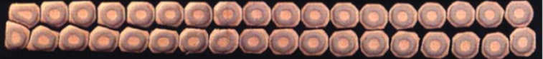
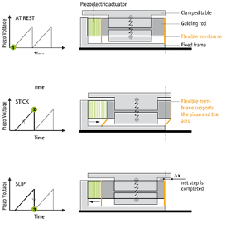
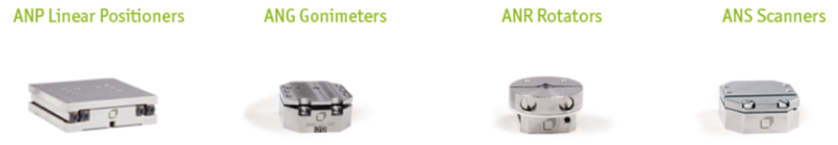

Task 2.2
Impregnated wound conductor insert:
K
Applying of multi axis stresses at 1.9 K and background field.
Testing of mechanical performance of either bare cable,
insulated/impregnated cable under strain effects in desired amount of DOF.
K₁
Actuation and instrumentation methods of an insert at 1.9 K:
Non magnetic, suitable for cryogenic temperatures high and ultra high vacuum;
Close and open loop operation;
Multi axes operations; sub-harmonic resonances excitation;
Displacement monitoring based on interferometrie.
Further industrial contacts: PI, CEDRAT

Slide 7
CERN contributors to task 2
Person/Section | Task
TE-MSC-LMF
F. Lackner | Coordination
S. Triquet | Tooling
E. Grospelier | Tooling & design
N. Dalexandro | Splicing
D. Pulikowski | PhD student, FEA + instrumentation aspects
P. Ebermann | PhD student (starts November 1st)
Fellow 1 + 2 | To be hired, testing + instrumentation + splicing
TE-MSC-SCD
EN-MME | Contributions to test campaigns

