Slide 1


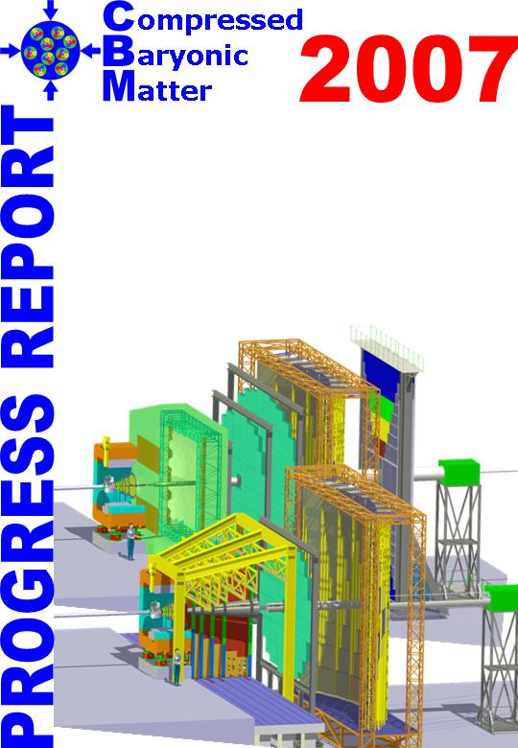
Charm measurements below top SPS energy
M. Deveaux, Goethe University Frankfurt

Slide 2
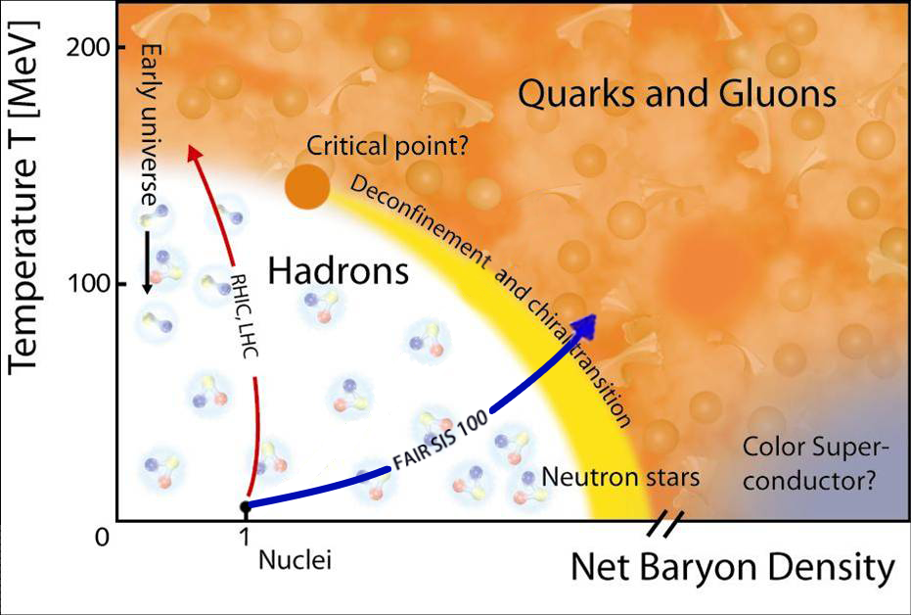
What means quark gluon plasma
Quark Gluon Plasma:
Numerous quarks move
freely in „common potential“.
Hadronic phase:
2 or 3 quarks are confined to hadrons.
They cannot be separated

Slide 3
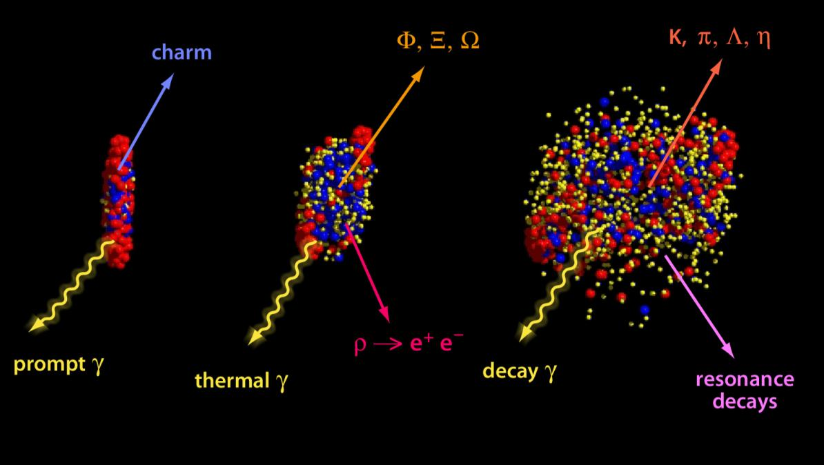
How to produce QGP
Need high temperatures and/or high pressure.
Idea: Collide heavy ions at high beam energies
UrQMD transport calculation U+U 23 AGeV
Nuclear fireball created may undergo phase transition.

Slide 4
How to recognize QGP
UrQMD transport calculation U+U 23 AGeV
Challenge:
Nuclear fireball cools down before reaching detector
Most information is lost during cooling
Idea:
Find probes, which carry information out.

Slide 5


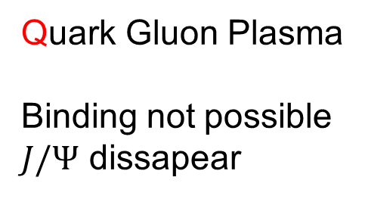
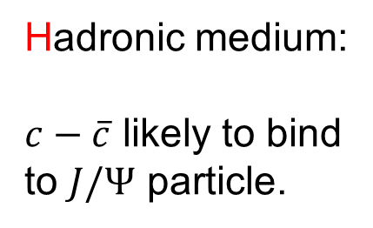

$J/Ψ$ as a probe for a phase transition
Initial idea:
☹
$$D$$
$$c−\overline{c}⇒J/Ψ$$
☺
☺
☹
☹
T. Matsui, H. Satz, “J/ψ suppression by quark-gluon plasma formation”, Phys. Let. B, Vol 178, PP 416-422 (1986)
$$\overline{D}$$
☺
Hadronic medium:
$c−\overline{c}$ likely to bind
to $J/Ψ$ particle.
Quark Gluon Plasma
Binding not possible
$J/Ψ$ dissapear

Slide 6
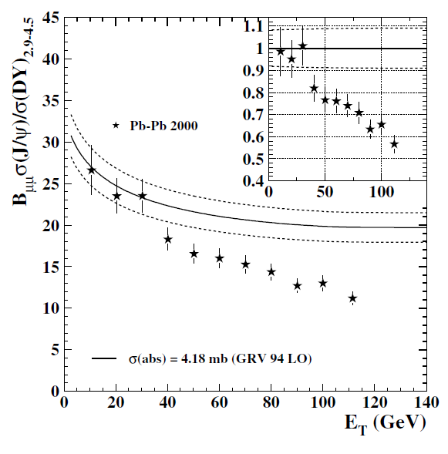
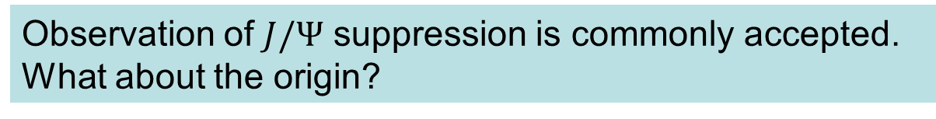
J/Psi suppression
No suppression
Observed/Expected J/Psi
Significant
suppression
More J/Psi / N-N collision
NA50 Eur. Phys. J. C 39, 335–345 (2005)
More energy in fireball
Observation of $J/Ψ$ suppression is commonly accepted.
What about the origin?

Slide 7
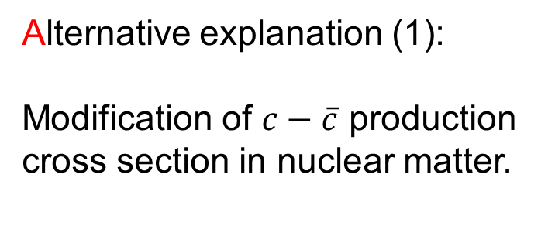
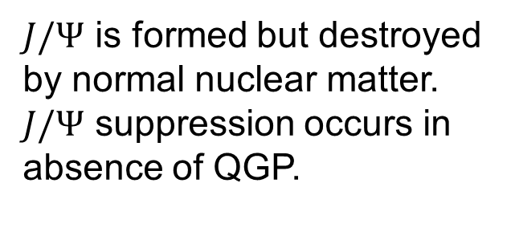
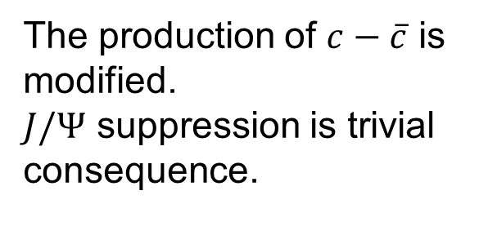
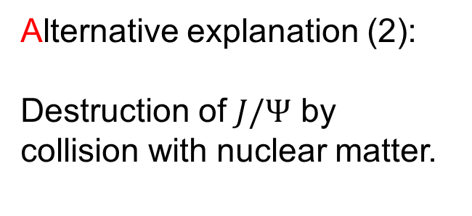
Alternative explanation
Alternative explanation (1):
Modification of $c−\overline{c}$ production
cross section in nuclear matter.
Alternative explanation (2):
Destruction of $J/Ψ$ by collision with nuclear matter.
☺
☺
☺
☹
h
☹
☺
The production of $c−\overline{c}$ is
modified.
$J/Ψ$ suppression is trivial
consequence.
$J/Ψ$ is formed but destroyed
by normal nuclear matter.
$J/Ψ$ suppression occurs in
absence of QGP.
To confirm/rule out alternative explanations, additional
measurements are needed.

Slide 8
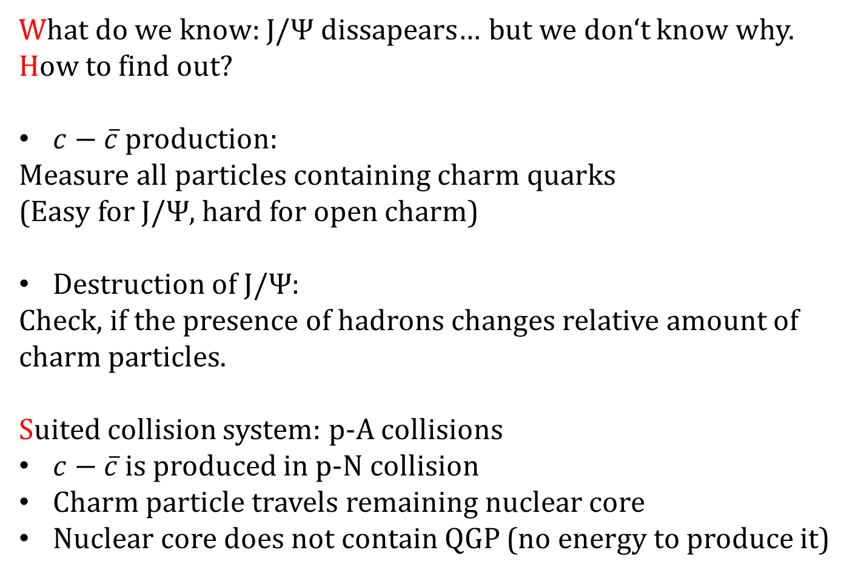
p-A as system of measuring CME
What do we know: $J/Ψ$ dissapears… but we don‘t know why.
How to find out?
$c−\overline{c}$ production:
Measure all particles containing charm quarks
(Easy for $J/Ψ$, hard for open charm)
Destruction of $J/Ψ$:
Check, if the presence of hadrons changes relative amount of
charm particles.
Suited collision system: p-A collisions
$c−\overline{c}$ is produced in p-N collision
Charm particle travels remaining nuclear core
Nuclear core does not contain QGP (no energy to produce it)

Slide 9
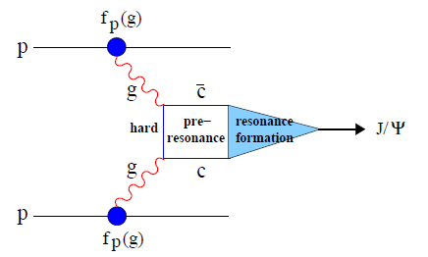
Measuring $σ(J/Ψ+N→\overline{D}+X)$
Proton or Neutron
Proton

Slide 10
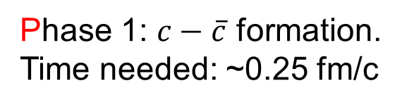
Measuring $σ(J/Ψ+N→D+\overline{D})$
c
Phase 1: $c−\overline{c}$ formation.
Time needed: ~0.25 fm/c
c

Slide 11

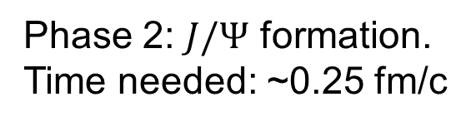

Measuring $σ(J/Ψ+N→D+\overline{D})$
Phase 1: $c−\overline{c}$ formation.
Time needed: ~0.25 fm/c
$$J/Ψ$$
Phase 2: $J/Ψ$ formation.
Time needed: ~0.25 fm/c
Phase 3: $J/Ψ$ travel through nuclear matter.

Slide 12


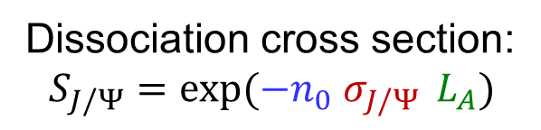
Measuring $σ(J/Ψ+N→D+\overline{D})$
Dissociation cross section:
$$S_{J/Ψ}=\exp{(−n_{0}{ σ}_{J/Ψ}} L_{A})$$
Nuclear density
Path of 𝐽/Ψ in
nuclear matter
Cross section
$λ_{C}$
Phase 1: $c−\overline{c}$ formation.
Time needed: ~0.25 fm/c
D
Phase 2: $J/Ψ$ formation.
Time needed: ~0.25 fm/c
Phase 3: $J/Ψ$ travel through nuclear matter.
Finally: Possible $J/Ψ$ dissociation.

Slide 13

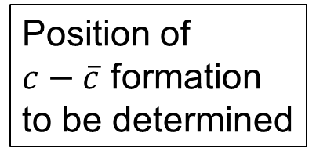


Measurement uncertainties?
Interaction
path too short?
$c−\overline{c}$ pair has
other $σ$ than
$$J/Ψ$$
$$D$$
g
$$\overline{D}$$
p
c
D
$$J/Ψ$$
c
D
Position of
$c−\overline{c}$ formation
to be determined

Slide 14
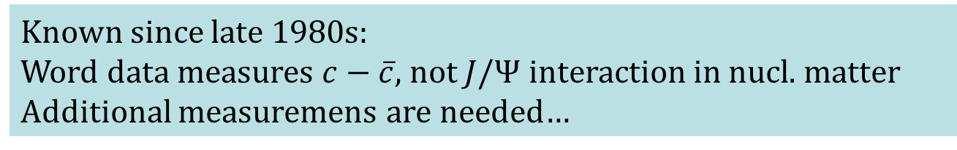
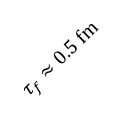
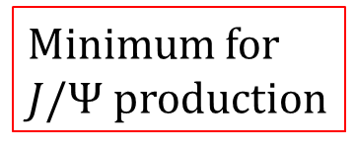
Formation length
World data*
Minimum for
$J/Ψ$ production
CERN SPS
*Compilation: A. Andronic et al.,
arXiv:1506.03981v1 [nucl-ex]
12 Jun 2015
$$τ_{f}≈0.5 fm$$
Average
thickness Au
Distance
N-N in core
Known since late 1980s:
Word data measures $c−\overline{c}$, not $J/Ψ$ interaction in nucl. matter
Additional measuremens are needed…

Slide 15
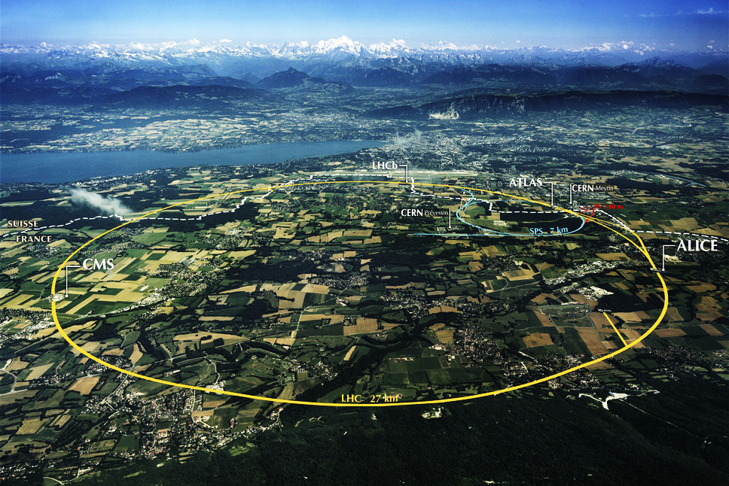
Experimental proposal for SPS (1990s)
CERN/SPS North Area

Slide 16
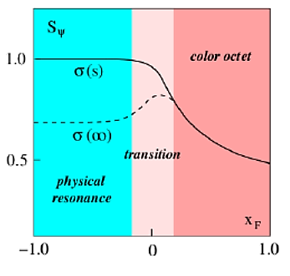


Measurements, initial proposal
D. Kharzeev, H. Satz, PLB 1995,
H. Satz – HICforFAIR Workshop: Heavy flavor physics with CBM, FIAS, May 2014
$$J/Ψ$$
$$c−\overline{c}$$
Idea:
Shoot Au on p-target at SPS.
Collect J/Ψ, which are emmitted in beam direction.
=> Select J/Ψ moving slowly in nuclear core.
Problem (1990s):
Existing experiments not suited for doing the job (acceptance).
Today: No J/Ψ sensitive experiment @ SPS.
slower
faster
than center of mass
Consequence: Issue remained open from ~1990 until today.

Slide 17
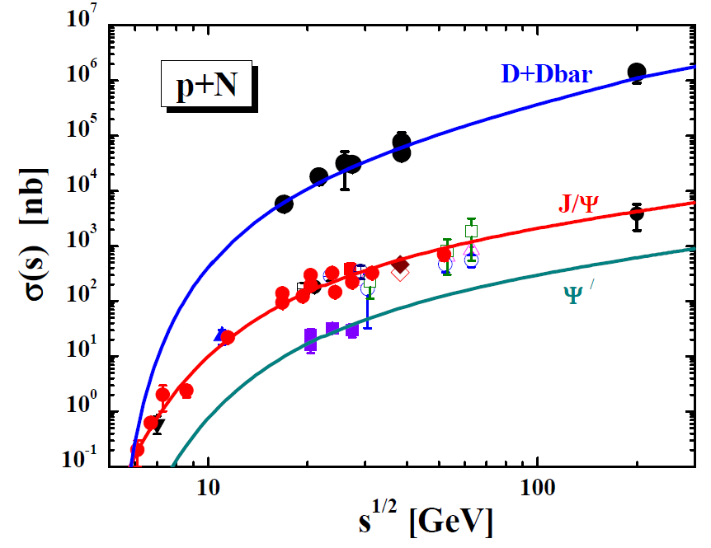
Direct measurements – the challenge
Need to perform precision
measurements with very
low charm X-sections.
High collision rate
Need to measure open
charm and J/Ψ.
=> Next generation instrument.
Compilation of charm
X-sections, HSD input
Region of
interest
Robust data available
Required: A unique set of accelerator and detector

Slide 18
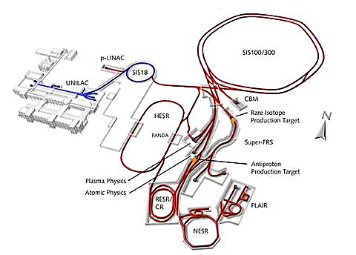
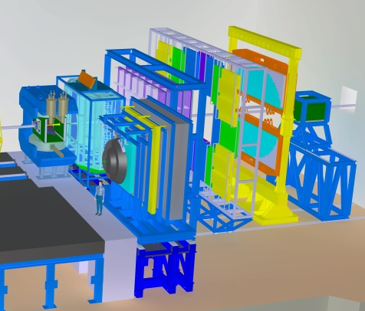
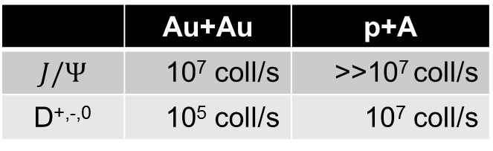
A possible technology
FAIR @ Darmstadt/Germany
The CBM - Experiment
Beam energy:
Detector (design performance):
 | Au+Au | p+A
SIS100 | ~12 AGeV | ~30 GeV
SIS300 | ~35 AGeV | ~90 GeV
 | Au+Au | p+A
$$J/Ψ$$ | 10⁷ coll/s | >>10⁷ coll/s
D^{+,-,0} | 10⁵ coll/s | 10⁷ coll/s
CBM@SIS100 will be available in 2021

Slide 19
Formation length
World data
CBM@
SIS100
CBM@
SIS300
SPS
$$τ_{f}≈0.5 fm$$
Average
thickness Au
Average
thickness Si
Distance
N-N in core
CBM@SIS100 covers the most interesting energy
range for measuring J/Ψ dissociation.

Slide 20
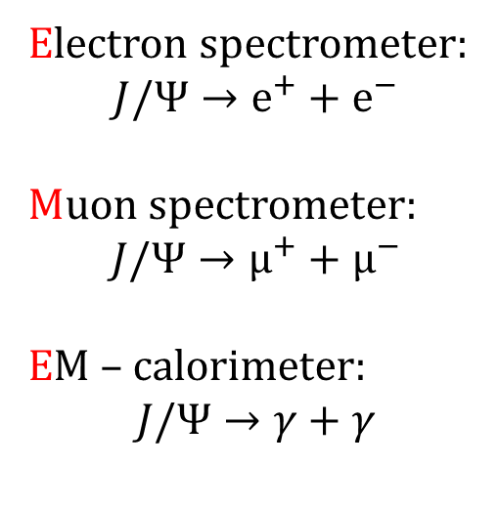

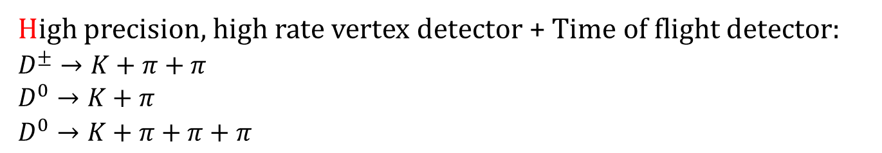
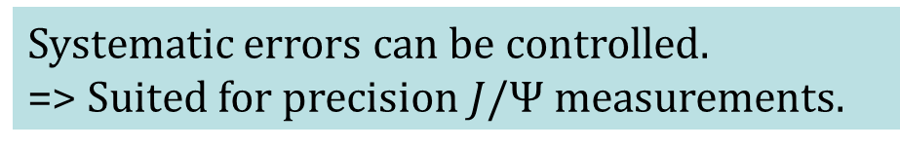
CBM design features
Electron spectrometer:
$$J/Ψ→e^{+}+e^{−}$$
Muon spectrometer:
$$J/Ψ→µ^{+}+µ^{−}$$
EM – calorimeter:
$$J/Ψ→γ+γ$$
Systematic errors can be controlled.
=> Suited for precision $J/Ψ$ measurements.
High precision, high rate vertex detector + Time of flight detector:
$D^{±}→K+π+π$
$D^{0}→K+π$
$D^{0}→K+π+π+π$
Open charm can be measured.
Suited to extract $c−\overline{c}$ cross sections.

Slide 21

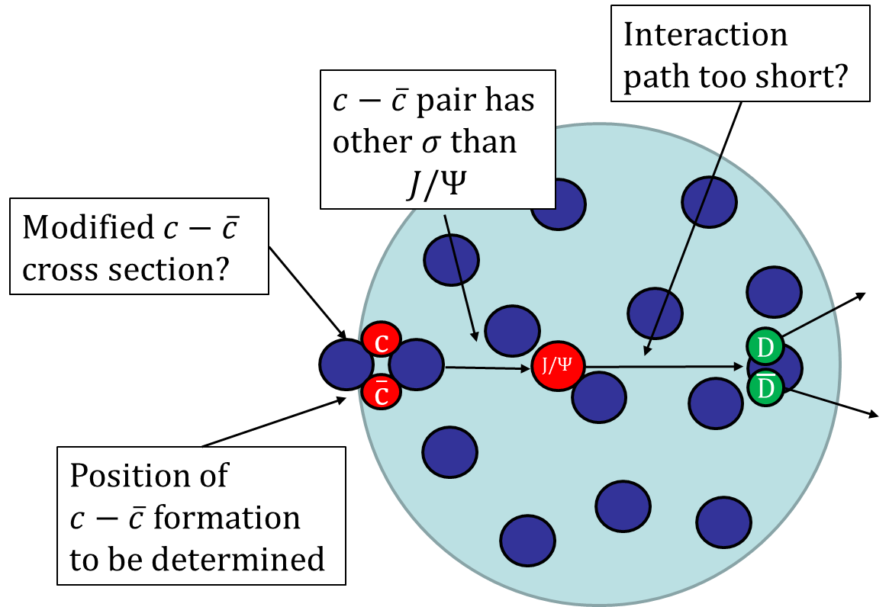
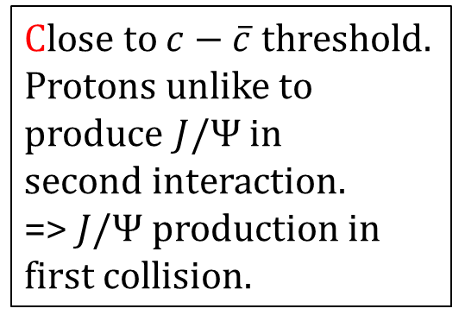
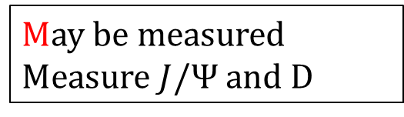
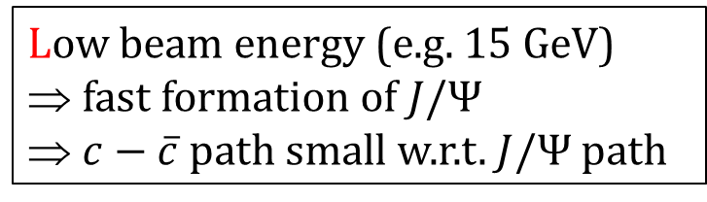
Measurement uncertainties?
Low beam energy (e.g. 15 GeV)
fast formation of $J/Ψ$
$c−\overline{c}$ path small w.r.t. $J/Ψ$ path
May be measured
Measure $J/Ψ$ and D
Close to $c−\overline{c}$ threshold.
Protons unlike to produce $J/Ψ$ in
second interaction.
=> $J/Ψ$ production in first collision.
CBM seems particularly well suited to answer these questions.

Slide 22
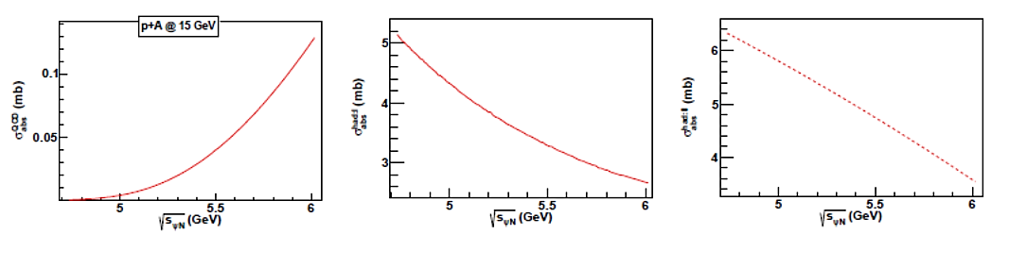
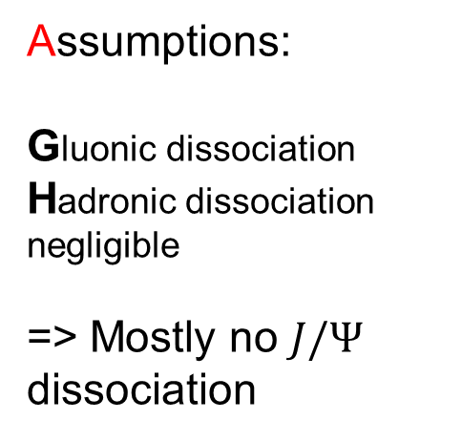


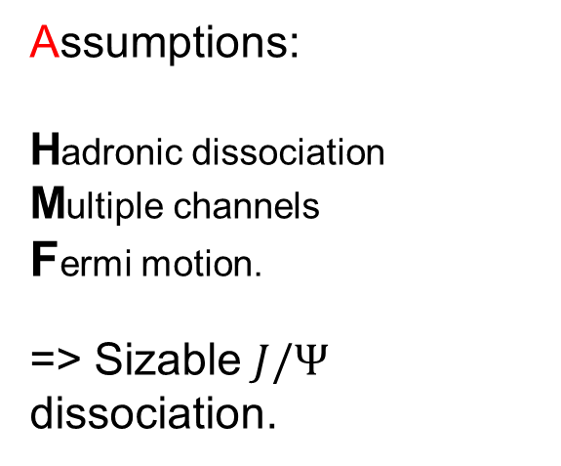
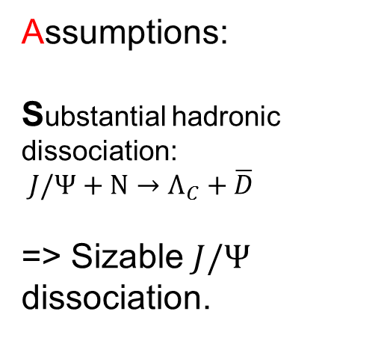
Different models
D. Kharzeev, H. Satz
PLB 1995
K. Haglin et al.
PRC 2000
R. Molina et al.
PRC 2012
more $J/Ψ$
dissociation
P. P. Bhaduri, ICMUHD, Sikkim India,
June 22, 2016
faster $J/Ψ$
Assumptions:
Gluonic dissociation
Hadronic dissociation negligible
=> Mostly no $J/Ψ$ dissociation
Assumptions:
Substantial hadronic dissociation:
$J/Ψ+N→Λ_{C}+\overline{D}$
=> Sizable $J/Ψ$ dissociation.
Assumptions:
Hadronic dissociation
Multiple channels
Fermi motion.
=> Sizable $J/Ψ$ dissociation.

Slide 23
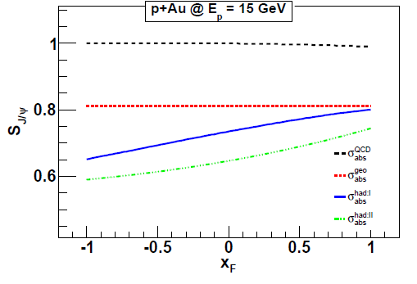
Model separation
Gluonic => Mostly no absorption
Surviving J/Psi [1]
Hadronic
Preliminary
P. P. Bhaduri, ICMUHD, Sikkim India,
June 22, 2016
slower
faster
than center of mass
CBM should be able to distinguish different
dissociation mechanisms (to be confirmed)

Slide 24
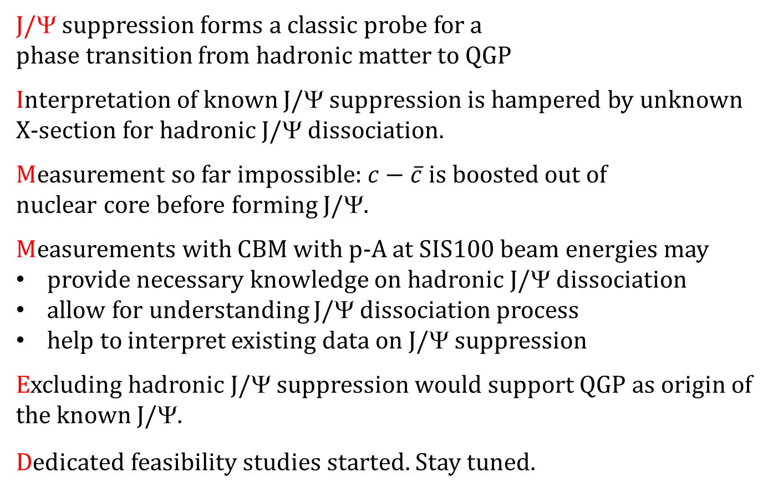
Summary and conclusion
J/Ψ suppression forms a classic probe for a
phase transition from hadronic matter to QGP
Interpretation of known J/Ψ suppression is hampered by unknown X-section for hadronic J/Ψ dissociation.
Measurement so far impossible: $c−\overline{c}$ is boosted out of
nuclear core before forming J/Ψ.
Measurements with CBM with p-A at SIS100 beam energies may
provide necessary knowledge on hadronic J/Ψ dissociation
allow for understanding J/Ψ dissociation process
help to interpret existing data on J/Ψ suppression
Excluding hadronic J/Ψ suppression would support QGP as origin of the known J/Ψ.
Dedicated feasibility studies started. Stay tuned.

