Slide 1


Forging New, Non-Traditional Partnerships among Physicists, Teachers and Students
quarknet.i2u2.org
Marjorie Bardeen, Fermilab
(mbardeen@fnal.gov)
Notes:
Traditional – organizers doing something FOR teachers; short-ish, one-shot program;

Slide 2
Overview
Context
The Collaboration
Benefits
Others too
M. Bardeen, ICNFP, July 2016

Slide 3
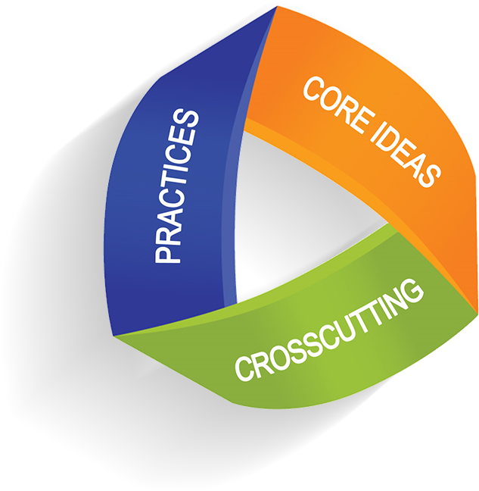
National Education Efforts
Next Generation Science Standards
Science and Engineering Practices
“. . . to make science education more closely resemble the way scientists work and think.
. . . students will gradually deepen
their understanding of scientific ideas by engaging in practices that scientists and engineers generally use.
Next Generation Science Standards: http://www.nextgenscience.org
M. Bardeen, ICNFP, July 2016

Slide 4
National Education Efforts
Next Generation Science Standards
Science and Engineering Practices
“The practices better explain and
extend what is meant by ‘inquiry’
in science and the range of cognitive,
social, and physical practices
that it requires.”
Next Generation Science Standards: http://www.nextgenscience.org
M. Bardeen, ICNFP, July 2016

Slide 5
Nature of HEP Research
. . . lends itself to non-traditional
education (outreach) programs.
Large collaborations & facilities
Long development & run times
Central management with
distributed work nationally & internationally
(more than 160 U.S. universities, institutes & labs)
M. Bardeen, ICNFP, July 2016
Notes:
Non-traditional from the get-go because of the SSC, the LHC and the need by NSF for an community-wide, LHC wide anyway. Broader Impacts program

Slide 6
The QuarkNet Collaboration
QuarkNet – starting its 19th year
A long-term professional development program
for physics teachers supported by the
particle physics research community
50+ centers at universities & labs across the U.S.
82 physicists as volunteer mentors
563 active teachers & their students
+ international outreach
M. Bardeen, ICNFP, July 2016

Slide 7
The QuarkNet Collaboration
Management Chart
Advisory Group
4 PIs
3 IT/Tech
Staff
3 Staff Teachers
Outside Evaluators
Center 1
Center 2
Center 3
Typical Center
Center 48
Center 49
Center 50
2 Mentors
2 Lead Teachers
8-10 Associate Teachers
M. Bardeen, ICNFP, July 2016

Slide 8
The QuarkNet Collaboration
What makes it non-traditional? It’s . . .
About building lasting relationships.
18 years old.
A partnership between physicists & teachers top to bottom.
An open door for teachers into our research community.
About teachers & student teams making meaningful contributions to HEP experiments.
Bringing 21st century physics into classrooms.
M. Bardeen, ICNFP, July 2016

Slide 9
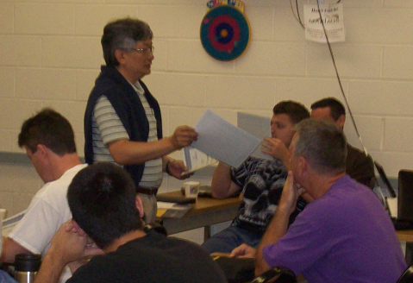
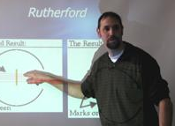
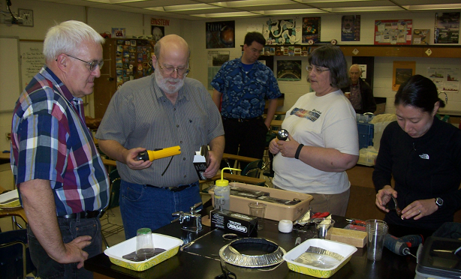
QuarkNet Program
Engagement with Scientific Investigations
Research internships
Research-based workshops
Masterclasses
Cosmic ray detectors
Access to online datasets
Data-based instructional materials
Ongoing support
M. Bardeen, ICNFP, July 2016

Slide 10
Local Centers
Where Teachers “Meet QuarkNet”
Contact point within a distributed program
Participants form their center
Meet local interests and needs
Supported by staff teachers
Variety of formats and activities
M. Bardeen, ICNFP, July 2016

Slide 11
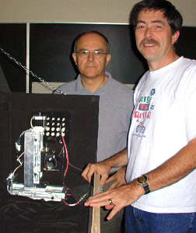
Research Experience
Year 1: Teacher Research Experiences
Construct & test detector components.
Analyze data & conduct simulation studies.
. . . .
M. Bardeen, ICNFP, July 2016

Slide 12
Associate Teacher Institute
Year 2: Typical Activities
All include a study of particle physics:
Lectures
Experiments
All include classroom transfer:
Activities
Investigations
Data analysis
Tours
Lesson plans
Demos
M. Bardeen, ICNFP, July 2016

Slide 13
Follow-on Program
Year 3+: Three Basic Formats
+ Student Research Teams
Physics Alliance
One-week workshop (summer/several days during the academic year)
An expanded program with a QuarkNet one-week program as the core
M. Bardeen, ICNFP, July 2016

Slide 14
For Students
Learning Fundamental Physics by:
Covering topics in 21th century physics.
Analyzing real data delivered online.
  Collaborating with students worldwide.
  Participating in inquiry-oriented investigations.
  Experimenting using classroom cosmic ray detectors.
  Visiting research groups & experiments.
M. Bardeen, ICNFP, July 2016

Slide 15
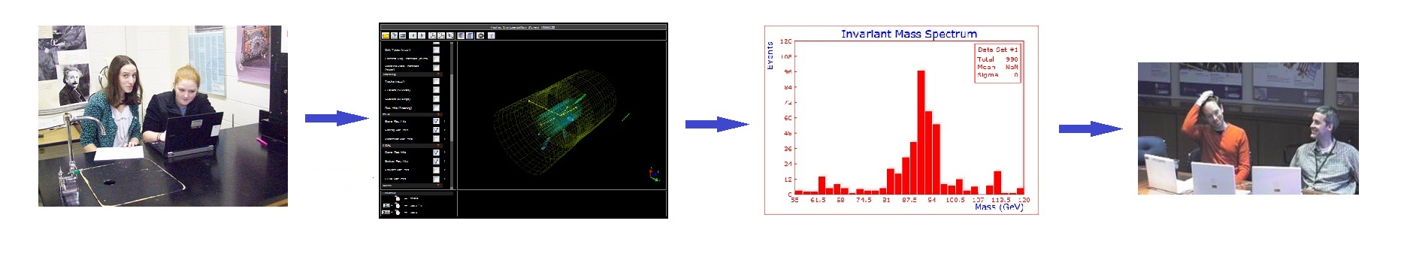
For Students
Participating in International Masterclasses
Students + Physicists + Teachers → Masterclass Institute
N institutes on one day (N < 5)
  Learn about particles physics.
  Analyze data and combine. → Upload results.
Videoconference with CERN or Fermilab
March is “Masterclass season.”
M. Bardeen, ICNFP, July 2016

Slide 16
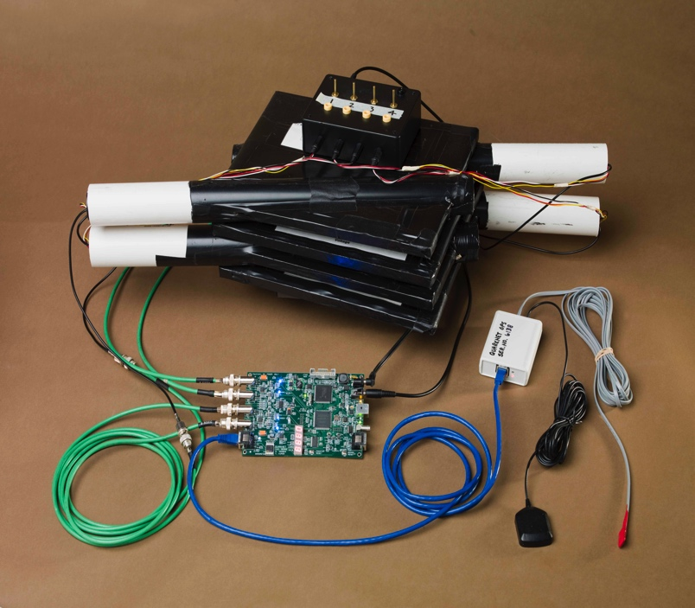
For Students
Studying Cosmic Rays
Hands-on experience with tools
just like particle physics experiments
Detectors - Analysis Tools - Collaboration
M. Bardeen, ICNFP, July 2016

Slide 17
What Students Get
Opportunities to:
Learn science by doing science, not just reading about science.
Go right to the experts; talk directly with physicists.
Collaborate with students worldwide.
Experience the environment of a scientific collaboration.
Conduct their own scientific investigations.
M. Bardeen, ICNFP, July 2016

Slide 18
What Physicists Get
Opportunities to:
Share their passion for particle physics.
“Recruit” the next generation of scientists . . . and new students for their department.
Get help in their ongoing research from an interested and eager team.
Use sophisticated cosmic ray experiments to inspire undergraduate and graduate students.
M. Bardeen, ICNFP, July 2016

Slide 19
What Physicists Get
Opportunities to:
Learn from the challenges and opportunities of teaching high school physics.
Reach out to their communities.
Participate in a credible, impactful outreach program that is highly regarded by our funding agencies.
M. Bardeen, ICNFP, July 2016

Slide 20
What Teachers Get
Opportunities to Work:
With physicists who are passionate about the work they do.
With real data . . . with all of the joys and frustrations that accompany that.
On "real-world" problems that don't necessarily have clear "back of the book" answers.
On building things! (e.g., detector components or classroom cosmic ray detectors)
M. Bardeen, ICNFP, July 2016

Slide 21
What Teachers Get
Opportunities to:
Study topics in 21st century physics.
Learn science by doing science, not just reading about science.
Have a sense of wonder about the universe.
----
Challenge even the brightest students.
Motivate students to potentially pursue physics or some STEM field.
M. Bardeen, ICNFP, July 2016

Slide 22
The QuarkNet Collaboration
QuarkNet – a strong outreach program that benefits teachers, students & physicists
  “The QuarkNet program offers a unique way to extend the excitement of particle physics to teachers and students everywhere in the United States. It is a jewel of the NSF portfolio.”
  Could you adapt our model?
M. Bardeen, ICNFP, July 2016

Slide 23
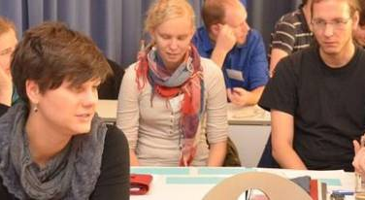
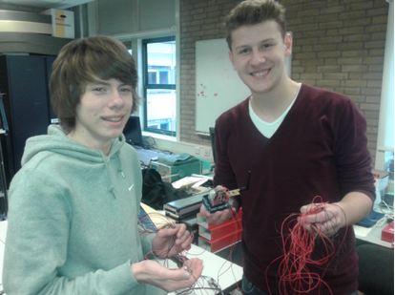
We Are Not Alone
Teilchenwelt, Germany (2010)
http://www.teilchenwelt.de
HISPARC, The Netherlands (2001)
http://www.hisparc.nl
- - - -
Institute for Research in Schools, UK (2016)
http://www.researchinschools.org
IRIS
Teichenwelt
HISPARC
M. Bardeen, ICNFP, July 2016
Notes:
Teilchwnwelt – 26 institutions, universities, institutes, lab
HISPARC – 7 clusters, 8 universities, 100 detector stations
IRIS – 183 schools

