Slide 1

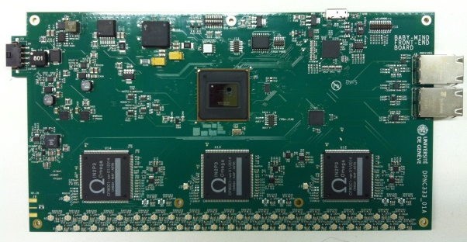
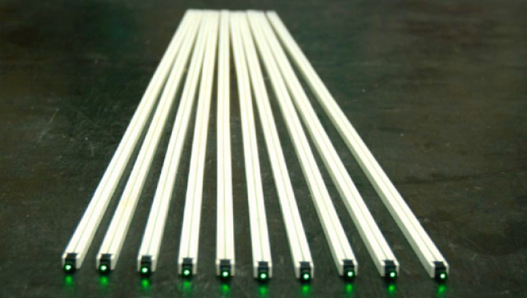
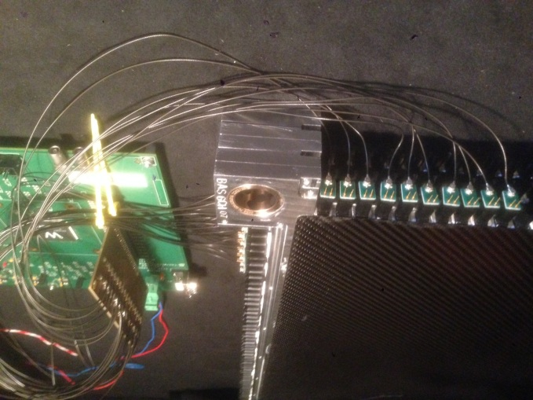
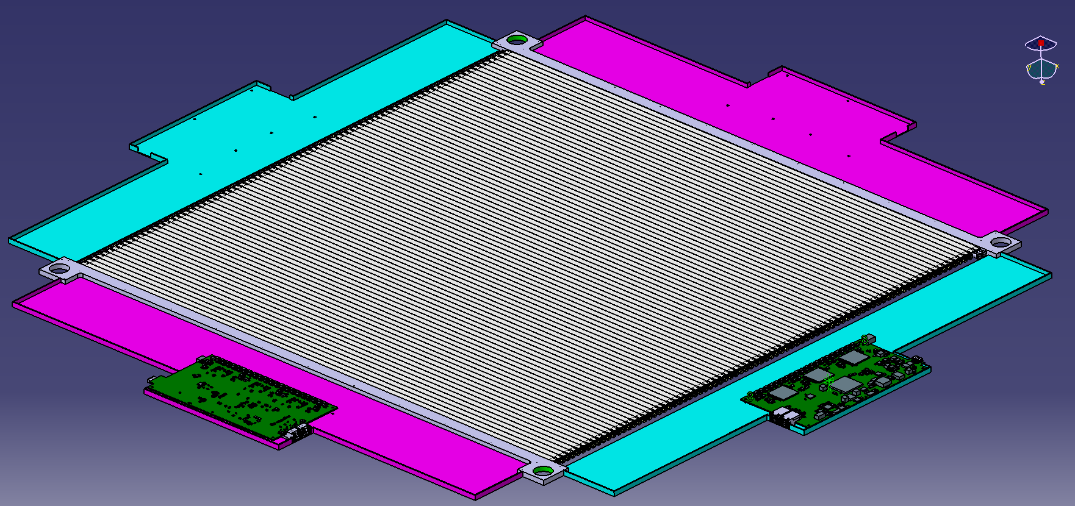
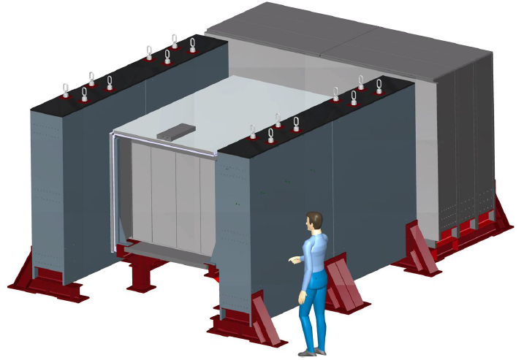
Baby-Mind SiPM Front End Electronics
Yannick FAVRE University of Geneva 3-09-2015
Etam Noah
A. Blondel

Slide 2
OUTLINE
Baby–Mind Detector Electronics Overview
Baby–Mind Readout Chain Overview
Front End Board
FPGA Firmware
Readout & Slow Control Protocol
Status & Conclusion

Slide 3
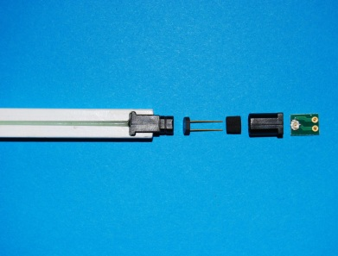
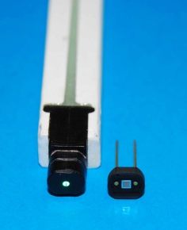
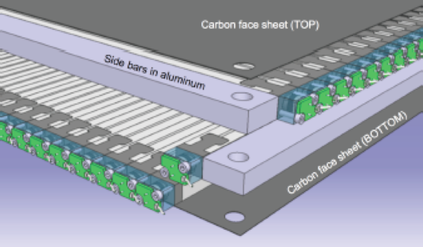
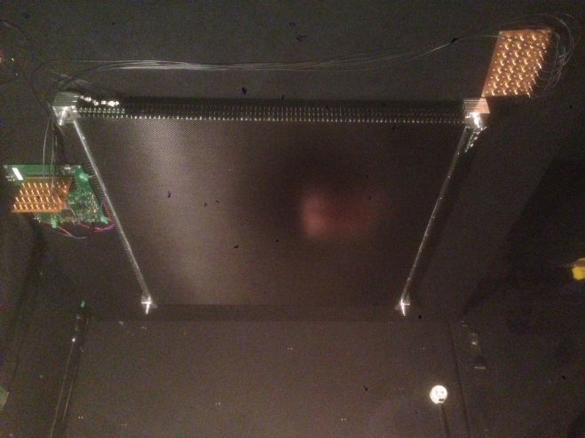
BABY-MIND ELECTRONICS DETECTOR OVERVIEW
Baby-Mind = 18 modules with ~3000 SiPM based channels on plastic scintillator bars
Modular architecture :
  1 Module = 2 planes (XY)
  1 plane = 84 channels + 1 FEB with
    3x32-ch CITIROC ASIC (3x4-ch unused)
    Analog & timing measurement
  1 channel =
    1 bar + custom optical connector + mini PCB + coaxial cable
    SiPM = MPPC S12571-025C 1x1mm²
Module
Integration
SiPM + mini-PCB + coax.

Slide 4
BABY-MIND READOUT CHAIN OVERVIEW
MICE LEGACY & REUSE (VME Readout Board)

Slide 5
FRONT-END BOARD
  96 coax. connectors (84 used)
  3 CITIROC ASICs 32-ch
  12-bits 8-ch 40Ms/s/ch ADC
  Altera ARIA5 FPGA :
    Timing : 2.5ns resolution
    Analog : 8µs for 96-ch LGain & HGain
    HV, ASIC T° + board T° + RH%
  Readout/Slow control on USB3 and/or Gigabit RJ45 chain
  External propagated Trig/sync. Signal
  Power supplies (HV/LV)
240
24V
LVs
USB
RJ45
FPGA
ADC
HV
130
ASICs
96 coax. (top/bot)
FEB prototype

Slide 6
FPGA FIRMWARE
ALTERA ARIA5 (BGA896) A7 on proto, A3 or A5 on production
- Code : Quartus dev. tool, VHDL behavorial (design reuse) + some FPGA IP specific modules
- Simulation : Modelsim test-benches for all modules

Slide 7
READOUT & SLOW CONTROL - PROTOCOL
Readout & Slow control accessible on USB3 (utile 2.5-3Gb/s) or Gigabit differential links on RJ45 (800Mb/s to 5Gb/s)
Readout protocol based on MICE legacy with :
  32-bits messages, multiple boards
  Synchronization : trigger/sync, standalone free, or master request
  Spill header/trailer with attributes (tags, time, board ID…) and containing N events
  Event with attributes (tags, time, event numbers) and containing N hits
  Hit based on channel ID, analog and/or timing data
  Can be adapted depending on other projects needs
Slow control protocol based on:
  32-bits messages with Master Request & Board Answer
  Individual board or broadcast, single or multiple frames arguments
  Transparent & easy read/write access to external & internal devices (ASIC, FPGA registers) from a buffered DPRAM into FPGA (send/read/verify/apply slow control config.)

Slide 8
READOUT & SLOW CONTROL – CABLING OPTIONS
- Number of chained FEB depends on events frequency and bandwidth limit => application specific
- Ex : 8 chained FEB for Baby-Mind (VRB limitation)

Slide 9
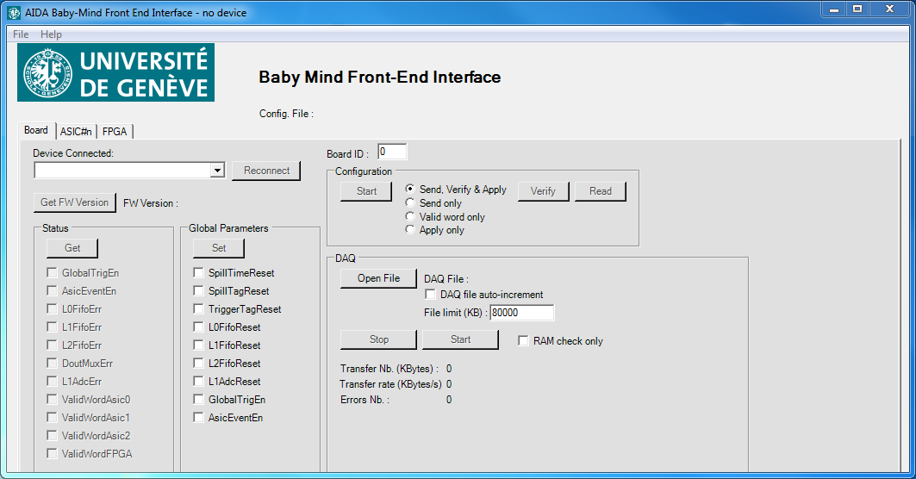
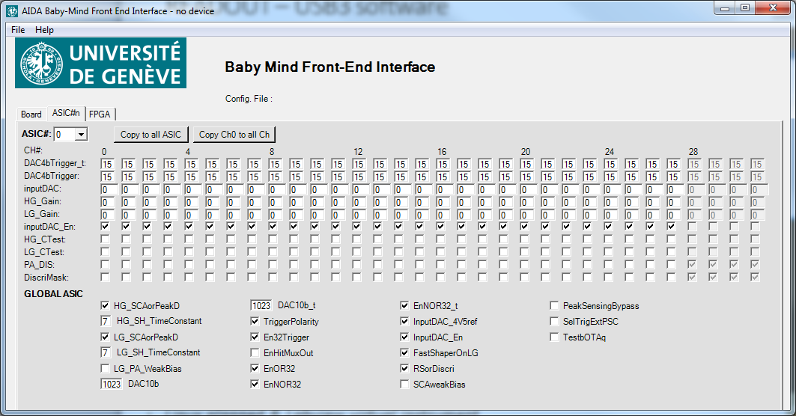
READOUT – USB3 software
C# Win7 (ms visual studio)
Versatile architecture designed for reuse:
  Low level classes for protocol communication handling
  Hardware slow control direct building & mapping through abstraction classes
    Direct connection to FPGA/ASIC trough USB3
    Simple building & hardware mapping
    File handling (HML open/save File)
    Ex : myBoard.myAsic[0].addVar(Type, Name, DefaultVal, Min, Max, BitLocation…)
  GUI direct connection with slow control variables declared from abstraction classes :
    Simple building
    Automatic coherency check (Min, Max)
    Ex : boolean connected to a checkBox, Byte connected to a textBox …
  Readout Save to file:
    2.5Gb/s to 3Gb/s achieved from USB3
    Some problems to be solved at low speed (low event frequency)
Linux planned & Labview virtual instrument
Readout & general tab
ASIC0 slow control tab

Slide 10
STATUS & CONCLUSION
Versatile Front-End Board:
  96-channels
  Timing = 2.5ns resolution (lower resolution possible with delay registers implementation)
  Analog = 12-bits, 8us latency (blind window, ASIC limitation)
  Autonomous or ext. trigger synchronization
  3Gb/s USB3 and/or Gigabit RJ45 diff. link
  Readout & slow control access – simple but powerful & adaptive protocol
Software:
  USB3 Readout & Slow control, application specific top level using generic architecture (will be used for 2 others projects under dev. at DPNC, DRS4/NA61, VATA64/HERD)
  Current C# Win7, Planned = Linux + Labview Virtual Instrument
Status:
  Hardware:
    5 FEB produced and ready for tests
    40 boards for January 2016
  FPGA firmware:
    90% developed & fully simulated (modelsim)
    Integration with HW ongoing (50% ok), to be ready for autumn
  USB3 win7 application :
    2.5Gb/s readout full bandwidth & slow control ok (3Gb/s planned)
    Some problems at low bandwidth on win side (low events frequency)
    Need help (real-time & low-level software engineer)

Slide 11
Thanks for your attention
Questions ?

Slide 12
BACKUP SLIDES

Slide 13
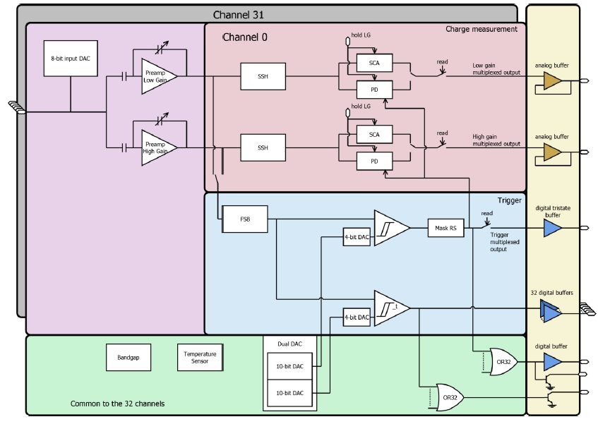
CITIROC BLOC DIAGRAM

Slide 14
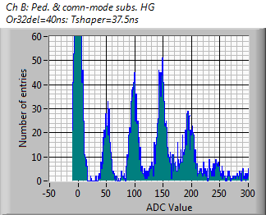
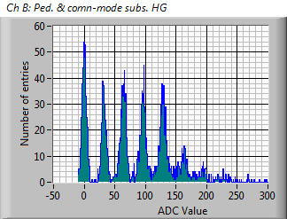
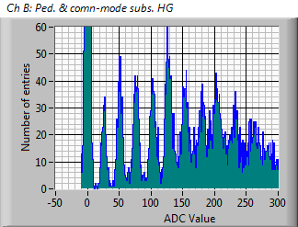
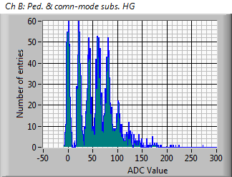
CITIROC :
Varying Pre-amp Feedback capacitance
Feedback capa.
= 1 [arb.]
48.2 ADC/p.e.
Regime:
  high enough gain to resolve indivual p.e. peaks
  whilst avoiding saturation
Dynamic range (HG):
  12-bit ADC
  Baseline ~950
  19.3 ADC/p.e.
  160 p.e.
> 1600 p.e. with LG.
Feedback capa.
= 4 [arb.]
32.2 ADC/p.e.
Feedback capa.
= 6 [arb.]
25.6 ADC/p.e.
Feedback capa.
= 8 [arb.]
19.3 ADC/p.e.

Slide 15
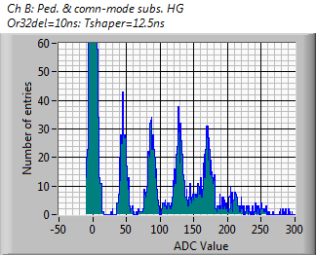
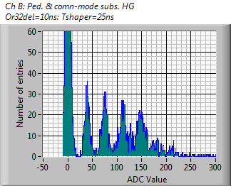
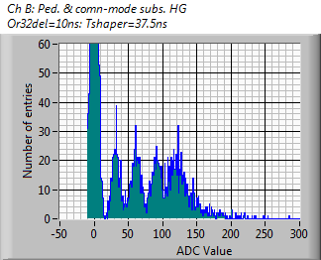
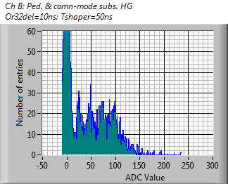
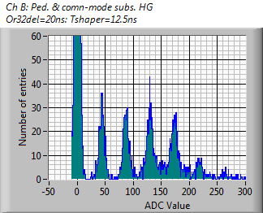
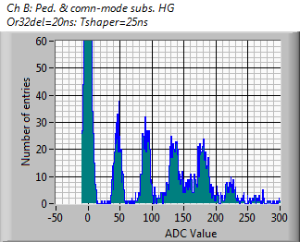
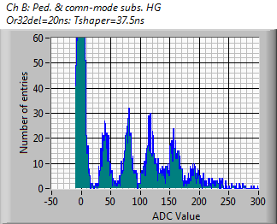
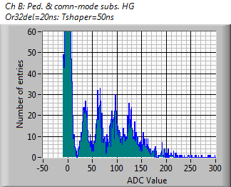
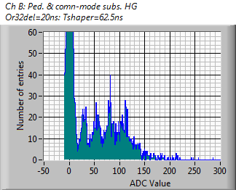
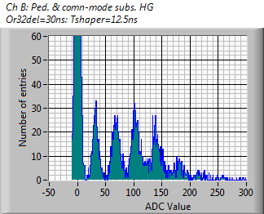
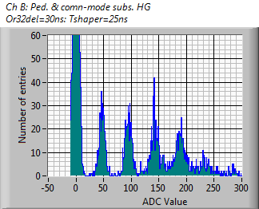
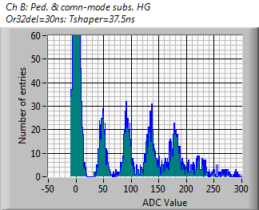
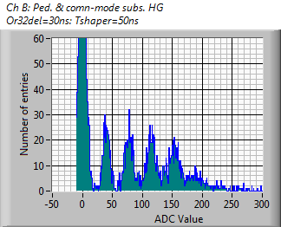
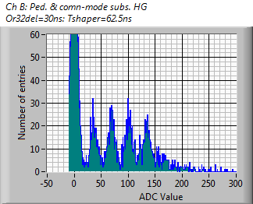
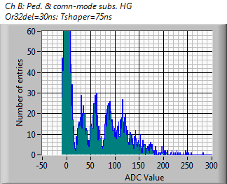
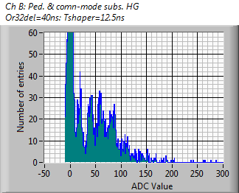

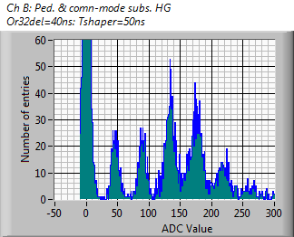
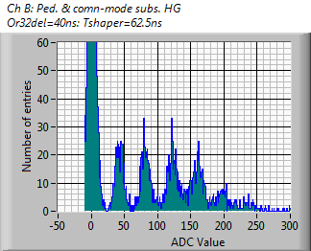
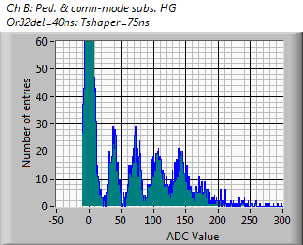
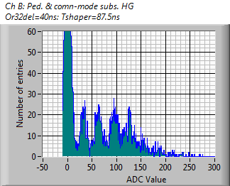
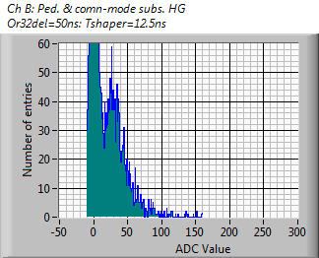
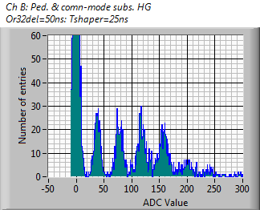
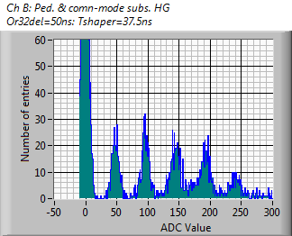
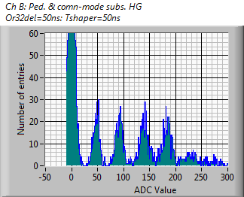
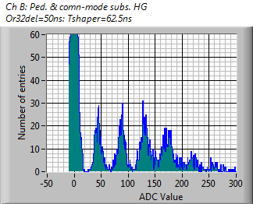
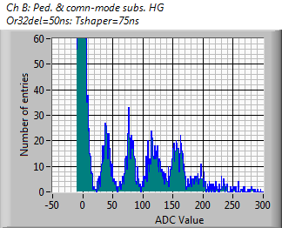
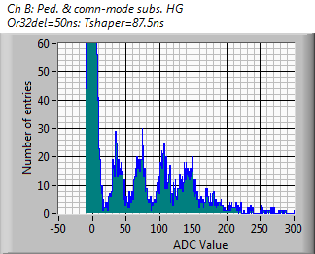
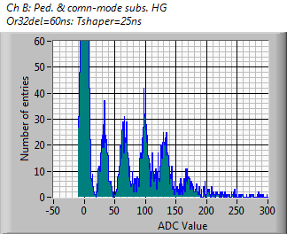
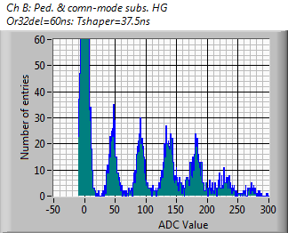
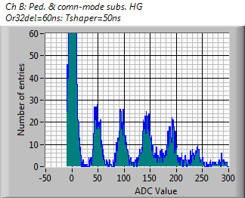
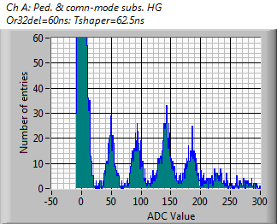
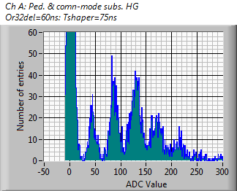
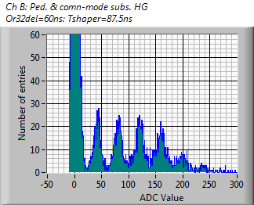
CITIROC : shaper time constant
12.5 ns
25 ns
37.5 ns
50 ns
62.5 ns
75 ns
87.5 ns
10 ns
20 ns
30 ns
OR32/Hold delay
40 ns
50 ns
60 ns

Slide 16
FPGA Architecture

Slide 17
Protocol
Readout
Slow Control

