Slide 1
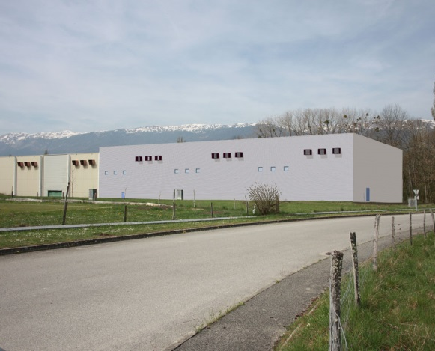
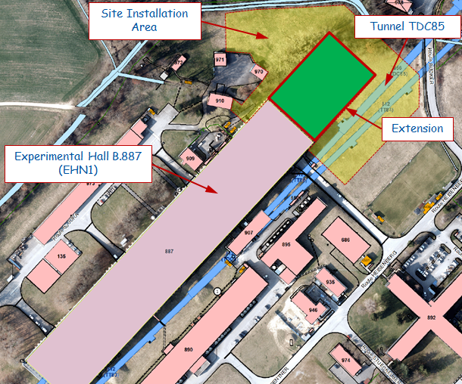
EHN1 civil engineering project status (AUGUST)
Summary:
Updating of the activities carried out on-site (Done) in AUGUST
List activities on going (Next steps) and scheduled for SEPTEMBER
Final consideration
Extension of Building 887 - Neutrino Platform General Meetings
N.Lopez – M.Manfredi
03 September 2015
1

Slide 2

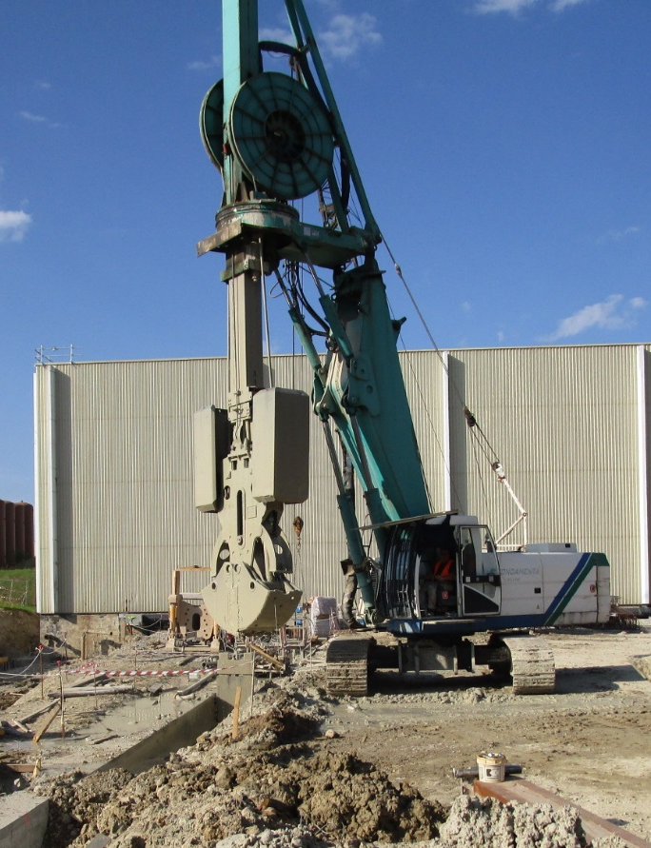
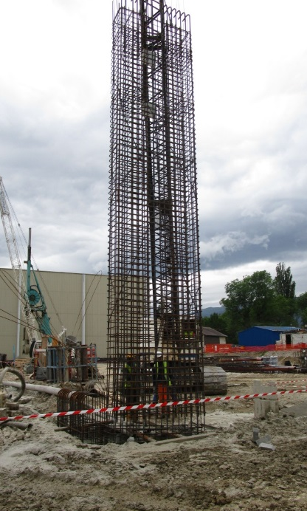
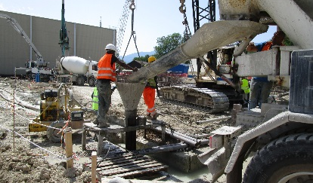
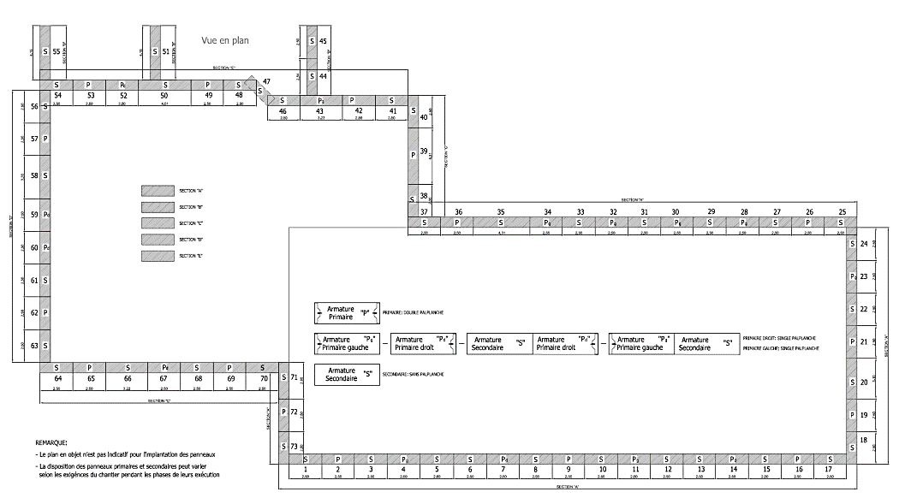
EHN1 civil engineering project status (AUGUST)
Done (1/3):
Guide walls allowing DW excavation: (100% completed)
(1) DIAPHRAGM WALLS
-73 panels-
Execution EAST side: (100% completed)
Execution SOUTH/WEST side: (100% completed)
100% TOTAL PANELS
Execution NORTH/WEST side: (100% completed)
Problem for execution of panels close to EHN1 has generated ~4 weeks of delay to complete the task
and..
Construction defects discovered in other panels already casted came out during excavation to set up the crown beam
lead to..
About 4 weeks of delay on the overall planning as connected activities have been blocked
TASK COMPLETED in AUGUST
S/W
N/W
EAST
Extension of Building 887 - Neutrino Platform General Meetings
N.Lopez – M.Manfredi
03 September 2015
2

Slide 3
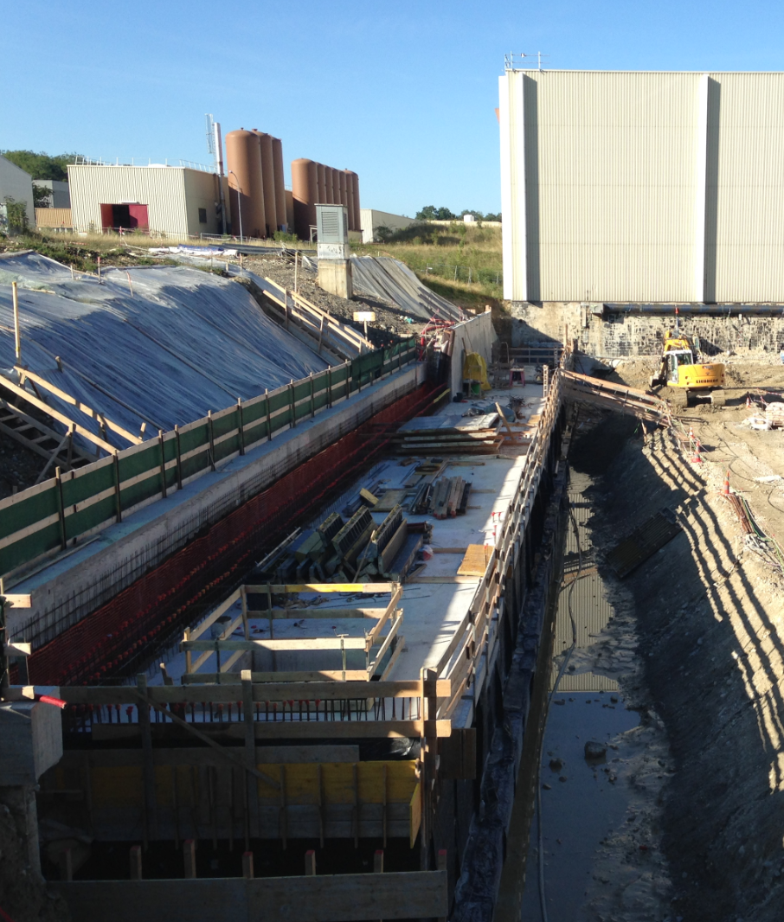
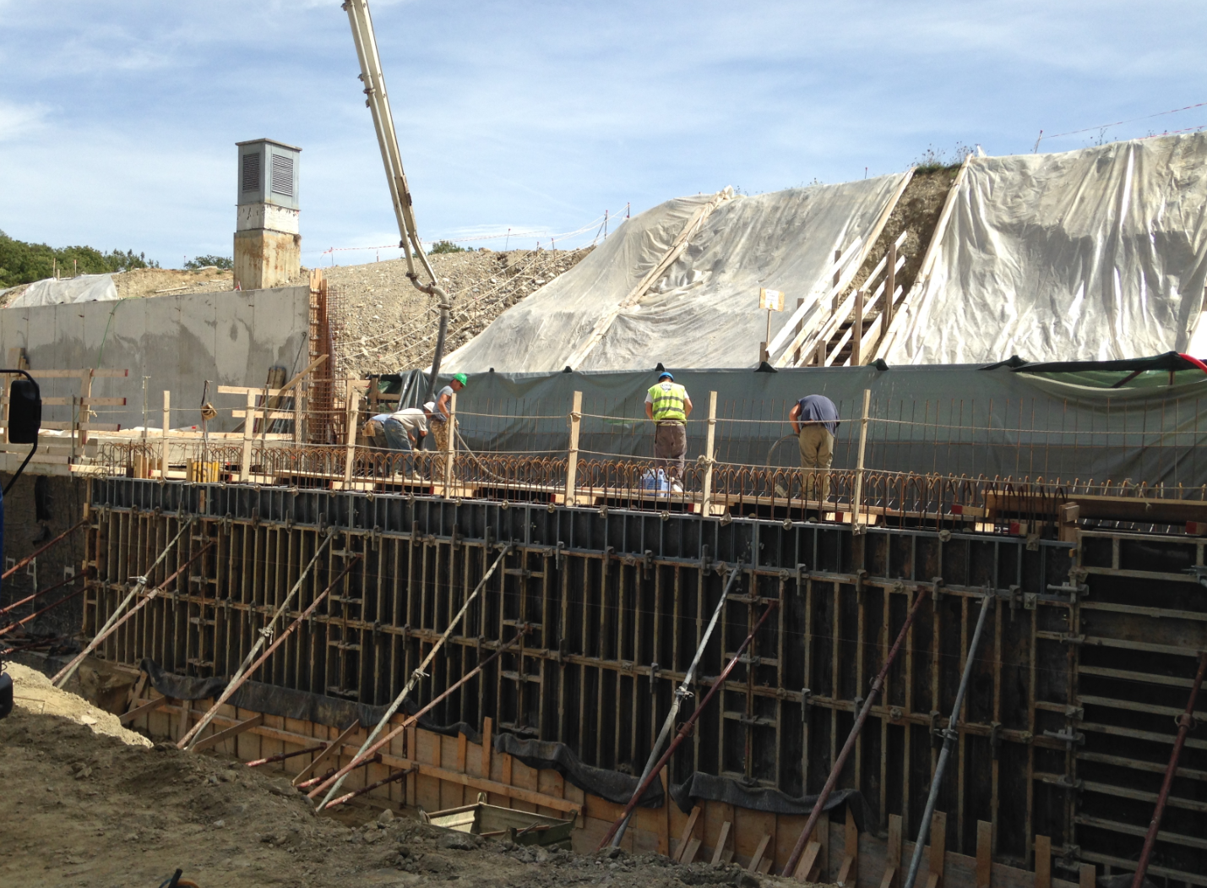
EHN1 civil engineering project status (AUGUST)
Done (2/3):
Earthworks: (100% completed).
Execution TG: (85% completed). Type 3 done. Type 1 to be completed
(2) TECHNICAL GALLERY
-70 meters-
Backfilling: (25% completed).
Side retaining wall and backfilling foreseen later as not in the critical path. Priority given to other activities
Extension of Building 887 - Neutrino Platform General Meetings
N.Lopez – M.Manfredi
03 September 2015
3

Slide 4
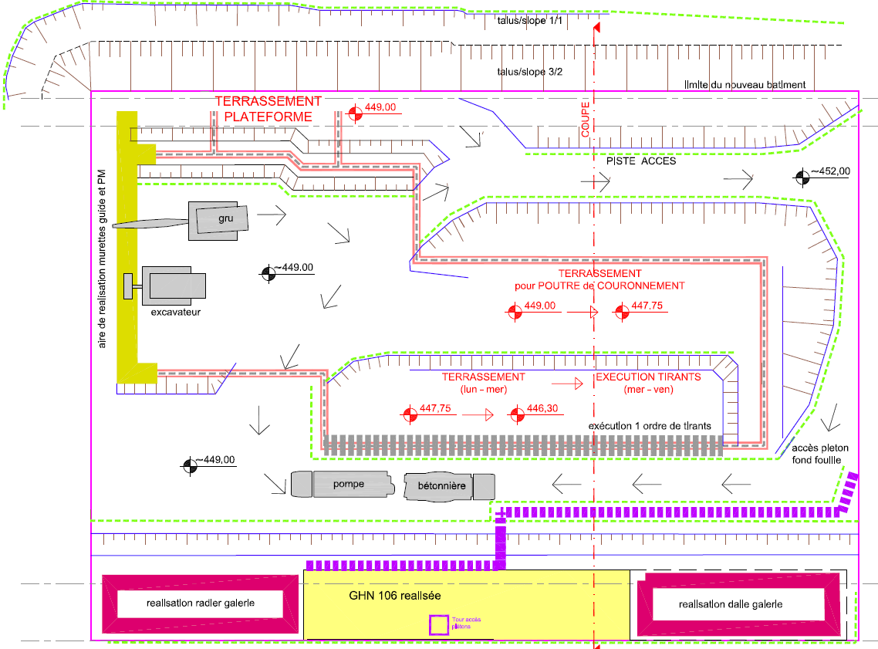
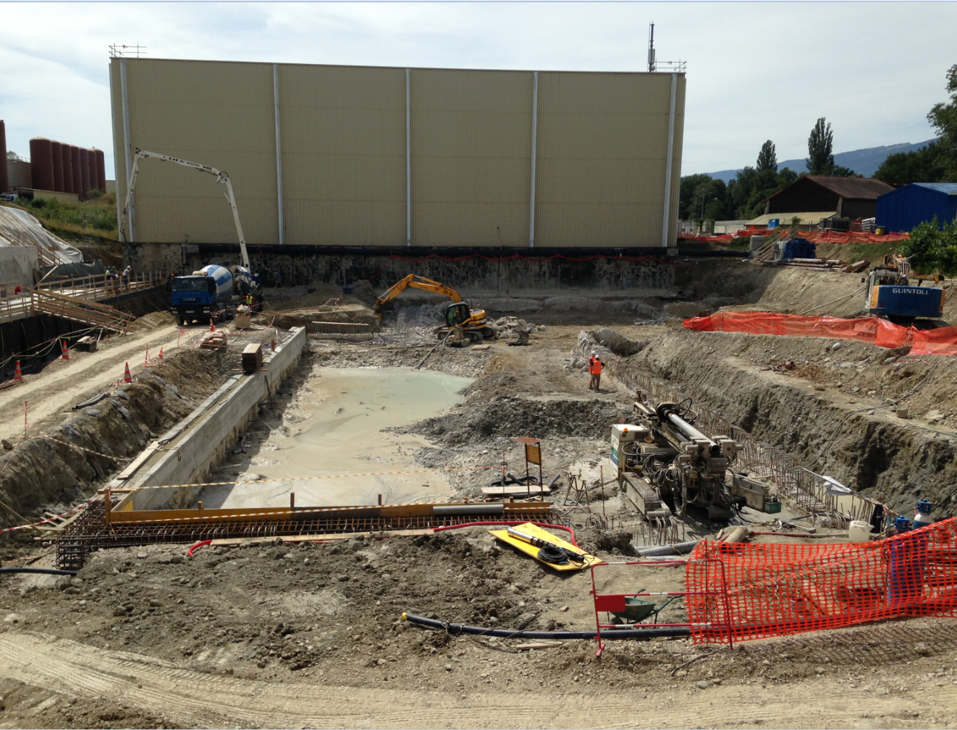
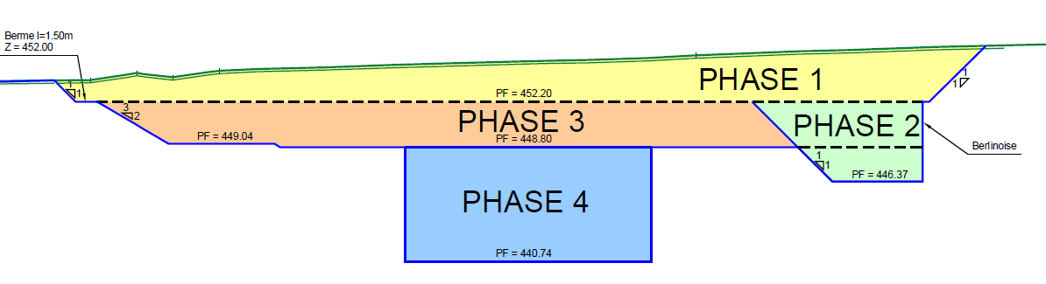
EHN1 civil engineering project status (AUGUST)
Excavation head DW level: (100% completed). After excavation pit A..
Done (3/3):
Crown beam execution: (22% completed). Start with E side.
Excavation first ties level: (22% completed).
(3) PITS EXECUTION
First ties level execution: (13% completed). Not yet in tension
-step by step-
Excavation second ties level: (0% completed). Only for certain DW panels
…Others
Extension of Building 887 - Neutrino Platform General Meetings
N.Lopez – M.Manfredi
03 September 2015
4

Slide 5
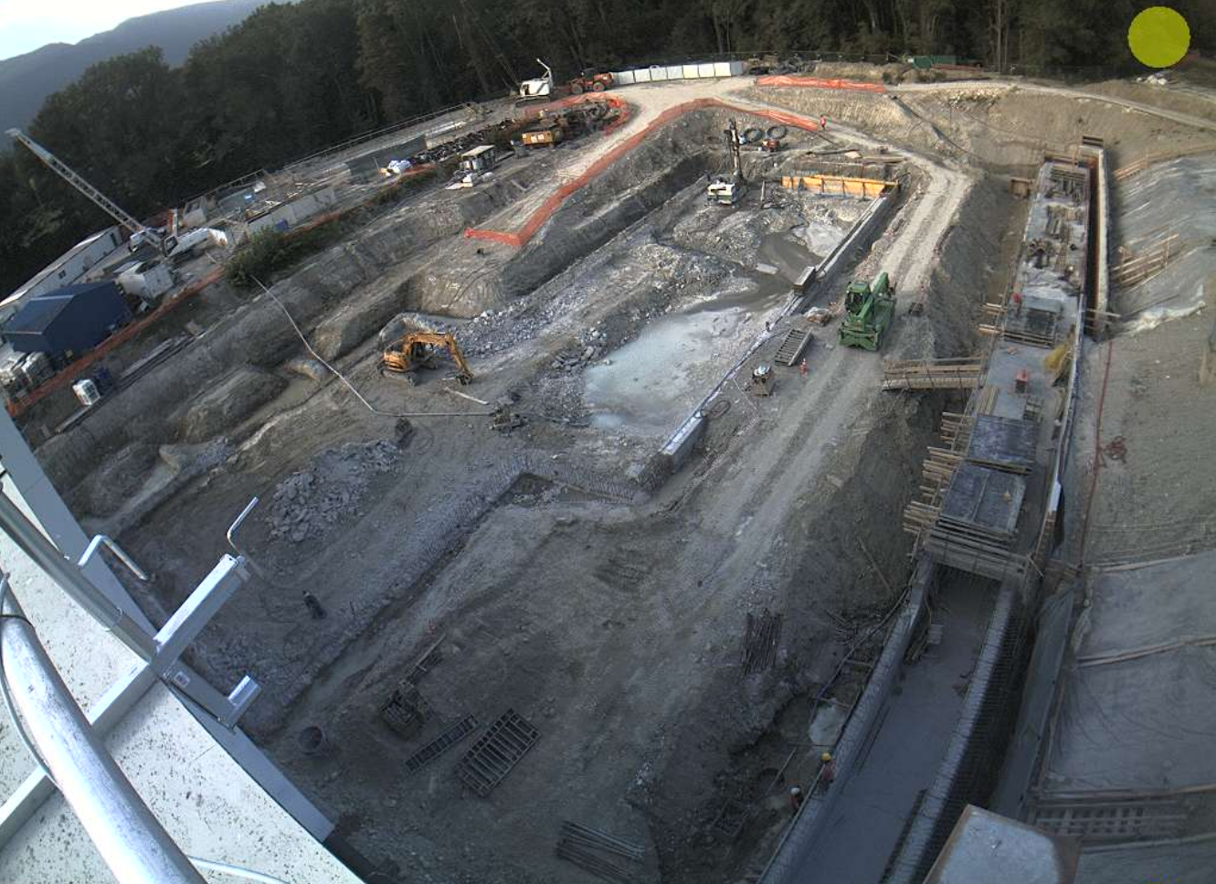
EHN1 civil engineering project status (AUGUST)
Next Steps: Activities scheduled for September
(2) TG: Upper slab and retaining wall to be executed in the 2nd half of September
(3) PITS: Has at the moment the High Priority.
80% Crown beam executed 1st half of September. Completion foreseen in the 2nd half..
Excavation inside pits and execution whole 1st order of anchors within the 2nd half of September
31/08/2015 =>
Extension of Building 887 - Neutrino Platform General Meetings
N.Lopez – M.Manfredi
03 September 2015
5

Slide 6
EHN1 civil engineering project status (AUGUST)
Final Consideration:
- The completion of the DW complex had ~4 weeks of delay on the planning.
Defects reparation and DW completion led to the inability to advance with the parallel activities foreseen. Overall delay estimated in about 4 weeks.
CE Contractor will evaluate all the possibility to retrieve or minimize time lost (i.e. work during the weekend, add different workshop and internal resources, overlap several activities with metallic contractor).
Planning will be reviewed given the priority to the execution of the pits (critical path).
CE Handover unchanged for the moment (Jul-2016).
Next status of the works end-September.
Extension of Building 887 - Neutrino Platform General Meetings
N.Lopez – M.Manfredi
03 September 2015
6

