Slide 1
cryostat STATUS b. 182

Slide 2
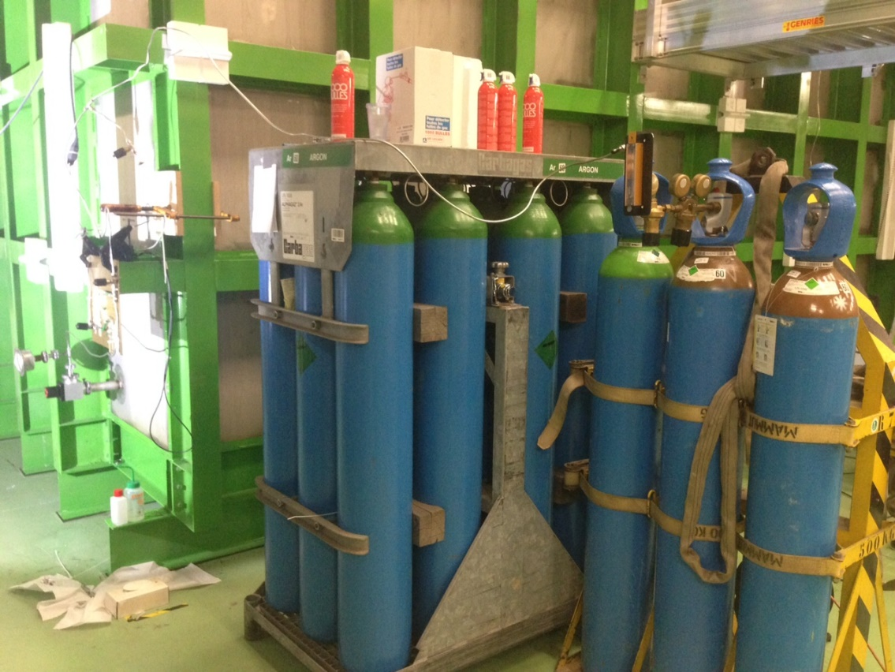
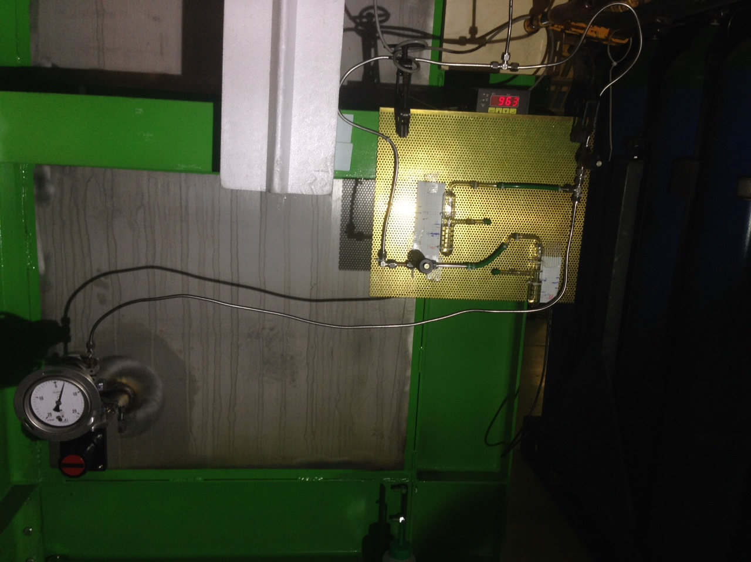
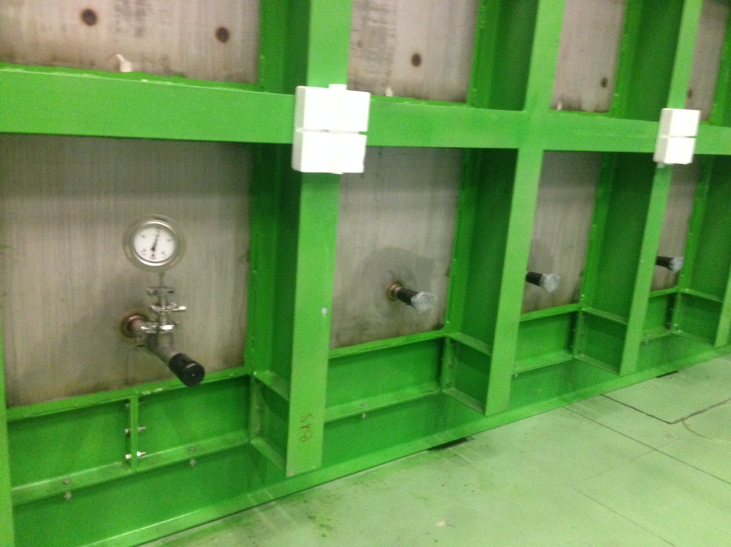
WA105 in b. 182
Since Tuesday:
- test set-up established
- pressurized the volume up to 2mBar (because the membrane is free)
    twice with Ar
    and once with He
Also constantly monitoring changes in the atmospheric pressure (up to 10 mBar/day)
Ar
He
Several manometers has been installed to monitor the pressure in different parts of the volume,

Slide 3
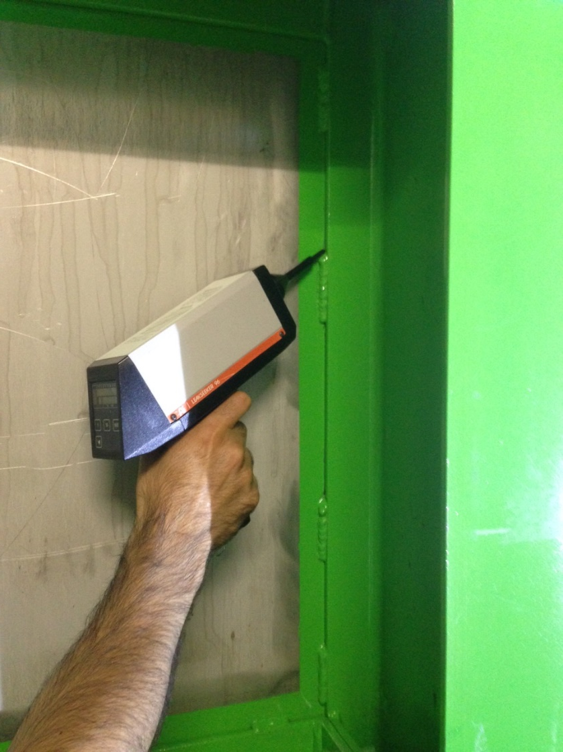
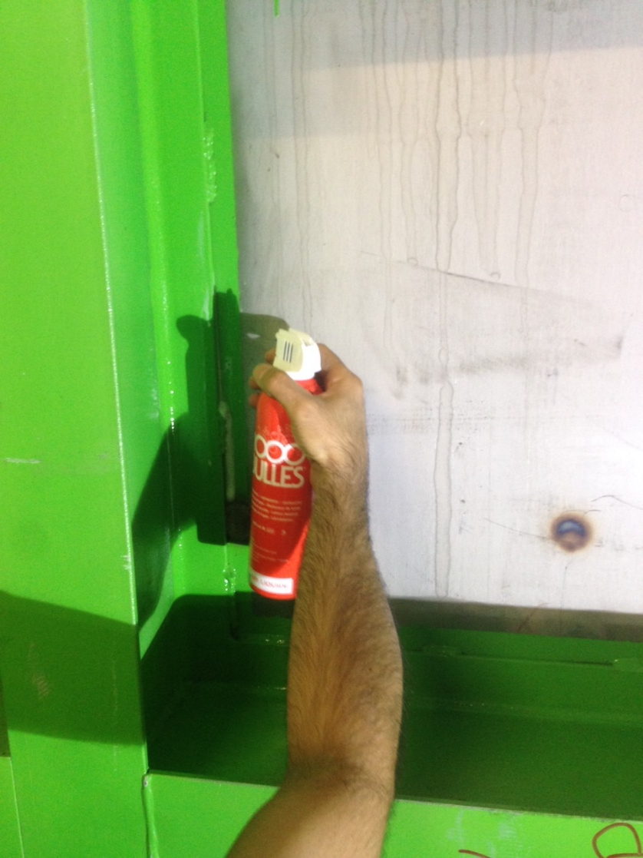
WA105 in b. 182
All external surfaces tested 100% with
- 1000 Bulles
- Leak seeker
No leaks found.
All done with the help of J. Bremer’s group
Also involving “40/30” consortium at CERN (official LHC contractor)

Slide 4
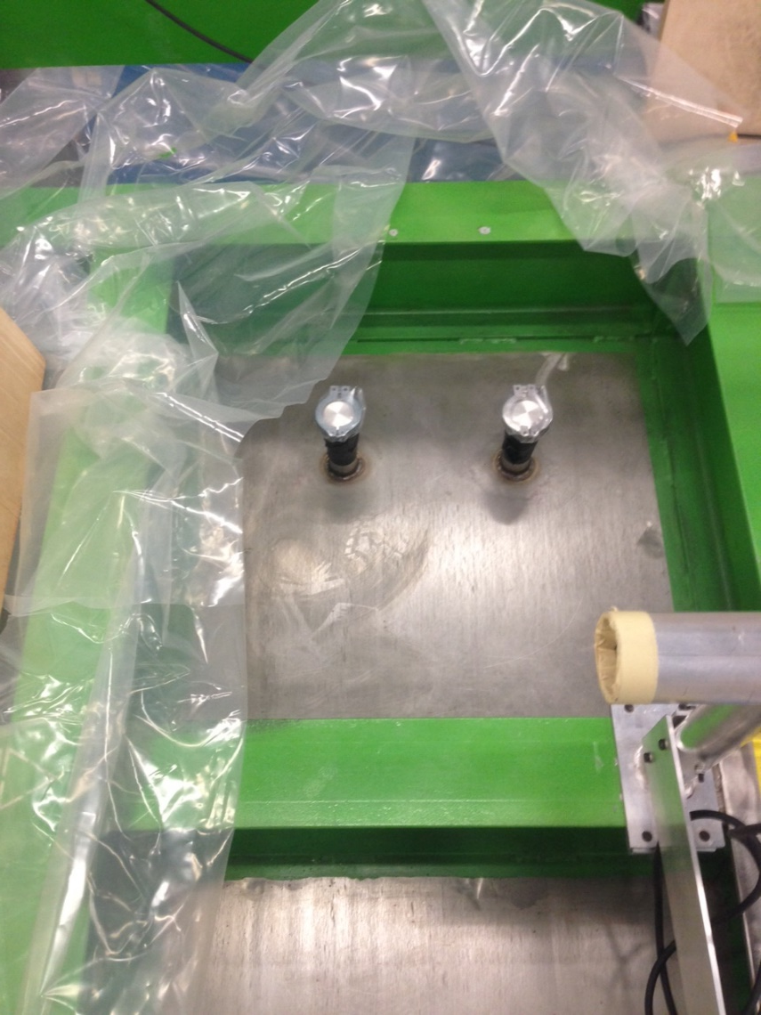
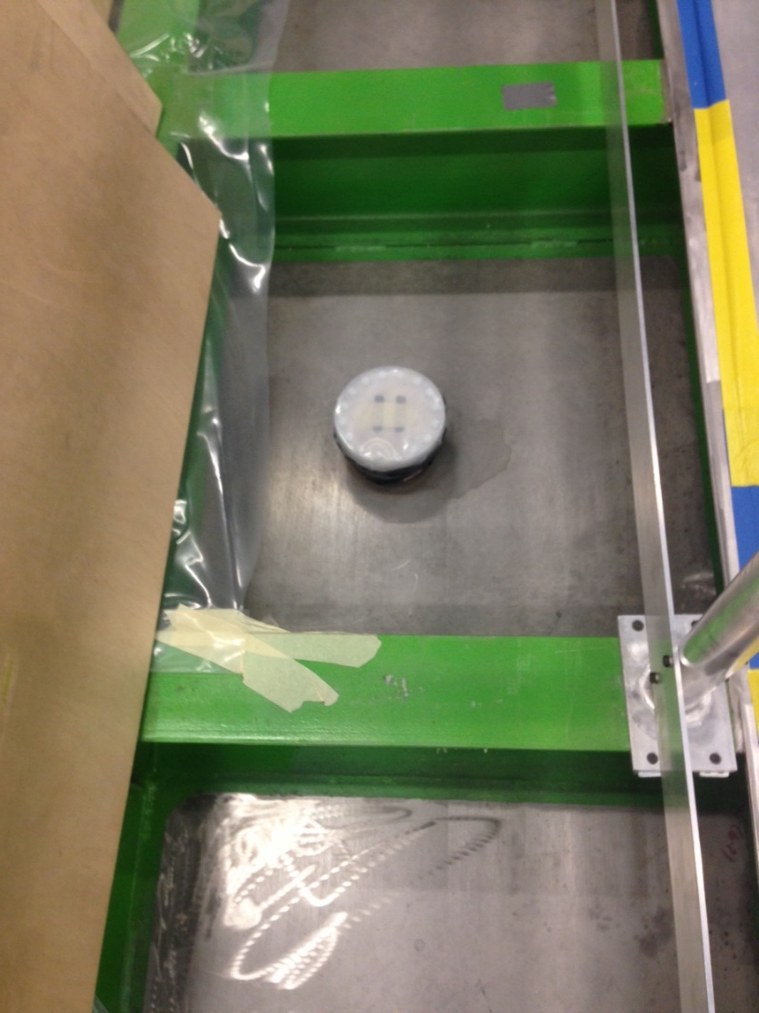
All feed-trough have been isolated as precautionary measure.

Slide 5
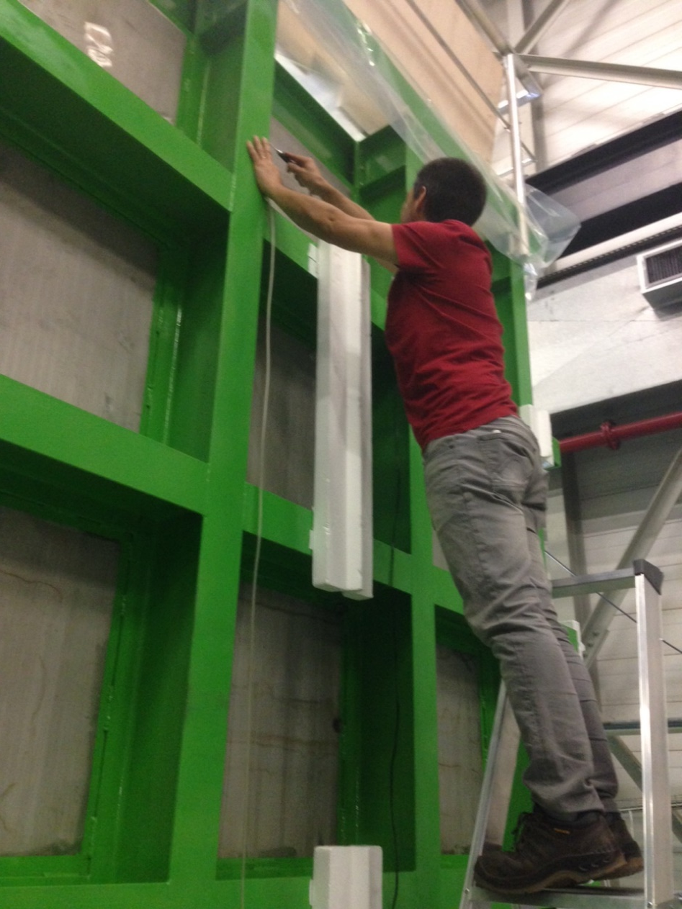
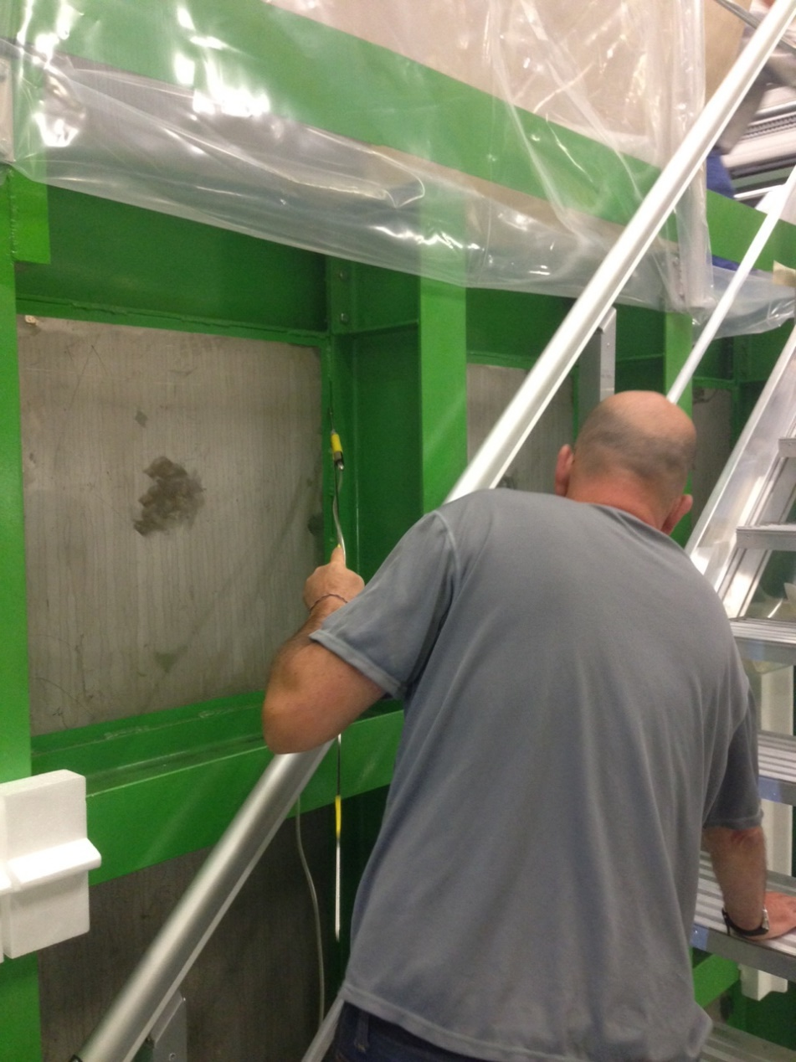
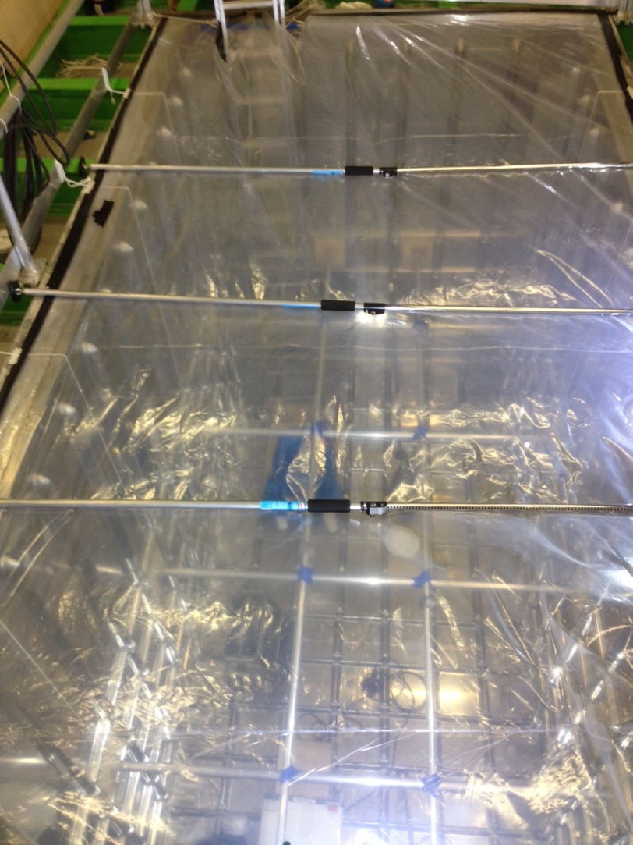
Since this morning a He sniffing test had been going on.
Also we are also constantly monitoring the He content inside of the membrane volume and so-far nothing has been found above the detection limit (x10⁻⁶).

Slide 6
One area of concern has been identified
The weld between the Stainless steel plates and the carbon steel main beams.
Plan:
To continue the work to sniff all the structure for He leaks
Stainless Steel Plate
Welding
Carbon Steel profile

