Slide 1

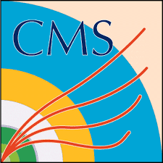
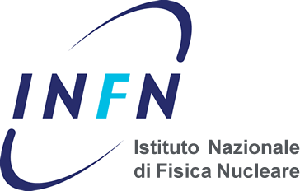
STEAM: Education and Communication with Art at ATLAS and CMS
Pierluigi Paolucci (I.N.F.N. Napoli)
on behalf of ATLAS and CMS outreach groups

Slide 2
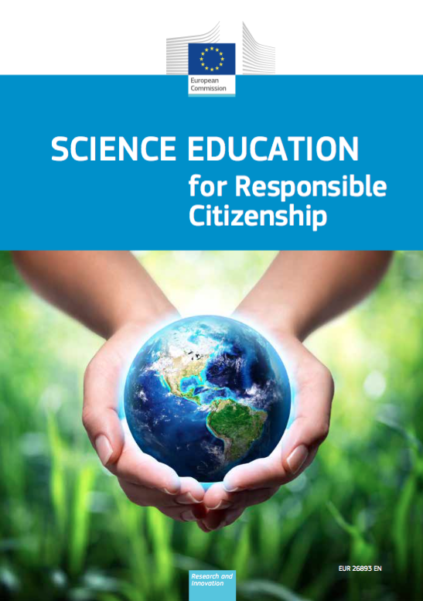
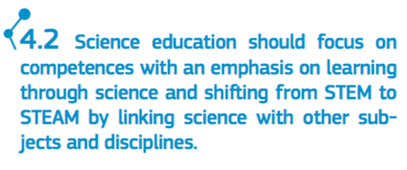
What is STEAM
STEAM is an educational and innovation framework bringing science, technology and engineering together with the arts/other disciplines and types of learners with the goal of being more engaging, creative and naturally successful for all members of any educational system.
Programme for Science Education Research

Slide 3
STEAM
expanding STEM education
is about
through
arts integration
Students who are involved in the arts are:
4 times more likely to participate in a math & science fair
3 times more likely to win an award for school attendance
4 times more likely to be recognized for academic achievement
Source: Americans for the Arts (2013)

Slide 4
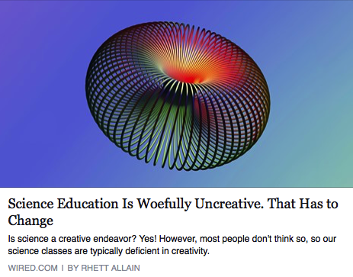
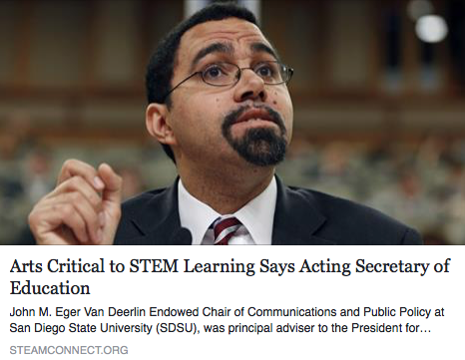

General interest about STEAM
Scientific knowledge is the product of creative thinking (Osborne et al. 2003)
Art is an excellent tool to help students learn science
(Ashley, 2011; Merten, 2011)

Slide 5
STEAM in CMS
Art@CMS is a collaboration between the CMS scientific community, art communities, and science education communities
The aim of the program is to reach out to as wide a range of people as possible in order to interest them in and inspire them to want to discover more about science, and in particular particle physics.
The program is comprised of 2 complementary modules, the Art@CMS exhibitions and the Science&Art@School.
40 exhibitions and 12 workshops done from 2012 to 2016

Slide 6
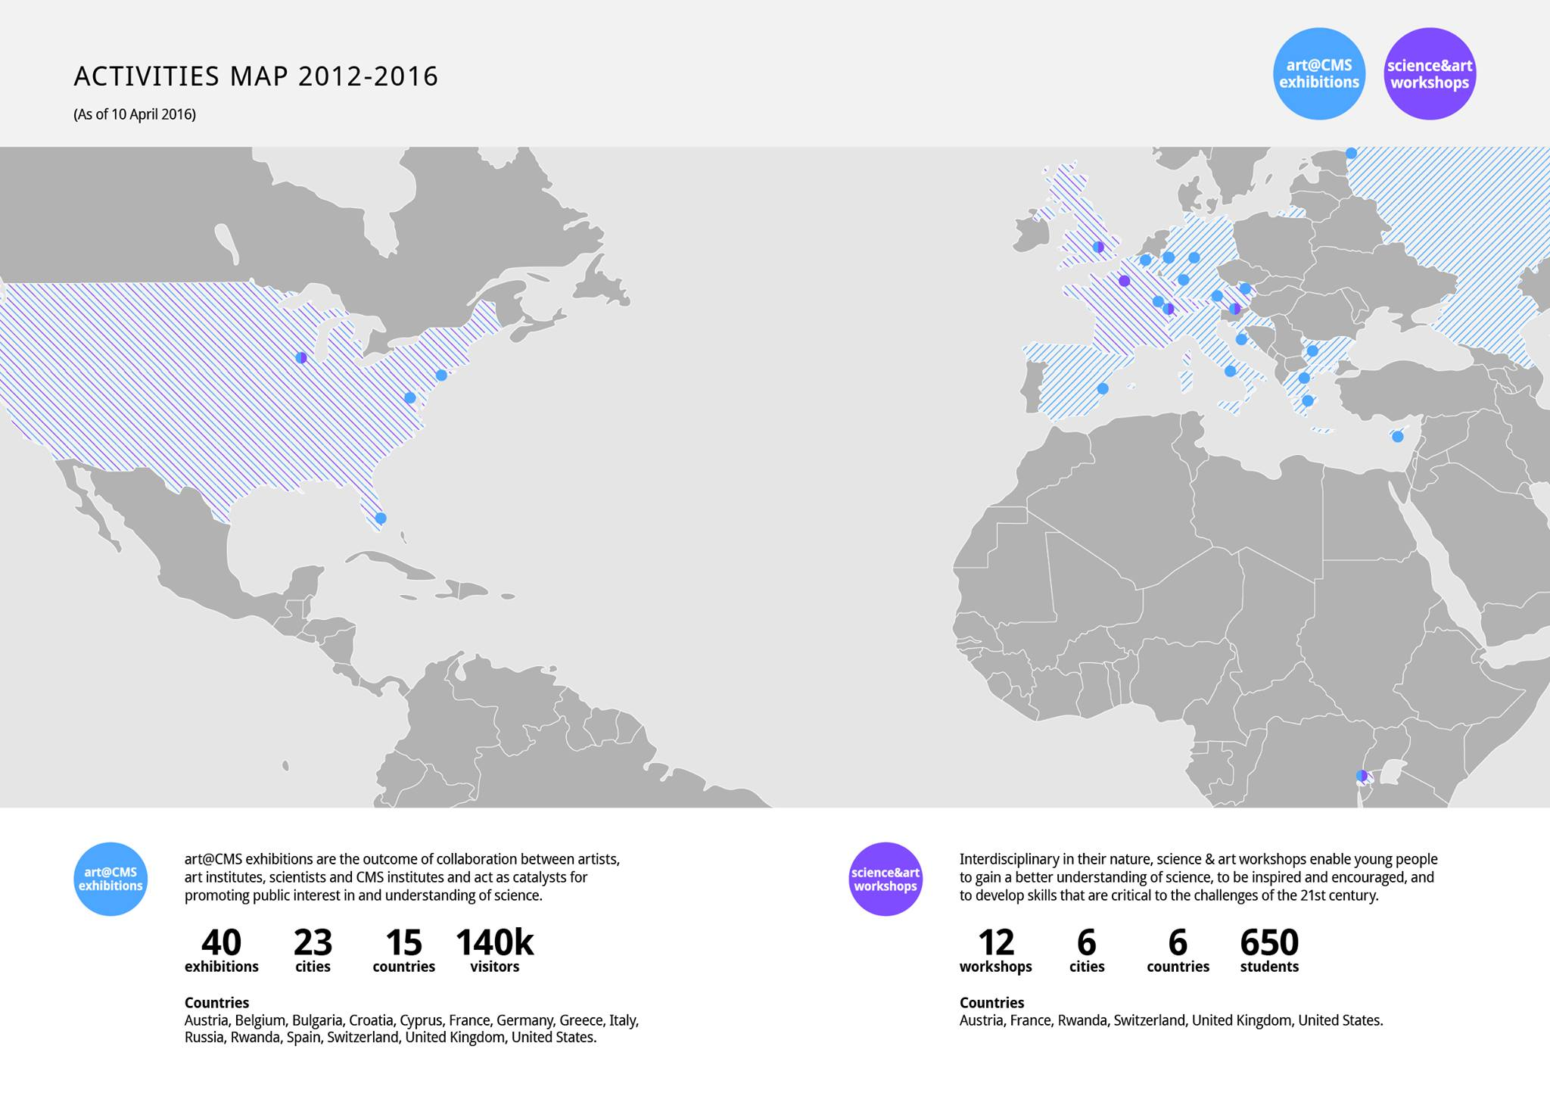
art@CMS
2014
B.A. International and European Economic Studies
Ph.D. Organisational Behaviour and
Human Resource Management
2016

Slide 7
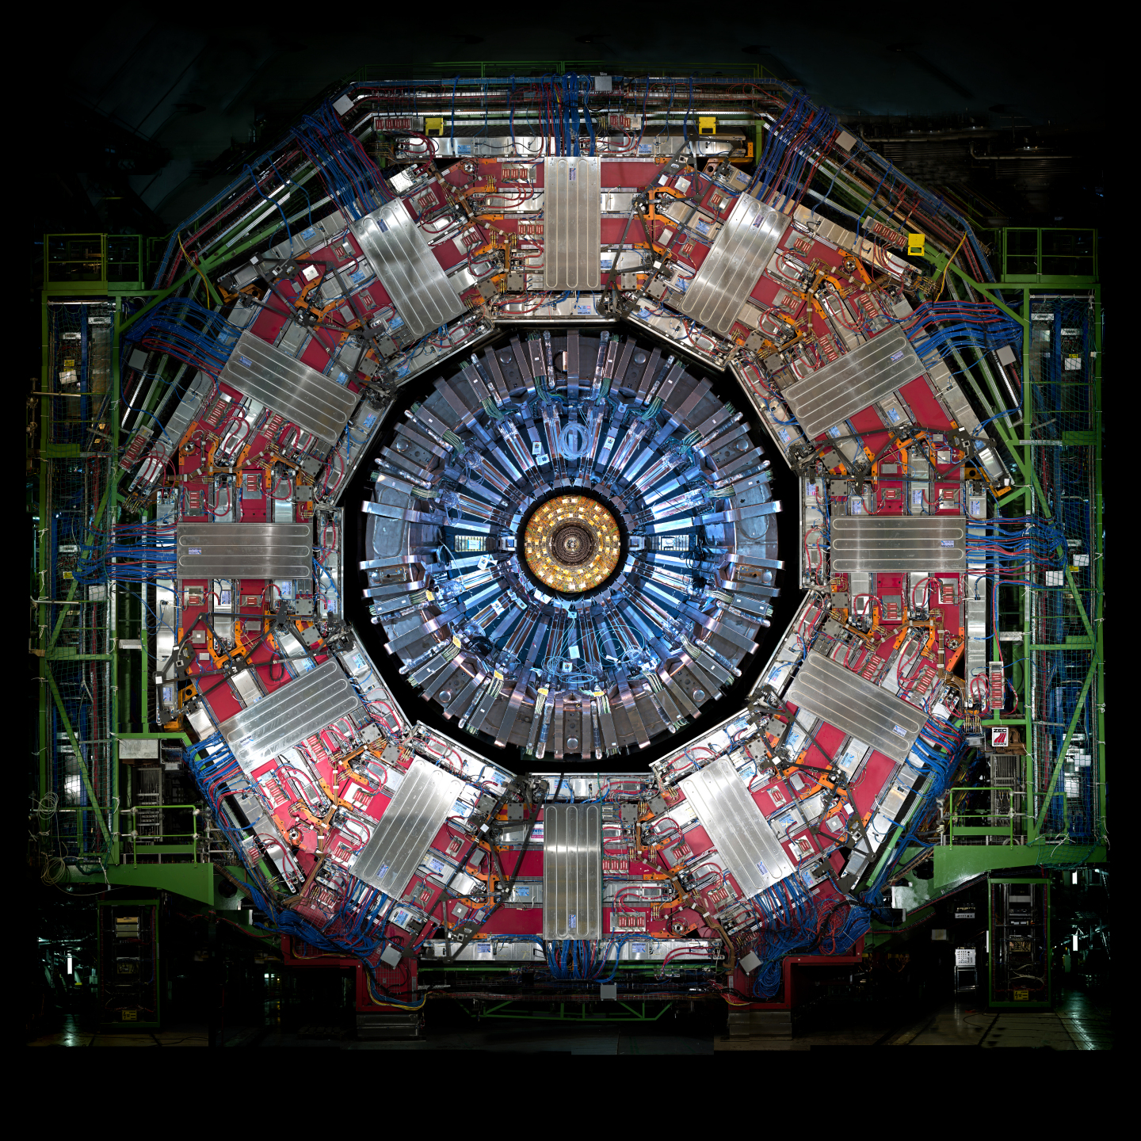
What is it ?
Fractal
O-ring
Window Rose
Catherine Wheel
Students have an open and creative mind

Slide 8
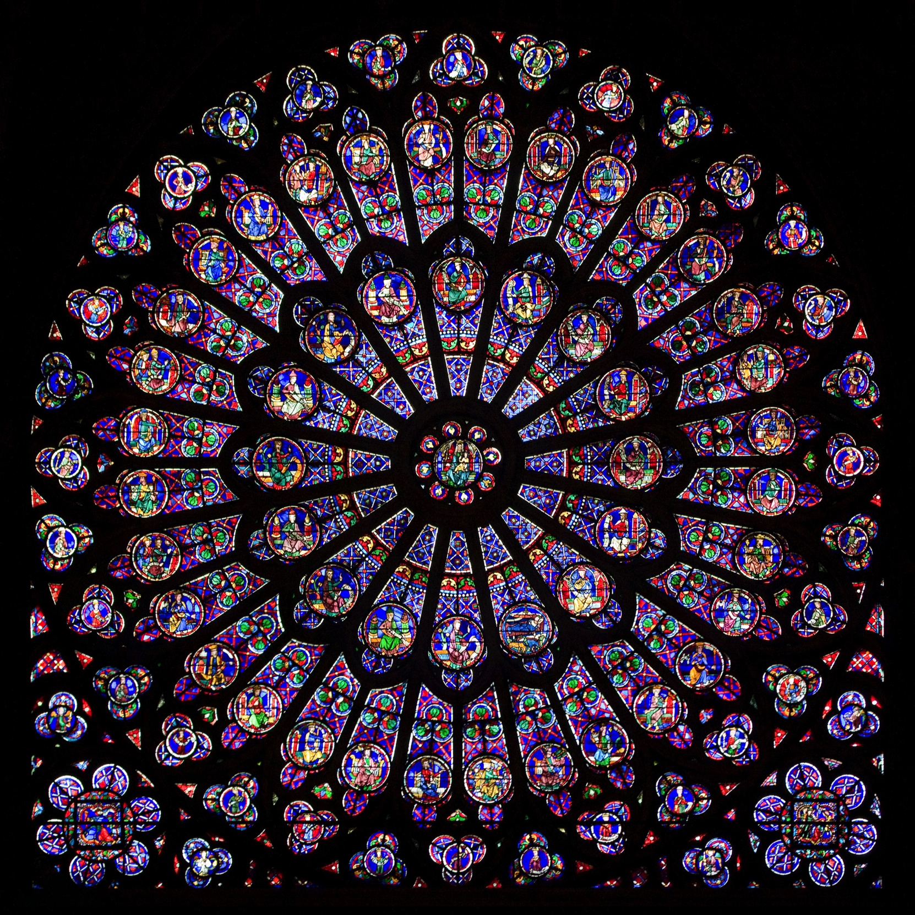

Slide 9
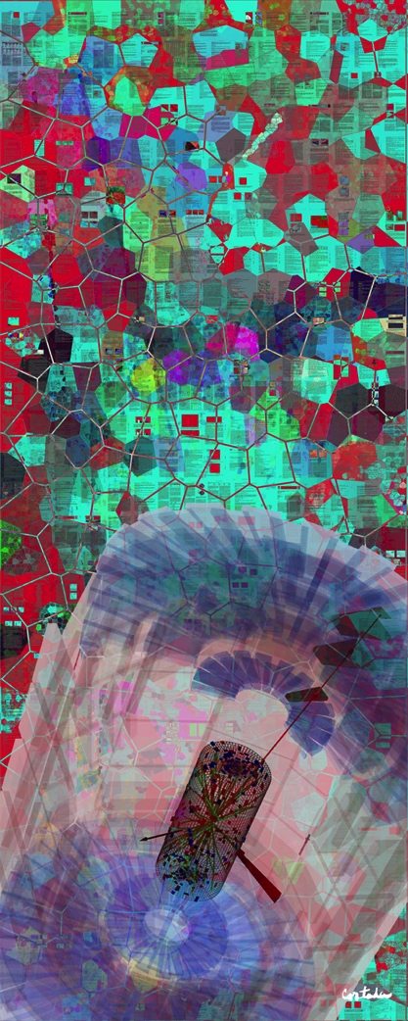
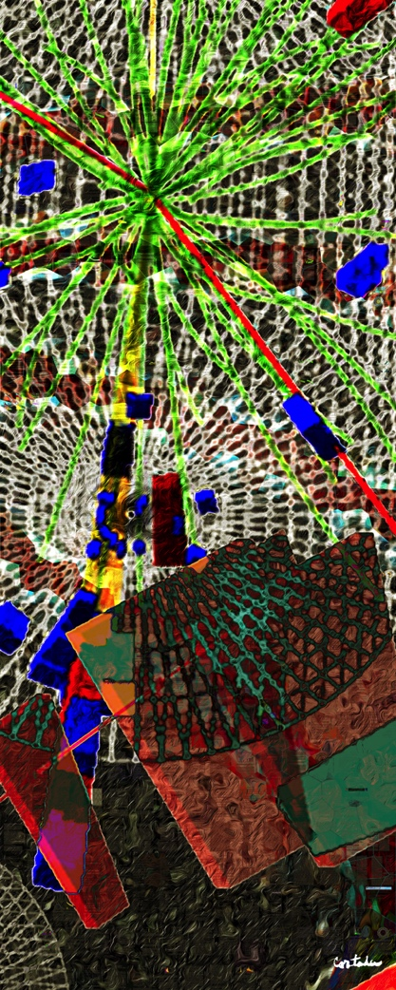
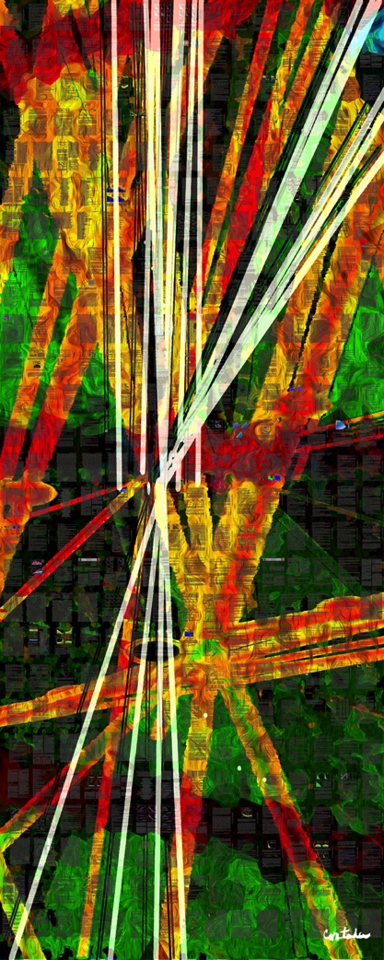
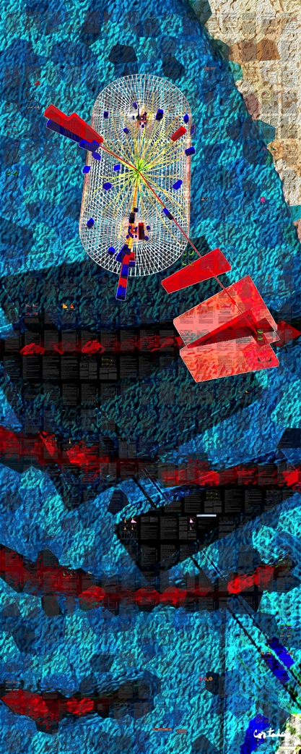
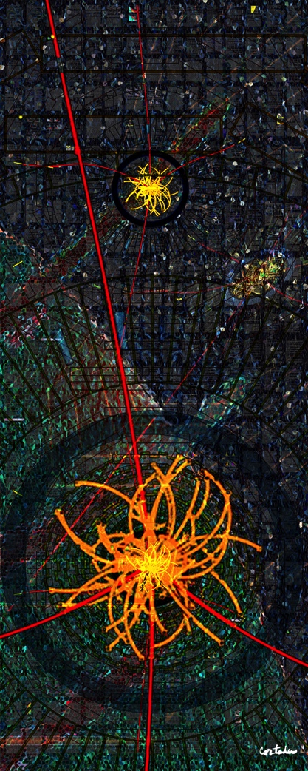
In Search of the Higgs Boson
Xavier Cortada (with the participation of physicist Pete Markowitz), digital art, 2013)
H→ WW
H→ γγ
H→ bb
H→ ττ
H→ ΖΖ

Slide 10
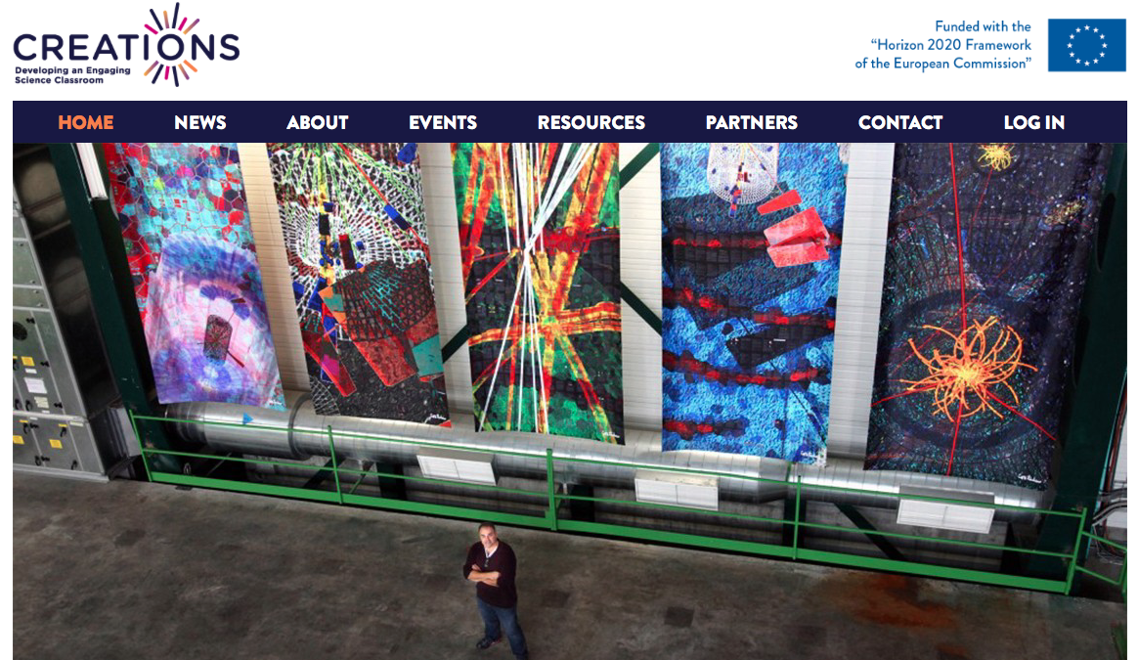
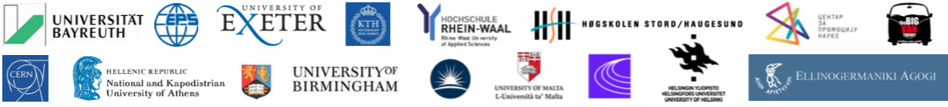

Slide 11
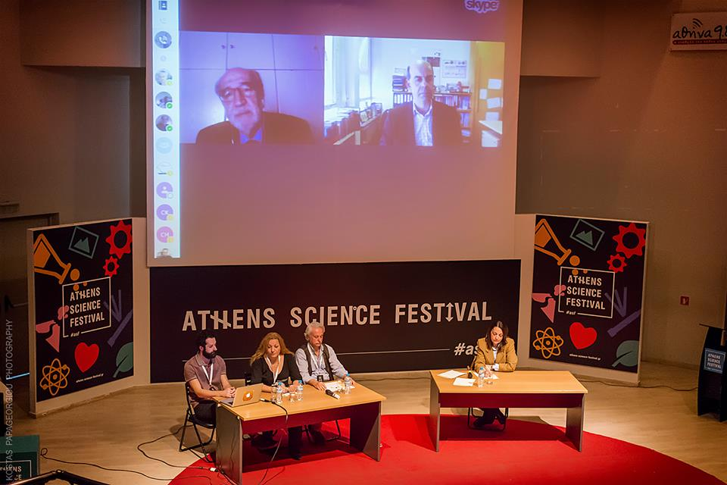
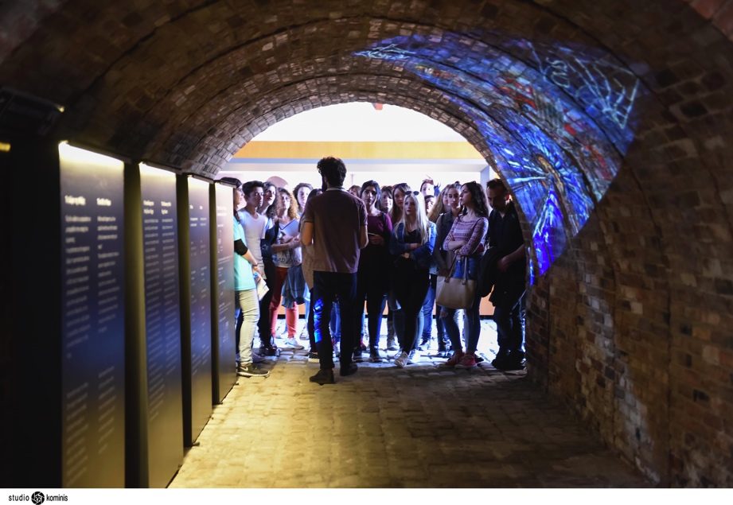
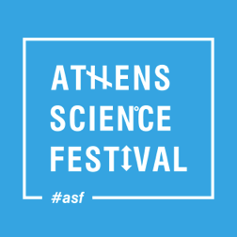
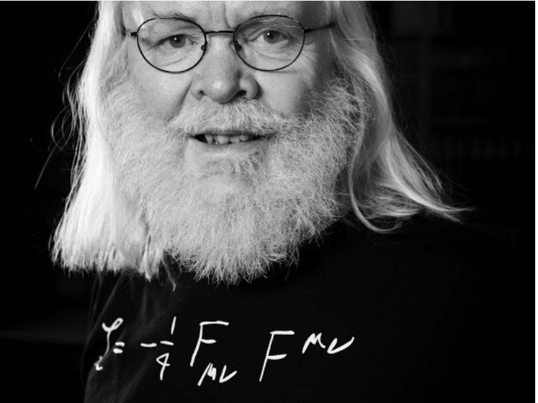
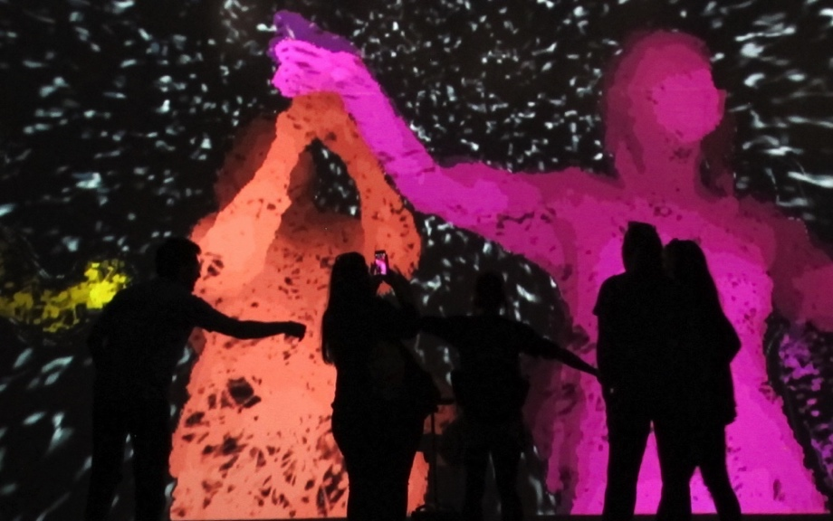
Athens Science Festival 2016

Slide 12

“Art & Science across Italy” project in Milano, Firenze, Venezia/Padova and Napoli
Goal: attract young and general people to Particle Physics
Addressed to: students and teachers of Italian Lyceums and art schools.
Steps:
  Seminar at school and INFN about Particle Physics and INFN/CERN research.
  Students create artworks with the help of teachers and scientists.
  Report (book) about how and why artwork was realized (description, pictures and explanations).
Best artworks will be awarded and exposed at the “I colori del bosone di Higgs” exhibition.
  Students will act as guide during the exhibitions.
Winners will be invited to visit CERN

Slide 13
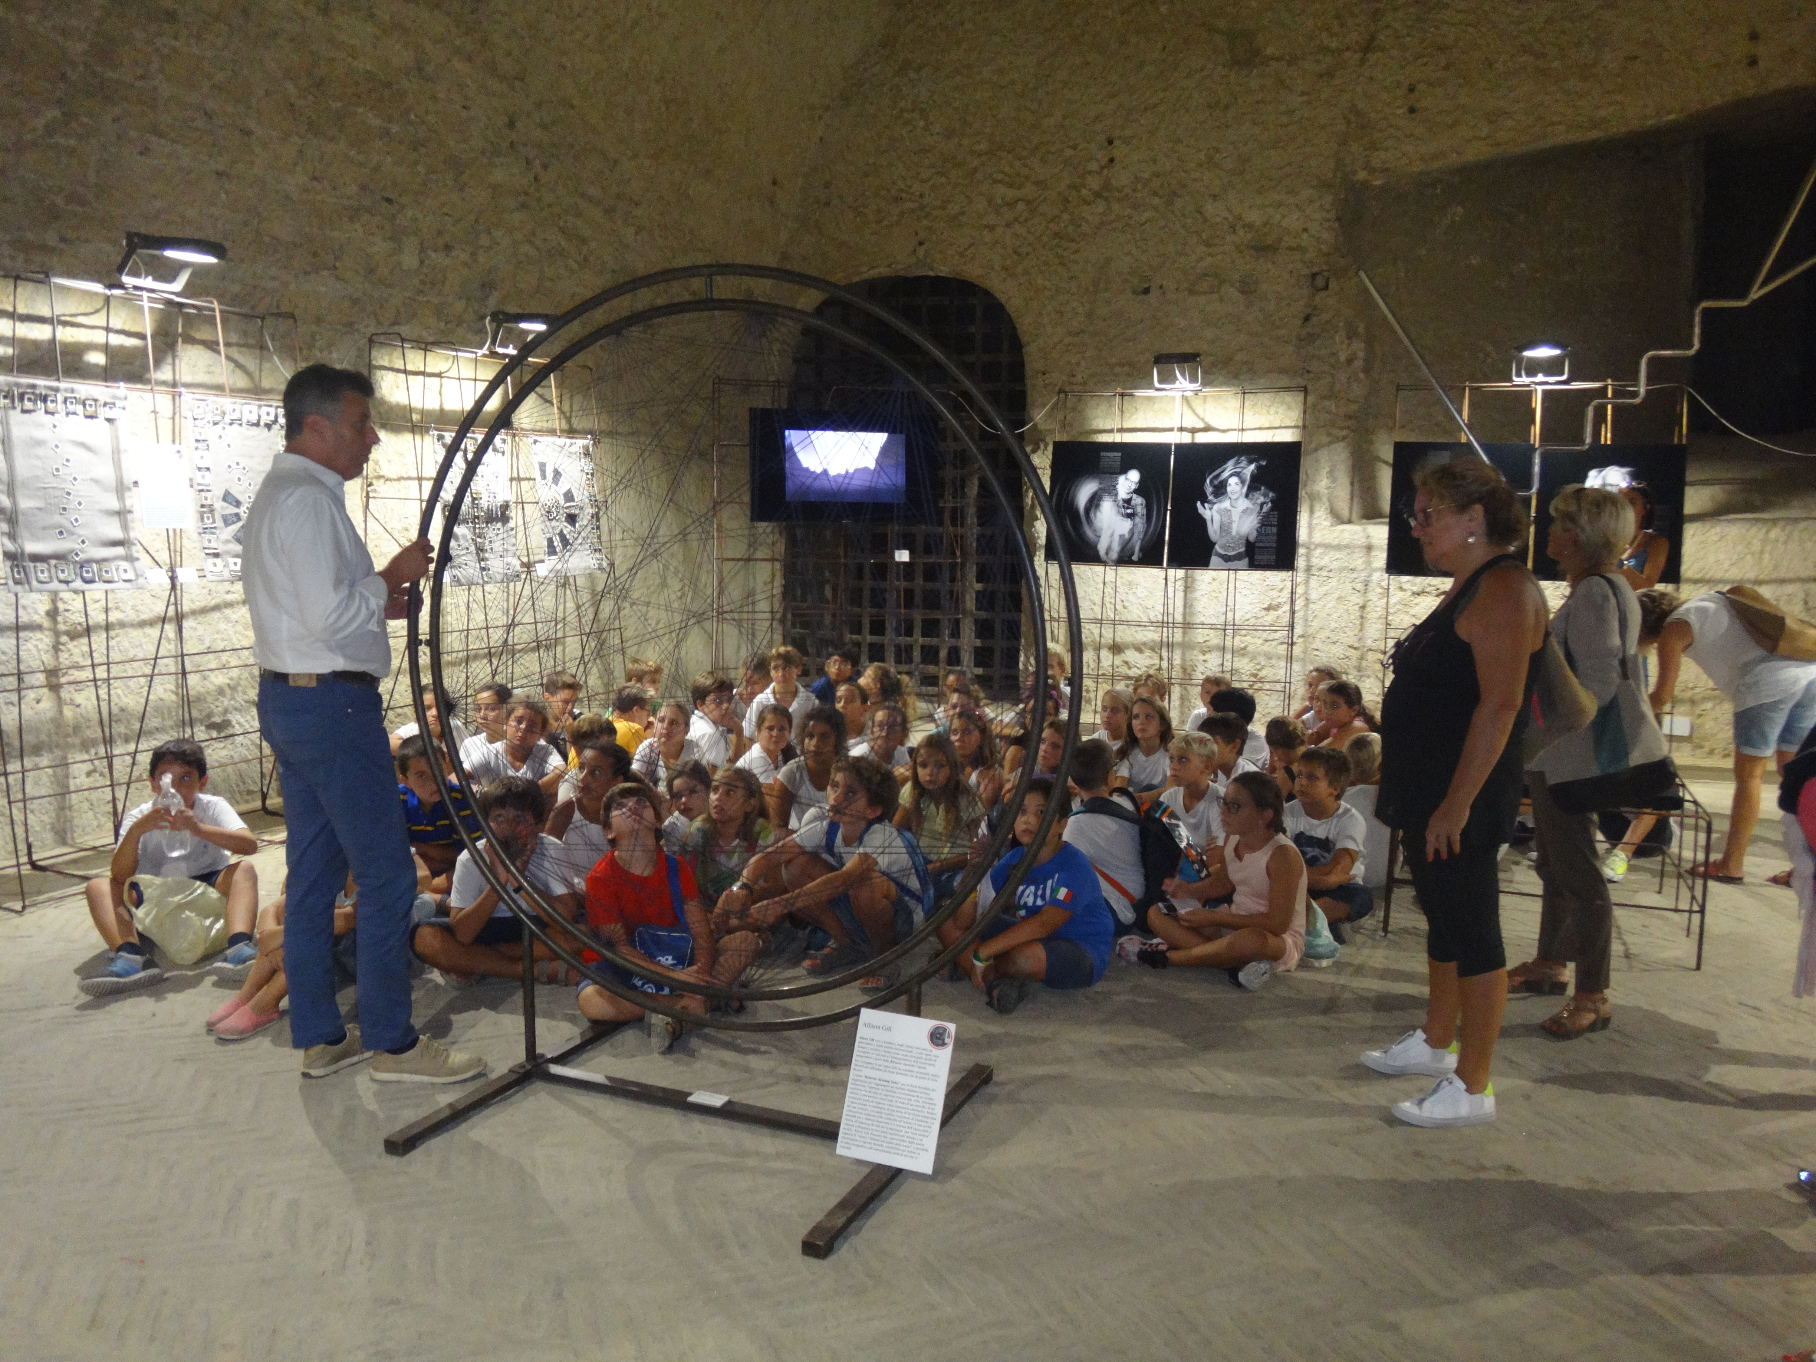
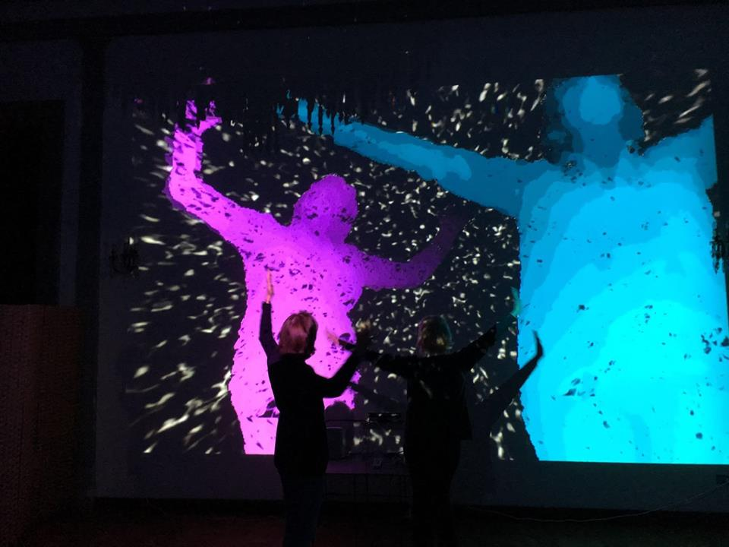
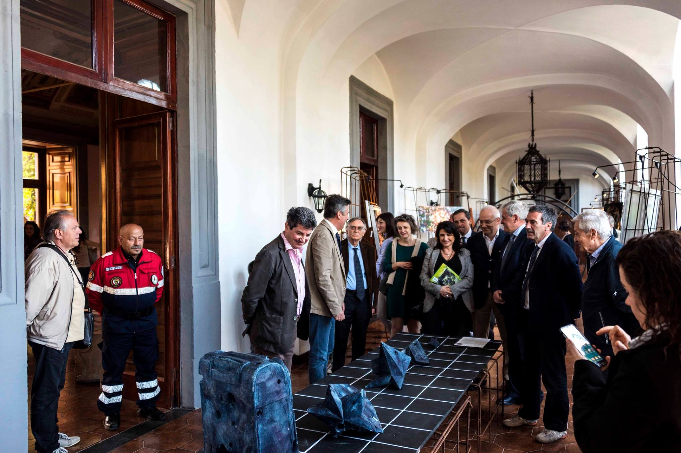
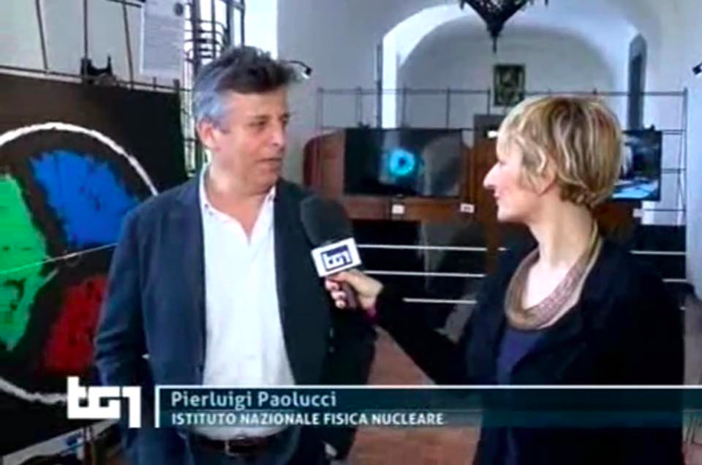
Pilot Run in Napoli
teaching
Il Dono della Massa (INFN)
Corriere della Sera, L’Espresso,
Il Mattino, RAI….....
RAI 1
file:///.file/id=6571367.27310722

Slide 14
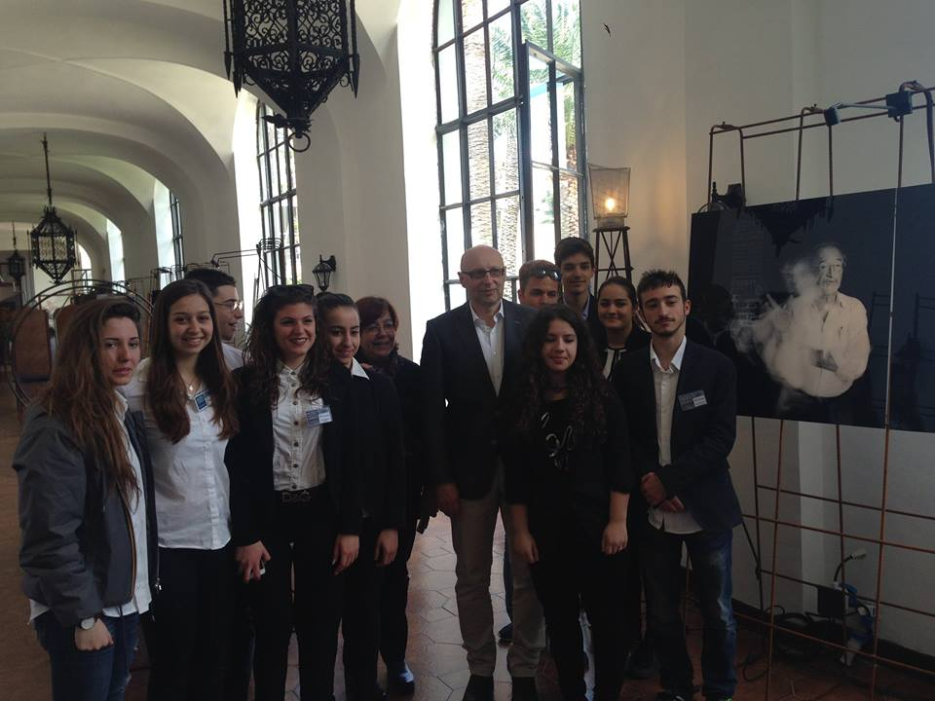
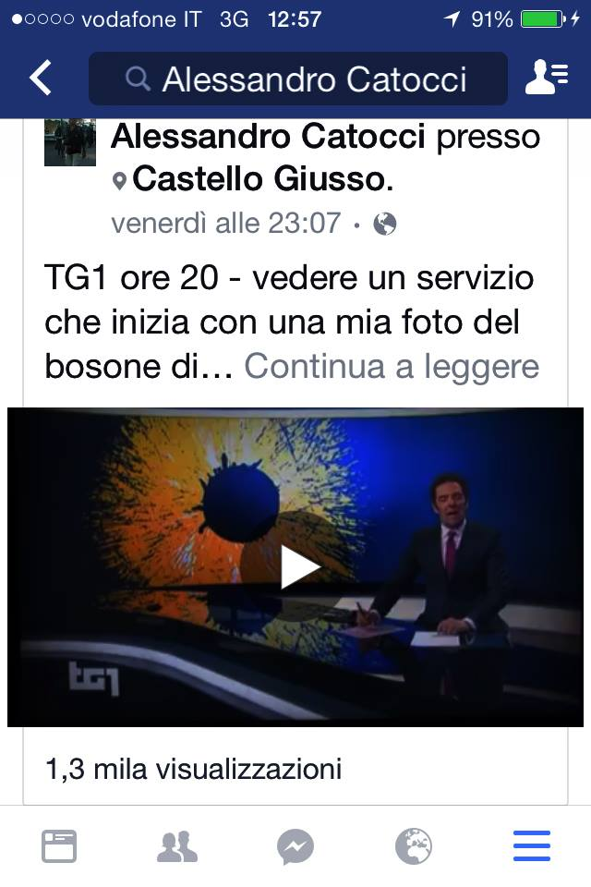
2014 Nobel Prize Stefan Hell at the exhibition in Vico Equense (2016): 1500 visitors + 12 schools (in 5 days).
2500 visitors in 4 days in Napoli 2015

Slide 15

STEAM @ ATLAS
STEAM in ATLAS is based on projects, proposed by a member and founded by her/his institute.
The project is presented to the ATLAS outreach group and eventually approved.
If approved the project will use the ATLAS logo and will be helped by the outreach group for publicity, news, web site….

Slide 16
Projecting pARTicles
Luis Flores Castillo, Chinese University of Hong Kong
Steve Goldfarb, University of Melbourne, Australia
Agnes Chavez is a media artist in US.
Informal partnership with some ATLAS physicists will be developed through a series of workshop (Virtual visit, Master Class and presence of physicists)
The goal is to use new media art to explore, teach and communicate particle physics concepts.
The project is based on a long term collaboration between artists, students and scientists.

Slide 17
Projecting pARTicles Activities
2014: the second pilot workshop includes an ATLAS Virtual Visit
2015: research stay of two weeks at CERN, Agnes meets a number of ATLAS physicists.
June 2015: workshop in Cuba, in collaboration with ATLAS physicist Luis Flores
March 2016: integration of a Master Class in Day 1 of workshop at the Harwood Museum (Taos, New Mexico)
May 2016: second research stay at CERN, one week long, to present and discuss future evolution
After a two days immersion with experts in particle physics, students began the exploration of projection art as a medium of expression and communication. The three-day workshop March 22-24 was led by three teenagers that participated in the workshop in December 2015. They lead a group of new students to explore a projection art iPad tool called Tagtool. Together they will storyboard, design and document a live projection on to a building inspired by the physics concepts.

Slide 18
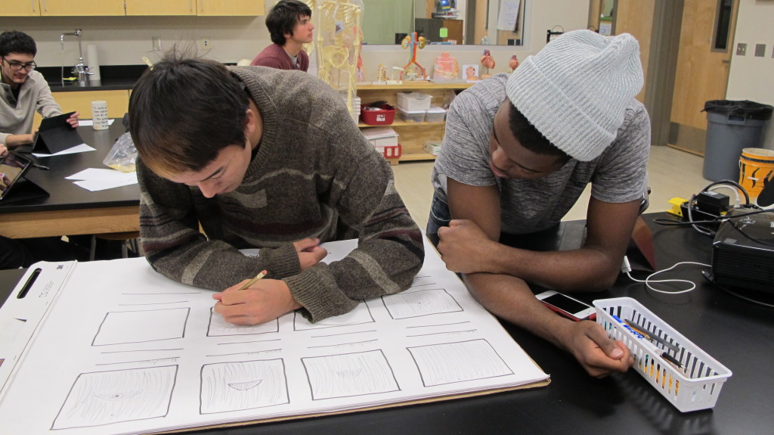
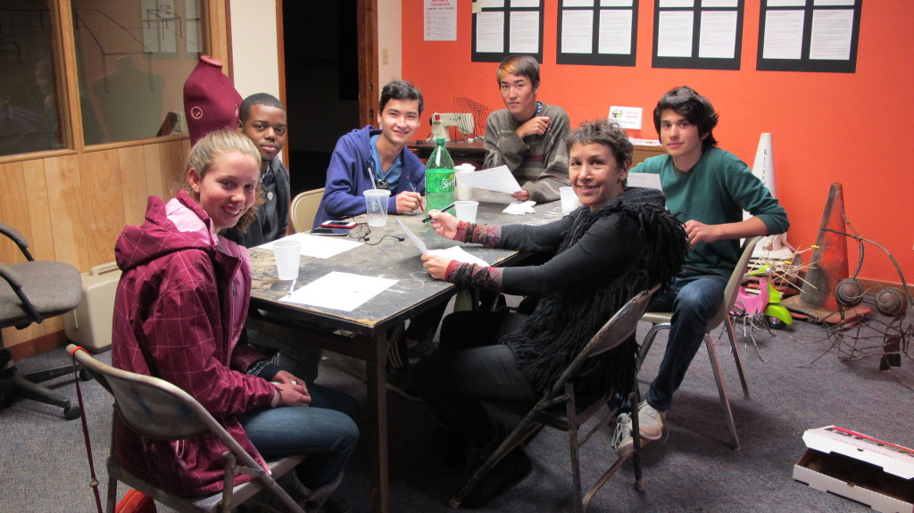
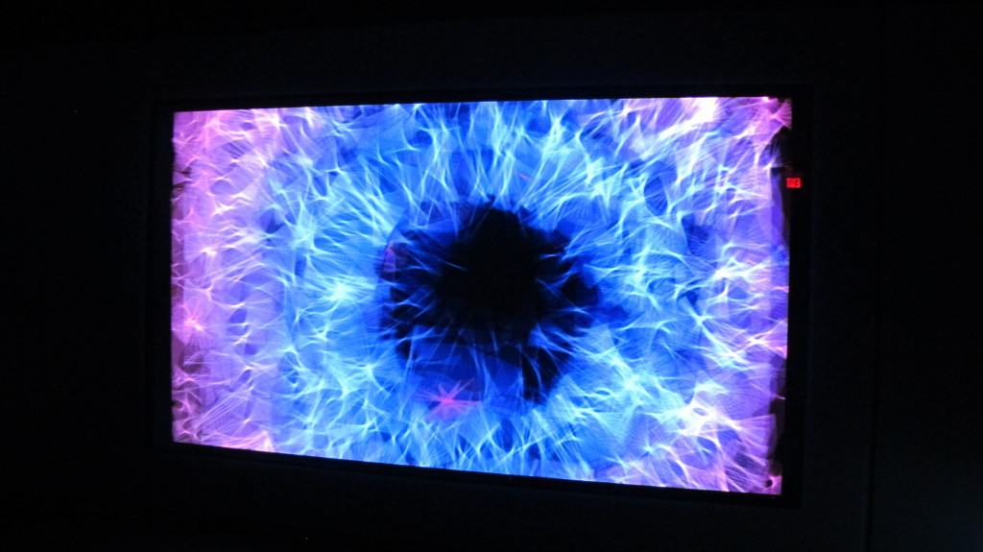
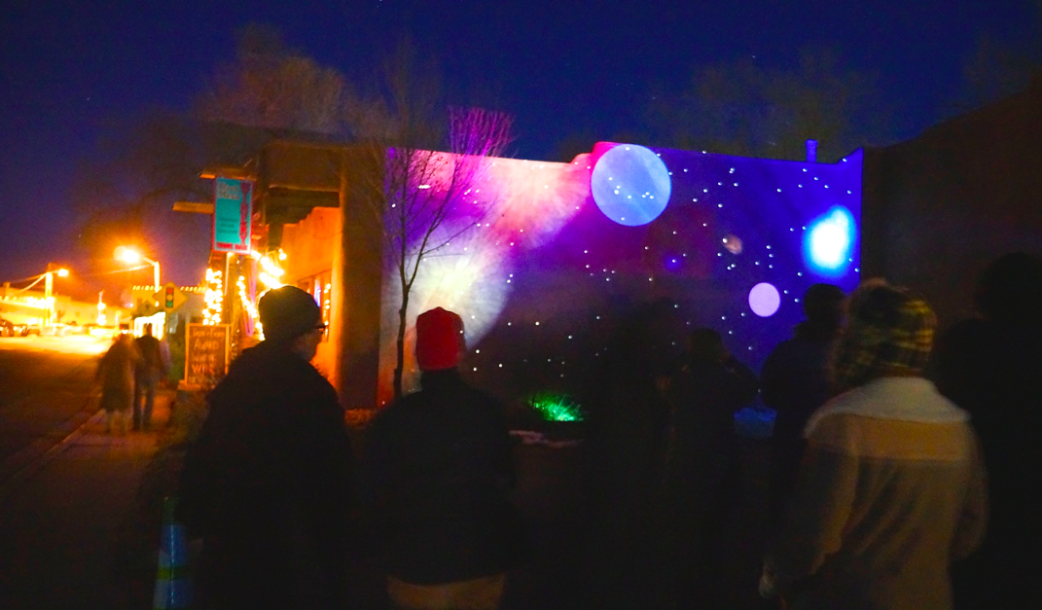
Projecting pARTicles Activities

Slide 19
ATLAS Quantizer
Ewan Hill, University of Victoria & Triumf, Canada
Steve Goldfarb, University of Melbourne, Australia
A new interface for musical expression
The goal is to transform ATLAS data into sound and explore how this could be a source of inspiration for musicians and general public.
The ATLAS collaboration permits access to the data streams which feed the live event display which are not public.
Event kinematics and the detector information contained in these events is transformed into musical sequences by a set of tools developed by the Responsive Environments Group (link is external) at the MIT Media Lab.

Slide 20
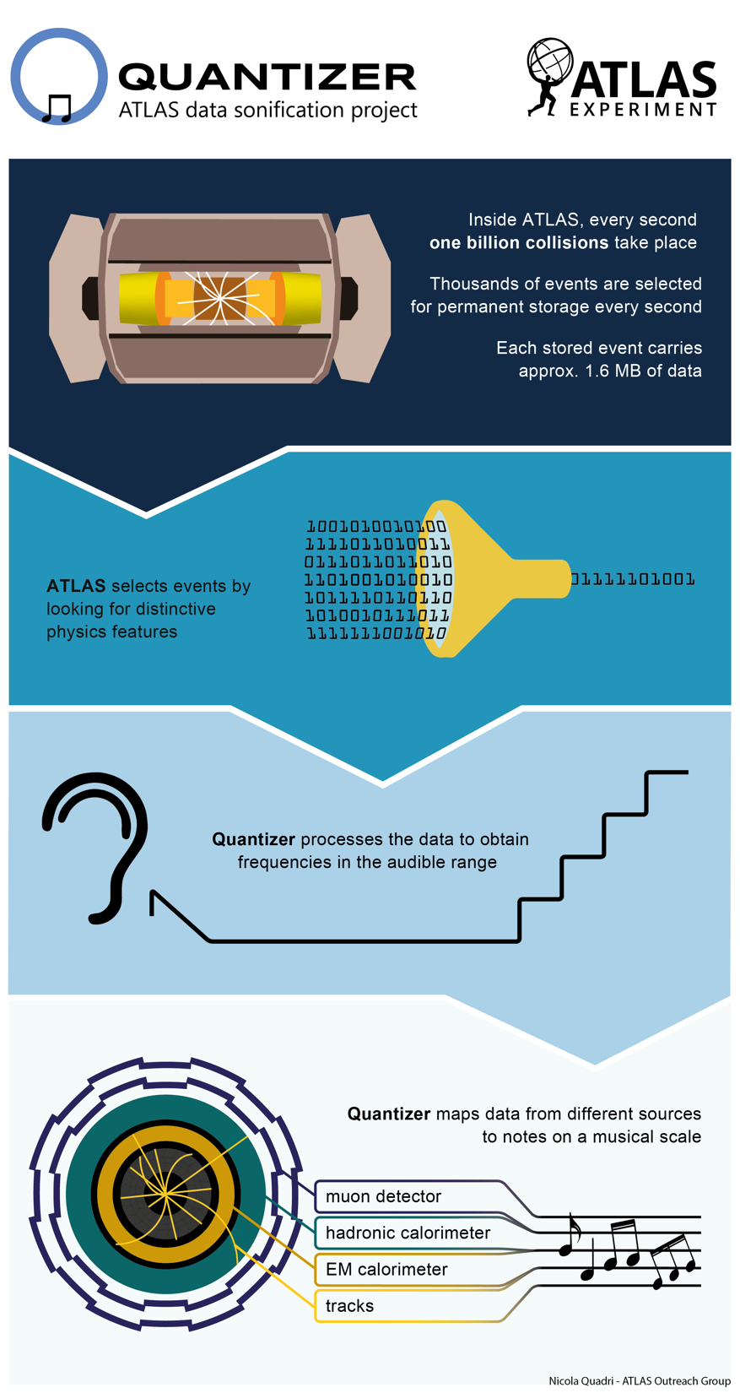
ATLAS Data Quantizer
2015: early prototype demonstration in June 2015 at the Montreux Jazz festival (link is external)
July 2015, Gratz. 2016 : presentation of the project architecture at the Computer Human Interface conference
Project web site was opened to the public on May 20th, 2016.
The Physics of Music and the Music of Physics | CERN at the Montreux Jazz Festival | 9 July

Slide 21
Conclusions
STEAM provides a framework for integrating art in science teaching and learning.
The STEAM movement is gaining more momentum and attention.
Education and Outreach (E&O) in particle physics have started to respond positively to STEAM efforts.
ATLAS and CMS are developing many interesting E&O projects:
  involving more and more students and teachers.
  attracting a larger and more diverse public to science through art.
Current and future EU Horizon 2020 projects can foster STEAM activities in the coming years.

