Slide 1


WLCG Status Report
CERN-RRB-2008-102
11th November, 2008
Computing Resource Review Board

Slide 2
Agenda
WLCG service status and CCRC’08
Planning for shutdown
Applications Area status
Procurement issues
Planning for 2010 (EGI etc)
Planning for CERN infrastructure

Slide 3
CCRC’08 & the WLCG Service
CCRC’08:
  Was run as planned in May; not all resources were in place
  Experiments and WLCG service met or exceeded most of the targets
    Not tape recall/re-processing for >1 experiment at Tier 1s
    Analysis not at a scale of 100’s of users
  Effort was sustainable (and is sustained), daily operations meeting, post mortems
    Sites have response/alarm procedures in place (outstanding milestone on 24x7 support now completed)
  Software process shown to work well – deployment of security and other patches as part of usual process
After May:
  Service continues as standard production service
  Continually increasing workloads – simulations, cosmic data, functional tests of all aspects

Slide 4
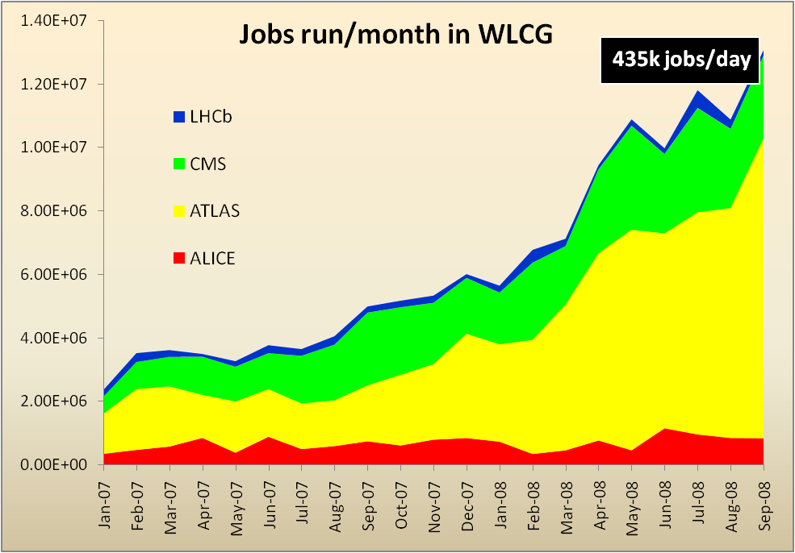
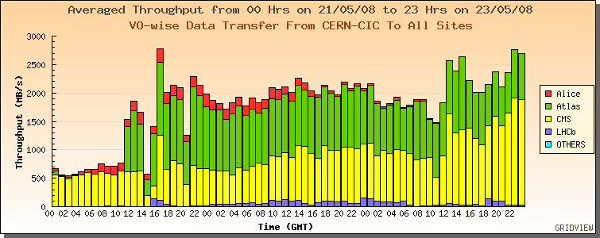
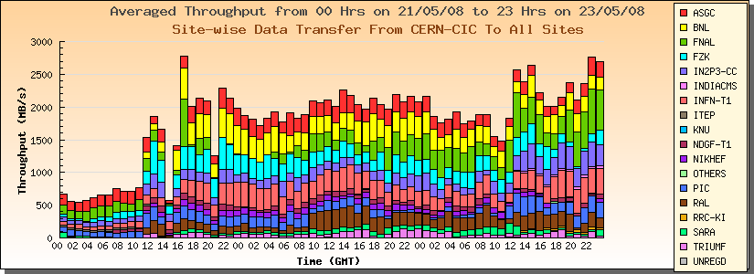
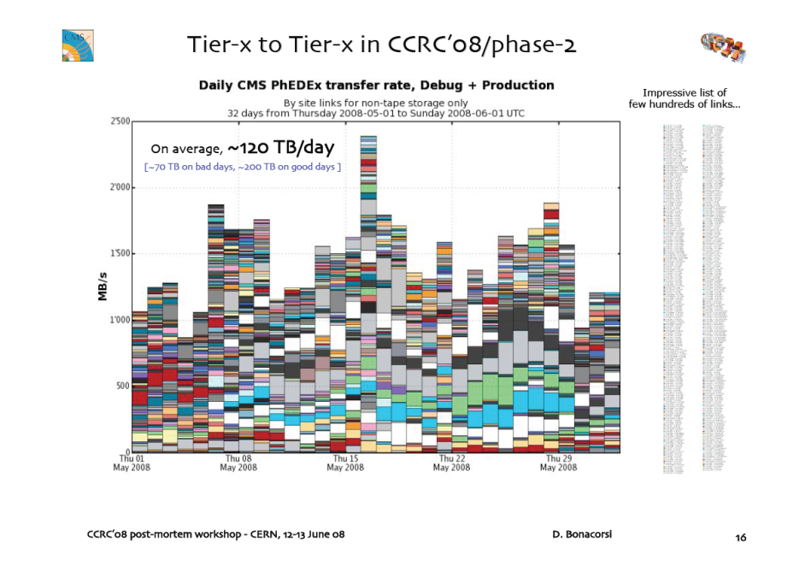
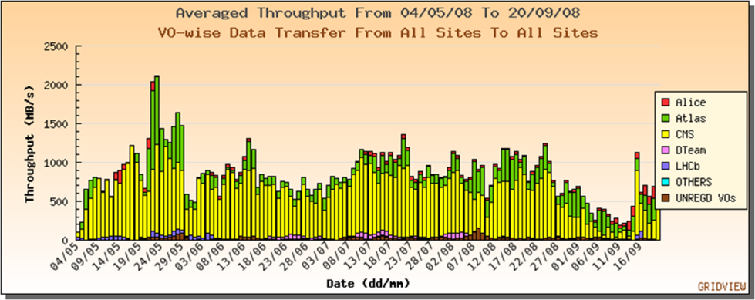
CCRC’08 and beyond

Slide 5
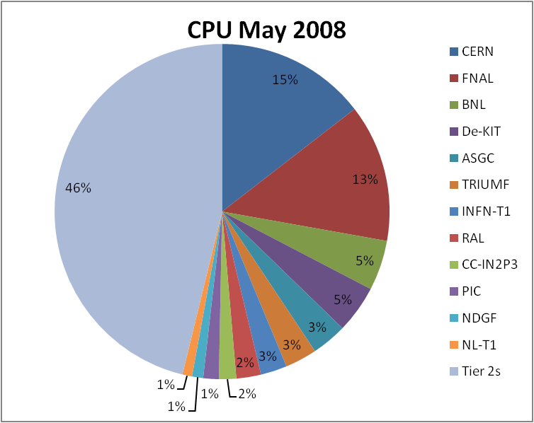
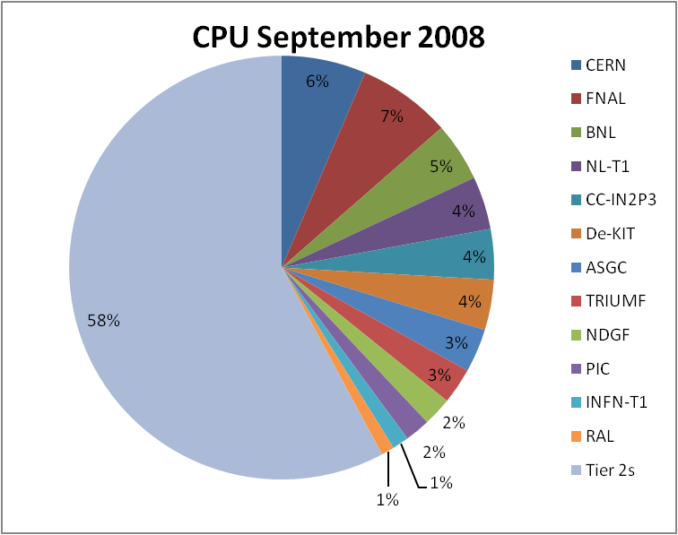
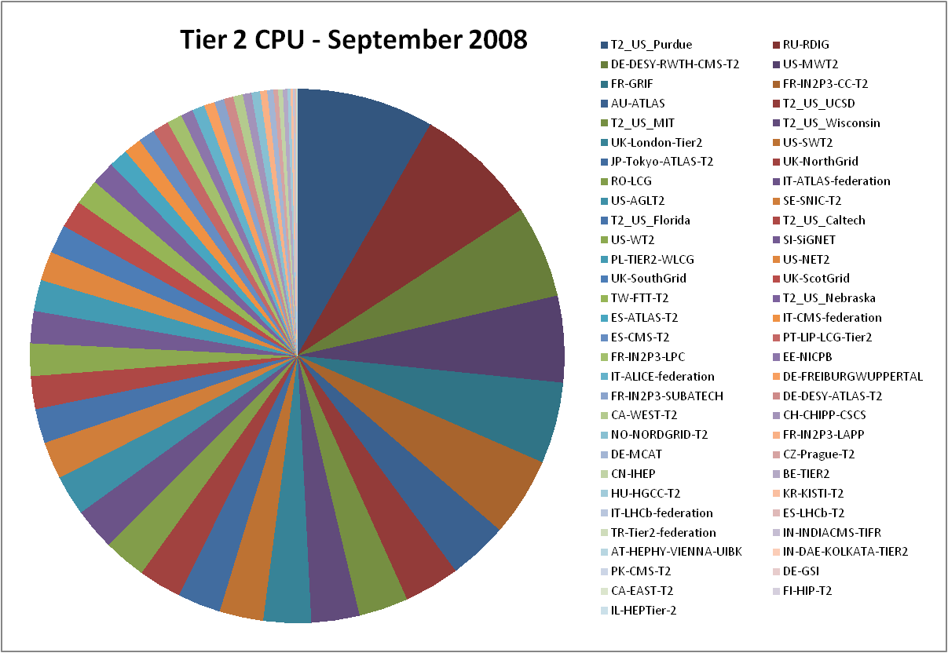
Usage Patterns
CCRC’08
Simulations/cosmics
Can change significantly e.g. between CCRC’08 in May and cosmics/simulations in September
Tier 2s consistently deliver ~50% of total

Slide 6
Outstanding service issues
Levels of support at many sites – especially during the summer
  It is not yet clear that there are sufficient staff in place to support the level of service needed
Continued rate of significant downtimes e.g. that trigger a “post-mortem” (Service Incident Review)
  More than 1 per week and is not improving
  Many are due to power/cooling issues (and recovery process!)
  Many are due to issues with storage services – but some are surely lack of adequate service resources or support
Main management focus is now on
  Trying to improve service deployments
  Understanding why we have so many incidents
    This is not a “grid” issue, it is really a traditional service management issue
  Absolutely essential that resolving these issues are seen as priorities by site management

Slide 7
Service incidents – since May
~ 1 major incident per week
  not improving
<impact time> ~ 3.5 days!
  this is worse now than it was
7/20 are hardware (electrical, cooling, network, etc)
  May be mostly unavoidable, but recovery must be rapid and tested!
  Power and cooling expectations
    1 per site per year ⇒ 1 /month at a Tier 1 !
Type of problem | # | <impact time>
Storage | 8 | 4 days
Electrical | 3 | 4.5 days
Cooling | 2 | 4 days
Hardware | 2 | 3 days
Database | 2 | 3 days
Middleware | 1 | 4 hours

Slide 8
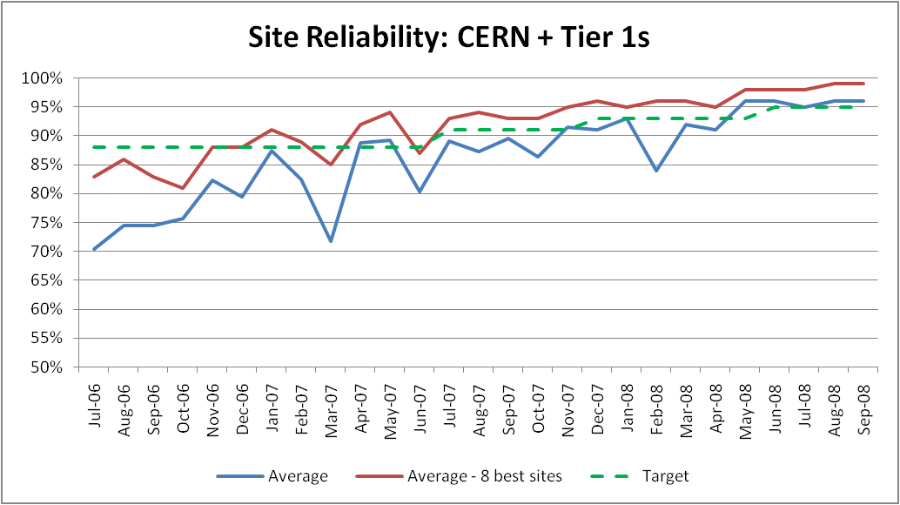
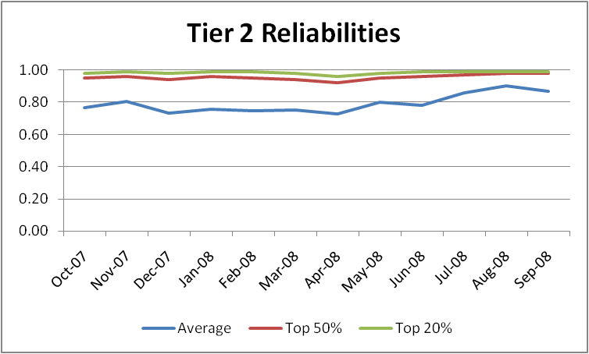
Reliabilities
Improvement during CCRC and later is encouraging
Tests do not show full picture – e.g. Hide experiment-specific issues,
“OR” of service instances probably too simplistic
a) publish VO-specific tests regularly;
b) rethink algorithm for combining service instances

Slide 9
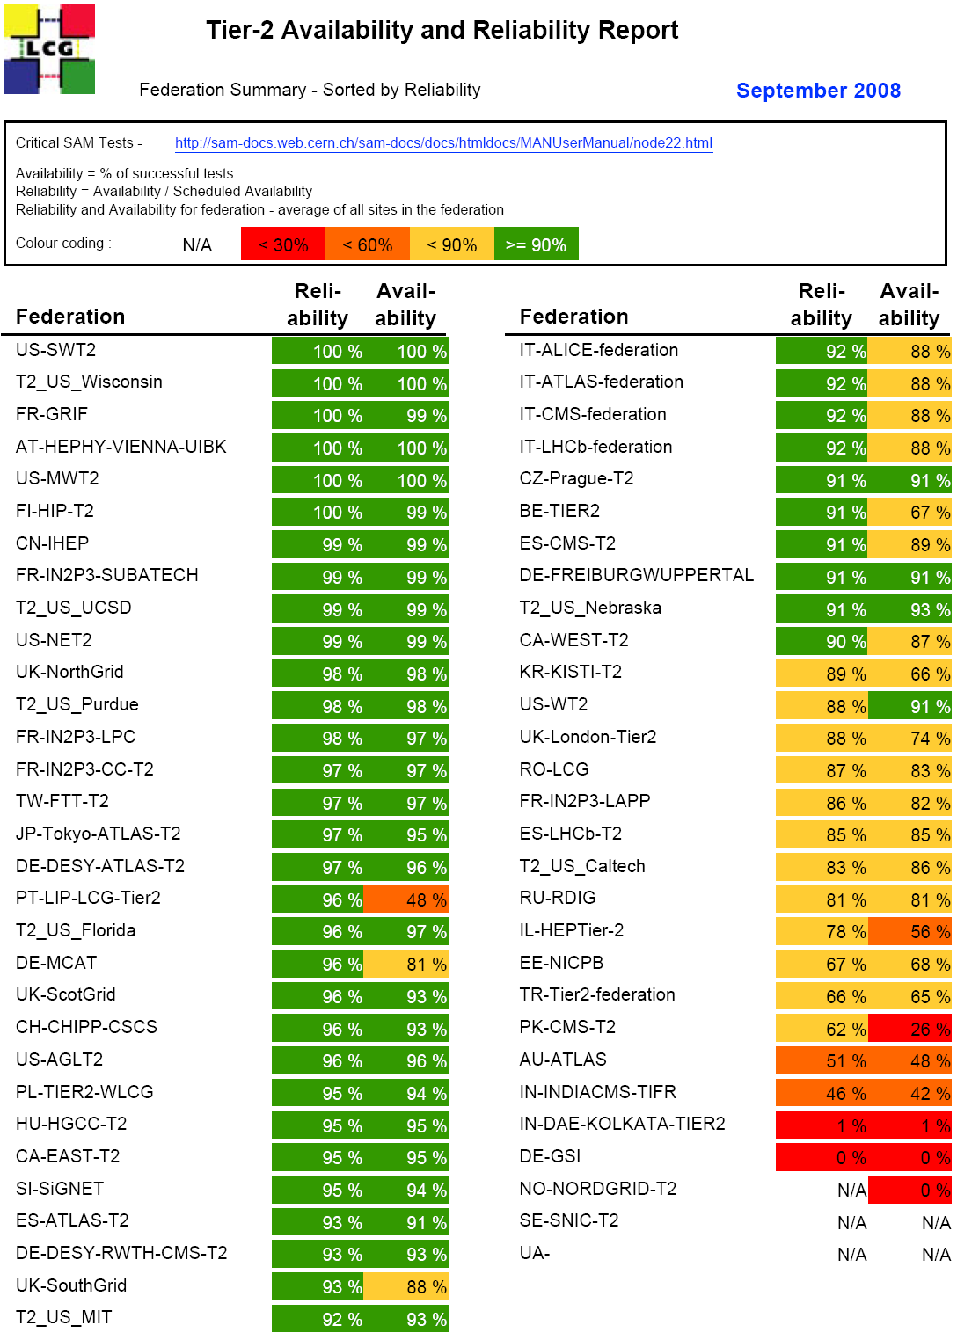
Tier 2 reliabilities
Big improvement
Federation average will be (soon) weighted by #CPU
Would like to fix target at 95%
  Should be achievable
e.g. of extended scheduled downtimes (availability << reliability)
Federations still not reporting

Slide 10
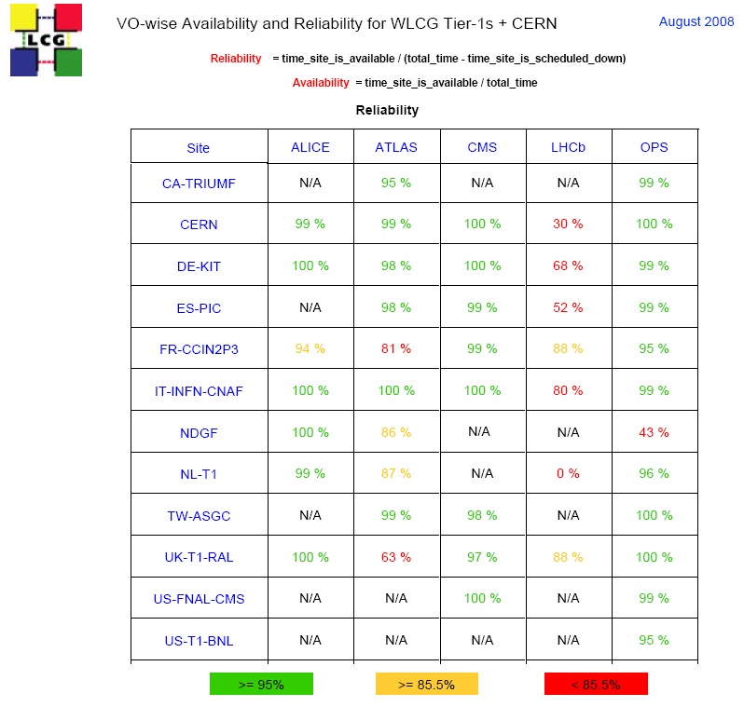
V0-specific testing ...
Draft
Validation process in progress

Slide 11
Consequences of LHC shutdown
The present shutdown of the LHC has a number of consequences for the planning of WLCG:
  Capacities and Procurements for 2009
  Software and service upgrades during the shutdown
  (Re-)Validation of services for 2009 following changes

Slide 12
Capacities and procurements
The WLCG MB has agreed that with the information currently available to us and the present understanding of the accelerator schedule for 2009:
  The amount of data gathered in 2009 is likely to be at least at the level originally planned, with pressure to run for as long a period as possible this may be close to or exceed the amount originally anticipated in 2008 + 2009 together
  The original planning meant that the capacity to be installed in 2009 was still close to x2 with respect to 2008 as part of the initial ramp up of WLCG capacity
  Many procurement and acceptance problems arose in 2008 which meant that the 2008 capacities were very late in being installed; there is a grave concern that such problems will continue with the 2009 procurements
  The 2009 procurement processes should have been well advanced by the time of the LHC problem in September
The WLCG MB thus does not regard the present situation as a reason to delay the 2009 procurements, and we urge the sites and funding agencies to proceed as planned. It is essential that adequate resources are available to support the first years of LHC data taking.

Slide 13
Upgrade plans
Since several software upgrades were postponed in anticipation of LHC start-up, we propose that the following changes are addressed in the coming months:
  SRM – agreed list of “short term” changes; available by end 2008
  FTS on SL4 (+available for SL5?) – deployment was postponed
  WN on SL5 to be available for deployment
  glexec/SCAS to support pilot jobs with identity changing
  CREAM CE – make available in parallel to existing CE which is known to have scaling issues when there are many different users;
    needs Condor_g client
    WMS: must be able to submit to CREAM
  a few other smaller changes ...
  Many of the above are deployments in parallel to existing production services and so non-disruptive

Slide 14
Re-validation of the service
All experiments are continually running simulations, cosmics, specific tests (and have been since CCRC’08) at high workload levels – this will continue
A full CCRC’09 in the same mode as 2008 is not regarded as useful
But, we will perform specific tests/validations:
  Service validation if software is changed/upgraded
  Specific tests (e.g. throughput) to ensure that no problems have been introduced
  Tests of functions not yet tested (e.g. Reprocessing/data recall at Tier 1s)
Details of the test programme will be discussed and agreed in the workshop already planned for November

Slide 15
Applications Area Status
No major releases of the AA software during last quarter
  Experiments preparing for beam did not want major changes
  Substantial progress on porting the complete software stack to other platforms such as gcc 4.3 and VC9.
Preparing ‘production’ versions for ROOT and Geant4
  ROOT 5.22 will include the new CINT based on Reflex and the support for the new ‘data model schema evolution’
  Geant4 9.2 will include the improvements in the FTF (Fritiof) hadronic model for pion incident interactions; alternative multiple-scattering models, and the first implementation of a GDML writer.
  New version of HepMC (2.04.00) was released last summer and adopted by all experiments
Release schedule adapted to new LHC schedule
  ROOT and Geant4 releases for mid-December
  The rest of the software stack should be ready by mid-January
  Experiments will start integrating their applications immediately after

Slide 16
Applications Area Status (2)
The LCG-AA nightly build and test system fully operational
  Several configurations in parallel for all supported platforms (including MacOSX and Windows)
  Geant4 builds and tests are also integrated
  LHCb has cloned the system for their software
Continuous Software Integration and Testing
  Allow us to release new software versions (with new functionality or bug fixes) on demand from the experiments with relatively short notice (1-2 days)
The two Theme 3 PH-R&D projects monitored by the AF
  Virtualization: The first release of the CernVM virtual appliance to provide a portable environment for analysis is ready
  Multi-core: Exploring in collaboration with experiments and IT (openlab) a number of possibilities to exploit multi-core architectures with the current software frameworks

Slide 17
Procurement Issues
2008 resources were not in place by April; and in some cases still not now:
Many procurement issues:
delays, faulty equipment,
vendor failures.
No indication that this will be any better in future years – must take into account in the procurement process
  For 2009 have added checkpoint milestones to follow up on process
  Little margin for error for April schedule
  Future years (>2009) anticipate splitting disk installations into 2 – first for April, second for end of Summer (details to be discussed and agreed)
Disk (80% of total pledge installed)
ASGC | 300 TB missing | Installation now?
BNL | 1 PB missing | Was expected November
IN2P3 | 700 TB missing | Ongoing, with 50% of 2009
CNAF | 750 TB missing | Installation ongoing
NDGF | 200 TB missing | Procurement complete
NL-T1 | 1400 TB missing (50%) | Power/cooling; not before mid-2009
CPU (100% of total pledge installed)
ASGC | 72% | Due October
NL-T1 | 88% | Not before mid-2009:

Slide 18
Capacity & Benchmarking
Capacity reporting
  In order to fully understand resource availability and usage need to see several pieces of information:
    Pledge, installed capacity, usage, efficiency, and availability
    Need also to know whether experiment has tried to fill capacity
  Today installed capacity gathered by hand for Tier 1s (and see mistakes); work in hand on automated means to gather installed capacity for all sites for CPU and storage
    Validation process needed before this can be published fully
Benchmarking
  SI2K is now obsolete, new machines not measured in this unit
  WLCG has agreed on a new unit based on SPEC 2006
  Working group will propose exact recipe for running the benchmark
    Conversion of pledges and requirements to new units (without change!)

Slide 19
Planning for 2010 (end of EGEE)
A second draft of the EGI blueprint has been produced
There are still some serious shortcomings in the process and in the blueprint:
  It is not clear exactly what is being proposed in terms of the roles and functions of the National and central organisations;
  Lack of representation of the user communities, and how those communities interact with the infrastructures; (they own many resources)
  It is not clear how the present operational infrastructure upon which WLCG depends will evolve and appear in the future, e.g.:
    Insufficient resources for central operations
    Risk of discontinuation of ROCs
    User support is being challenged
  Very few of the NGIs are as yet established, and so how they can support the WLCG sites is not clear, in particular during a transition period;
Given the state of the current blueprint, it seems unlikely that there will be an organisation in place in time to take over the European grid infrastructure from EGEE in early 2010 with a managed transition process during the preceding year.

Slide 20
WLCG & EGI/NGIs
The Tier 1 and Tier 2 sites in Europe will rely on National Grid Infrastructures being in place to provide the support and functions today provided by EGEE
  Important for operations and middleware support (maintenance and distribution)
  The Tier 1s have provided position statements
    Still important that WLCG members raise this to the NGI and national funding agencies
The Tier 0 is probably in a reasonable position – current planning does not rely on external funding; but the capability will be strictly limited to core WLCG Tier 0/CAF tasks
It seems optimistic that EGI will be in place by the end of EGEE-3, and likely that not all NGIs will be in existence when it does start
WLCG must have a concrete plan to operate without relying on the European level support, either for an interim period or indefinitely

Slide 21
Planning for EGI
Agreed in OB that we will now document how each of the core functions that we today rely on will be managed in future
  Start with the position statements sent by Tier 1 sites
  Consider each of the major functions:
    GGUS, operational support, monitoring tools, middleware support, certification, deployment support, service management, etc.
    Work with EGEE to understand the expected status of each of these in mid-2010
    Negotiate who will manage /contribute to each function if there is no EGI

Slide 22
Planning for Tier 0 infrastructure
Capacity in CERN CC will run out in ~2010; electrical capacity cannot be extended above currently foreseen levels
Strategy:
  Expand the capacity of the building as far as possible (2.5 → 2.9 MW), addition of water-cooled racks: NB. This leaves no redundancy in the power supply;
  Aggressive removal & replacement of older equipment with new lower-power units. Replace at end of warranty (3 yrs);
  Planning for a second centre to be built on Prévessin site;
  Investigate stop-gap solutions for 1.5 – 2 years between running out of power and having a new building available
First 2 points + better estimate of power evolution of new systems ➔ sufficient capacity until ~end 2010
Planning ongoing at the level of conceptual designs
Stop gap solutions being investigated; commercial solutions very expensive (x10 over CERN cost), some possibilities under discussion with other WLCG sites.

Slide 23
Summary
CCRC’08 was successful
  Almost all experiments’ and service targets were achieved
    Exception: user analysis with 100’s of users; T1 reprocessing at full scale
Service has continued to be used at significant levels
  Main focus is on improving service reliability – especially storage systems
Important that resource ramp-up for 2009 continues:
  Must be ready for the accelerator start-up, even if resources are today not saturated
Resource procurements/installations –
  Were significantly delayed in 2008
  Concern that this does not improve in future years
Planning for future – Tier 0/CAF and European Grid infrastructure

