Slide 1
Shunt-LDO Regulator in C65nm
simulation results, status & plans
Michael Karagounis
Pixel Powering Meeting – 15.09.15

Slide 2



Design Concept
The Shunt-LDO regulator combines the functionality of an LDO voltage regulator with the capability of a shunt regulator to drain a constant current
Two control loops: 1) constant output voltage 2) constant current flow through the regulator
k : 1
$$I_{Ref}≈\frac{V_{in}−V_{TH}}{R_{3}}$$
$$r_{in}=\frac{∂V_{in}}{∂I_{in}}≈\frac{R_{3}}{k}$$
$$V_{out}=2V_{ref}$$

Slide 3
Constant Supply Current Power Scheme
(Shunt Mode Operation)
main application case: constant current supply in a serially powered scheme
supply current which is not drawn by the load is shunted to next module in chain
Improvements compared to conventional
shunt regulator
Safe operation of parallel regulators
(Parallel: Iin and Iout ports are shorted)
→ shunt current is uniformly distributed
Parallel operated regulators may
generate different output voltages
(Iin and Vout are separated ports)
Capable to shunt extra current in case
a parallel placed regulator fails

Slide 4



Constant Supply Voltage Power Scheme
(LDO Mode Operation)
Current Control Loop can be switched-off
→ Shunt-LDO can be used as an ordinary LDO voltage regulator
$$I_{in}$$
$$V_{IR_{Drop} }$$
Activated Current Control Loop
→ Constant Current Flow $I_{in}$
→ Constant IR Drop on cable

Slide 5
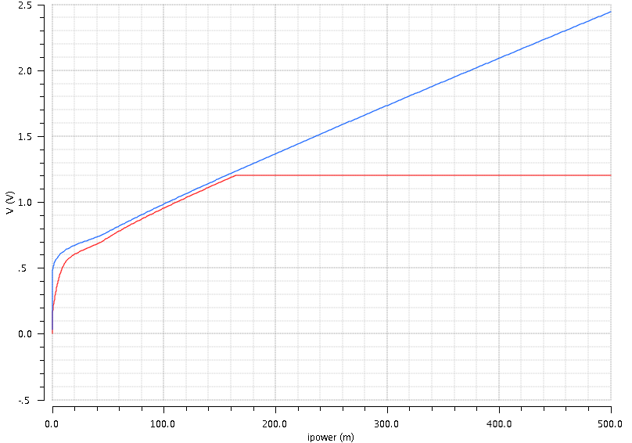



Simulation in C65nm
Single Regulator Operating in Shunt-Mode
Slope is defined by input impedance
$$V_{in}$$
$$r_{in}≈\frac{R_{3}}{k}$$
$$V_{out}$$
output voltage settles as soon as the amplifier are saturated and the referenced voltage is reached

Slide 6
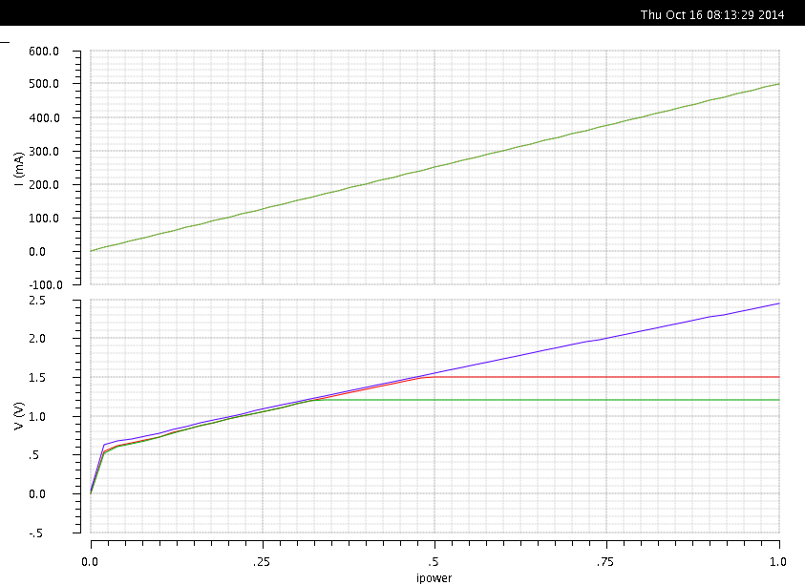




Simulation in C65nm
Two parallel operating regulators
$$I_{shunt1}=I_{shunt2}$$
output voltages settle on different potentials
$$V_{in}$$
$$V_{out1}=1.5V$$
$$V_{out2}=1.2V$$
output voltages settle on different potentials

Slide 7
LDO Error Amplifier A1
Class AB OTA to achieve (almost) rail-to-rail output voltage range
Cascoded transistors: increase supply voltage operation range up to 2V
  Limiting factor: transistor M11 at low load current and hot corner
Regulated Cascoded PMOS M15 necessary for high output impedance at low load current
  Low load current -> high PMOS pass device gate potential -> M13 leaves saturation

Slide 8
Mirror Amplifier A2 & Shunt Amplifier A3
Mirror Amplifier A2
Shunt Amplifier A3
A2: NMOS input stage to deal with “higher” input voltages >1V (regulator output voltages)
A3: PMOS input stage to deal with lower input voltages ~600mV
Cascoded transistors: increase supply voltage operation range up to 2V
  Limiting factor: transistor M13 at high load current and fast corner
Special cascode biaising by using lvt/hvt transistor combination

Slide 9
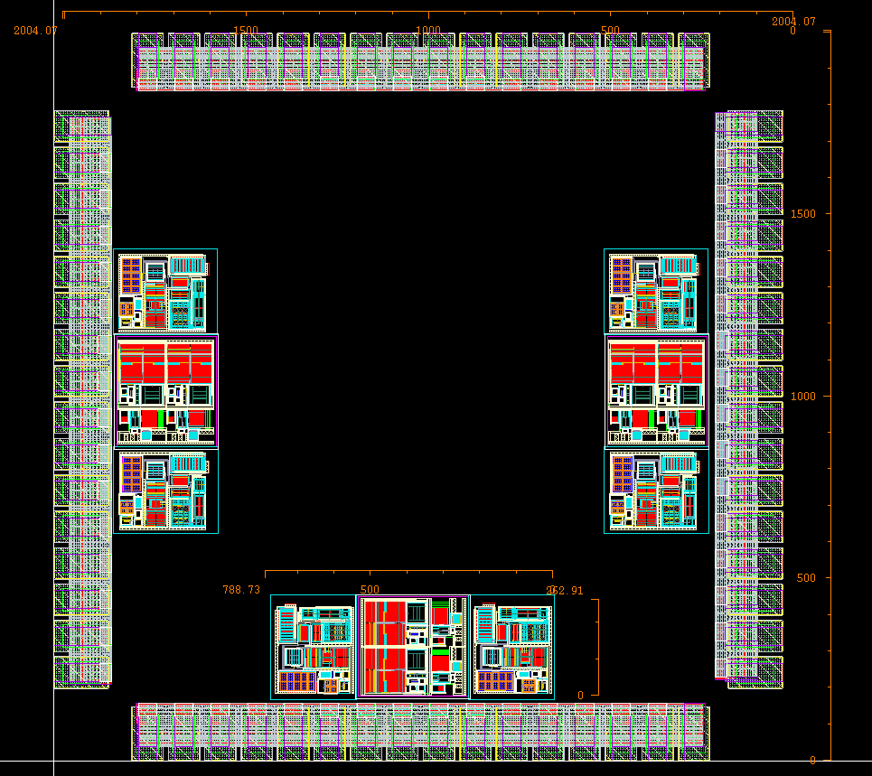
Chip Layout (shown without top level wiring)
Testchip – Size
2 mm x 2 mm
Testchip - Content
3 regulator incl. biasing
Pad – Count
4 x 16 with 100 µm pitch
Area per Regulator:
800 µm x 400 µm
Pads per Regulator:
5 x input current
5 x shunt current
5 x output voltage
1 x reference voltage
1 x biaising voltage
1 x internal resistor con.
1 x external resistor con.
1 x shunt-circuitry supply

Slide 10
Status
All regulator core components (amplifier /shunt circuitry) ported to TSMC 65nm
  LDO part: Layout done and characterized
    Monte Carlo, Noise, PSRR simulations have to be documented
  Shunt part: Layout done and characterized
    Simulation results have to be documented
  Biasing: Layout done and characterized
    Simulation results have to be documented
  Top Level Layout: LVS problems
    Need help on CERN pad library
  Clear picture of power specs for new pixel chip required for design optimization
    maximum load current
    output voltage range
Voltage reference circuit IP reuse of other group?
  Reference circuits are connected to unregulated voltage
    special requirements on PSRR and supply voltage limits

Slide 11
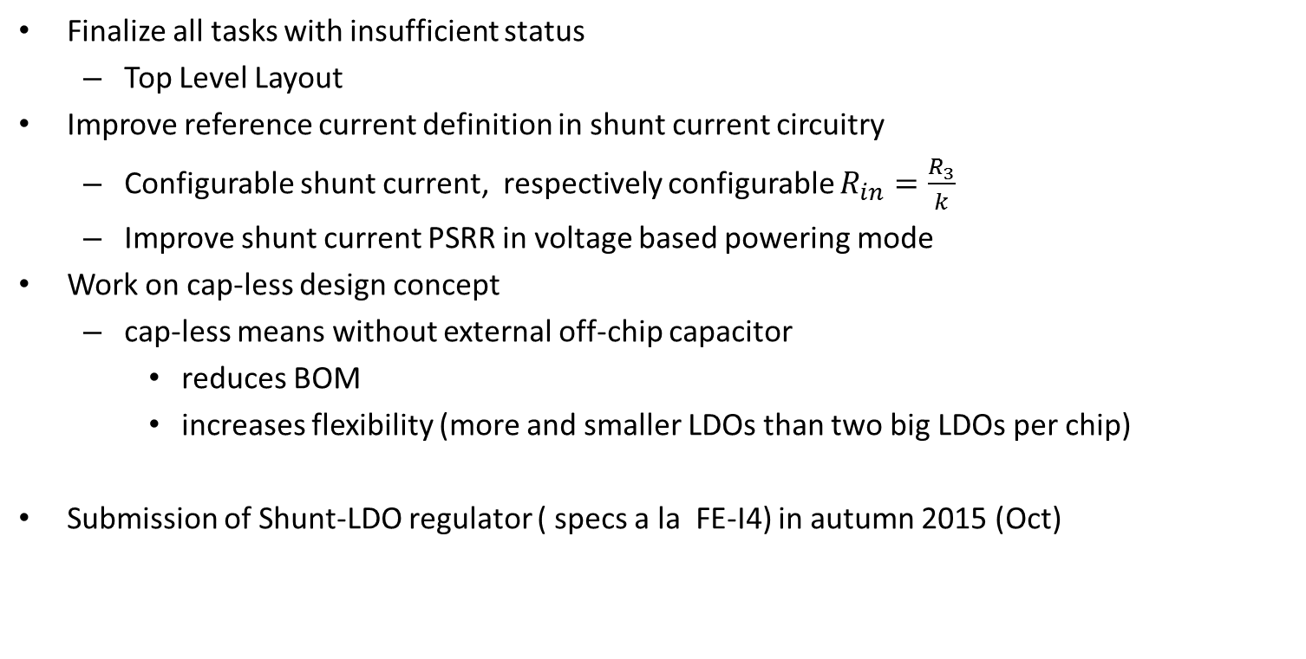
Plans
Finalize all tasks with insufficient status
  Top Level Layout
Improve reference current definition in shunt current circuitry
  Configurable shunt current, respectively configurable $R_{in}=\frac{R_{3}}{k}$
  Improve shunt current PSRR in voltage based powering mode
Work on cap-less design concept
  cap-less means without external off-chip capacitor
    reduces BOM
    increases flexibility (more and smaller LDOs than two big LDOs per chip)
Submission of Shunt-LDO regulator ( specs a la FE-I4) in autumn 2015 (Oct)

Slide 12
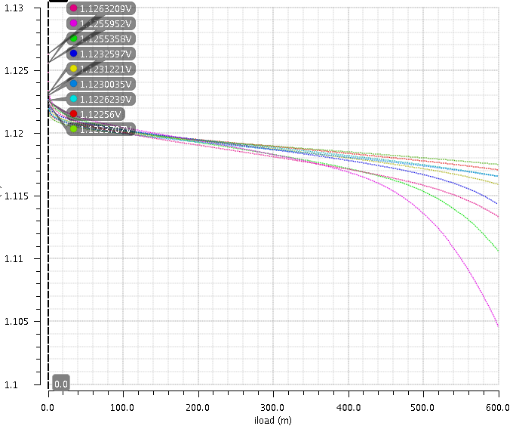
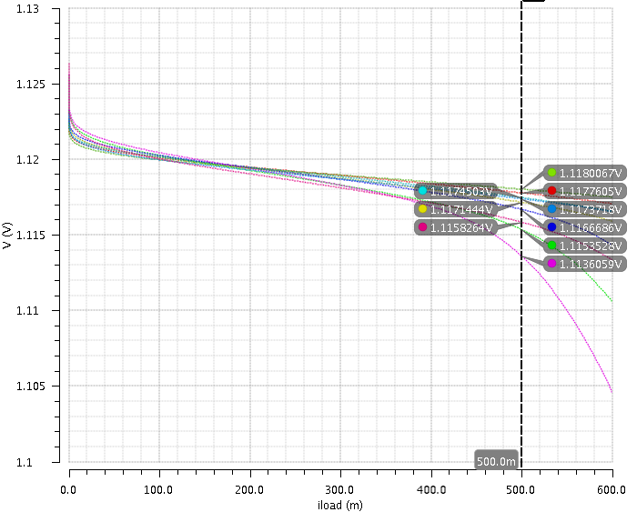
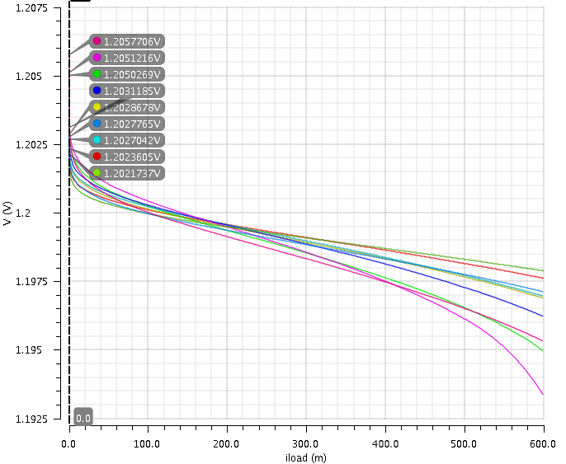
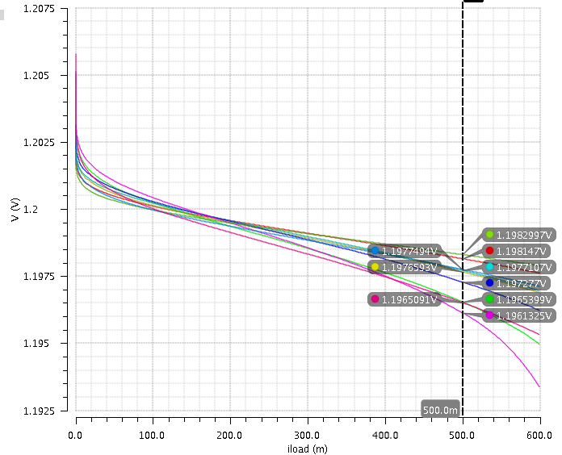
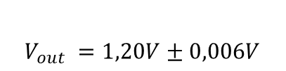
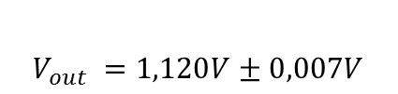
Simulation Results LDO Mode: Load Regulation
$$V_{out }=1,120V±0,007V$$
Extracted Netlist
Corner: ss,tt,ff
Temp: -50,27,120
Vdrop: 200mV
$$V_{out }=1,20V±0,006V$$

Slide 13
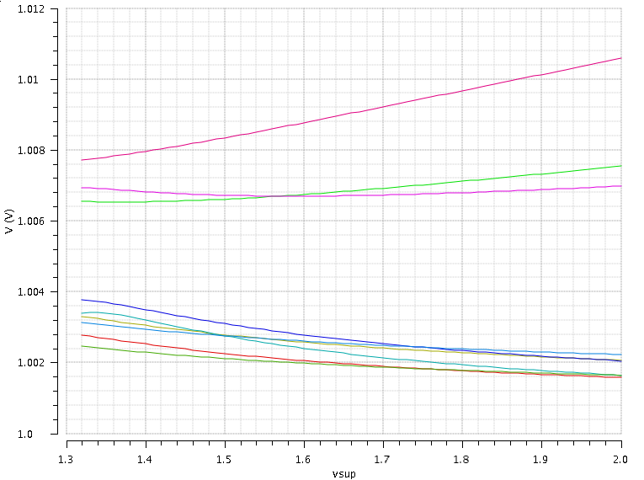
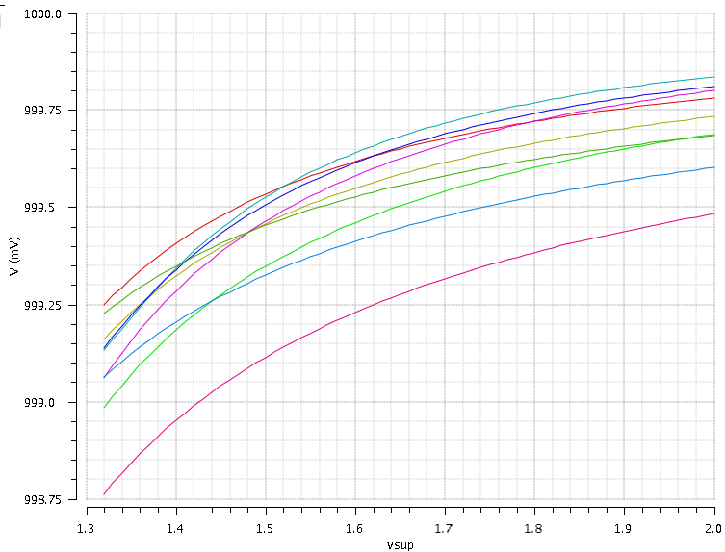
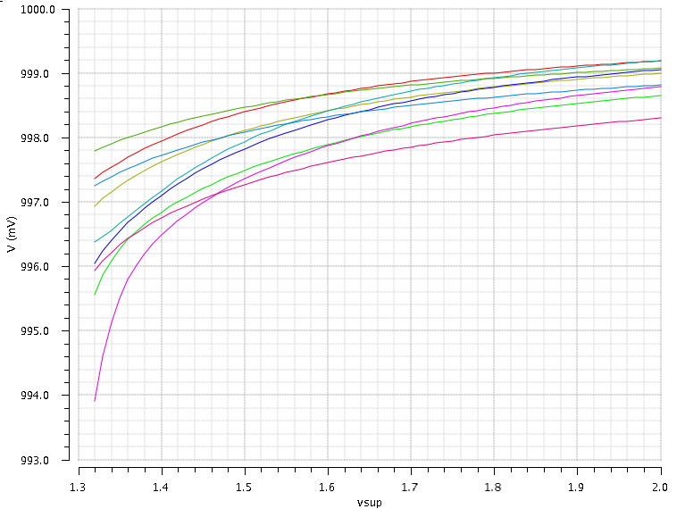



Simulation Results LDO Mode: Line Regulation
$$I_{load }=0A$$
$$I_{load }=250m A$$
Extracted Netlist
Corner: ss,tt,ff
Temp: -50,27,120
Vout: 1,0V
$$I_{load }=600m A$$

Slide 14
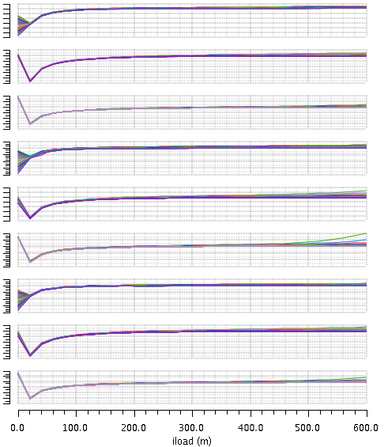
Simulation Results LDO Mode: Phase Margin
Extracted Netlist
Corner: ss,tt,ff
Temp: -50,27,120
Vout: 1.20V
Vin=1.32-2.00V

Slide 15
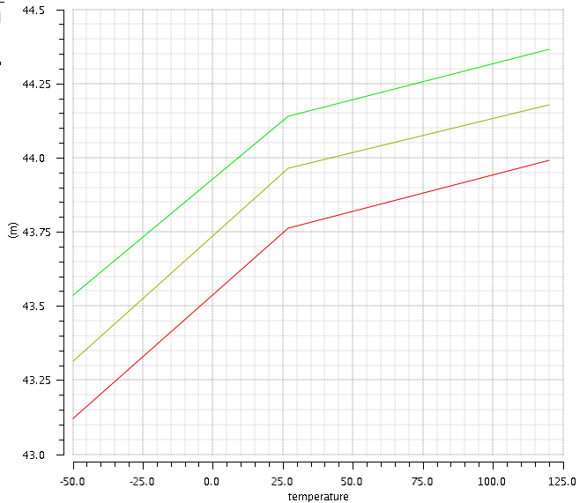
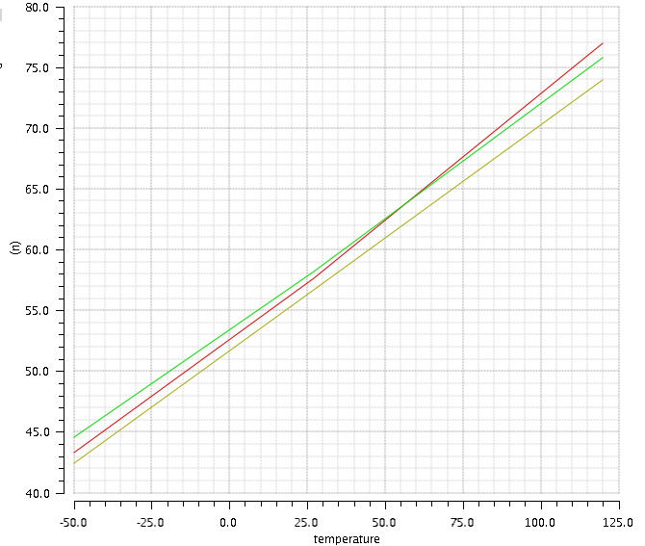
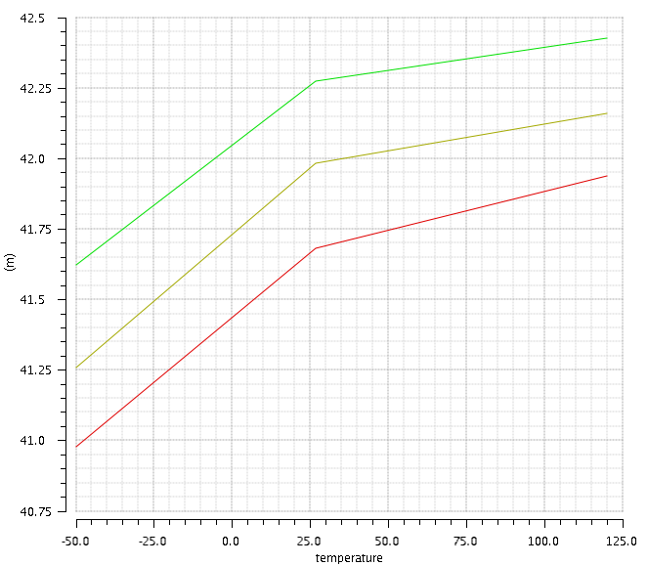
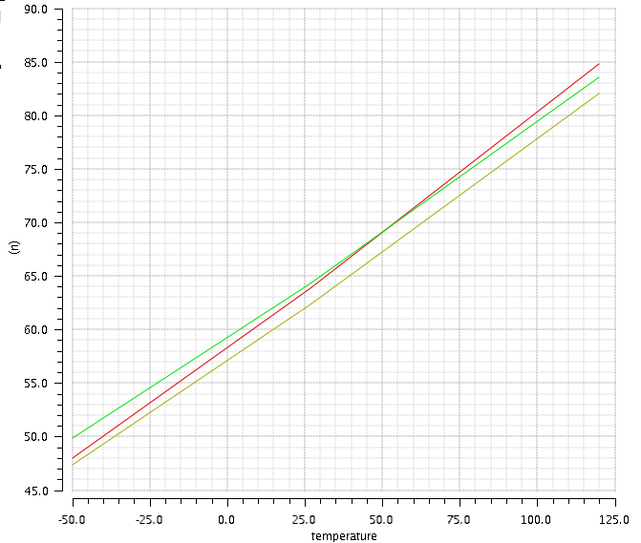
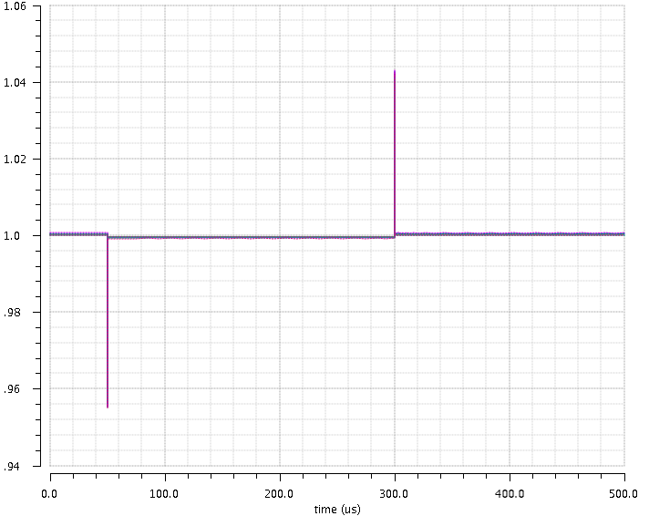
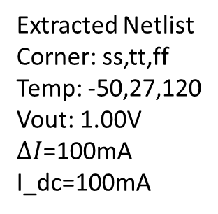
Simulation Results LDO Mode: Load Transients
Extracted Netlist
Corner: ss,tt,ff
Temp: -50,27,120
Vout: 1.00V
$ΔI$=100mA
I_dc=100mA
Positive Voltage Peak
Settling Time
Negative Voltage Peak
Settling Time

