Slide 1
Baseline Geometry and Performance Characterization
FCC Hadron Detector Meeting
Sept, 16th 2015
W. Riegler

Slide 2
Dates for Next Meetings
We have defined the dates for all FCC hadron detector meetings, leading up to the next FCC week in Rome (April 11-15, 2016).
Nov. 03, 2015
Dec. 09, 2015
Jan. 21, 2016
Mar. 03, 2016
Apr. 06, 2016
https://indico.cern.ch/category/6069/

Slide 3
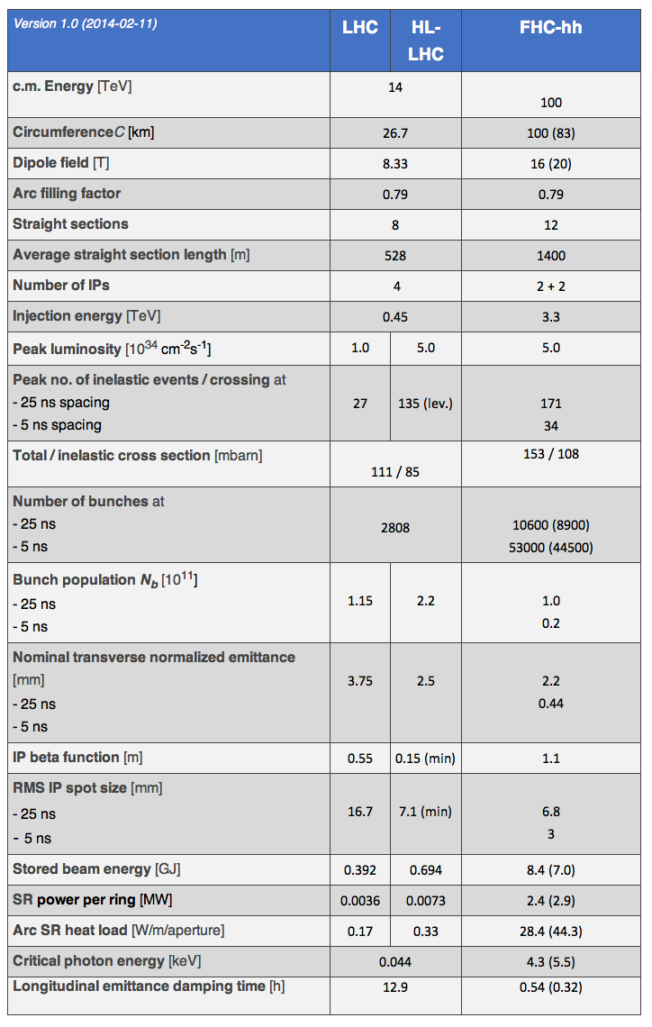
Baseline FCC-hh Parameters
The baseline FCC hadron accelerator parameters are defined in a table linked from the FCC homepage.
https://fcc.web.cern.ch/Pages/Hadron-Collider.aspx
Peak Luminosity and Integrated Luminosity for the different phases are not yet listed there, so we should use the following assumptions →

Slide 4
Baseline Parameters
From M. Benedikt: The present working hypothesis is:
- peak luminosity baseline: 5E34
- peak luminosity ultimate: <= 30E34
- integrated luminosity baseline ~250 fb-1 (average per year)
- integrated luminosity ultimate ~1000 fb-1 (average per year)
An operation scenario with:
- 10 years baseline, leading to 2.5 ab-1
- 15 years ultimate, leading to 15 ab-1
would result in a total of 17.5 ab-1 over 25 years of operation.
Since the operation scenario is somewhat arbitrary we quote O(20ab-1) as total integral luminosity over the lifetime.
Please use these numbers in presentations/talks.
More importantly (at least for the design and maintenance concepts) than the operation scenario might be the fact that we foresee a periodicity of 5 years: beam operation over around 3 to 3.5 years followed by a shutdown of 2 to 1.5 years.
For your information, the above numbers will be published as deliverable report for EuroCirCol and the FCC-hh parameter list will be updated accordingly.

Slide 5
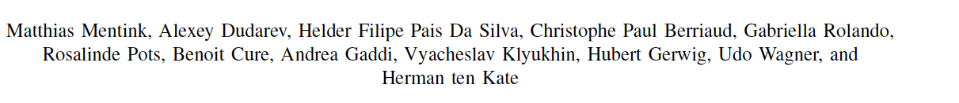
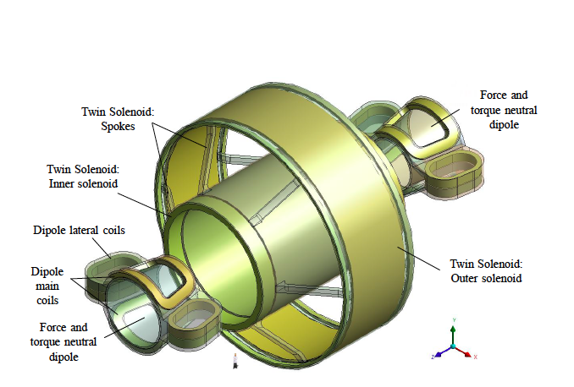
Twin Solenoid + Dipole Magnet System

Slide 6
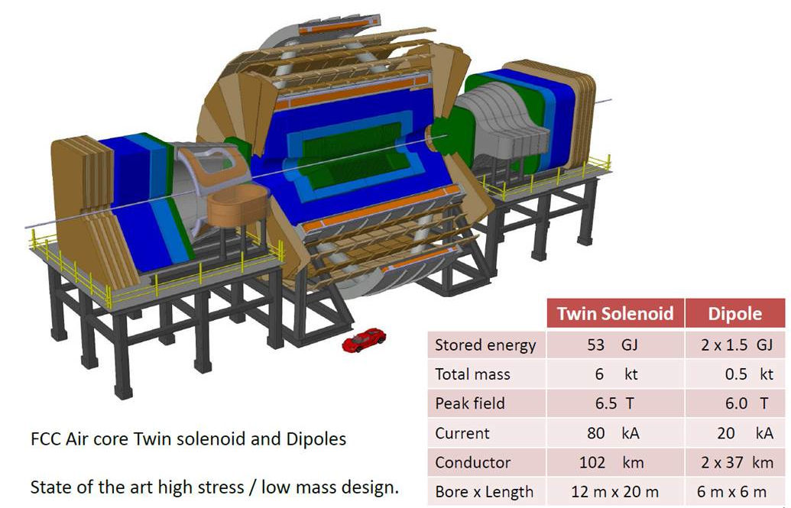
Twin Solenoid + Dipole Magnet System

Slide 7
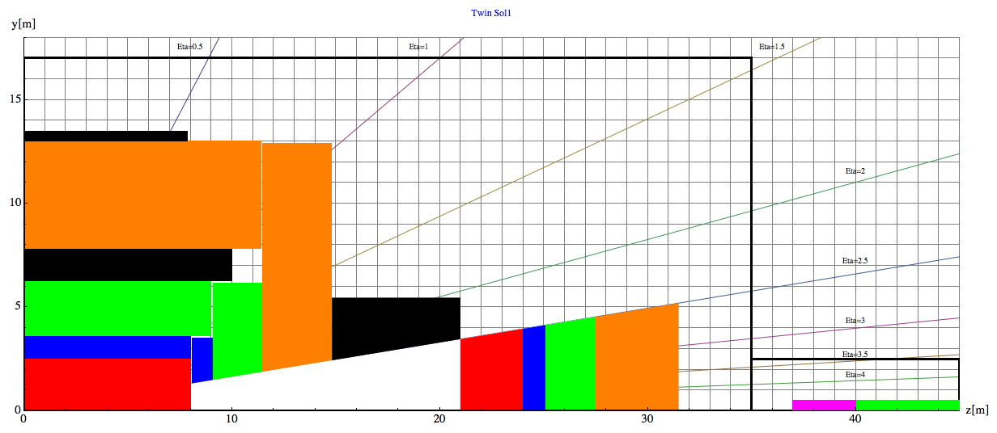
Baseline Geometry, Twin Solenoid
Barrel:
Tracker available space:
R=2.1cm to R=2.5m, L=8m
EMCAL available space:
R=2.5m to R= 3.6m → dR= 1.1m
HCAL available space:
R= 3.6m to R=6.0m → dR=2.4m
Coil+Cryostat:
R= 6m to R= 7.825 → dR = 1.575m, L=10.1m
Muon available space:
R= 7.825m to R= 13m → dR = 5.175m
Coil2:
R=13m to R=13.47m → dR=0.475m, L=7.6m
Endcap:
EMCAL available space:
z=8m to z= 9.1m → dz= 1.1m
HCAL available space:
z= 9.1m to z=11.5m → dz=2.4m
Muon available space:
z= 11.5m to z= 14.8m → dz = 3.3m
Forward:
Dipole:
z= 14.8m to z= 21m → dz=6.2m
FTracker available space:
z=21m to R=24m, L=3m
FEMCAL available space:
Z=24m to z= 25.1m → dz= 1.1m
FHCAL available space:
z= 25.1m to z=27.5m → dz=2.4m
FMuon available space:
z= 27.5m to z=31.5m → dz=4m

Slide 8
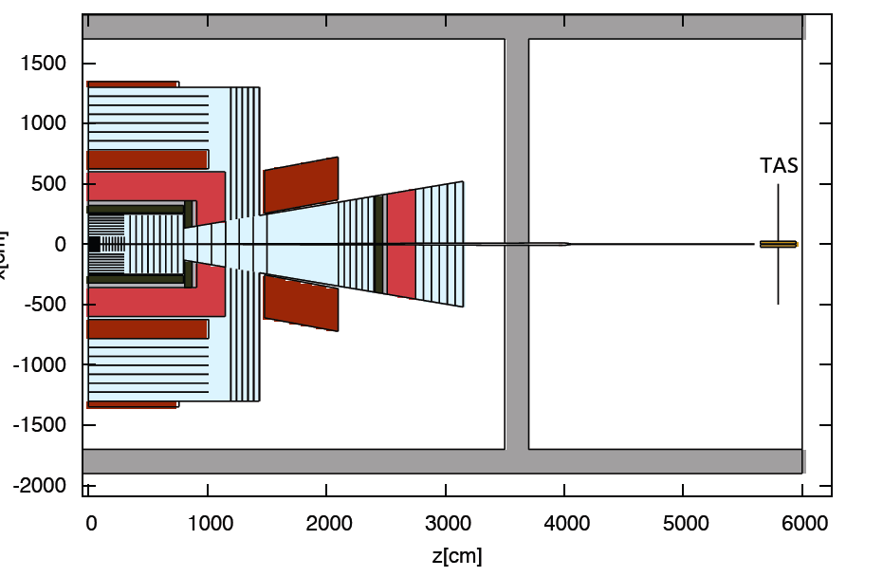
Geometry for Radiation Calculations
The CERN FLUKA Team (M. I. Besana, F. Cerutti) has implemented this geometry with
The proper coil geometry
The correct field map
A basic tracker geometry with 3% of radiation length/layer and proper material
A LArg Calorimeter with ATLAS material composition
A Iron/Scintillator TILECAL style calorimeter.
Simulations started.

Slide 9
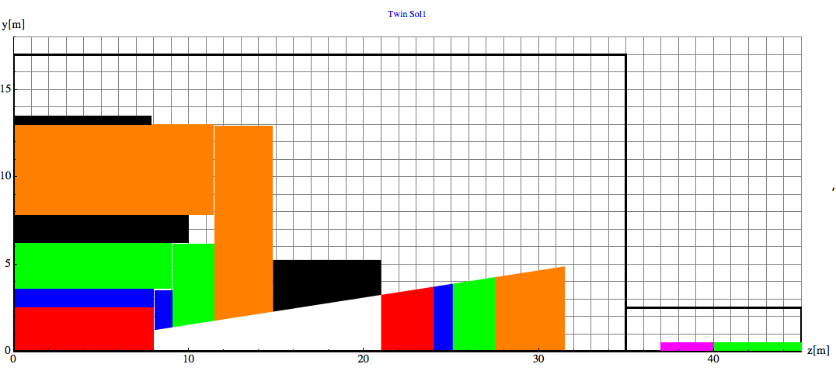
Geometry for Radiation Calculations, superposition for Check

Slide 10
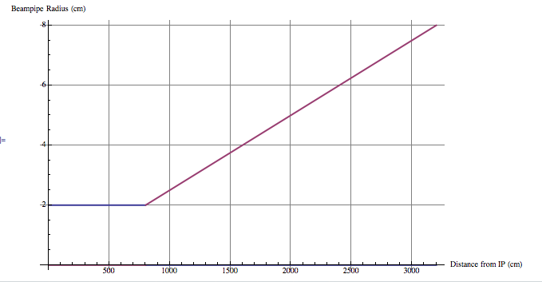
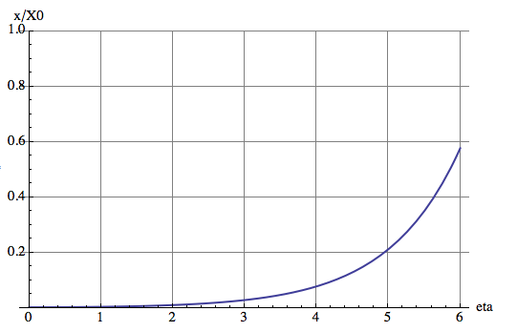
Beampipe
Central beampipe: Cylinder
Beryllium R_{in} =2cm, R_{out}=2.1cm
From z=0 to z=800cm
Forward beampipe: Cone
Beryllium 1mm wall thickness
Projective cone (inner envelope) along 2.5mRad
From z=800cm to z=32000cm
Radius at 32m: 8cm
From z=3200 to 3230cm – cone to go from R=8cm to R=1cm-2cm (matching TAS), Aluminum
Between 3230cm and TAS – keep cylindrical beampipe, Aluminum
Cylindrical shield around this beampipe will be necessary.
Still to be checked with FCC aperture requirements !!
X0beampipe[eta_] := 0.00286*Cosh[eta]

Slide 11
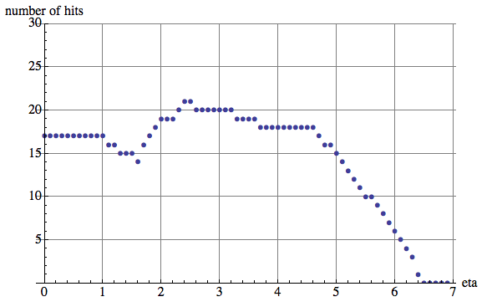
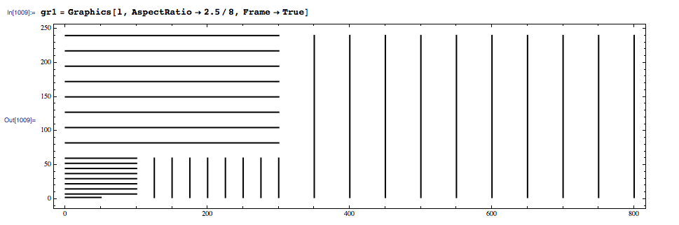
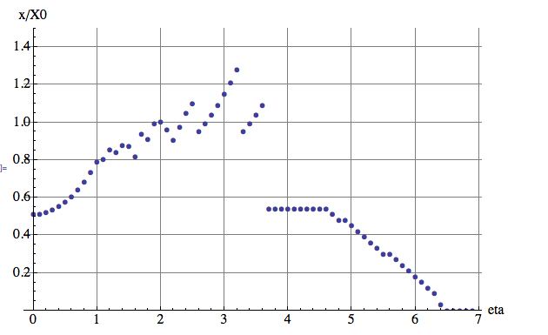
Tracker
Material composition in Volume (%):
Si 20%, C 42%, Cu 2%, Al 6%, Plastic 30%
X₀ of this mix: 14.37cm
We assume 3% of radiation length per layer,
i.e. each layer has a thickness of 0.43cm.
R_{out}=2.4m
Half the leaver arm at eta=2.6→ L=8m

Slide 12
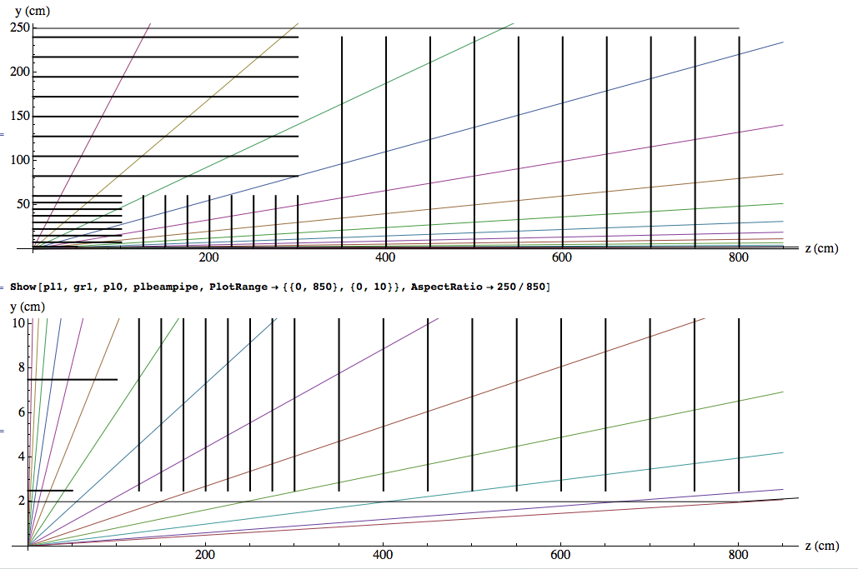
Tracker
Eta=0.5
1
1.5
2
2.5
3
3.5
4
4
4.5
5.
5.5
6.
6.5
6.7

Slide 13
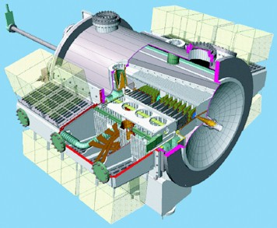
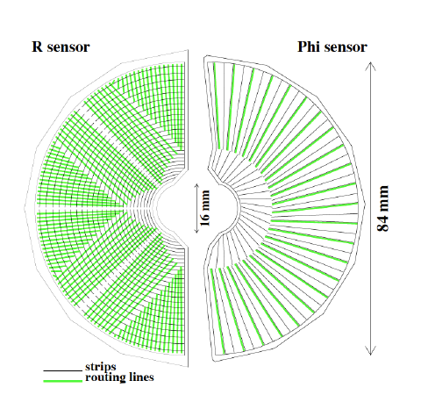
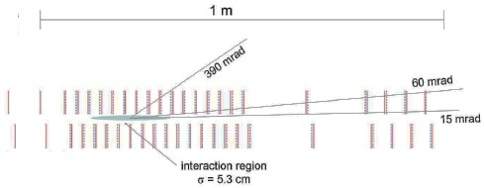
Tracker
Note: A track at eta=5 hits the first detector layer only at 200cm distance from the IP. We cannot dream of B-tagging a’la LHCb.
LHCb has the VELO with discs only a few mm from the beam in a secondary vacuum.
This arrangement has significant infrastructure around the IP which is not compatible with a co-existent central detector.
→ Clever ideas needed !!
4
4.5
5.
5.5
6.
6.5
6.7
LHCb:

Slide 14
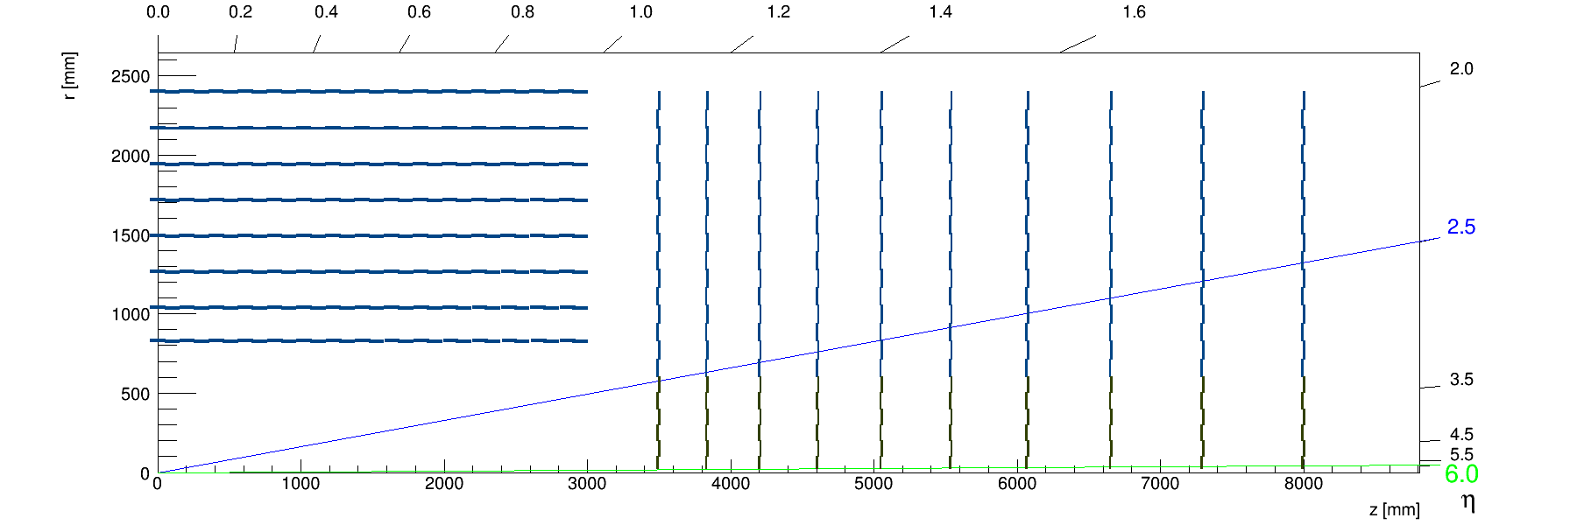
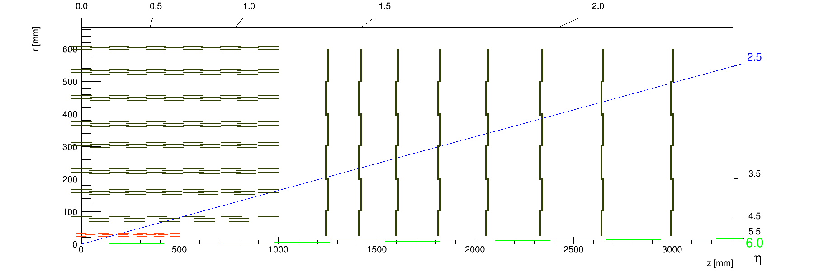
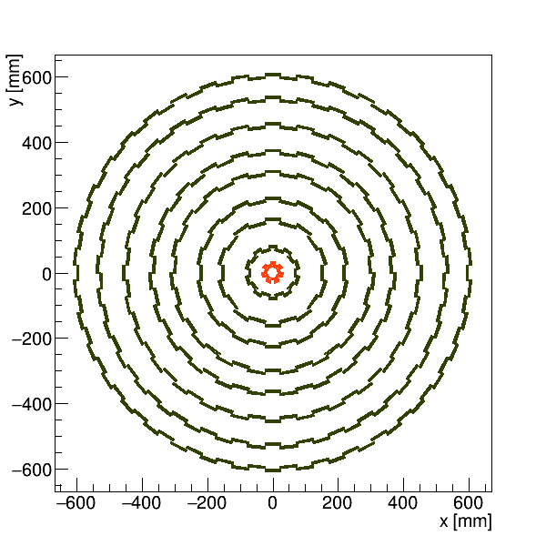
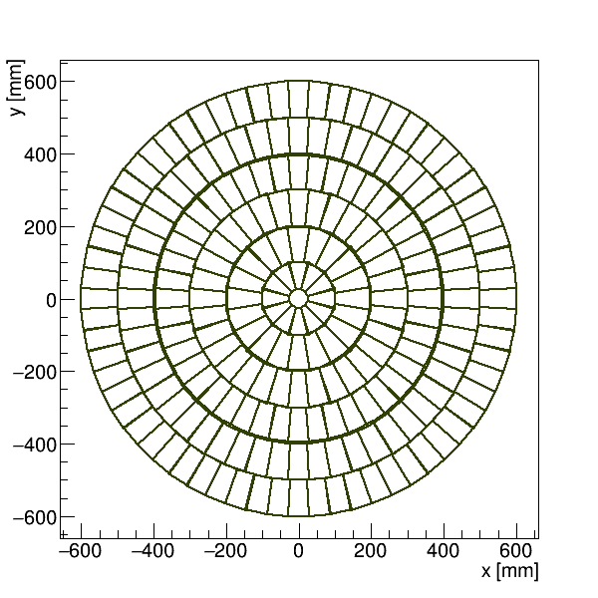
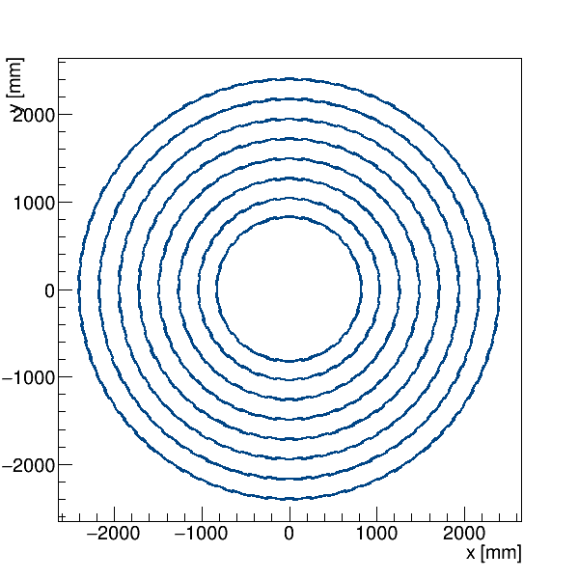
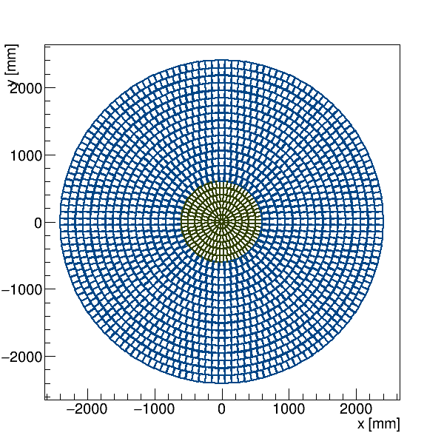
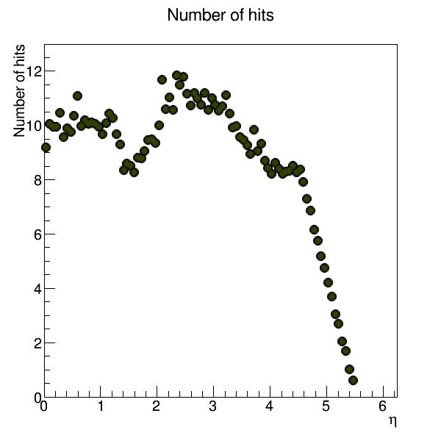
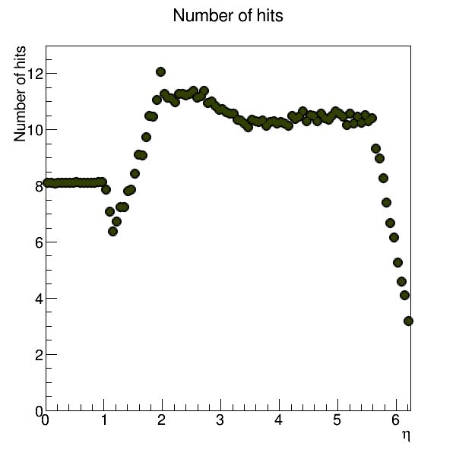
Tracker
Z. Drasal, M. Manelli: Realistic Layout with correct modules using TKLayout (CMS PhaseII upgrade tool)
http://fcc-tklayout.web.cern.ch/fcc-tklayout/FCChh_Option2/errorsTRK.html

Slide 15
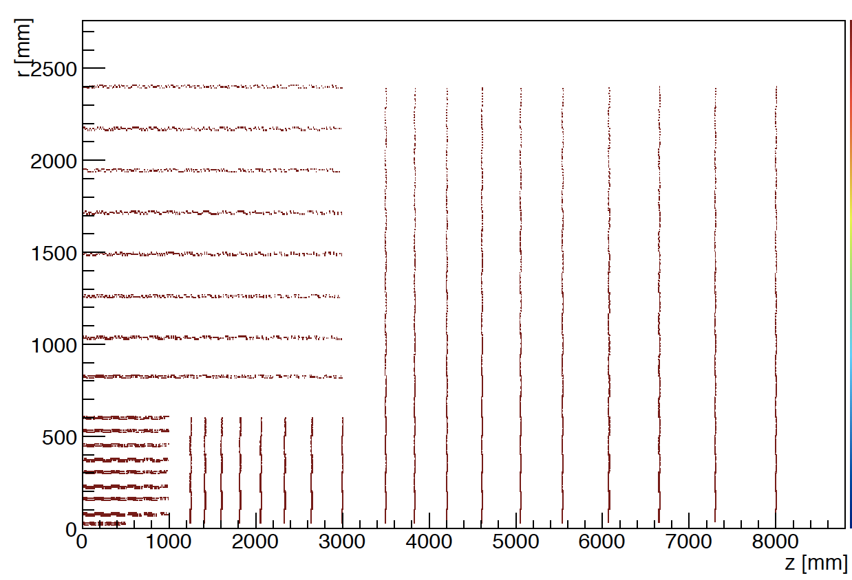
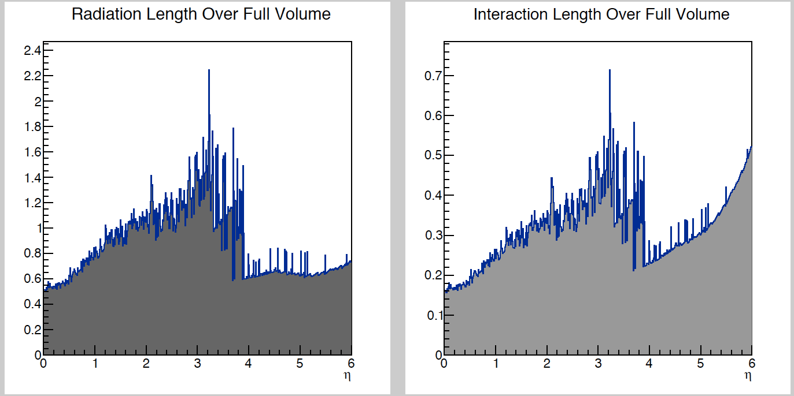
Tracker
Z. Drasal,
M. Manelli

Slide 16
Tracker
Realistic Layout with correct modules using TKLayout (CMS PhaseII upgrade tool)
Trivial model with x/X₀=3% per layer superimposed.

Slide 17
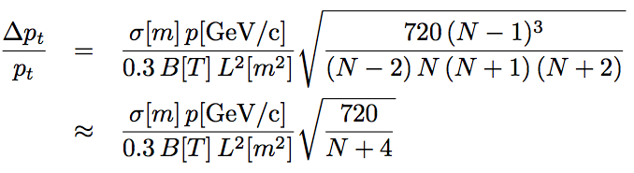
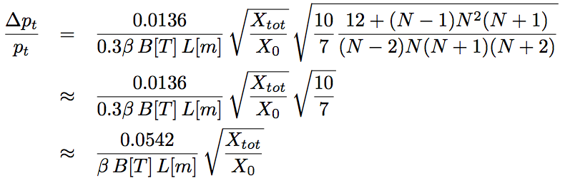
Point Resolution and Multiple Scattering
1 2 3 … N
B
σ … point resolution/plane
X_{tot}/X₀ … total material budget
N equidistant layers
…..
L
Position Resolution
Multiple Scattering,
Equal weighting
≈1.2. Taking into account the correlation (Kalman filter etc.) this number can be reduced to 1.0

Slide 18
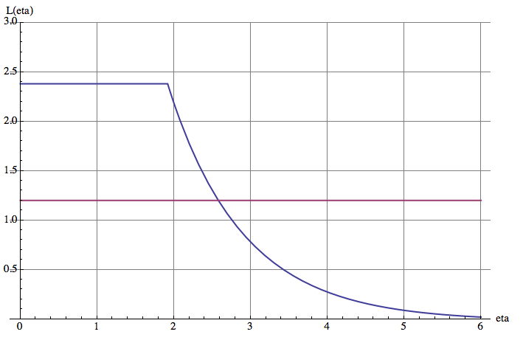
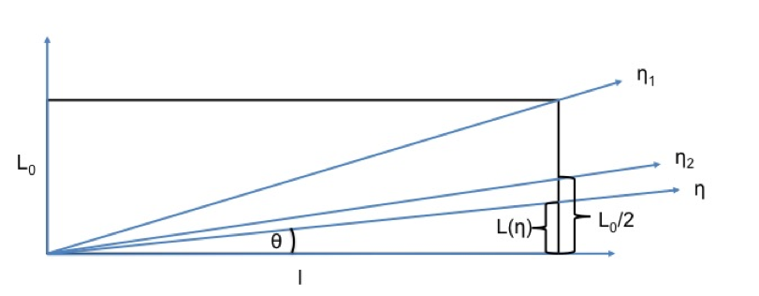
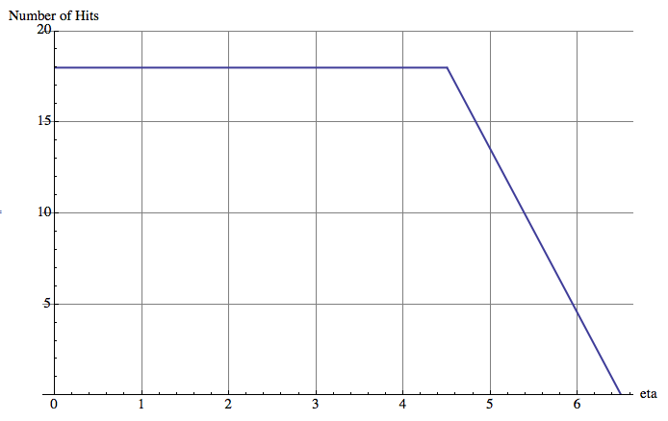



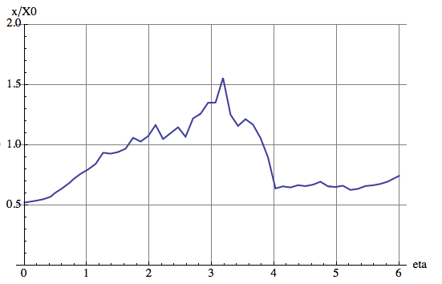

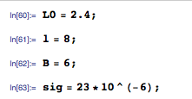
Tracker

Slide 19
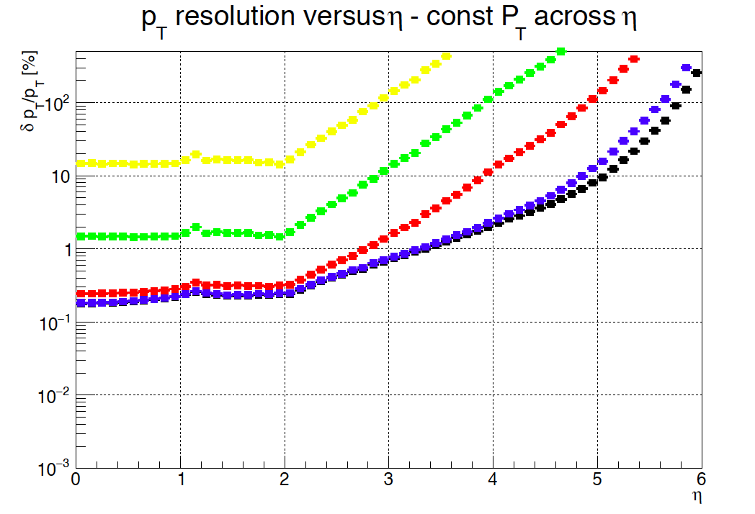
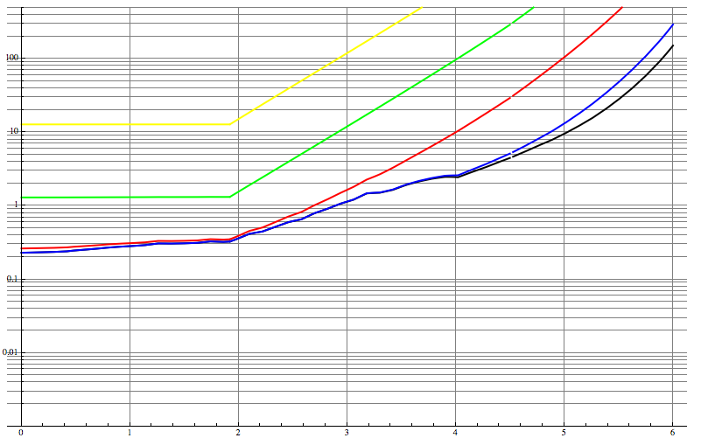
Tracker
Z. Drasal
The points are Zbynek’s results from the TKLayout Tool, the solid lines are the formulas from the previous slide.
10 000GeV, 1000GeV, 100GeV, 10GeV, 5GeV

Slide 20
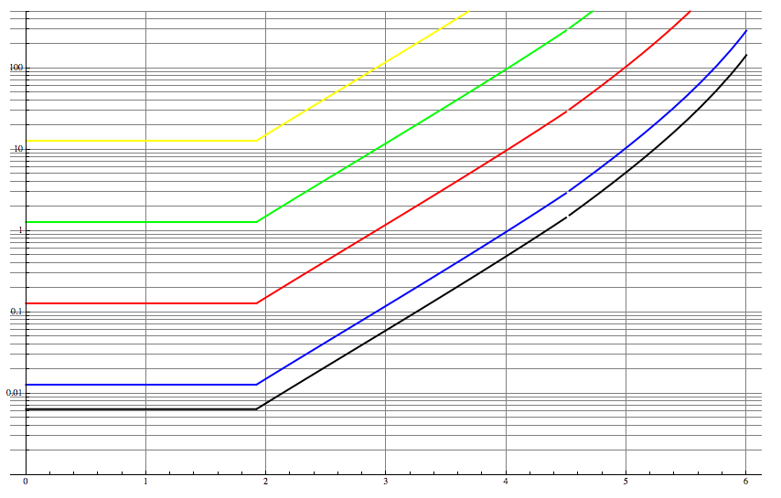
Tracker
Solid lines show the formulas from the previous slide, multiple scattering neglected.
10 000GeV, 1000GeV, 100GeV, 10GeV, 5GeV

Slide 21
Tracker
Large BL² needed for high momenta, but large BL also key to minimize multiple scattering contribution.
With BL 2.5 times larger than CMS, the multiple scattering contribution for the same amount of tracker material is a factor 2.5 smaller (reso: 0.8% → 0.32%).
How to scale the system and keep the performance constant ?
At constant B and 1/2 the tracker radius (free bore of solenoid from 12m to 10m) we need:
4 times the tracker resolution (20um → 5um) and
4 times less material budget (x/X₀=50% at eta=0 to x/X₀=12.5% at eta=0 i.e. 3% per Layer to 0.75% per layer)
These values are challenging but not out of reach.
Tracker instead of diam=4.8m, length=16m to half of that !
A final choice is part of an optimization that depends on future technologies
We will have to show ‘cost scaling’ models in the 2018 report.

Slide 22
Forward Tracking

Slide 23
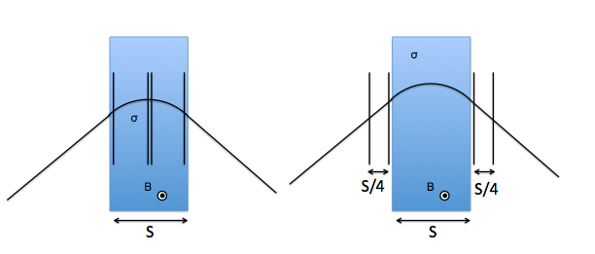
Forward Tracking Resolution, Position Resolution
Using 4 tracking stations for a dipole with constant magnetic field and length S, the optimum spectrometer resolution is achieved by placing 2 stations in the center and one on each end to measure the sagitta.
The same performance is achieved by placing the chambers outside the dipole at separation of S/4.
This is what LHCb uses, because if space is available it is more easy to implement the detectors outside, and also avoid occupancy from loopers in the field (detals on catching Ks etc. are of curse to be considered …)
We use this idea for now (is also easier to calculate ! It is just the
Int Bdl that counts)

Slide 24
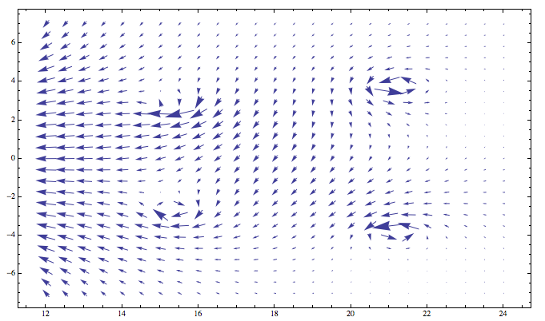
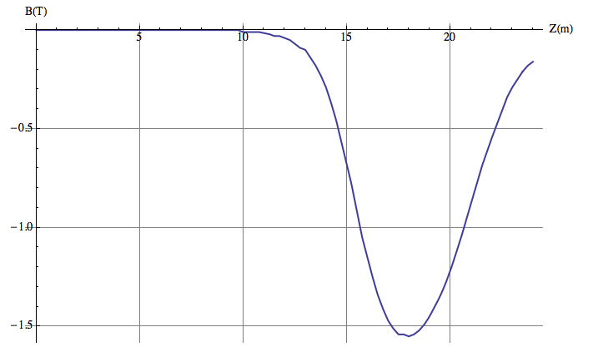

Slide 25

Forward Tracker Resolution, Position Resolution
σ
σ
θ
σ
σ
B
L
L

Slide 26

Forward Tracker Resolution, Multiple Scattering
L
Δα₁
θ
B
L
Δα₂

Slide 27



Forward Tracker Resolution, Measurement of angle
Material budget of first layer dominates !
Δθ
Pixel L2
θ
Pixel L1
IP

Slide 28


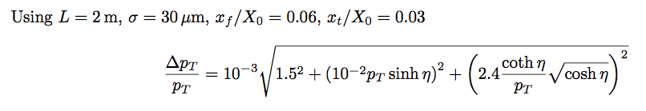
Forward Tracker Resolution
σ=30μm
Int Bdl=10 Tm
L=2m
X_{f}/X₀=0.06
Int Bdl=10 Tm
X_{t}/X₀=0.03

Slide 29
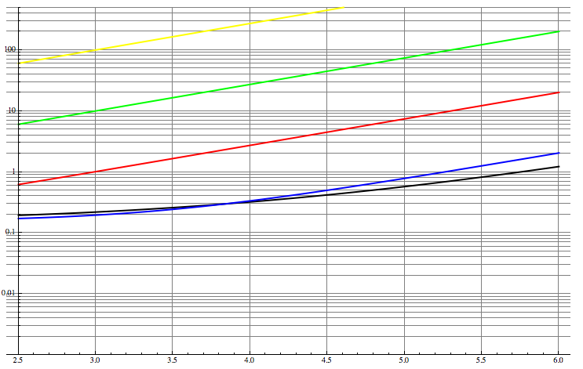
Forward Tracker Resolution
10 000GeV, 1000GeV, 100GeV, 10GeV, 5GeV
Solid lines show the performance of the forward dipole

Slide 30
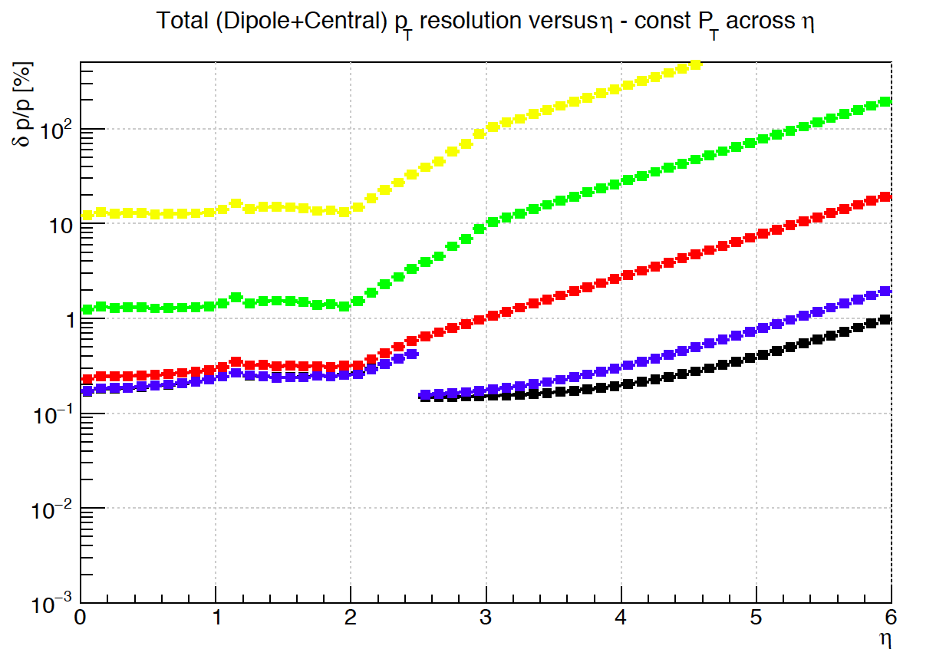
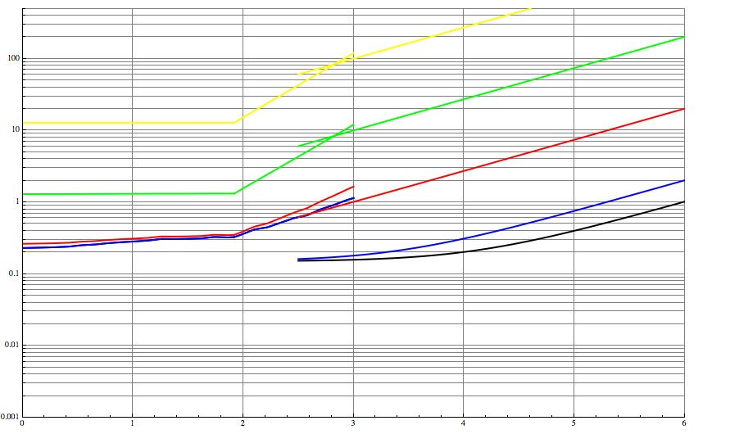
Forward Tracker Resolution
This is the baseline parametrization used for DELPHES
10 000GeV, 1000GeV, 100GeV, 10GeV, 5GeV

Slide 31
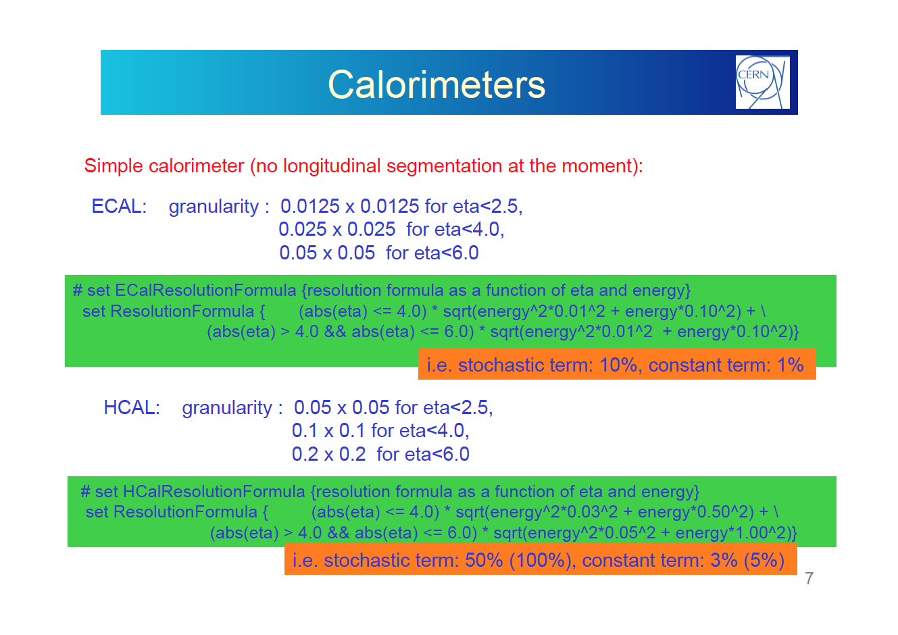
Calorimeter Granularity

Slide 32
Calorimetry

Slide 33
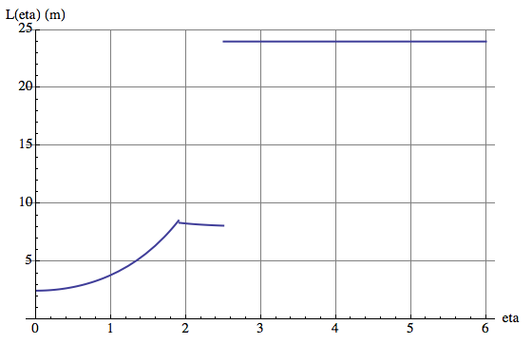
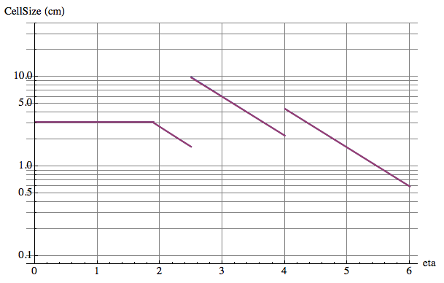
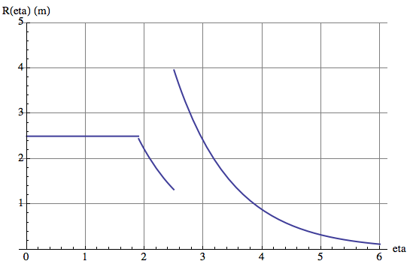
Cell Size in cm
0.025x0.025
0.0125x0.0125
0.05x0.05

Slide 35
Muon System

Slide 36
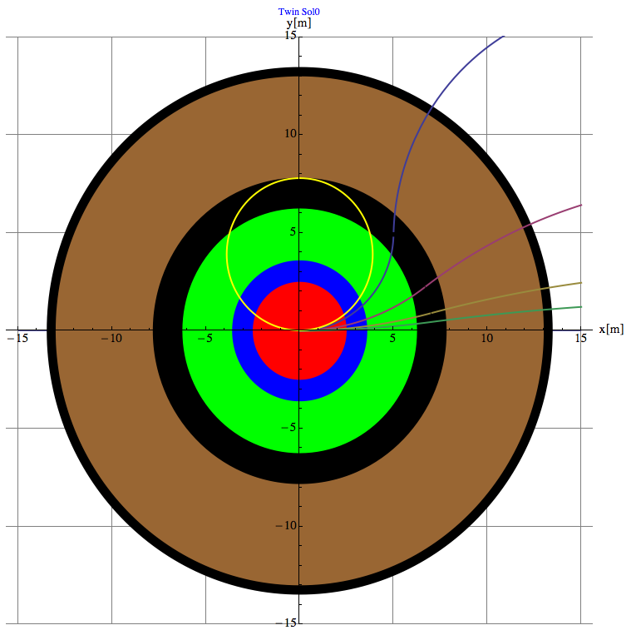
At B₀=6T and R₀=6m,
Muons below 7GeV do not enter the muon system.
No Muon Trigger below 7GeV.
Possibly muon ID with HGCAL.
9 GeV
7 GeV
20 GeV
50 GeV
100 GeV

Slide 37
Muon Momentum can be measured by
1) The inner tracker
→ resolution plots from before
2) The track angle at the entrance of the muon system → Trigger
3) A sagitta measurement in the muon system (no iron → precise !)
4) The combined fit of inner tracker and outer layers of the muon system.
R₀
R₁

Slide 38
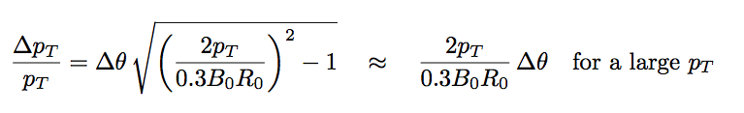

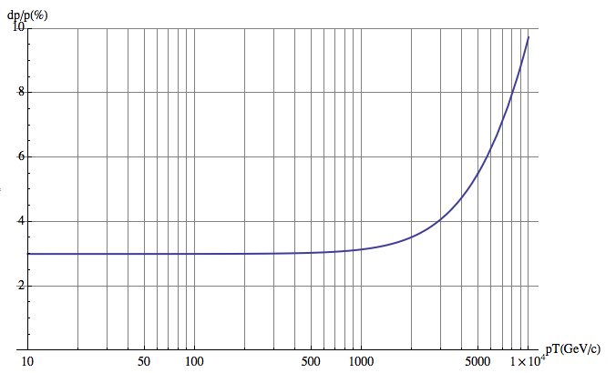

2) Track angle at the entrance of the muon system
θ
10% at 10TeV, B₀=6T, R₀=6m
Δθ=50μRad
2 stations at 1.5m distance with 50um position resolution
For low momentum, limit due to multiple scattering in the calorimeters and coil:
Calorimeter+Cryostat: 35X₀
HCAL: 110X₀
Coil: 5X₀
→ x_{tot}/X₀ ≈150
B₀=6T, R₀=6m
dp/p=3% !!!
(CMS 9% because B₀R₀=1/3)
At eta=0 ATLAS type standalone Muon Performance up to 10TeV !!!

Slide 39
3) Sagitta measurement in the muon system
The return field is 2.45T
Measuring over the 5m lever arm with stations of sig=50um resolution we have
dp_{T}/p_{T}= sig*p_{T}/(0.3*B*L²)*8
= 20% @ 10TeV
with possibly excellent performance at low p_{T} due to the absence of iron (vs. CMS) .
but very hard to beat the angular measurement at high p_{T} and the inner tracker at low p_{T}.
Surface > 5000 m²
CMS sagitta measurement in the muon system is limited to dp_{T}/p_{T} = 20% due to multiple scattering alone.

Slide 40


CMS Muon Performance
10%
5%

Slide 41


Combined Measurement
If the full flux is returned trough the muon system, the muon trajectory at the exit of the system points exactly to the IP !
The maximum excursion y_{t}(x₀) is always at the same radial distance of x₀
For values below: x₀=4m, y_{t}(x0)=1.44mm
Ideal measurement point is at the peak, but y_{t}(2.4m)= 1.24mm still good !
B₀=6T, R₀=6m, R₁=12m, p_{T}=10000GeV
σ₁
σ²=σ₁²+(x/R₁σ₂)²
x=2.4m,R₁=12m, σ₁=50μm, σ₁=250μm,
σ=64μm, dp_{T}/p_{T}=5% at 10TeV !
Measuring just in the last tracker layer and in the outermost muon station already beats the full inner tracker performance (14 layers, 23um).
σ₂

Slide 42

Preliminary Conclusion on Muon Measurement:
No Muons below 7 GeV in the Muon System.
Angle measurement at entrance of the muon system provides excellent performance.
Sagitta measurement in the muon system is not competitive with angle measurement and the inner tracker.
Using the last layer of the muon system together with the last layer of the central tracker alone gives excellent performance at high p_{T}.
Minimizing the gap size is a very interesting option, because it does not affect the angle measurement and has only small impact on the full sagitta measurement.
An Iron return yoke with partial shielding is also interesting.
The achievable precision on the angular measurement has to be evaluated, should be OK
The full sagitta measurement will suffer – to be evaluated.
Stray fields are of course a pain
→ To be done: eta dependence of all these arguments !!
B₀=6T, R₀=6m, p_{T}=10000GeV
R₁=12m
R₁=9m

