Slide 1
NTNU - Entrepreneurship Geneva, November 3 - 7
Technology Transfer at CERN:
Jean-Marie Le Goff
DSU-TT
Jean-Marie.Le.Goff@cern.ch

Slide 2
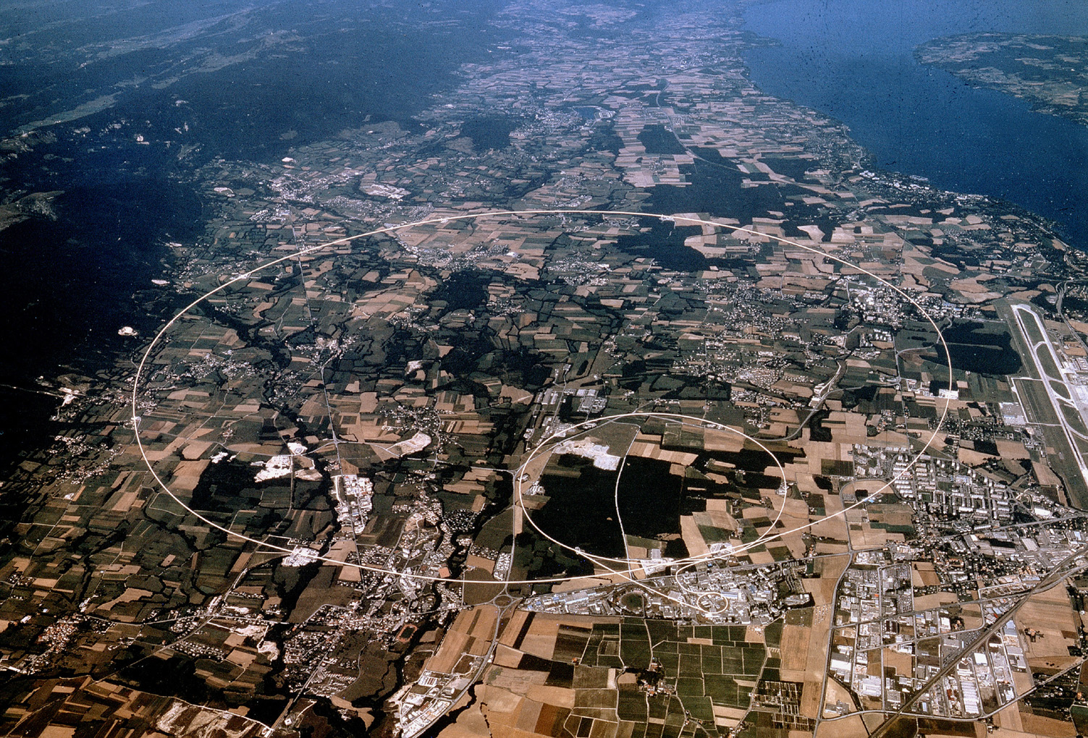
CERN
where the scientific knowledge and the technology
are transferred to industry and society
Research & Discovery
Technology
Training
Collaboration

Slide 3

CERN in Numbers
2464 staff*
753 Fellows and Associates*
9035 users*
Budget (2007) 982 MCHF (610M Euro)
*15 November 2007
Member States: Austria, Belgium, Bulgaria, the Czech Republic, Denmark, Finland, France, Germany, Greece, Hungary, Italy, Netherlands, Norway, Poland, Portugal, Slovakia, Spain, Sweden, Switzerland and the United Kingdom.
Observers to Council: India, Israel, Japan, the Russian Federation, the United States of America, Turkey, the European Commission and Unesco

Slide 4
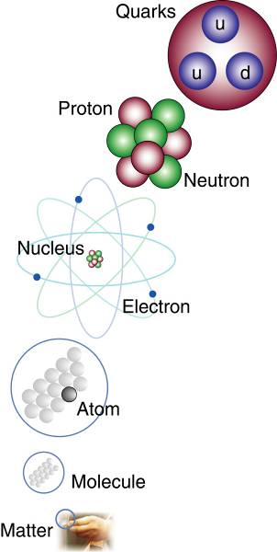
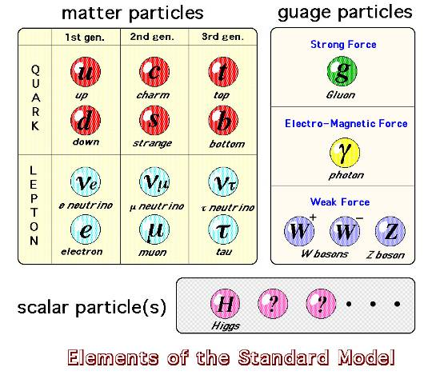
The study of elementary particles and fields
and their interactions
gauge
x8
In 50 years, we’ve come a long way, but there is still much to learn…

Slide 5
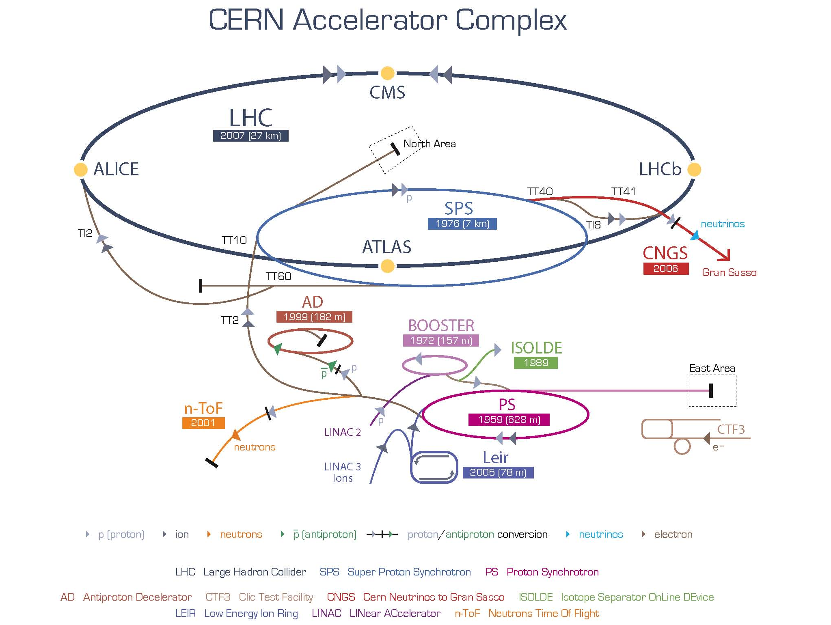

Slide 6
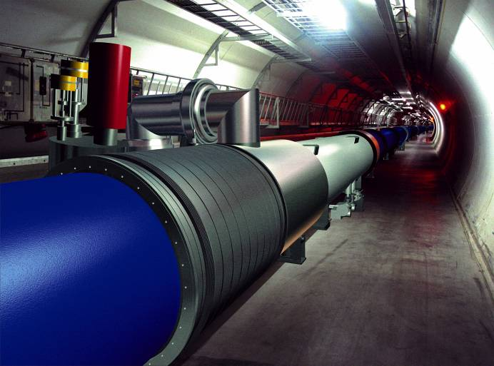
The LHC = Proton - Proton Collider
7 TeV +
7 TeV
Luminosity = 10³⁴cm⁻²sec⁻¹
Primary targets:
Origin of mass
Nature of Dark Matter
Primordial Plasma
Matter vs Antimatter
The LHC results will determine the future course of High Energy Physics

Slide 7
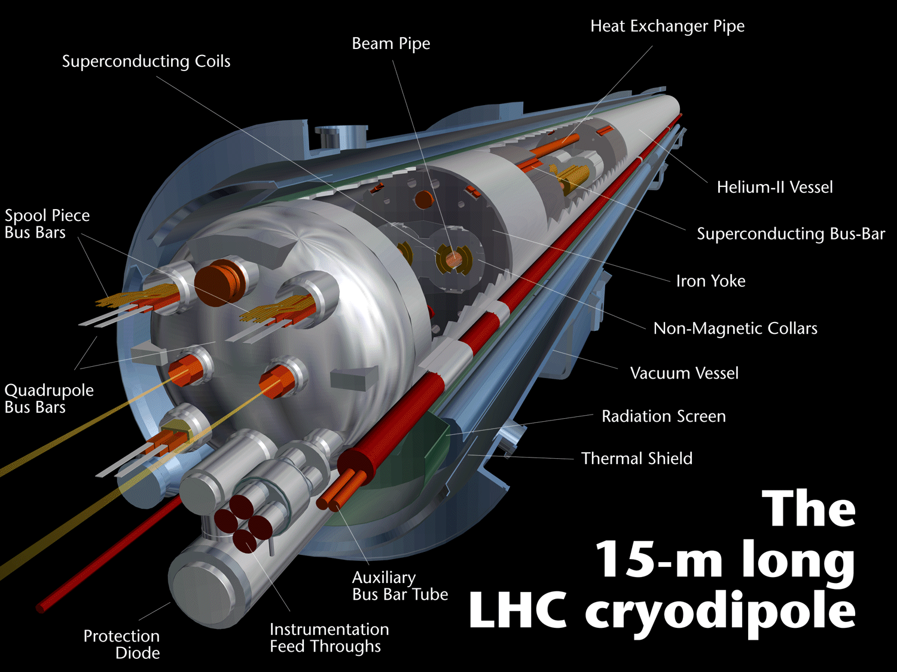

Slide 8
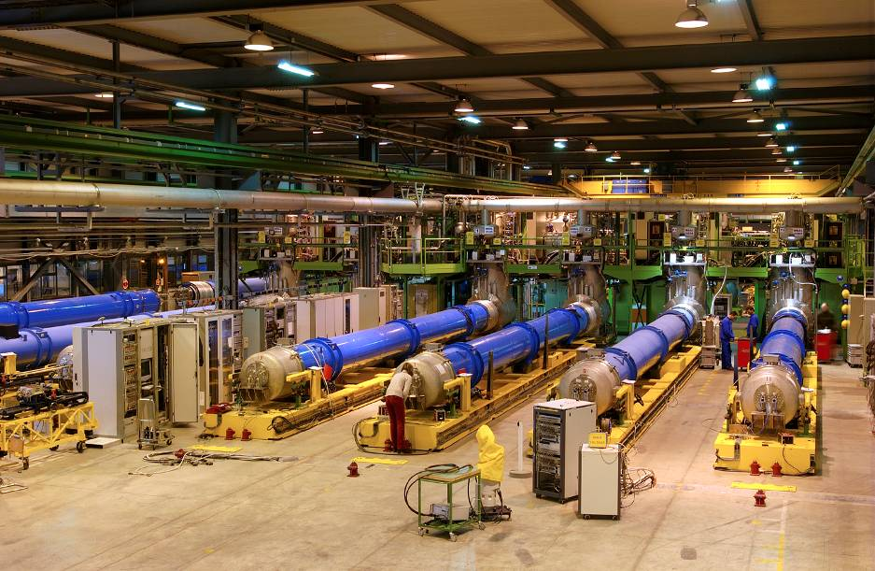
Magnet – Cryostat Assembly & Test

Slide 9
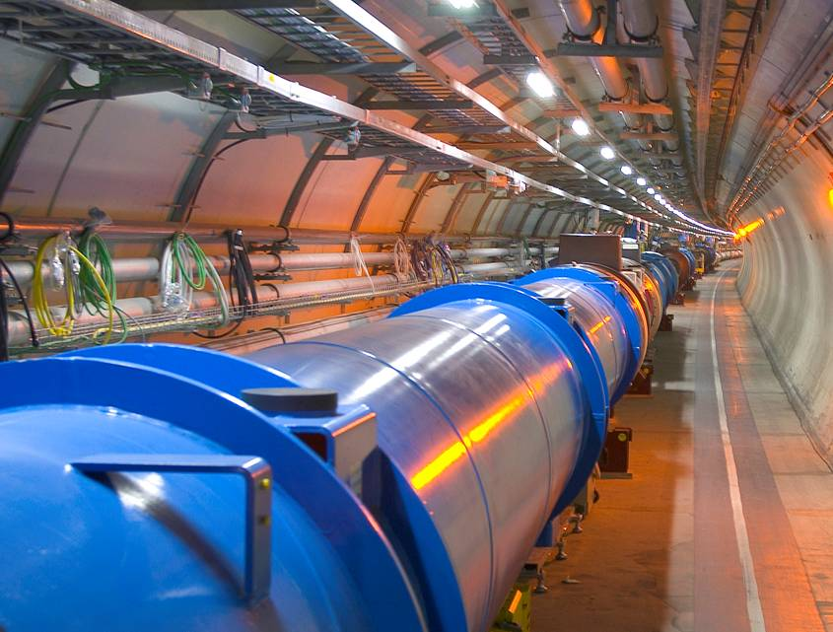
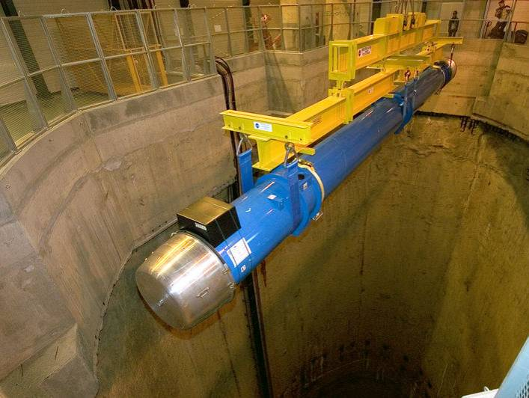
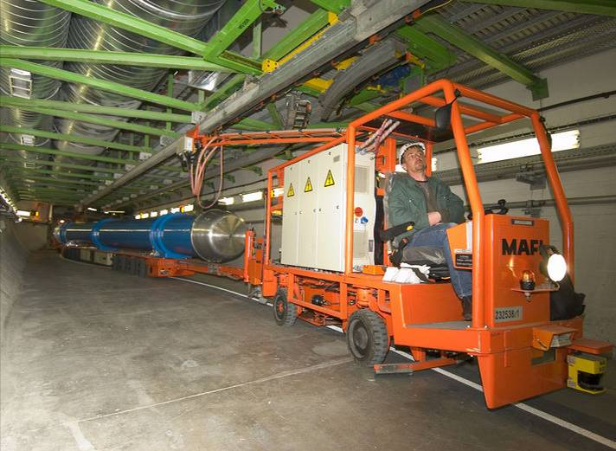
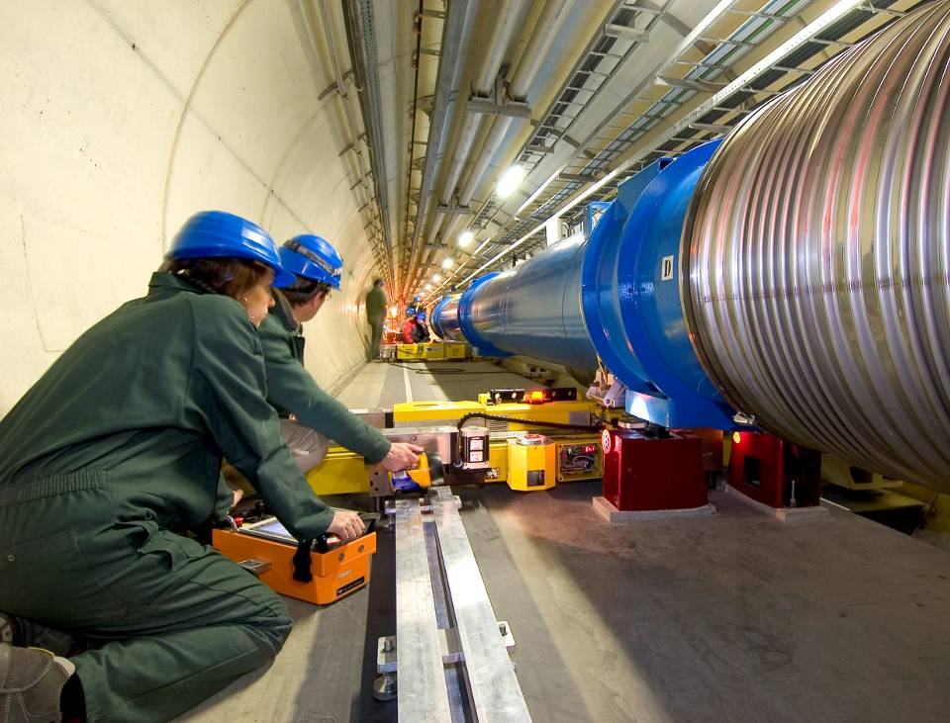
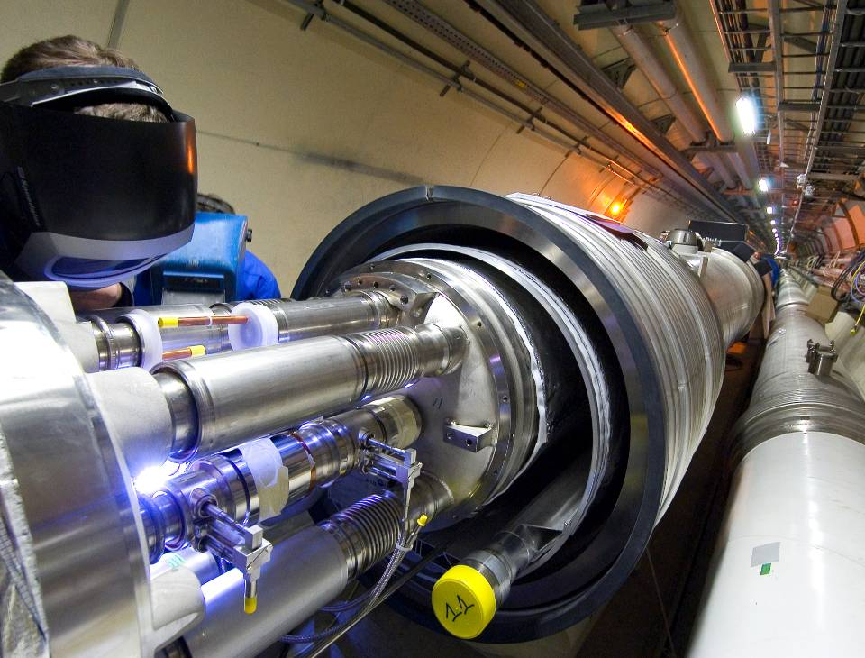
Magnet installation

Slide 10
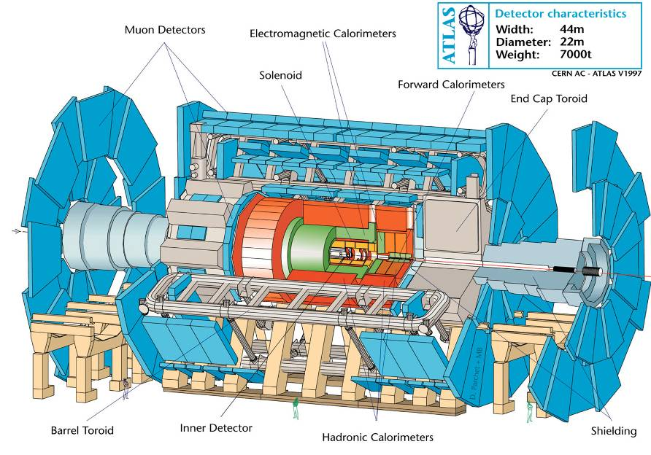
ATLAS (spokesperson Peter Jenni)
Number of scientists: 2000
Number of institutes: 164
Number of countries: 35

Slide 11
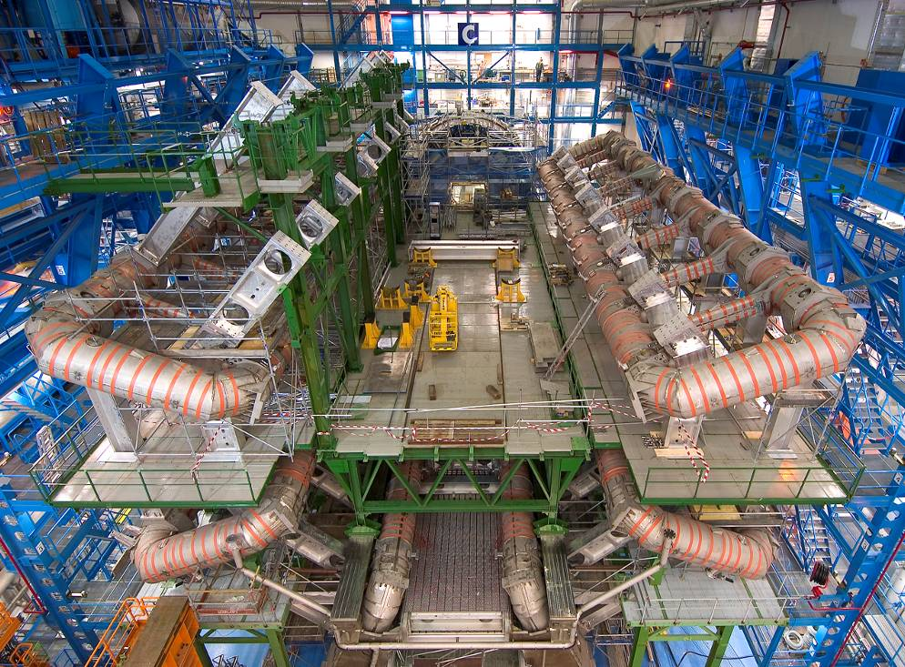
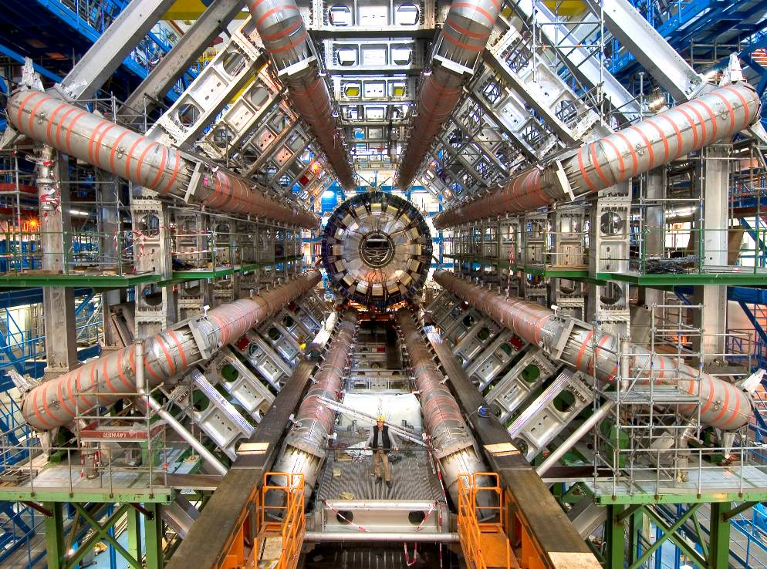
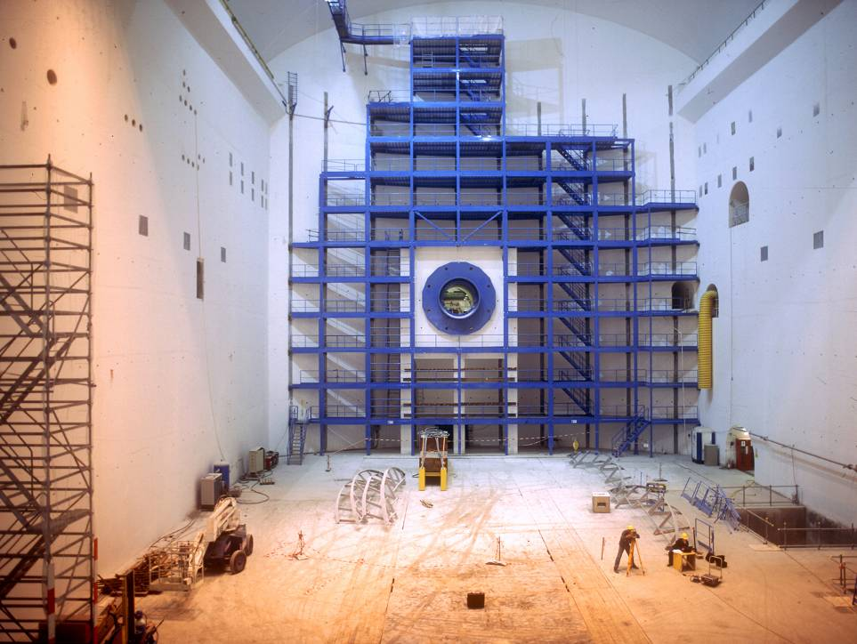
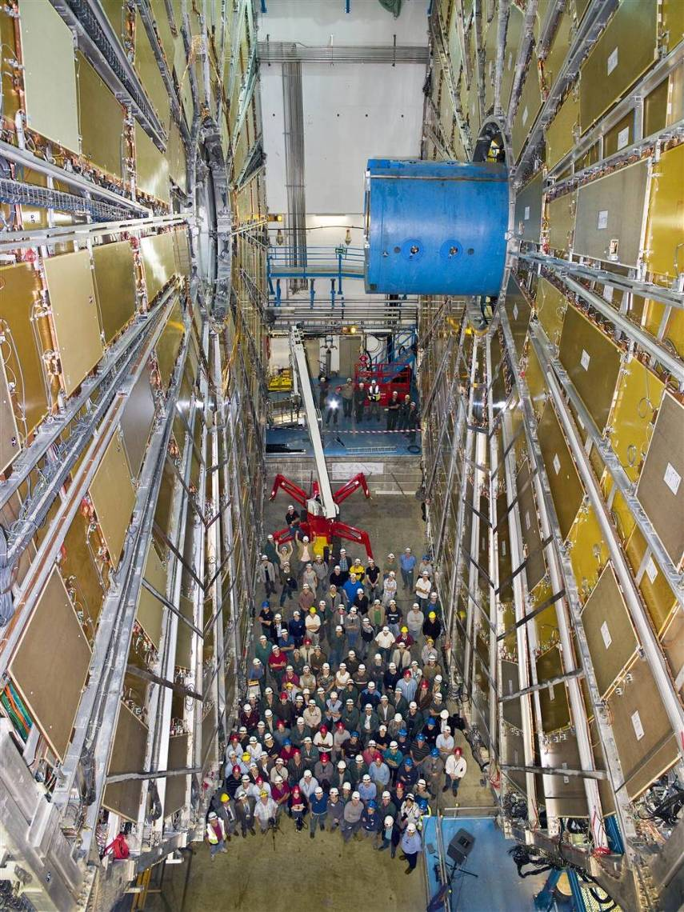
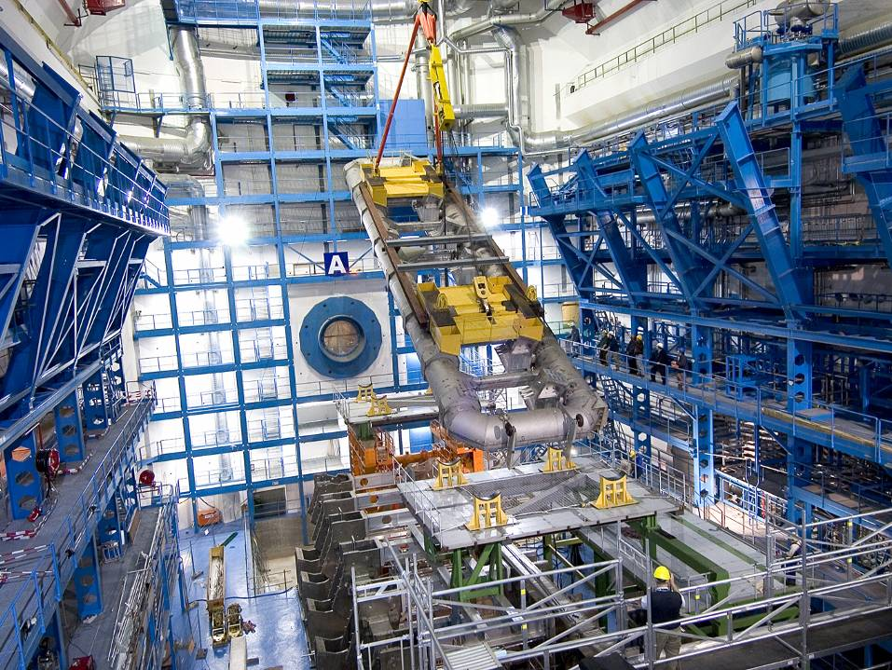
ATLAS Cavern

Slide 12
The CMS Detector
(Spokesperson Jim Virdee)
CALORIMETERS
ECAL
HCAL
Scintillating
PbWO4 crystals
SUPERCONDUCTING
Plastic scintillator/brass
sandwich
COIL
IRON YOKE
Number of scientists: 2350
Number of institutes: 180
Number of countries: 38
TRACKER
Silicon Microstrips
Pixels
Total weight : 12,500 t
MUON
ENDCAPS
Overall diameter : 15 m
Overall length : 21.6 m
MUON BARREL
Magnetic field : 4 Tesla
Drift Tube
Resistive Plate
Cathode Strip Chambers
Chambers
Resistive Plate Chambers
Chambers

Slide 13
CERN…
Seeking answers to questions about the Universe
Advancing the frontiers of technology
Training the scientists of tomorrow
Bringing nations together through science

Slide 14

Content
Research context
Impact of procurement on industry
Technology opportunities
TT Dissemination activities
Examples at CERN

Slide 15
CERN
where the scientific knowledge and the technology
are transferred to industry and society
Research
Technology
Formation
Collaboration

Slide 16
Fundamental Science and TT
Science leads to technology innovation.
High tech industry is becoming the backbone of economy.
Society relies on technology.
Discoveries alone are no longer sufficient to substantiate the investment level of MS in fundamental science.
High Energy Physics is required to demonstrate its importance to Society:
Communication is key to reach this objective
High Energy Physics is required to demonstrate its usefulness to Society.
TT is a key mean to reach this objective.

Slide 17
CERN as a source of technology & know-how
Large fundamental research apparatus not directly available from industry
CERN’s purchasing requirements into 3 categories:
Standard industrial products
New high-tech products requiring a conceptual design phase
Non-standard products which can be produced with existing manufacturing techniques and / or technologies
Long and Intensive R&D and Prototyping required
Source of innovation
Source of new technologies
Existing technologies pushed to the limits
Creation of know-how
Although developed for the purpose of fundamental research, many technology developments and know-how have strong impact to society
Notes:
17

Slide 18
From research to industry: Challenges
Finding an IP management strategy compatible with open science
Possible limitation of dissemination of R&D results due to unclear IP situation
Finding the right balance between openness and the commercial exploitation
Possible negative effects of IP protection on the willingness to share research results
Identifying market for CERN technologies
Innovations in PP result from R&D programmes requiring non-commercially available products. Applications and markets identification outside PP requires dedicated efforts and understanding of potential application domains specific requirements
Funding the gap between public innovation and commercial application
Firms are reluctant to invest in basic research; need for funds to support collaborative R&D with commercial aims and for early phases of start-ups promoting PP innovations
Collaborating with industry on basic technologies research while remaining compatible with CERN purchasing rules
Basic technology developed in collaboration with industry may generate IP needed for future procurement contracts. Risk of monopolistic situations incompatible with purchasing rules

Slide 19
Impact of fundamental science to society
Generic technologies developed for accelerators, particles detection and data processing will find applications in many domains if:
Match between technology offer and product needs
Cost effectiveness of manufacturing products with technology
Value of technology within product
Acceptable product price with added features enabled by technology
Main domains:
Health
Information Technology
Energy & Environment
Industrial processes
Security
Notes:
19

Slide 20
R&D contexts for PP and industry, impact on TT
Research: Open science
Industry: In/out sourcing technology
Publication of discoveries & R&D results
Scientific recognition
Value in copyrights
R&D to meet scientific programme objectives
Long-term
Best possible solution within budgetary constrains
R&D results: Technology
IP rights to use internally
Highly collaborative
Memorandum of Understanding (MoU)
Unclear IP situation
Joint ownership of R&D results
Complex dissemination
Funding
Public
Quality of research program
Protection of innovations & know-how
Required to facilitate industrial dissemination
Value in IP rights (patents, etc.)
R&D to increase market share
Short-term
Best cost-effective solution
R&D results: Products (prototypes)
IP rights to manufacture
Highly competitive
Licence and/or partnership agreement
Clear IP situation
Clear ownership of R&D results
Dissemination based on manufacturing
Financing
Private with public support (EU, National funds)
Product market potential
TT

Slide 21
The aims and objectives of TT
Aim: The CERN TT activities are aimed at the following:
Maximizing the technological and knowledge return to the MS industry without diverting from CERN HEP mission.
Promoting CERN’s image as a center of excellence for technology.
Objectives: To steadily increase TT dissemination expressed in terms of R&D projects and commercial exploitation agreements:
While securing external resources for such activities,
So as to minimize their burden on the Organization’s resources.

Slide 22

TT activities at CERN
Protect the interests of the Organization in Intellectual Property (IP) matters
Provide support to the Management in the protection, transfer, use, further development and dissemination of CERN’s IP.
TT activities are executed in a process composed of 3 sub-processes:
Technology Assessment & IP Protection
Promotion
Dissemination
TT R&D Projects
Commercialization of IP

Slide 23
Dissemination principles
First option and favorable conditions to Member State industry
Equal opportunities for the commercial actors in the Member States
Dissemination Vs income
Market price
Military application are excluded

Slide 24
Dissemination models
Commercialisation of CERN IP
Licensing
Service and consultancy
TT R&D projects (collaborative R&D)
Collaboration with other institutes
Partnership with industry

Slide 25
Content
Research context
Impact of procurement on industry
Technology opportunities
Dissemination activities
Examples at CERN

Slide 26
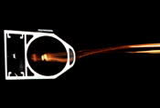
New products from Procurement
Industry acquires new technologies and know-how through procurement contract with CERN
Impact of procurement to industry (results of studies):
Financial:
For 1 Euro invested in purchasing technology goods, more than 3 Euros are generated in companies
Knowledge transfer:
Context: 629 High Tech supplier projects, ~1Bn Euros, 178 survey respondents, No companies with orders < 20 kEuros):
Results:
38% developed new products
17% opened a new market
14% started a new business unit
Vacuum chamber
Hood clamshell tool in elastomer
Notes:
26

Slide 27
Content
Research context
Impact of procurement on industry
Technology opportunities
TT dissemination activities
Examples at CERN

Slide 28
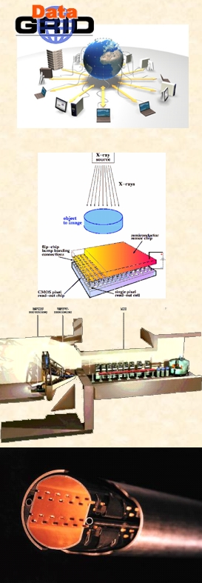
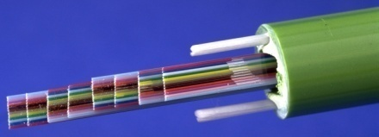
Potential of CERN technologies in non-HEP application domains
Detectors
Electronics
IT
Accelerator
Magnets
Material
Mechanics
Detectors
✓
✓
✓
Health & Lifesc.
✓
✓
Electronics
Isotopes
✓
✓
✓
Vacuum Technology
✓
✓
Renewable Energy
✓
✓
Energy & Environment
Thermal Insulation
✓
✓
✓
Nuclear Waste treatment
✓
✓
Eng.
✓
✓
✓
Material & Mechanics
CERN Technology Transfer Website

Slide 29
Content
Research context
Impact of procurement on industry
Technology opportunities
Dissemination activities
Examples at CERN

Slide 30
Dissemination models
Commercialisation of CERN IP
Licensing
Service and consultancy
TT R&D projects (collaborative R&D)
Collaboration with other institutes
Partnership with industry

Slide 31
Licensing
Object of the licenses
Patent
Copyright (software, chip masks, documented design)
Know-how and expertise
R&D and/or commercial licenses
May include the supply of technology
Principles
Technology licensed on an “as-is” basis
Non-exclusive licenses (normally)
Conditioned to effective exploitation
Restrictions may be imposed by chip manufacturers for ASICs

Slide 32
Dissemination models
Commercialisation of CERN IP
Licensing
Service and consultancy
TT R&D projects (collaborative R&D)
Collaboration with other institutes
Partnership with industry

Slide 33
Collaborations
Academic members only
Object of the collaborations
Core technology with applications in Particle Physics and in commercial markets
Funding
Academic members
Access to and exploitation of IP
Promising technology is protected by suitable IP mechanisms
Collaboration members have free access to results for R&D purpose
Exploitation agreements with commercial actors (licenses or partnerships) in specific markets

Slide 34
Dissemination models
Commercialisation of CERN IP
Licensing
Service and consultancy
TT R&D projects (collaborative R&D)
Collaboration with other institutes
Partnership with industry

Slide 35
Partnerships
Object of the partnerships
Development of commercial product based on CERN technology and/or expertise
Pre-competitive R&D (basic technology, feasibility studies, …)
Development of commercial products
Funding
No funding from CERN
Public funding are possible (CERN is eligible for European and national funding schemes)
Full cost recovery is essential
Access to and exploitation of IP
The commercial partner usually have exclusivity on the results of the R&D project in his market and have access to CERN background IP in order to exploit the results

Slide 36
Partnerships
Pre-competitive R&D (basic technology, feasibility studies, …)
Funding
CERN may cover part of the R&D costs depending on the interest for CERN’s core R&D program
Public funding are possible
Access to and exploitation of IP
The commercial partner usually have exclusivity on the results of the R&D project in his market and have access to CERN background IP in order to exploit the results
CERN and the Particle Physics community have access to the results
The commercial partner has access to CERN background IP in the framework of the project and in order to exploit the results
CERN has access to the background IP of the industrial partner for R&D purpose and to manufacture the components based on the results

Slide 37
Content
Research context
Impact of fundamental research on industry
Technology opportunities
Dissemination activities
Examples at CERN

Slide 38




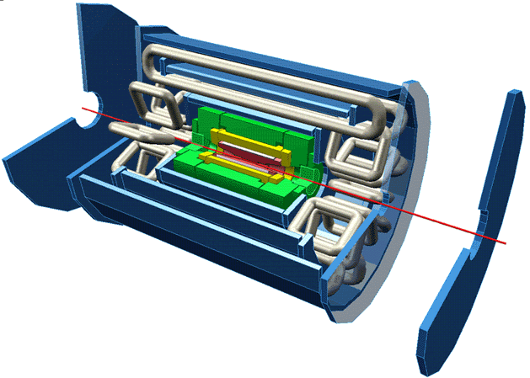

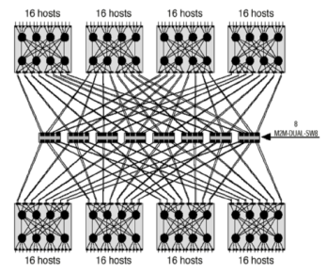
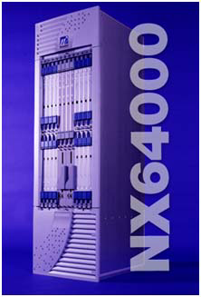
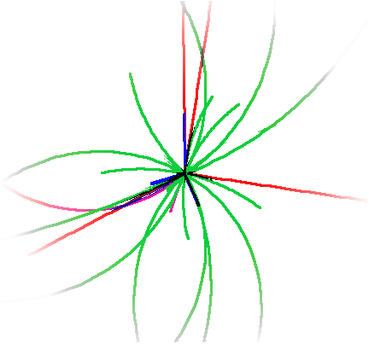
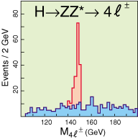
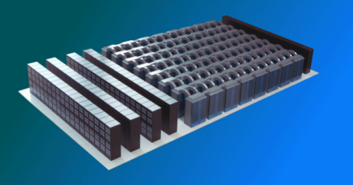
Scientific programme: The ingredients
Accelerator
Experiments
30
20
Measurements and selection
10
0
0
100
200
300
400
500
Data communication
Data processing
Notes:
38
At CERN we conduct our research activities by making use of the Accelerators for extremely complex experiments that detect and collect data that have been selectively triggered and transferred for the offline data analysis through fast communication channels.
The results of the research activities are published and they are highly appreciated by the HEP community and have brought significant progress and benefits to the society with many concrete applications that contributed significantly to increase the quality of life of people.

Slide 39
Applications of particle accelerators
CATEGORY OF ACCELERATORS | Number in use (2005)
High Energy acc. (E >1GeV) | ~ 120
Synchrotron radiation sources | > 100
Medical radioisotope production | ~ 200
Radiotherapy accelerators * | > 7500
Research acc. including biomedical research | ~ 1500
Acc. for industrial processing and research | ~ 1500
Ion implanters, surface modification | > 7000
Total | > 17500
* Linacs used in radiotherapy represent 40% of all running accelerators:
France, Germany, Italy: 4 units per million inhabitants
Switzerland: 11 units per million inhabitants
Finland: 14 units per million inhabitants
Notes:
39

Slide 40
Science to Health: Radiopharmaceuticals
Technology
Isotopes produced in reactors and accelerators
Advanced accelerator technologies developed in PP enable large scale production and secure supply
Health care
Medical isotopes instrumental for:
accurate diagnostics through medical imaging
cancer therapy
Business impact
Strong increase in demand expected. Market for diagnostic and therapeutic isotopes forecasted a 10% annual growth and should reach 4.5 Bn Euros in 2020.
Year: | 2005 | 2010 | 2015 | 2020
Diagnostic (M EUR) | 987 | 1589 | 2559 | 4121
Therapeutic (M EUR) | 89 | 143 | 230 | 372
Source: Frost & Sullivan
Notes:
40

Slide 41
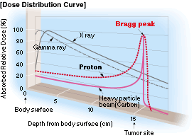
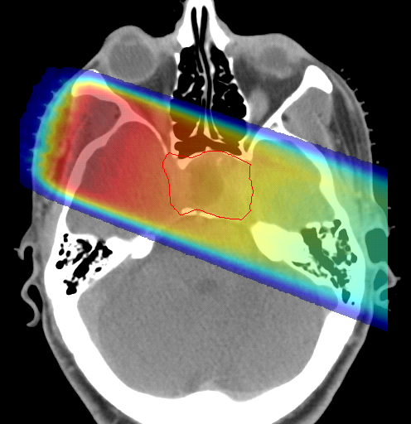
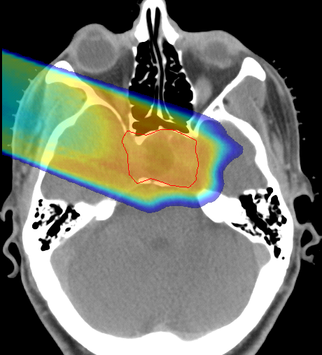

Hadron Therapy
Loma Linda(p)-US; PSI(p)- CH; Heidelberg, Pavia-CNAO (C), Lyon-Etoile (all C ions, p), Medastron (C)
200 MeV
protons
480 MeV
carbon ions
which control
radioresistant
tumours
(G. Kraft)
28 cm
tumour
target
charged hadron beam
that loses energy in matter
X rays
protons or
carbon ions
Photons
Protons
linac
Cobalt
tail
GSI

Slide 42
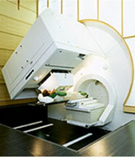
Science to Health: Hadron Therapy
Technology
Complex accelerator technology in combination with precise imaging systems developed for PP constitute the infrastructure for hadron therapy centers.
(ex. PIMMS Design Study (published in 2000))
Health care
Protons and ions have proved to be extremely efficient to treat deep seated tumors without damaging healthy tissue.
Effective also for radio resistive tumors
Impact
29 centers have treated 48 000 patients to date, many of them being PP centers (1)
5 dedicated hadron therapy facilities are being constructed. In 10 years up to 30 is forecasted (2). CERN is contributing to the construction of CNAO (Italy) and MedAustron (Austria) (Former members of the PIMMS study group).
Epidemiological data suggest one center per 10M inhabitants (3)
Construction costs for the infrastructure of such center is approximately 120 Million EUR. Annual running costs 15 Million EUR.
Sources: (1) Particle Therapy Co-Operative Group, (2) Siemens, (3) TERA
Notes:
42

Slide 43
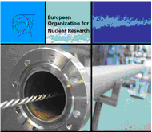

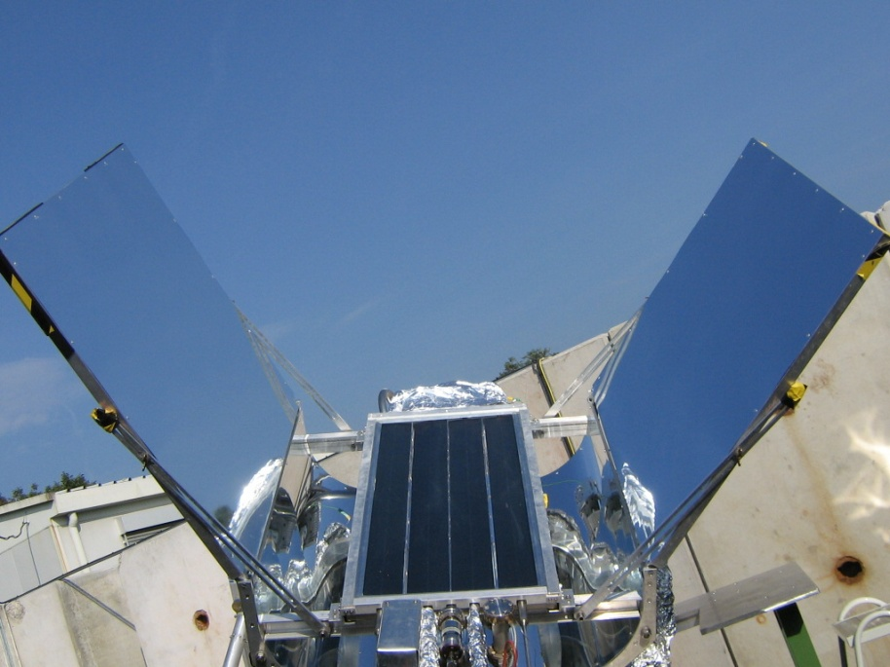
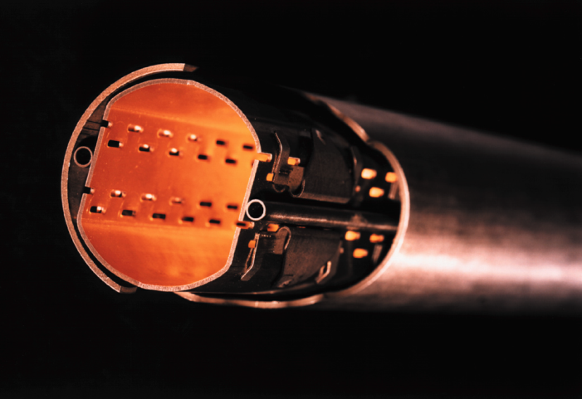

Application of NEG technology to Renewable Energy
High vacuum
for flat solar collectors
Achieve XUHV (10⁻¹³ Torr) in vacuum tubes
Heating & Cooling, Electricity, Agriculture, Desalination
The flat plate evacuated solar collector

Slide 44
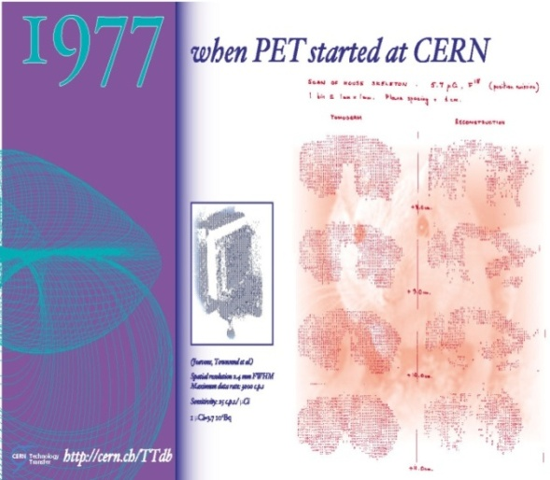
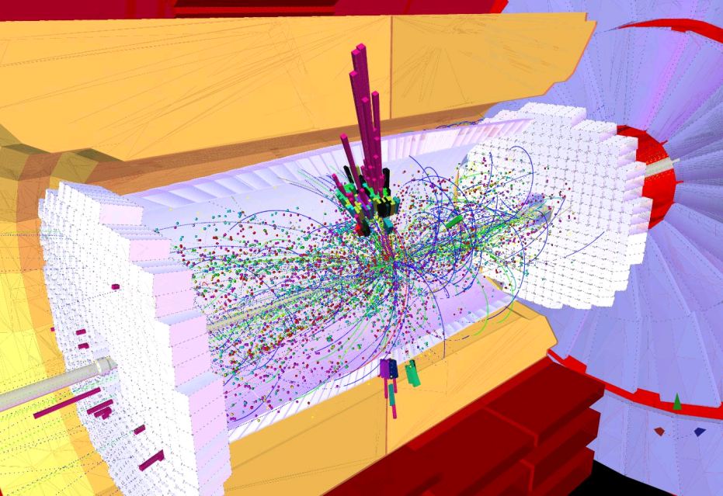
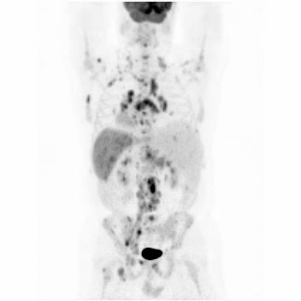
Science for society: Health
Brought the
idea of PET
Photon detection used for calorimetry
PET
today
CMS calorimeter

Slide 45
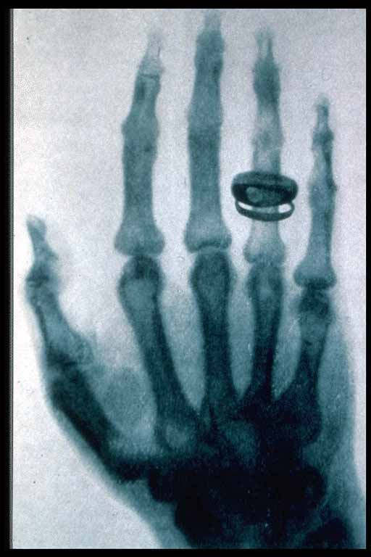
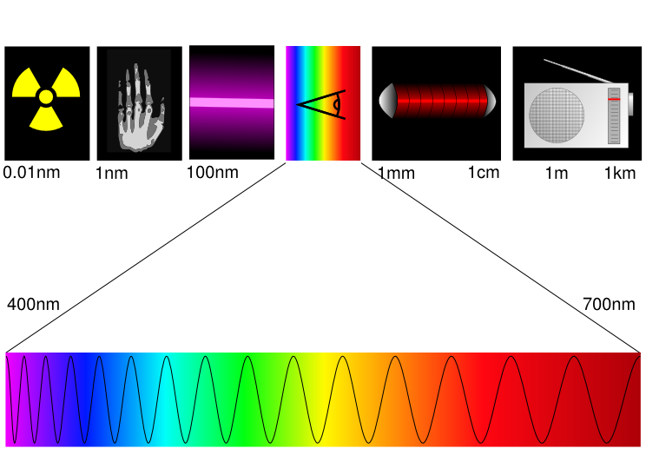
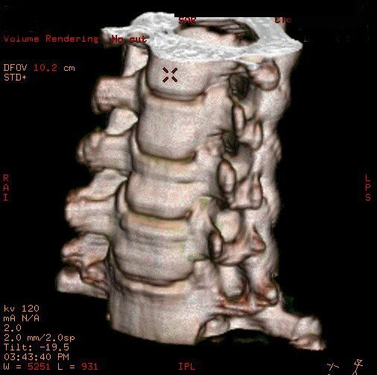
X Rays
Since 1895
30 – 100 kEV
Originally: Sensitive film Today: Computed tomography
Röntgen
Radiofréquence
Courtesy GE

Slide 46
Novel Particle detector electronics for health & industrial processes
A paradigm shift: current to counting mode
Current
Limited contrast
High dose
Restricted use for screening
Limited access to preventive health care market
Counting
High contrast
Colour mode possible
Lower dose (factor of 10)
Opportunity for screening
Access to preventive health care
Courtesy GE
Courtesy Rabin Medical Center, Israel
Computed tomography (CT)
Low-cost, high-reliability, high-speed, true-colour / higher-quality imaging and less patient radiation exposure
Industrial process: Digital X-Ray camera
Notes:
46

Slide 47
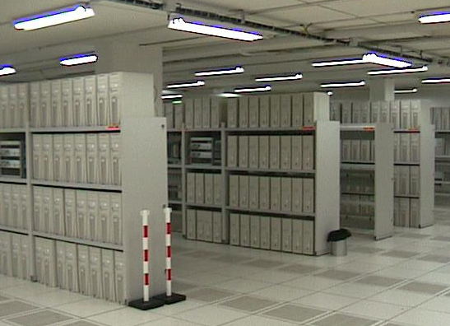
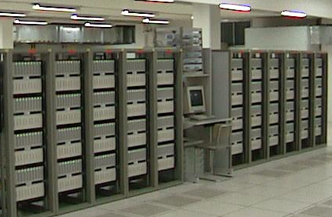

Science for society: ICT*
Scientists deployed the Internet Infrastructure
CERN invented the World Wide Web
Scientists are developing the Grid computing
Web infrastructure
Internet infrastructure
World wide distributed computing
* Information & Communication Technology
Notes:
47

Slide 48
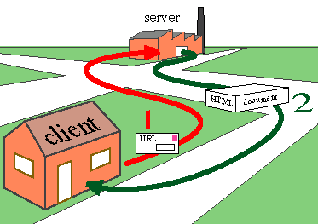



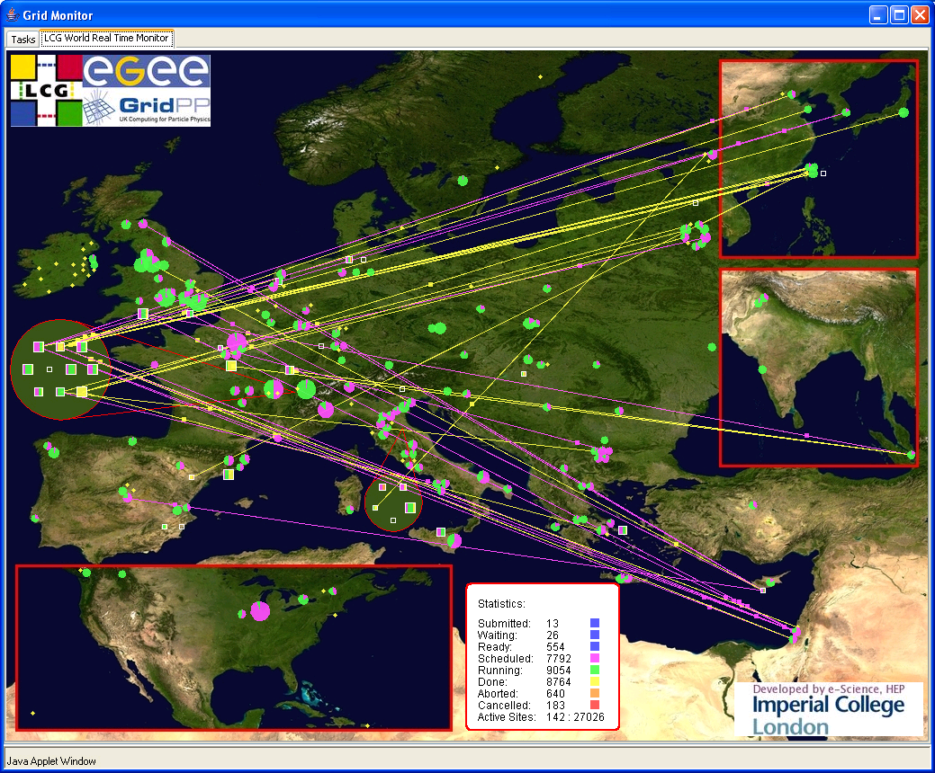
Science for society: ICT
Brought to
the general
public
GRID for distributed computing
Global Web-based
Economy

Slide 49
Science to e-Society: WWW
Physicists needed to share computer-stored information to answer tough questions about the Universe and to network within the R&D community
1989 - Sir Tim Berners - Lee created an information management system using hypertext to share data, documentation and news to help the Physicists community
World Wide Web
Web pages in the publicly indexable web ⁽¹⁾ | 11.5 billion
Number of World Internet Users ⁽²⁾ | 1.04 billion
New hostnames/month - 1st quarter 2006 (average) ⁽³⁾ | 2.75 million
Total hostnames from Jan.1994 – Jan.2006 ⁽⁴⁾ | 450 million
Domains currently registered on the Internet (.Com/.Net/.Org) ⁽⁵⁾ | 76.10 million
- As of Jan.2005, Wikipedia, September 7, 2006 - World Internet Usage and World Population Statistics, June 30, 2006 - NetCraft (http://news.netcraft.com/), September 12, 2006 - Internet System Consortium (ICS), September 7, 2006 - Domaintools (http://domaintools.com/internetstatistics), September 12, 2006
E-business related revenue expected to reach $ 3 trillion by 2006, protecting the flow of credit cards, financial transactions, and all forms of commerce across the Internet;
E-business spending $ billion. Hosting Service $ 12.5 billion.
Products $ 11.7 billion. US spending $ 24.2 billion.
Notes:
49

Slide 50
Conclusions
Basic research has a strong impact on technology developments and innovation
Technology developed for science have major repercussions on the global community
Technology developed for science is a source for Industry that leads to important business prospects
Fundamental science accelerates the industrial process and improves daily life
Many issues, including funding and IP complexity are limiting the impact of public research to industry and society
TT Contact: +41 22 767 84 44, Technology.Transfer@cern.ch
http://technologytransfer.web.cern.ch/TechnologyTransfer/
Notes:
50

