Slide 1
Practical information
NSE Technology screening week – November 3, 2008
Henning Huuse, PPM

Slide 2


Outline
  Schedule for the week
  Project rooms/navigate at CERN
  Resources
  NDA

Slide 3
  Schedule for the week
Online at Indico:
http://indico.cern.ch/conferenceTimeTable.py?confId=44317

Slide 4
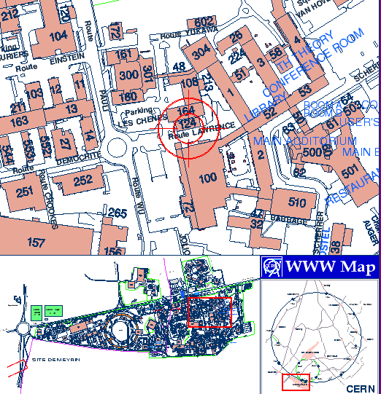
Rooms – Navigate at CERN
Rooms: Naming convention:
    “Building-Floor-Room “
    Example: 602-R-021
    R: Ground floor
    S: Basement
    S2: 2nd level below ground floor
How to find a building:
http://building.web.cern.ch/building/

Slide 5
Rooms – Offices and meeting rooms
Groups | Technology | Room
Group 1 | PTC | 4-3-016
Group 2 | GRID | 4-3-034
Group 3 | CDS | 51-R-019
Group 4 | QD | 104-R-B09
Group 5 | NEG | 5-3-012
Plenary sessions: Council Chamber, 503-1-001
Supervisors office: Room C, close to council chamber, 61-1-007
Afternoon meetings: 602-R-021
TT Office: 33-S-001
Henning Huuse: 33-S-010, Phone: 76971
Bjørnulf Lande: 33-S-022, Phone: 71253

Slide 6
Resources
Registration of PC – web access:
http://it-div.web.cern.ch/it-div/gencomputing/VisitorPortables.asp
Printing:
https://winservices.web.cern.ch/winservices/Help/?kbid=070107
Telephone:
Phone in each office and meeting room. Direct line should have been installed. Type “0” to get external line.
CERN phone book: http://user.web.cern.ch/user/Welcome.asp
CERN Scientific Library, CDS
http://library.cern.ch/

Slide 7
Non-Disclosure Agreement (NDA)
Why?
    Privileged access to information
    Everybody at CERN are under confidentiality – free flow of information
    Information provided may be confidential
    ”Additional” information received from inventors may not be protected
    To be signed individually

