Slide 1
Patenting @ CERN – Why, when and how
NSE Technology screening week – November 03, 2008
Henning Huuse, Patent Portfolio Manager

Slide 2

Index
CERN Patent Portfolio overview
Why and when CERN takes patents
How patents are handled at CERN

Slide 3
Portfolio overview – Patent family
Application process:
PCT
EP
DE
UK
International
Regional
National
FR
NL
….
Grant patents
Application procedure
Application procedure
CN
JP
US
Grant “European Patent”
International Search Report

Slide 4
Patent Portfolio overview
Key portfolio data as of October 2008:
    First patent taken (NEG) : 19.06.1996
    Number of families where CERN is applicant: 35
    Total number of patents or applications: 229
    Number of new filings in 2008: 2 (4)
Patent expenditure 2007: 545 kCHF
Notes:
The oldest patent in the portfolio is the NEG.
Patenting was mentioned in the constitution and that in particular event patents may be taken upon approval from the DG.
New patents: Dosepix 2, Pulse tube cryo cooler, Readout for PET/CT, Quantum dosimeter,
How many patents are licensed? Rough count:
Active Licenses: 12
Expired licenses: 2
Cross licenses: 6

Slide 5
Patent Portfolio overview
Key portfolio data as of May 2008:
    Number of families jointly owned with industry: 3
    Number of families jointly owned with institutes: 5
    Number of families jointly owned with inst. & Ind.: 2
    Number of families managed by CERN: 28
“CERN Patent”- Applicant is CERN, inventors are CERN scientists
Notes:
Mention that CERN is the applicant, CERN Scientist are the inventors.
Income from TT activities 2007:
Commercialization of CERN IP: 1548 kCHF
TT R&D projects: 1173 kCHF
Total: 2721 kCHF

Slide 6
Index
CERN Patent Portfolio overview
Why and when CERN takes patents
How patents are handled at CERN

Slide 7
Why CERN takes patents
Benefits of the patent system
  Well defined IP – makes innovative results more tangible
  Recognition of ownership:
    Strong publication, examined for inventiveness and novelty with recognized ownership
    Easier to trace the origin of the invention
  Gives the right to prevent others from using your invention – in other words: gives the owner a mean to control exploitation of the invention

Slide 8
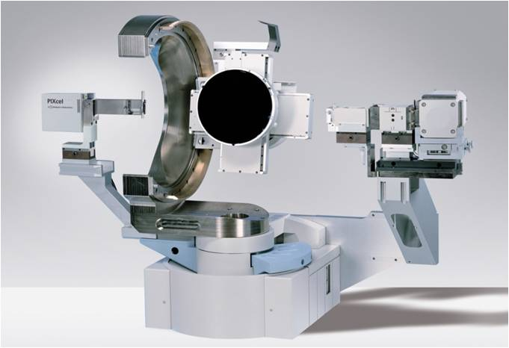
Why CERN takes patents
Strategic motivation:
  “Promote and enhance the image of the Organization as a source of innovation and economic activities”
  Increase attractiveness for industry
Does this conflict the obligation and long tradition of publishing at CERN?
Notes:
Taking patents is also a way to proactively identify commercial potential at CERN. Management of the patents require active follow up of the inventions by TT.
Revenue is the primary indicator for successful dissemination. Not the goal in itself. For TT revenue is secondary. For patents revenue is expected.

Slide 9
Why CERN takes patents
A patent application is considered when it is believed that:
- a patent will increase the probability of having the technology transferred
- a patent will significantly enhance the commercial value of the technology
- a patent is needed to ensure CERN’s recognition as the originator of an exceptional invention
and/or
and/or
Notes:
Patent makes it easier to transfer. In many occasions it enables TT. Exclusivity required to cover investments.
Industry ready to pay more for a license when there is a patent. The IP is better identified, ownership clearly defined, and it is possible to enforce patent rights. Valid for both exclusive an non-exclusive licenses.
For particularly interesting technologies with no apparent commercial potential, or very long way to market, CERN may want to take a patent to recognize the ownership. Licenses are not intended.
Examples:
NEG, Medipix
Solar panel
Klystron amplifier. Very important for CLIC.

Slide 10
When does CERN take patents
Scenario 1 – Invention made at CERN
Flowchart
Invention is disclosed to the TT group
Commercial potential and patentability is assessed
If patentability is confirmed, the value of patent protection is assessed.
A patent will be filed if
  Protection will facilitate transfer; exclusivity needed
  It will increase the value of the invention
  It is important to ensure CERN’s recognition
A patent will not be filed if
  The invention is obviously not patentable
  The invention has limited commercial value
  Alternative protection is preferred
Invention disclosed
Assessment of commercial potential
Assessment of the need for protection
File patent application
No patent application
Decisive element: Assessment of Commercial Potential
Notes:
Key issue is the assessment of commercial potential
Alternative protection may be the masks to produce wafers, etc. Copyright and secrecy.

Slide 11
When does CERN take patents
Scenario 2 – Industrial partnership
Flowchart
Inventions are developed jointly by CERN and a company under a partnership agreement
A patent may be filed to protect the industrial partner and its investments
Ownership may be shared or separate
Exclusivity for the company in its market
Alternative to patenting may be other forms of protection, such as secrecy
Jointly developed
invention
Assessment of the need for protection
File patent application in both names
No patent application, alternative protection
Decisive element: Assessment of the need for protection
Notes:
Key issue is the assessment of the role and value of a patent.

Slide 12
Index
CERN Patent Portfolio overview
Why and when CERN takes patents
How patents are handled at CERN

Slide 13
How does CERN handle patents
Inventors
CERN TT Group
External patent attorneys
Invention disclosure
Technology assessment
Patentability assessment
Prepare patent application
Review of application
File application (PCT, EP, N)
Patent management
Represents CERN as applicant
Review, approve amendments

Slide 14
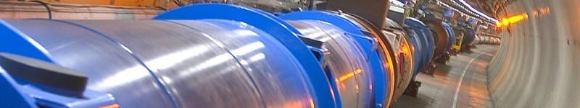
Summary:
  CERN has taken patents since 1996 and are currently holding 33 families
  A patent makes an invention more tangible, defines ownership, and is considered as a strong publication
  A patent may enhance the commercial value of an invention, increase the probability of dissemination, and is often a prerequisite for an investor.
  CERN takes patents to enable dissemination, generate revenue, and gain recognition.
  If you invent something, contact the TT group before you publish the results
Patent first, publish after!

Slide 15
Thank you for your attention!
Henning.Huuse@cern.ch

