Slide 1
WLCG Report
Ian Bird
LHCC Referees meeting
CERN; 22nd September 2015

Slide 2
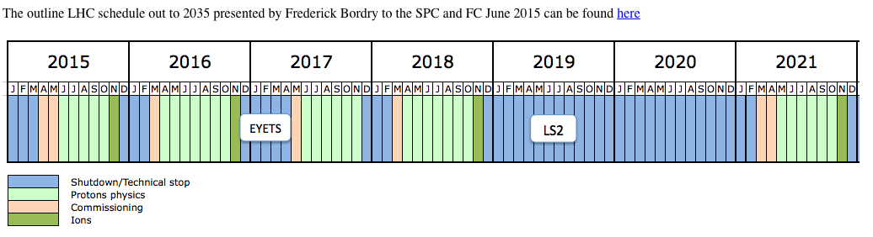
LHC Running conditions
LHC estimates of live time for 2017 reduced wrt previous
  ➔ 5 M secs live time for pp in 2016 and 2017
  Has changed resource estimates
Less data in 2015, LHCb reduced 2016 requirements
Likely to reflect in updated pledges

Slide 3
Current state of 2016 pledges
Based on April RRB approved requests, and pledges as updated in preparation for October RRB (still some updates missing, biggest missing is Russia)
  May change following RRB

Slide 4
Status of Tier-0 Resources (1)
Pledge fulfilment
  Disk and tape provided early in 2015 as pledged
  CPU slightly late (firmware issue), provided as pledged in July
General concerns:
  Capacity provided as virtual machines in CERN private cloud; currently performance hit of ~10%
    Already compensated for regarding installed capacity
    On-going work on further optimisations (~5% or less)
  With settings deployed on part of capacity, worker nodes can get into state of very slow processing
    Initially reported by LHCb
    Reason found, will be fixed with on-going optimisations

Slide 5
Status of Tier-0 Resources (2)
ALICE concerns
  Same class of jobs 15…20% less efficient (CPU/wall) than elsewhere – under investigation
  Sporadic high I/O wait of worker nodes – under investigation
ATLAS concerns
  Rocky start of dedicated LSF Tier-0 instance; okay as of mid-July
  Changed ATLAS Tier-0 workflow means that worker nodes can only be used ~50% sometimes
CMS concerns
  Slow Tier-0 nodes due to memory over-commitment: in process of being resolved
For 2016 we will increase installed capacity (~10%) above pledges to compensate
  Also planning to test deploying containers or “bare-metal” where performance should not be penalised
NB: the use of openstack helps to manage the much larger Tier 0
  Size has doubled wrt 2012, and significant increase again for 2016

Slide 6
VM performance
Non-uniform memory architectures in modern CPUs
Problem arises if hypervisor allocates virtual cpu cycles on different physical cores
Effect is worse for larger VM’s
Pinning and tuning can reduce effect to few %

Slide 7
Upgraded connectivity P5 → Tier 0
10 Gb/s connection was limiting CMS ability for Run 2 and in being able to make full use of HLT
Now upgraded to 100 Gb/s – data rates of 800 MB/s achieved

Slide 8
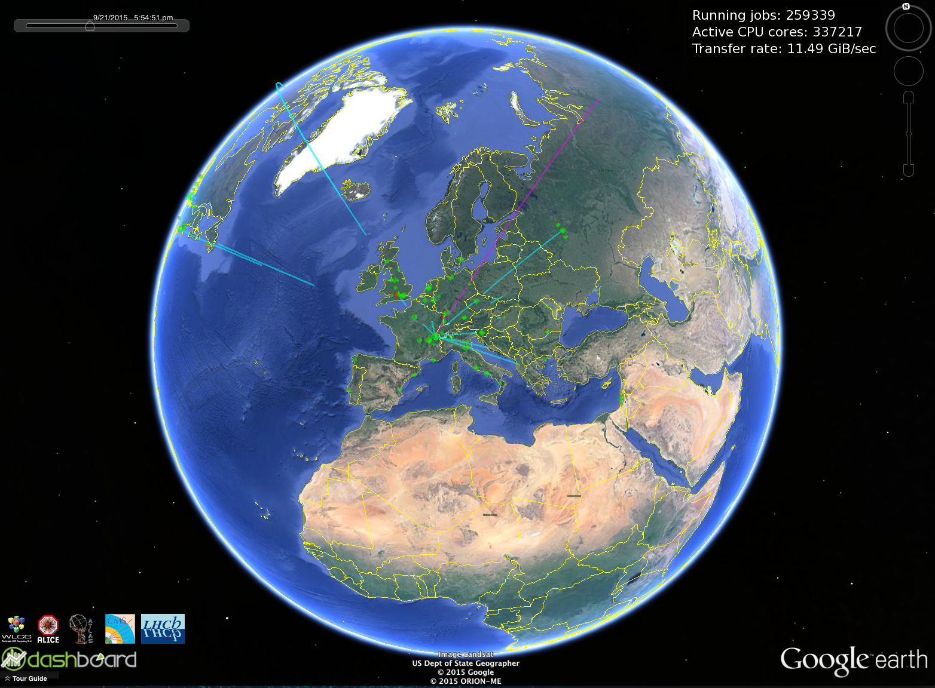
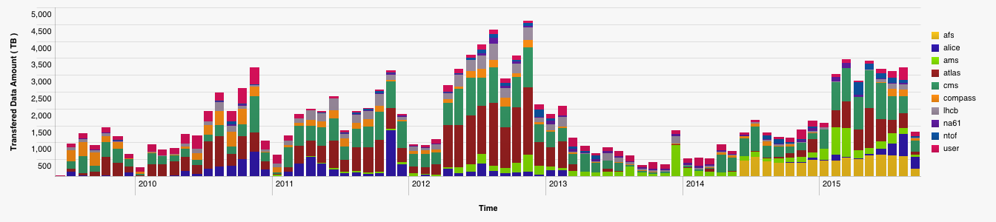
WLCG fully operational with Run 2 data
Multi-core jobs
WLCG sites were prepared for Run 2
Some delays in deploying new resources, but all were in place for 1st collisions
Major procurement exercise has essentially doubled existing installations
  that took significant effort and time
Data written to tape at Tier 0
2015

Slide 9
Longer term planning
Putting in place a “WLCG Technical Forum” to explore possible computing models for the Hl-LHC era
  Initial action will be to document some outline ideas for investigation
  WLCG workshop in Feb 2016 is an opportunity for further input on this
  In parallel look at a number of evolutionary topics
Must be done in parallel with ramping up effort on software improvements (HSF)

Slide 10
Science Cloud
PCP project has been approved and will start in January 2016
  Derogation of CERN procurement rules to allow compliance with EC procurement (EC member states) agreed by CERN Council last week
  ➔ see next few slides
Independent of the PCP project, CERN is doing 2 procurements to understand market prices and usage models:
  200 KCHF for compute (essentially simulation)
  400 KCHF for data intensive use cases (needs market survey)
  To be procured as extensions of the CERN cloud
  Eventual use cases – investigate alternatives to “Wigner-style” extensions for next round; dynamic expansion of CERN resources
  This capacity is in addition to pledges

Slide 11
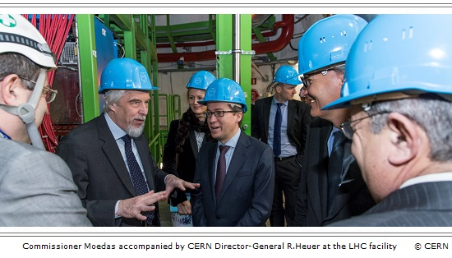


Open Science Cloud and the EC
Questions posed by RJ Smits during visit to CERN
with Commissioner Moedas in January 2015:
Commissioner Moedas announced in June 2015:
“The Commission will launch a European Cloud initiative including cloud services certification, contracts, switching of cloud services providers and a research open science cloud.”
The draft H2020 Work Programme 2016 – 2017 (annex 4) includes funding call INFRADEV-04-2016 European Open Science Cloud for Research (10M€)
CERN produced a paper Towards the European Open Science Cloud that answered these questions http://dx.doi.org/10.5281/zenodo.16140

Slide 12










HNSciCloud H2020 PCP Project
The group of buyers have committed
~1.6M€ of funds
(generating ~6M€ total funds)
Manpower
Applications & Data
In-house IT resources
To procure innovative IaaS cloud services integrated into a hybrid cloud model
Commercial cloud services
European e-Infrastructures
In-house IT resources
Procured services will be made available to end-users from many research communities
Notes:
Research organisations from 7 countries have proposed to work together to develop a cross-border joint procurement of innovative cloud services. This is an important change: never before have research organisations across Europe pooled their funds and resources to procure cloud services to support their scientific programmes.
eduGAIN federated identity mgmt. should include commercial identity providers taking into account multiple levels of assurance.

