Slide 1
ILC08
Project tools and Cost/Schedule WG
Extract from CLIC cost and schedule status
H. Braun, G. Riddone: 19.11.2008
Extract from summary of the WG ILC08
P. Garbincious: 20.11.2008

Slide 2

Cost tool
Updated version of specification including schedule information [EDMS#975066]
Updated version of DB Entry template
  Schedule information
  Two energy configurations (500 GeV and 3 TeV)
Development of tool at CERN using Excel DBE, oracle database and web interface similar to existing CERN management tools (M. Draper, J. De Jonghe)
  first prototype ready by 2Q 2009
  final version by end of 2009

Slide 3
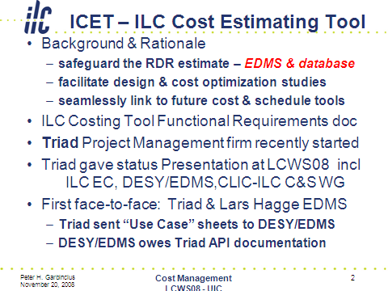

Slide 4
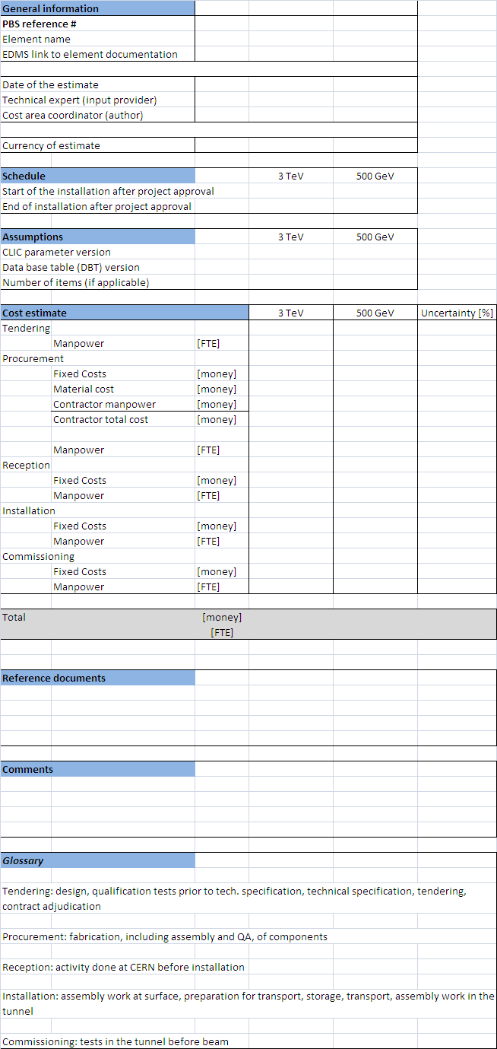
Template 1/2

Slide 5
Template 2/2

Slide 6
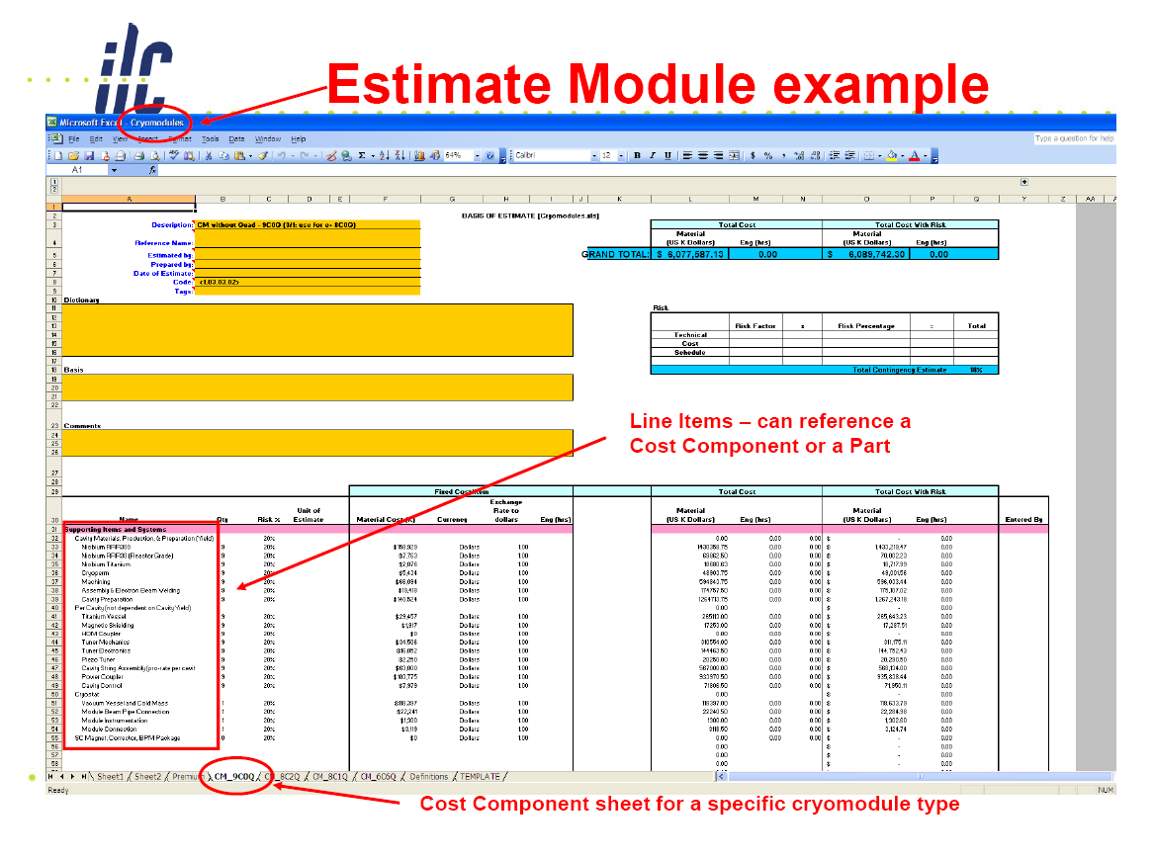

Slide 7
Definition of roles
Role of the coordinator (PBS, levels 2 and 3)
  Gather technical specifications, total numbers, delivery schedule
  Cost estimate from experts based on cost template
  Provide preliminary levels 2 and 3 estimates (even when level 4 is not available)
  Filling template for level 4 estimate based on input from experts
  Archive the system filled templates in EDMS
Role of experts
  Provide cost estimate input for the related system (PBS level 4)
Role of accountant, M. Draper
  Put all the numbers together

Slide 8
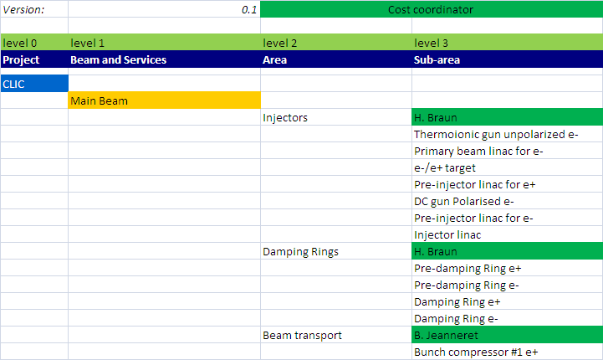
PBS levels 2 and 3 cost coordinators

Slide 9
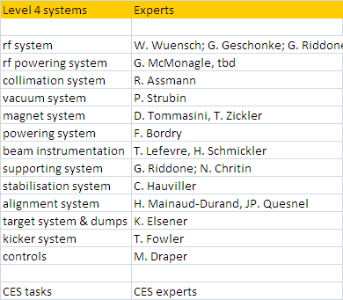
PBS level 4 experts

Slide 10

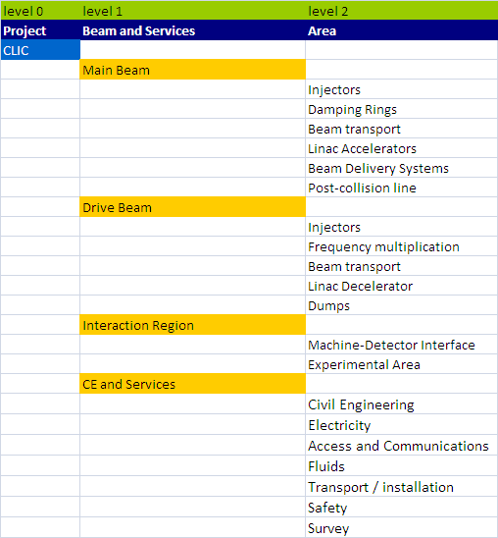
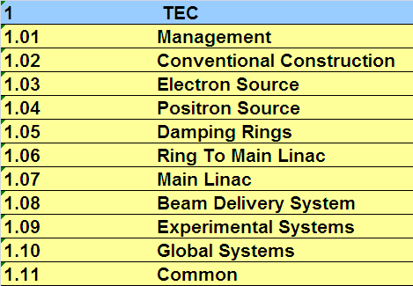
PBS comparison
CLIC
ILC

Slide 11
CLIC Future work
Schedule for PBS level 2 areas (K. Foraz)
Preparation of templates (coordinators)
  Schedule information
  Number of units
Filling of template (coordinators) with input from experts (archive in CERN EDMS structure)
Selected area estimate (e.g. module) to be ready by Jan 09
Full cost estimate to be ready by end of 09
Tool development in 2009 (prototype by 2Q 09, final version by end of 09)

Slide 12
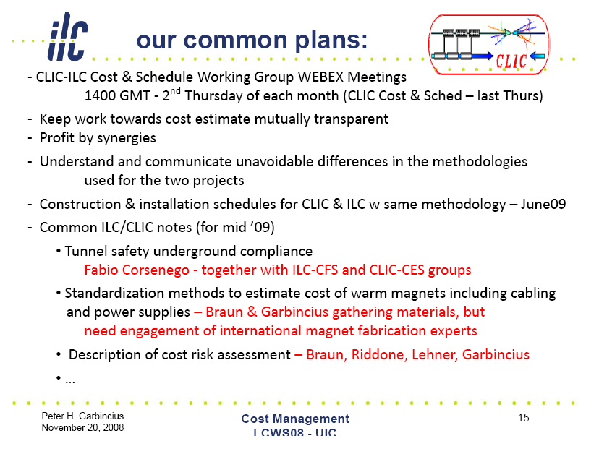
ILC-CLIC cost & schedule WG

