Slide 1
CLIC cooling and ventilation requirements
G. Riddone
2008.11.25

Slide 2
Introduction
Power requirement calculated for 3 TeV, extrapolated for 0.5 TeV
Calculated power dissipation based on input from several groups (last update for tunnel components Feb 2008)
  Power requirement comparison
  Identification of high contributions
Next step ➔ see conclusions

Slide 3
Cooling/ventilation system
Present baseline for tunnel (CESWG and CMWG)
Water - CIRCUIT A : MODULES COOLING - Demineralised water - Accelerating structure, Loads, PETS, Quadrupoles
Water - CIRCUIT B : GENERAL COOLING - Demineralised water - transfer lines, UTRA, UTRC, Vacuum, Beam Dump
Ventilation : GENERAL VENTILATION – AIR 22 C

Slide 4
Circuit A - Module cooling layout
Uniform duct over a full length of a linac
Unique inlet/outlet point close to IP
(§CES WG)
All modules cooled in parallel
ACS and loads cooled in series
ACS, PETS, MB Q and DN Q cooled
in parallel
IN
M
M
M
M
M
IP
M
M
M
M
M
OUT
Linac e+
Linac e-

Slide 5
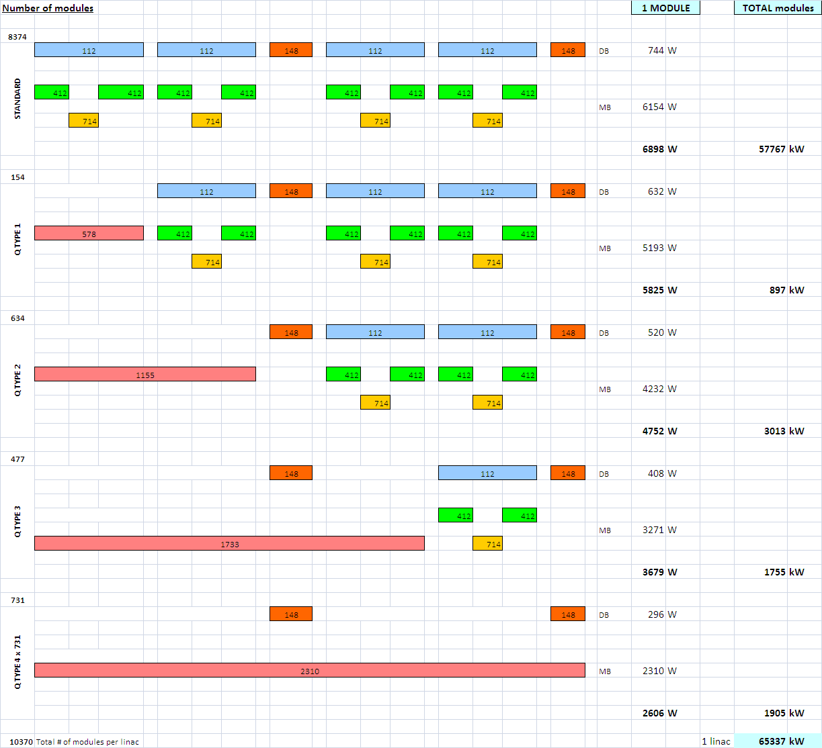
Power cooled by water - circuit A (module)
EDMS# 964715 - 964717

Slide 6
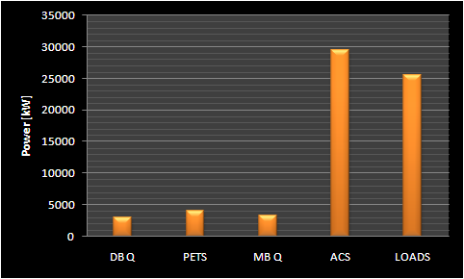
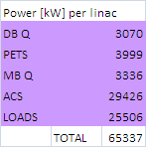
Circuit A – Power contributions
Total dissipated power
65.3 MW x 2 = 130.6 MW (2 linacs)
Tin = 25 +/- 0.1 ˚C (ref. EDMS 925173, EDMS 964549)
Tout = 43-45 ˚C
Standard module = ΔT for ACS => 10 K
(ref. EDMS 901290, rf str. meeting 16.06.2008)

Slide 7
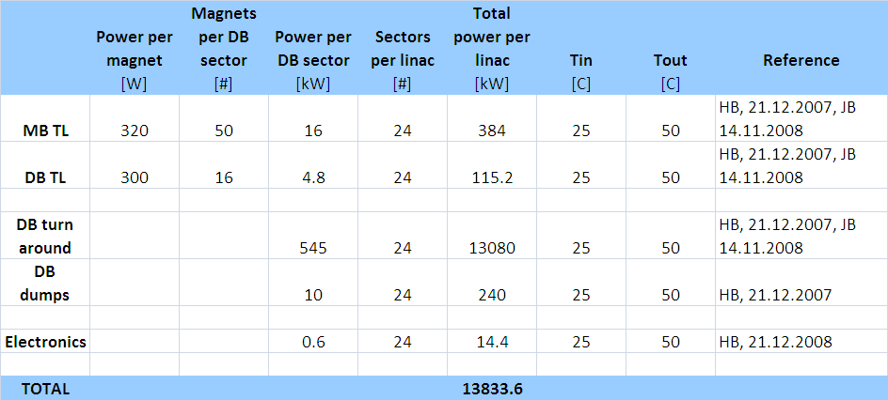
Power cooled by water - Circuit B

Slide 8
Volumetric mass-flow and pipe diameters
 | Circuit A |  | Circuit B
 | 27.02.2008 | 14.11.2008 | 27.02.2008 | 14.11.2008
Volumetric flow [m3/h] | 3215 | 3100 | 470 | 470
Flow speed [m/s] | 3.2 |  | 3
Pipe diameter [m] | 0.6 | 0.58 | 0.25 | 0.25
DeltaT | 20 (each module in parallel) |  | 25
Power [kW] | 70172 | 65300 | 13620 | 13833

Slide 9
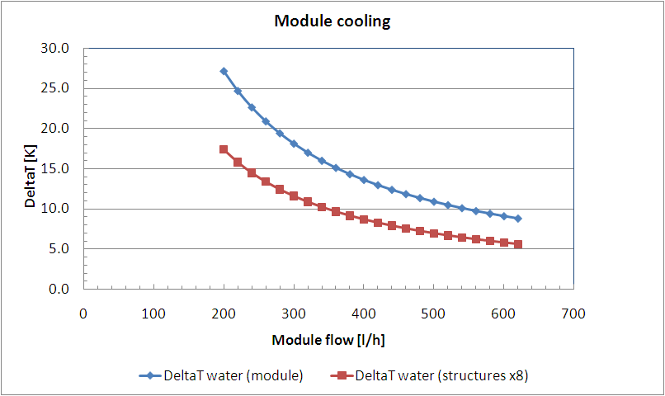
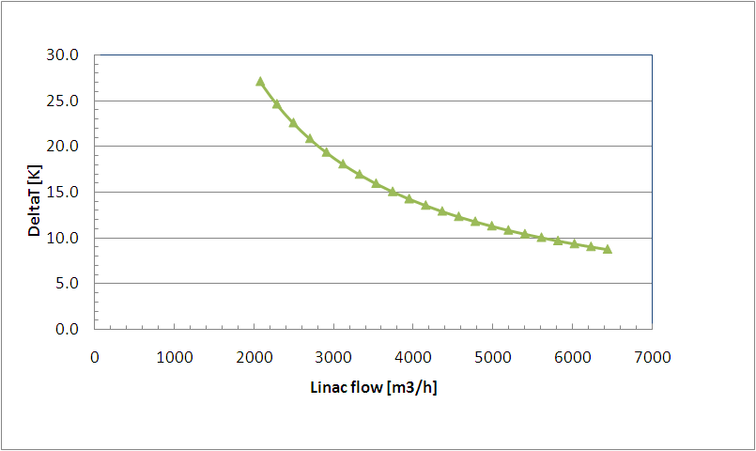
Module cooling
Present working point
Present working point

Slide 10
J. Osborne, CLIC08

Slide 11
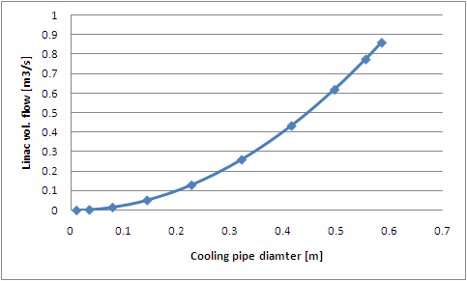
Module cooling
Present working point
DeltaT = 20 C
V = 3.2 m/s

Slide 12
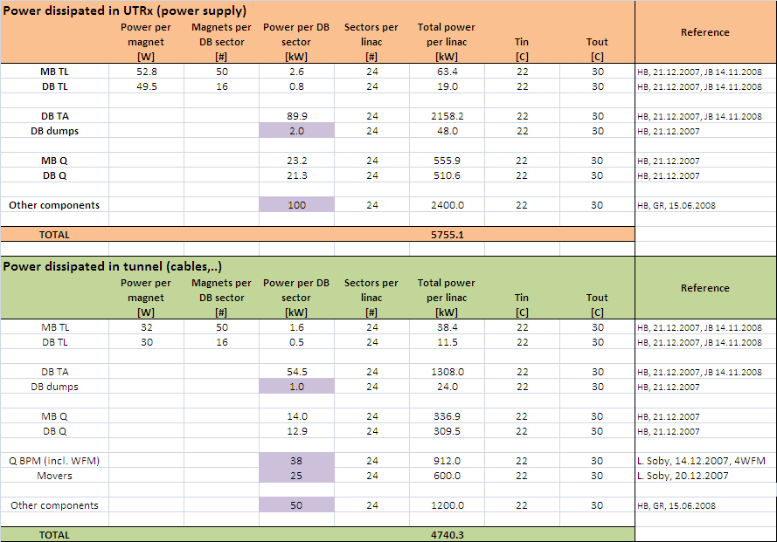
Power cooled by air

Slide 13
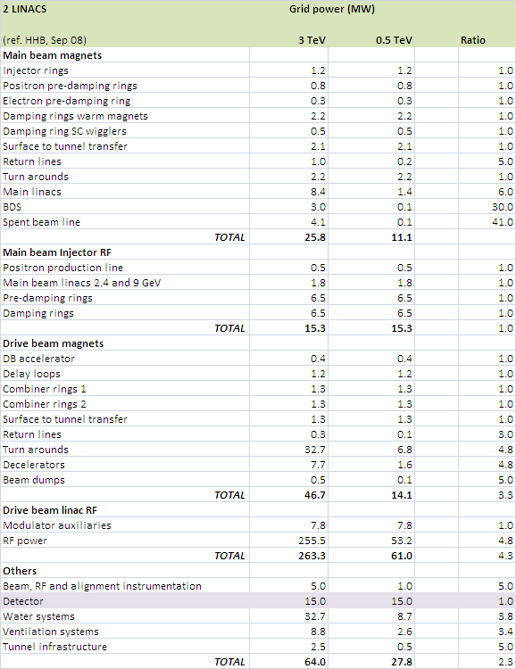
CLIC electrical power

Slide 14
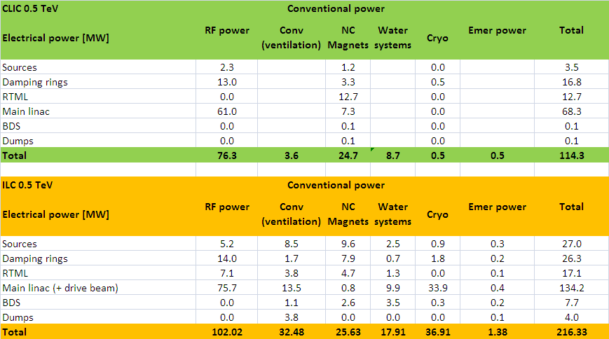
Electrical power comparison

Slide 15
Conclusions
Identification of inconsistencies and re-contact people to confirm values
Values for power to air in the tunnel are too high by at least a factor 2
Study alternative linac cooling process
Study alternative module cooling methods
Study alternative tunnel integration

