Slide 1


Martin Benjamin
The Particles of Language:
"The Dictionary" as elemental data for 7000 languages across time and space
21 May, 2015 – CERN, Geneva

Slide 2
kamusi is Swahili for dictionary

Slide 3
Goal: A complete matrix of human expression across time and space
As a knowledge resource
As a data resource

Slide 4
In service since 1994 (originally at Yale Council on African Studies)
International NGO since 2009
Registered non-profit in USA and Switzerland
Academic Home since 2013:
EPFL - Swiss Federal Institute of Technology in Lausanne
LSIR - Distributed Systems Information Laboratory

Slide 5

White House Big Data Initiative:
Launch Partner for Building the Data Innovation Ecosystem Networking and Information Technology R&D Program
Office of Science and Technology Policy

Slide 6

What is the overlap between and ?
Big goals, small particles
Big collaboration
  7000 languages
  “Human Languages Project”
Pure science – data for knowledge
Practical science – data for use
High energy particle detectors

Slide 7
Problems for Lexicography
What are Concepts?
What are Words?
How to explain an idea in its own language
How to express an idea across languages
How to account for variation
A set of letters?
A set of sounds?
A “canonical” form?
A single entity?

Slide 8
Problems for Lexicography
What are Concepts?
What are Words?
How to explain an idea in its own language
How to express an idea across languages
How to account for variation
A set of letters?
A set of sounds?
A “canonical” form?
A single entity?

Slide 9
Problems for Lexicography
What are Concepts?
What are Words?
How to explain an idea in its own language
How to express an idea across languages
How to account for variation
A set of letters?
A set of sounds?
A “canonical” form?
A single entity?

Slide 10
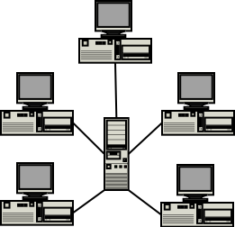
Problems for Lexicography
What are Concepts?
What are Words?
How to explain an idea in its own language
How to express an idea across languages
How to account for variation
A set of letters?
A set of sounds?
A “canonical” form?
A single entity?
C-L-I-E-N-T

Slide 11
Problems for Lexicography
What are Concepts?
What are Words?
How to explain an idea in its own language
How to express an idea across languages
How to account for variation
A set of letters?
A set of sounds?
A “canonical” form?
A single entity?
whined wind wined

Slide 12
Problems for Lexicography
What are Concepts?
What are Words?
SEE
sees
saw
seen
seeing
Kinyarwanda
900 million forms for every verb
How to explain an idea in its own language
How to express an idea across languages
How to account for variation
A set of letters?
A set of sounds?
A “canonical” form?
A single entity?

Slide 13
Problems for Lexicography
What are Concepts?
What are Words?
How to explain an idea in its own language
How to express an idea across languages
How to account for variation
A set of letters?
A set of sounds?
A “canonical” form?
A single entity?
African fish eagle
drive up the wall

Slide 14
light

Slide 15



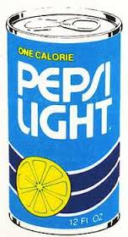
light
why multilingual dictionaries were impossible

Slide 16
lumineux
light
léger
léger
allégé
why multilingual dictionaries were impossible

Slide 17
PWN (English Wordnet):
light x 47
WOLF (French Wordnet):
light = lumière x 44
light = léger x 37
WOLF 00269989-a:
lumière
lumineux
clair
lumineux
light
léger
léger
WOLF 02121424-a:
léger
lumière
WOLF 01186408-a:
léger
allégé
WOLF 00993117-a:
léger
allégé
lumière
light
why multilingual dictionaries were impossible

Slide 18

lumineux
light
léger
léger
allégé
why multilingual dictionaries were impossible

Slide 19
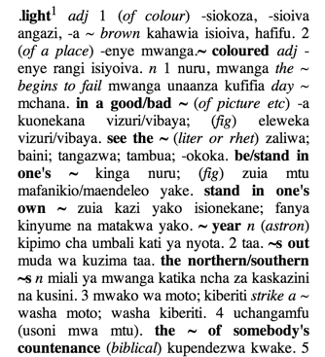
why multilingual dictionaries were impossible

Slide 20
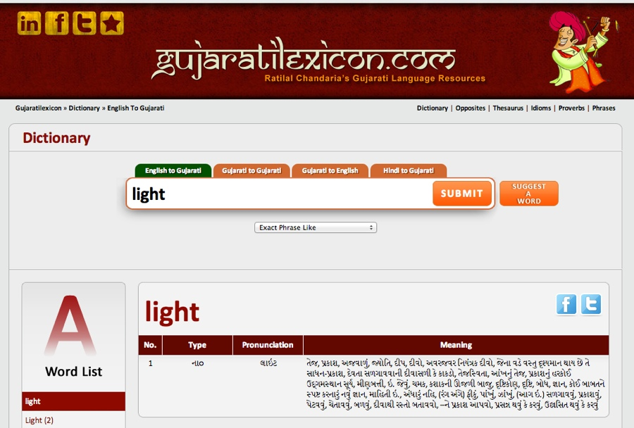
lumineux
why multilingual dictionaries were impossible

Slide 21
sw: -enye mwanga
fi: valoisa
fr: lumineux
th: สว่าง
fr: léger
fr: léger
sw: -epesi
sw: -a kuchekesha
light
fi: kevyt
fi: tyhjänpäiväinen
th: เบา
th: ซึ่งไร้สาระ
th: ที่แคลอรี่ต่ำ
fr: allégé
sw: pungufu
fi: kaloriton
why multilingual dictionaries were impossible

Slide 22
sw: -enye mwanga
fi: valoisa
fr: lumineux
th: สว่าง
en: light
fr: léger
fr: léger
sw: -epesi
sw: -a kuchekesha
en: light
en: light
fi: kevyt
fi: tyhjänpäiväinen
th: เบา
th: ซึ่งไร้สาระ
en: light
th: ที่แคลอรี่ต่ำ
fr: allégé
sw: pungufu
fi: kaloriton
why multilingual dictionaries were impossible

Slide 23
sw: -enye mwanga
fi: valoisa
fr: lumineux
th: สว่าง
fr: léger
fr: léger
sw: -epesi
sw: -a kuchekesha
light
fi: kevyt
fi: tyhjänpäiväinen
th: เบา
th: ซึ่งไร้สาระ
th: ที่แคลอรี่ต่ำ
fr: allégé
sw: pungufu
fi: kaloriton
why multilingual dictionaries were impossible

Slide 24
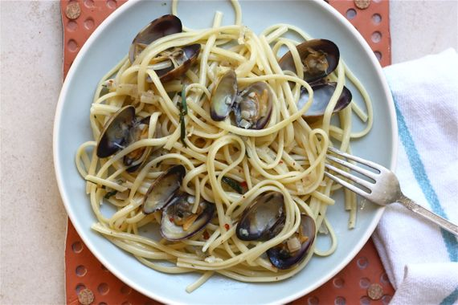
why multilingual dictionaries were impossible

Slide 25
light
how Kamusi makes a multilingual dictionary possible

Slide 26
light (not dark)
light (not heavy)
light (not serious)
light (not fattening)
how Kamusi makes a multilingual dictionary possible

Slide 27
light (not dark)
fr: lumineux
light (not heavy)
fr: léger
light (not serious)
fr: léger
light (not fattening)
fr: allégé
how Kamusi makes a multilingual dictionary possible

Slide 28
light (not dark)
fr: lumineux
sw: -enye mwanga
fi: valoisa
th: สว่าง
light (not heavy)
light (not serious)
light (not fattening)
how Kamusi makes a multilingual dictionary possible

Slide 29
light (not dark)
light (not heavy)
fr: léger
sw: -epesi
fi: kevyt
th: เบา
light (not serious)
light (not fattening)
how Kamusi makes a multilingual dictionary possible

Slide 30
light (not dark)
light (not heavy)
light (not serious)
fr: léger
sw: -a kuchekesha
fi: tyhjänpäiväinen
th: ซึ่งไร้สาระ
light (not fattening)
how Kamusi makes a multilingual dictionary possible

Slide 31
light (not dark)
light (not heavy)
light (not serious)
light (not fattening)
fr: allégé
sw: pungufu
fi: kaloriton
th: ที่แคลอรี่ต่ำ
how Kamusi makes a multilingual dictionary possible

Slide 32
light (not dark)
fr: lumineux
sw: -enye mwanga
fi: valoisa
th: สว่าง
light (not heavy)
fr: léger
sw: -epesi
fi: kevyt
th: เบา
light (not serious)
fr: léger
sw: -a kuchekesha
fi: tyhjänpäiväinen
th: ซึ่งไร้สาระ
light (not fattening)
fr: allégé
sw: pungufu
fi: kaloriton
th: ที่แคลอรี่ต่ำ
how Kamusi makes a multilingual dictionary possible

Slide 33
fr: léger (without much luggage)
light (not heavy)
fr: léger
sw: -epesi
fi: kevyt
th: เบา
fr: léger (low alcohol)
fr: léger (sandy)
how Kamusi makes a multilingual dictionary possible

Slide 34
light (not dark)
light (not heavy)
light (not serious)
light (not fattening)
how Kamusi makes a multilingual dictionary possible

Slide 35
light (not dark)
light (not heavy)
light (not serious)
light (not fattening)
how Kamusi makes a multilingual dictionary possible

Slide 36
light (not dark)
light (not heavy)
light (not serious)
light (not fattening)
how Kamusi makes a multilingual dictionary possible

Slide 37
light (not dark)
light (not heavy)
light (not serious)
light (not fattening)
how Kamusi makes a multilingual dictionary possible

Slide 38
light (not dark)
light (not heavy)
light (not serious)
light (not fattening)
how Kamusi makes a multilingual dictionary possible

Slide 39
sw: -enye mwanga
fi: valoisa
th: สว่าง
/\/\/\/\/\/\/\/\/\/\/\/\/\/\/\/\/\/\/\
light (not dark)
fr: lumineux
light (not heavy)
light (not serious)
light (not fattening)
how Kamusi makes a multilingual dictionary possible

Slide 40
Catalan: brillant illuminós
Croatian:
svjetleći
svijetao
light (not dark)
Spanish:
claro
luminoso
Japanese:
明るい 明らか
how Kamusi makes a multilingual dictionary possible

Slide 41
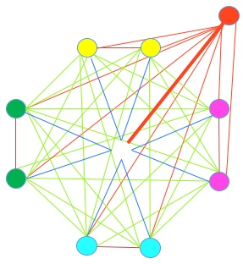
light
how Kamusi makes a multilingual dictionary possible

Slide 42
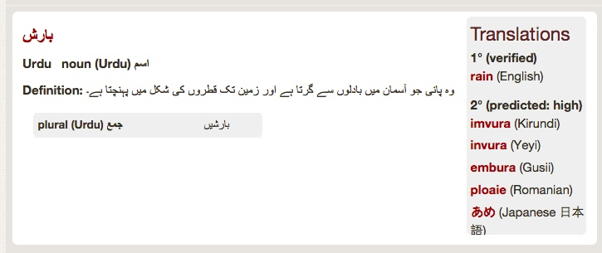

Slide 43
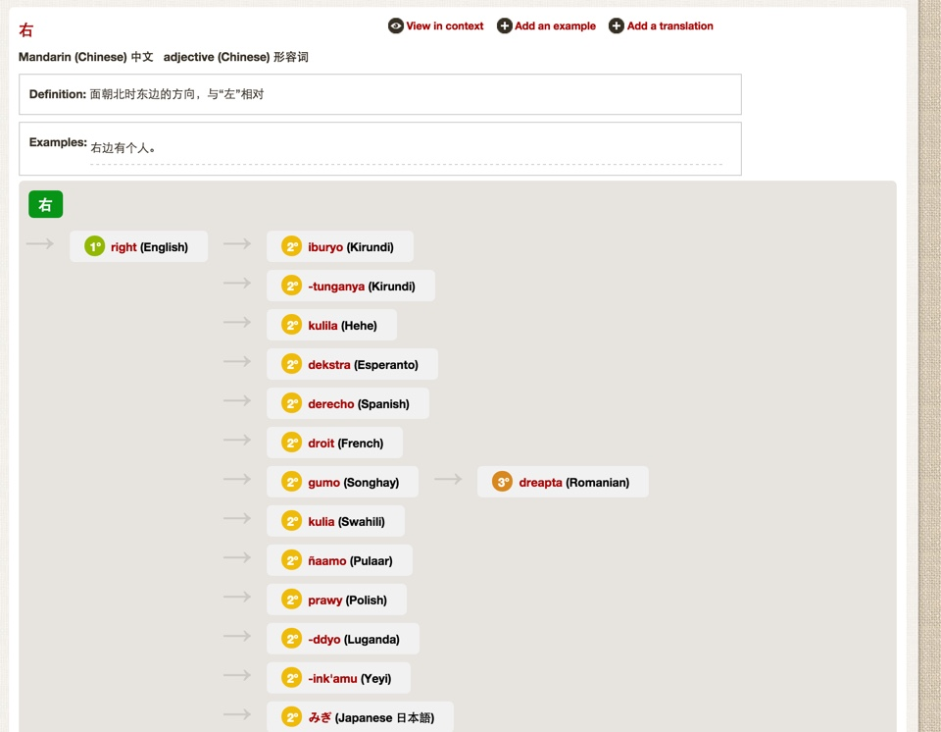

Slide 44
light

Slide 45
light

Slide 46
light

Slide 47
light
meaning
shape
place
sound
time
relationships

Slide 48
light
meaning
shape
place
sound
time
relationships

Slide 49
light
lights
lighted
lit
lighting
light
lighter
lightest
meaning
shape
place
sound
time
relationships

Slide 50

light
robot
meaning
shape
place
sound
time
relationships

Slide 51
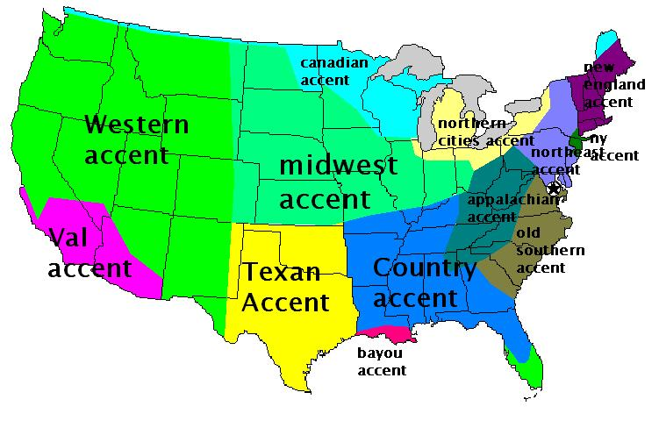
light
meaning
shape
place
sound
time
relationships

Slide 52

light
meaning
shape
place
sound
time
relationships
linhtaz

Slide 53
light
lighthouse
(spawn)
lamp
(synonym)
meaning
shape
place
sound
time
torch
(hyponym)
relationships
dark
(antonym)
car
(holonym)

Slide 54
light
(difference)
lamp
(synonym)
meaning
shape
place
sound
time
relationships

Slide 55
light
meaning
shape
place
sound
time
relationships

Slide 56
light
meaning
shape
place
sound
time
relationships

Slide 57
light
meaning
definition
examples
translations

Slide 58
light
meaning
translations

Slide 59
light
meaning
translations

Slide 60
equivalence
Parallel
Similar
Explanatory
translations

Slide 61

equivalence
Parallel
Similar
Explanatory
hand (English) = main (French)
✓: transitive across languages
translations

Slide 62
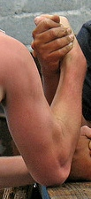
equivalence
Parallel
Similar
Explanatory
difference
difference translation
mkono (Swahili) = hand + arm (English)
⁇ : might be transitive across languages
translations

Slide 63
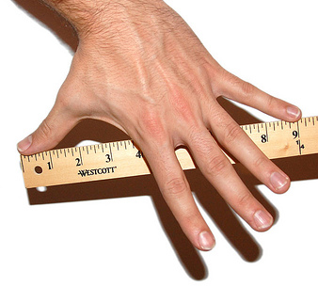
equivalence
Parallel
Partial
Similar
hand (English) = 10.2 cm (most languages)
✗: not transitive across languages
translations

Slide 64
light
meaning
definition
examples
definition
translations
example translations
translations

Slide 65
light
meaning
definition
examples
easy
hard
time
place
notes

Slide 66
light
shape
inflections
multiple words
alternates

Slide 67
light
lighter
lightest
Simple
  Configurable form
  e.g., English verbs
Complex
  Fixed table
  e.g., French verbs
Agglutinative
  Rule-based coding
  e.g., Swahili verbs
shape
sound
translation shape
separability (MWEs)
alternate spellings
place
spelling sets:
polysemous terms often have the same inflections.
inflections

Slide 68
light
lite
shape
Kanji | Hiragana | Katakana | Rōmaji | English
金魚 | きんぎょ | キンギョ | kingyo | goldfish
alternates
https://en.wikipedia.org/wiki/Japanese_writing_system

Slide 69
separability
drive || up the wall
shape
inflections (+separability)
drives || up the wall
drove || up the wall
driven || up the wall
driving || up the wall
multiple words
Research question:
Can we determine Separability Sets?

Slide 70
sign languages
e.g. Uganda Sign Language
Solomon Islander Sign Language
no sound
no spelling
need for gesture recognition
(future research)
ideograms
光
no relation between shape and sound
no sequencing
ontological relationships
shape

Slide 71
light
place
dialect
dialect word sightings
sound sightings

Slide 72
light
sound
audio
tone
place
IPA (phonetics)

Slide 73
light
time
ancestors
(other languages)
ancestors
(own language)
datings (examples)

Slide 74
light
relationships
synonyms
ontologies
transitivity
with translations
hierarchies
or
reciprocity
terminologies

Slide 75
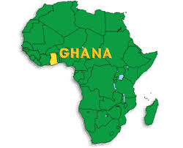
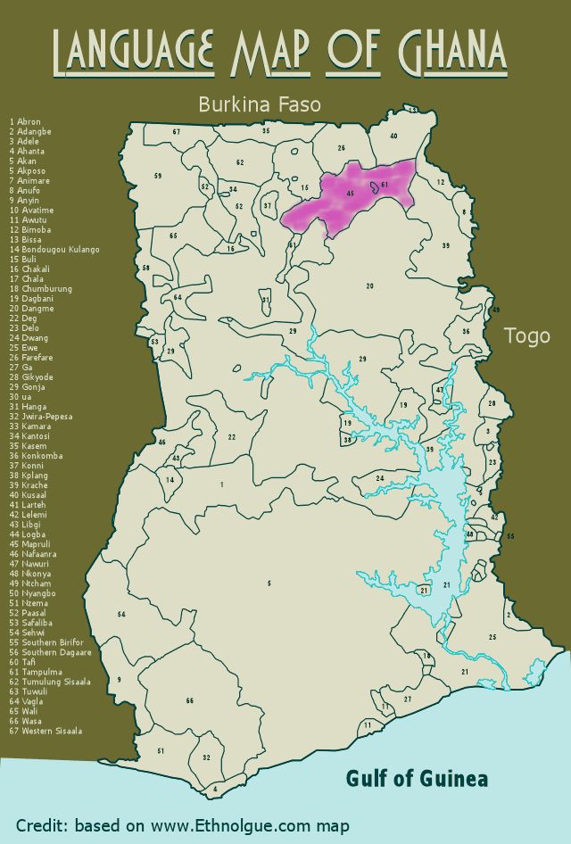

Lexicography
vs.
Terminology
Lexicography:
  General terms
  Variability of concepts among languages
  Describes indigenous words
Terminology
  Domain-specific terms
  Fixed meaning within context
  Prescribes words
sabilli

Slide 76
Collecting Data
Gathering new data
  For languages with zero digitized data (most world languages)
  For languages with incomplete data (all languages)
Aligning existing data
  To separate terms at concept level
  To match concepts across languages

Slide 77
Collecting Data
Existing Data
Copyright restrictions
Data structure
Data alignment

Slide 78
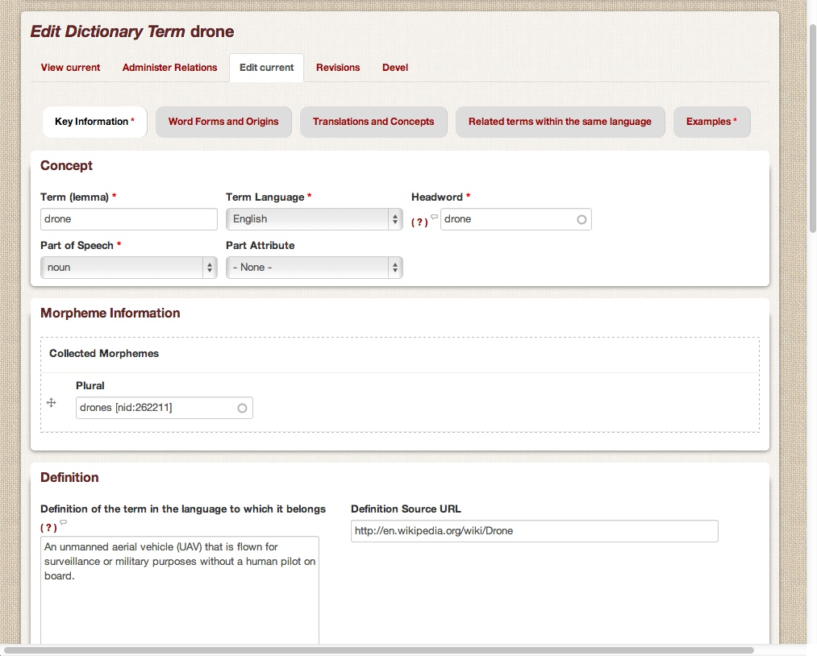
Collecting Data
Expert Interface: Edit Engine

Slide 79
Crowdsourcing Lexicography
Gathering new data
  For languages with zero digitized data (most world languages)
  For languages with incomplete data (all languages)
Aligning existing data
  To separate terms at concept level
  To match concepts across languages
People are very good at these tasks
Machines are very bad
Scholars are very busy

Slide 80
Crowdsourcing with Games
Engage the public in producing raw data
Data can be built upon and refined over time
Collecting “facts” that
  can best come from native informants
  can be verified by consensus as fulfilling a communicative role
Wrong data and bad actors can be removed

Slide 81
Game Architecture
Simple tasks the public can understand
“Word” questions to stimulate the mind
Competition elements to stimulate the heart
Answers validated by consensus
Starts with English concept set to have a shared realm of ideas
Grows progressively – winning answers in one mode generate more advanced questions in the next

Slide 82
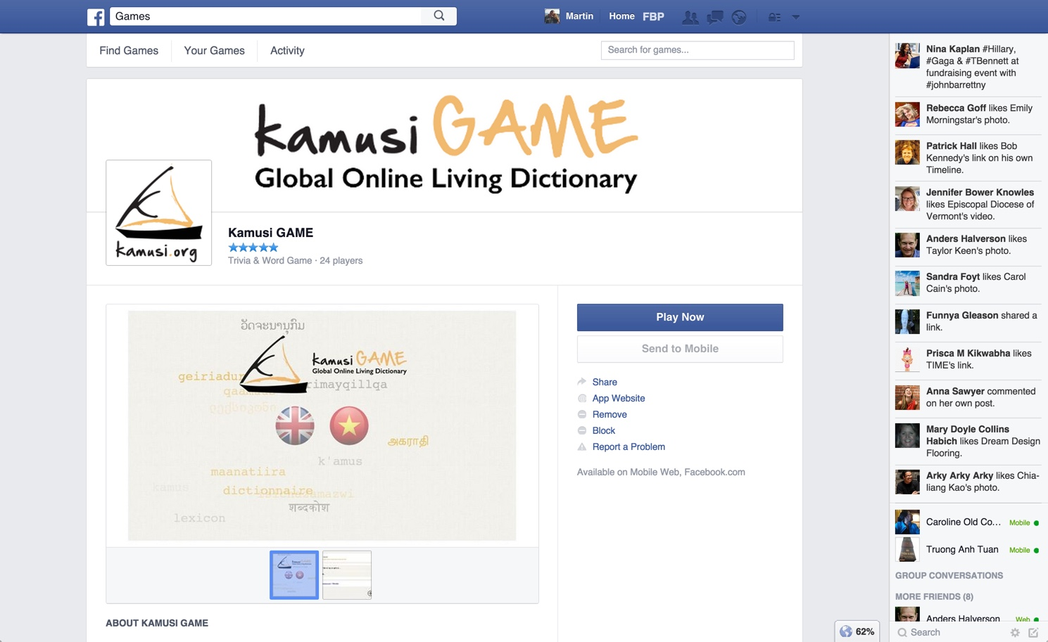

Slide 83
Game Modes
Translation
Synonyms
Word Forms
Definitions
Examples
Alignment
Equivalence
Difference

Slide 84
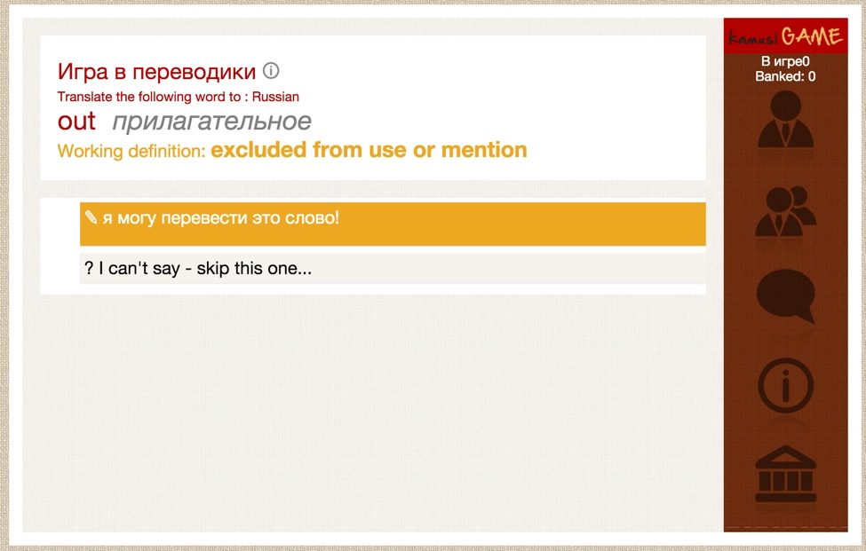
Translation Game

Slide 85
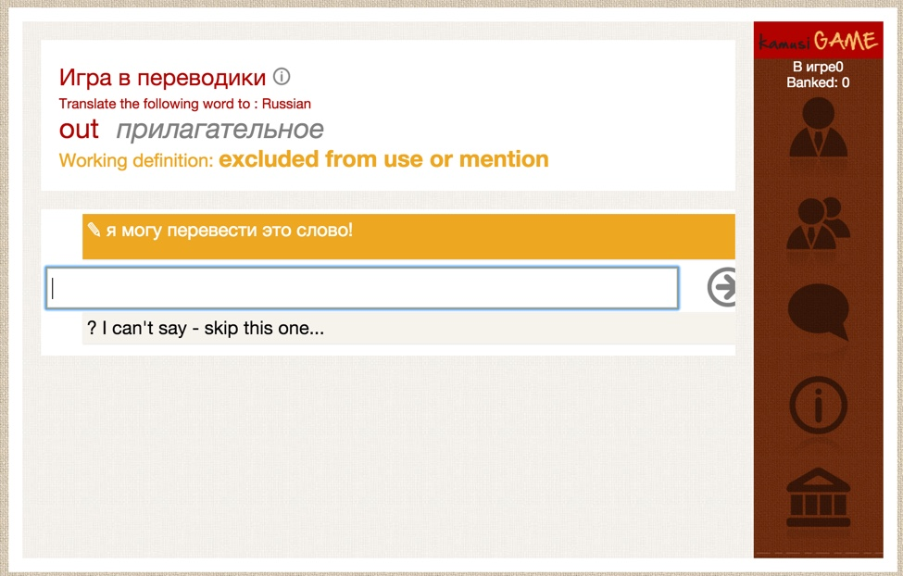
Translation Game

Slide 86
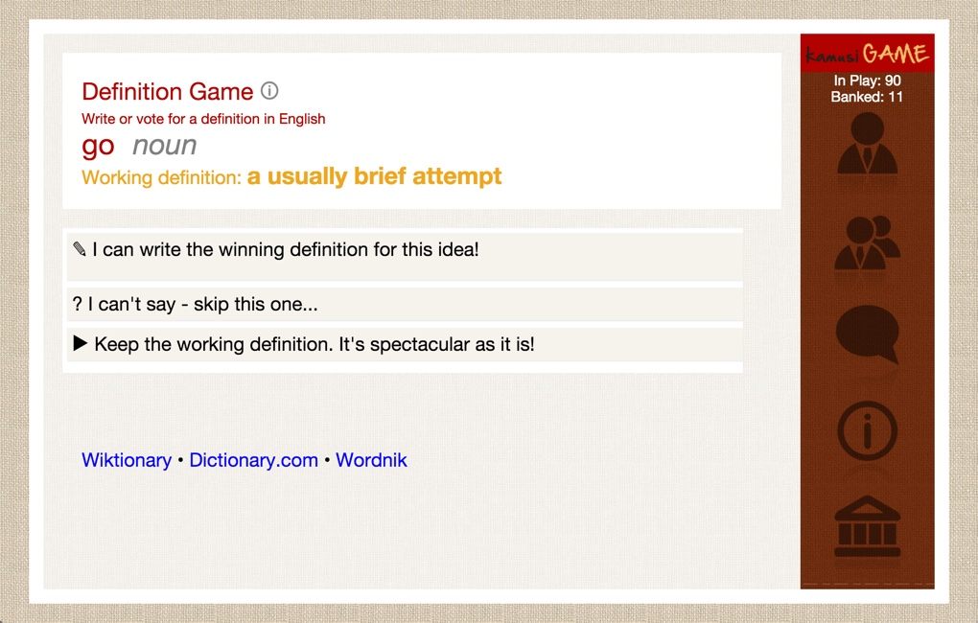
Definition Game

Slide 87
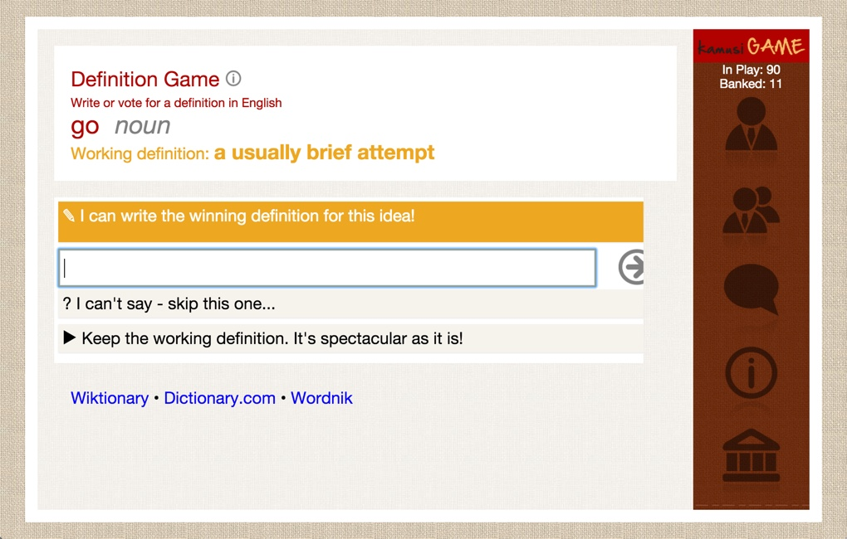
Definition Game

Slide 88
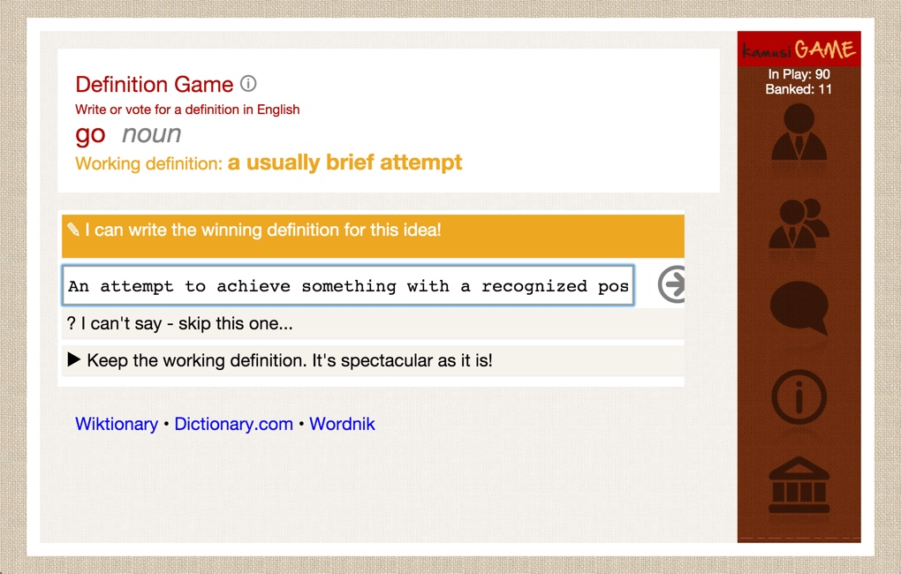
Definition Game

Slide 89
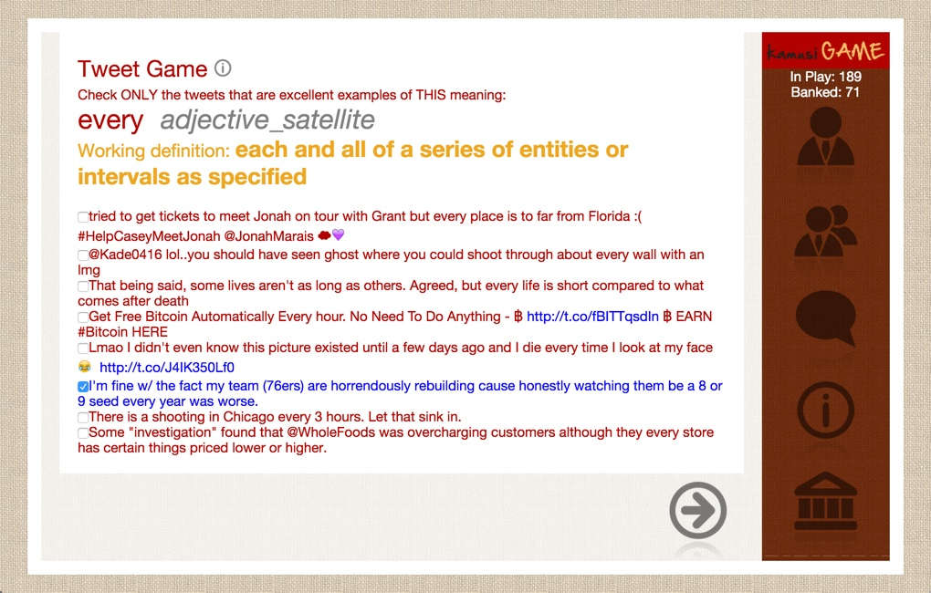
Example Game

Slide 90
Martin Benjamin
The Particles of Language:
"The Dictionary" as elemental data for 7000 languages across time and space
martin.benjamin@epfl.ch

