Slide 1
PH Theme 3 R&D
Introduction
Lucie Linssen
Meeting with WP leaders 3/11/2008

Slide 2
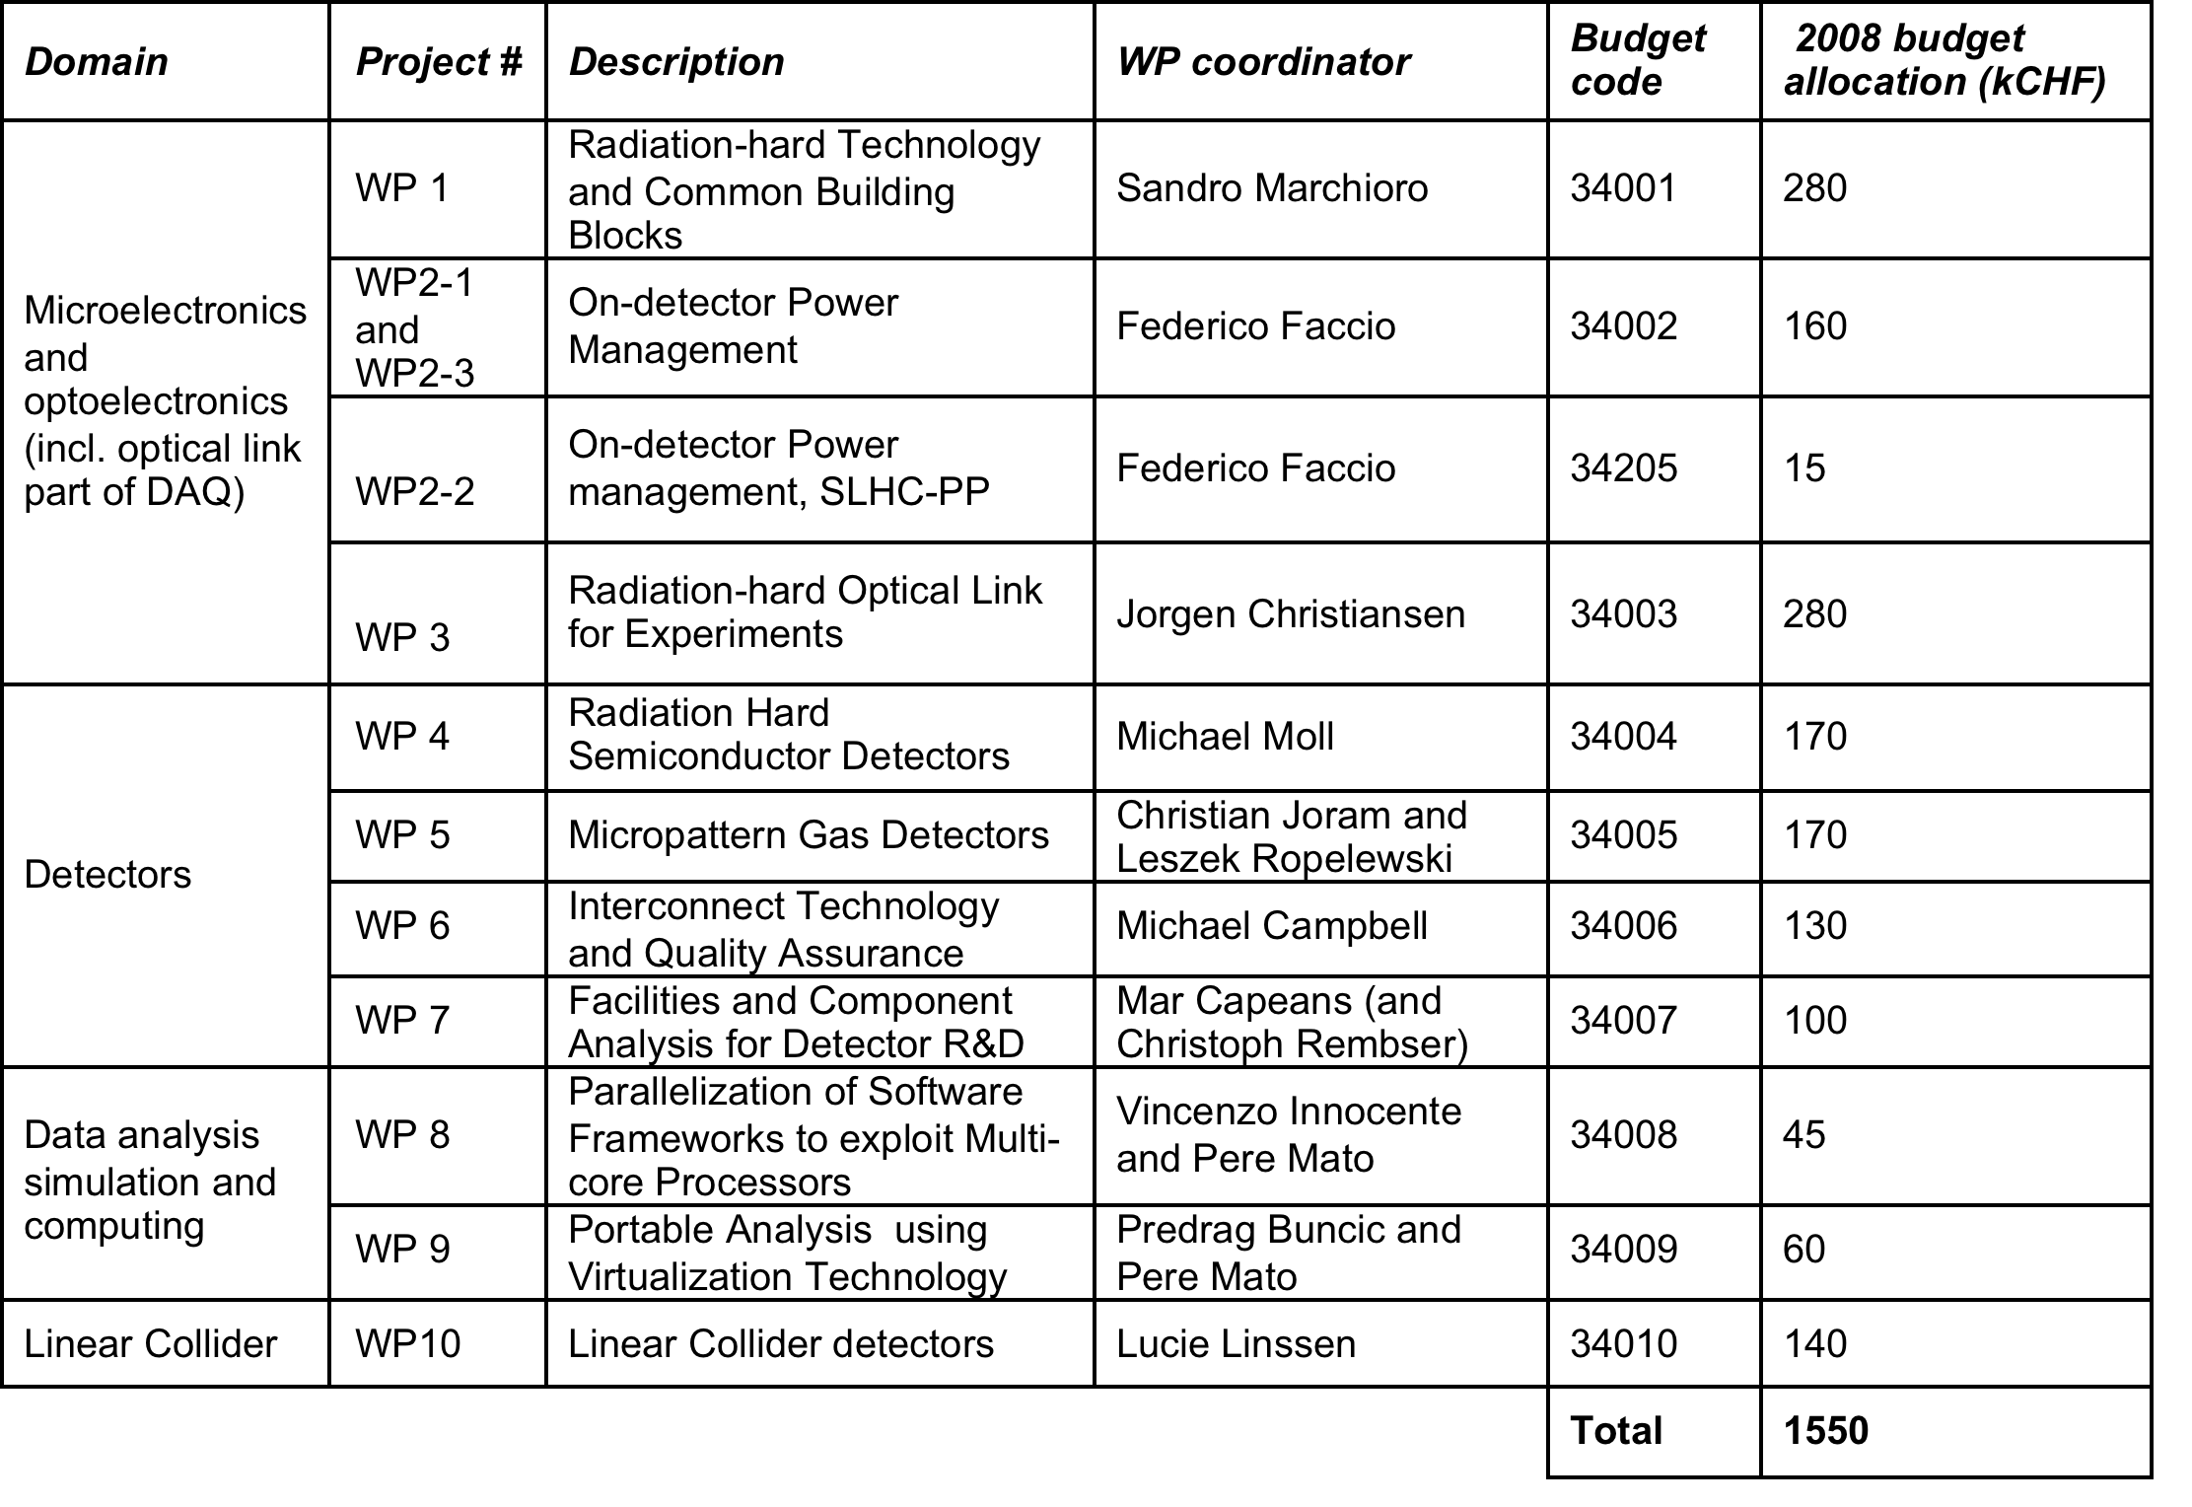
Overview of WP’s

Slide 3
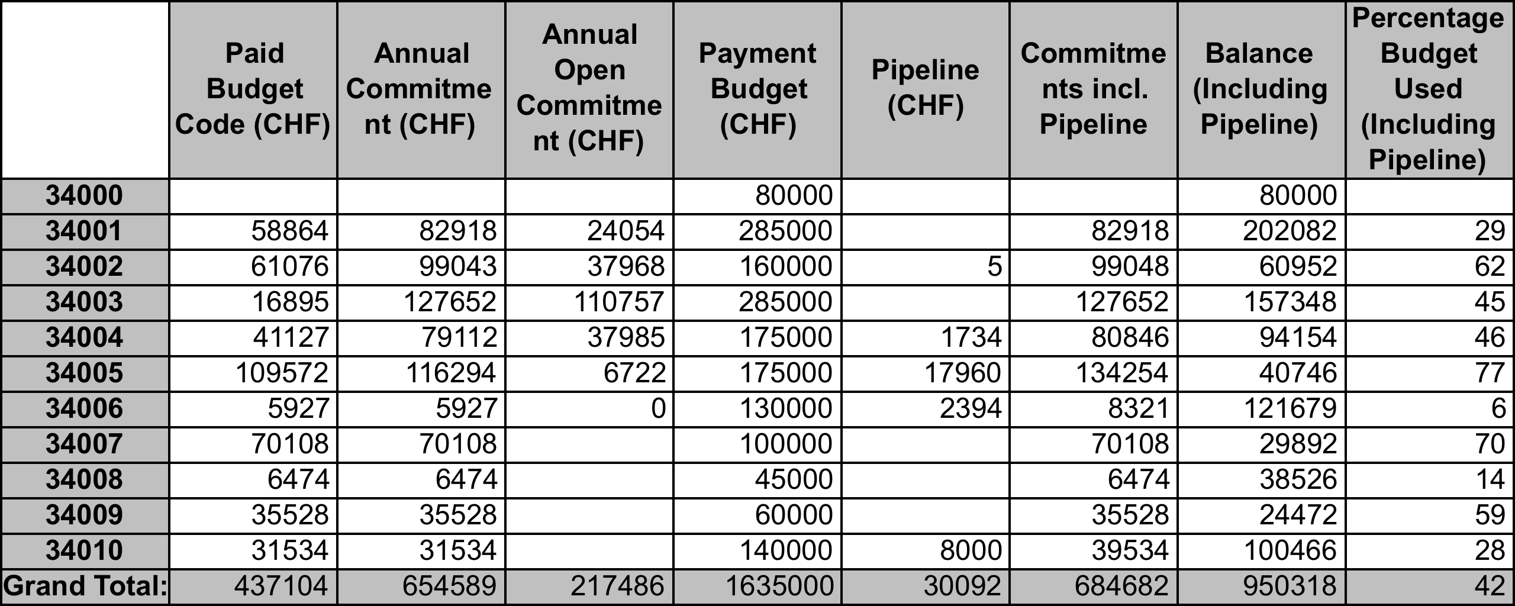
Materials expenditures
Status for 2008, CET summary 31/10/2008
Presently committed ~44% of 1.550 MCHF planned
Total 2009 materials budget expected ~40% higher than in 2008

Slide 4
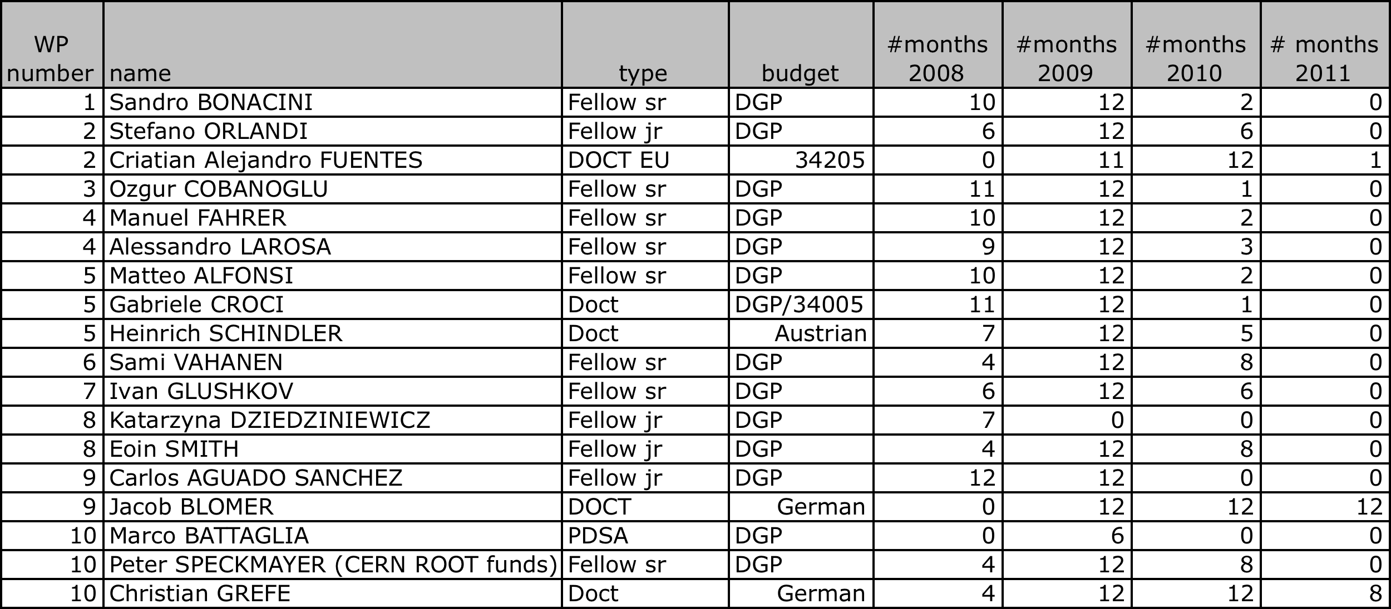
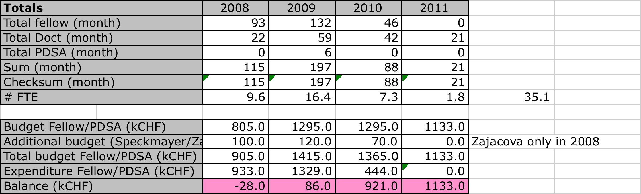
Fellows/associates/students
Currently trying to get M=>P transfer for more fellows in 2009

Slide 5
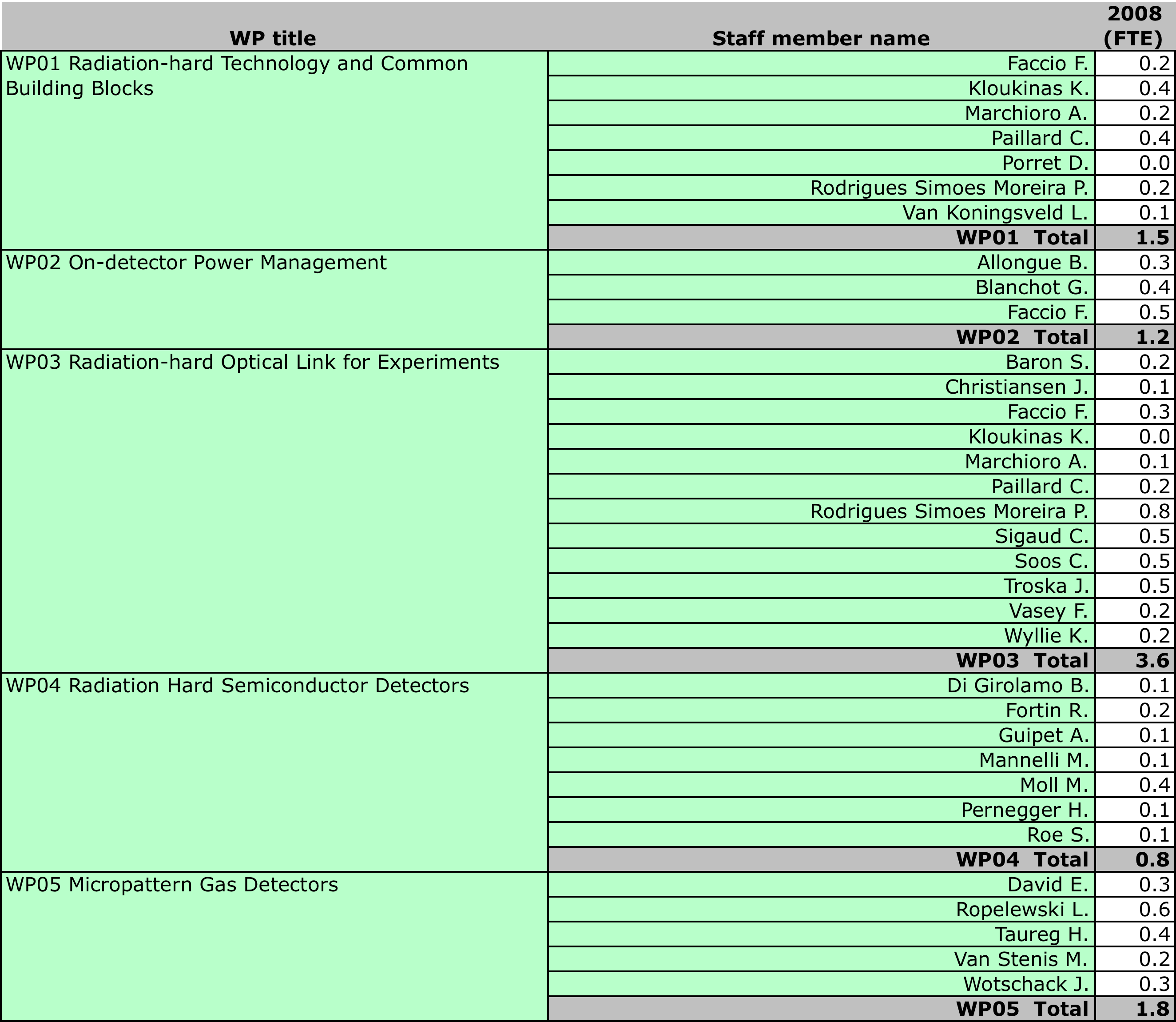
Existing staff expenditures 2008

Slide 6
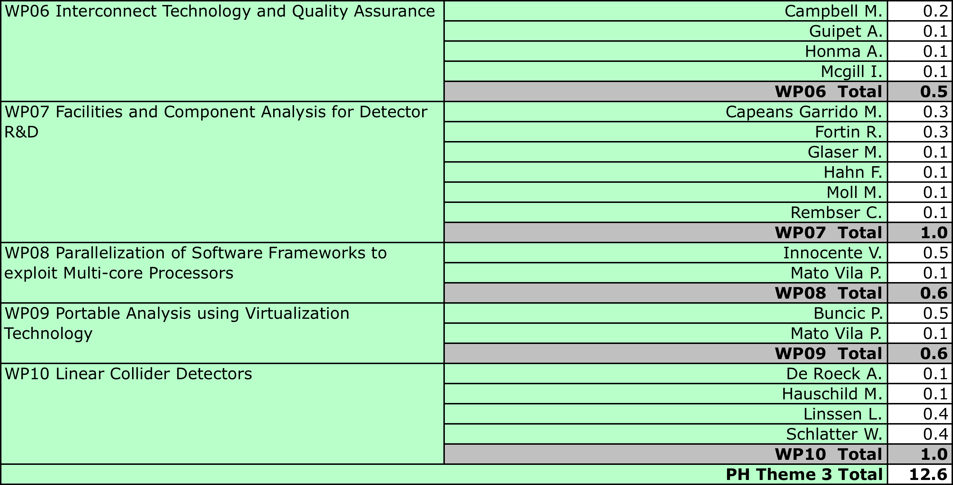
Existing staff expenditures 2008
2008, existing staff resources | Foreseen (FTE) | Actual (FTE)
Microelectronics/optoelectronics | 4 | 6.3
Detectors | 3 | 4.1
Analysis analysis / simulation / computing | 1 | 1.2
Linear collider detectors | 0 | 1.0
Total | 8 | 12.6

Slide 7
Remarks
Discussion with the experiments are important to stay in line with the needs and the time-scales of the upgrades !
Be prepared to report on your communication channels
indico category for PH Theme 3 work packages http://indico.cern.ch/categoryDisplay.py?categId=1935
Upcoming common R&D in mechanical engineering:
  Detector materials (structural and thermal)
  Detector cooling
  3D metrology and reverse engineering
  Sub-lifting and precise movements of large loads

Slide 8
Next meeting
Tuesday 11/11, 14 hrs, room 6-2-002
WP2, WP8, WP9
2009 budget request
  New standardised APT format

