Slide 1
Status report WP7
Facilities and Component Analysis for Detector R&D
Activities and Status
Resources and Expenditures
Work plan
Mar CAPEANS

Slide 2
http://cern.ch/WP7/
Facilities and Component Analysis for Detector R&D
Timescale: 2008-2011
Lines of activity:
Mar Capeans, together with C.Rembser for GIF++, lead this WP
  Construction of SLHC compatible Gamma and Hadron irradiation facilities
  Component Analysis for Detector R&D:
    LHC RPC Gas Studies
    Material Studies & Test Reference Lab
  Clients: CERN users
  Clients: RPCs, LHC/SLHC, RD51, NA62, etc

Slide 3
SLHC-compatible Irradiation Facilities
Activity started in the framework of the Working Group for Future Irradiation Facilities, created at the end of 2007 http://cern.ch/irradiation-facilities
In this context, the Group launched a broad web-based survey of requirements (Gamma, proton and mixed field, high energy high Z ions) in February 2008.
WP7 shall include the work to upgrade:
  the high rate, large area gamma facility GIF (GIF++), and
  the PS, high fluence, proton and neutron facilities.
The bad news: DevDet project, submitted to the EC FP7 program and with WPs including the upgrade of those facilities, failed. Need to see how to keep alive the collaboration/activities foreseen there.

Slide 4
GIF++
Current Limitation of GIF: old ⁶⁰Co source, no particle beam… Shutdown is foreseen for end 09
The analysis of answers to the GIF++ questionnaire shows that the users can be easily clustered in two groups:
  Those interested to test radiation hardness of materials, small prototype detectors, electronic components and radiation monitors or dosimetry under a strong photon flux.
  Users focused on the characterization and understanding of the long-term behavior of large particle detectors. In addition to the high rate photon background a simultaneous, high energy (SPS), low rate and narrow muon beam is needed.

Slide 5
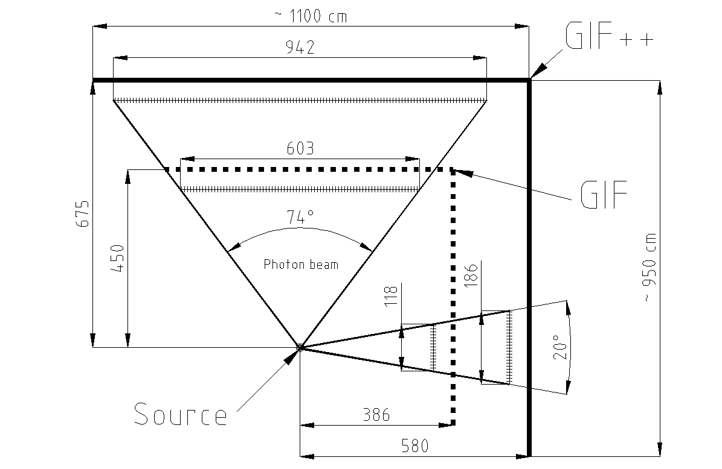
GIF++ Specs
SPS West Area Particle beam: muon beam (~ 10⁴ particles per spill traversing an area of 10 cm x 10 cm) with option of an electron beam. Beam momentum ~ 100 GeV
Source: ¹³⁷Cs (662 keV) ~10TBq; 2 Gy/h at 50 cm
Photon rate attenuation in steps and up to 5 orders of magnitude
Clever peripheral infrastructure
Uniform Irradiation area:
http://cern.ch/WP7/Documents/20080919_Specs_GIF++_V2.pdf

Slide 6
Upgrade of PS p, n facilities
Current limitations: parasitic operation (DIRAC), access via primary beam area, personnel exposure, limited space, limited rate.
  Machine Community prefers 450 GeV/c and Experiment Community needs 24 GeV/c
  PS vs. SPS being worked out
  Targeting overall work program and timescale similar to GIF++
Feedback for proton facility dominated by Inner Tracker communities of the experiments (known users)

Slide 7
Timescale
June 08 – April 09
Design
May 09 – Dec 09
Collection of User Requirements
Proposals by AB (Nov 08)
Approval of:
  Final Technical Description
  Cost books
  Contributions
Construction & Procurement
Jan 10 – May 10
Commissioning
May 10
Ready

Slide 8
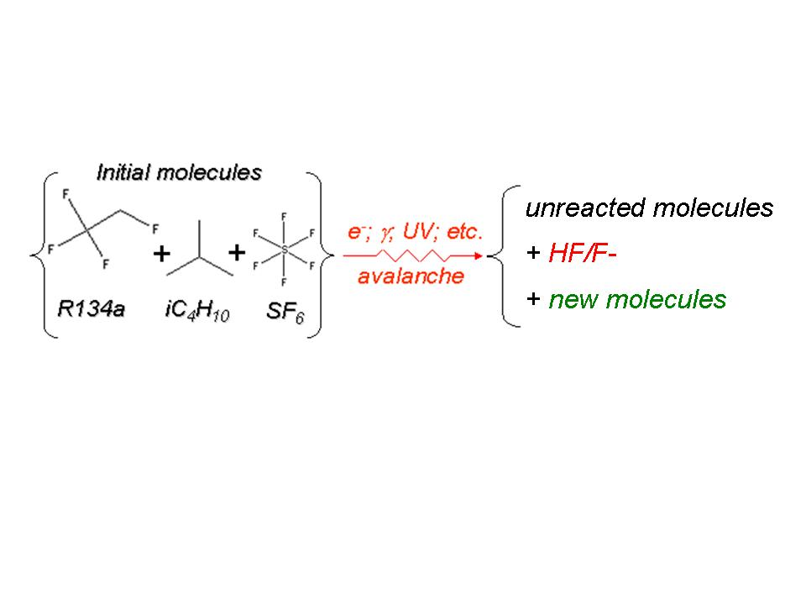
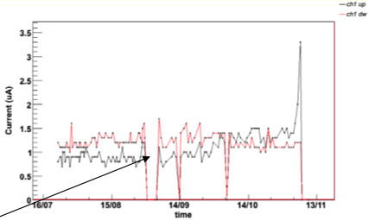
Component Analysis for Detector R&D
➤ LHC RPC Gas Studies
Background: when RPCs are operated in a high radiation environment, many different chemically very reactive impurities are created which are potentially dangerous for the detector materials and the closed-loop gas system.
The current study aims at the understanding of these processes in the GIF irradiation field and the development of methods to mitigate or reverse the degrading effects:
  Identifying harmful impurities in the gas
  Finding suitable Filters
  Optimizing operation in LHC
HV Off

Slide 9
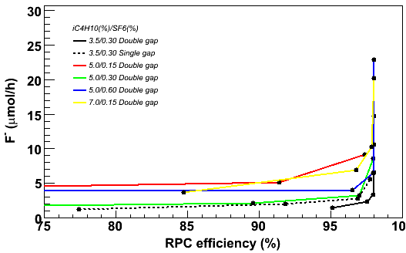
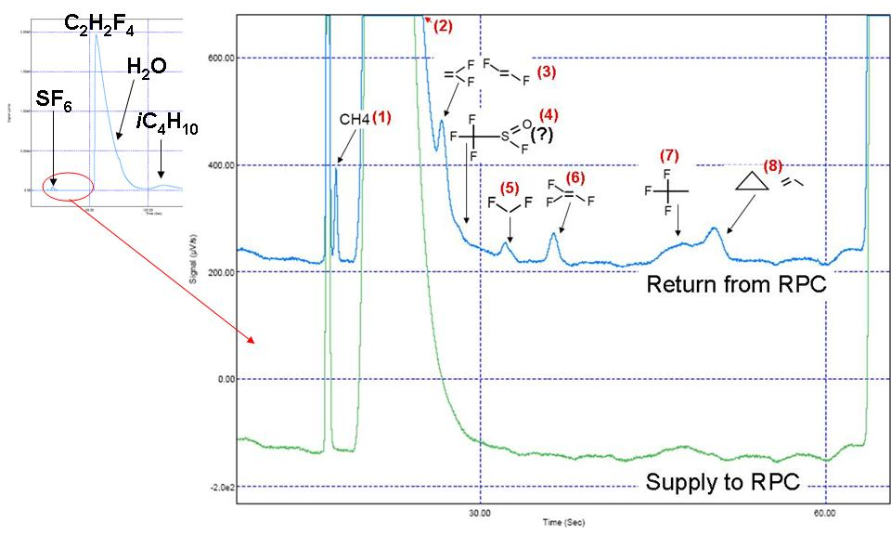
RPC studies at the GIF (R.Guida, I.Glushkov)
Running at the GIF since 6 months (1 cGy/h over a large area of the detectors)
Six CMS double gap RPC
Small scale gas system, equivalent to the systems installed at the LHC, plus a custom made filter rack that allow parallel studies of different filtering agents
Fluoride concentration as a function of RPC efficiency (HV) for different concentrations of the components in the RPC gas mixture (C₂H₂F₄+ iC₄H₁₀+SF₆) >> R.Guida
Impurities identified by GC/MS in the returned gas mixture for heavily irradiated RPCs (~300 Hz/cm²) >> I.Glushkov

Slide 10
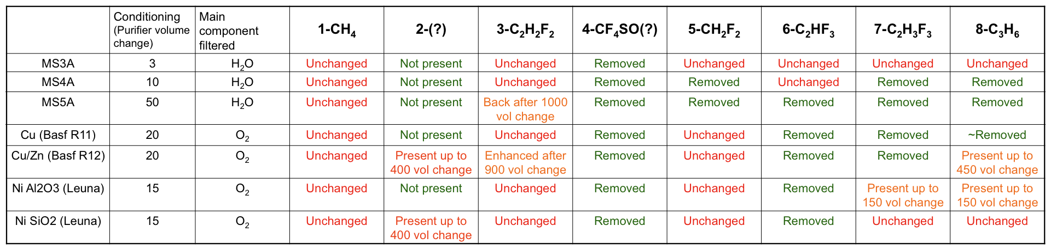
RPC studies at the GIF (R.Guida, I.Glushkov)
  Characterized the filtering capacity of 6 different purifying agents, their lifetime and how to use them optimally with the complex RPC gas mixture.
  Tests will continue focusing on the identification of impurities dangerous for RPC operation and how to avoid them

Slide 11
Component Analysis for Detector R&D
➤ Material Studies
Objective: some effort will be devoted to compile the knowledge available on materials, gas systems components and filtering techniques, and on tests and operation procedures developed during the R&D LHC detector phases.
Status: just taking off
    Materials DB framework being established
    Agreed data collection with gas detector communities of LHC experiments
    Agreed on the scope to maintain a ‘Test Reference Lab’ heavily used by the ATLAS TRT community (specialized Lab in B.155)
  Add data on structural materials (discussion with PH engineers in the next days)

Slide 12
Meetings
Irradiation facilities
  Meetings with CERN Departments are held in the framework of the Irradiation Facilities Working Group
  Dedicated meetings with users take place every 3-4 months
RPC studies
  Topic discussed within the RPC Task Force Meeting organized by A.Sharma. It includes LHC RPC groups and takes place every 2-3 weeks.
Materials
  Contacts with Experiments and TS as needed

Slide 13
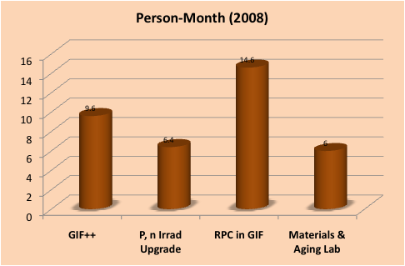
Resources
Approximate resources over 4 years: 13 FTE & 1000 kCHF
In 2008: ~2.3 FTE and 100 kCHF material budget (9 months of Associates)

Slide 14
Expenditure: Budget, Actual, Projected
Projected
Actual
Budget

Slide 15
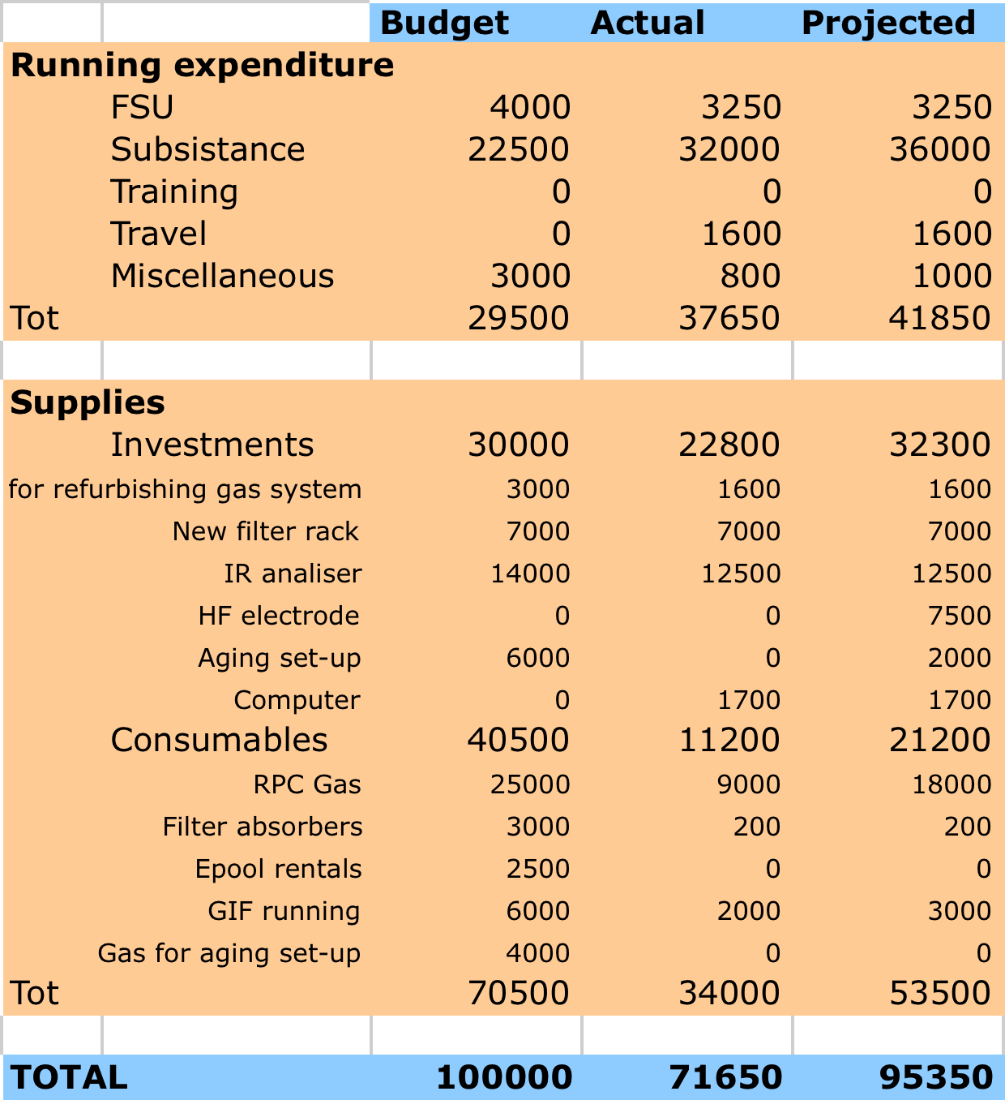
Expenditure

Slide 16
WP7 Work Plan
2008
    Gas studies at ISR (lab facility) and dedicated GIF set-up
    Materials DB framework and establish benchmarks (SLHC)
    Define User Requirements for Upgraded Irradiation Facilities
2009
    Consolidation of cost-effective RPC operation parameters for LHC
    Set-up Reference Aging Lab, collect existing data on materials
    Preparation and approval of a Technical Design Proposal for Irrad. Facilities (AB Dept)
    Procurement and Construction Phases of Upgraded Irradiation Facilities
2010
    Implement optimal filtering elements in LHC RPC gas systems
    Deliver Material Books
    Irradiation Facilities > Target date ‘Ready for Users’: May
2011
    Update Material Books
    Irradiation Facilities > First report of results
✔
Just Started
✔

Slide 17
Next difficult efforts
Funding proposal for irradiation facilities
Materials DB (IT work)

