Slide 1
Linac4 – Project Meeting
Short and medium term schedule

Slide 2
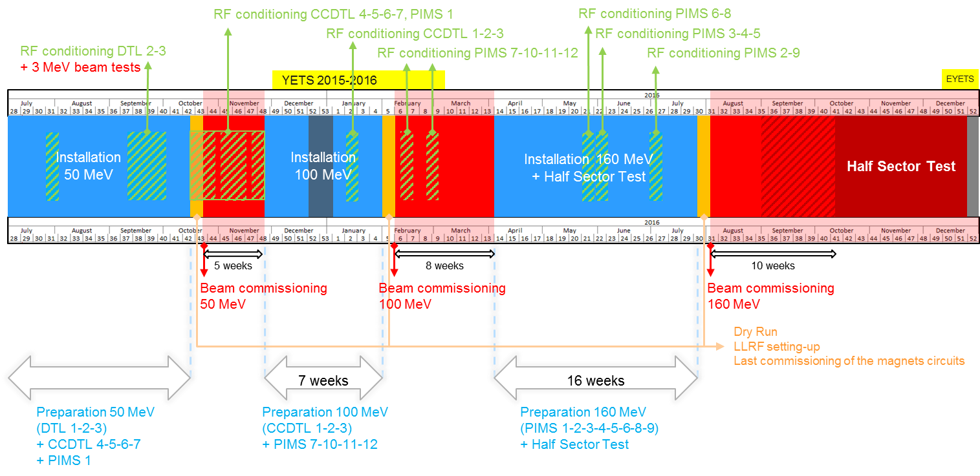
Master Schedule – mid term
Schedule 1 week delayed to complete RF conditioning
1 week less in the installation of the 160 MeV to compensate the delay
Important to make a priority for the resources on the Linac4 to keep the schedule.

Slide 3
Master Schedule – short term up to 50 MeV
Objectives and Milestones
  Start the 50 MeV beam commissioning with
    1 week of Dry Run from 8th October → 15th October
    Beam from 15th October → 22nd October
  Prepare the CCDTL 6 and 7 (with pumping groups) to start RF conditioning in parallel of the start of the beam commissioning.
  Prepare the CCDTL 4, 5 and PIMS1 to start RF conditioning after CCDTL6 and 7 are RF conditioned and before the end of the beam commissioning
Deadline : 15th October

Slide 4
Master Schedule – short term up to 50 MeV
Objectives and Milestones
  All equipment for next beam commissioning phase must be ready for installation in the tunnel or test before the end of the previous beam commissioning phase.
Deadline for equipment on 100 MeV beam line : 26th November 2015
Deadline for equipment for 160 MeV beam line : 1st April 2016
  All equipment for the L4T need to be ready by the end of the beam commissioning 50 MeV
  Linac4 ready for 50 MeV connection in case of failure of the Linac2
Deadline for equipment on L4T : 26th November 2015

Slide 5
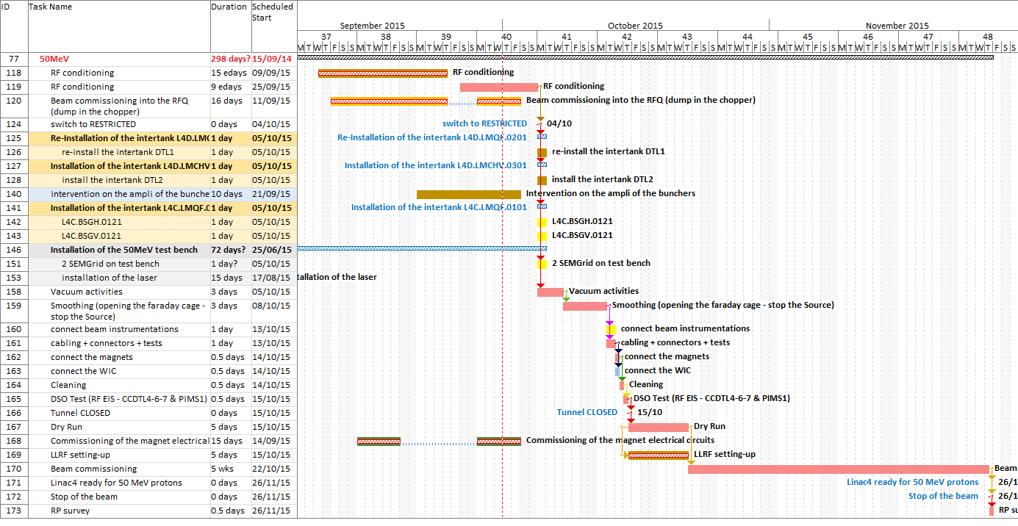
Master Schedule – short term up to 50 MeV

Slide 6
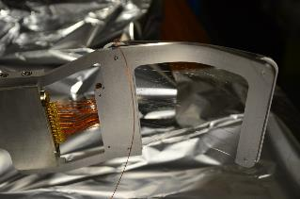
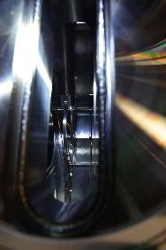
Master Schedule – short term up to 50 MeV
Issue
  Beam Instrumentations
  Lors des tests de fonctionnement des moniteurs sur la ligne de diagnostiques 50MeV ,1 fils d’instrumentation mal positionné sur le W Scanner est rentré en collision avec le SEMGrid horizontal entrainant la destruction de la grille sur le “pot N1”.
    1 SEMgrid totally “kaputt”
    Pieces of the ceramics were floating around the vacuum chamber
    The wire scanner signal cable damaged
    Most (all?) parts from the ceramic frame have been extracted from the vacuum chamber
  SEMGrid repaired: ok for installation next week
  Wire Scanner: Christophe is doing his best to have it ready by the end of next week
Courtesy BE-BI: U. Raich, F. Roncarolo, C. Vuitton

Slide 7
Master Schedule – short term up to 100 MeV
Modulators and klystrons almost ready
  Final test of the klystron 5 (CCDTL1 and 2)
CCDTL 1, 2 and 3 almost ready
  Tuning of the CCDTL 3
Start the 100 MeV beam commissioning with
    1 week of Dry Run from from 1st February 2016
    Beam from 8th February 2016
  Prepare the PIMS 7, 10, 11, 12 to start RF conditioning in parallel of the start of the beam commissioning.
Deadline : 1st February 2016

