Slide 1
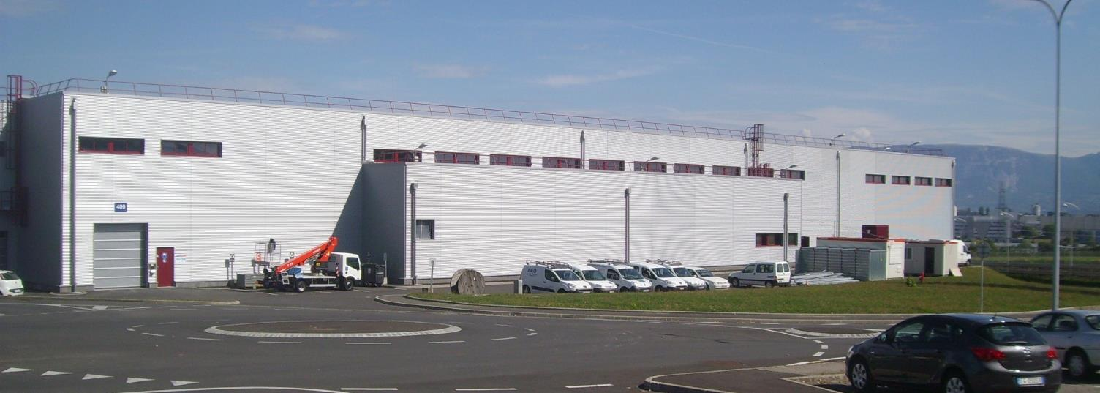
Linac4 status and long-term schedule
M. Vretenar, Project Meeting 1.10.15
status
timeline
open issues
Notes:
What is the result of EN for Linac4

Slide 2

Where are we?
The situation is not too bad: we are preparing for an important milestone, the 50 MeV beam (our objective #1), with many thanks to all those who have worked hard to come to this point. On top of that the new ion source operates steadily since August with a current sufficient for the 50 MeV tests.
LINAC4 PROJECT OBJECTIVES:
50 MeV readiness (replacement of Linac2 with Linac4 protons): summer 2015.
160 MeV H- connection readiness (all equipment ready for connection): end 2016.
Actual connection during Long Shutdown 2.
It is time to look at the future and to present and discuss the next milestones and the steps that will bring us to the connection of Linac4 during LS2.
While the general communication in the project goes via the Monday morning Installation meetings, we need from time to time a general project meeting to discuss the medium-long term and to agree on the Masterplan. If you have comments please make them now (or never!).

Slide 3
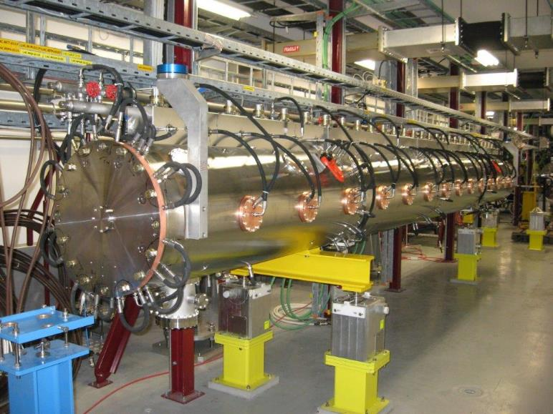
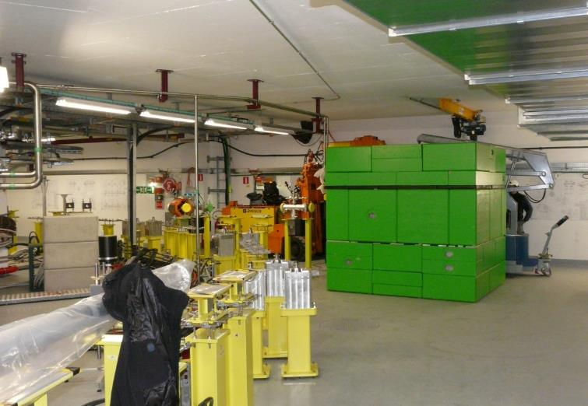
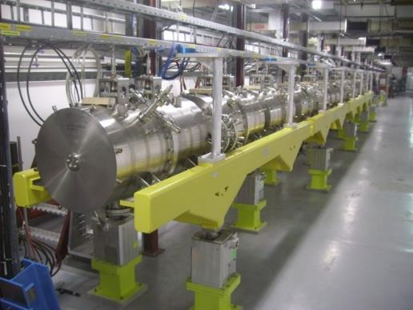
Linac4 Status - tunnel
Installed in accelerator tunnel about 75% of all components: ion source, RFQ, chopper line, 3 DTL tanks, 5/7 CCDTL tanks, 3/12 PIMS tanks, main beam dump, bendings, parts of transfer line.
DTL tank3
Main dump and bending to PSB
CCDTL (100 MeV)

Slide 4

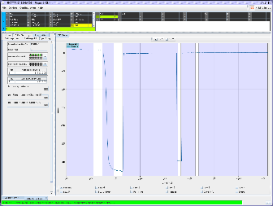
Commissioning status – 09/15
diagnostic line
diagnostic line
107 MeV
12 MeV
Linac4 is commissioned in 5 stages of increasing energy:
Measurement line with temporary dump
BREAKING NEWS:
(more in Alessandra’s presentation)
The ion source is steadily delivering ~50 mA since early August.
The emittance is still larger than design but can be improved.
Beam tests at 3 MeV (RFQ) in last week: 46 mA source, 40 mA LEBT, 33 mA after RFQ.
Phase | Energy | Duration (incl. HW test)
1 | 3 MeV | 11.2013 – 3.2014
2 | 12 MeV | 7.2014 – 12.2014
3 | 50 MeV | October 2015
4 | 107 MeV | February 2016
5 | 160 MeV | August 2016
Expected October 2015

Slide 5
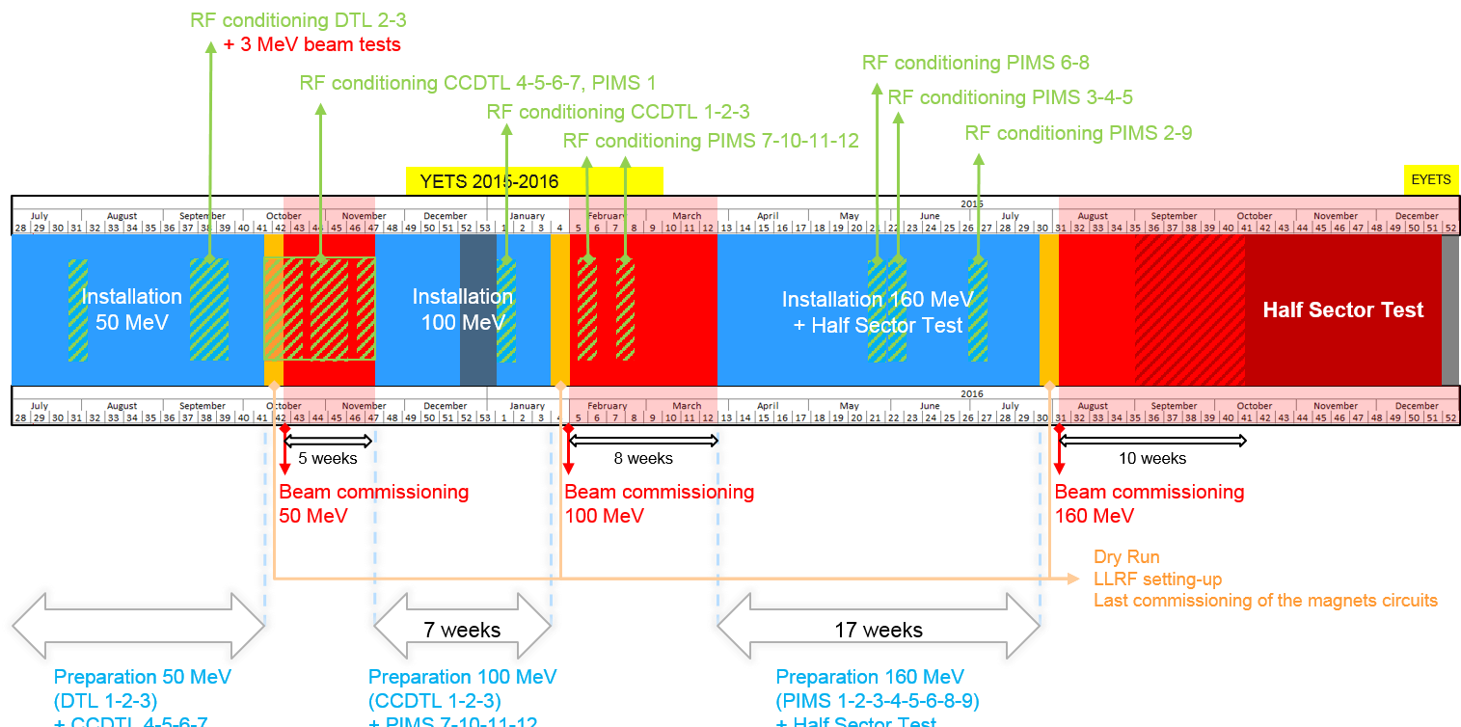
Medium-term schedule (2015-16)
Planning by J. Coupard

Slide 6

Longer-term schedule (2017/20)
start connection activities
Install Debuncher at the position of the HST, leave temporary dump in, send beam in first 3 bendings and in debuncher
8-month window for inteerventions and repairs after reliability run (eg. DTL2)
6-month long reliability run (beam sent on the main dump)
3-month beam testing after the repairs and interventions
After installation of new LBE and dump at PSB entrance, transport and measure the nbeam in LBE (PS closed)

Slide 7
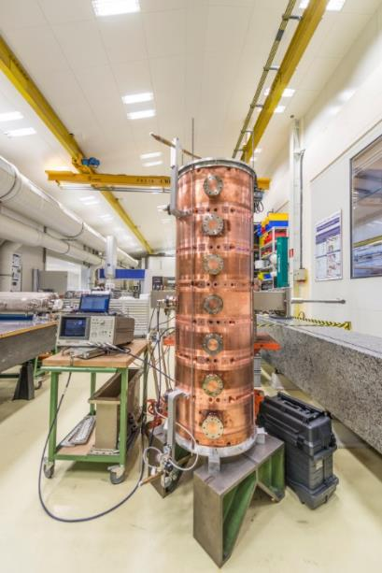
PIMS production
The last remaining endeavour of the Linac4 project is the construction of the PIMS (Pi-Mode Structure) cavities (100-160 MeV). Components built in Poland. Metrology, assembly, re-machining, cleaning, EB welding, survey, vacuum and RF tests at CERN. Some delay (long time needed for the qualification of the production in Poland, some recent transport and brazing accidents). Is now on the critical path for reaching 160 MeV in time for the Half-Sector Test of PSB H- injection foreseen in Linac4 from August 2016.
Out of the 12 cavities, 3 are installed in tunnel and 2 are almost completed. 7 cavities are in production phase; (+ the debuncher). Last cavity should be ready for installation at beginning of June 2016.

Slide 8
A spare RFQ ?
The CMAC Cost Review in March observed that «the large operating cost of the LHC could justify the acquisition of a spare RFQ to address this single-point failure item». This was already considered several times in the past (Linac2 has a spare RFQ, which was never used).
In June, we have done a risk analysis meeting with all persons involved in the construction and operation of the Linac4 RFQ. We analysed 9 possible RFQ failure scenarii, based on our experience and on the experience of other laboratories, and proposed a number of mitigations (more spare parts, interventions on upstream equipment to protect the RFQ).
Conclusion is that in all scenarii mitigations would allow to come back to normal operation in a time below 2 weeks (estimated as exchange time with a spare RFQ). Are there other failure scenarii that we did not consider?
The results will be presented at the sector level to take a common decision. Even if we do not have a spare RFQ, we could purchase the copper to build one or more RFQ modules in emergency (8 months delivery time).
Electrode damage (sputtering of copper) due to beam loss at the RFQ entrance
Electrode contamination due to Cs deposition / normal cesiation.
Electrode contamination due to Cs deposition / cesiation accident.
Damage of the RF power coupler (mechanical deformation or surface effects)
Vacuum degradation due to a cooling circuit water leak (e.g. erosion of the brazed joints of water circuit caps
Repeated sparking between vanes due to loss of LLRF control.
Mechanical deformation of the RFQ.
Vacuum contamination of the RFQ from hydrocarbons.
Flanges for RF tuner or RF pick-up are broken because of mechanical stress.
The 9 RFQ failure scenarii
Report to be prepared by C. Rossi

Slide 9
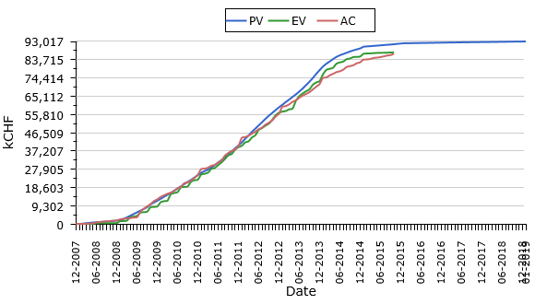
EVM
One final worry: EVM
Looks like in the last 9 months we are spending a large amount of money but there is very little progress…
Is it the reality or simply you have stopped reporting your progress in EVM?
Please update your reporting (there are several late reports!)
Late reporting:
Buncher amplifiers, LLRF, power converters, survey, (BIDs?)

Slide 10
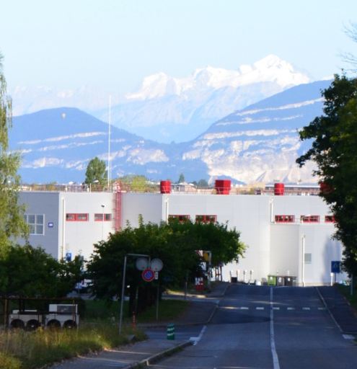
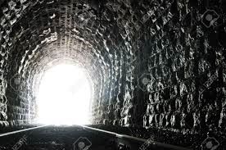
Conclusions
After 7 years of work we start seeing light at the end of the tunnel…
…but we remain vigilant, it could still be a train!
Notes:
Look forward to a bright day

Slide 12
The Linac4 Design Report
Every new accelerator must publish a Design Report (as CERN Yellow Report)
The only Linac4 complete reference is the old Technical Design Report published in 2007 (Linac4 is still double frequency and positioned in the PS South Hall…)
This is the right moment to work at the final Design Report, because: a) the design of the accelerator is completely defined; and b) we still (vaguely) remember what we have done.
The production of the report should not be too difficult because a lot of information exists in the form of EDMS documents, Workpackage Descriptions, Conference papers, etc. More than writing, we need to do copying, pasting and cutting.
The goal is to produce a small (100 pages) report with references (and links!) to existing documentation.
It should be both a Quick Reference Guide and an entry point to retrieve Linac4 information.

Slide 13
Proposed structure and authors
Editorial Board:
S. Ramberger
M. Vretenar
C. Noels/J. Double

Slide 14
Contents and Timetable
Each Section should contain:
Design choices
Description
Parameters
Schematics, drawings, photographs
Testing and commissioning
List of reference documents, with links
Deadlines:
- Send mail and templates 01.10.2015
- Contributions received 30.12.2015
- First complete draft 31.03.2016
- Revised draft 30.6.2016
- Final version 30.9.2016
- Ready for publication 31.10.2016

Slide 15
Design Report Contributions
Information from S. Ramberger
LaTeX or Word – but LaTeX preferred!
  TeXLive 2015: http://cern.ch/XML/textproc.html
Follow Guidelines:
  https://e-publishing.cern.ch/index.php/CYR/about/submissions
Use the Templates:
  https://e-publishing.cern.ch/index.php/CYR/pages/view/templates
  Limit yourself to the available styles!

