Slide 1
Overview of the
Half-Sector Test
B. Mikulec for the HST project members
Linac4 Project Meeting 01/10/2015

Slide 2
Work Breakdown Structure

Slide 3
Future PSB H⁻ Injection Section
No experience at CERN with H⁻ charge-exchange injection → technical risk
Extremely compact and complex section (4 rings and very limited space); combining equipment from TE/ABT, EN/STI, BE/BI, TE/EPC, TE/VSC, TE/MPE + services
Long installation (~4 m) and commissioning (~1.5 m) times → planning risk for LS2
~2.65 m
Courtesy of
L. Zuccalli, W. Weterings
Notes:
1.5 months of cool-down, 4 months of installation, 1 month HW commissioning, 2 weeks cold checkout

Slide 4
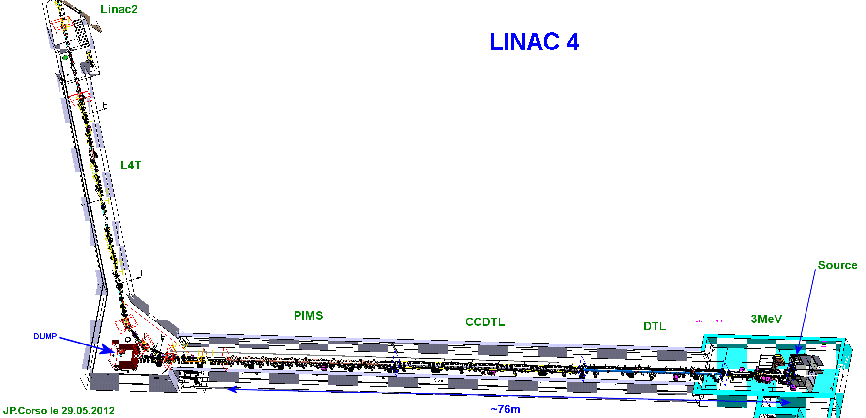
Location of the HST Installations
L4T: new Linac 4 to Linac 2 transfer line
PSB half-sector test installation (temporary installation)
H⁻ stripping foil+BTV unit (permanent installation)

Slide 5
Top View of Future PSB Injection Section
Stripping foil
test - Phase 1
HST –
Phase 2
Courtesy of L. Zuccalli, R. Noulibos, B. Riffaud, C. Baud, S. Burger and J. Borburgh

Slide 6
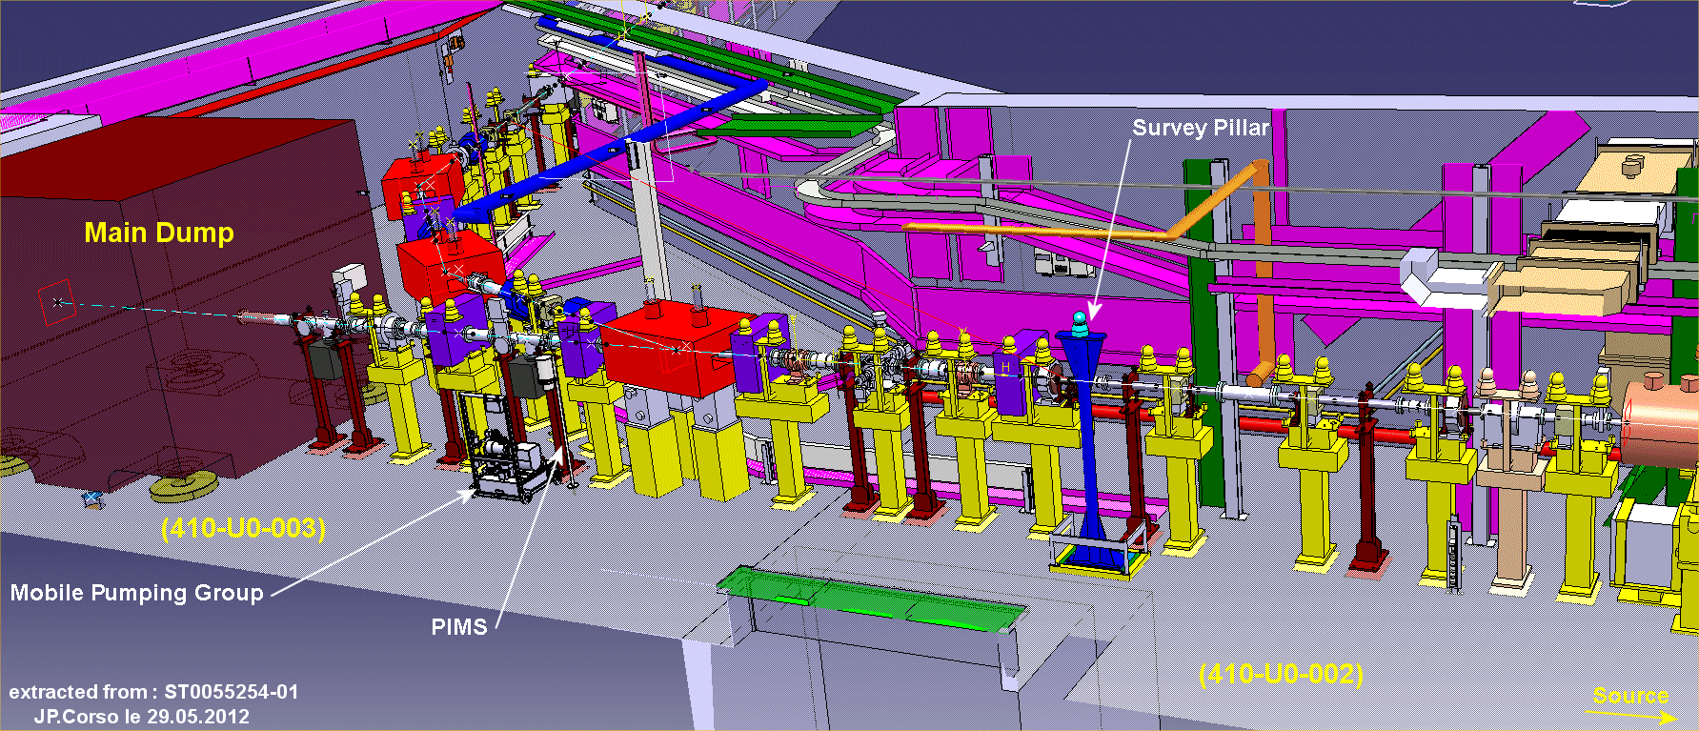
Scope of the Project – Phase 1
Phase 1: Permanent installation of one H⁻ stripping foil+BTV unit
2012 L4T layout of section 1.1
Location for
H⁻ stripping foil unit
Future location for BI laser
stripping installation (not part of
this project, but modifications to
L4T have been included in stripping
foil ECR EDMS 1376356)

Slide 7
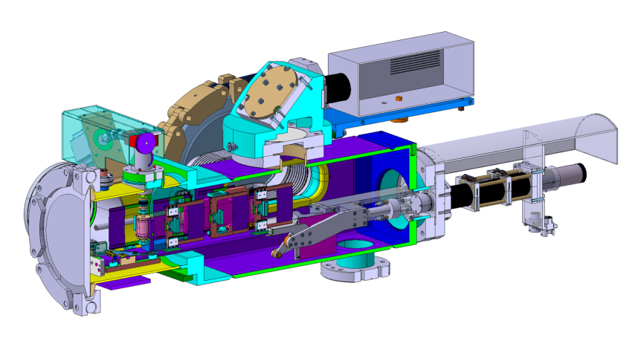
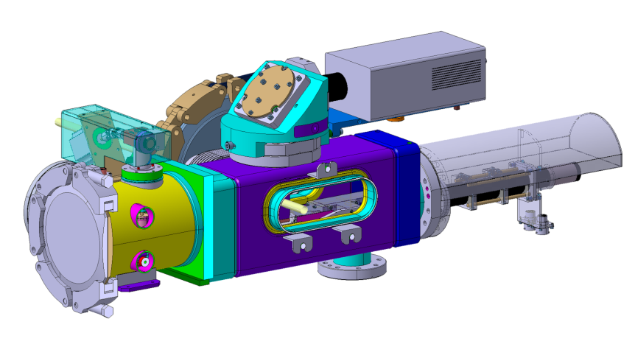
Foil Handling Mechanism
Radiation Hard
Camera
Mirrors and
Optical Filters
Stepping motor
Beam
Magnetic
coupling
Foil Changer
Beam Observation
System (BTV) with
Screen retracted
Vacuum
Chamber
Courtesy W. Weterings, R. Noulibos

Slide 8
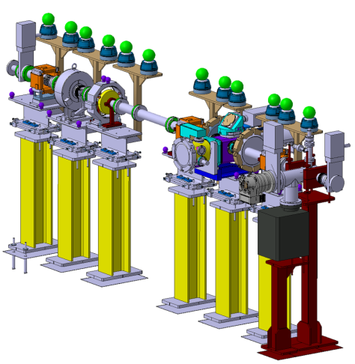
New Layout of L4T sector 1.1
Beam Current
Transformer (BCT)
PIMS
Beam
Vacuum
Valve
Vacuum
Valve
To optimise intervention time and avoid foil damage due to differential pressure, the system is installed in a dedicated vacuum sector.
Stripping Foil
Test Stand
Courtesy W. Weterings

Slide 9
Test Program for Part 1
Lifetime of different foils and foil holders
Controls of foil changer including interlock with screen insertion
Commissioning and optimisation of the instrumentation at the stripping foil (screen + mirrors + camera, foil temperature and current measurement from foil holder)
Rough estimate of stripping efficiency of different foil types and thicknesses
  Need 2 well cross-calibrated BCTs (L4T.BCT.0107 and L4Z.BCT.0273); H⁰ will not be detected and H⁻ will cancel with p (but H⁻ signal negligible), so expect transmission of ~98%!
Detection of foil breakage (foil current)
Hope to be able to obtain a rough estimate of emittance growth through the foil using the SEM grids in L4Z line
Beam size on foil will be similar to situation at PSB injection
Tests can be performed in parallel to Linac 4 beam tests (except for emittance measurements of H⁻ beam at end of line)

Slide 10
Status of Phase 1 – Stripping Foil Test Stand
ECR done and L4T layout and drawings of section 1.1 modified
Holes drilled for new supports
Rack platform in b.400 modified and permanent rack installed
Cables pulled
Stripping foil unit:
  System being tested in the lab including interlocking with BTV screen movement
  Some details still outstanding (support, targets for alignment, foil current meas., T probe,…)
  Second unit being prepared for installation
  Installation foreseen for end of this year
Notes:
First stripping foil loader not vacuum compatible. Will be dismounted later and reassembled once all individual pieces have been cleaned.

Slide 11
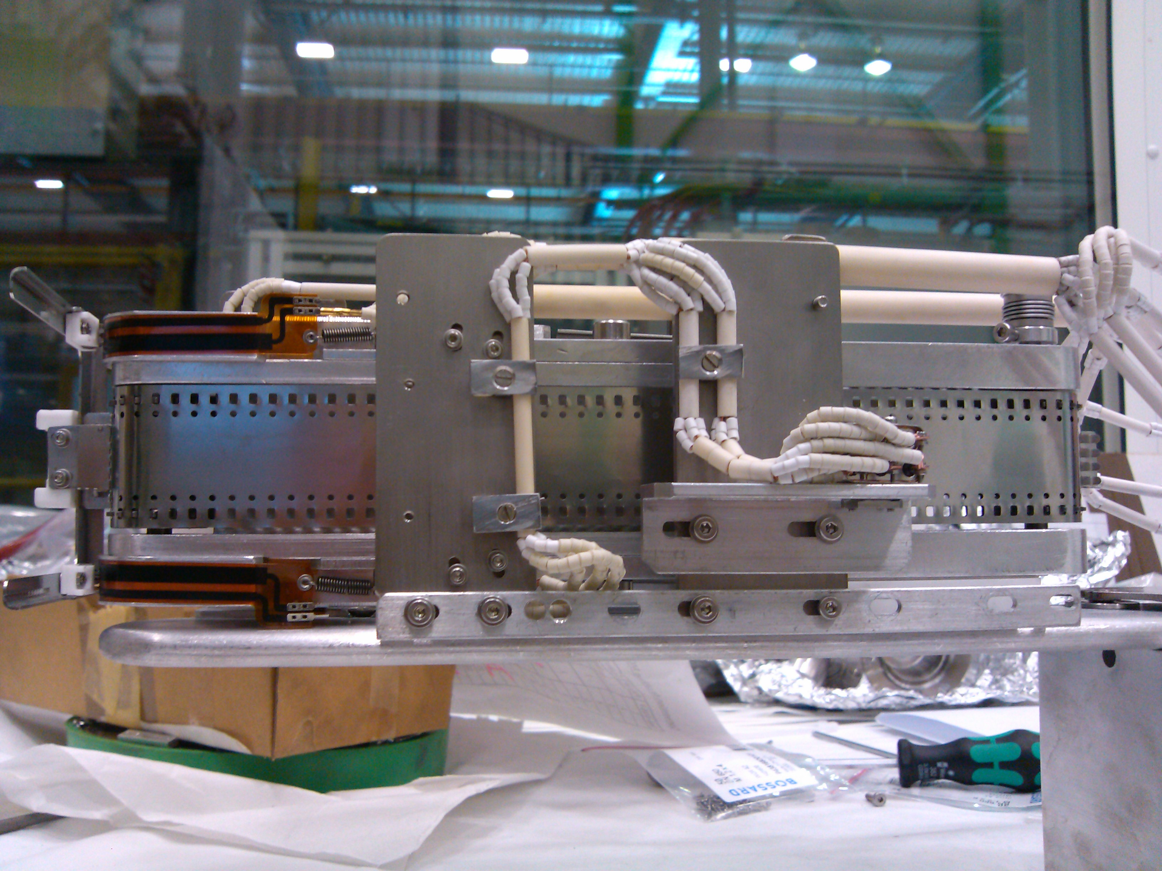
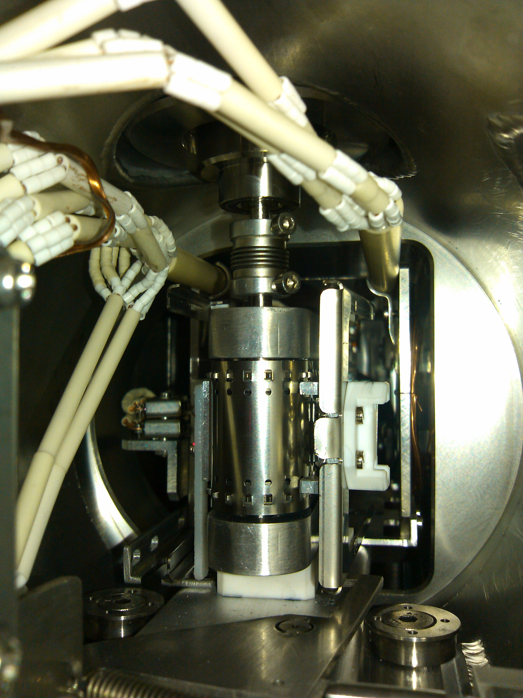
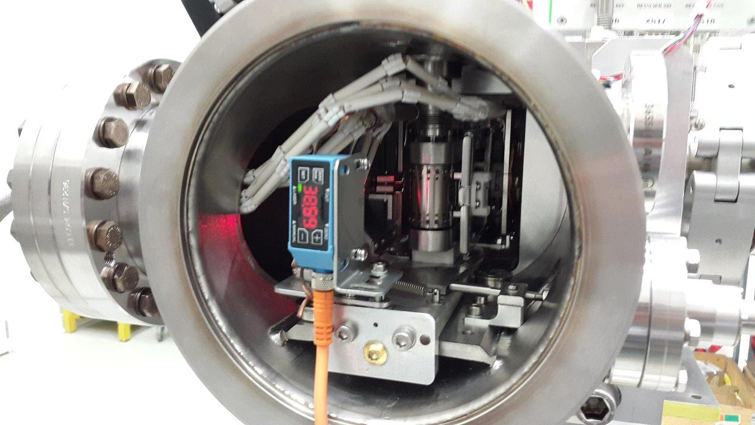
Stripping Foil Unit Status
Foil loader (left), complex cabling with ceramics isolation in tight space (right) and stripping foil chamber unit (bottom).

Slide 12
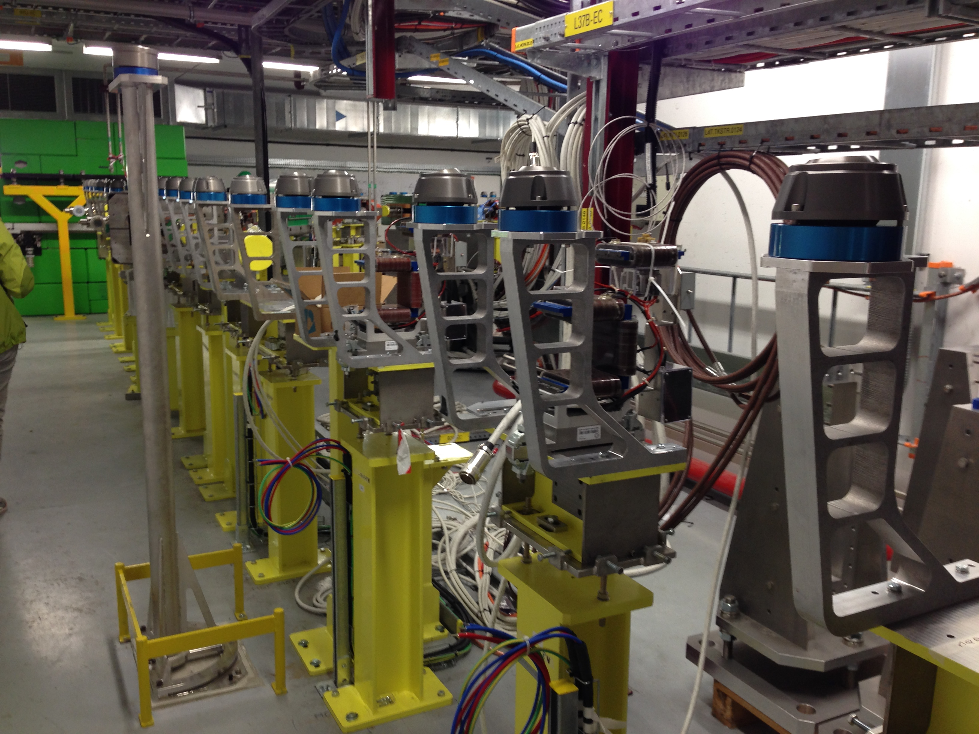
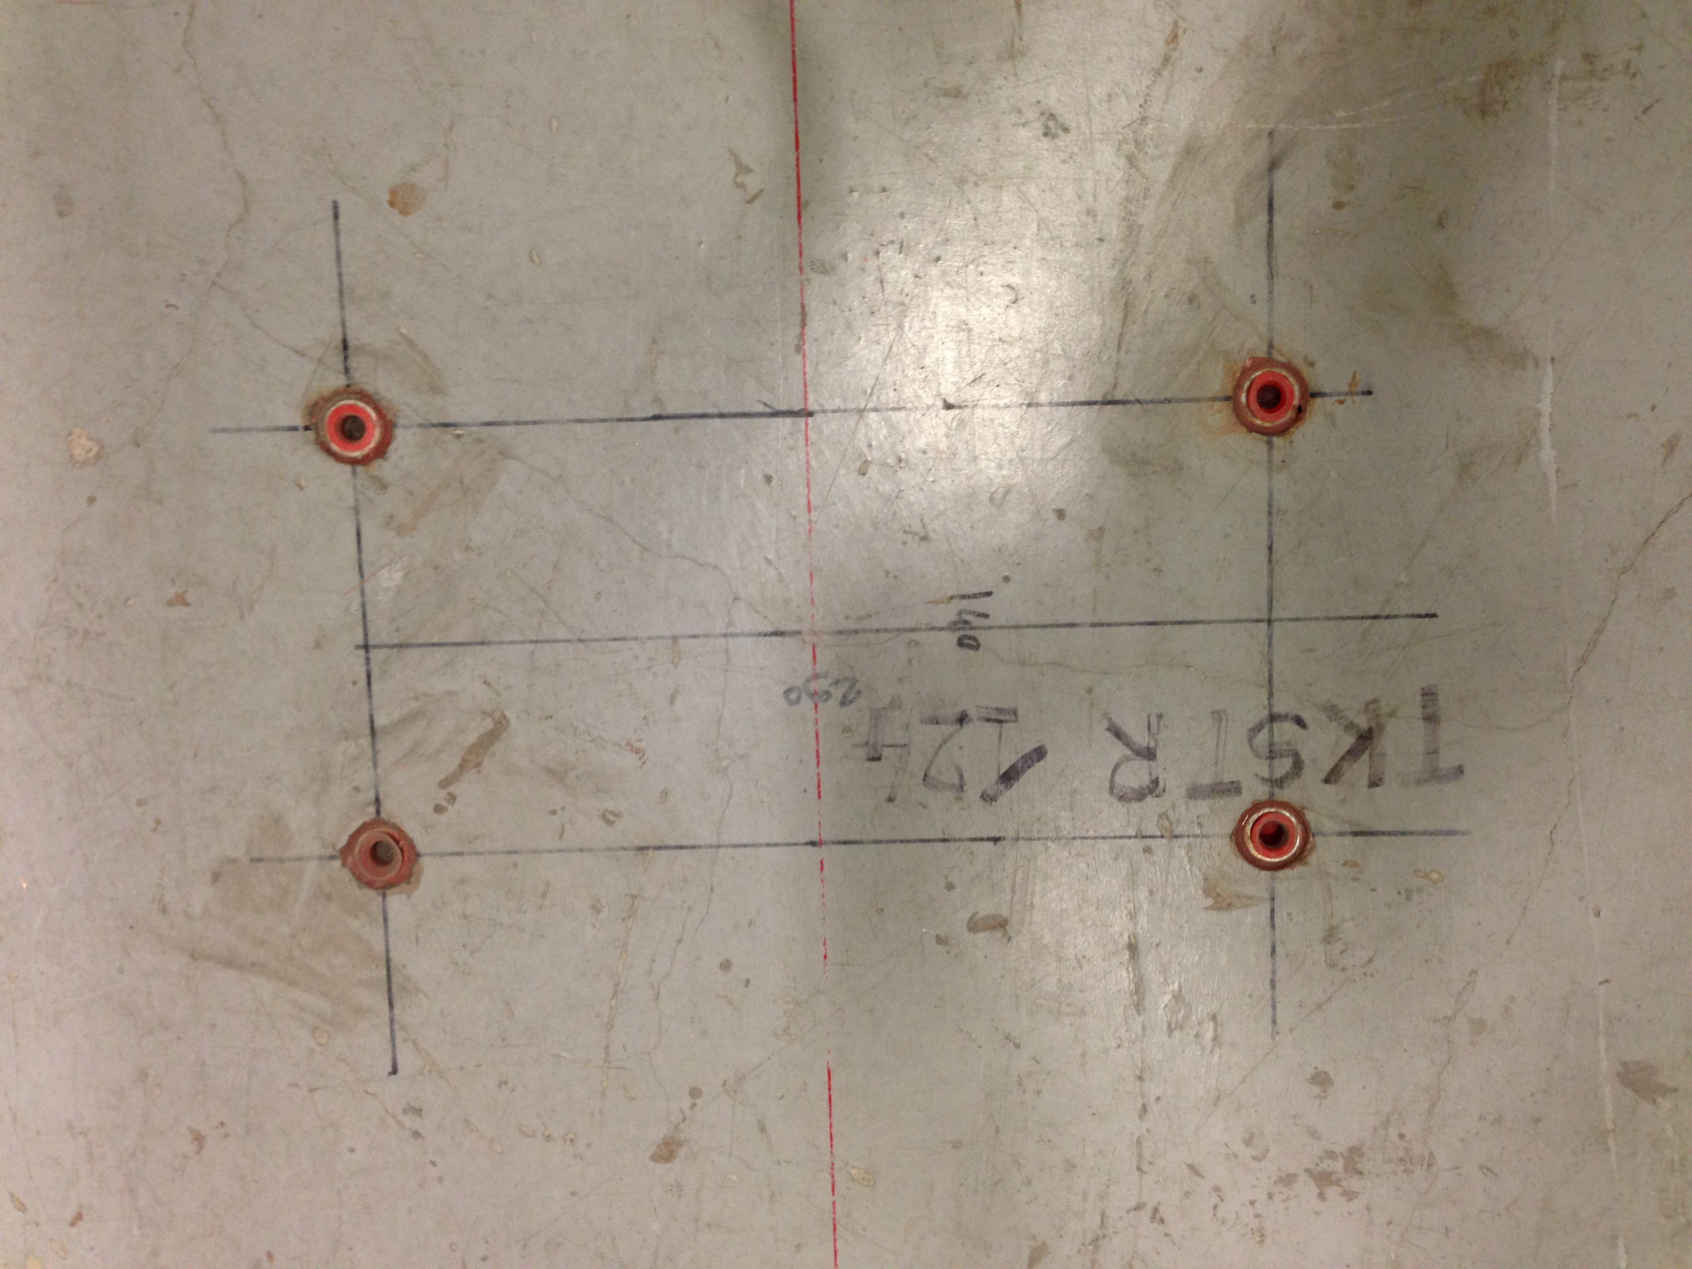
Stripping Foil Unit Installation Status
Holes drilled and everything
prepared in L4T for the installation.

Slide 13
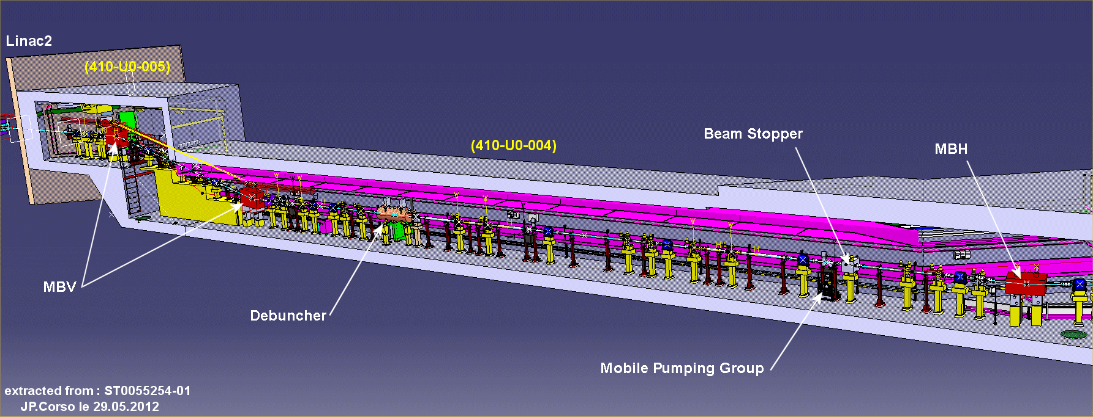
HST – Phase 2
Phase 2: Temporary installation of half of the future PSB H⁻ injection chicane + external dump
  Around location of debuncher (L4T sector 4.5)
  Install L4T only up to this point (plus line between 2 vertical bends)
  Positive ‘side effect’: Commission already L4T line until debuncher

Slide 14
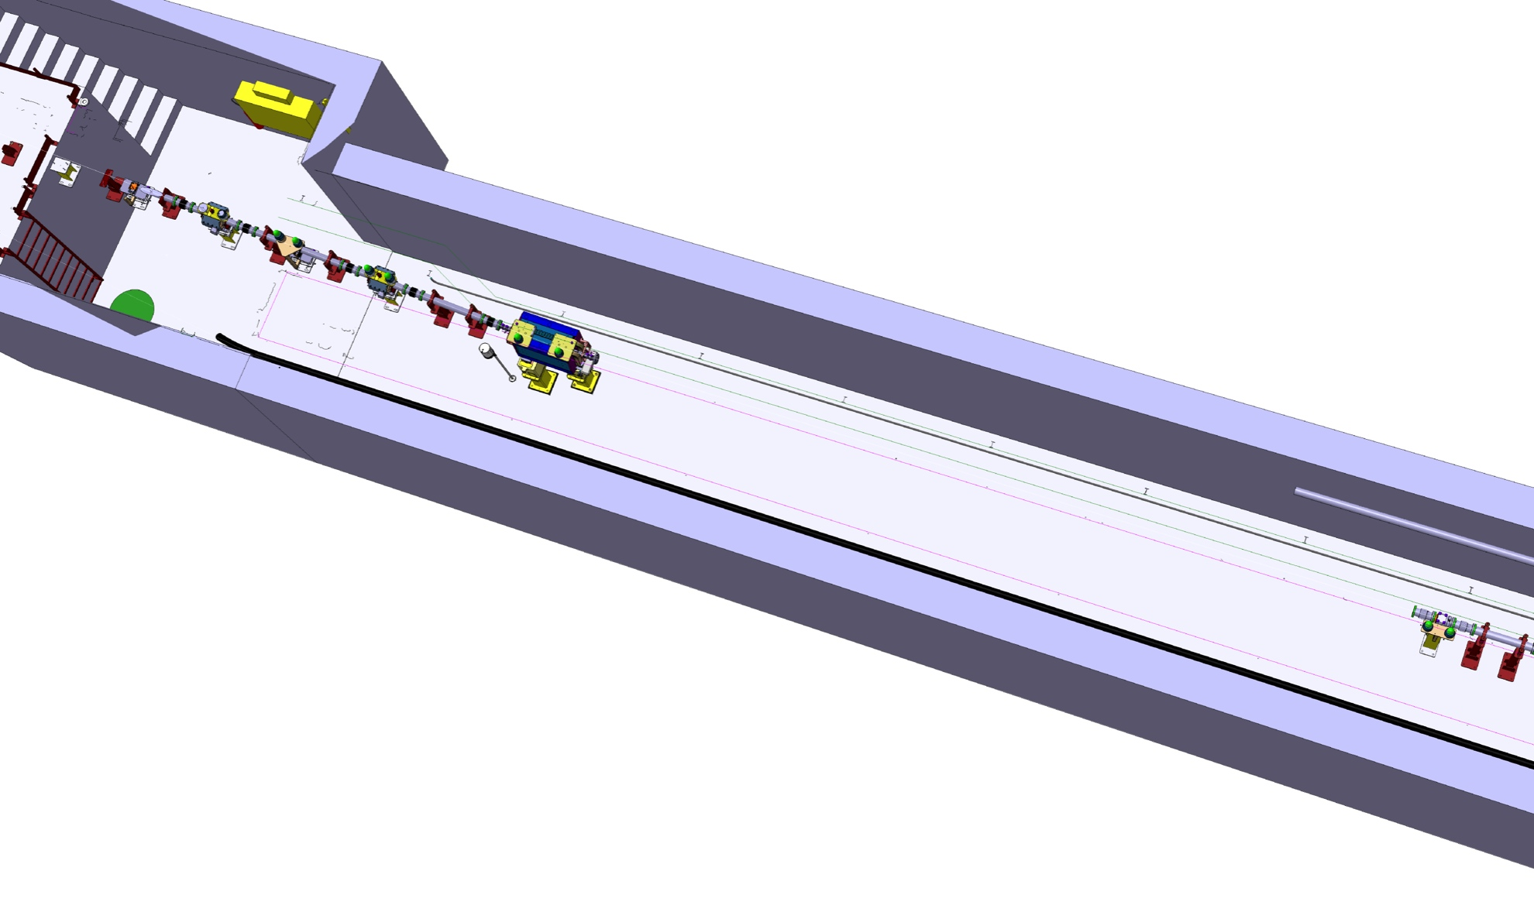
HST Implementation

Slide 15
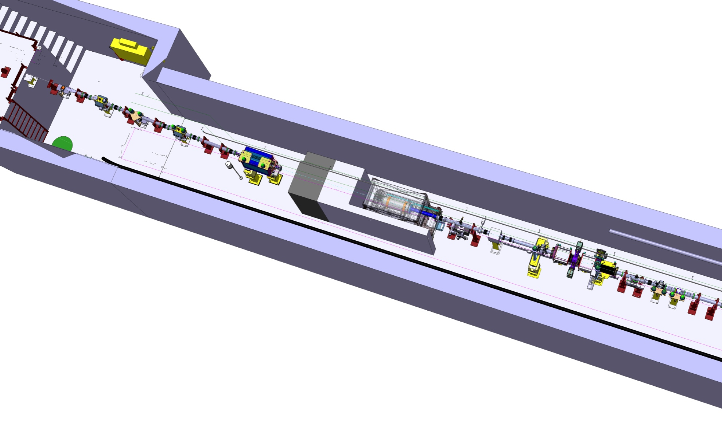
HST Implementation
Courtesy B. Riffaud and J-P. Corso

Slide 16
Schematic Layout of HST
~12 m
SHIELDING
Notes:
Shielding: 0.8 m iron + 0.8 m concrete.
Lateral shielding thickness: 20 cm.

Slide 17
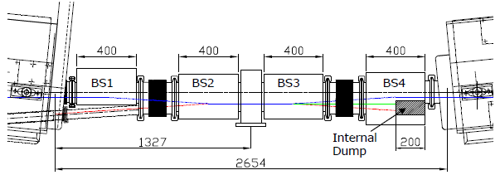
Inventory of the Half Sector Test
Install another stripping foil+BTV unit, half of the injection chicane (BSW3+BSW4) including the H⁰/H⁻ dump and the H⁰/H⁻ current monitor
In addition: 1 standard + 1 diamond BLM, 2 BCTs (stripping efficiency cross-check), 1 BTV + external beam dump+shielding (including vacuum valve)
2 sector valves enclosing the installation, pumping groups
Strategy: Use where possible prototypes, spares or not yet required Linac 4 equipment and cabling (e.g. standard BLM and BCTs)
L4-T-EP-0002 rev 1.0
Notes:
Requires ~1.3 m space (half-sector with stripping foil unit).

Slide 18
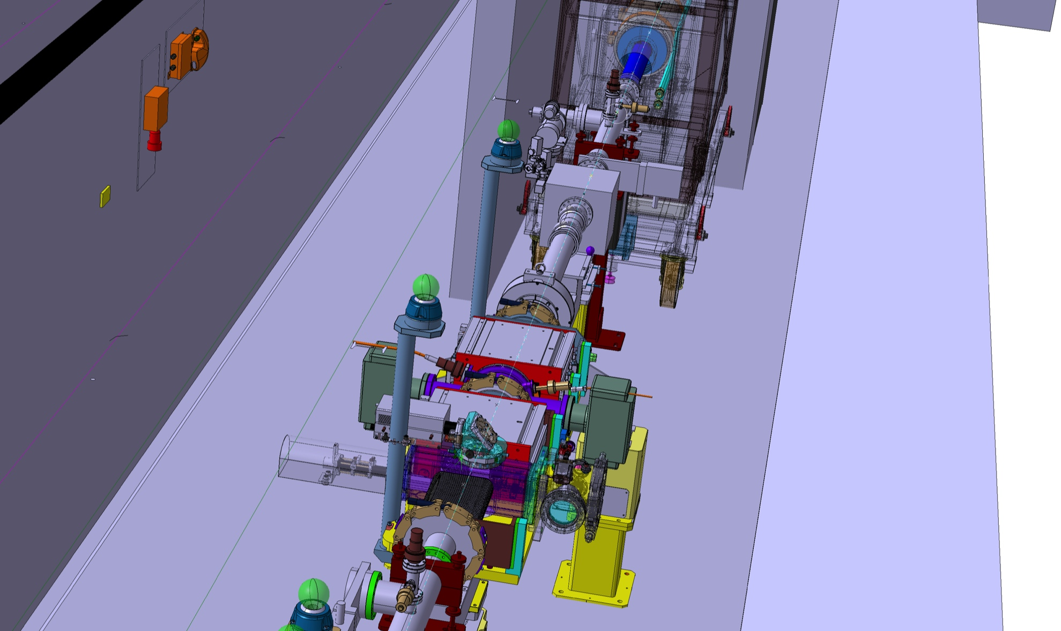
Courtesy B. Riffaud and J-P. Corso (2014 version)

Slide 19
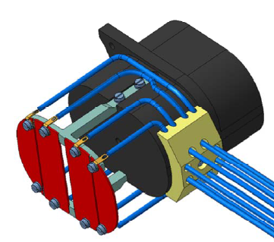
Test Program for Part 2
Stripping foil
  More precise stripping efficiency measurement of H⁰ and H⁻
BSW3+4
  Powering and control of half of the chicane magnets
  Refine chicane parameters
  Current stability, precision and interlocking
H⁰/H⁻ dump
  Aperture check
  Temperature cross-check with simulated values → refine cooling needs
  Interlocking (temperature and pressure drop – define operational thresholds)
Diamond BLM
  Diamond BLM to measure secondaries close to H⁰/H⁻ dump; evaluate operational conditions for foil degradation measurement and fast losses
H⁰/H⁻ current monitor: New development!
  Sensitivity check for H⁻; comparison to theory
  Aperture check
  Influence on measurement if beam passes besides the monitor (use thicker foil; simulate circulating beam)?
  Interlocking – essential for dump protection
Interlock system test for part of PSB injection (BIS + SIS)
Prepare and test new applications + controls
Drawing of H⁰/H⁻
monitor provided
by F. Zocca

Slide 20
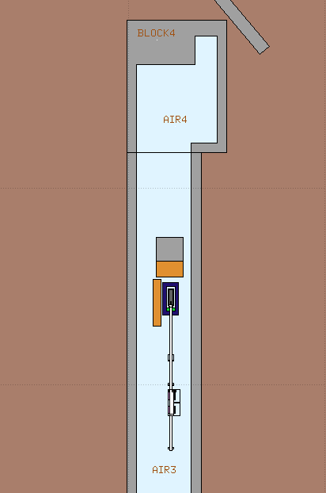
Prompt Radiation and Activation Studies
Temporary dump installation: use a spare 160 MeV dump core, reuse trolley from 100 MeV commissioning dump with modified shielding and install shielding walls.
Detailed geometry has been implemented in FLUKA
Assumption in RP analysis:
  2%/5% of H⁰/H⁻ on the internal dump (“unshielded”)
  Up to 100% can go to the “shielded” beam dump
Courtesy of M. Morgenstern
Courtesy of I. Leitao

Slide 21
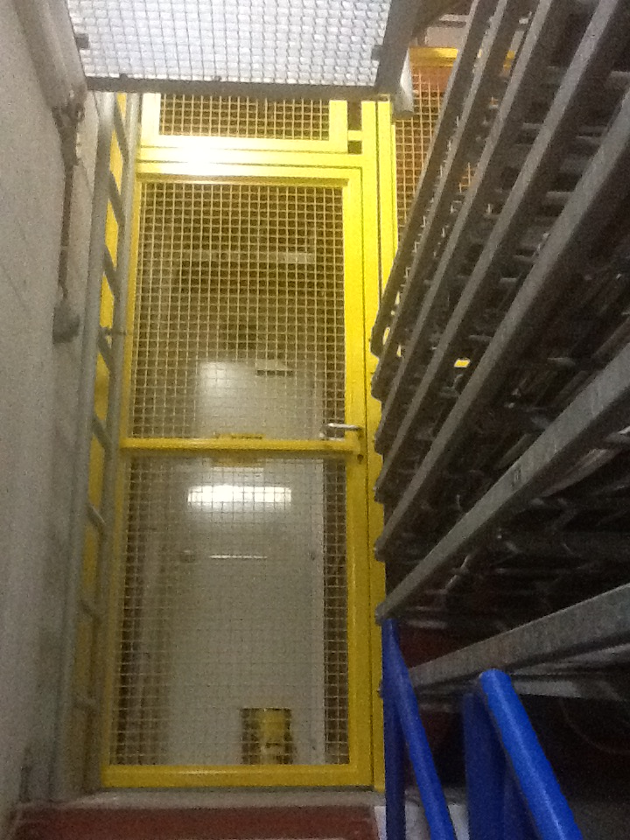
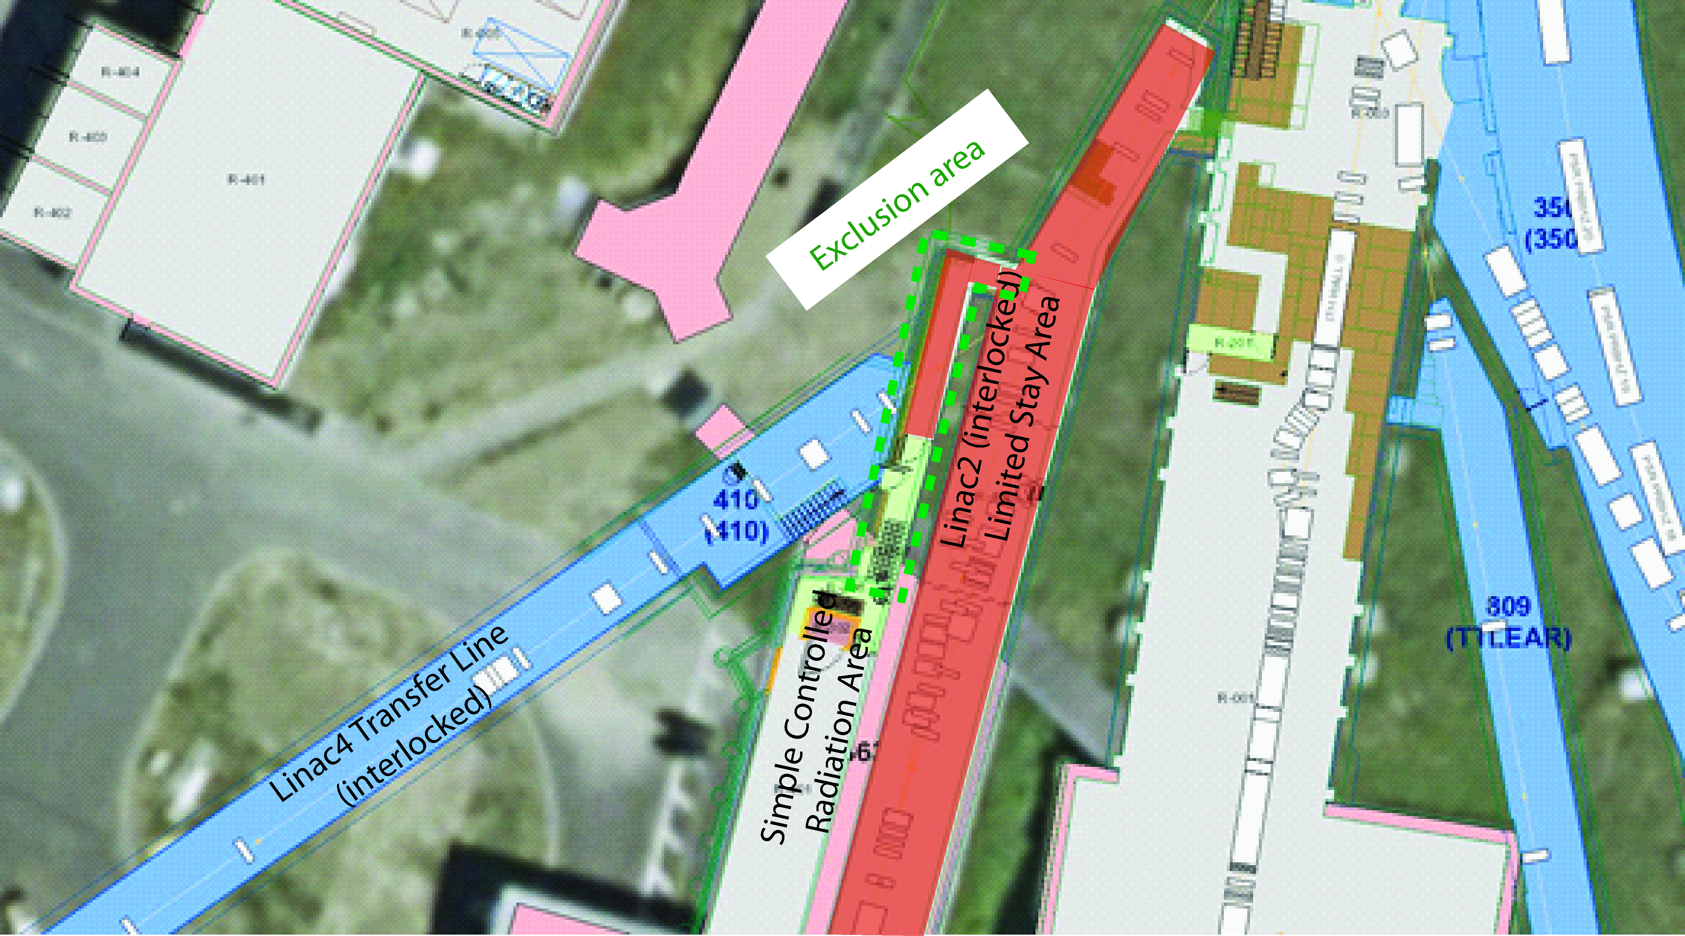
Prompt Dose Rate
Issue: Limit prompt radiation levels in the Linac 2 technical gallery (already classified by RP due to losses from Linac 2)
During operation the zone that is only used as emergency route from Linac 2 to the equipment gallery will be reclassified as ‘exclusion area’
  Fences with crash bars already installed

Slide 22
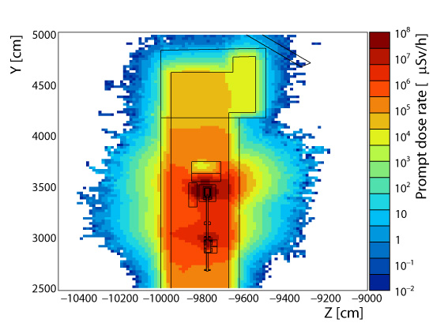
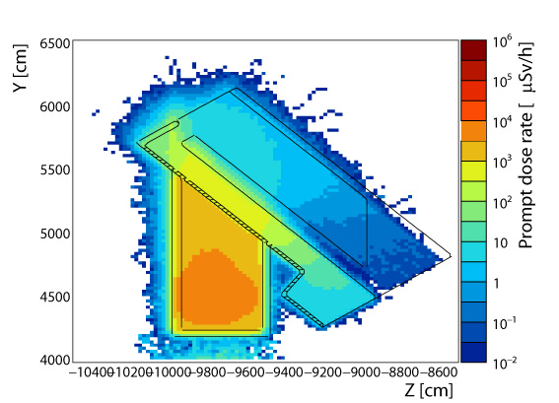
Prompt Radiation
Shielding was optimized with regard to the available space (yet streaming along the sides of shielding; emergency exit door in direct line of sight to H⁰/H⁻ dump)
Max. beam power with 95%/98% stripping efficiency determined to be 325 W/445 W in order to stay below 25 μSv/h at the boundary of the exclusion zone (warning level for low-occupancy area 50 μSv/h, to be divided up between Linac 2 and HST operation)
Prompt dose rate (Linac 4 level)
Prompt dose rate (amplifier gallery)
Exclusion area to be
implemented during HST
Courtesy of M. Morgenstern

Slide 23
Residual Dose Rates
Residual dose rate simulations have been carried out
  Might have to be refined with final numbers for intensity and stripping efficiency
  Will determine required cool-down time for interventions and HST dismantling
Work and dose planning for HST removal has started
  Preliminary time estimate: 3-4 days if work is done in parallel (less if temporary external dump will stay in place for beam tests with debuncher)

Slide 24
Proposed Operation
Plan to run only during daytime and week days, but detailed commissioning planning still to be elaborated
RP simulations: max. allowed beam power for 98% stripping efficiency is 445 W, corresponding to ~2E13 H⁻, but only single shots planned at convenient times
  With these results might be able to increase slightly the intensity of phase 2, in particular also because the repetition rate will be much lower
Operating Scenario | Phase 1 (2 months) | Phase 2 (2 months)
Max. pulse current | 40 mA | 40 mA
Max.+avg. pulse length | 0.5-1 μs | 10 μs
Max. repetition rate | 0.833 Hz | 0.833 Hz
Pulse period | 1.2 s | 1.2 s
Max. number of particles/pulse | 2.5E11 | 2.5E12
Particle energy [MeV] | 160 MeV | 160 MeV
Particle energy [J] | 2.563E-11 J | 2.563E-11 J
Max. energy/pulse | 6.4 J | 64 J
Mean power/pulse | 5.33 W | 53.3 W
Beam designation | Pencil beam | Low-intensity beam
1σ beam size | ~1.9 x 2.4 mm² | ~2.2 x 3.3 mm²
Notes:
For 325 W (5% stripping foil efficiency): max. no. of particles/pulse would be 1.5E13 (factor 6 higher than in table).

Slide 25
Status of Phase 2 – HST
Layout drawing approved (SPLLJLHS0001)
HST Engineering Specifications (including a chapter on safety) will be submitted before end of the year
Rack area in b.400 modified for temporary rack installation (rack layout SPLEY___7001); cables pulled
Equipment will be ready for installation (current status)
  Some issues with welding to the BSW Inconel chambers; new chambers should arrive by the end of the year
Commissioning planning to be worked out in more detail
Preparation of applications/controls and MADX survey file started

Slide 26
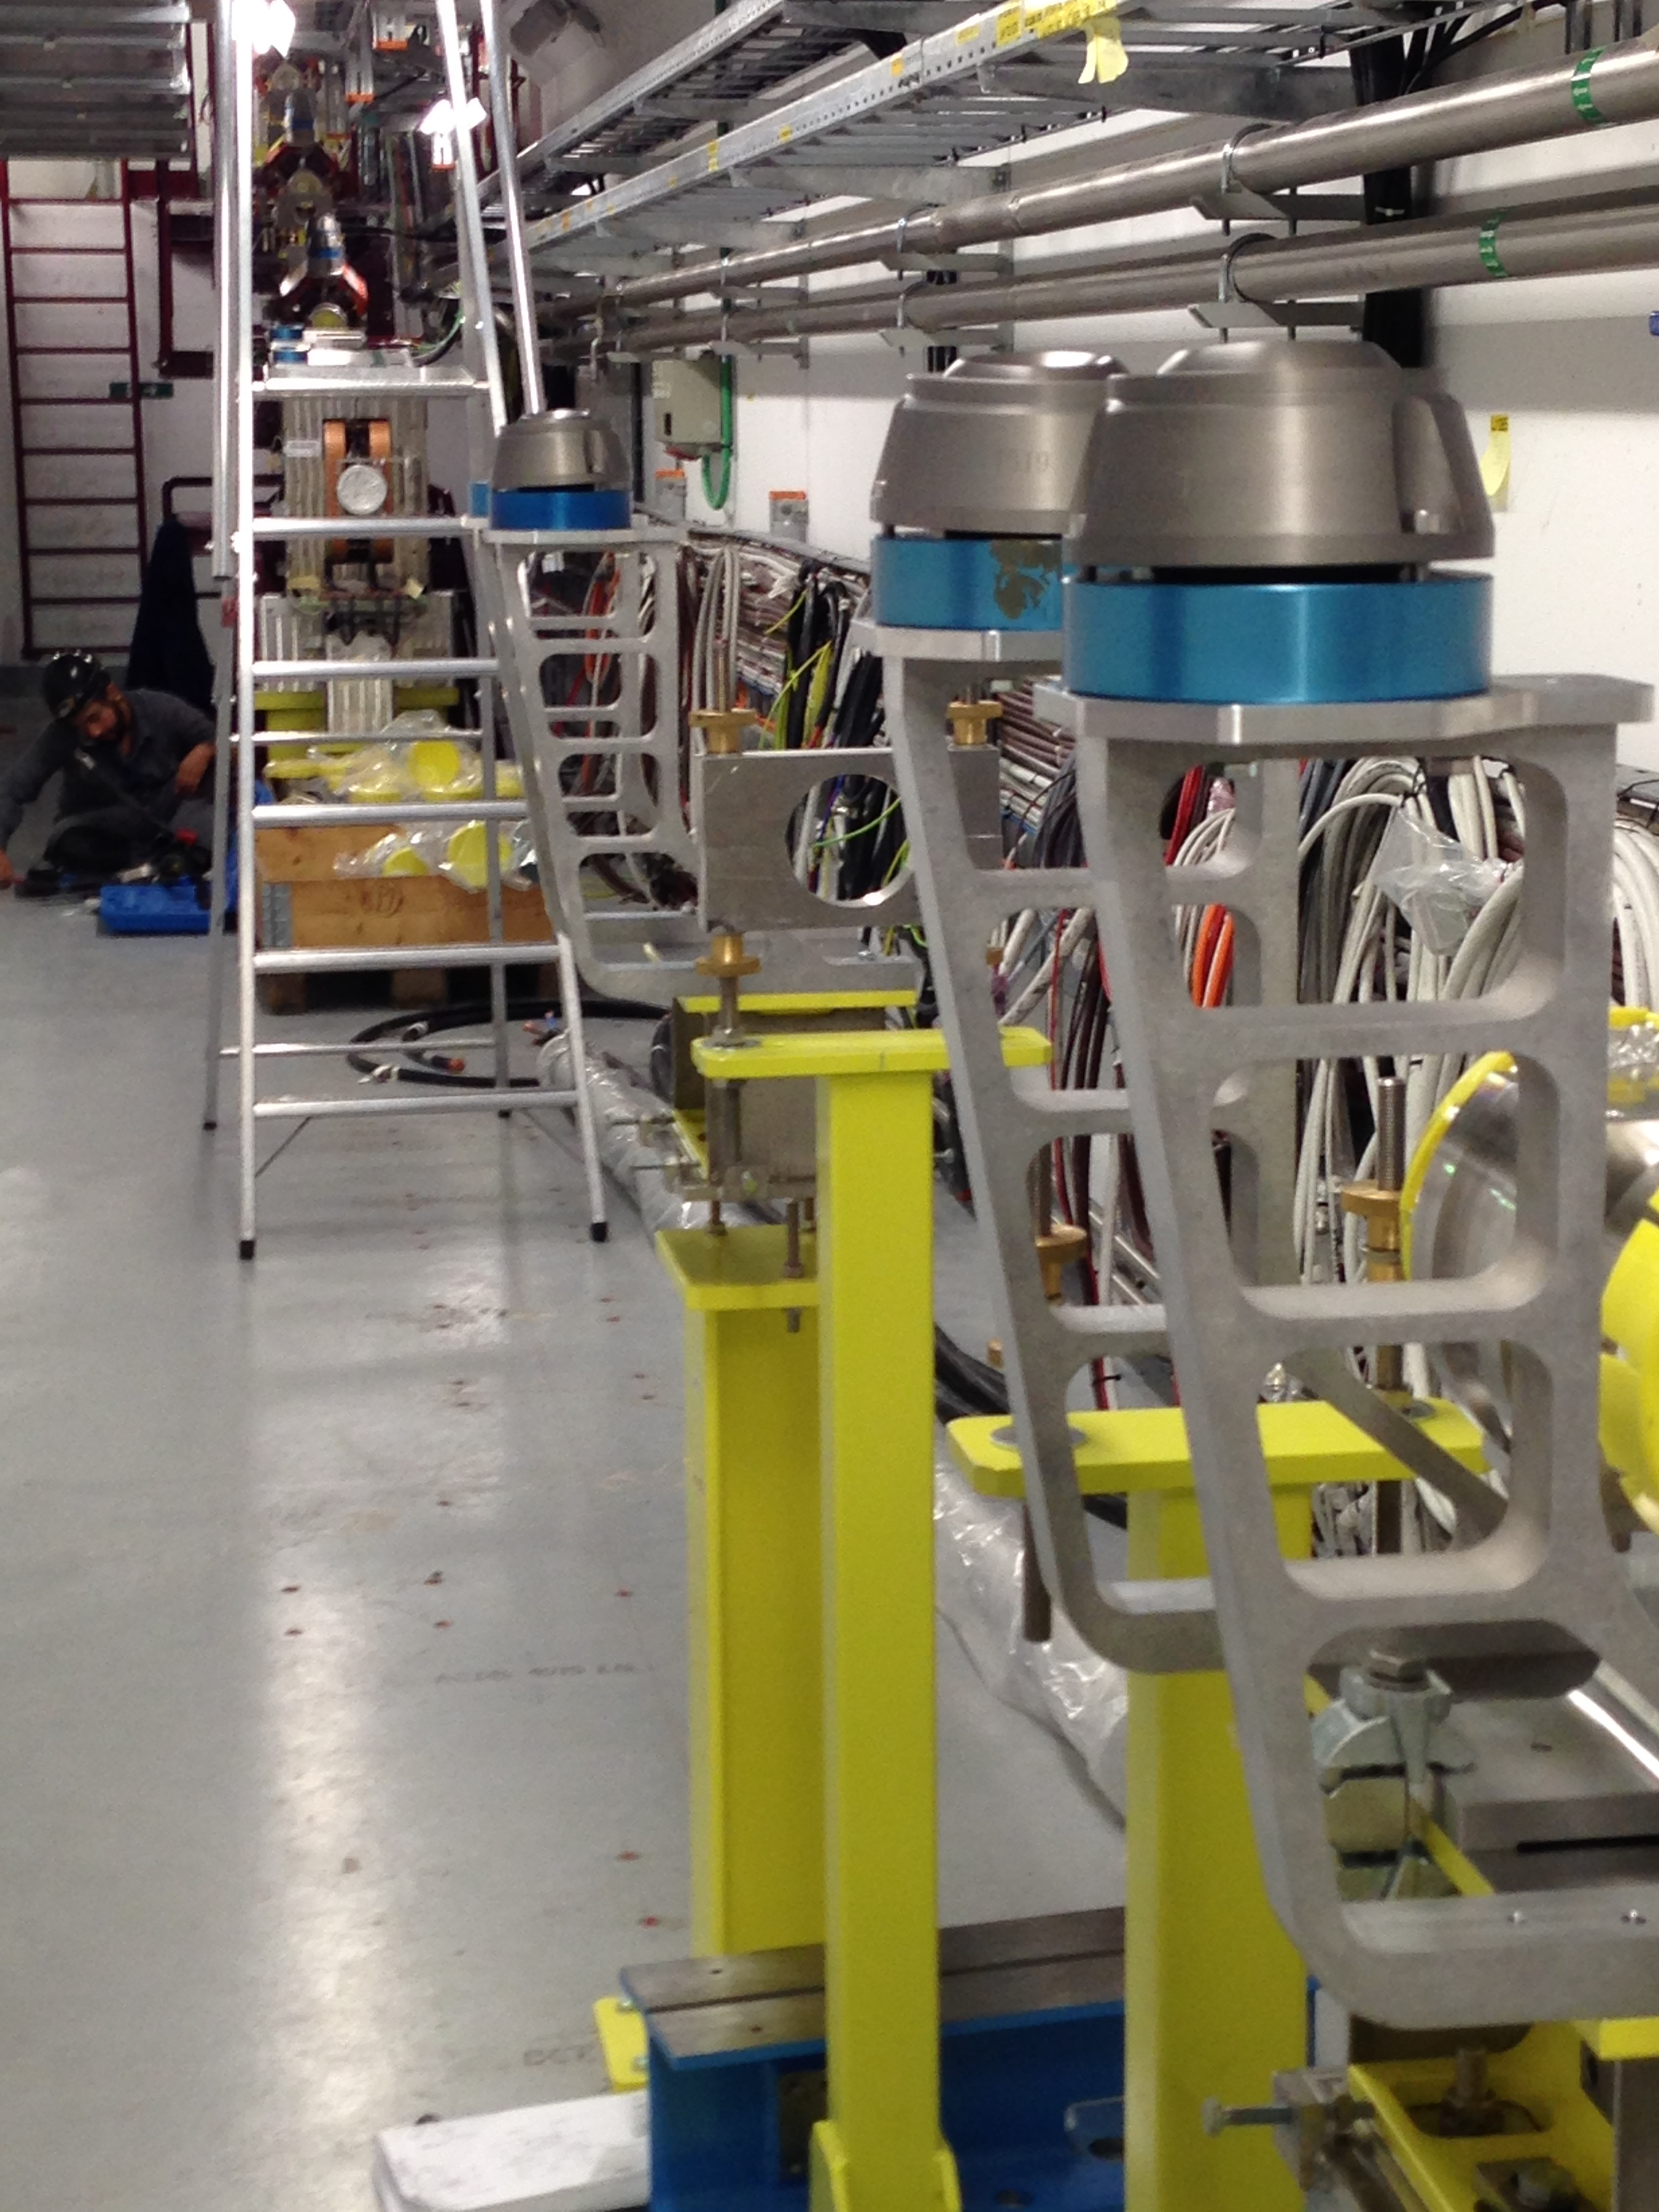
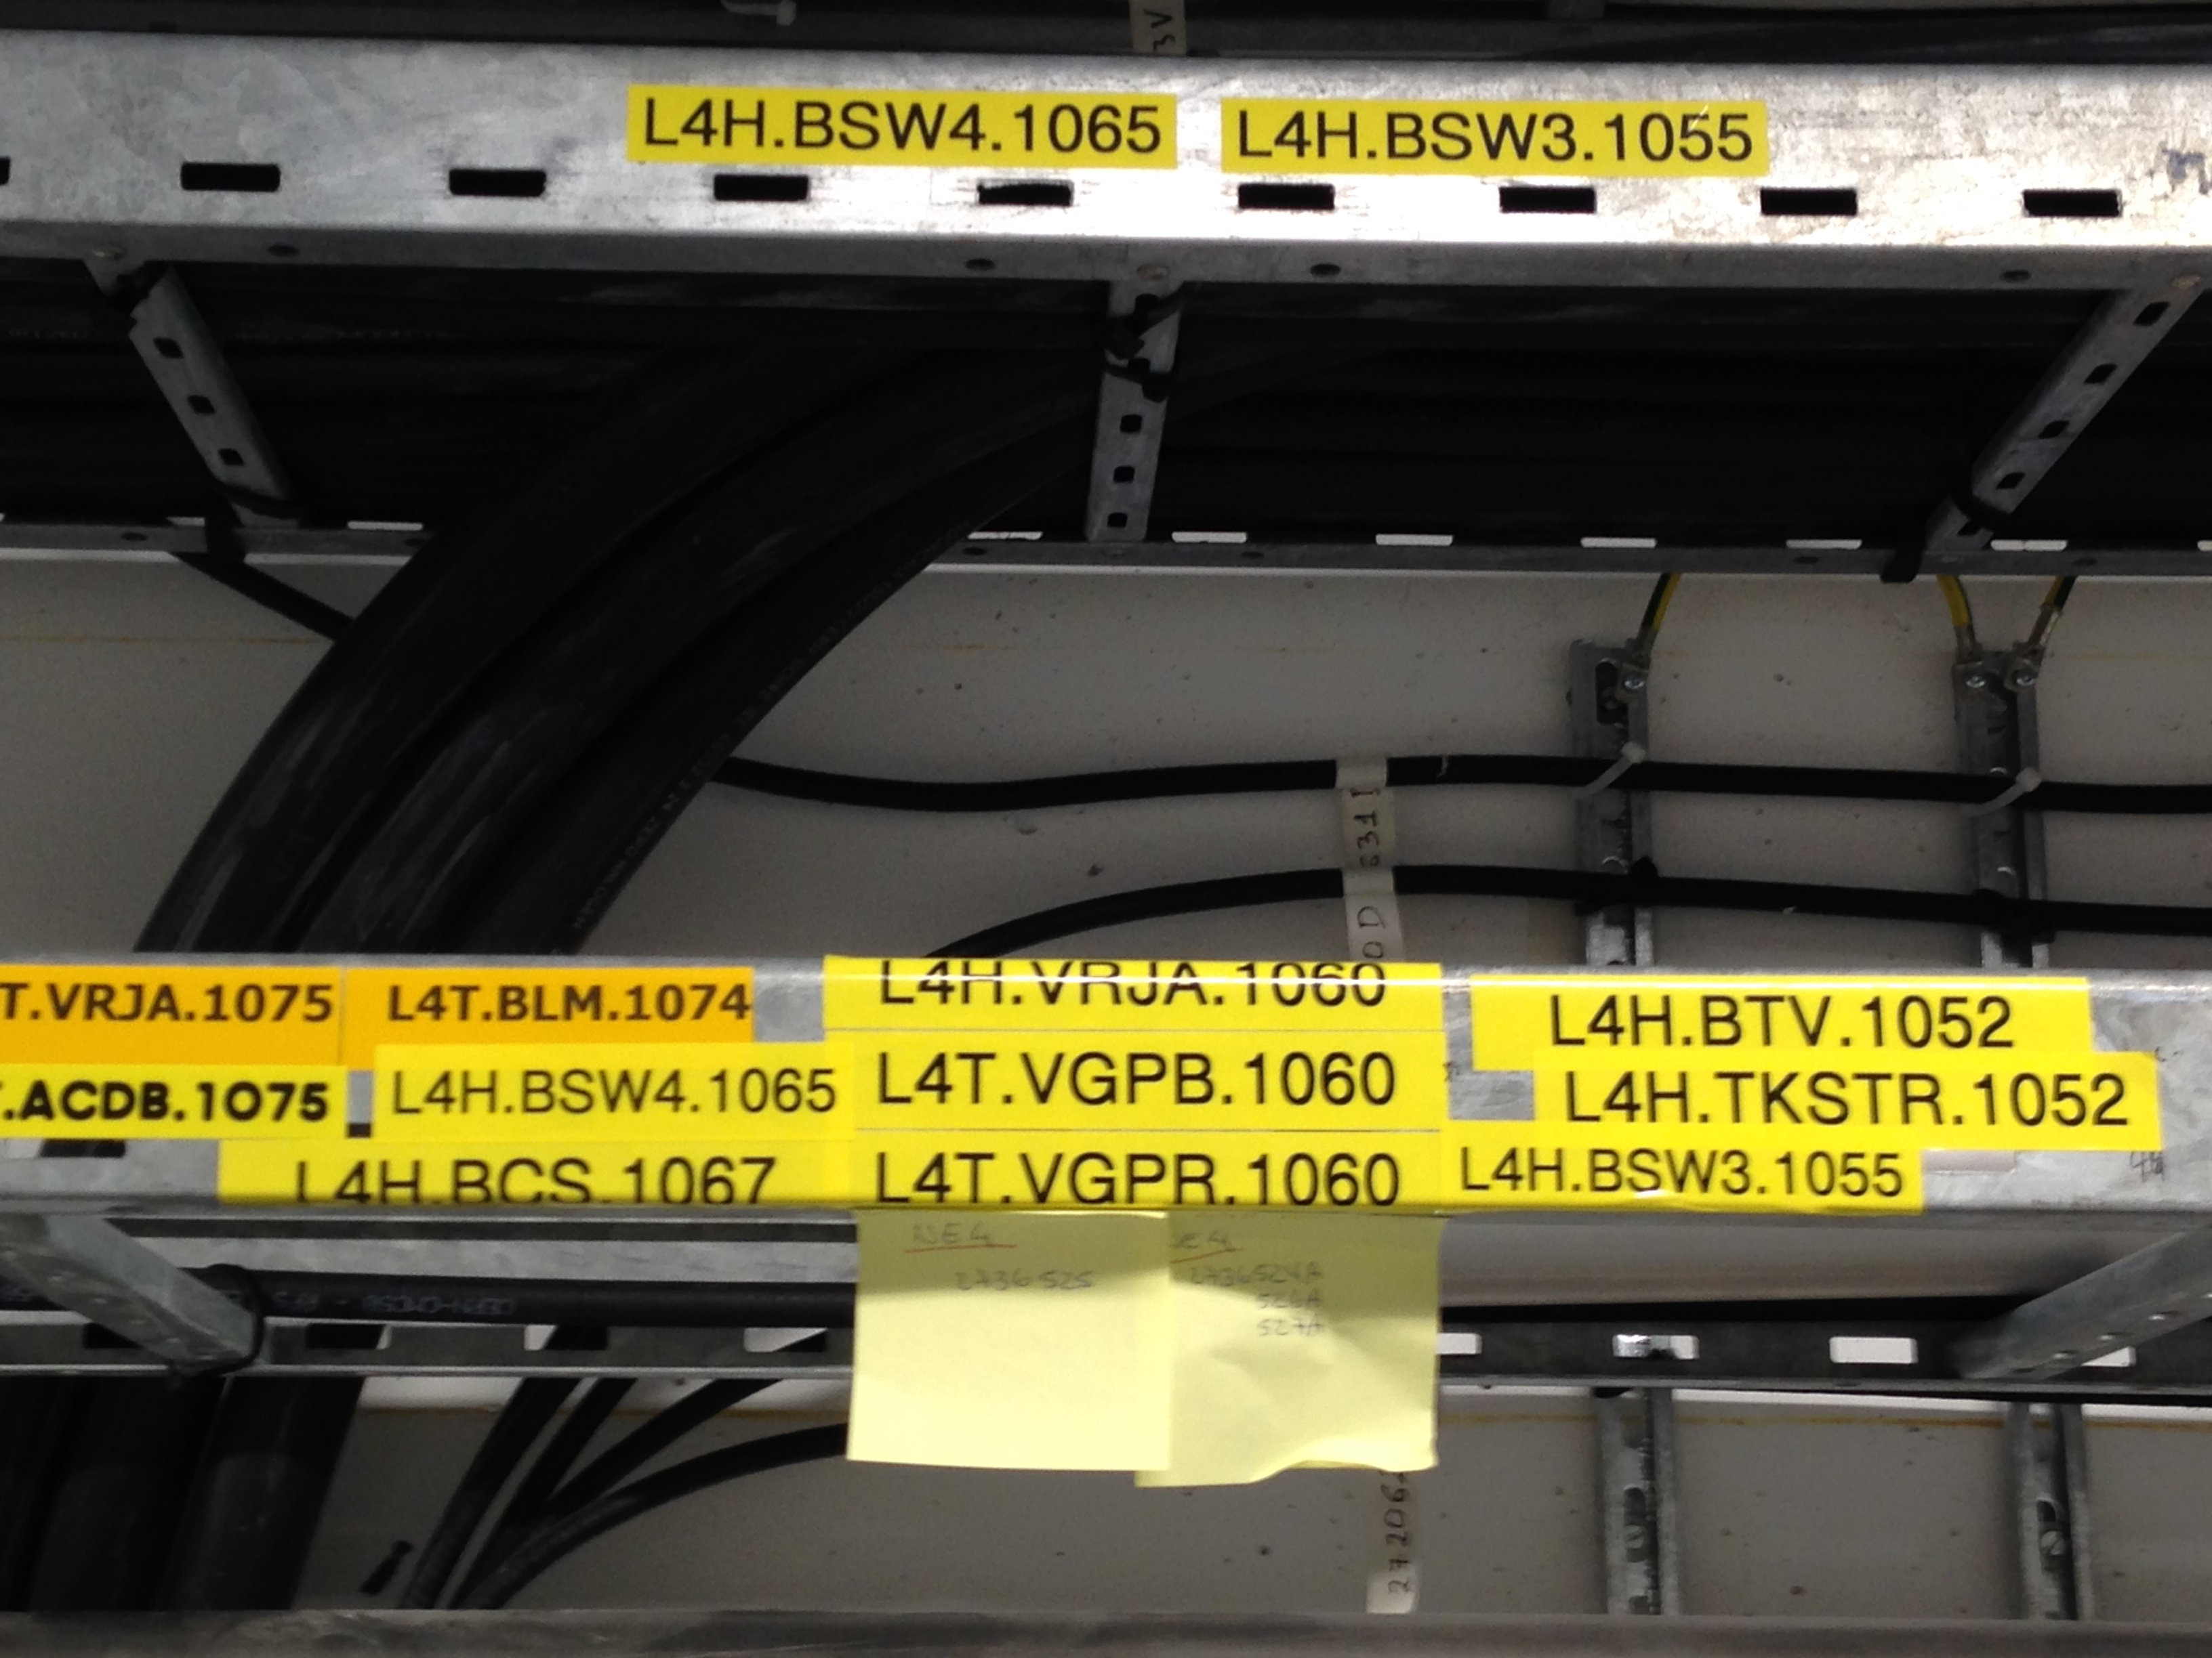
HST Installation Status
Cables pulled and area prepared; some holes still need to be drilled and supports/equipment to be installed

Slide 27
Organisation
Indico site available (under LIU-PSB)
HST Twiki website: https://twiki.cern.ch/twiki/bin/view/PSBHalfSectorTest/WebHome
Mailing lists:
  LIU-PSB-HALFSECTOR-TEST@cern.ch
  liu-psb-HST-WP-holders@cern.ch
Installation planning integrated in Linac 4 installation coordination meetings (organised by J. Coupard)

Slide 28
Current Linac4 Masterplan
J. Coupard
HST installation: ~April-July 2016
HST beam tests could start from end August 2016 in parallel with 160 MeV beam commissioning
  In case of additional delays/overlap with Linac 2 TS activities might be forced to limit the intensity
  Need support from equipment experts also during test phase!
Notes:
mid-October until November 2014: H- stripping foil permanent test stand installation (replace stripping foil system with vacuum pipe)
April – June 2015: HST services, cabling and what else can be installed (BCT + vacuum pumping module?)
November 2015: install everything else – will this be feasible (dump shielding installation?)

Slide 29
Conclusions
HST preparations well underway; currently no show stoppers
RP FLUKA simulations have been refined and have helped defining intensity limits, implementation of exclusion area and radiation monitor thresholds
Installation slots: dependent on Linac 4 commissioning planning
  Permanent installation (stripping foil test) to be installed end of the year
  HST preparation for installations well underway
Beam tests in parallel with Linac 4 160 MeV commissioning and reliability run
  Need to take into account boundary conditions in case of parallel Linac 2 shutdown works
  Need support from equipment experts before and also during beam commissioning; might not be evident if parallel to shutdown works…

