Slide 1
Measurements at 3MeV
Lombardi reporting for the source and linac team
(JB Lallement, J. Lettry, D. Fink and V. Dimov)

Slide 2
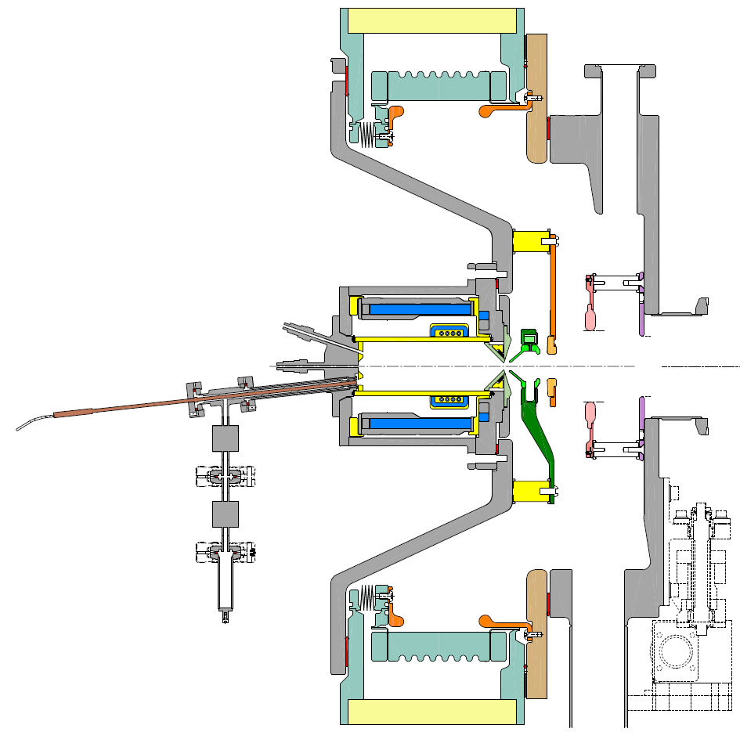

IS03a B-Op, B-ll optics
Orientation of the Filter and Dump magnetic dipoles:
B-Op := Opposite (or antiparallel)
B-ll := Parallel
Beam optics:
Source -45 kV
Puller / Dump -35 kV
Gnd. El.
Einzel lens +35 kV
Compatible to previous flanges & PGs
Reduction of the drift in the front-end by 100 mm
Protection of the Main insulator vs. Cs-deposition.
Improvement towards nominal emittance.

Slide 3
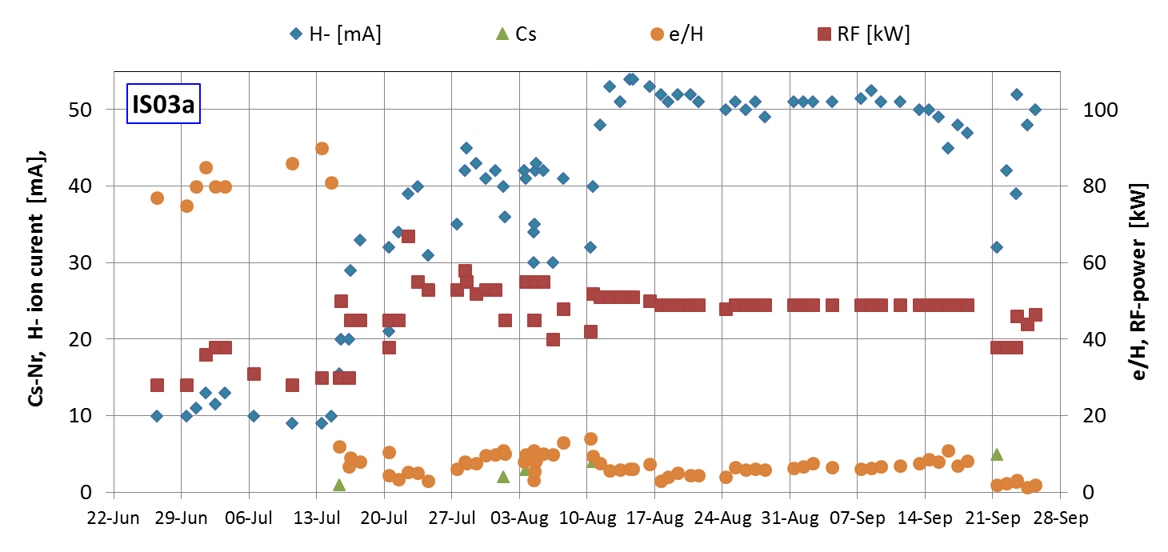
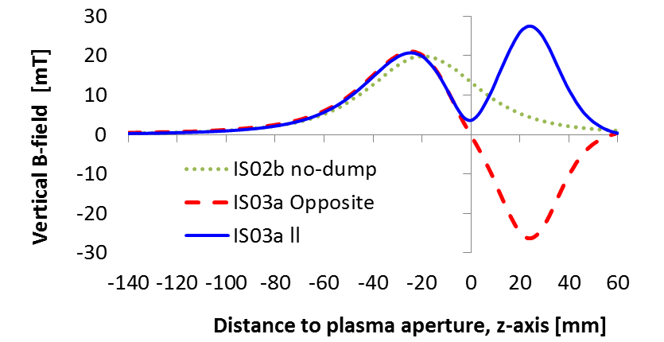
IS03a Linac4 Cs: 21.5 mg
No Cond. effect
9-weeks
2015
Plasma chamber Extraction / e-dump
Filter & dump B-Field
Inst. FE + leak test
Bake-out.
6 days
Opposite
Parallel

Slide 4
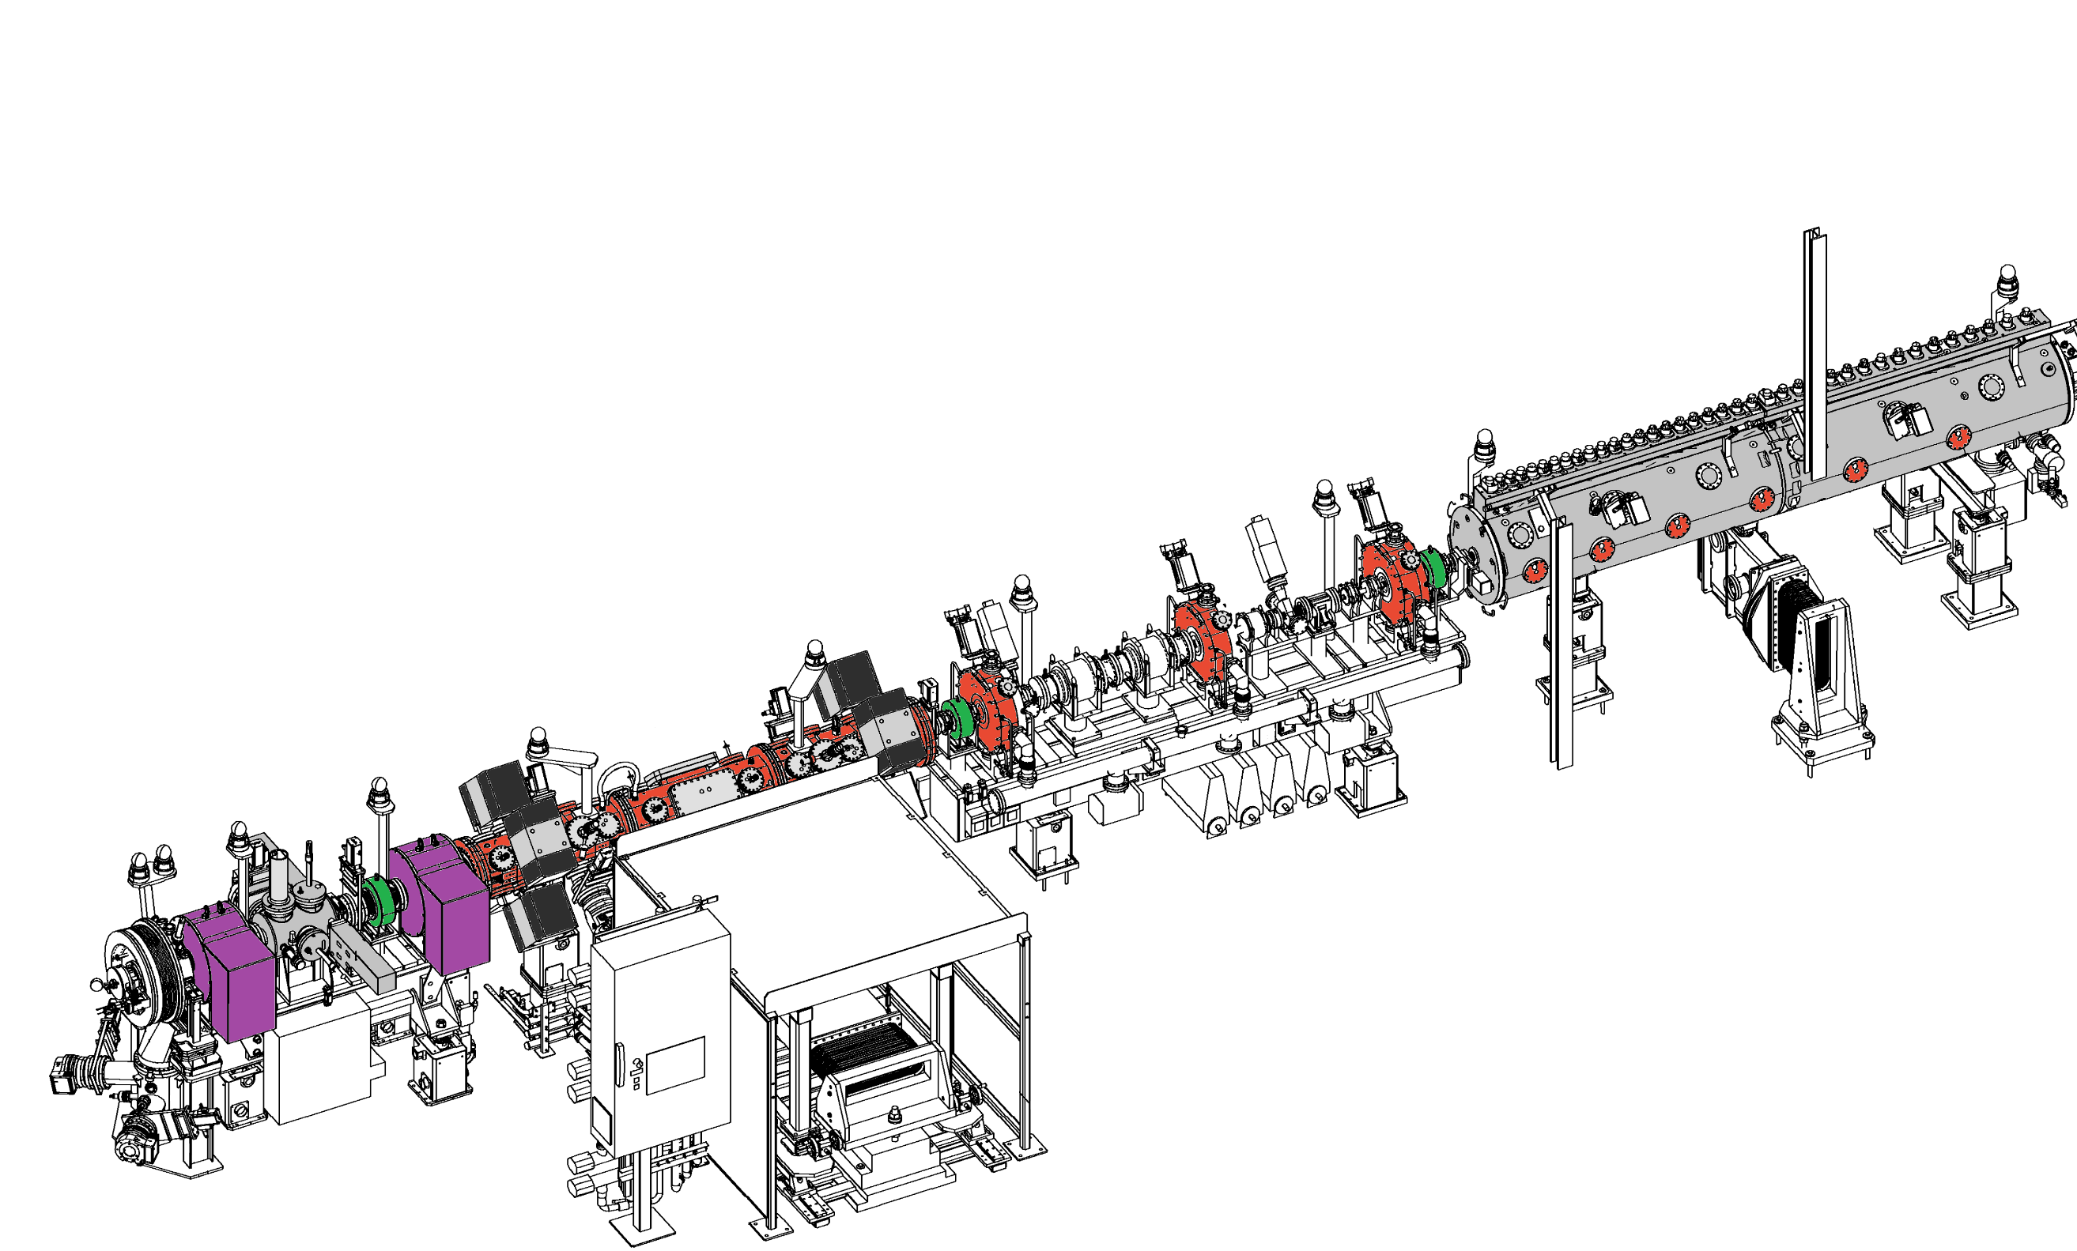
Measurements at 3 meV
Beam Current Transformers for Transmission measurements
(BCT)
Dump
Chopper

Slide 5
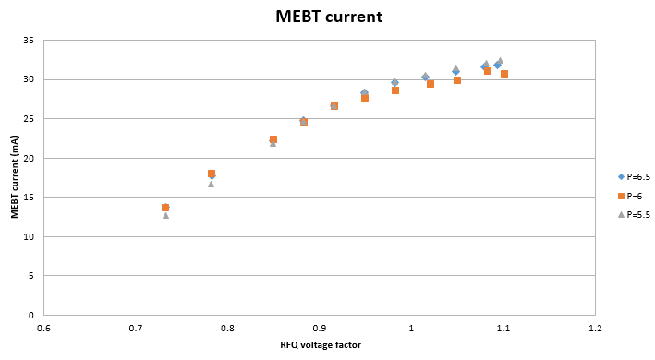
Measurements 1: we have 30mA at 3 MeV

Slide 6
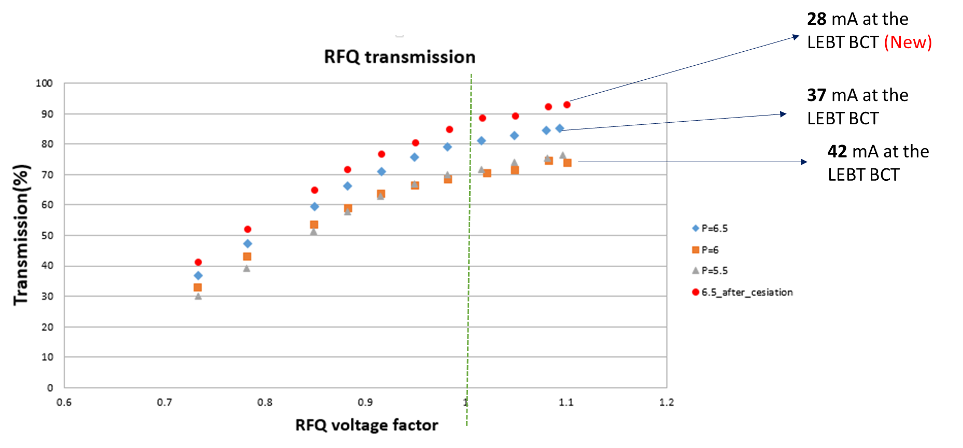
Measurement 2 : the source emit is still a bit too large and mismatched to the LEBT acceptance

Slide 7
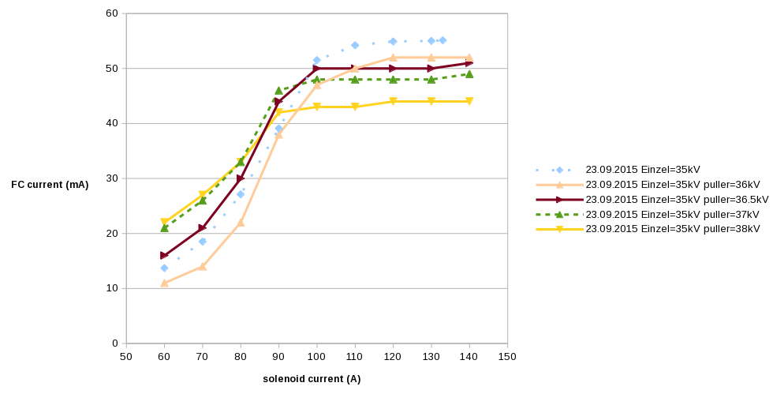
Measurement3 : we have a mismatch in the LEBT

Slide 8
Good news
We have a 30mA beam at 3 MeV available for commissioning the DTL up to 50 MeV
We have learned a lot about source/LEBT bottleneck and we think we are more knowledgeable on the matching into the LEBT
The emittance from the source is still too big, but the current has improved by factor and the stability/reliability is remarkable

