Slide 1
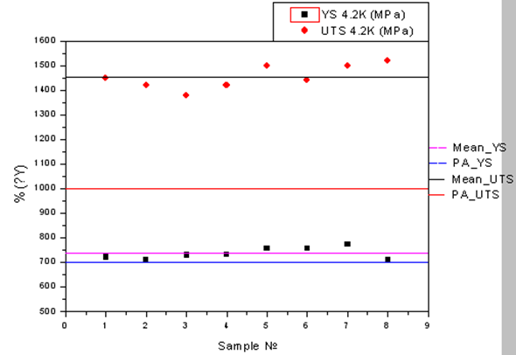
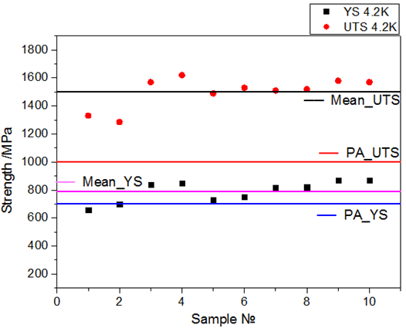
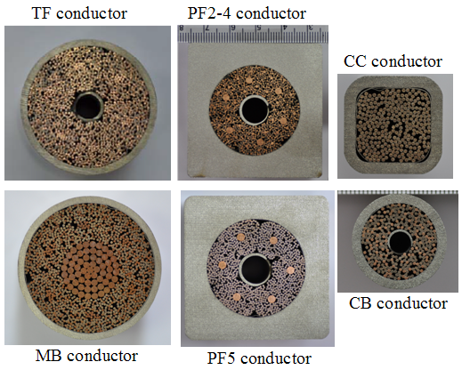
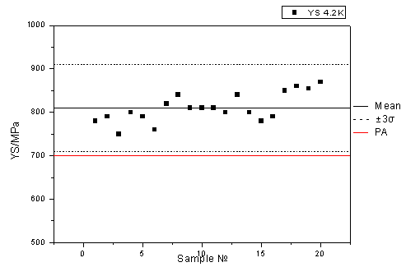
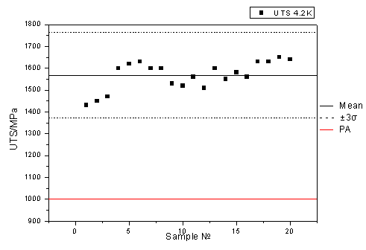
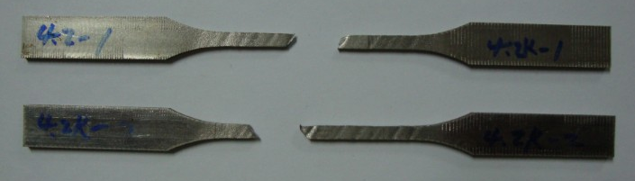
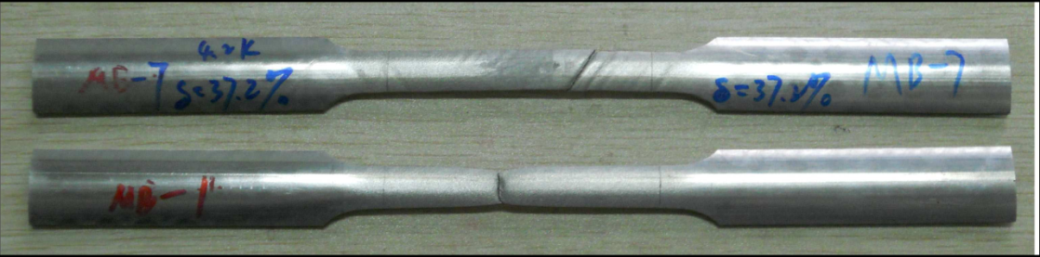
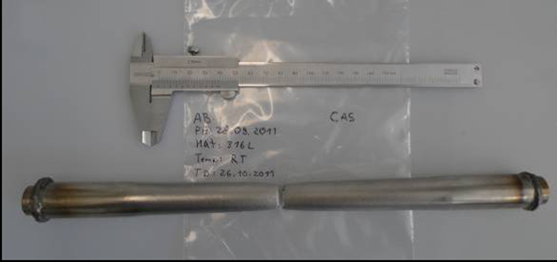
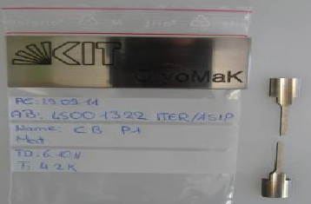
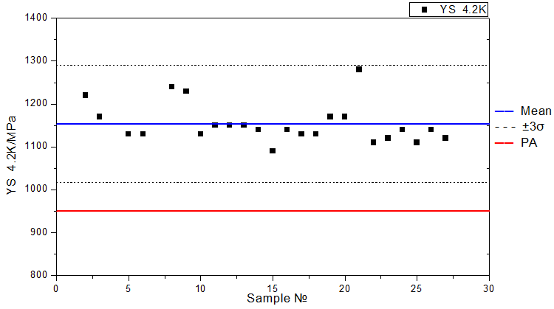
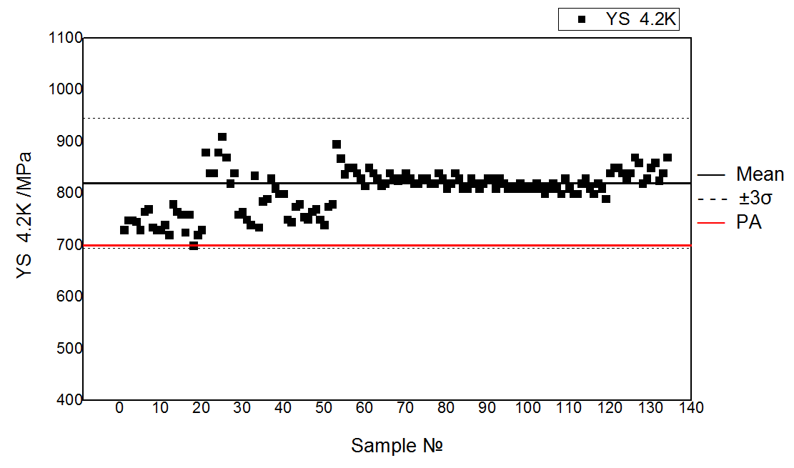
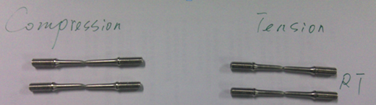
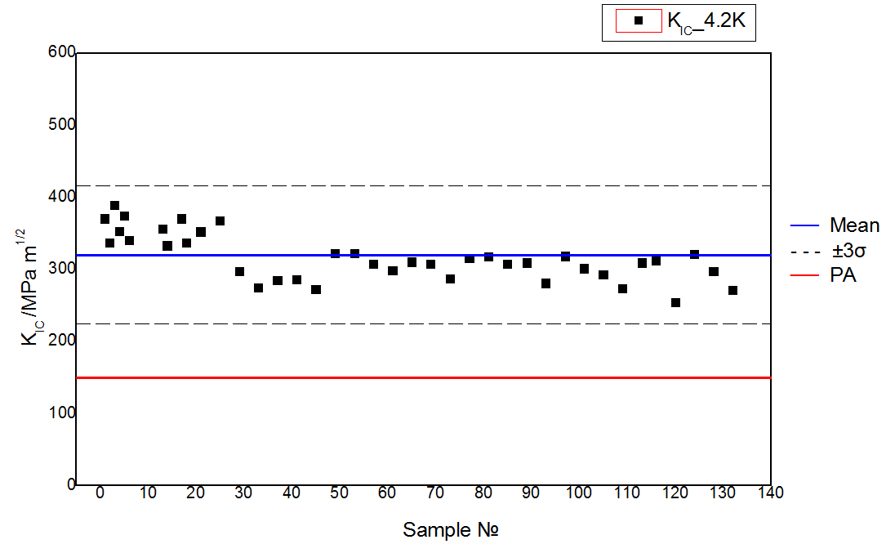
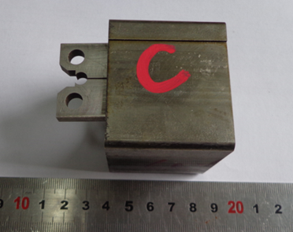
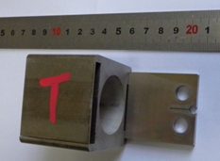
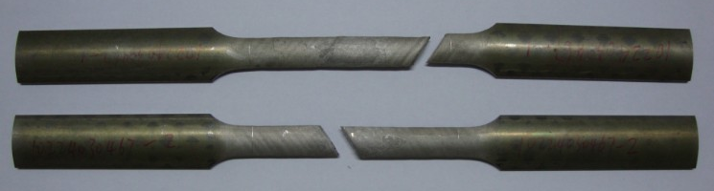
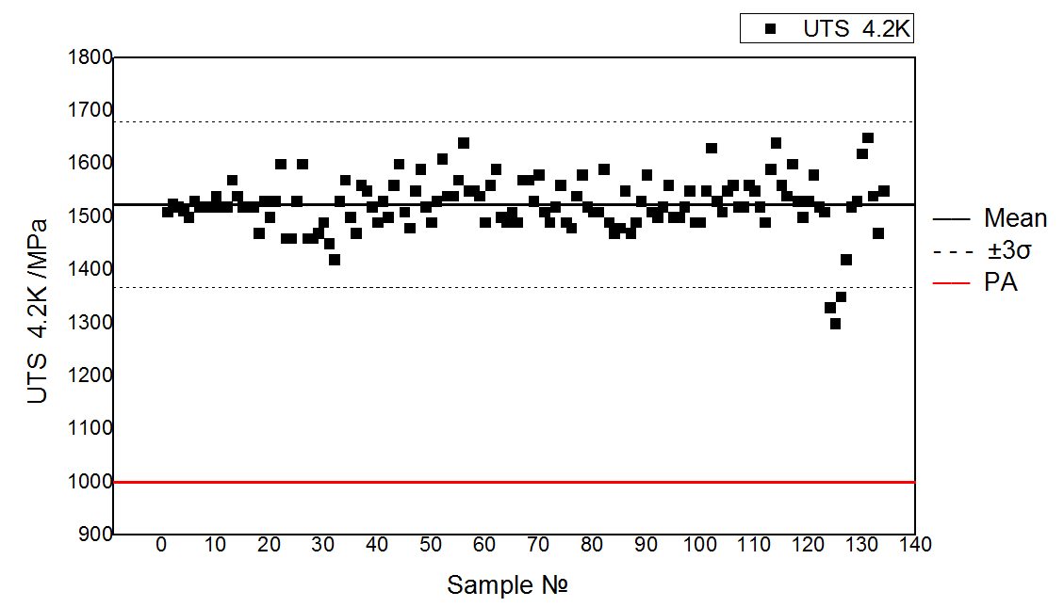
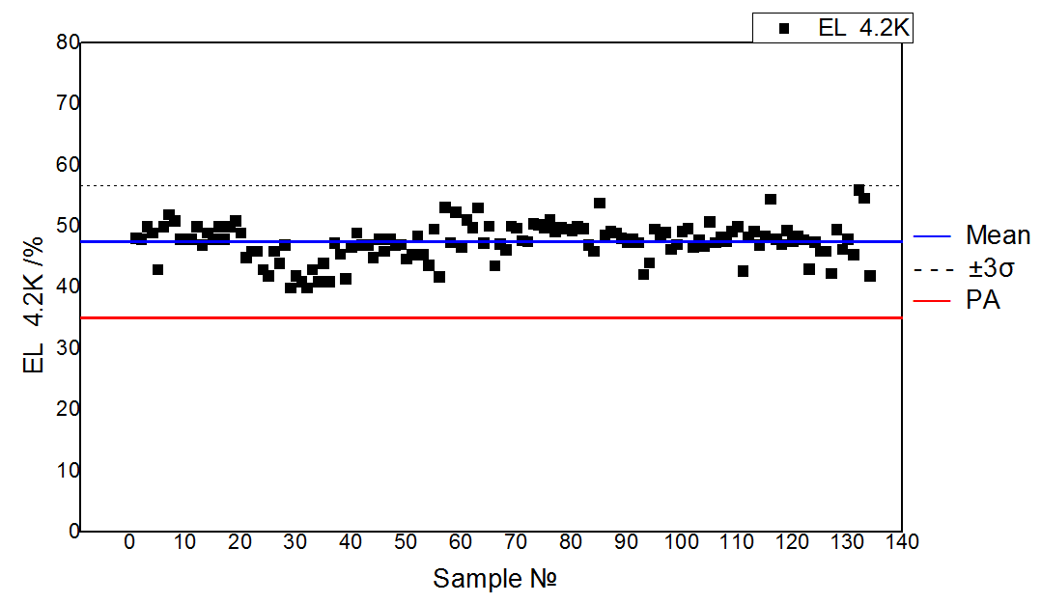
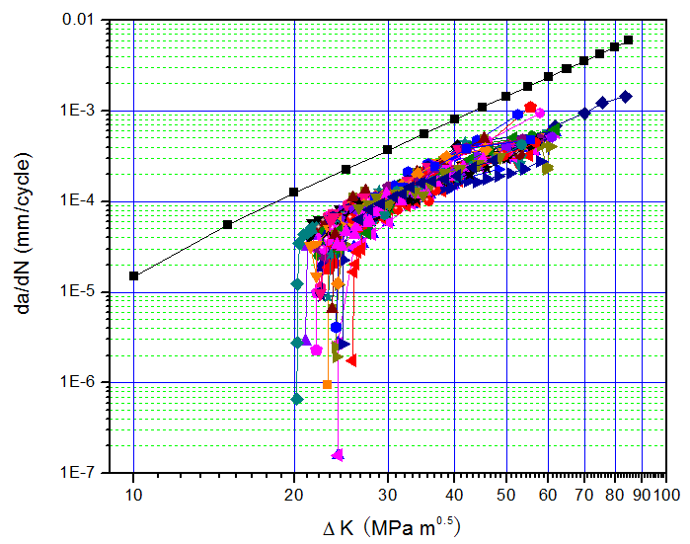
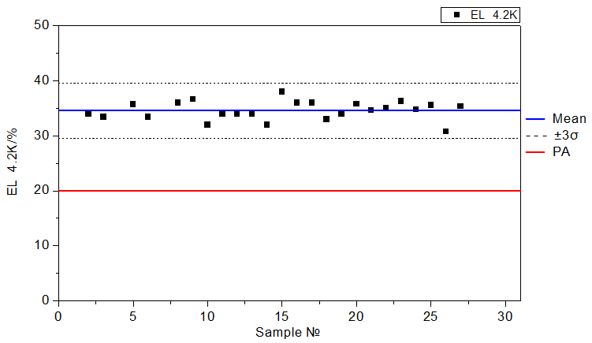
Wed-Af-Po3.10-07 (54)
Mechanical properties of ITER CICC jacket in China
Xiangbin Li¹, Huan Jin², Jinggang Qin², Yu Wu², Yanyan Zhang³, Laifeng Li⁴, Hui Ji³, Sheng Liu¹
¹CNDA, Beijing, China, ²ASIPP, Hefei, China , ³JIULI company, Huzhou China , ⁴TIPC, Beijing, China
Background
CC and Feeder Jacket Mechanical performance
The ITER magnet system is made up of four main sub-systems: The 18 Toroidal Field coils (TF), the Central Solenoid (CS), the 6 Poloidal Field coils (PF), and the Correction Coils (CC). The Feeder system with its Main Busbar (MB) and Correction Coil Busbar (CB) represents one of the main magnet components as well. All coils and busbars with different dimensions used Cable-In-Conduit Conductors (CICC). China needs to provide 6 different types of conductors. The ITER CICCs consist of a cable made of Nb₃Sn or Nb-Ti strands inserted in a stainless steel tube (called jacket or conduit). Depending on the coil type, the jacket material is either made of a low carbon AISI 316LN (for Toroidal Field coil) and AISI 316L grade stainless steels (for Poloidal Field and correction coils). Mechanical properties of base material need to be tested at room and/or cryogenic temperature under predefined mechanical deformation and heat treatment conditions. This paper will introduce the mechanical properties, including tensile and fatigue testing.
Objectives
CC, MB and CB jackets are all made of SS316L. China as a member of ITER has supplied all required CC and feeder conductor. Totally manufactured :
CC jacket - 12000 m
MB jacket - 2000 m
CB jacket - 1600 m
Jacket types and parameters
MB
CB
Item | Material Type | OD (mm) | ID (mm) | OD (mm) | ID (mm)
 |  | Before compaction |  | After compaction
TF | Low C 316LN | 47.0 | 43.2 | 43.7 | 39.7
PF 2-4 | 316L | 54.2×54.2 | 38.0 | 51.9×51.9 | 35.3
PF 5 | 316L | 54.2×54.2 | 38.0 | 51.9×51.9 | 35.3
CC | 316L | 23.2 | 18.8 | 19.2×19.2 | 14.8
MB | 316L | 47.8 | 44.0 | 44 | 40
CB | 316L | 23.9 | 20.1 | 22 | 18
Mean strength of MB jacket at 4.2K:
Yield Strength (YS) - 740MPa
Ultimate Tensile Strength (UTS) - 1500MPa
Mean strength of CB jacket at 4.2K:
Yield Strength (YS) - 800MPa
Ultimate Tensile Strength (UTS) - 1500MPa
Mean strength of CC jacket at 4.2K:
Yield Strength (YS) - 810MPa
Ultimate Tensile Strength (UTS) - 1560MPa
CC
CC
Fig.1 Cross section of ITER conductors produced in China.
CC (sub-size)
MB (sub-size)
CB (full size)
CB (sub-size)
TF Jacket Mechanical performance
PF Jacket Mechanical performance
Conclusion
TF jacket (C≤0.015% SS316LN) sample preparation:
- Compaction with 3.5% cold working
- Stretching by 2.5% to monitor coil winding
- Heat treated at 650ºC for 200 hours.
All required TF, CC, CB and MB conductors have been finished manufacturing in China, and PF conductors will finish manufacturing in 2018. Mechanical performance of ITER CICC jackets manufactured in China have been tested for samples randomly selected from each heat lot. Conclusions can be summarized as follows:
Even undergone 6% cold working and aging treatment at 650ºC for 200 hours, TF jacket showed the combined high strength and good ductility at cryogenic temperature. Elongation for all samples were higher than 30%.
Tensile properties, FCGR and fracture toughness of PF jacket under representative operation conditions of conductor compacted and coil bended states were tested at cryogenic temperature. Results showed the tested tensile and fatigue properties satisfy the ITER requirements.
Yield strength, ultimate tensile strength and elongation of CC and feeder busbar jackets were higher than the required values of 700 MPa, 1000 MPa and 30% at 4.2K, respectively.
K_{IC}
FCGR
45º
Tensile properties of TF jacket in cold worked and aged condition at cryogenic temperature (4.2K):
Yield Strength (YS):
1050 MPa ~ 1300 MPa
Elongation (EL):
30% ~ 40%
Tensile and fatigue properties of PF jacket (SS316L) under representative condition: compacted (5% cold working) + bending (R=4m) +straightening
Mean values of YS, EL and UTS at 4.2K for PF jacket under representative are about 810 MPa, 48% and 1510 MPa respectively. Mean fracture toughness: 300 MPa·m^{1/2}.
Presented at the International Conference on Magnet Technology , 2017 Aug. 27 – Sep. 1, RAI - Amsterdam; I.D. number: #78

