Slide 1


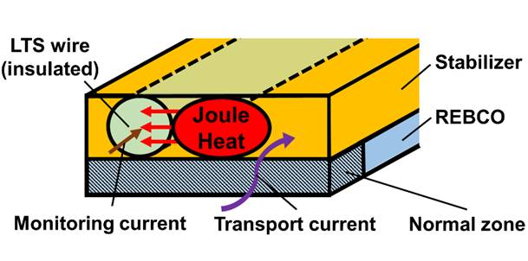
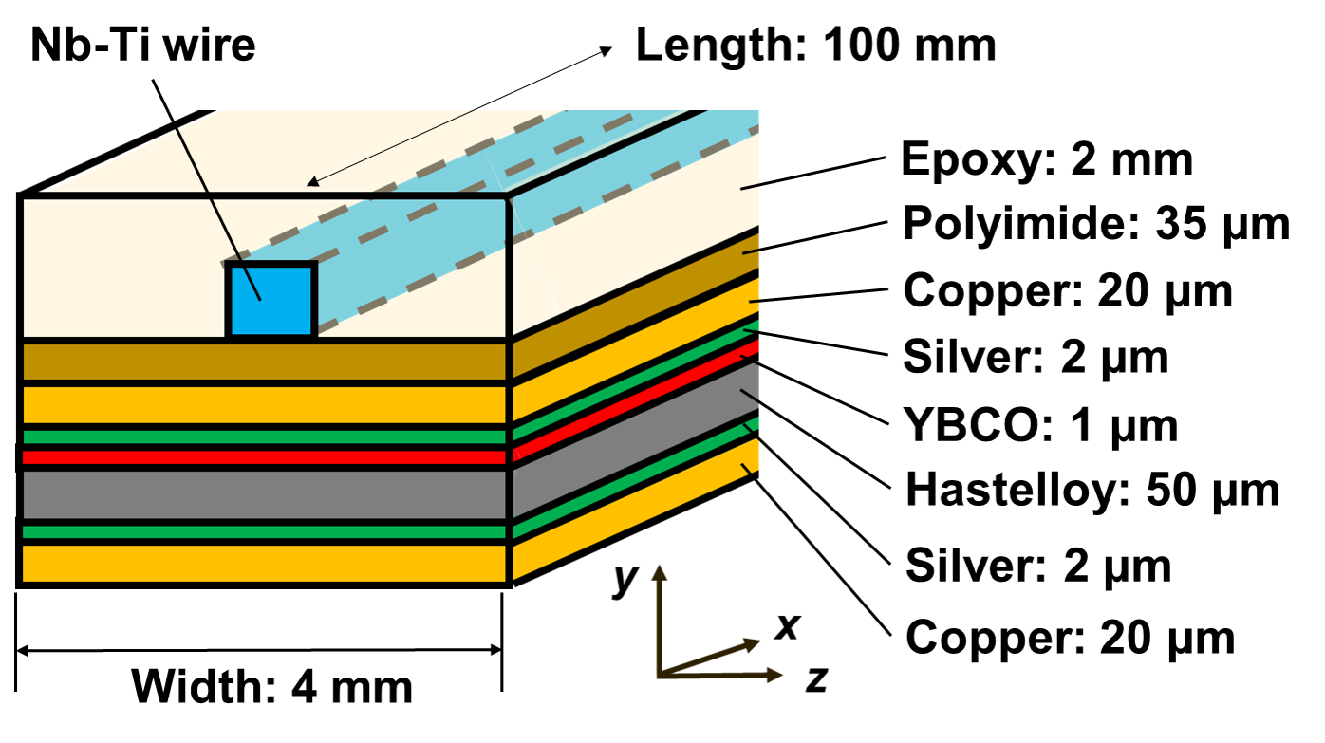
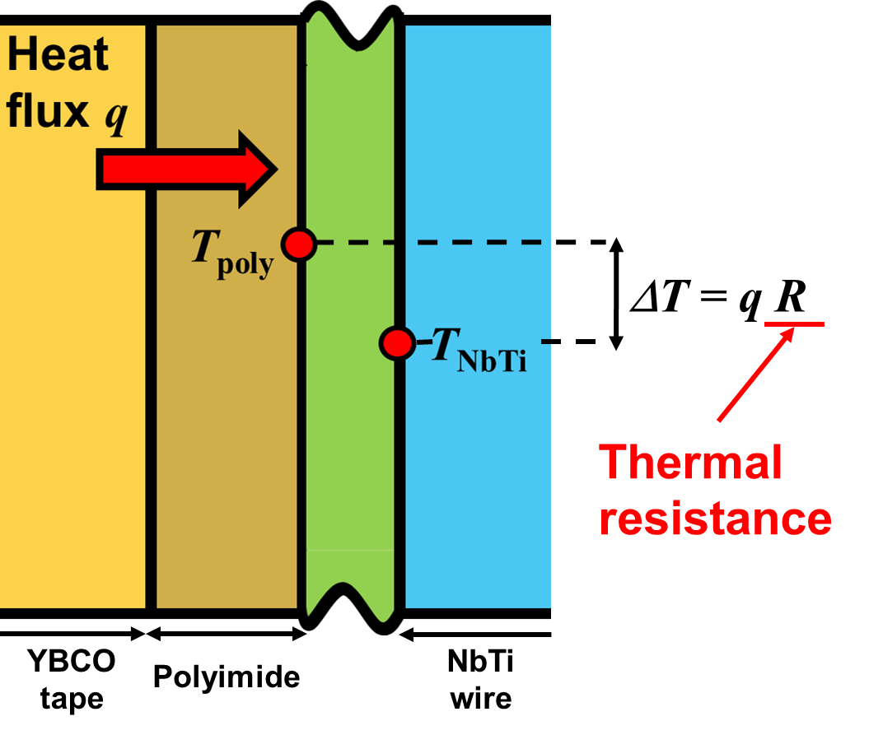
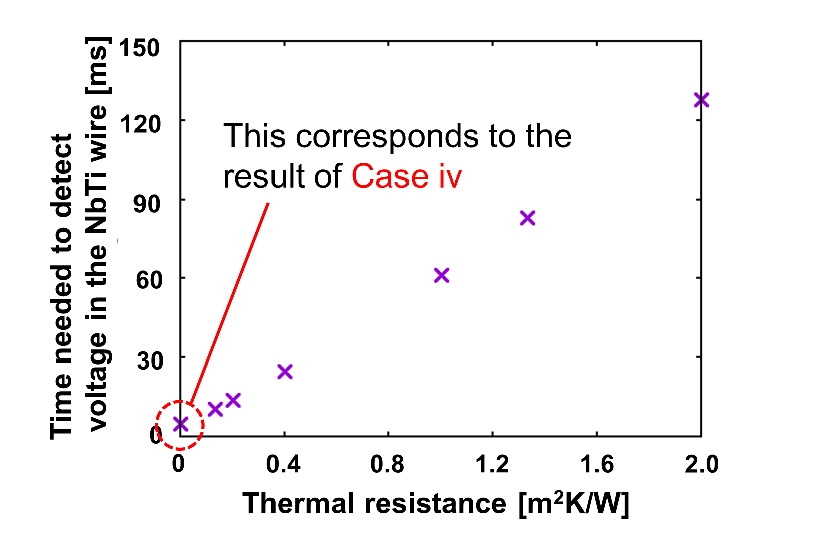
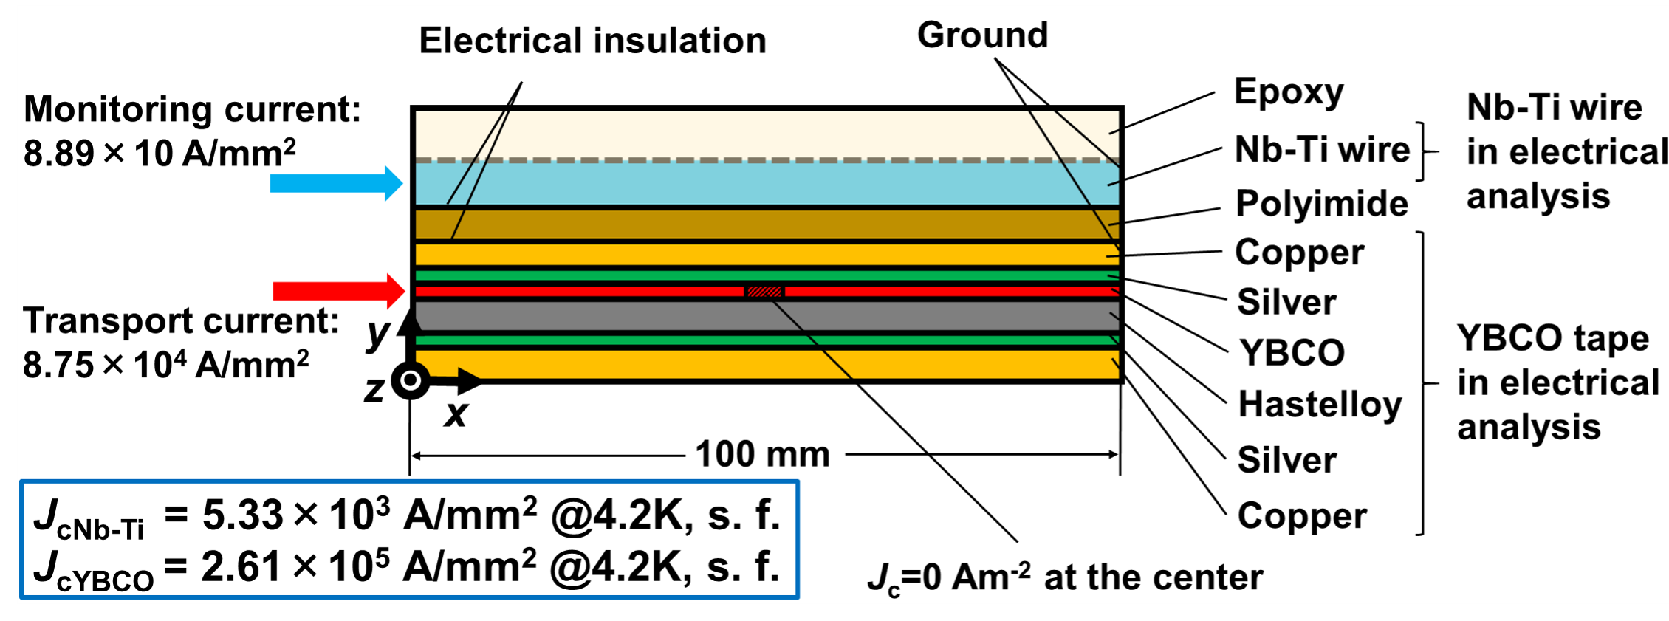
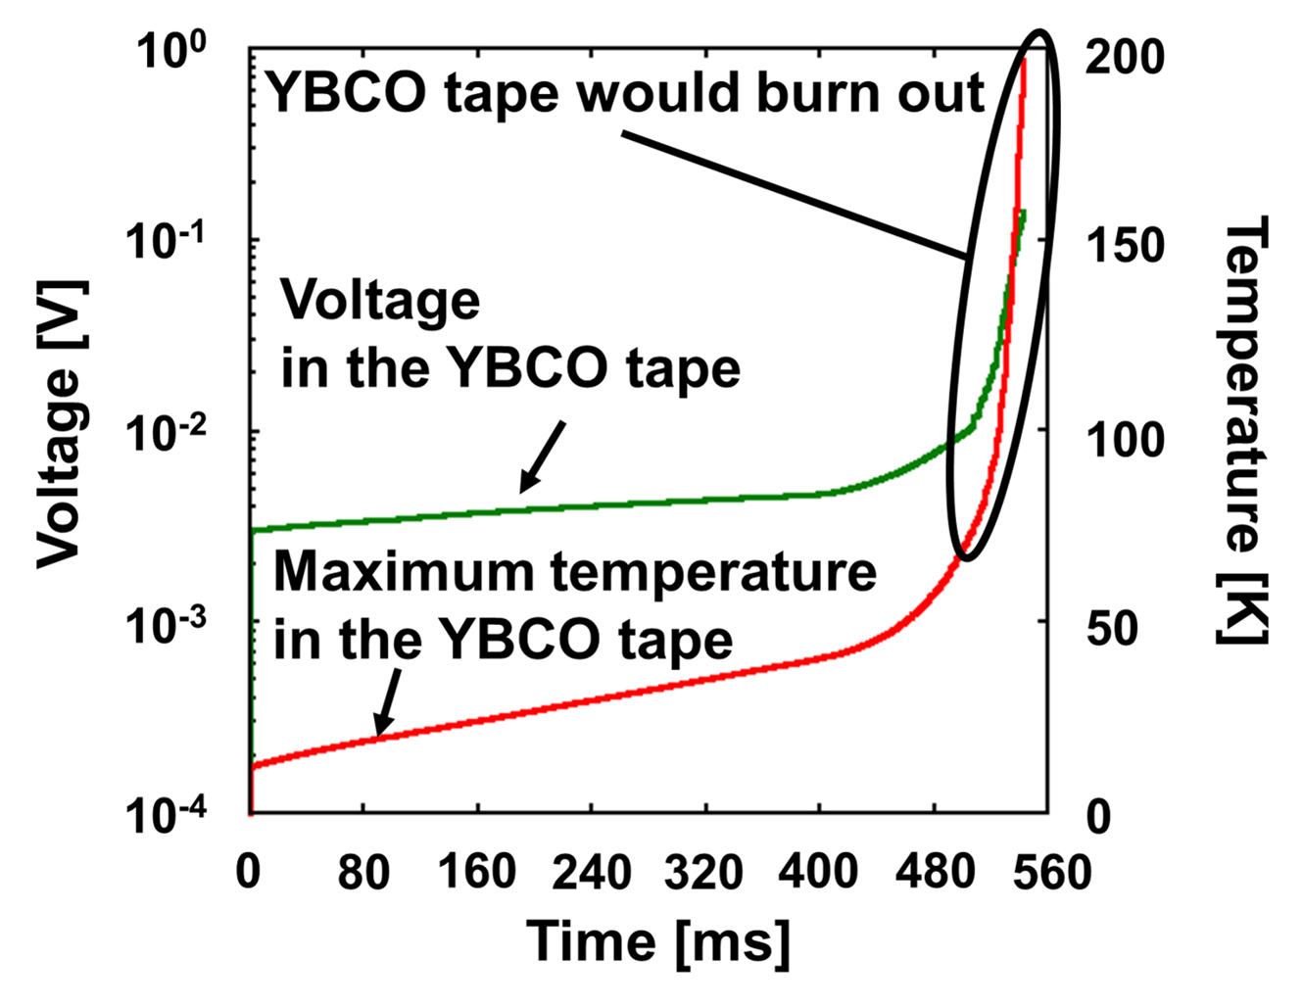
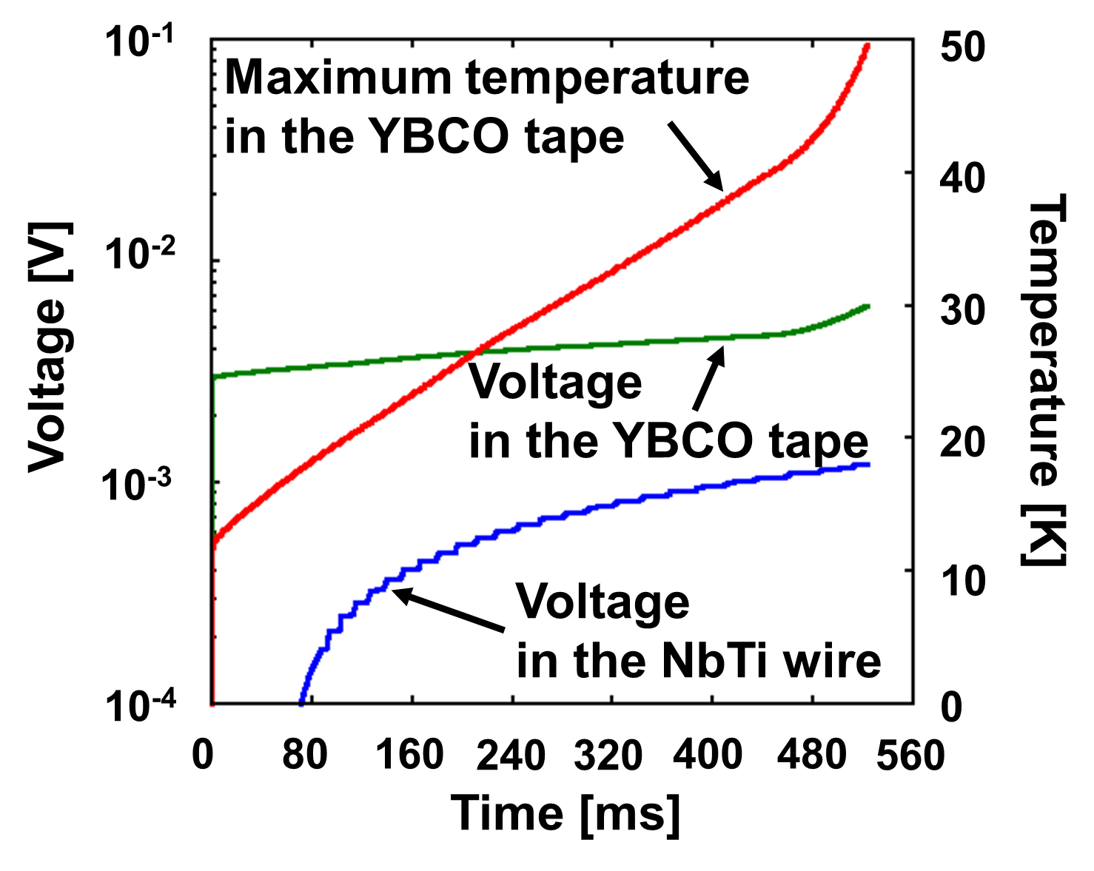
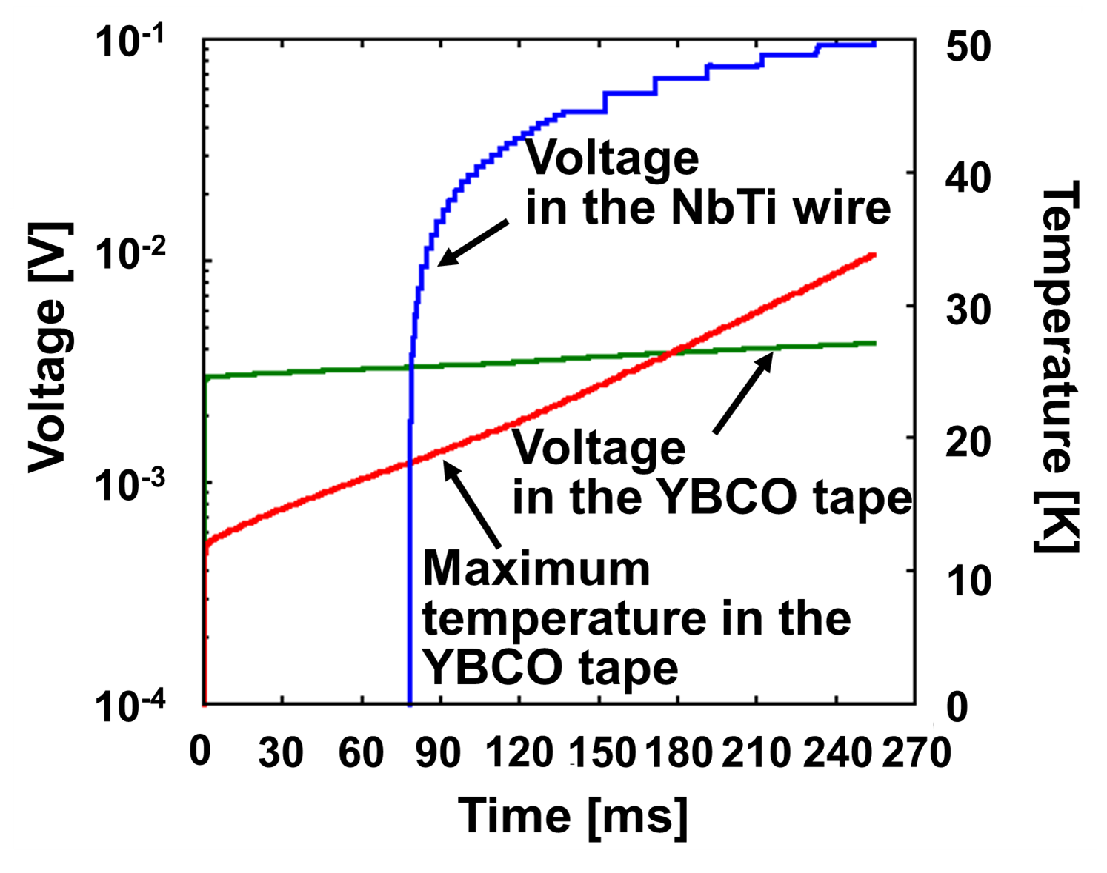
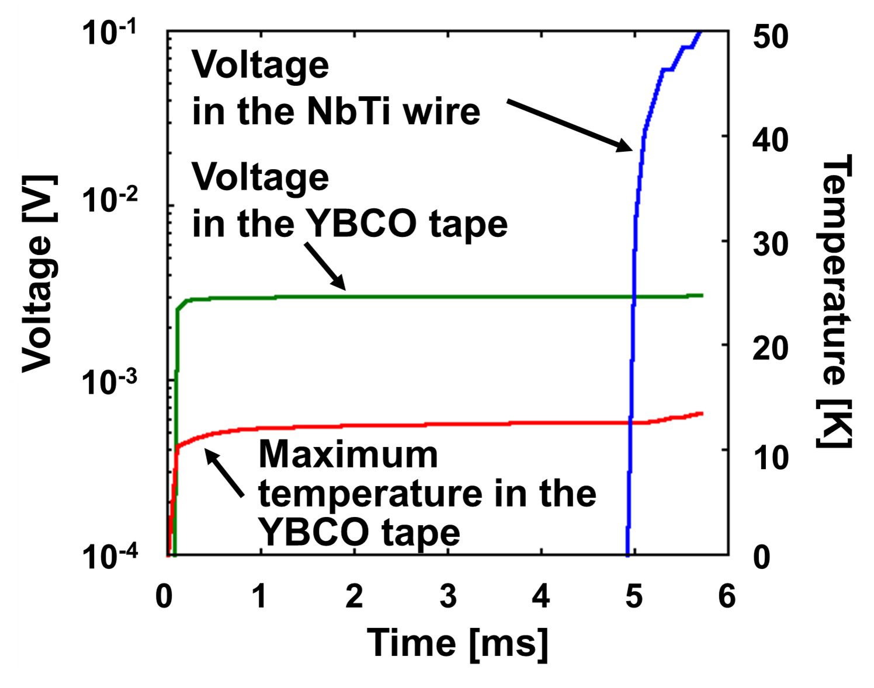
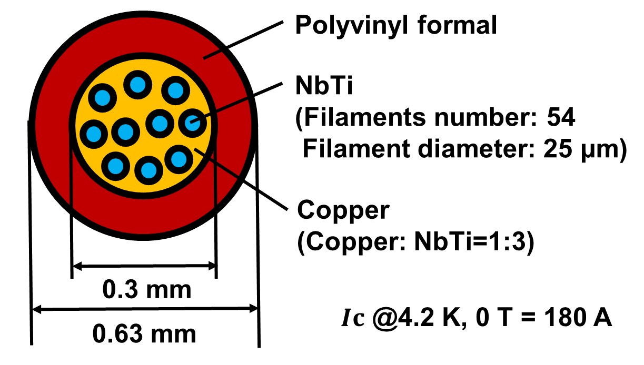
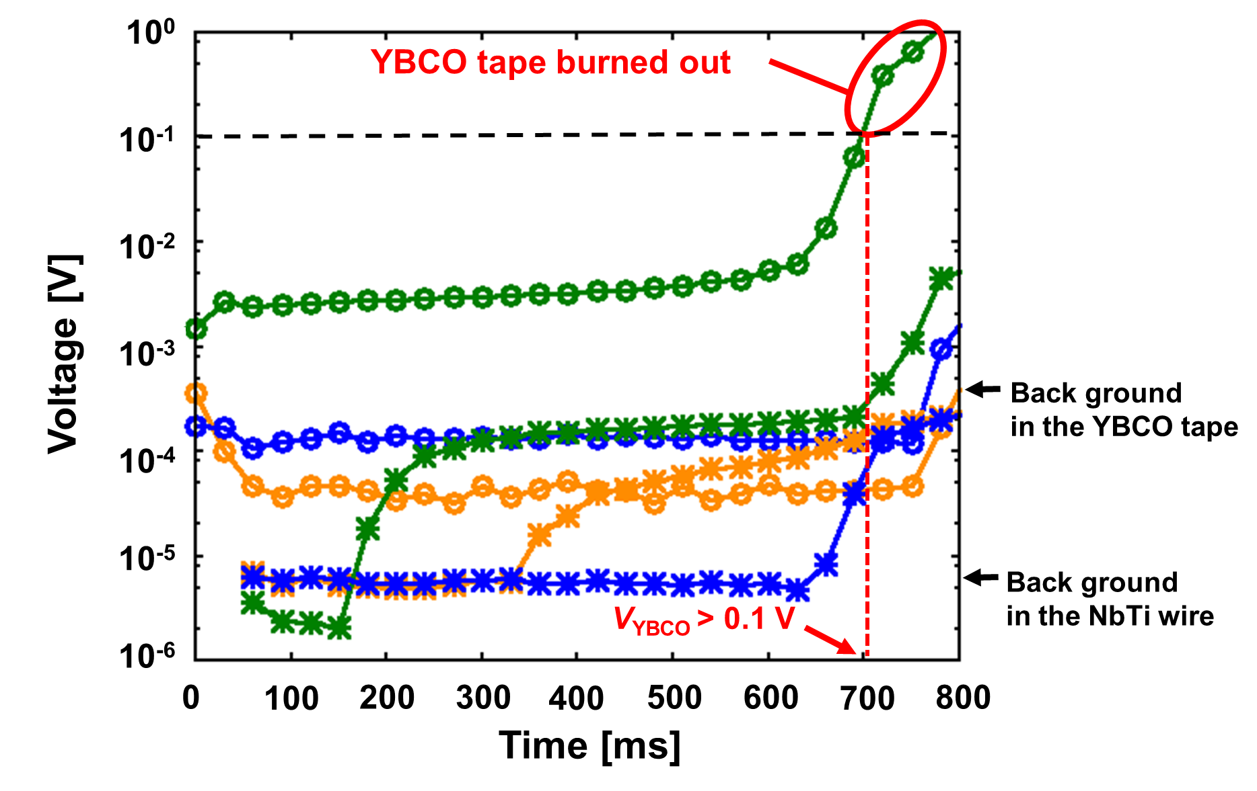
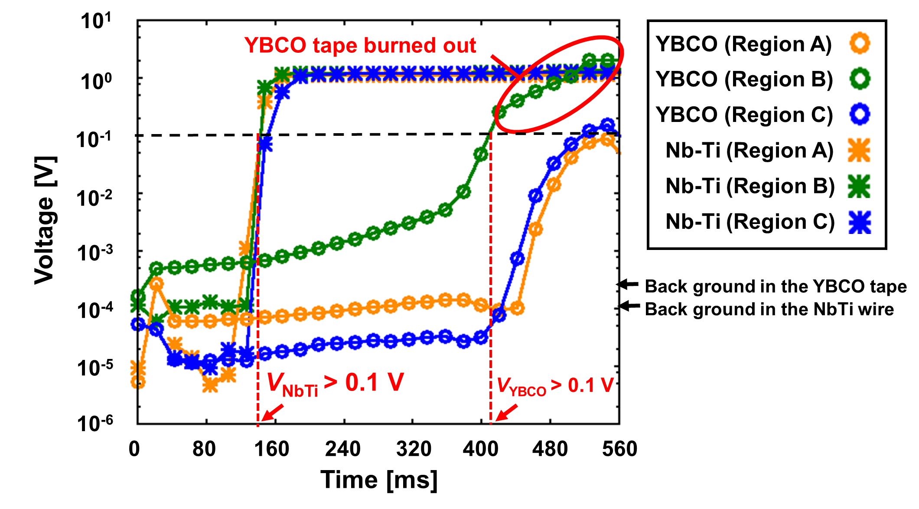
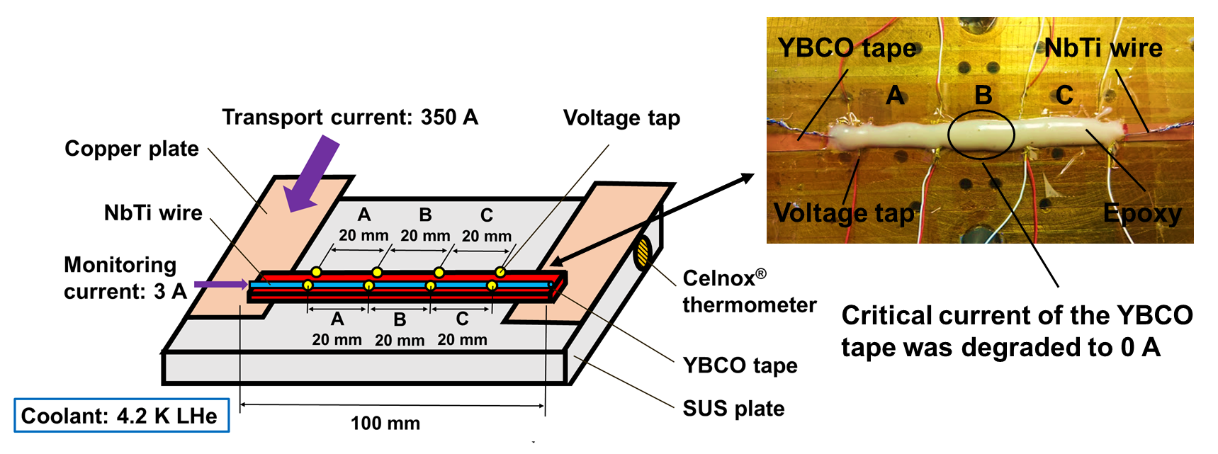
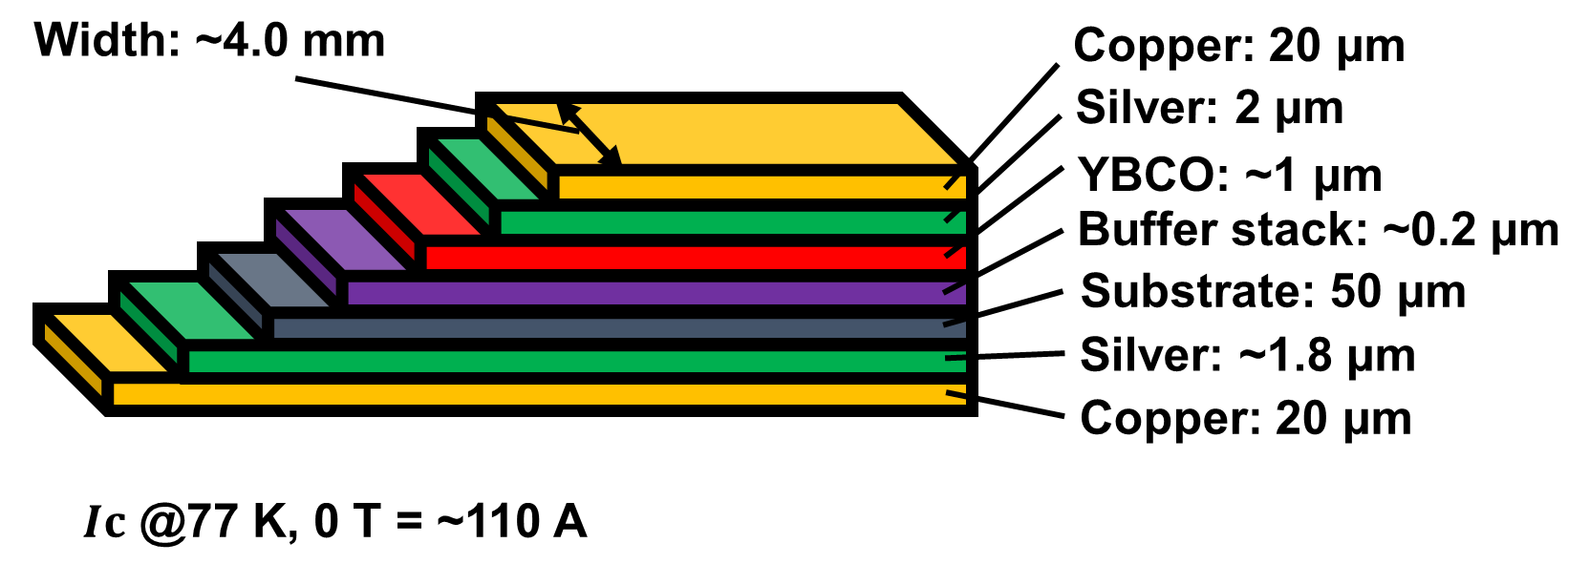
Thu-Af-Po4.09-15 [152]
Numerical and Experimental Evaluation on
the Quench Detection Performance of NbTi/YBCO Hybrid Tape
S. Hasegawa*, S. Ito, H. Hashizume (Tohoku Univ.)
Corresponding author: shase@karma.qse.tohoku.ac.jp
1. Background
2. Objective
5. Conclusion
Difficulty in Quench Detection for the RECBO tape
Verification of the quench detection performance
of a LTS/REBCO hybrid tape used for 4.2 K
・Quench in the YBCO tape can be detected using
the NbTi wire with high normal resistance was demonstrated
Slow quench propagation in a REBCO tape at very low temperature
Quench detection by voltage measurement is difficult
・Quench detection performance of the hybrid tape was sensitive to
the thermal resistance between the NbTi wire and the YBCO tape
(0.1 V < is needed while temperature of the YBCO tape is < 50 K)^{[1]}
Especially for a NbTi/YBCO hybrid tape
Several methods have been proposed
Research Issues
Future tasks
Dependence of the LTS materials
(e.g. Magnetic coupling^{[2]}, using optical-fiber sensor^{[3]})
① Numerical simulation for the experiment
Proposal of LTS/REBCO Hybrid Tape
To determine the suitable type of the NbTi wire
for the hybrid tape
Dependence of the external field
REBCO
High J_{c} at very low temperature
on the quench detectability of the hybrid tape will
be investigated
＋
② Experiment with a prototype of the hybrid tape
LTS
Low critical temperature
Quench detectable
LTS/REBCO hybrid tape
To verify the result of the numerical simulation
The suitable LTS materials for the hybrid tape
under high field will be determined
Fig. Conceptual diagram of hybrid tape
To demonstrate the possibility of the hybrid tape
3. Numerical Simulation
Electrostatic Potential distribution
Temperature Distribution
Simulation Model
NbTi wire
YBCO tape
・Governing equation
・Calculation of electrostatic potential
・Governing equation
3-D heat transfer equation
j is stabilizer
in Cases A and B
and NbTi in Case C
2-D Poisson equation on electrostatic field
・Joule heat
(φ is assumed to be uniform in z-direction)
・Transition to normal conducting state in NbTi
・Current distribution in YBCO ^{[4]}
1. σ_{sc} = σ_{sc0} (σ_{sc0} is sufficiently large)
Thermal resistance
between the YBCO tape
and the NbTi wire is
important for the quench detection sensitivity
of the hybrid tape
‘normal’ means
the normal conducting
state of NbTi
2.
Iteration is continued until
σ_{sc} converges
Fig. Three-dimensional model of the hybrid tape
Simulation Conditions
Table. Four cases for the numerical simulation
Results of the Simulation
Fig. Thermal resistance model
Fig. Dependence of thermal resistance
Case | Stabilizer | Cross sectional area
i | No NbTi wire
ii | Copper | 0.374 mm×0.374 mm
iii | Cupro Nickel | 0.374 mm×0.374 mm
iv | No stabilizer | 25×10⁻³ mm×1.35 mm
・Detectable voltage in the
YBCO tape was < 0.1 V
・0.1 V < can be detected
by the NbTi wire before
temperature of the YBCO
tape reaches 50 K
in Cases iii and iv
・Electrical insulation over surfaces (x-y, y-z plane)
Fig. Result of Case iv
(pure NbTi wire)
Fig. Simulation conditions
・Heat flux = h(T-T_{o}) over surfaces (x-y plane)
Fig. Result of Case i
(no NbTi wire)
Fig. Result of Case ii
(with copper stabilizer)
Fig. Result of Case iii
(with CuNi stabilizer)
4. Experiment
Experimental results
General threshold
for the quench detection
V_{YBCO}: Voltage in the YBCO tape V_{NbTi}: Voltage in the NbTi wire
・Detectable voltage in the NbTi wire was smaller
than that in the YBCO tape in Case ii (0.1 mV~)
Overview of the Experiment
・1 V scale voltage was measured in the NbTi wire
before the YBCO tape burned out in Case iv
Fig. NbTi wire(Supercon® 54S43)
・Quench in the YBCO tape can be detected
by using the pure NbTi wire
Fig. Test section and the prototype hybrid tape
・Quench detection sensitivity would be
influenced by 1.6 ~ 2.0 m²K/W
thermal resistance in Case iv
Experiment was conducted for two conditions of the NbTi wire
(Case ii: with copper stabilizer, Case iv: pure NbTi wire)
Fig. YBCO tape(Superpower® SC4050)
Fig. Experimental result of Case ii
(the NbTi wire was with copper stabilizer)^{[5]}
Fig. Experimental result of Case iv
(the NbTi wire was pure NbTi wire)
Acknowledgements We would like to give gratitude to Axis Co. provided us NbTi wires.
[4] H. Hashizume, et al., Int. j. Appl. Electromag. Mater., 1992
[5] S. Hasegawa, et al., Presented at 1st Asian ICMC-CSSJ 50th Anniv. Conf., Kanazawa, Japan, 2016
[1] O. Tsukamoto, et al., Cryogenics, 2014
[2] M. Mentink, et al., IEEE Trans. Appl. Supercond., 2015
[3] F. Scurti, et al., Supercond. Sci. Technol., 2016

