Slide 1
LHC 2015 Pb-Pb run :
Progress report on IR2 squeeze beam process and BFPP orbit bumps in the LHC
T. Mertens, M. Schaumann, J. Jowett, J. Wenninger, A. Lechner, T. Risselada, M. Giovannozzi, R. de Maria, B. Auchmann, R. Bruce, M. Brugger, F. Cerutti, V. Parma, S. Redaelli, N.V. Shetty, G.E. Steele,E. Skordis, A. Verweij, R. Van Weelderen, M. Zerlauth
HSS
Sept. 16, 2015
LMC 02/09/2015
LBOC 08/09/2015
COLUSM 28/08/2015

Slide 2
Outlook
Ion Squeeze
BFPP losses in connection cryostat at IP1 and IP5 (Run II / HLLHC)
BFPP losses in IP2: a different story
Mathematica tools : Beam Process Function for analyzing a Beam Process
Orbit bumps using Beam Process Function and Analysis Functions

Slide 3
Ion Squeeze : Background and history
What we did in previous heavy ion runs:
  2010 Pb-Pb: took over β*=3 m from p-p run in ALICE, ATLAS, CMS (no LHCb) (this was the only time we did not change optics).
  2011 Pb-Pb: took over squeeze to β*=1 m from p-p run in ATLAS, CMS and appended squeeze to β*=1 m in ALICE (no LHCb).
  2013 p-Pb: relaxed from β*=0.6 m to β*=0.8 m in ATLAS, CMS (off-momentum squeeze!!) and implemented simultaneous squeeze to β*=0.8 m in ALICE and β*=2 m in LHCb.
(New) features:
  Magnetic field change: 6.5 Z TeV ➔ 6.37 Z TeV.
  Crossing-Angles: 145μrad in IP1/5 (as in pp), 60μrad in IP2 (might still change due to vertical displacement and ZDC shadowing).
  Collisions in LHCb ⇒ Close beam-beam encounters near ALICE, which has small crossing angle (for ZDC).
  Polarity reversal for ALICE (ATS/Note/2012/039 MD)
  ⇒ keep larger parallel separation (1mm instead of 0.55mm).
  Vertical IP displacement of -2 mm in ALICE.
M. Schaumann
LBOC 15/09/08
LMC approved 0.8m
J. Jowett
LMC 02/09/2015

Slide 4
Ion Squeeze : Strategy
M. Schaumann
LBOC 08/09/2015
General principles:
  We aim for equal β* in ALICE, ATLAS, CMS.
  We minimise commissioning time for new optics.
  We do not try to go beyond β* used for p-p in ATLAS/CMS (80 cm – LMC/02092015, except maybe in one IP for the quench test LHC MD844: BFPP Quench Limit)
  We now prefer the faster simultaneous squeeze (put more beam into physics).
Boundary conditions for Squeeze 2015:
  β*=0.8 m in ALICE (new), ATLAS, CMS.
  β*=3 m in LHCb to attempt first Pb-Pb collisions.
  Simultaneous squeeze in all IPs:
  Keep pp-Squeeze as it is and fit IR2 on top.
J. Jowett
LMC 02/09/2015

Slide 5
Ion Squeeze : Simultaneous squeeze
M. Schaumann
LBOC 08/09/2015
Bring IR2 down to β*=0.8m within squeeze of IP1/5.
Timing restrictions from power convertors (PC)
The initial part of the IR2-squeeze is slow, because the PC have to bridge large current differences.
M. Schaumann considered different scenarios
  Starting from β*=10m the IR2 squeeze does not fit into the existing sequence.
  Starting from β*=8m an IR2 sequence can be found, which arrives at β*=0.8m within the existing steps.
Steps | 1 | 2 | 3 | 4 | 5 | 6 | 7 | 8 | 9 | 10 | 11 | 12
β* [m] in IP1/5 | 11 | 9 | 7 | 4 | 3 | 2.5 | 2 | 1.5 | 1.2 | 1 | 0.9 | 0.8
β* [m] in IP2 | 8 | 7.6 | 7.2 | 4.5 | 3.5 | 2.5 | 1.8 | 1.4 | 1.2 | 1 | 0.9 | 0.8

Slide 6
Ion Squeeze : Simultaneous squeeze
M. Schaumann
LBOC 08/09/2015
Bring IR2 down to β*=0.8m within squeeze of IP1/5.
Timing restrictions from power convertors (PC)
The initial part of the IR2-squeeze is slow, because the PC have to bridge large current differences.
M. Schaumann considered different scenarios
  Starting from β*=10m the IR2 squeeze does not fit into the existing sequence.
  Starting from β*=8m an IR2 sequence can be found, which arrives at β*=0.8m within the existing steps.
Steps | 1 | 2 | 3 | 4 | 5 | 6 | 7 | 8 | 9 | 10 | 11 | 12
β* [m] in IP1/5 | 11 | 9 | 7 | 4 | 3 | 2.5 | 2 | 1.5 | 1.2 | 1 | 0.9 | 0.8
β* [m] in IP2 | 8 | 7.6 | 7.2 | 4.5 | 3.5 | 2.5 | 1.8 | 1.4 | 1.2 | 1 | 0.9 | 0.8
Pre-squeeze from 10m to 8m taking 3 minutes

Slide 7
Ion Squeeze : Beta-Beating Prediction
M. Schaumann
LBOC 08/09/2015
Two independent tools :
  MAD-to-Mathematica LHC packages - we can now construct and analyze beam processes in a fairly clear and simple way using tools in Mathematica (see later)
  LHC Online Model (J. Wenninger)
Results are in agreement.
Maximum beta-beating between two match-points: <7%

Slide 8
Ion Squeeze : Tune and Chromaticity
M. Schaumann
LBOC 08/09/2015
Maximum tune change between two match-points: <0.004 units
Maximum Chroma change between two match-points: <0.5 units

Slide 9
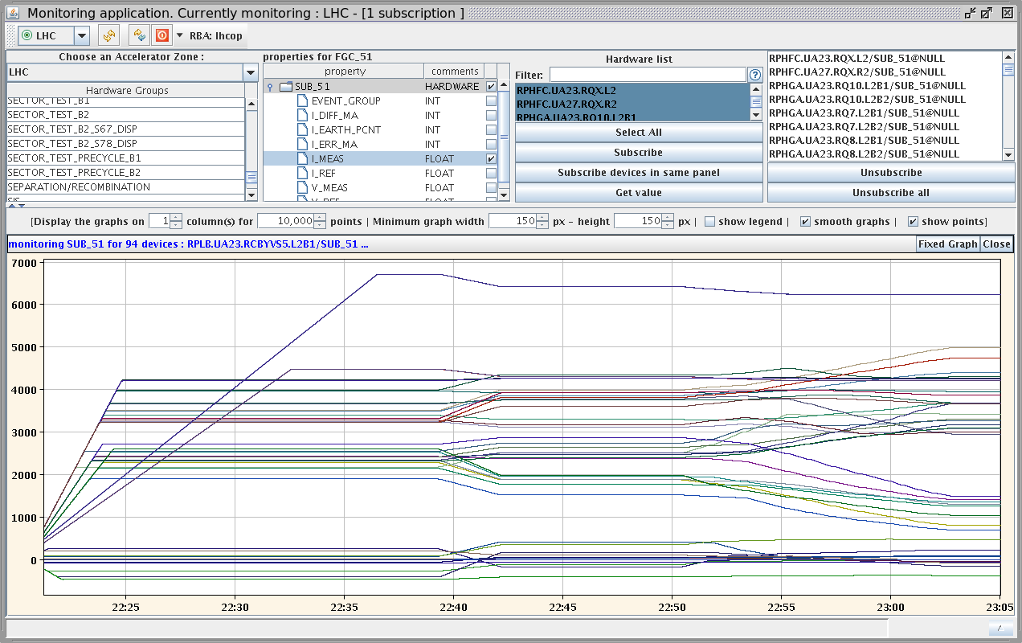
Ion Squeeze : Dry Run
Dry run of ion squeeze successfully executed in IR2, while the machine was blocked by S81 QPS issue on Friday evening (04/09/2015). No magnet trips encountered!
M. Schaumann
LBOC 08/09/2015
ONLY quads no orbit bumps !!! (yet)

Slide 10
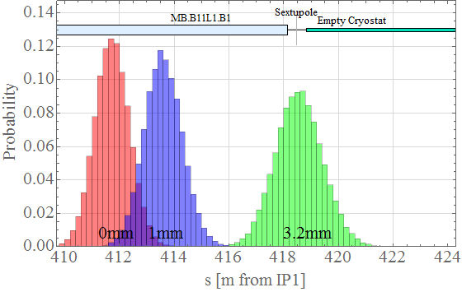
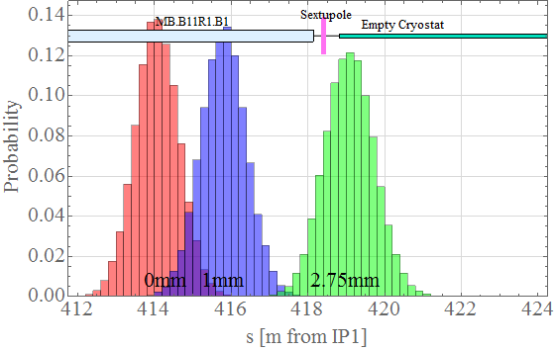
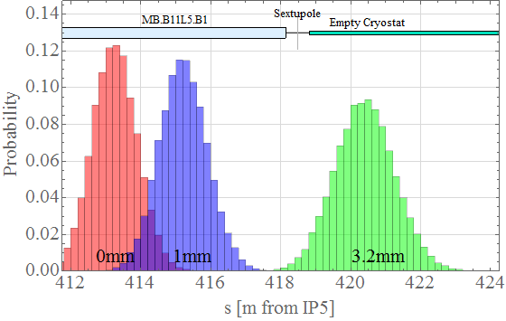
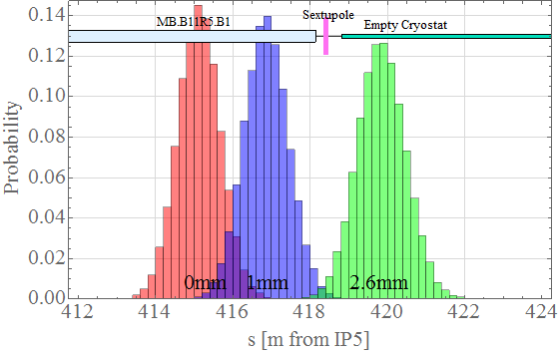

BFPP losses : Input for Fluka simulations
BEAM 2
BEAM 1
BEAM 2
BEAM 1

Slide 11
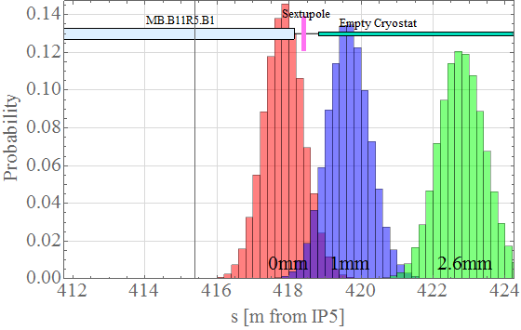
BFPP losses : aperture remark
Beam pipe @ 22.00 mm
Beam pipe@ 23.15 mm

Slide 12
BFPP losses : 2011 Fluka vs BLM data
A. Lechner
LMC #233
M. Schaumann
Phd. thesis

Slide 13
BFPP losses : Anticipated losses peak power in MB
A. Lechner
LMC #233
See also :
J. Jowett et al ., 20th IEEE Particle Accelerator Conference (2003),
J. Jowett, R. Bruce et al., Phys. Rev. Spec. Top. Accel. Beams 12 (2009) 071002

Slide 14
BFPP losses : Anticipated losses peak power in MB
A. Lechner
LMC #233

Slide 15
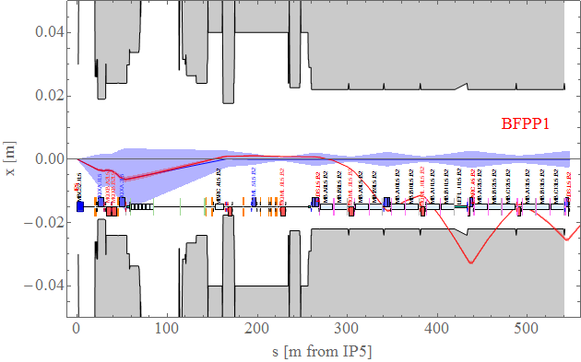
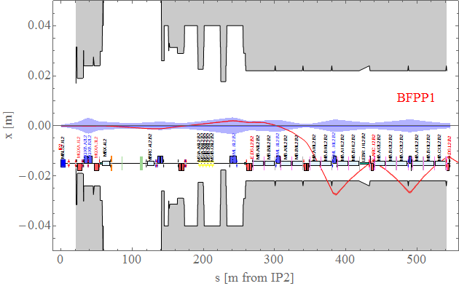
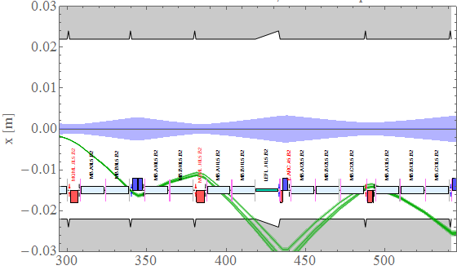
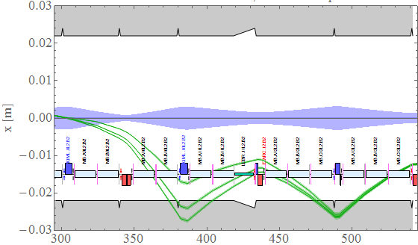
BFPP losses IP2 : Difference with IP1 and IP5
BEAM 4
BEAM 4
Left :
IP 5 Beam 4
(x -> -x)
Right :
IP 2 Beam 4
(x -> -x)
BEAM 4
BEAM 4

Slide 16
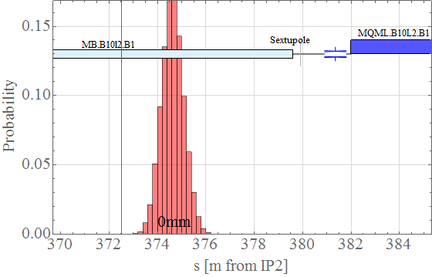
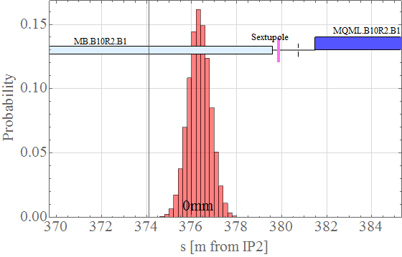


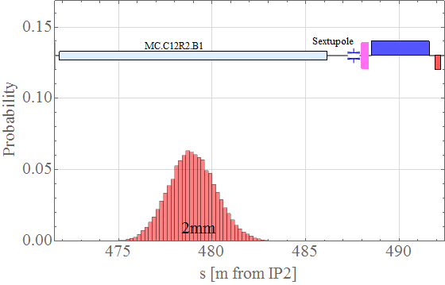
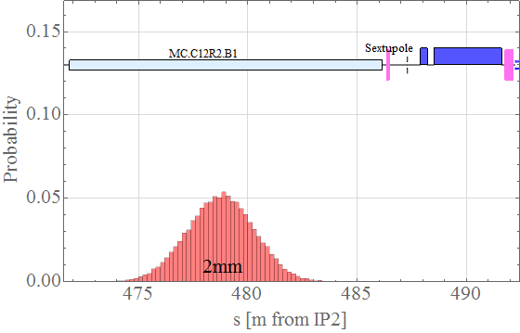
BFPP losses IP2 : Fluka input

Slide 17
BFPP losses IP2 : Quench
Run2 : ALICE levelled at
Expect no issue with power deposition in magnets
Run3 : movable collimator as baseline

Slide 18
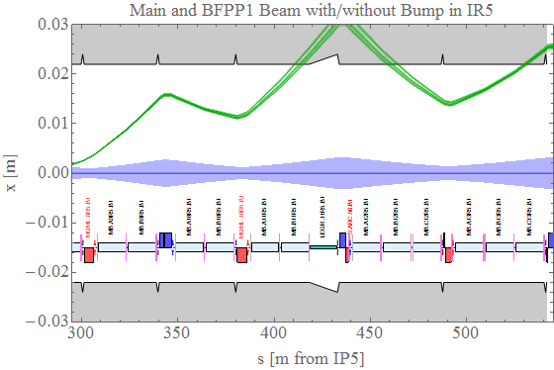
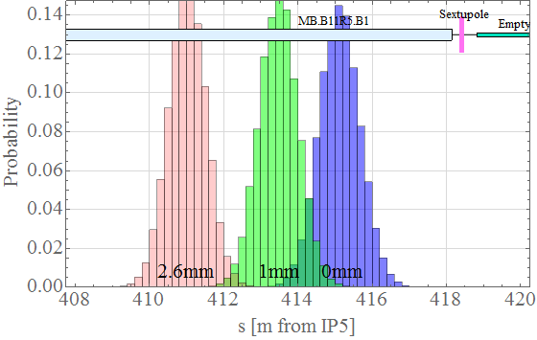
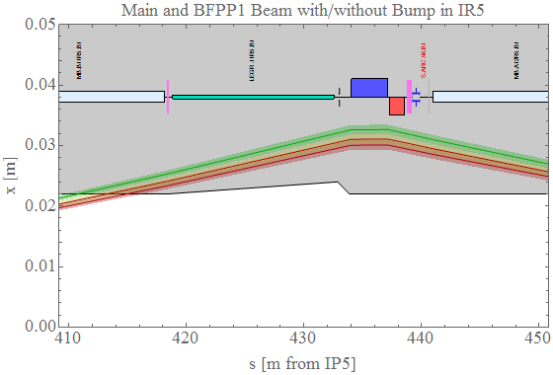
BFPP proposed quench test MD : inverted bumps

Slide 19
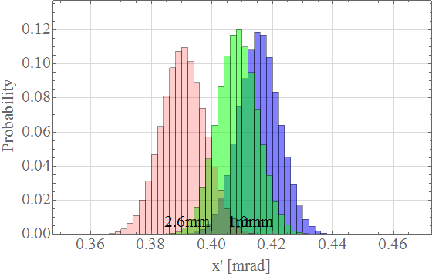
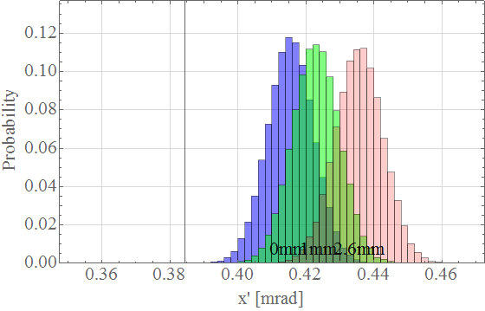
BFPP Quench test MD : inverted bumps
Mitigation bump
Inverted bump

Slide 20
Mathematica Tools
Previously available in Mad to Mathematica LHC packages
  Interface to MAD language and TFS tables (since 1995)
  Functions to return LHC optics and geometry - recently simplified and generalised to handle changes of conventions in LHC optics repository
  Extensive knowledge of LHC modular structure, tree structures of element hierarchy, their links to strength variables, robust testing of strength limits, etc.
  Evaluation of beam-beam quantities at encounters in two-beam optics in LHC IRs
  Flexible graphics functions, etc, etc.
Recent additions:
  Easy interface to orbit bump matching (you don’t need to know the strength names)
  Automated analysis of an entire “beam process” (for example: ramp+squeeze)
  Tune and chromaticity matching
  Beam-beam encounters in all IRs at each step
  Beta-beating, dispersion, tune and chromaticity variation at interpolated points
Checks of quadrupole and corrector strength usage at Beam Process Steps

Slide 21
Orbit Bumps: IR2 during squeeze
Minimizing corrector currents used by the bumps (based on script provided by R. De Maria), not completely automatic requires some manual intervention (still without most recent bump function implementation, needs updating)
Using minimal settings and matching -> generate complete strength files with bump knobs (variables updated to latest conventions of optics repository):
  Separation (ON_SEPi)
  Crossing angle (ON_Xi)
  Offset (ON_Oi)
  Angular (ON_Ai)
  Special for IP2 – vertical offset (ON_OE2)
Load on top of matched Quadrupole files (provided by Thys for IP2) -> provided files also to J. Wenninger

Slide 22
Mathematica Tools : IR2 separation bump
testrun = LHCBeamProcessStep[
"ENERGY1"->82*6370, "ENERGY2"->82*6370,
"SPECIES1"->"ION","SPECIES2"->"ION","NPART1"->2.0 * 10^8,"NPART2"->2.0 * 10^8,
"KBUNCH1"->2700,"KBUNCH2"->2700,
"EXN1"->1.5 * 10^-6,"EYN1"->1.5 * 10^-6,"EXN2"->1.5 * 10^-6,"EYN2"->1.5 * 10^-6,
"ET1"->FET[6370], "ET2"->FET[6370],
"SIGE1"->FSIGE[6370],"SIGT1"->FET[6370]/FSIGE[6370],
"SIGE2"->FSIGE[6370],"SIGT2"->FET[6370]/FSIGE[6370],
madLHCOpticsScenario->{"runII","2015"},
madLHCSequenceFiles->{{Automatic,"lhc_as-built.seq"}},
madLHCSettingsFiles->{{Automatic,"opt_inj_colltunes.madx"},
{Automatic,"opt_800_10000_800_3000.madx"},
{"G:\\Projects\\ILHC\\TM\\Mathematica\\Matching\\IP2_STR\\Combined","NEW_IP2_beta_0.80.str"},
{"G:\\Users\\t\\tomerten\\Public\\IR2_STR_FILES\\BFPP_Bumps","IP1Bump_9_11_13.madx"},
{"G:\\Users\\t\\tomerten\\Public\\IR2_STR_FILES\\BFPP_Bumps","IP2Bump_8_10_12.madx"},
{"G:\\Users\\t\\tomerten\\Public\\IR2_STR_FILES\\BFPP_Bumps","IP5Bump_9_11_13.madx"}
},
madLHCSettingsRules->Flatten[{
"ON_X1"->0,"ON_X2"->0,"ON_X5"->0,"ON_X8"->0,"ON_A1"->0,"ON_A2"->0,"ON_A5"->0,"ON_A8"->0,
"ON_SEP1"->0,"ON_SEP2"->1,"ON_SEP5"->0,"ON_SEP8"->0,
"ON_O1"->0,"ON_O2"->0,"ON_OE2"->0,"ON_O5"->0,"ON_O8"->0,
"ON_BFPP1"->0,"ON_BFPP2"->0,"ON_BFPP5"->0,
"ON_ALICE"->7000./6370,"ON_LHCB"->-7000./6370}],
madLHCOpticsEpilog->{MADcycle["LHCB1","IP6"],MADcycle["LHCB2","IP6"]}];
MAD beam setup
Applying one of the Analysis Functions:
LHCBeamSqueezeOptics[testrun]
MAD files to load
MAD Variable settings

Slide 23
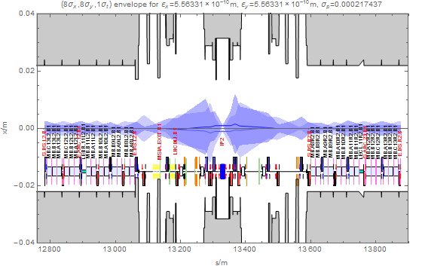
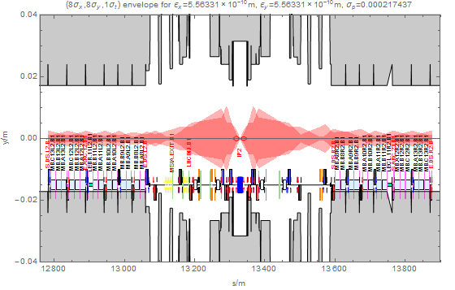
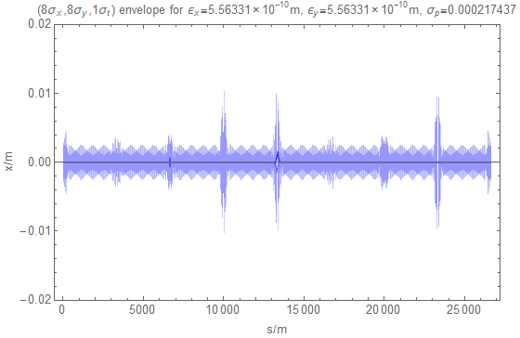
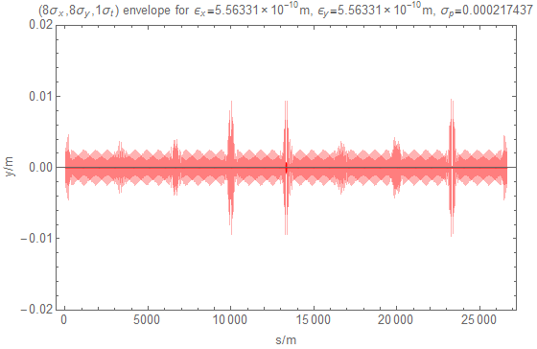
Mathematica Tools : IR2 separation bump

Slide 24
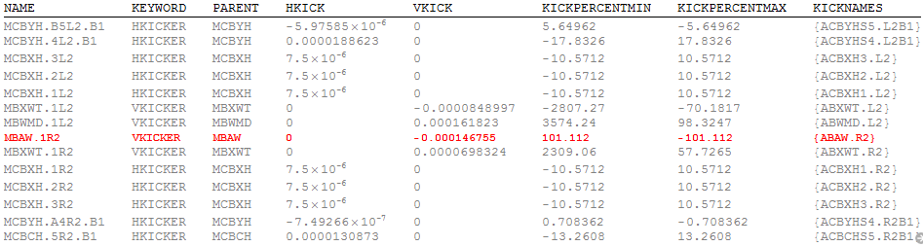
Mathematica Tools : IR2 separation bump
Strength Analysis
Shows table of used correctors in the Beam Process Step
Highlighting available
Same available for quadrupoles

Slide 25
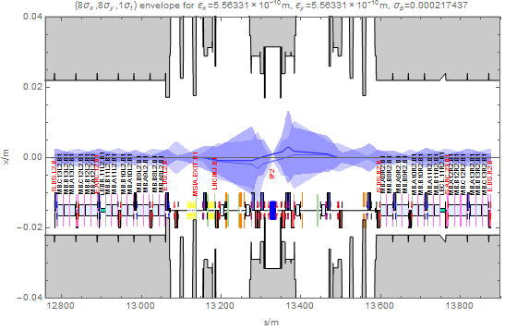
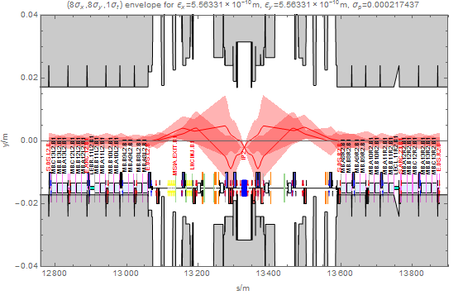
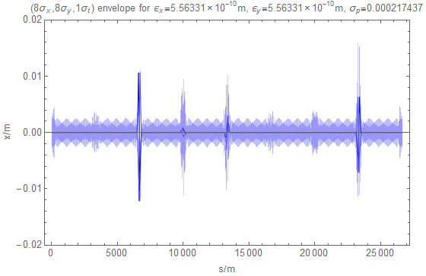
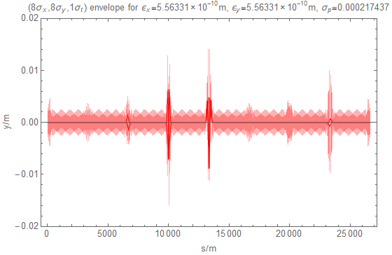
Mathematica Tools : IP2 all bumps

Slide 26
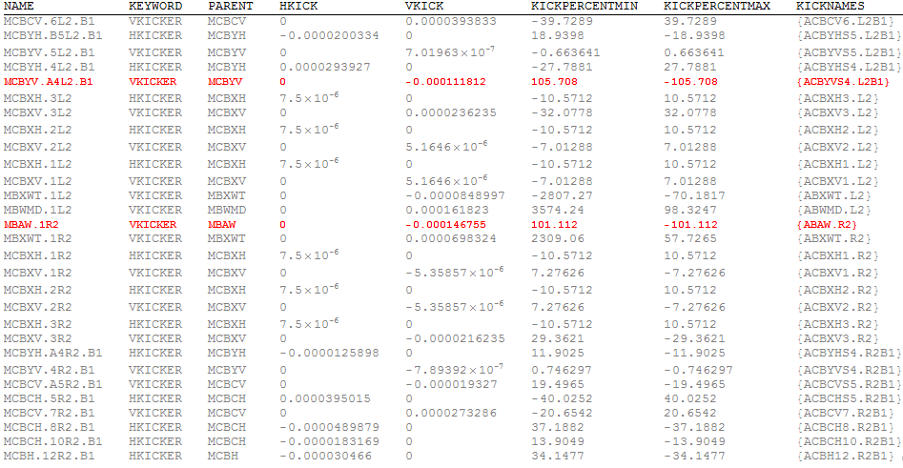
Mathematica Tools : IP2 all bumps
mfsopticsAddCorrectorStrength function
reveals problem with ACBYVS4.L2B1

Slide 27
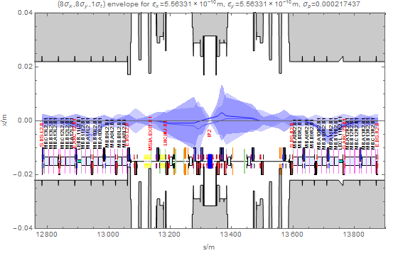

Mathematica Tools : BFPP bumps (IP2 as example)
Same approach as for other bumps
MADX file for BFPP bumps adds extra knobs for IP1/IP2/IP5 to set the strength of BFPP bumps and can be loaded on top of the other MADX files.
Selected correctors that give cleanest bumps
Different bumps (different correctors) are available if we run into problems with available corrector strengths

Slide 28
Conclusions
Current proposal for squeeze of IR2 seems to work in the machine and only adds 3 minutes to the squeeze process for ions compared to the proton squeeze
Beta star will be kept at 80 cm except maybe for one IP (1 or 5) for quench test MD
FLUKA simulations seem to indicate that we will not quench with current luminosity expectations for Run2 and expected quench limits (might be even ok for HLLHC with some remarks)
Orbit bump strength files for IR2 in the squeeze are now available
BFPP bumps are now available and are being tested in combination with the other orbit bumps to check possible strength limitations
Inverted bumps might help to try to trigger a quench in the quench test MD

