Slide 1
EHN1 extension
Beam lines integration
S. Girod, V. Clerc

Slide 2
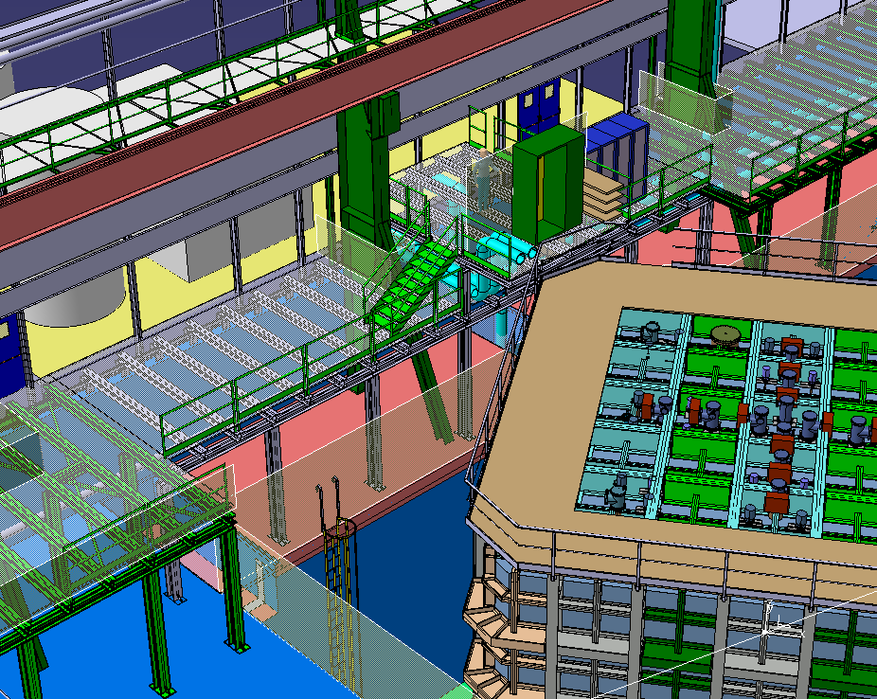
Access to WA105

Slide 3
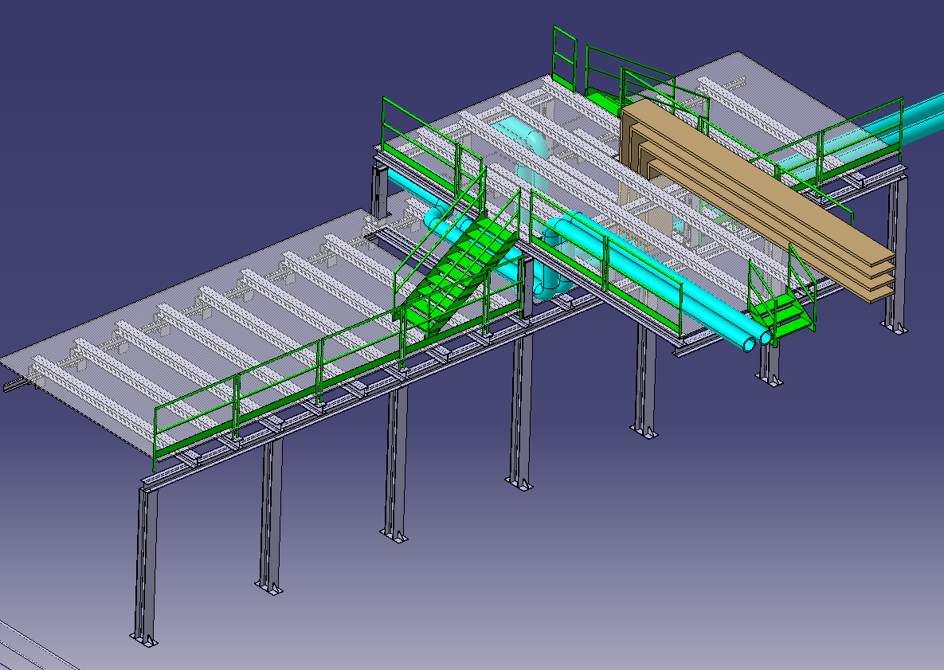
Access to WA105

Slide 4
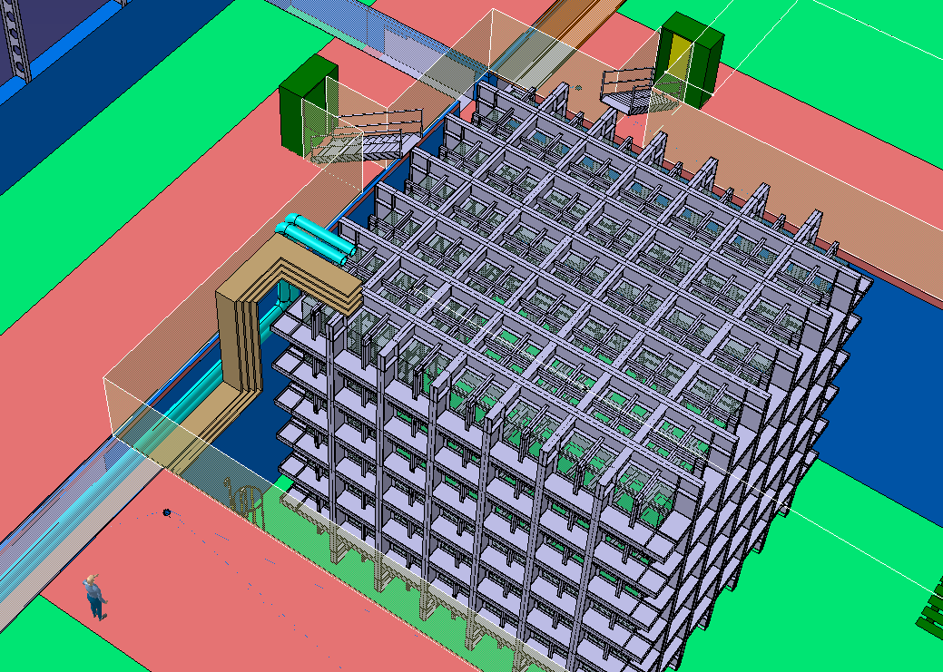
Access to DUNE

Slide 5
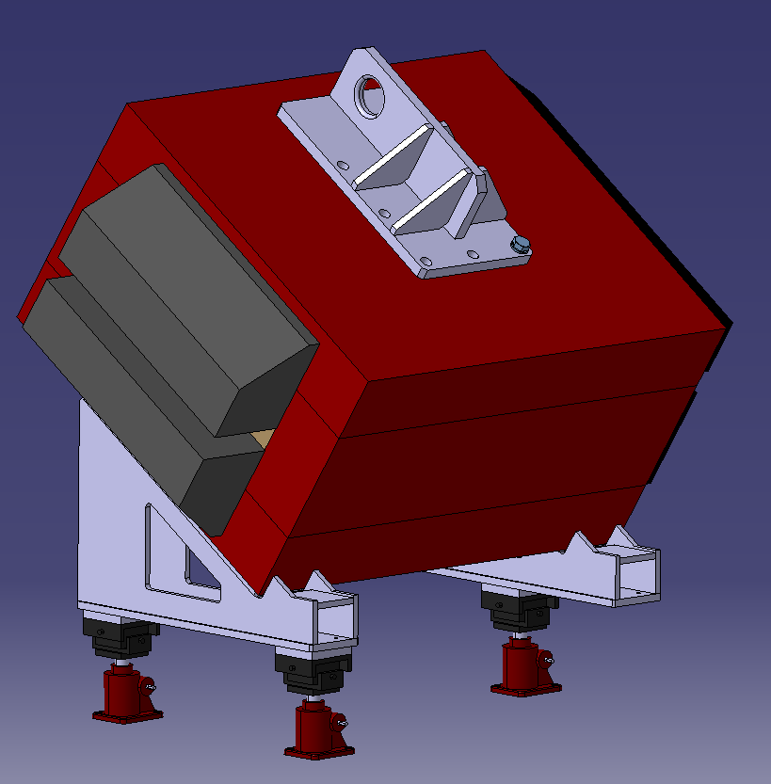
MBPL magnet tilted 33.5°

Slide 6
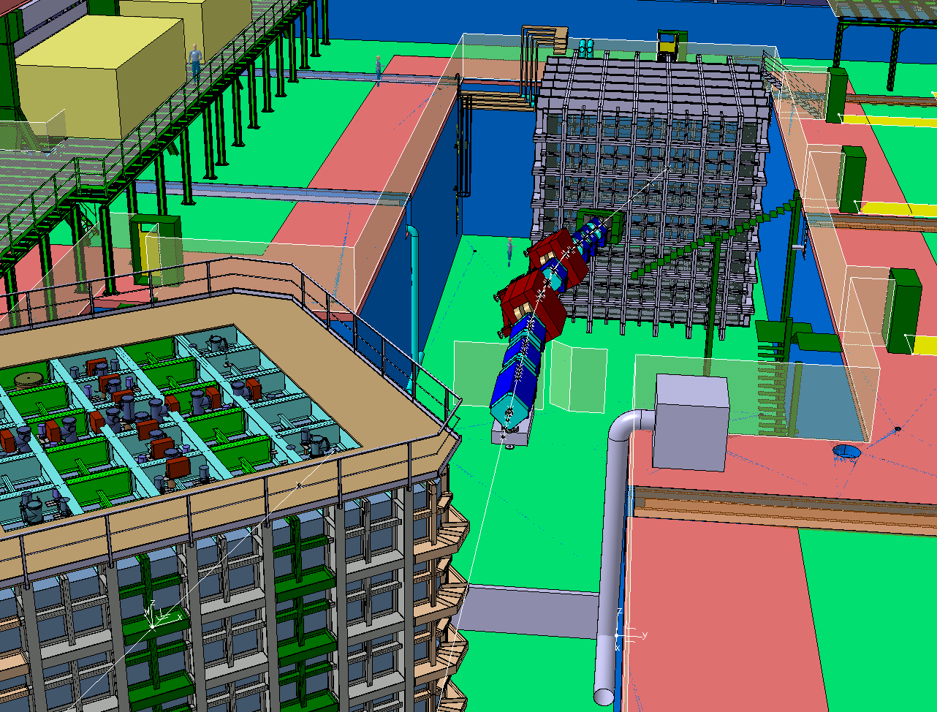
H4 beam line

Slide 7
