Slide 2
TE-VSC reporting to:
Superconducting RF R&D coordination meeting 01 on
Nb₃Sn magnetron sputtering

Slide 3
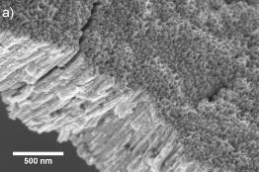
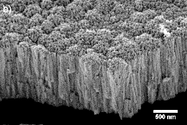
Current status
AS-DEPOSITED FILMS @ RT
As deposited films composition can be easily tuned by acting on coating pressure
Films are highly disordered with very small crystallites sizes (<10nm)
No superconductivity observed

Slide 4
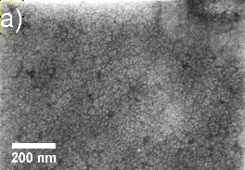
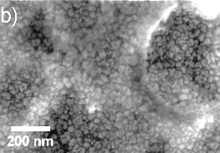
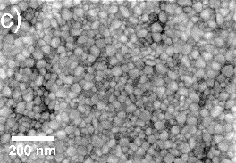
Current Status
ANNEALED FILMS
Annealing temperatures: 700 / 750 / 800 °C
Atmosphere: Vacuum (~1.10⁻⁶ mbar)
Duration: 24H
Goal: Obtain A15 superconducting cubic phase
Up to now: 1 film deposited at 1.10⁻³ mbar annealed.
A15 phase obtained (XRD)
Superconducting properties to be characterized
700°C
750°C
800°C

Slide 5
Next steps: transition from EUCARD2 to FCC
Task | 2015 |  | 2016
 | Q3 | Q4 | Q1 | Q2 | Q3 | Q4
Nb₃Sn – RT + annealing characterization
Nb₃Sn high temperature coatings
V₃Si coatings
Fellow contract
Scale-up cathode design
Eucard2 milestone
RF properties
EUCARD 2 milestone: March 2016 = RF characterization of Nb₃Sn coating
Nov 2015 : High temperature coatings + V₃Si ramp up

