Slide 2
TE-VSC reporting to:
Superconducting RF R&D coordination meeting 01
on
CERN-LNL-STFC collaboration KE2722/BE/FCC

Slide 4
Meetings
Kickoff meeting at CERN on 23.06.2015
  Discuss the Laboratories capabilities, confirm common scope
  Agree on planning, deliverables and milestones
  List of short-term actions
Follow up meeting in Whistler during SRF2015, 17.9.2015
  Follow-up on actions
  Discuss samples testing and analyses plan
Next meeting not scheduled yet.
  (yearly review meeting foreseen in collaboration agreement)

Slide 5
Planning

Slide 6
Milestones and deliverables

Slide 7
Short term actions
CERN
Launch a framework contract for the delivery of certified Cu-OFE up to a maximal value. -> Available
Supply Cu-OFE in 2mm or 3mm sheet to LNL for 6GHz cavities manufacturing -> 31.10.2015 agreed in Whistler
Delivery of approved drawing of 800 MHz cavity to LNL (M8). Deadline: 31.8.2015 -> 31.10.2015
Work out a plan for production and testing follow-up and circulate. Deadline: 31.8.2015 -> Discussed in Whistler
Setup a tool for sharing of communication. Deadline: 31.8.2015 -> 31.10.2015
Ensure quick signature of Contract documents. Deadline: 1.7.2015 -> see next page
LNL
Provide a testing program, with relevant parameters, techniques, procedures, for 6GHz cavities, to circulate. Deadline: 1.8.2015 -> Discussed in Whistler
Provide a request for size, quantity and thickness, of certified Cu-OFE for 6GHz cavities, to CERN. Deadline: 1.8.2015 -> 31.10.2015
ASTeC
Prepare a summary description of what the deliverables would be under 3D Nb/Cu Coating System. Deadline: 3.7.2015 -> Received in Whistler

Slide 8
Example: surface treatments
Chemical polishing (SUBU)
Use of existing LHC SUBU installation.
Define and fabricate specific tooling for handling at different processing phases.
Pickling + Passivation auxiliary tanks.
Define and fabricate top and bottom cavity interfaces for SUBU.
Define and fabricate tools for bath circulation inside the cavity (avoid pinholes and get homogeneous etching).
COMSOL simulations (bath speed homogeneity and tools geometry).
Foreseen budget 50 kCHF.
Electropolishing
COMSOL simulation to define cathode geometry and working parameters.
Define and fabricate electropolishing installation for both horizontal or vertical electropolishing.
Fabricate cathode in accordance with simulations.
Find space in the present premises to install the set-up.
Foreseen budget for the EP installation 200 kCHF.
18 months to have the surface treatments equipment ready: a bit tight but we will do our best.

Slide 9
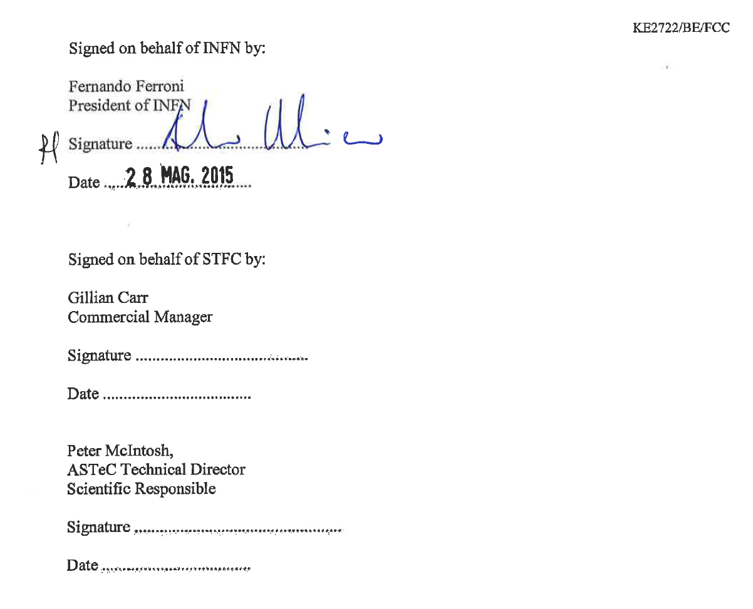
Signatures
Retrieved on 5.10.2015 the lost document signed by INFN’s president, which is now being sent to STFC for signature

