Slide 1

FCC
R&D on RF (SRF and high $η$)
Erk Jensen
14-Oct-2015

Slide 2
The Context
LHC to run for 20+ years → we must keep key technologies in house!
A future large machine (FCC or other) will need key technologies:
  high field magnets,
  efficient power conversion,
  RF systems (normal conducting or superconducting)
    normal conducting: pulsed – superconducting: CW (requires also efficient cryogenics)
European Strategy for Particle Physics (2013):
  Europe’s top priority should be the exploitation of the full potential of the LHC, including the high-luminosity upgrade of the machine…
  CERN should undertake design studies for accelerator projects in a global context, with emphasis on proton-proton and electron positron high-energy frontier machines. These design studies should be coupled to a vigorous accelerator R&D programme, including high-field magnets and high-gradient accelerating structures, in collaboration with national institutes, laboratories and universities worldwide.
Collaboration: This is a global effort: what can partners provide – what should be concentrated at CERN?
  → Keep the R&D @ CERN complementary to the successful global R&D program!

Slide 3
The CERN Context
We have an ongoing SRF program for LHC and HL-LHC!
(Highest priority, includes 400 MHz crab cavities as baseline (32 + spares), 200 MHz and 800 MHz harmonic & subharmonic cavities as options)
We have an ongoing SRF program for HIE Isolde (High priority, 20 cavities 100 MHz, QWR, Nb-on-Cu, for radioactive isotope post-acceleration)
Since LHC has to run 20+ years, we’re building/processing LHC spare cavities/cryomodules and FPCs!
There is the FCC SRF R&D programme described here.
And also we have an ongoing SRF R&D program covering interesting R&D that is not focused on FCC (e.g. High Gradient test cavities 704 MHz in collaboration with ESS, alternative compact crab cavity study using Nb-on-Cu, cold diagnostics studies, new forming, joining and cleaning techniques, SRF theory …)
There is a certain synergy – which is by all means intentional/welcome!
But infrastructures and services have to be shared!

Slide 4
The Strategy
Long term goals: significant performance improvement for future accelerators with better …
  …overall energy efficiency
  …reliability
  …performance reach (accelerating gradient, intensity, brilliance, size …)
  Reaching these goals will have impact on other accelerators, e.g. medical & light sources, and on society at large.
  The R&D itself will have a positive societal impact (academic interest – training – excellence).
R&D must be fundamental and basic – not incremental!
  We must dare to do things that are very different! The risk is high – but also the potential.
  We must understand the underlying physics – this requires time and contemplation as well as systematic studies.
  I believe CERN is an excellent place to do this – where else?

Slide 5
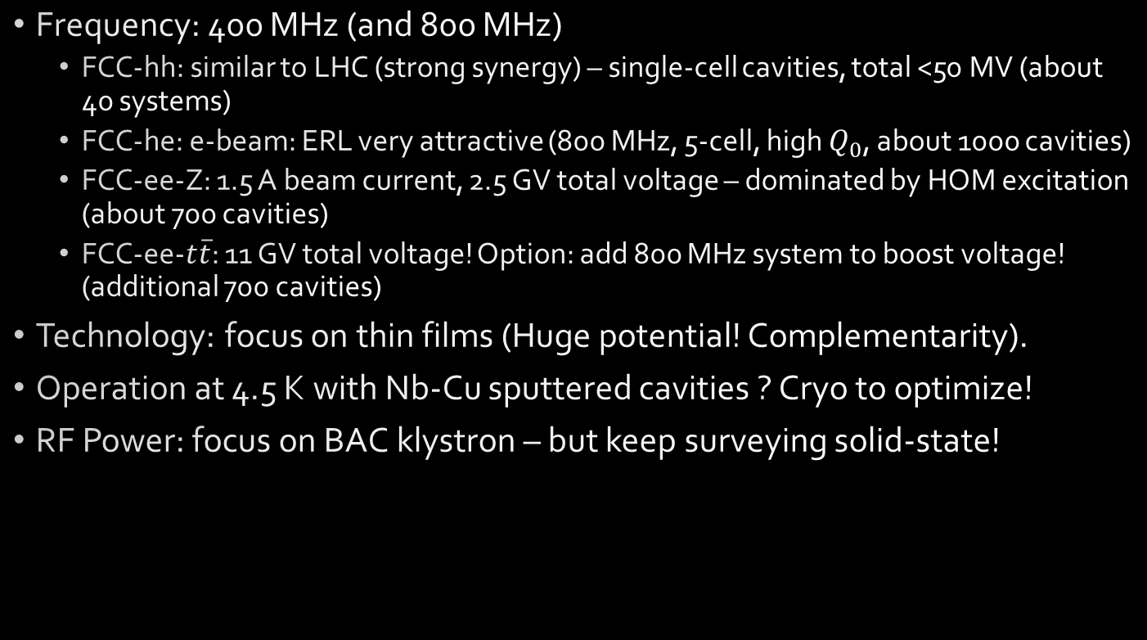
Initial Choices for FCC
Frequency: 400 MHz (and 800 MHz)
  FCC-hh: similar to LHC (strong synergy) – single-cell cavities, total <50 MV (about 40 systems)
  FCC-he: e-beam: ERL very attractive (800 MHz, 5-cell, high $Q_{0}$, about 1000 cavities)
  FCC-ee-Z: 1.5 A beam current, 2.5 GV total voltage – dominated by HOM excitation (about 700 cavities)
  FCC-ee-$t\overline{t}$: 11 GV total voltage! Option: add 800 MHz system to boost voltage! (additional 700 cavities)
Technology: focus on thin films (Huge potential! Complementarity).
Operation at 4.5 K with Nb-Cu sputtered cavities ? Cryo to optimize!
RF Power: focus on BAC klystron – but keep surveying solid-state!

Slide 6
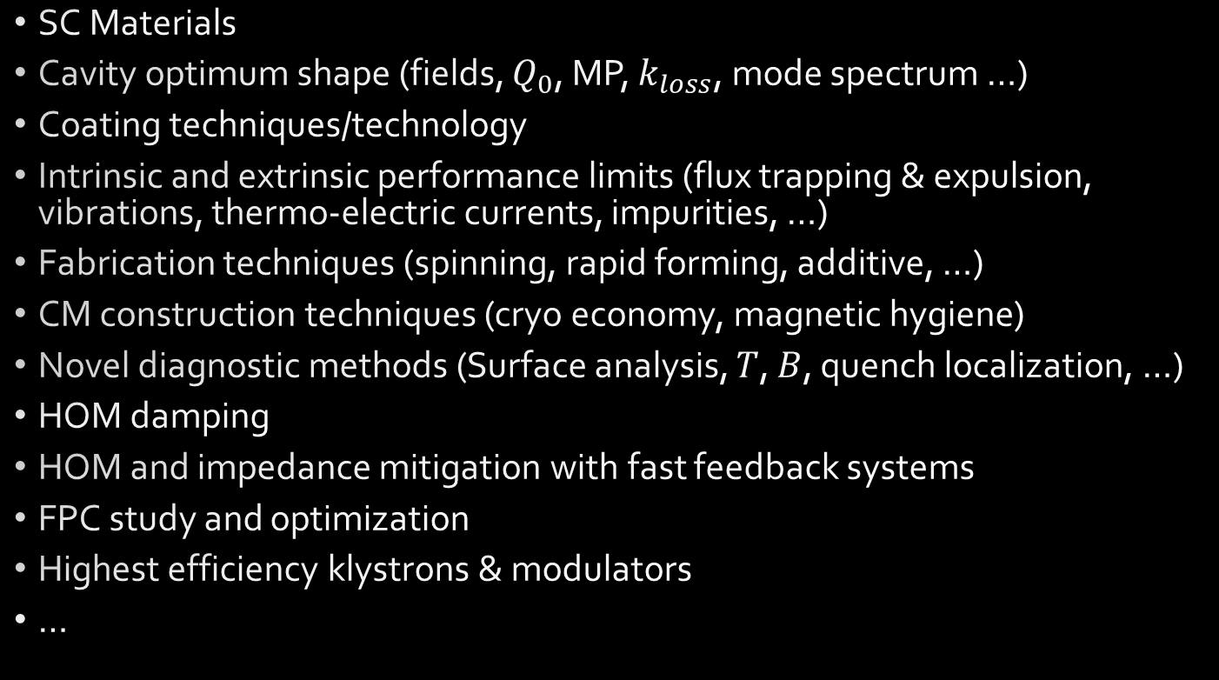
Some areas of R&D
SC Materials
Cavity optimum shape (fields, $Q_{0}$, MP, $k_{loss}$, mode spectrum …)
Coating techniques/technology
Intrinsic and extrinsic performance limits (flux trapping & expulsion, vibrations, thermo-electric currents, impurities, …)
Fabrication techniques (spinning, rapid forming, additive, …)
CM construction techniques (cryo economy, magnetic hygiene)
Novel diagnostic methods (Surface analysis, $T$, $B$, quench localization, …)
HOM damping
HOM and impedance mitigation with fast feedback systems
FPC study and optimization
Highest efficiency klystrons & modulators
…

Slide 7
The work packages (draft)
# |  | name | topics / objectives
WP 1 | Collaboration Agreement “KE2722/BE/FCC” | P. Chiggiato | 6 GHz: Nb/Cu performances + diagnostics 800 MHz: fabrication of seamless cavities 400 MHz: feasibility study (fabrication)
WP 2 | Cavity Design (+ cavity impedance and HOMs) | R. Calaga | 400 MHz: low loss factor cavities for FCC-ee 800 MHz: for 2nd harmonic system
WP 3 | Cavity Material and Performance | W. Venturini Delsolaro | Preparation, diagnostics & measurements @ CERN Bulk Nb, Nb/Cu & Nb₃Sn at low frequencies
WP 4 | Cavity Fabrication | K. Schirm | Collaboration with JLab? BINP? Mainz?? High velocity forming of cavities (EN/MME)
WP 5 | Cryomodule Challenges | K. Schirm | CM design & architecture (SPL?, JLab, CEA Saclay) CM assembly (CEA Saclay) Auxiliaries (tuning, FPC, etc)
WP 6 | LLRF System | W. Hofle | Fast cavity feedbacks, cavity trip handling, impedance mitigation
WP 7 | High Efficiency Power Systems | N.N. | Super-efficient klystrons …

Slide 8
Next target: FCC week in Rome, April 16
Progress to be reported in Rome:
  Convergence towards FCC RF parameters (locations, staging scenarios …)
  Initial cavity designs compatible with the different requirements
  Launch of R&D program – structure, WBS – international players
  First results of R&D program!
  First results of very high efficiency klystron prototypes

