Slide 1
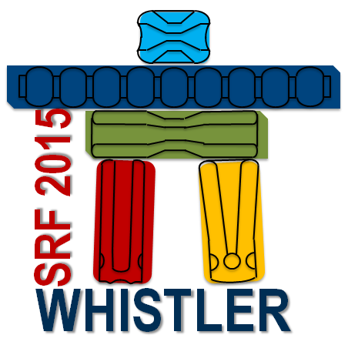
Feedback from the SRF conference 2015
1st SRF R&D coordination meeting for FCC
14.10.2015
Sarah Aull

Slide 2
SRF2015: 5 days, 332 participants, 385 contributions
http://srf2015proc.triumf.ca/prepress/

Slide 3
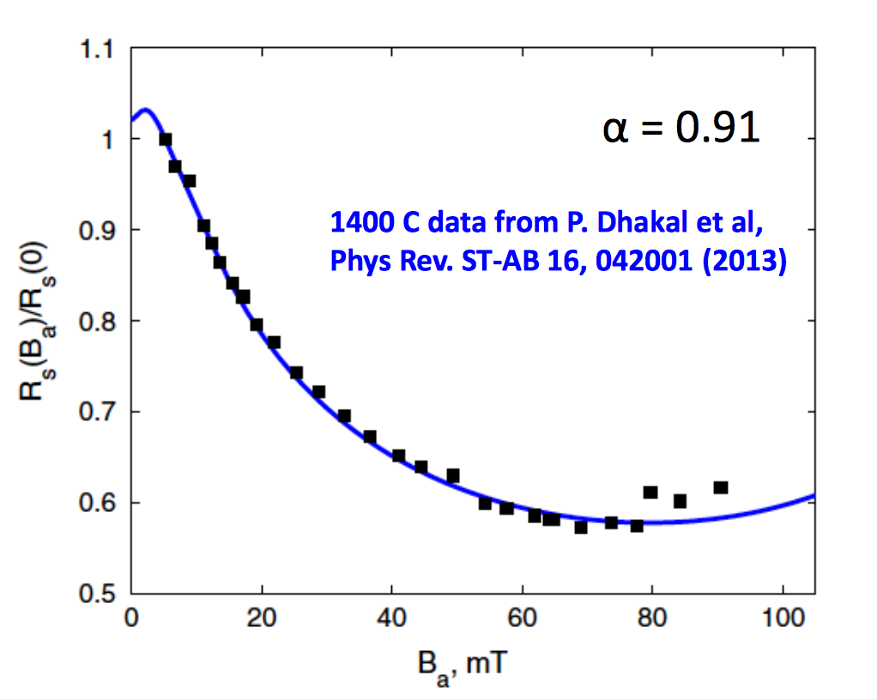
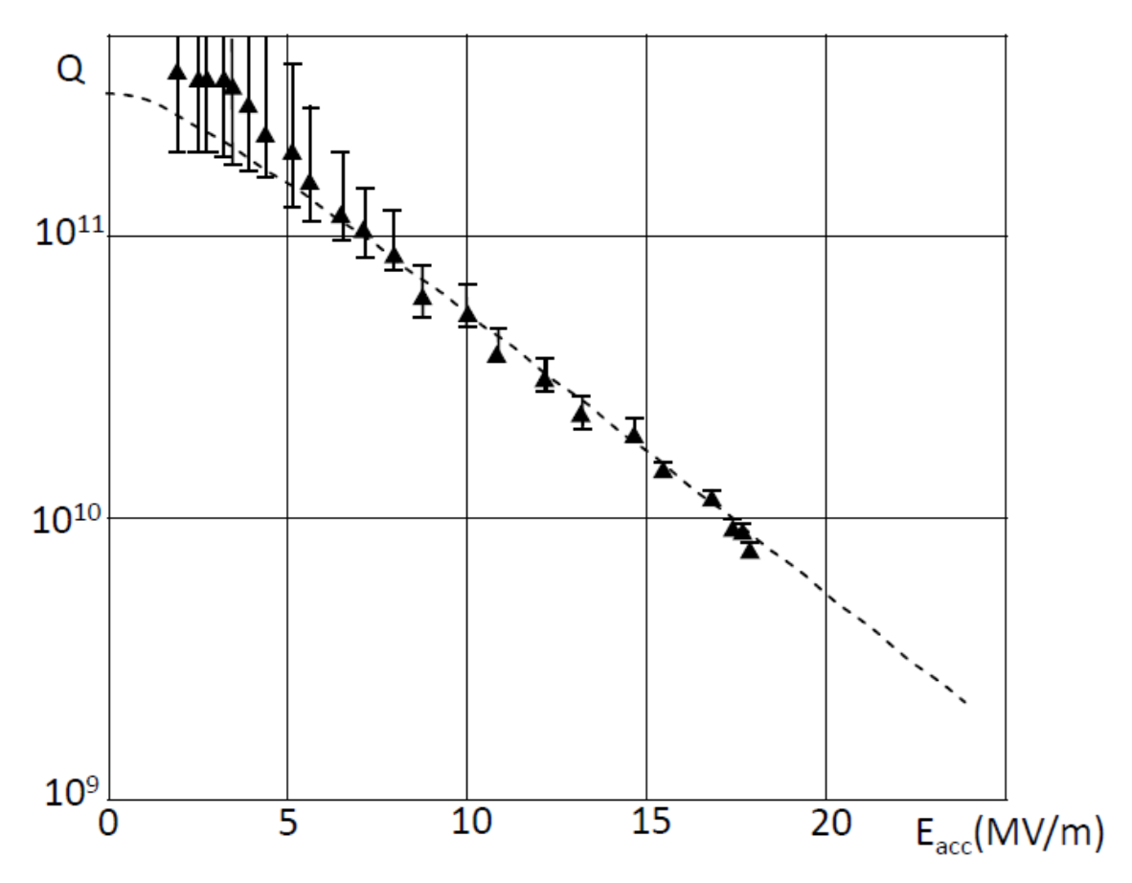
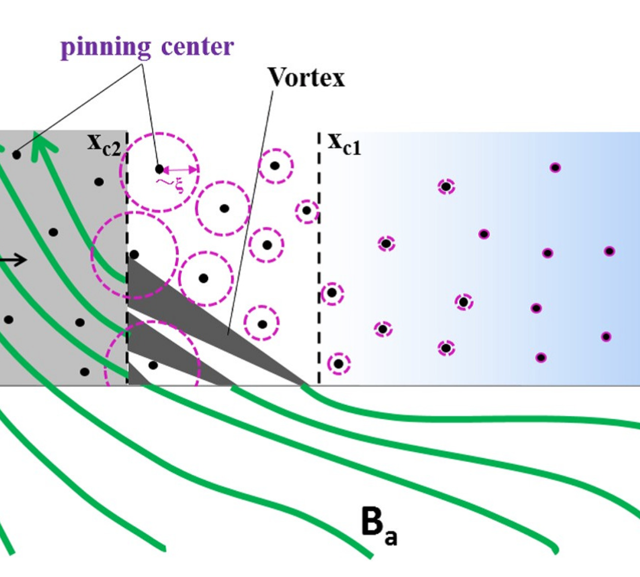
Key theoretical contributions
Non-equilibrium BCS theory describes anti-Q-slope in nitrogen and titanium doped cavities
Description of the Q-slope in Nb/Cu cavities by thermal boundary resistance due to locally bad adhesion
Description on how an ambient magnetic field is trapped depending on a temperature gradient
A. Gurevich, WEA1A01
V. Palmieri, TUBA02
T. Kubo, MOPB009

Slide 4
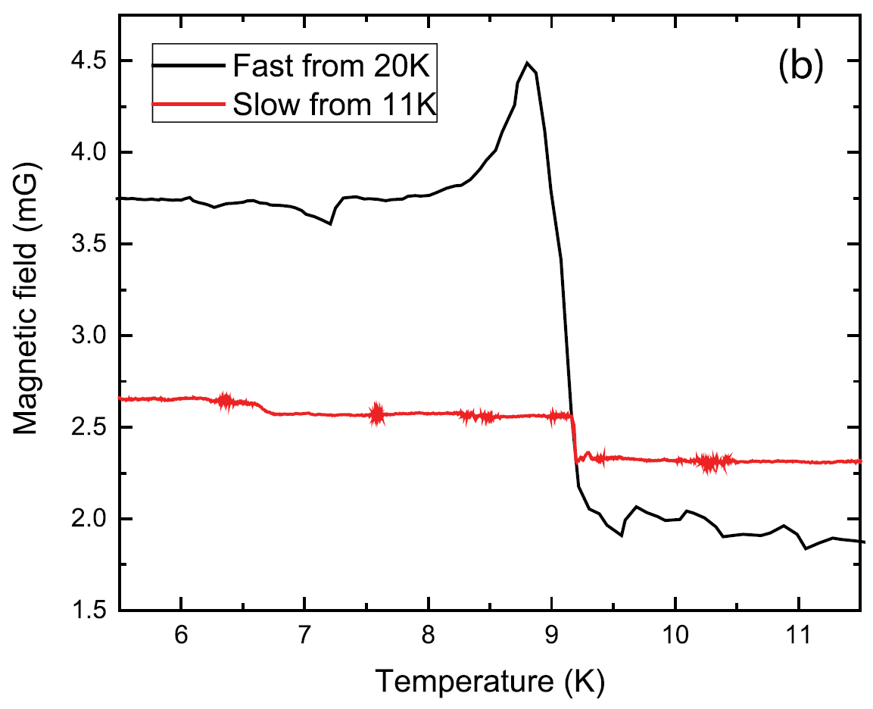
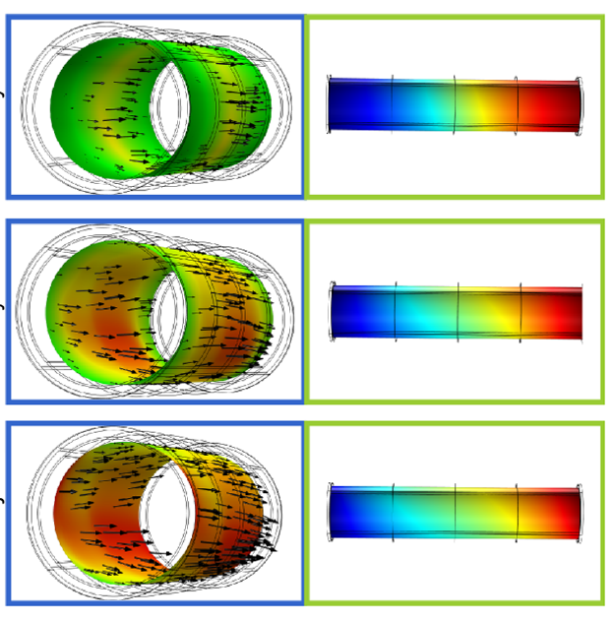
Bulk Niobium: Losses due to trapped flux
Efficiency of trapping the ambient magnetic field depends on the cooling dynamics.
Temperature gradients along the cavity can induce thermo-electric currents which create additional magnetic fields that can be trapped. Stronger effect for dressed cavities and asymmetric cooling.
Next generation of cryomodules must allow thermal cycling and defined cooling schemes.
Flux expulsion
Flux trapping
Thermally induced magnetic fields
A. Romanenko, et al. J. App. Phys. 115, 184903 (2014)
J.-M. Vogt, et al. Phys. Rev. ST-AB 18, 042001 (2015)

Slide 5
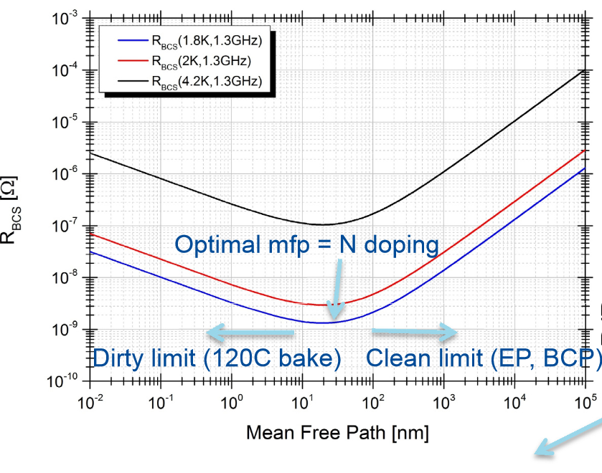
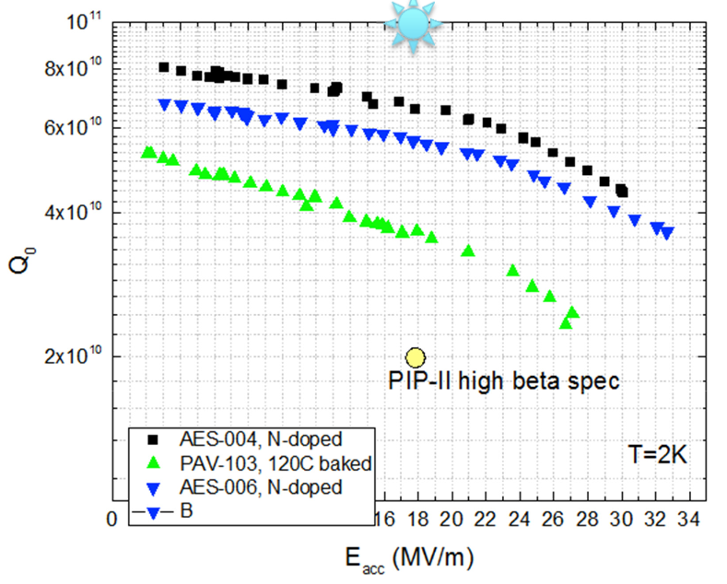
Progress on N doping
Suppression of nanohydrides was ruled out as origin of anti-Q-slope
High Q is explained by BCS optimum.
Doping recipe not 1:1 transferrable to lower frequencies
There seems to be a correlation between mean free path and quench field
650 MHz
If anti-Q-slope is a BCS effect, the same performance should be expected from a perfect Nb/Cu film
A. Grasselino et al., MOBA06
A. Grasselino et al., MOBA06

Slide 6
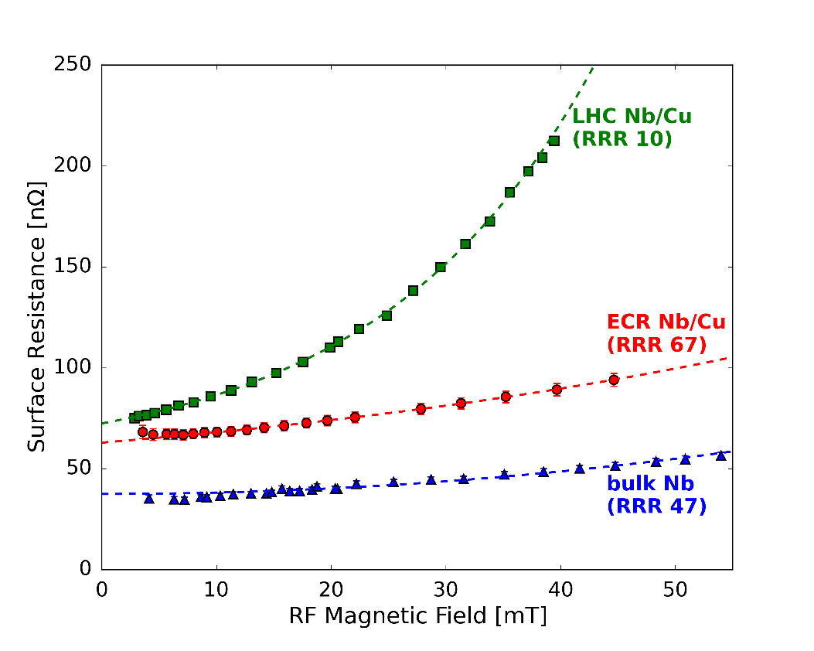
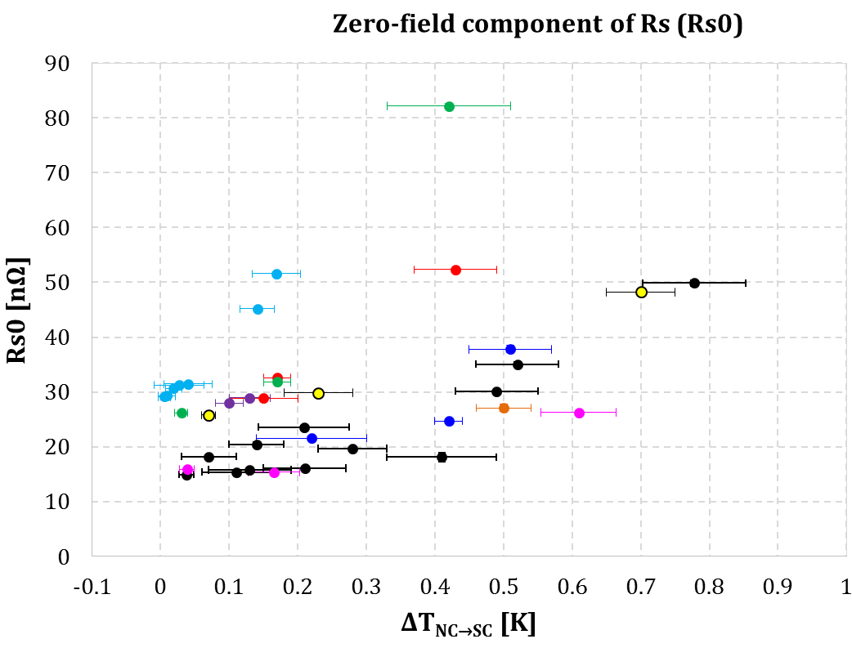
Thin films: Nb/Cu
Energetic condensation gives first promising results on curing the Q-slope.
Thermo-electric seem to have strong effect on Nb films.
Further development of high quality Nb/Cu coating is needed.
Dedicated studies on the cooling dynamics of Nb/Cu are needed
S. Aull, et al., TUBA03.
P. Zhang, et al., TUPB077.

Slide 7
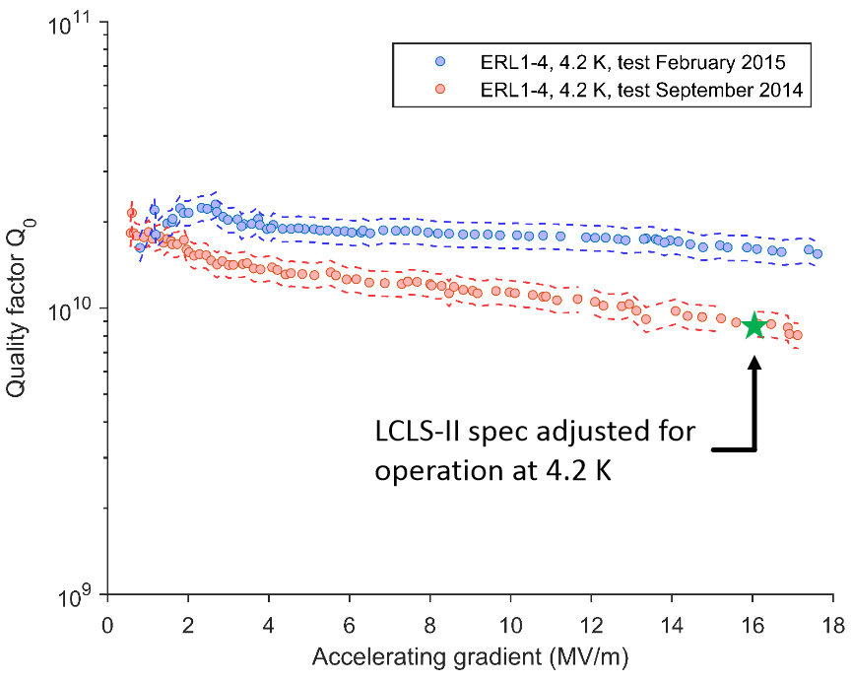
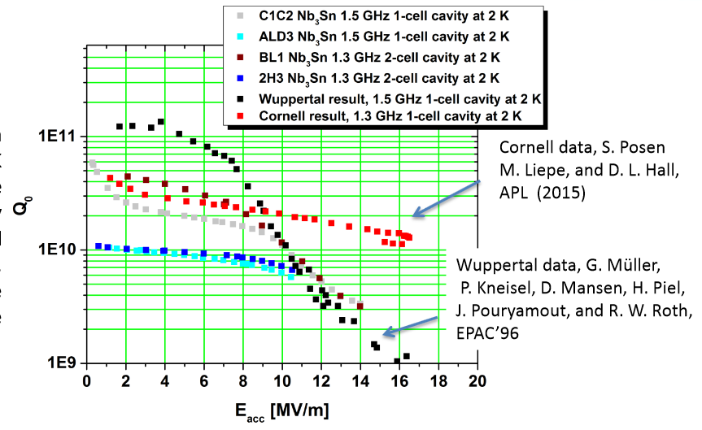
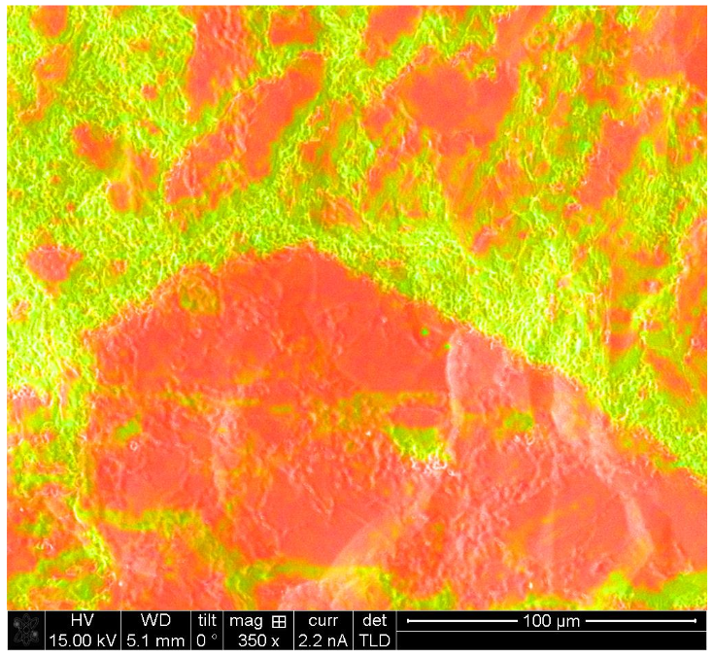
Thin films: Nb₃Sn based on diffusion recipe
Improved quench field on single cells
(E_{acc} = 13 MV/m in 2013)
Main issue: tin depleted areas
Coating 2-cell cavities started:
Limited to low gradients
Nb₃Sn/Cu started at CERN
D. Hall, et al., TUBA04.
G. Eremeev, et al., TUBA05.

Slide 8
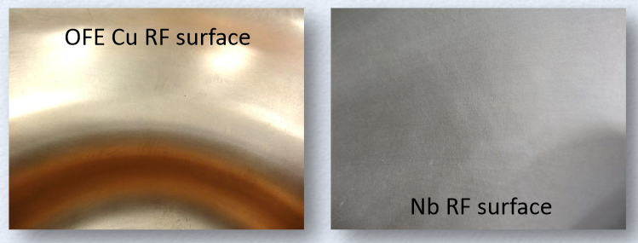
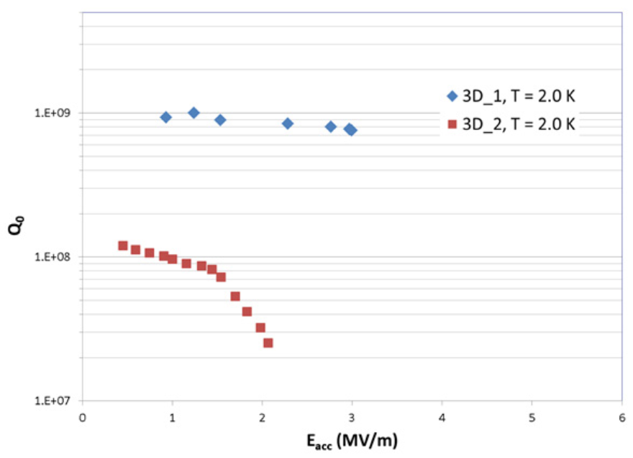
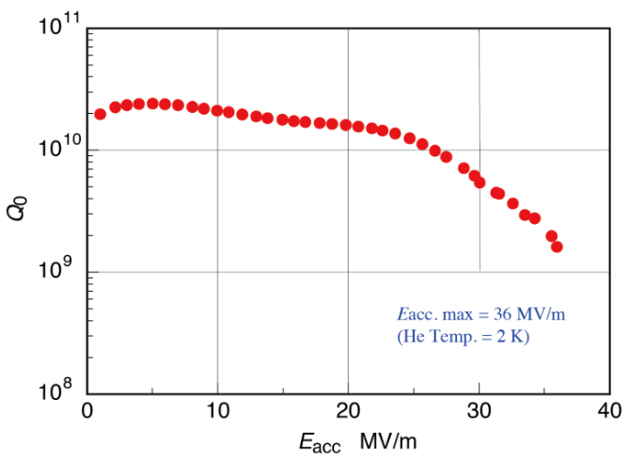
Cavity fabrication
R_{res} = 170 nΩ
R_{res} = 2.5 μΩ
M. Yamanaka, et al., THPB041.
P. Frigola, et al., THPB042.
First 3.8 GHz single cell cavity from additive manufacturing (Arcam EBM)
Hydro-formed cavity reaches 36 MV/m (after CBP + 15 um EP)
S. Atieh, et al., THAA05.
First hydro-electro formed half cells show conservation of surface roughness and low wall thickness variation

Slide 9
General take home messages for CERN
CERNs current SRF activities cover many different shapes and frequencies:
Continue development of geometry independent diagnostic tools
Benefit from synergies between different projects
Sample test cavities:
Quadrupole Resonator (QPR) is still the best setup on the market
Strong interest in QPR around the world: Upgrade of CERN’s QPR is essential

