Slide 1
High Efficiency Klystron (HEKCW) for FCC info/status
I. Syratchev

Slide 2
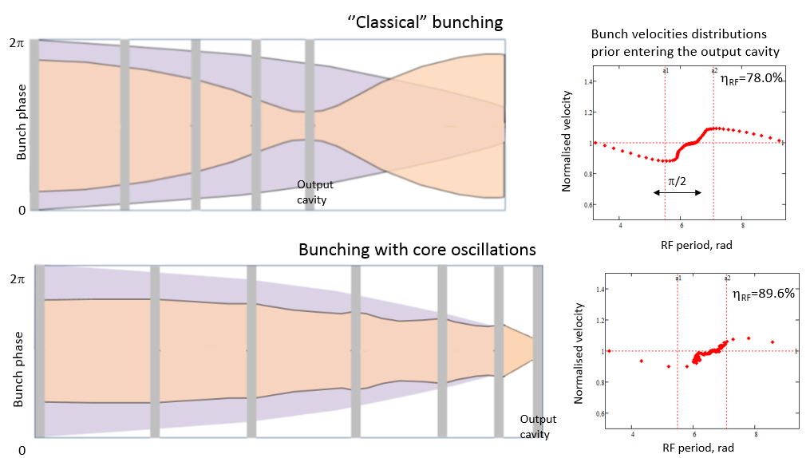
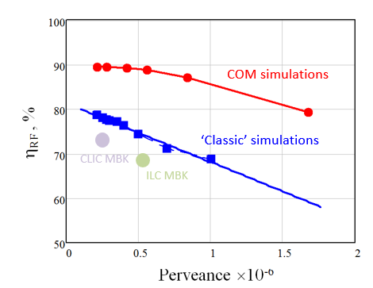
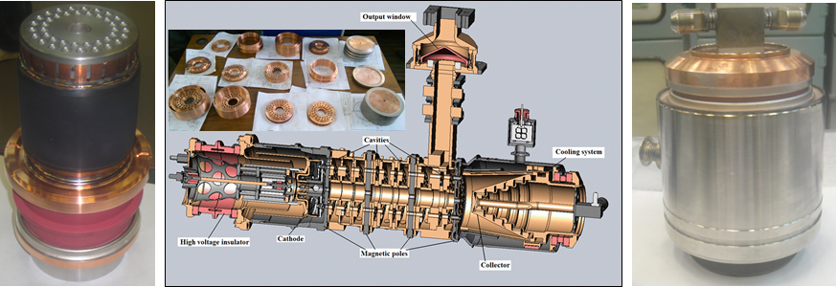
The new bunching technology has a potential to boost klystron efficiency to the 90% level.
The first conceptual/ technological S-band MBK prototype is now being built in Russia.
PPM, 52 kV, 7MW, Duty cycle 0.002, Eff. >70% (to be demonstrated)

Slide 3

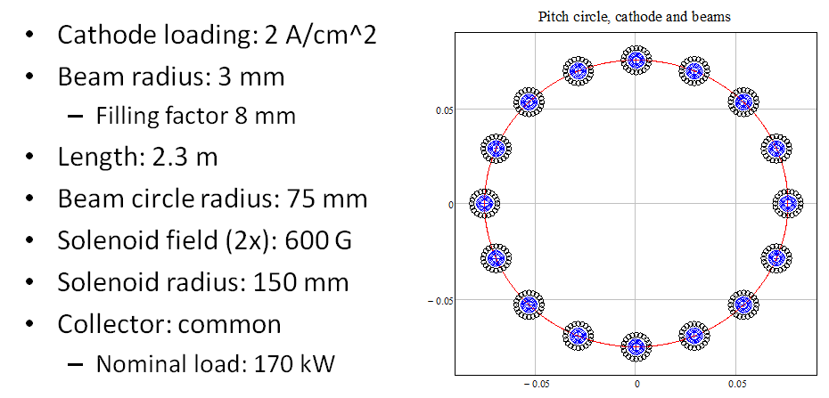
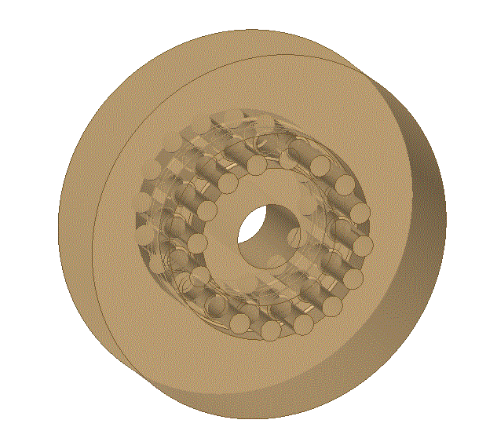
FCC ^{e+e-} CW, MBK klystron (HEKCW)
HEIKA/HEKCW working team:
Syratchev (CERN)
G. Burt (Lancaster)
C. Lingwood (Lancaster)
D. Constable (Lancaster)
V. Hill (Lancaster)
R. Marchesin (Thales)
Q. Vuillemin (Thales/CERN)
A. Baikov (MUFA)
I. Guzilov (VDBT)
C. Marrelli (ESS)
R. Kowalczyk (L-3com)
Tube parameters:
Voltage: 40 kV
Power: 1.5 MW
Total current: 42A
N beams: 16
µK/beam : 0.33
N cavities: 7
Bunching methods COM/BAC
HEKCW
16 beams MBK cavity
R/Q = 22 Ohm/beam

Slide 4
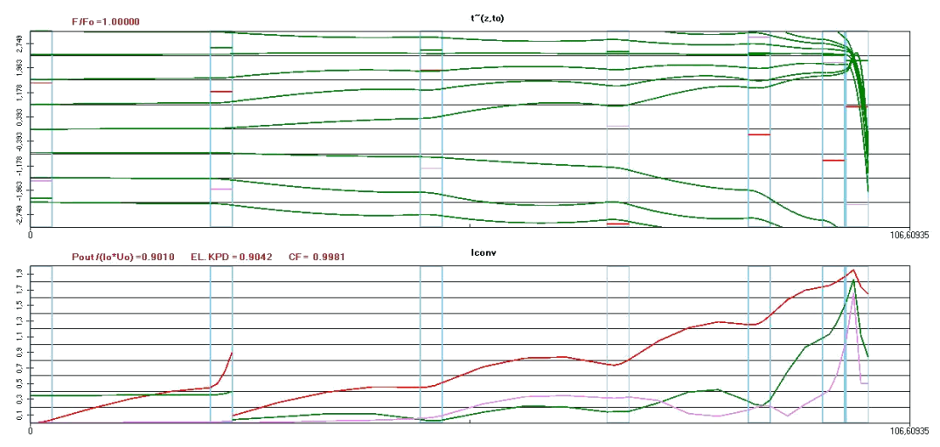
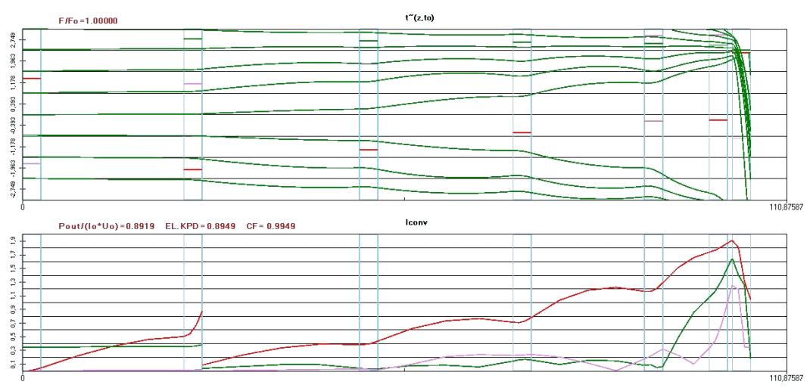
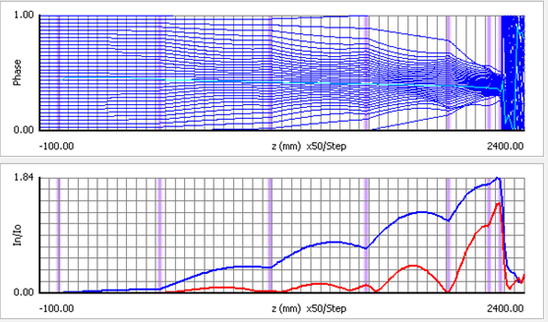
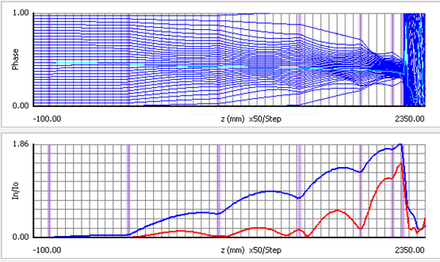
HEKCW RF COM circuit optimisation
Few tubes were optimised using KlypWin (1D code). Two of them were selected for further study.
HEKCW #11-02 (highest efficiency) η= 90.1%
HEKCW #11-07 (‘cleanest’ phase trajectories) η=89.2%
High efficiency confirmed by another non-commercial 1D code AJDisk
η= 88.0%
η= 87.5%

Slide 5
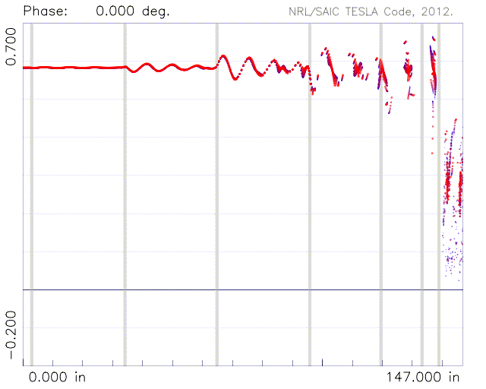
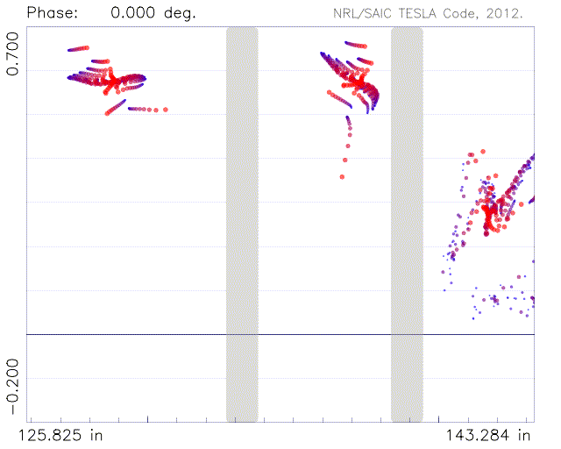
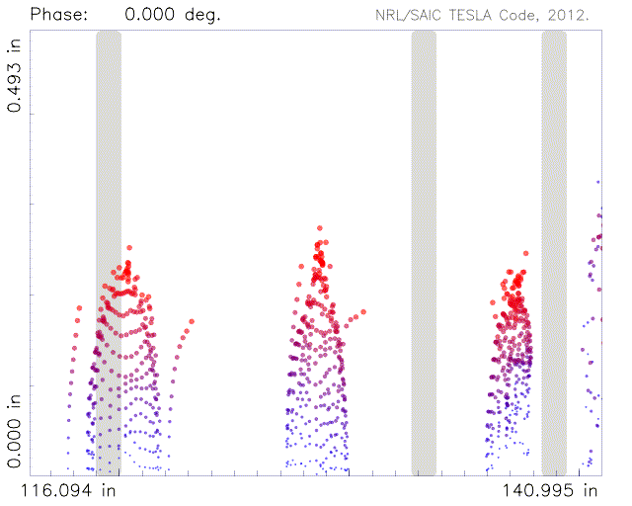
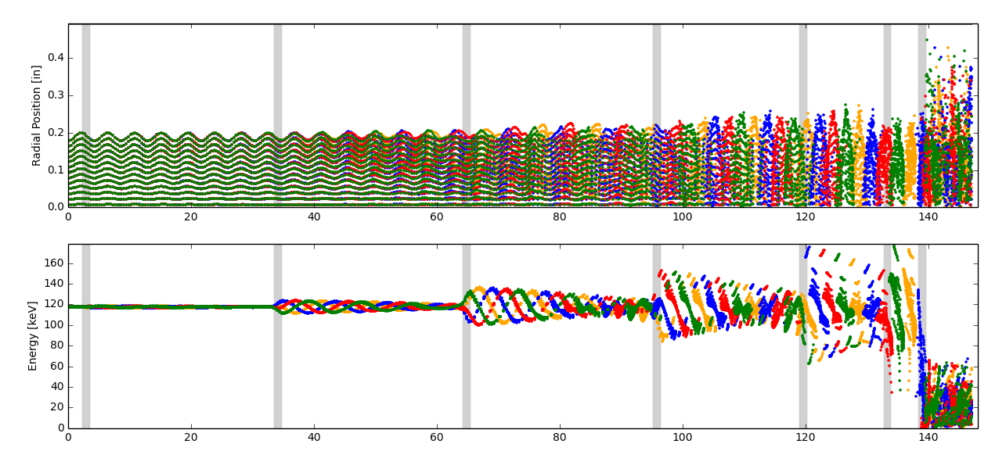
NRL/SAIC TESLA (2.5D). Tube is slightly re-tuned (stability issues). Efficiency 80%.

Slide 6
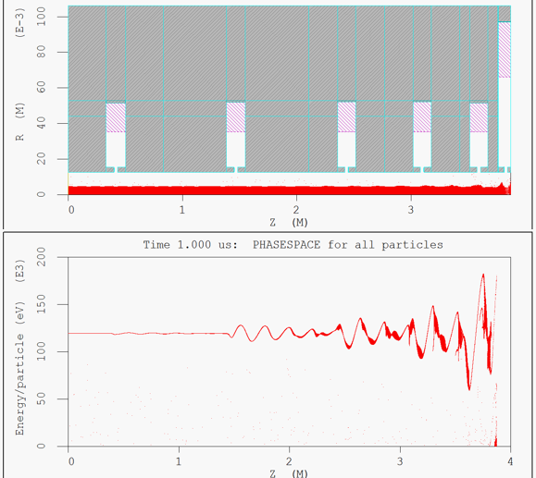
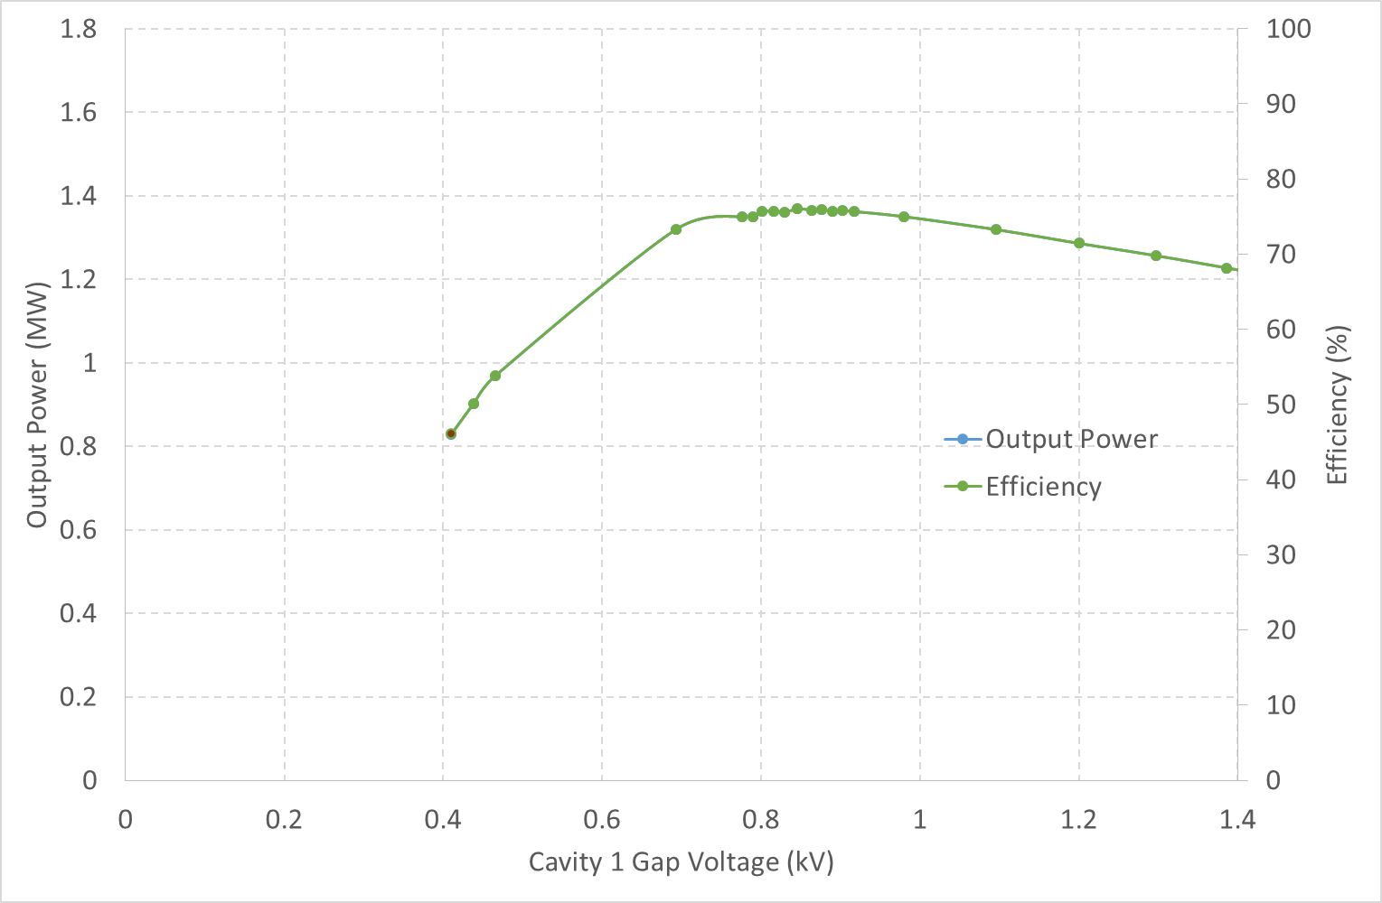
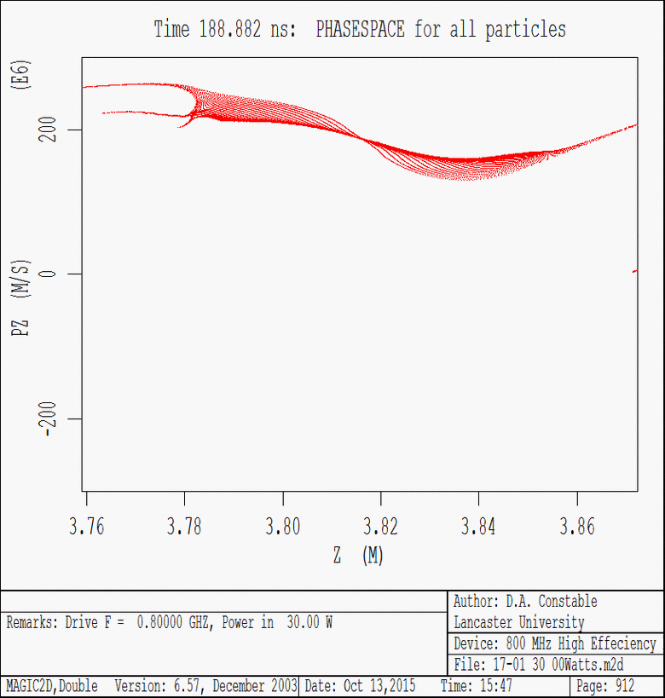
MAGIC (2.5D). Tube is shortened (6 gaps) (reflected electrons issues). Efficiency 78%.
(yet in a progress)
Reflected electrons

Slide 7
HEKCW ‘preparatory’ activities. ~Needs and ~schedules.
1. Computer simulations (1D, 2D, 3D). Development/improving of the klystron circuit (COM/BAC/new methods) and exploring the new ideas (electron beam mixing technique, hollow beams etc.).
-Target: robust MBK klystron design with efficiency above 80%.
- Resources:
CERN: I. Syratchev, Q. Vuillemin (PhD. CERN/Thales)
Others: HEIKA team contribution.
- Needs: Dedicated computer facility (Lancaster U). Investment: computer cluster ~30 kCHF.
- Schedule: Ongoing activity (+ 3 years?)
2. HEKCW prototyping. GSP (scaled) tubes.
- Target: Inexpensive experimental demonstrators of the HEKCW concept(s) at a lower power
(different frequency (3 GHz)). 3-4(+) tubes.
- Resources:
CERN: I. Syratchev, Fellow or equal (for testing).
Others: HEIKA team contribution
Industry (on the collaborative bases)
Needs: General purpose test stand (XBOX area (?)), LLRF/ ‘flexible’ modulator; app. 150 kCHF.
Investment (industry): klystrons/(solenoid) fabrications; app. 200 kCHF. Total 350 kCHF.
Schedule: Starts from ~mid. 2016. Two years program.

Slide 8
3. Alternative/advanced technologies:
- Other than klystron. IOT with extra bunching cavity(ies). The existing 0.53 GHz,10 kW
tube (called Tristrod. Developer: “Kontact”, Russia) operates routinely at 90% efficiency.
- Cathodes:
* Gated (low voltage controlled) cathode. Overall system efficiency improvement.
* Hollow beam cathodes (MIG, cold emission…). Reaching the ultimately
high efficiency (90%).
- Resources, needs and schedules are not yet specified. For now covered by HEIKA.
Fabrication and testing of the final HEKCW prototype.
The choice of final circuit configuration and computer detailed design. HEIKA team.
Technical design of the klystron (including all subsystems). Industry.
Efficiency demonstration (target: 85%) in pulsed mode. CERN/X(S)BOX modulators.
If accepted, could be started not before late 2017. Overall project duration is about 3 years (tests at 2021). Anticipating reduced NRE expenses in industry, the projected cost is 500 kCHF.

