Slide 2
STP-WP9 - Beam Vacuum report
P. Chiggiato

Slide 3
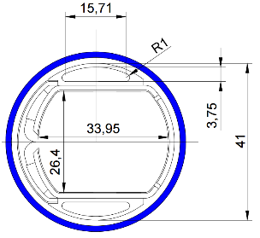
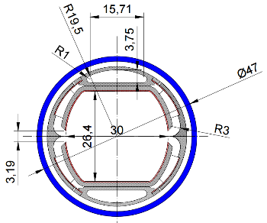
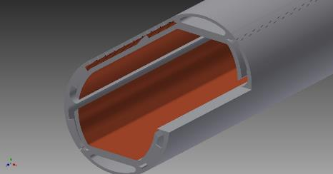
2 rows of pumping slots here too!
Beam Screen Design Evolution
The 1-slot concept originally presented at the FCC Week in Washington has moved to a more practical version
During an FCC-hh meeting at CERN, it has been noticed that from the impedance point of view a symmetric double slot would be beneficial
We have therefore designed and analysed such a configuration.
The second slot would also allow the removal of the 2 rows of pumping slots in the beam area required by the 1-slot version, thus decreasing further the impedance contribution

Slide 4
Next steps
Gas density evaluation (M. Ady and ALBA’s student).
Mechanical deformation during quench (C. Garion and third PJAS from CIEMAT)
Insertion of cryosorbers (V. Baglin and R. Cimino)

Slide 5
FCC-ee
The preliminary study shown by C. Garion and R. Kersevan is still our baseline, i.e. extensive NEG coating with local synchrotron radiation adsorbers.
We have the impression that the "management" of the FCC-ee part of the FCC study has decided that vacuum is not an issue for such a machine and that data from LEP at 104 GeV can be used.
We would like to underline that the SR power load for all FCC-ee machines is in this case much higher than the one for LEP104, and most of all the 47.5 GeV Z-pole machine at very high current.
1450 mA poses the biggest challenge in terms of vacuum, since its SR spectrum has a critical energy of only 18.9 keV, and therefore most of its photon flux will not penetrate much the vacuum chamber (VC) surface, unlike the tt-pole machine at 175 GeV which has a critical energy of 1.1 MeV and therefore generates a lot of Compton-scattering and pair-production in the bulk of the vacuum chamber.

