Slide 1
Overhead cranes consolidation in EHN1
R.Rinaldesi EN-HE

Slide 2
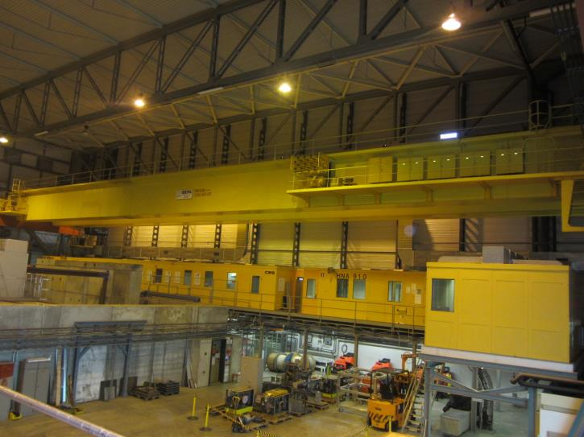
Before consolidation
Two identical overhead cranes: PR534-PR538
Manuafcturer: SEPA
Year: 1976
Capacity: 40 ton
Span: 46 m
Lifting height: 10 m
Possibility to work in «tandem» mode

Slide 3
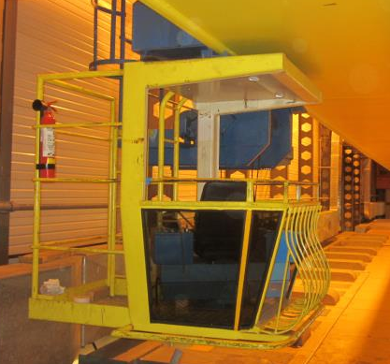
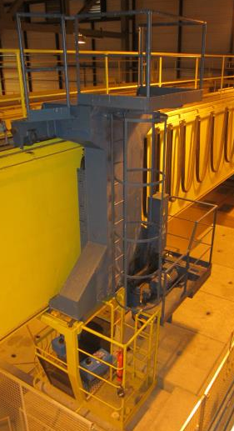
Before consolidation
Command: cabin sliding along one girder
Access: only from crane girder
Auxiliary hoist: 5 ton

Slide 4
PR-538 consolidation
Total value: 383.500 € (DL 6040962 – May ‘15)
Includes:
  Replacement of main hoist: new lifting height 19m
  Emergency brake
  Replacement of long-travel mechanisms
  Replacement of electrical plant
  Cabin renovation
  Replacement of auxiliary hoist: new capacity 10 ton
  Electronic skewing correction

Slide 5
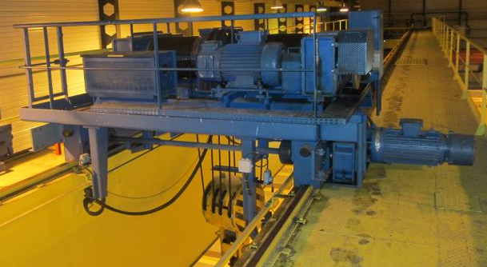
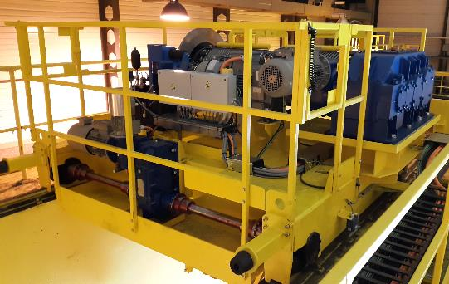
PR-538 consolidation

Slide 6
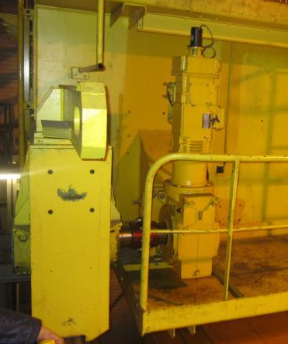
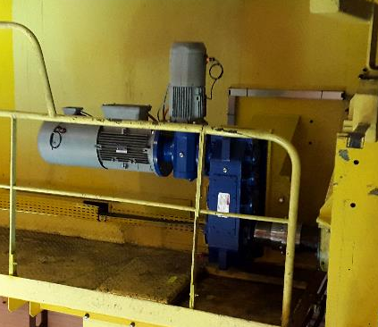
PR-538 consolidation
Double motor

Slide 7
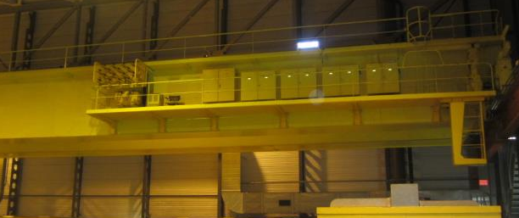
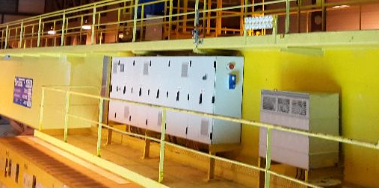
PR-538 consolidation

Slide 8
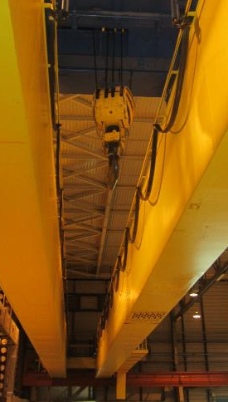
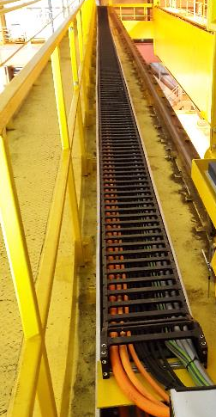
PR-538 consolidation
Festoon replaced with a cable chain; all new cables according to CERN standards

Slide 9

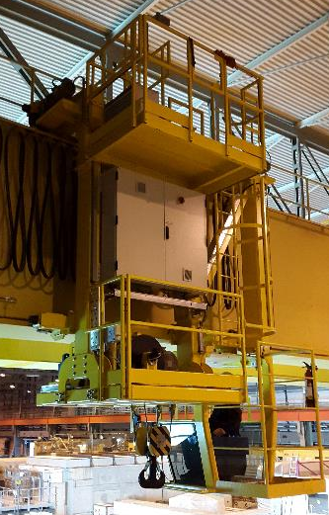
PR-538 consolidation
New structure with access from future walkway
Cabin revision with new joysticks
10 ton auxiliary hoist

Slide 10
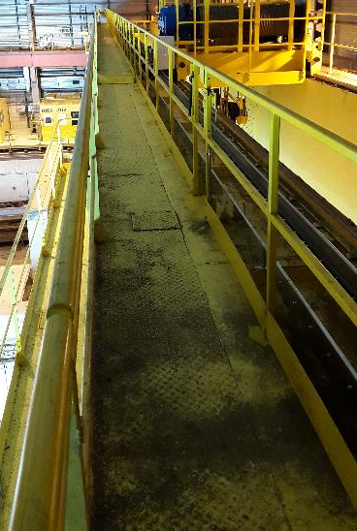
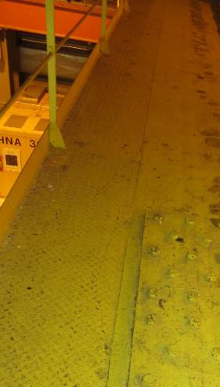
PR-538 consolidation
Second handrail added
Height increase of the existing handrail

Slide 11
PR-538 consolidation
Start of activities: June 29th
Acceptance tests held on September 16th
More than 5 weeks delay due to:
  Late delivery of some commercial components
  Mechanical failure of the emergency brake during the crane commissioning
  Time needed to setup the software which corrects the skewing

Slide 12
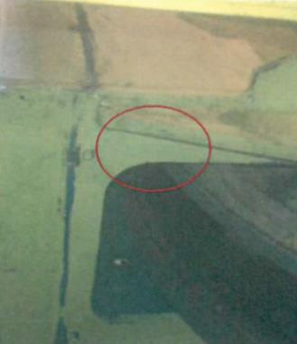
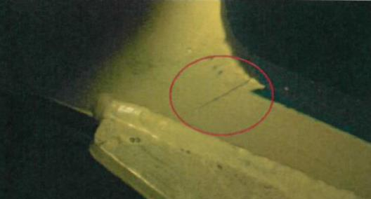
PR-538 consolidation
Non-destructive tests showed cracks in the existing structure:

Slide 13
PR-538 consolidation
CE marking not yet delivered
Manufacturer has authorized the temporary use of the crane
Intervention ~1 week (to be agreed with user)
Cost ~10.000 €

Slide 14
PR-534 consolidation
Identical to renovation of PR-538
Offer awaited: ~400.000 € (due to structure reparation and new cabin structure)
Intervention planned for January 2016

