Slide 1
MultiJob pilot on Titan.
ATLAS workloads on Titan
Danila Oleynik (UTA), Sergey Panitkin (BNL)
US ATLAS HPC. Technical meeting
18 September 2015

Slide 2
Overview
Current status
Workflow and issues
ATLAS workloads on Titan

Slide 3
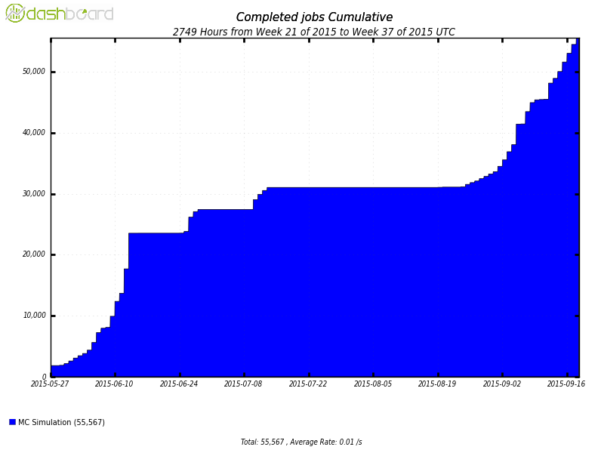
MultiJob Pilot on Titan
First version deployed at the end of May 2015
Validation starts June
          ~50 000 Completed jobs
          2 simultanius pilots
          Only backfill mode
2015-06 | 754172 | Increasing loading from 15 to 300 PanDA jobs in bunch.
2015-07 | 146250 | Have no steady stream of jobs form PanDA
2015-08 | 114474 | Have no steady stream of jobs form PanDA
2015-09 | 697337 824668 | Steady stream of jobs from 15 to 300 jobs in bunch, two Pilots.

Slide 4
How to be efficient with backfill
Be fast and smart enough to grab recourses, before other bastards users steal them and while time gap is enough for execution of payload.
Minimize start up time as much as possible
Minimize post processing procedures – to be ready for next round

Slide 5
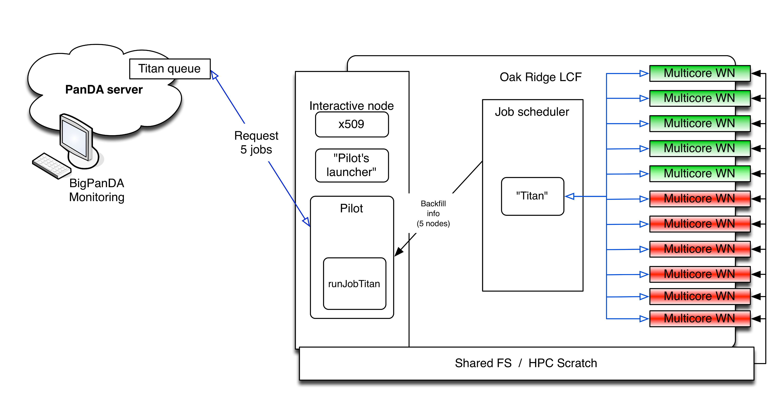
Workflow & Issues 1
Pilot requests information about available resources (backfill)
According to available resources, pilot requests jobs from PanDA server
Sequential requests works good for small chunks (one request took about 1 sec.), but for chunks with few hundred jobs it take significant time.
Simultaneous requests gave about 10-15% of benefit due to execution time each particular request increasing in depending of number of parallel process
Finally bulk function on PanDA server was implemented - now request for 300 jobs tooks about 15-20 sec.

Slide 6
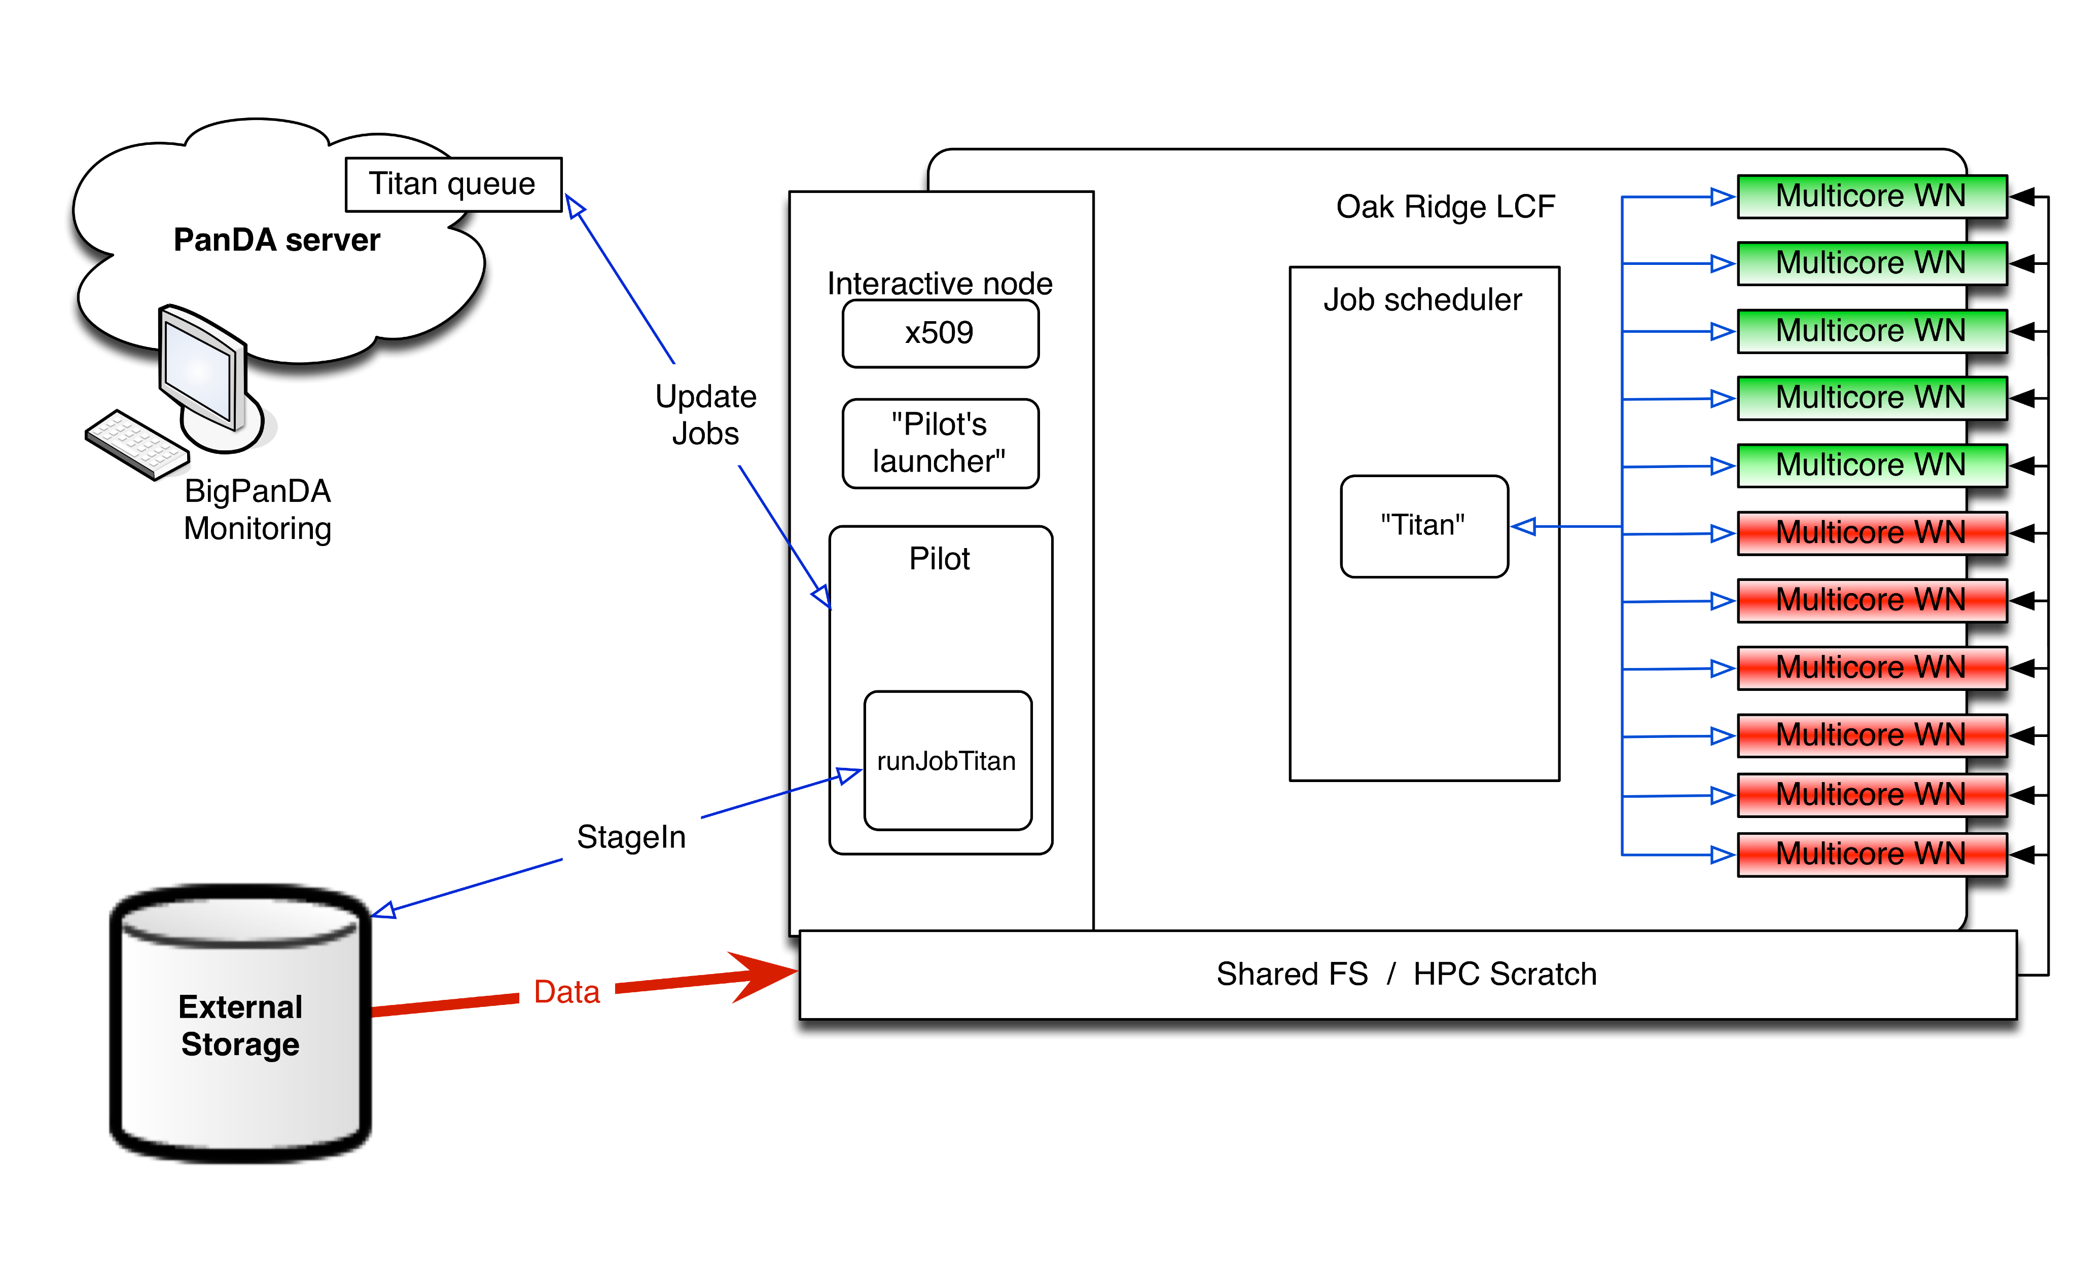
Workflow & Issues 2
Pilot stage-in and prepares environment before launching
Jobs updates with initial info (space report etc.)
Stage-in of one file take ~15-20 seconds;
Stage-in procedure was modified to decrease number of real remote downloads. It takes now for 300 jobs about 300 seconds, it’s very good, but will be great to decrease this time as well.
Since update of one job on PanDA server consume about 1 sec. I try to minimize number of updates of PanDA server before job really launched. For example, 'space report' was disabled - and now this information come with regular job state update.

Slide 7
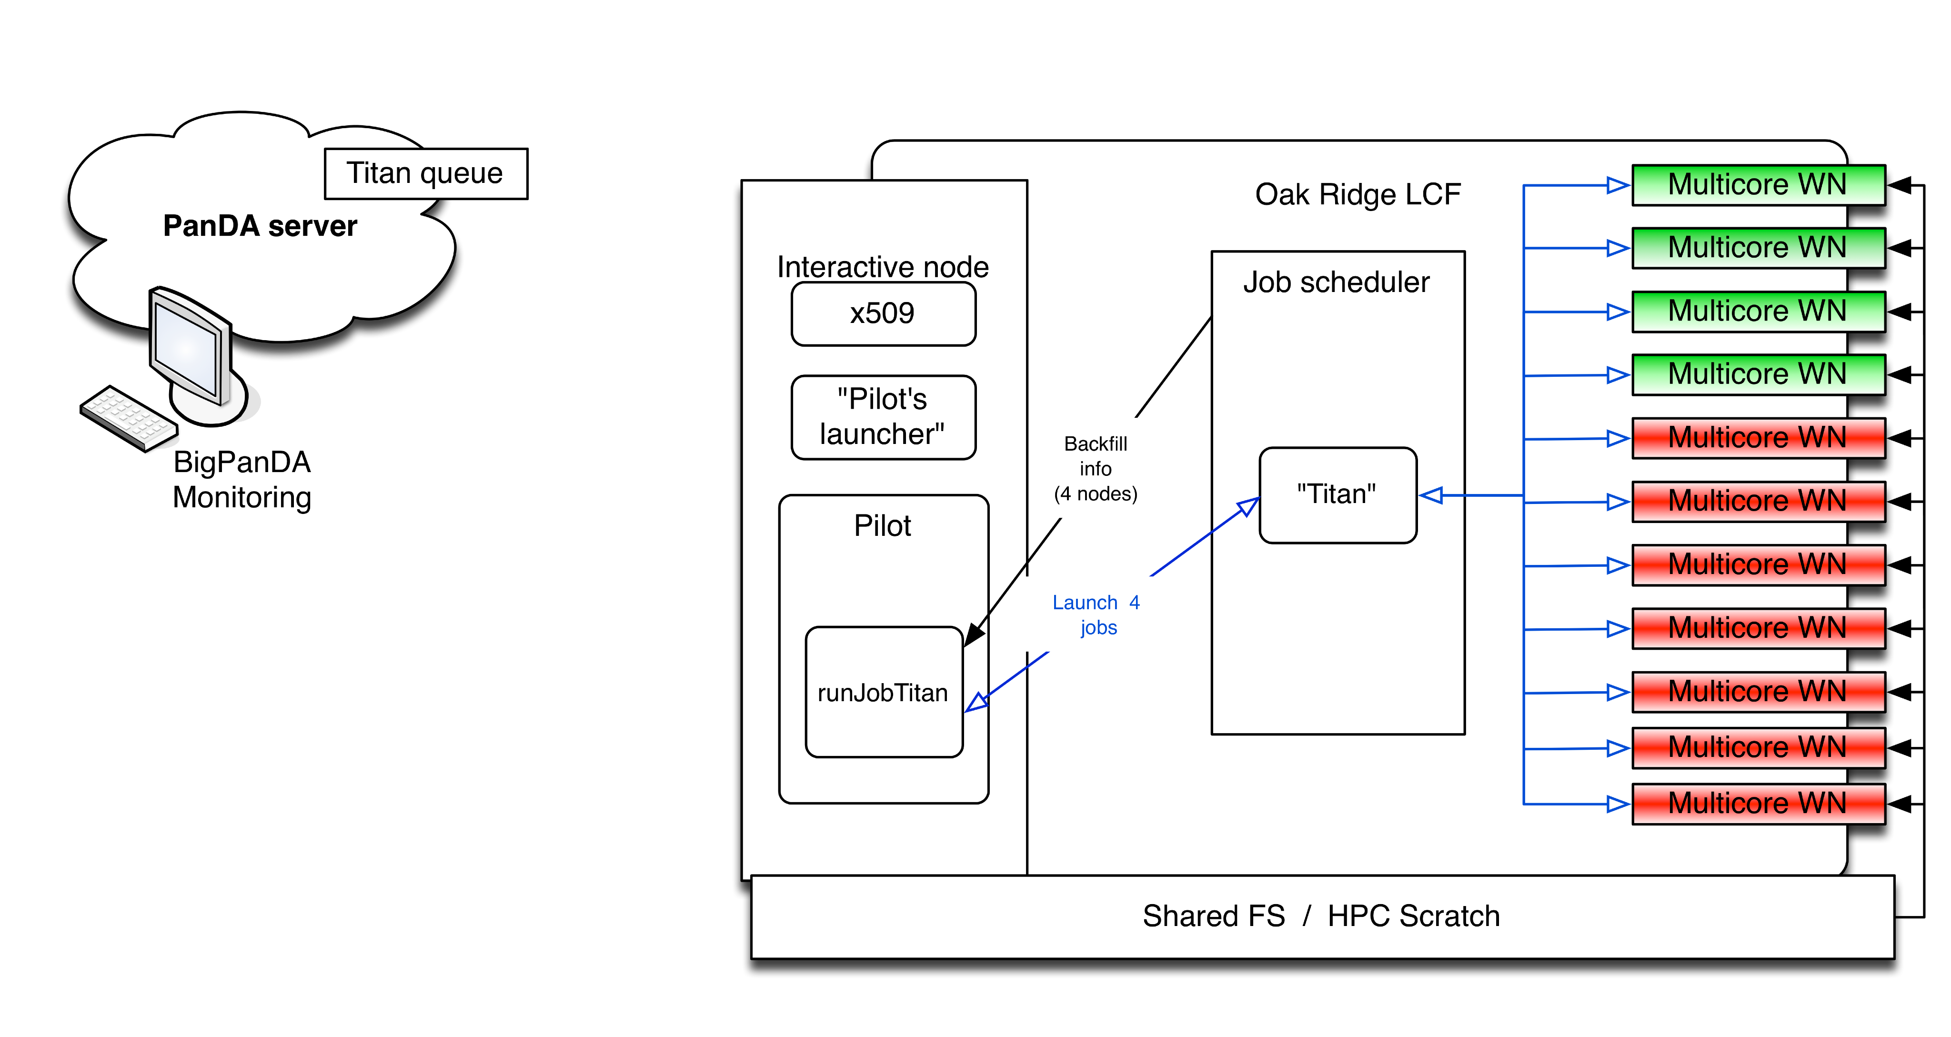
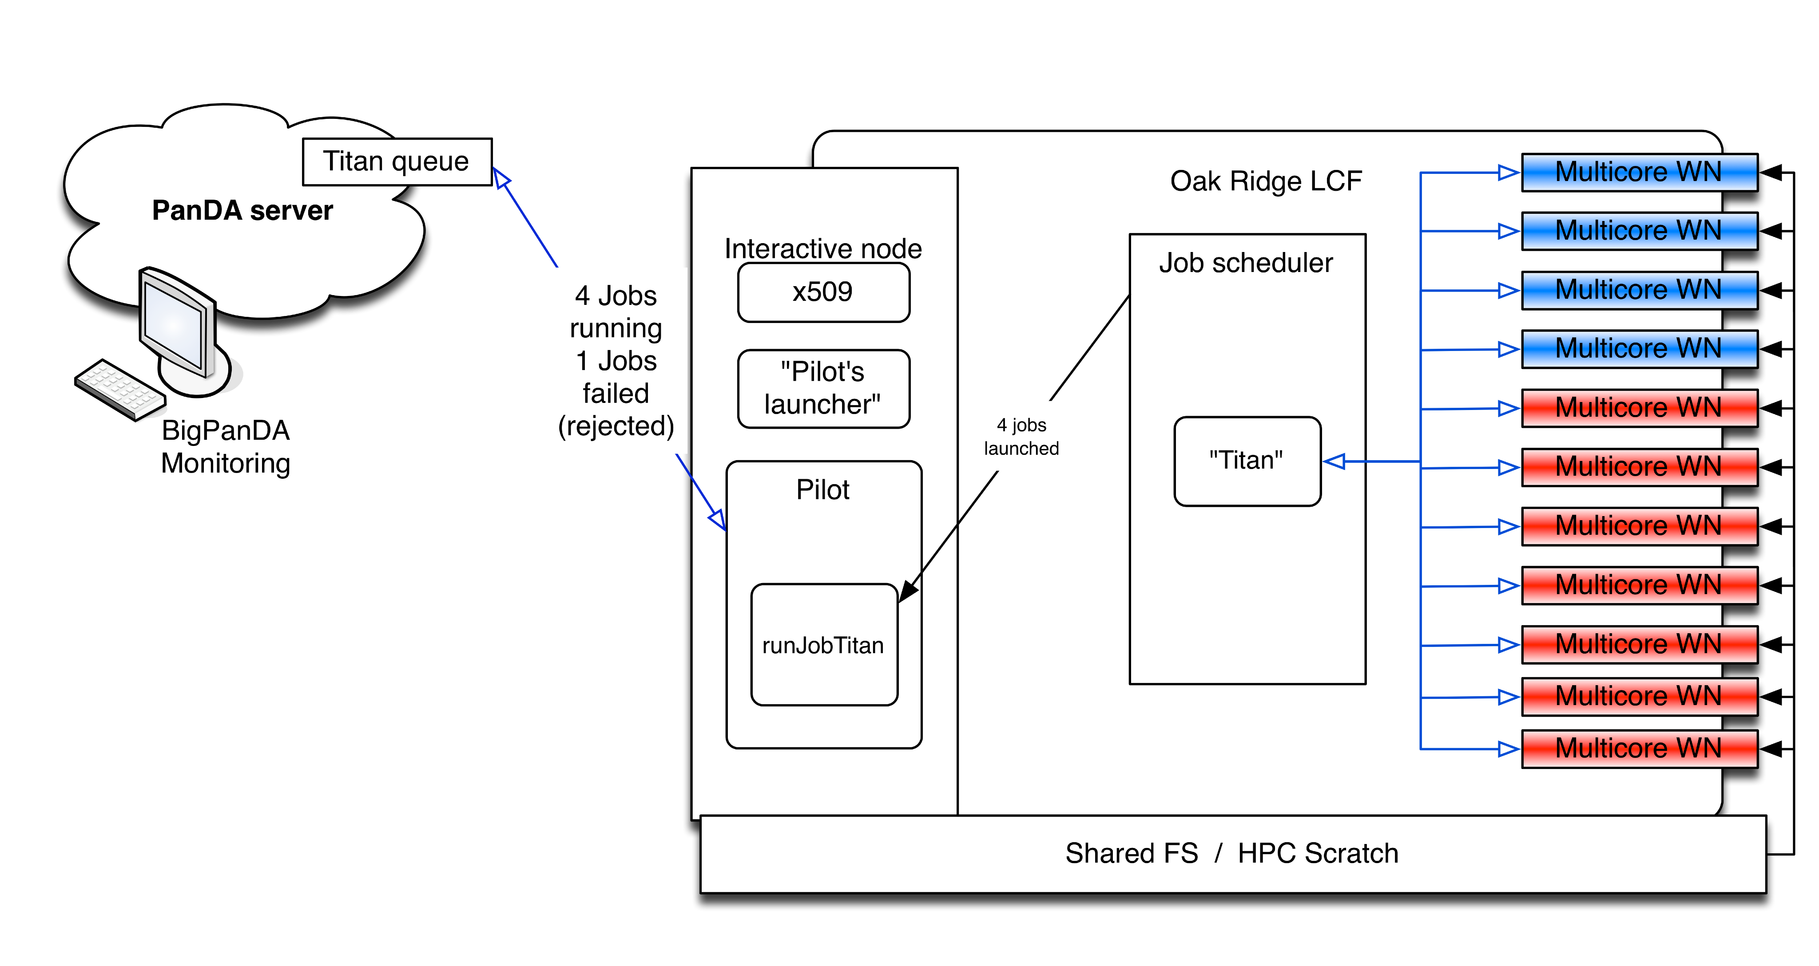
Workflow & Issues 3
Request availble backfill and adjust number of jobs for launching.
Not fitted jobs will be failed and sub status of jobs will be updated, as only MPI job will be launched.

Slide 8
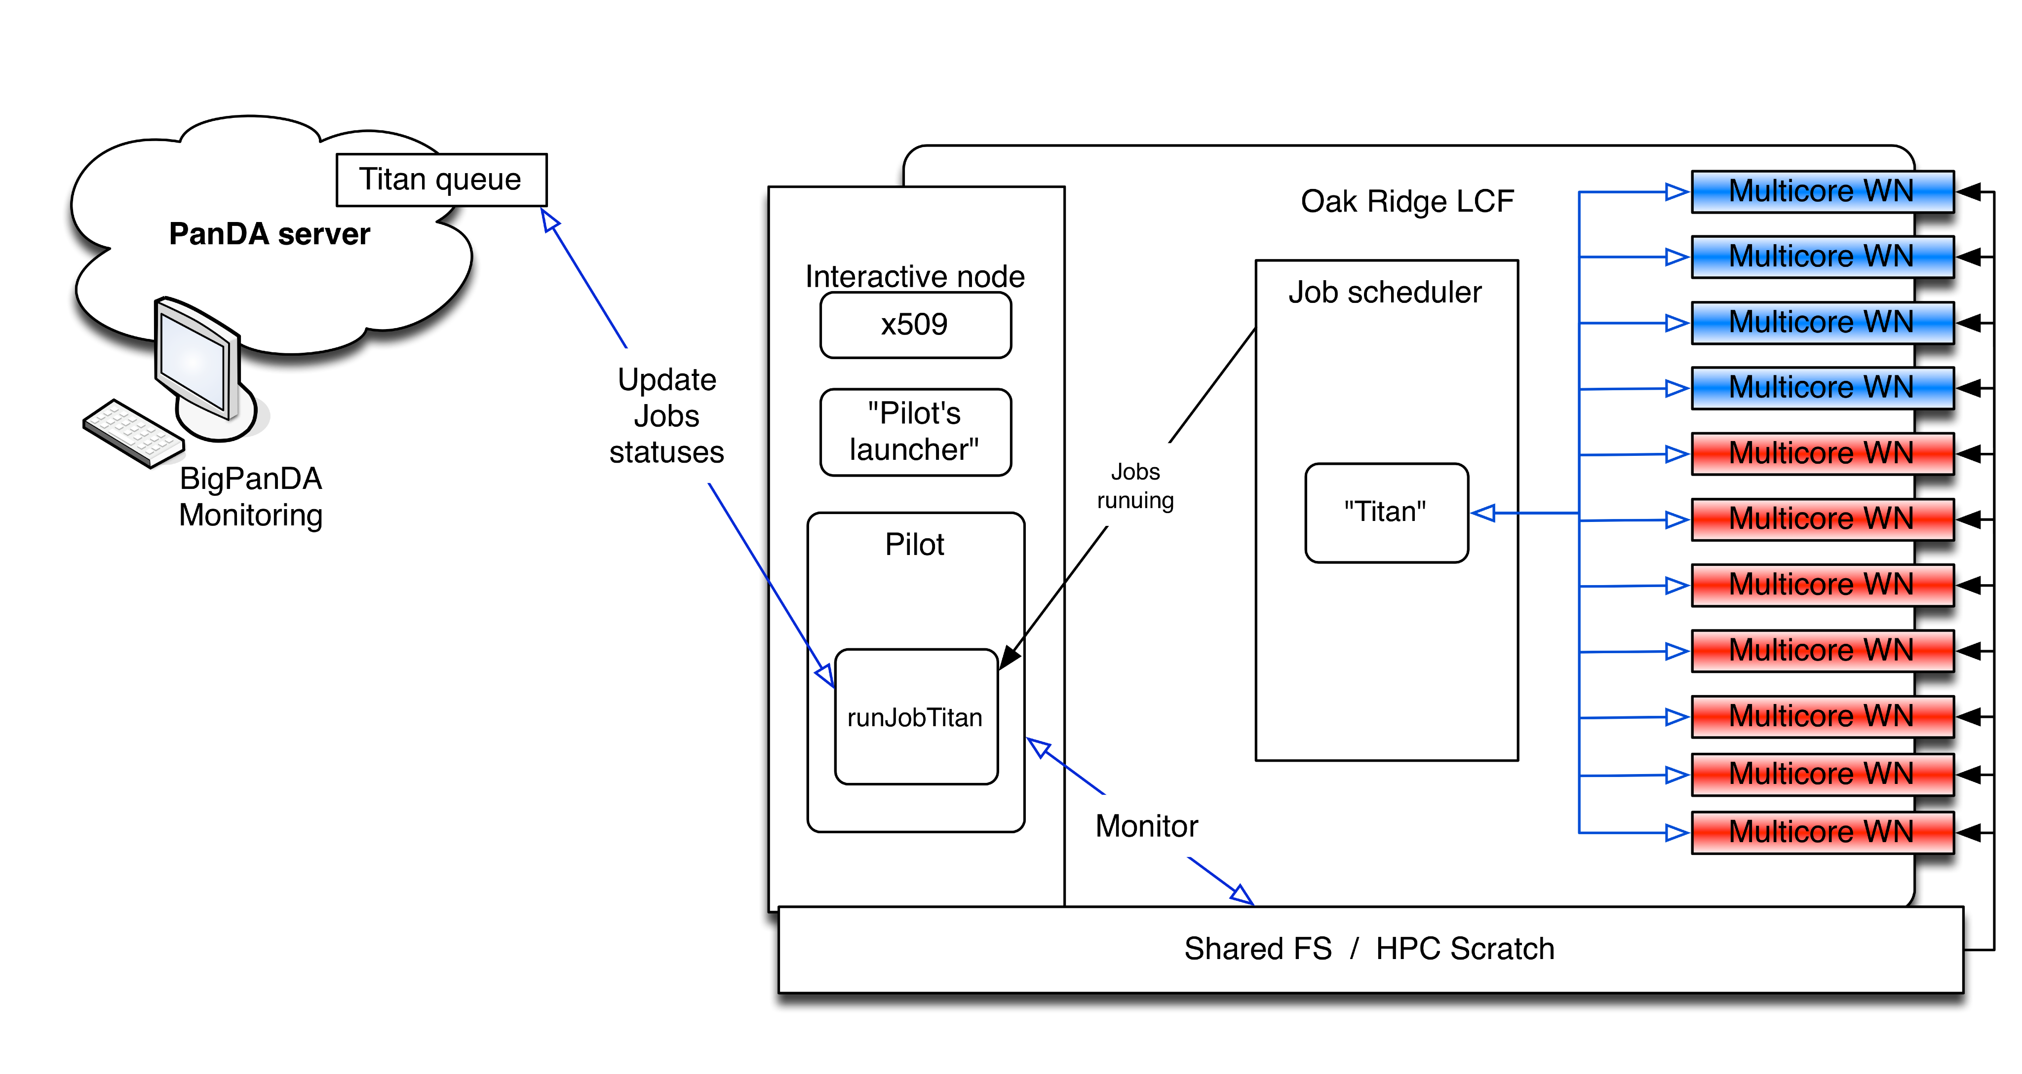
Workflow & Issues 4
Pilot monitors availble space, output and sends hearbeat during payload execution
Procedures, related with checking of space and outputs should be reviewed to avoid significant impacts to FS.

Slide 9
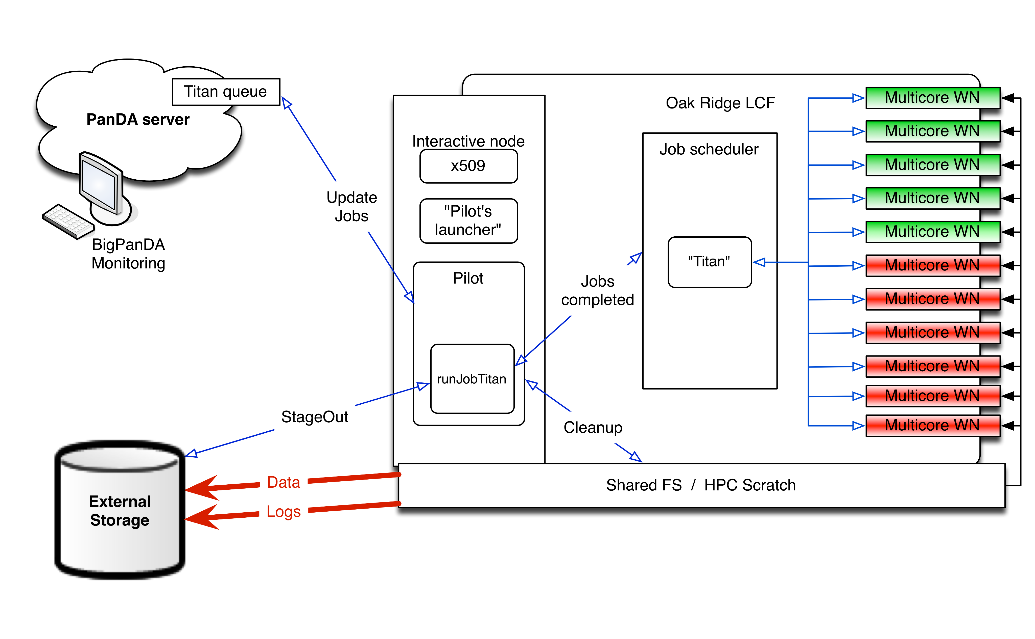
Workflow & Issues 5
Jobs completed, pilot perform stage-out and cleanup…. and it may take up to few hours

Slide 10
Conclusion about workflow
We still got ‘surprises’ related with scalabilty.
There are still a lot of room for improvements, some of them may be achived by optimizotion of code of Pilot, anothers by extnesion of architecture for exmple optimization of data management, prestaging of data etc.

Slide 11
Update on Titan workloads
Sergey Panitkin

Slide 12
Validation of the data produced on Titan
We ran validation jobs since May
  Started with Rel. 19.2.3.8 based tasks
    A set of physics validation pages generated
    http://pagacova.web.cern.ch/pagacova/Technical_validation/BNLvsTitan/
    No conclusive message. Some plots there are green, some are red
    Looks like larger statistics are needed
  Rel 19.2.3.7 based task started recently on Titan
    Found a curious bug in the release’s pacman file (ref. to older release). Fixed now.

Slide 13
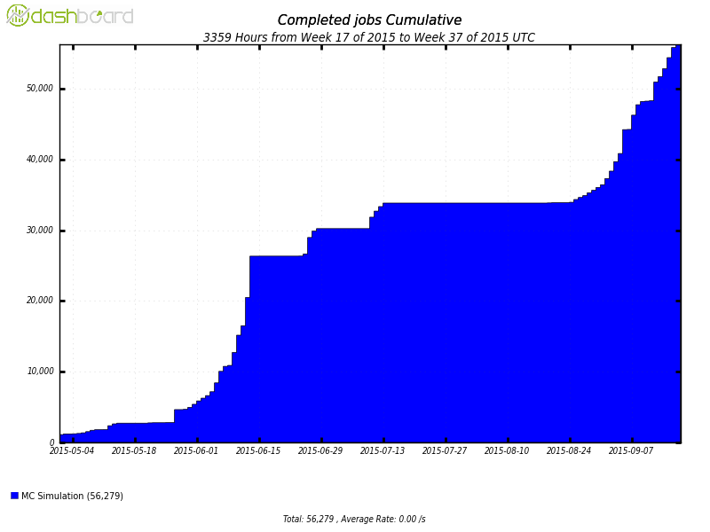
Completed ATLAS jobs on TITAN
From May 1 to Sept 17

Slide 14
ATLAS Simulations with Geant4 v10
Installed rel. 20.3.2.1
Ran on data suggested by Sasha
Tests on events that caused crashes on other platforms.
Interim conclusion: What crashes on Intel runs on AMD
We would like to run a few tasks with this release to help with Geant4 v10 validation

Slide 15
ATLAS simulation release
“Small” release fitting on RAM disk
  ~12 GB in size right now
Installed AthSimulationBase 1.0.0, then 1.0.1
  Many Root 6 persistency related crashes
Reported initial crashes to dev. team (Zach and John Chapman)
After fixes and patches suggested by Vakho rel. 1.0.1 ran in a single threaded mode
AthenaMP still crashes in the merging step
  Identified as CLHEP related issue
  Devs are working on it.
  Waiting for the next release 1.0.2

