Slide 1
FCC-- ee VIDYO meeting
26 Oct 2015
Brief news

Slide 2
NEXT meetings
Physco: Thursday s
12Nov2015
10Dec2015
Physics VCs
26Oct2015,
30Nov2015
Accelerator VC
2 Nov 2015
Next General FCC-ee physics workshop
2-5 February 2016 at CERN
FCC week see next slides in April 2016

Slide 3
FCC-ee activities
-- workshops
Detector workshop
1st FCC-ee mini-workshop on Detector Requirements
17-18 Jun 2015 - 13:00 - CERN - 40-5-A01 see report later.
First FCC-ee mini-workshop on Precision Observables and Radiative Corrections
13-14 Jul 2015 - 14:00 - CERN - TH Conference Room
    Higgs physics workshop Markus Klute
    https://indico.cern.ch/event/401590/ 24-25 September 2015
Workshop on high-precision alpha_s measurements: from LHC to FCC-ee https://indico.cern.ch/event/392530/ 12 Oct - 13 Oct 2015 (CERN)
Next General FCC-ee physics workshop 2-5 February 2016 at CERN
FCC week 10-15 April
Following which we are discussing to invite HF2016 in Europe
possibly in UK.

Slide 4
Other date of note:
P-ECFA plenary meeting 19-20 November
C. Grojean will give review on ‘future e+e- colliders’
NB There is a ‘Muon meeting’ on 18 November to discuss
the possibilities of a muon beam program
muon storage rings as neutrino source or μμ collider

Slide 5
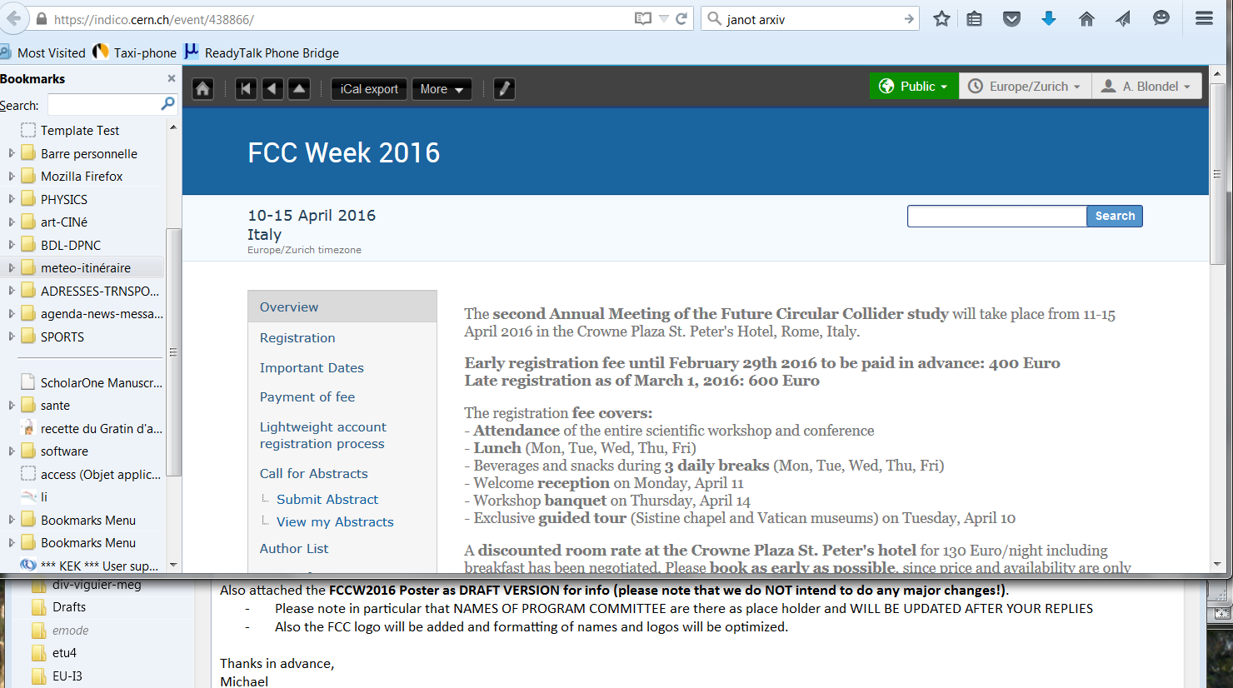

Slide 6
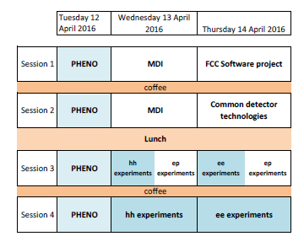
FCC meeting in Rome
Proposed agenda for physics sessions:
-- need to plan contributions
- new things reports from mini-workshops, new papers
- important basics event rates, detector design, detector requirements, etc
Avoid duplication and incompatibility
with FCC-ee machine sessions (e.g. for MDI)

Slide 7
14 October 2015, Review of FCC-ee optics & beam dynamics
Reviewers: Ralph Assmann (DESY), Alain Blondel (U. Geneva), Yunhai Cai (SLAC), Stephane Fartoukh (CERN), John Jowett (CERN, Chair), Jean-Pierre Koutchouk (CERN), Valeri Lebedev (FNAL), Eugene Levichev (BINP), Pantaleo Raimondi (ESRF)
Scope: Define a (new) baseline configurations for collision scheme, IR layout, final focus, overall configuration; converge on beam parameters; identify critical issues

Slide 8
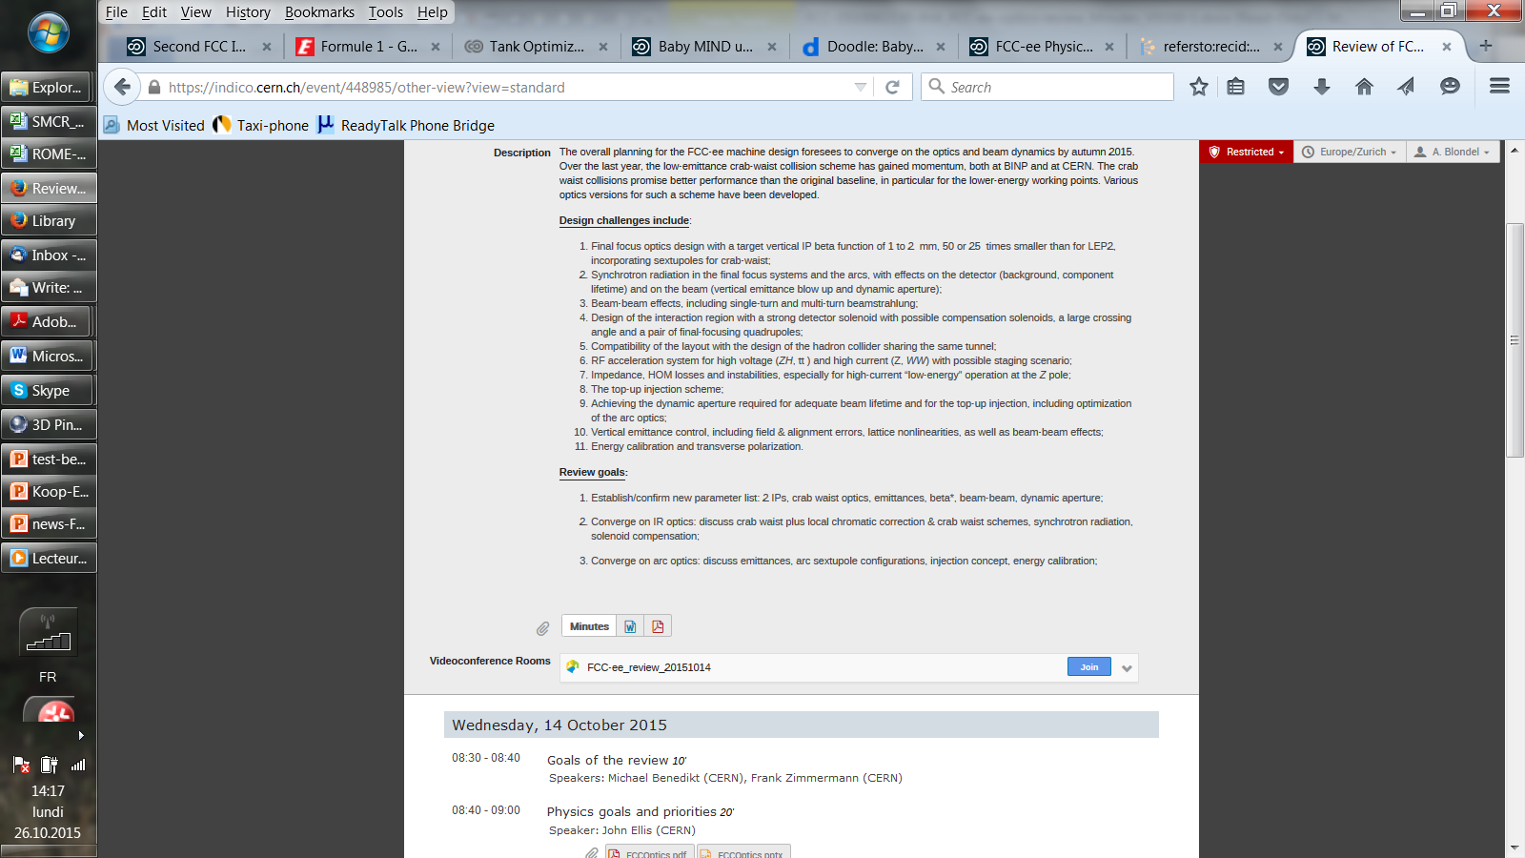

Slide 9
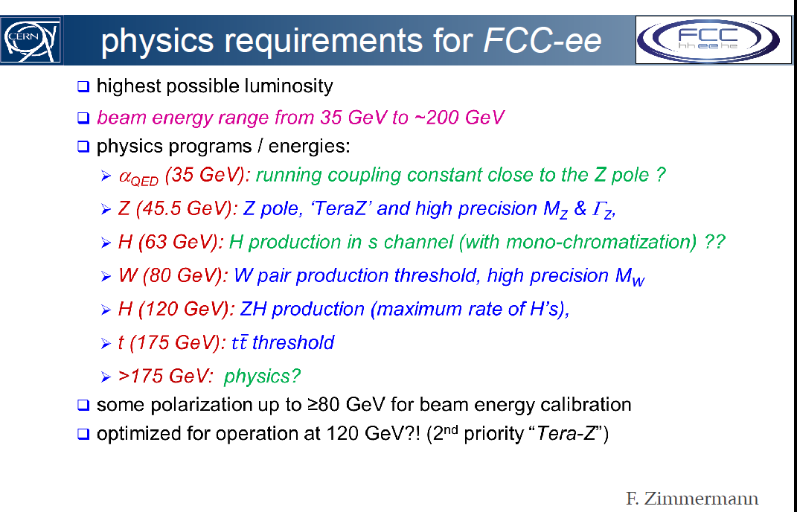
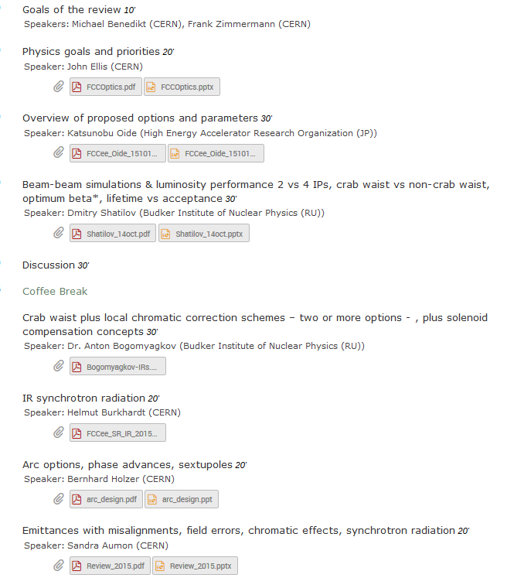
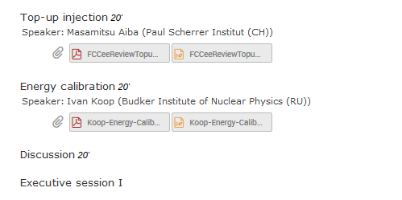
rather 44
-- great progress in layout
-- scheme appears more and more feasible
-- for now lumi is 5 10^34 @ 240 GeV, 2IP
-- more to come
-- asymmetric IP very good for SR →
-- more to come to improve luminosity
-- in particular in alignment, feedacks etc..
-- injection scheme now being worked on
-- MDI group to gain importance
Review conclusions in preparation.

Slide 10
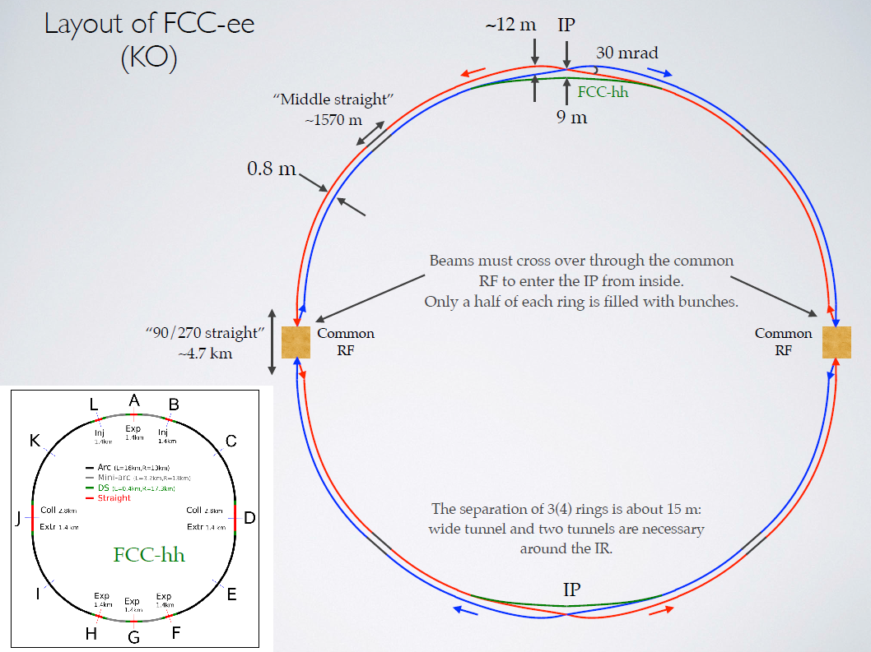
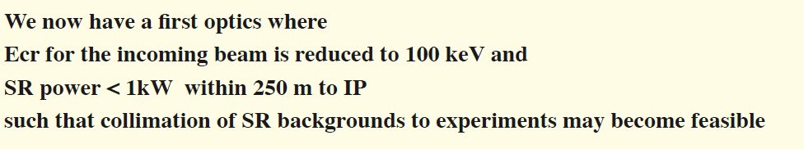
K.Oide
H. Burkhardt

Slide 11
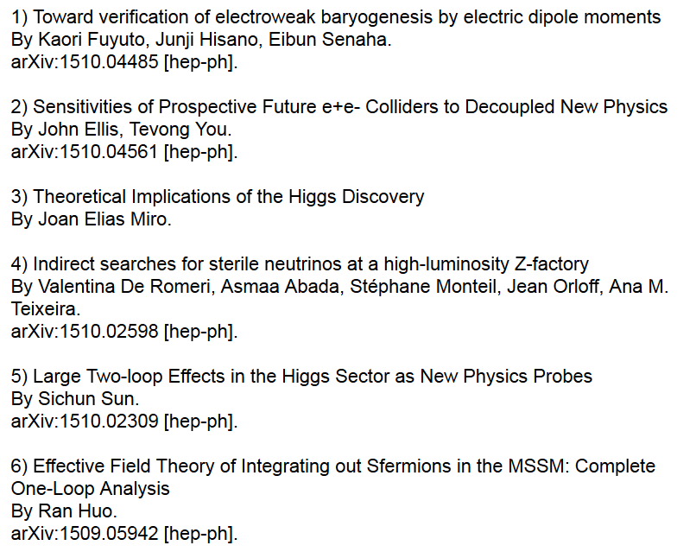
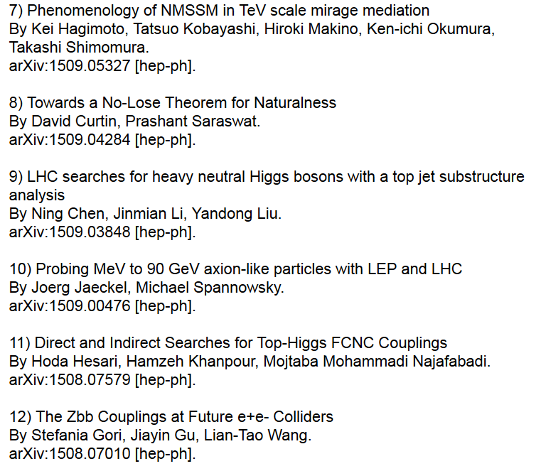
‘First look a the physics case of TLEP’ now cited 158 times.
recent quotes. Have a look some of these are really interesting
and enrich our panorama of physics reach!

