Slide 1
Progress in the Design of FCC-ee Optics
30 Nov. 2015
K. Oide (KEK)
Many thanks to M. Aiba, S. Aumon, M. Benedikt, A. Blondel, A. Bogomyagkov, H. Burkhardt, Y. Cai, A. Doblehammer, B. Haerer, B. Holzer, J. Jowett, I. Koop, M. Koratzinos, E. Levitchev, K. Ohmi, Y. Papaphilippou, P. Piminov, D. Shatilov, S. Sinyatkin, D. Zhou, F. Zimmermann.

Slide 2
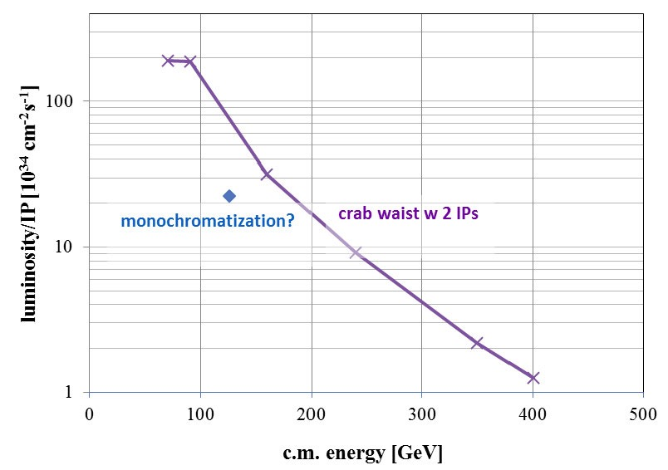

luminosity vs c.m. energy
α_{QED}
Z
H?
WW
HZ
?
F. Zimmermann

Slide 3
Design constraints & assumptions
C = 100 km, fits to the FCC-hh tunnel as much as possible.
2 IPs / ring.
30 mrad crossing angle with crab waist.
critical energy of the incoming photons to the IP less than 100 keV
Common lattice for all energies.
εx ≦ 1.3 nm @ 175 GeV.
±2% dynamical acceptance at 175 GeV.
vertical emittance less than 1 pm at 175 GeV, 0.2 pm at 45.6 GeV.
βx,y* = (1 m, 2 mm), explore to (0.5 m, 1 mm).
“Tapering” to cure the sawtooth orbit due to SR at high energy.

Slide 4
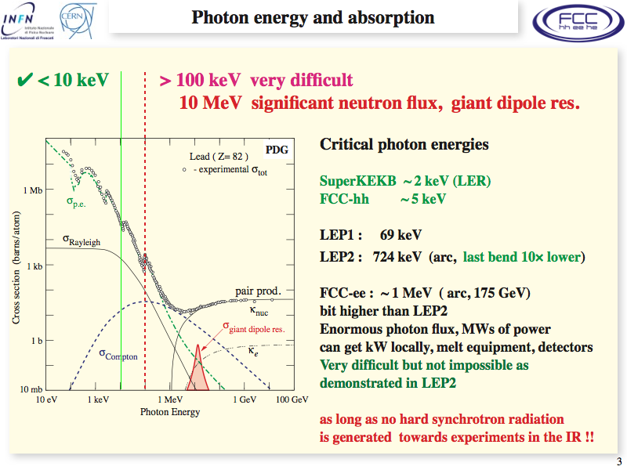
H. Burkhardt

Slide 5
There are at least two solutions for optics so far
 | Anton Bogomyagkov V. 8 | K. Oide 58_32
Concept | modular | integrated
Circumference [km] | 100
Number of IPs / ring | 2
Crossing angle at IP [mrad] | 30
Solenoid with compensation at IP | ±2 T × 1 m
ℓ* [m] | 2 | 2.2
Critical energy of photons to IP [keV] | 400 | 100
IR Optics | symmetric | asymmetric
Local chromaticity correction | X, Y | Y
Crab sexts | separated | integrated with LCCS
Arc cell | FODO, 79.2°/60° | FODO, 90°/90°
Arc sextuple families | 2 | 294 (paired)
mom. comp. [10⁻⁵] | 0.67 | 0.69
Cross-over of beams | possible but unnecessary | necessary at 175 GeV
Parameters at Ebeam = 175 GeV
SR energy loss per turn [GeV] | 8.0 | 7.4
Current / beam [mA] | 6.6
PSR,tot [MW] | 105 | 98
εx [nm] | 1.3 | 1.24
β*x [m] | 0.5 | 0.5 (1)
β*y [mm] | 1 | 1 (2)
RF frequency [MHz] | 400
σδ,SR [%] | 0.146 | 0.140
A newer version (asymmetric/100 keV) for AB optics are under development.

Slide 6
Machine parameters
parameter | FCC-ee crab waist (2 IPs)
 | Z (IPAC’15) | Z (these designs | t (IPAC’15) | t (these designs)
Ebeam [GeV] | 45.5 | 45.6 | 175 | ←
current [mA] | 1450 | ← | 6.6 | ←
PSR,tot [MW] | 100 | 95 | 100 | 94 - 105
no. bunches | 45154 | ← | 51 | ←
Nb [10¹¹] | 0.66 | ← | 2.6 | ←
εx [nm] | 0.13 | 0.1 | 2 | 1.2 - 1.3
εy [pm] | 1.0 | 1.0 | 2 | 2.5
β*x [m] | 0.5 | 0.5 | 0.5 | 1 (0.5)
β*y [mm] | 1 | 1 | 1 | 2 (1)
RF frequency [MHz] | 400
RF voltage [GV] | 0.4 | 0.08 | 11 | 9.6 - 11
circumference [km] | 100
mom. comp. [10⁻⁵] | 0.5 | 0.936 | 0.5 | 0.7
synchrotron tune | -0.03 | -0.015 | -0.07 | -0.068
σz,SR [mm] | 1 | 3.9 | 2.31 | 2.4
σz,tot [mm] (w beamstr.) | 2.8 | 6.4 | 2.83 | 2.9
σδ,SR [%] | 0.052 | 0.041 | 0.202 | 0.140
σδ,tot [%] (w beamstr.) | 0.061 |  | 0.248
θc [mrad] | 30
Piwinski angle | 5.3 |  | 1.8
L* [m] | 2 | 2 - 2.2 | 2 | 2 - 2.2
beam-beam param. ξx/IP | 0.07 | 0.032 | 0.06 | 0.06
beam-beam param. ξy/IP | 0.18 | 0.064 | 0.12 | 0.09
luminosity/IP [10³⁴ cm⁻²s⁻¹] | 247 | 160 | 2.6 | 1.2

Slide 7

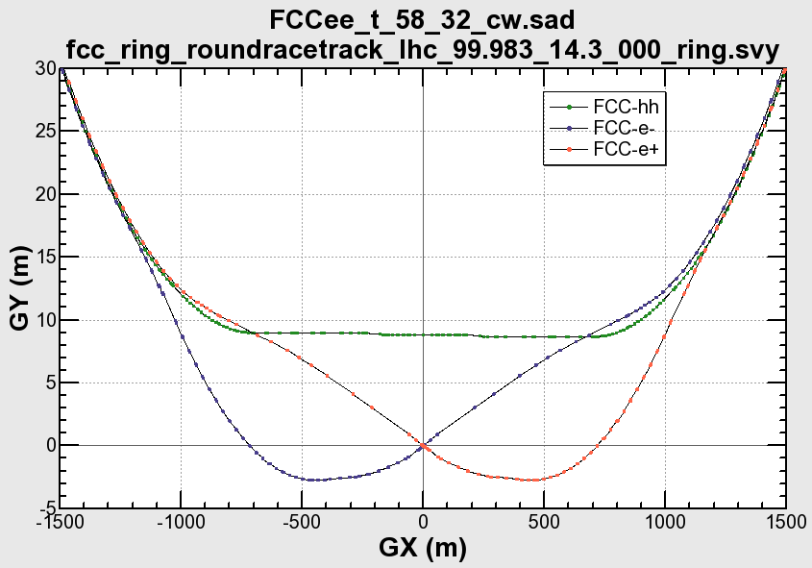
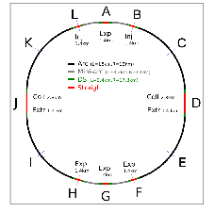
Layout of FCC-ee (KO 58_32)
∼11.6 m
IP
30 mrad
“Middle straight”
∼1570 m
FCC-hh
8.7 m
0.6 m
Beams must cross over through the common RF to enter the IP from inside.
Only a half of each ring is filled with bunches.
“90/270 straight”
∼4.7 km
Common
RF
Common
RF
FCC-hh
Wide tunnel: ±1,150 m
IP

Slide 8
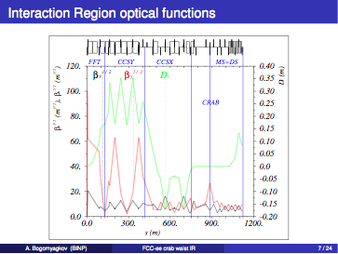
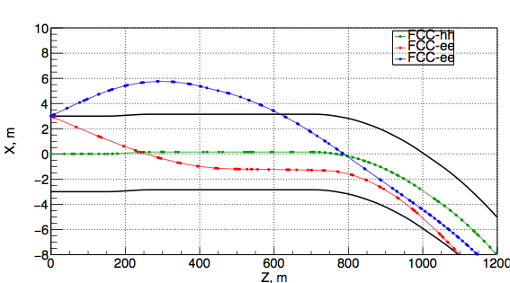
Layout near IR (AB)
A. Bogomyagkov
The discrepancy between the ee and hh rings can be smaller in the AB design than the KO.

Slide 9
Anton Status comments:
The goal of the optics changes now is to fit better in the tunnel defined by FCC-hh.
Burkardt's demands for critical energy to be less than 100 keV within 250m from IP together with geometry of the tunnel forced us to have asymmetrical optics.
The incoming beam goes through weaker dipoles than the outgoing.
We agreed to vary crossing angle and shift IP with respect to FCC-hh IP.
I have made two variants of optics with crossing angle of 30 mrad and 26 mrad.
The 26 mrad option gives a smaller tunnel, therefore I am developing it deeper now.
We also proposed to Burkhardt a staging in critical photons energy, that is the first 100 m from IP E_gamma<=100 keV, next 100 m it is <=200 keV, next 100 m is 300 keV.

Slide 10
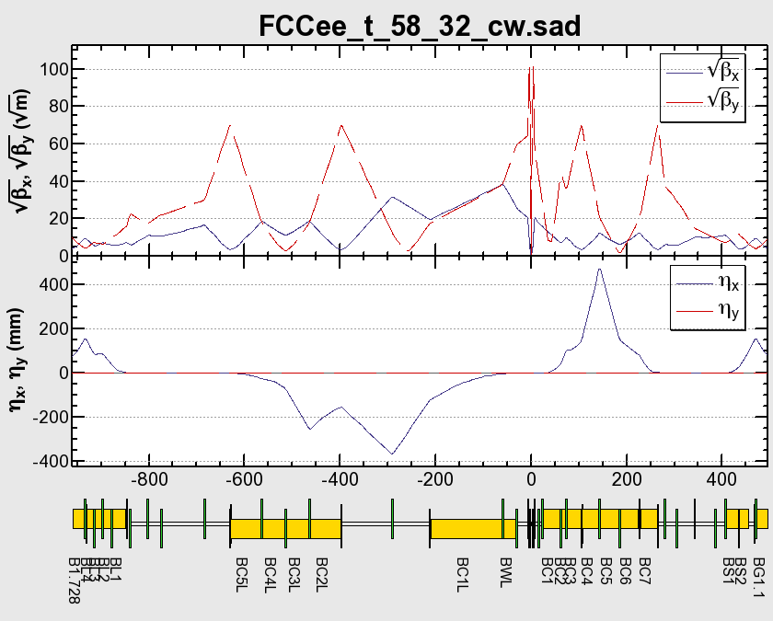

IR Radiation (KO)
Local CCS + Crab Waist
Local CCS + Crab Waist (*)
beam
IP
uc
PSR/dipole
1054
16.5
1070
19.1
391
4.3
238
2.2
100 100 742 1368
0.92 0.15 11.8 31.3
1377
41.4
998
14.9
keV
kW
- The critical energy and radiation power of the dipoles are as above (175 GeV, 6.6 mA).

Slide 11
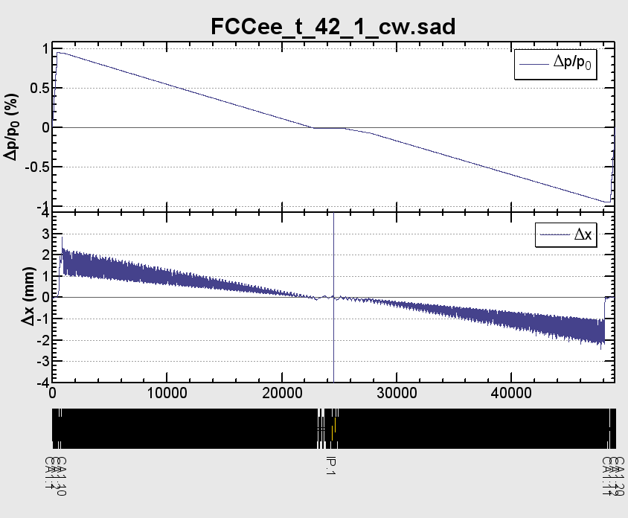
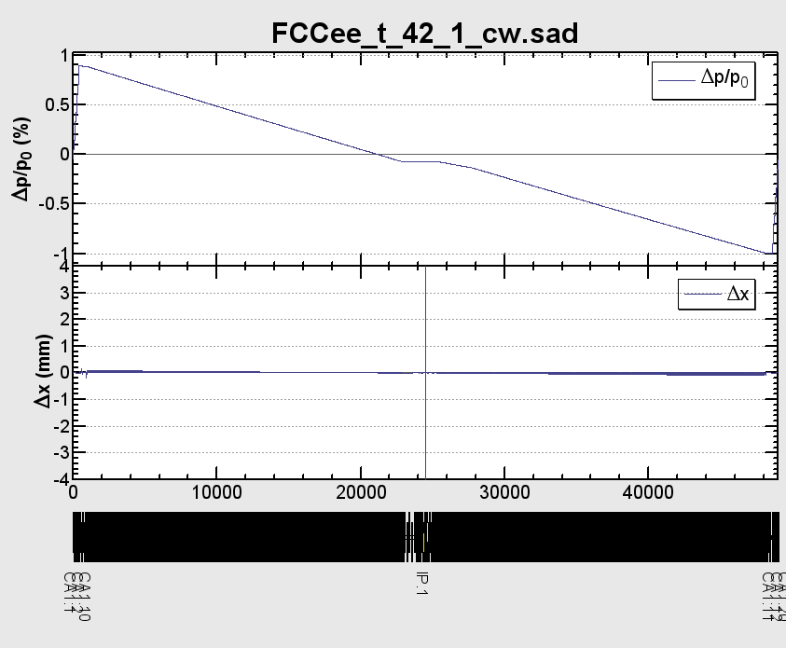
Tapering
This plot of beam optics is not the latest one.
No tapering
With automatic tapering
The “automatic tapering” scales the strength of dipoles, quads, and sexts with the local momentum deviation of the closed orbit.
Thus no sawtooth orbit nor optics deformation arise.
This is one of the biggest merit of the double-ring scheme.

Slide 12


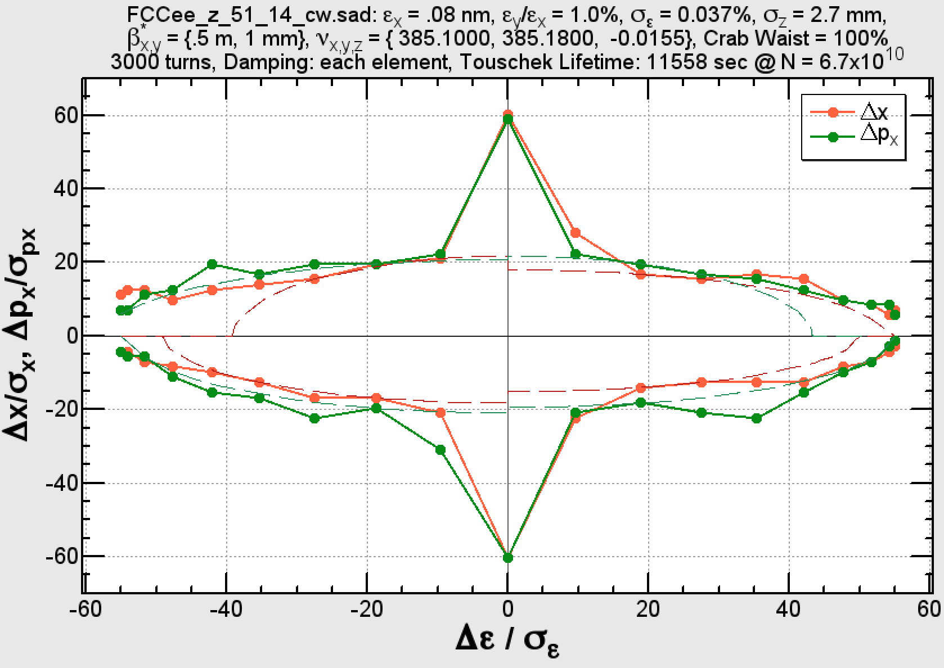
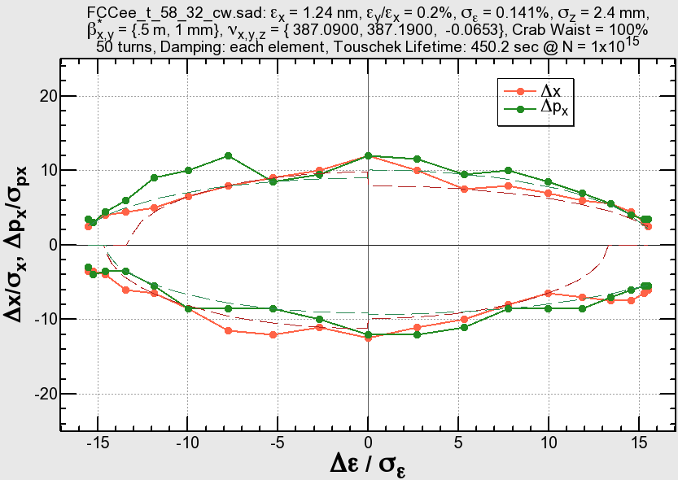
Dynamic Apertures (KO)
Ebeam = 45.6 GeV
3,000 turns
Ebeam = 175 GeV
50 turns
±2%
±2%
      Sextupoles must be optimized at each beam energy.
      3,000 turns are enough to determine the aperture at 45.6 GeV (long. damping = 1,500 turns).
      ±2% acceptance is not necessary for beamstrahlung, but may be useful for synchrotron injection.
      The on-momentum peak of the transverse aperture is recovered due to weaker radiation.

Slide 13
Summary
Optics for FCC-ee are presented, considering:
  2IPs/ring, with ±15 mrad crossing angle
  Local chromaticity correction with crab waist
  Suppression of synchrotron radiation in the IR below 100 keV.
  Solenoid at IP & its compensation
  Element-by-element synchrotron radiation
  No sawtooth by tapering of all magnets according to the local beam energy
  Common RF sections with cross-over of two beams (KO)
  Optimization of dynamic aperture with hundreds of sextuple families (KO)
  Geometrical fitting to the FCC-hh tunnel
Resulting dynamic aperture almost satisfies the requirements.
Things not included:
  Dynamic aperture with beam-beam + injection
  Field quality, realistic profile of magnets (cf. Mike’s talk).
  and more…

Slide 14
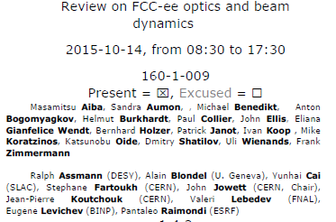
Note on the optics design review:
Pre-final version of recommendations exist.
Noted much progress, but much remains to be done.!
recommends combining the advantages of AB (modularity and chromatic corr)
and KO (asymmetric collision point).
sees design of orbit corrections and feedbacks to achieve small emittances as next frontier
for what concerns MDI:
-- should now be given a strong impetus
-- constraints to detectors of Synchrotron radiation should be quantified soon
by experimenters given progress in detector design.

