Slide 1
FCC-- ee Physics meeting
30 Nov 2015
Brief news

Slide 2
.
-- MDI project (FCC coordination group tomorrow)
charge has been drafted, issued soon
big emphasis (see next talk)
-- Physics behind precision & Physics workshop February 2-5
FCC academic training same week
-- Rome meeting April 11-15, 2016
-- how to get more manpower
Patrick is collecting a list of manpower needed to carry out the design study.

Slide 3
VC meetings
Physics VCs
Today 30Nov2015
Accelerator VC
7 Dec 2015

Slide 4
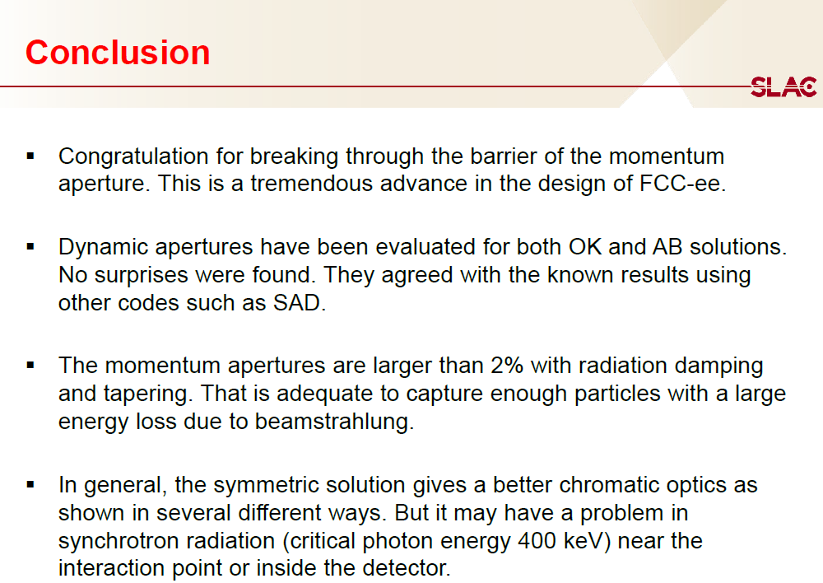
2 Nov. 2015 21st FCC-ee accelerator VC
https://indico.cern.ch/event/457696/

Slide 5
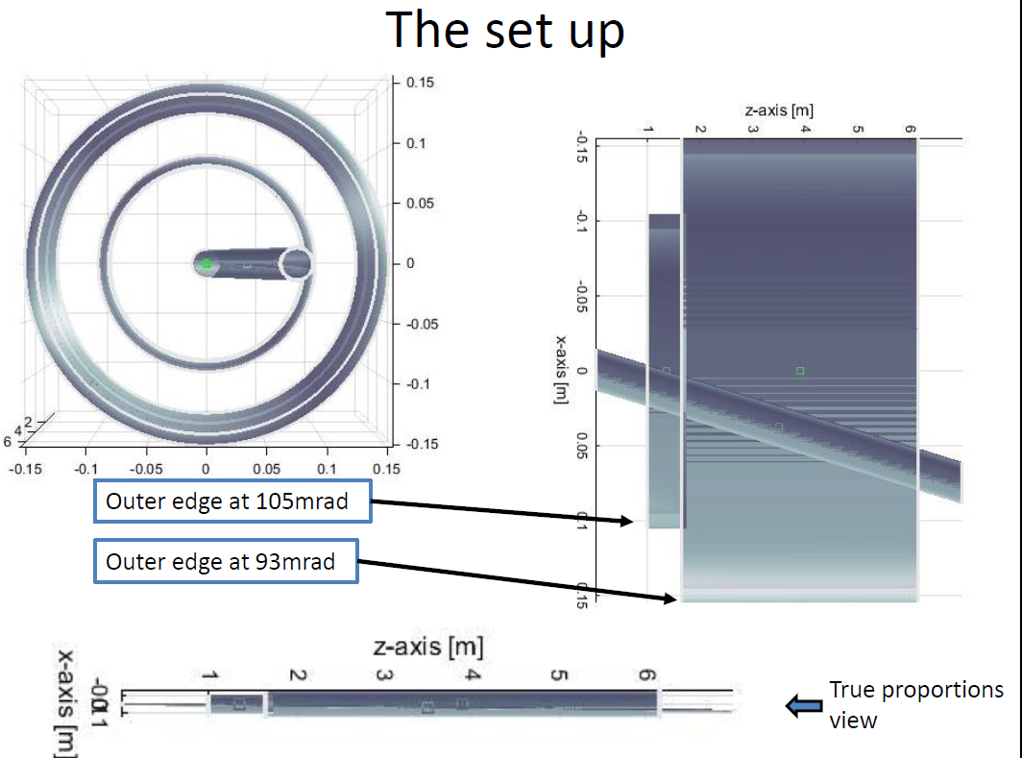
First look at compensating magnets set-up
(Koratzinos)

Slide 6
FCC-ee workshop 2-5 Feb’15 @ CERN (filtration plant)
2-3 February: mini-workshop on Physics behind precision
or ‘physics discovery potential of FCC-ee precision measurements’
Org: Azzi, Piccinini, Tenchini
4-5 February FCC-ee physics workshop
Org: Alain Blondel, Physics conveners
Suggest to specify
-- invited CERN director
-- overall news from FCC and FCC-ee accelerator
-- highlight talks on FCC-ee physics
-- work in progress from working groups + discussion
Academic training will take place every day that week
10h30 - 12h30 : Academic training
rest of the day: FCC-ee workshop

Slide 7
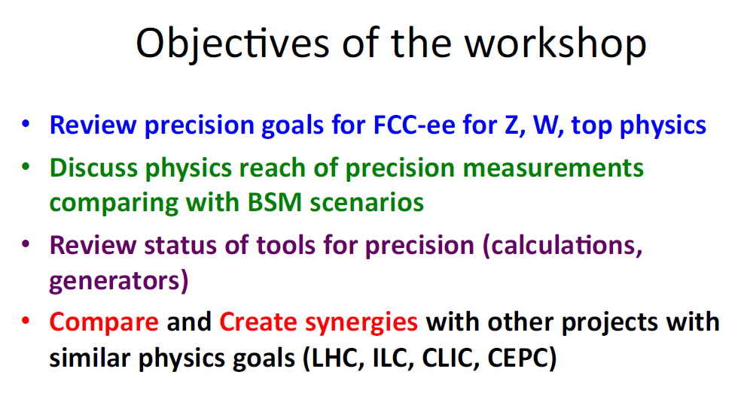
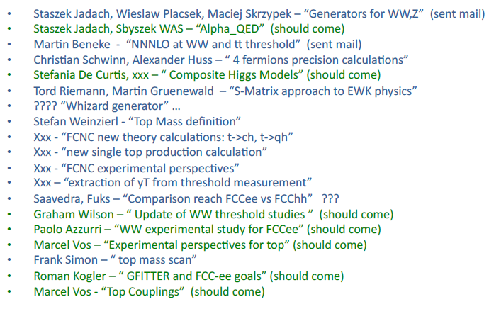
2-3 February: mini-workshop on Physics behind precision
or ‘physics discovery potential of FCC-ee precision measurements’
Org: Azzi, Piccinini, Tenchini

Slide 8
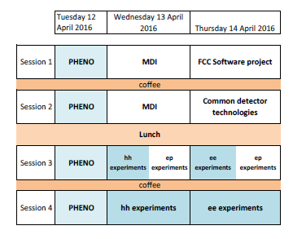
FCC meeting in Rome
Proposed agenda for physics sessions:
-- need to plan contributions
- new things reports from mini-workshops, new papers
- important basics event rates, detector design, detector requirements, etc
Avoid duplication and incompatibility
with FCC-ee machine sessions (e.g. for MDI)
suggest to get going after FCC-CG meeting tomorrow.

Slide 9
Manpower estimates
see Janot, https://indico.cern.ch/event/446561/
(exists)
Priority#1a: Experimental environment
beam backgrounds, IR design and compromises, Beam Energy calibration 3FTE
Priority#1b: Physics Software
Fast sim; full sim; reconstruction; analysis framework 4FTE (1)
Priority#2: Theory (needs refinment)
‘towards FCC-ee precisions’, SM and new BSM generators, global fit 5 FTE
Priority#3a: Detector design (+external inst)
requirements wrt beam backgrounds (SR), lumi mst, optimization for various physics
collaboration with CLIC and ILC groups! 4 FTE
Priority#3b: Physics studies
FCC-ee in context of other projects / qualify detector performance needed/ interplay with theory/ help software development
5 FTE
total 20 FTE
NB point is made at various instances that a clear CERN recognition is required
and strong collaboration with CLIC group (already started at low level)

