Slide 1
Interaction region design: first steps
M. Koratzinos
FCC-ee physics meeting,
Monday, 30/11/2015

Slide 2
Purpose
I will try to state the problem
Indicate steps already made
Discuss future steps
Many thanks to:
Glyn Kirby and Jeroen Van Nugteren of TE-MSC for fruitful discussions, guidance and the use of very useful tools (Field 2015)
Shlomo Caspi for an introduction to CCT magnets
Katsunobu Oide for helpful discussions

Slide 3
Background information
There was a very nice talk given by E. Paoloni at HF2014 in Beijing.
I will be using some of his transparencies interspersed with mine during this presentation

Slide 4
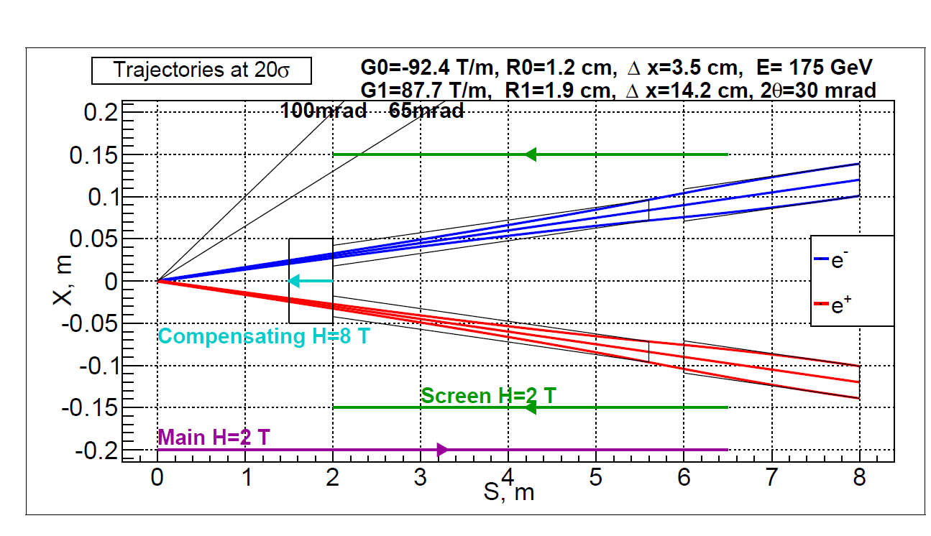
The IR region of a typical FCC-ee experiment
Final quads
Main detector solenoid
Quad screening solenoid
Compensating solenoid
An artist’s impression of the forward region around the IP

Slide 5
Objectives
Objective no. 1: the vertical emittance blow up should be as small as possible
Objective no.2: the crosstalk between final focus quads should be minimised
Constraints: stick to the 100mrad cone
(for all that follows, I am using the Field2015 program – thanks, Jeroen. Calculations are done in Excel)

Slide 7
Emittance blow up
The beams arrive at an angle (+- 15mrad)
The detector solenoid is strong and rather long
We need to shield the beams as much as possible from the solenoid field of the detector.
What we cannot shield we need to ‘undo’ by ensuring that the field integral seen by the beam is zero
There is a resulting vertical emittance blow up due to this; the value should be small compared to our emittance budget
Vertical emittance budget: ~1pm

Slide 8
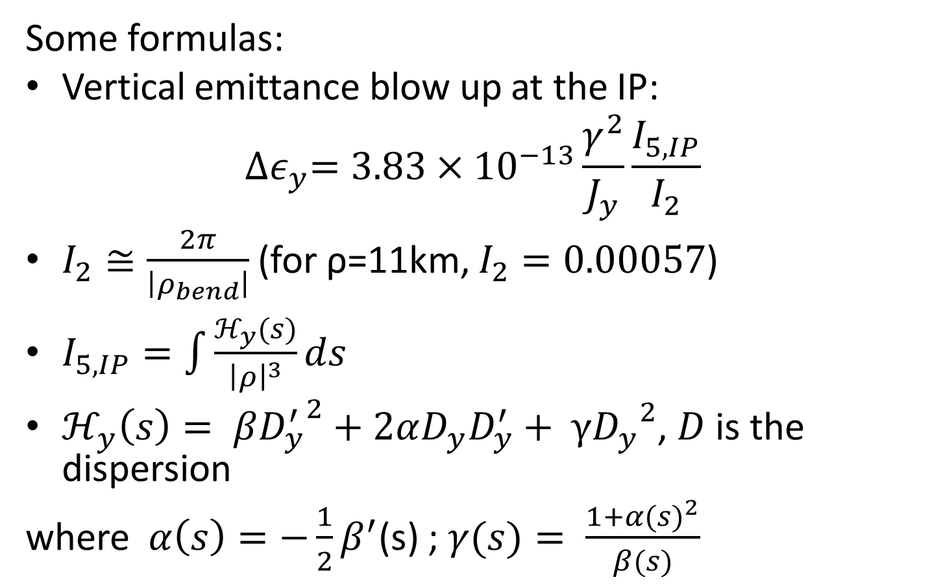
Emittance blow up
More important at low energies!
Some formulas:
Vertical emittance blow up at the IP:
$${∆ε}_{y}=3.83×{10}^{−13}\frac{γ^{2}}{J_{y}}\frac{I_{5,IP}}{I_{2}}$$
$I_{2}≅\frac{2π}{\left|ρ_{bend}\right|}$ (for ρ=11km, $I_{2}=0.00057$)
$I_{5,IP}=\int{\frac{ℋ_{y}(s)}{{\left|ρ\right|}^{3}}ds}$
$ℋ_{y}\left(s\right)= β{D_{y}^{′}}^{2}+2αD_{y}D_{y}^{′}+ γ{D_{y}}^{2}$, $D$ is the dispersion
where $α\left(s\right)=−\frac{1}{2}β^{′}$(s) ; $γ(s)= \frac{1+{α(s)}^{2}}{β(s)}$

Slide 9
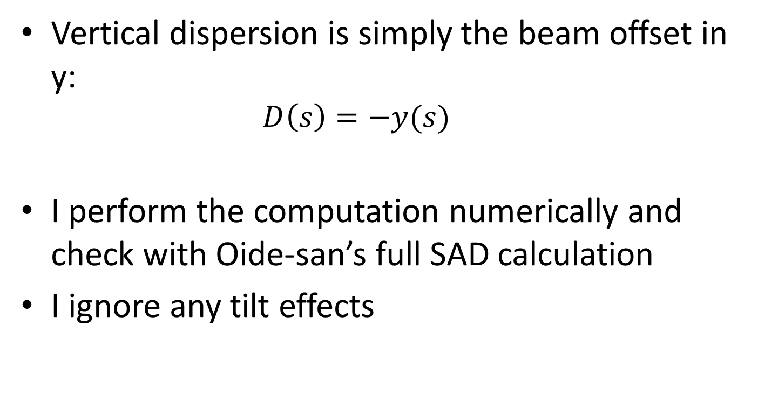
Calculation of dispersion
Vertical dispersion is simply the beam offset in y:
  $$D\left(s\right)=−y(s)$$
I perform the computation numerically and check with Oide-san’s full SAD calculation
I ignore any tilt effects

Slide 10
The layout
Many different layouts have been tried. Sergei Sinyatkin (BINP) performed some minimization using two solenoids that gave him the optimal position of the solenoids.
Building up on Segei’s work, I tried three solenoids and eventually
The best combination that I could find is a two solenoid arrangement with the short solenoid tapered – see next slides

Slide 11
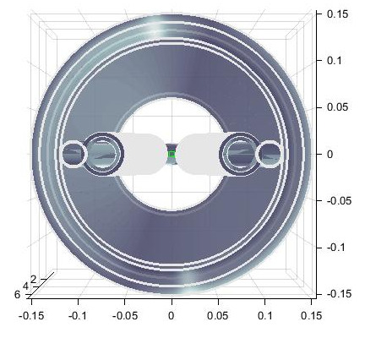
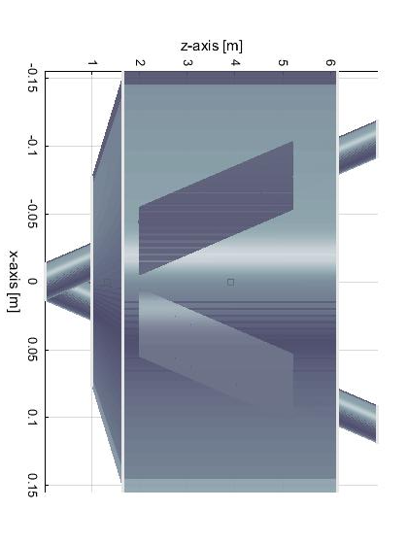
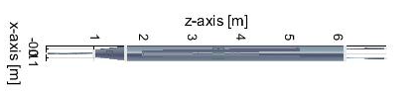
The layout
True proportions view

Slide 12
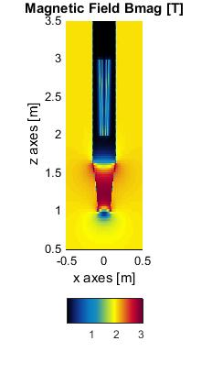
Shielding solenoids
Two screening solenoids are used: a long -2T solenoid, ensuring zero field where the quads are, and a -5T tapered but short (65cm) solenoid, ensuring that the overall field seen by electrons is zero
Other schemes were used, but the one on the left gave the best results: emittance blow up due to two such IPs in the ring of 0.11pm
The tapered solenoid improves the emittance blow-up by a factor ~2

Slide 13
Note on the layout
Ensuring a minimal emittance blow up is not an easy task: one needs to minimize the edge effects, so the bigger the solenoid, the better. But one needs to respect the 100mrad cone.
Further optimization is possible.
The existence of a stand alone tool (Field2015 + calculations in excel) allowed for fast progress compared to MAD

Slide 14
Bx and Bz components
Emittance is increased by two components of the field:
Bz*sin(theta) and
Bx (due to edge effects)
Out of the two contributions, the second one is more important
e⁻

Slide 15
Magnetic field
Z and X components of the overall field long the path of the electrons
Field components perpendicular to direction of motion of electrons (giving y kick)

Slide 16
α,β,γ, D, D’ close to the IP

Slide 17

Curly H
$$ℋ_{y}\left(s\right)= β{D_{y}^{′}}^{2}+2αD_{y}D_{y}^{′}+ γ{D_{y}}^{2}$$
At ~1m, H is small, maximum at ~1.4m

Slide 18
Components of I5
Edge at ~1m dominates

Slide 19
Emittance blow up
The result is for two IPs. It has been verified by K. Oide and his code who gets a total value of 0.11pm

Slide 20
First estimation of forces
Name | x [m] | y [m] | z [m] | Fmag [N] | Tmag [N/m]
anti_solenoid | 0 | 0 | 3.9 | 2.0E+05 | 1.7E+04
beampipe | 0.0525 | 0 | 3.5 | 0.0E+00 | 0.0E+00
anti_sol_4T | 0 | 0 | 1.325 | 2.0E+05 | 5.3E+02
beampipe_2 | -0.0525 | 0 | 3.5 | 0.0E+00 | 0.0E+00
nested coil - 1_left | -0.0375 | 0 | 2.5 | 1.6E+03 | 5.8E+02
nested coil - 2_left | -0.0375 | 0 | 2.5 | 3.3E+03 | 1.2E+03
nested coil - 1_right | 0.0375 | 0 | 2.5 | 1.6E+03 | 5.8E+02
nested coil - 2_right | 0.0375 | 0 | 2.5 | 3.3E+03 | 1.2E+03
Left quad
Right quad

Slide 21
Estimation of inductances
 | Anti solenoid | beampipe | Anti solenoid 4T | beampipe_2 | nested coil - 1_left | nested coil - 2_left | nested coil - 1_right | nested coil - 2_right
Anti solenoid | 2.13E+01 | 0.00E+00 | 1.23E+00 | 0.00E+00 | -1.79E-01 | 3.27E-01 | -1.90E-01 | 3.42E-01
beampipe | 0.00E+00 | 0.00E+00 | 0.00E+00 | 0.00E+00 | 0.00E+00 | 0.00E+00 | 0.00E+00 | 0.00E+00
Anti solenoid 4T | 1.23E+00 | 0.00E+00 | 6.73E+01 | 0.00E+00 | -4.78E-03 | 8.73E-03 | -5.07E-03 | 9.12E-03
Beampipe 2 | 0.00E+00 | 0.00E+00 | 0.00E+00 | 0.00E+00 | 0.00E+00 | 0.00E+00 | 0.00E+00 | 0.00E+00
nested coil - 1_left | -1.79E-01 | 0.00E+00 | -4.78E-03 | 0.00E+00 | 4.85E-01 | -2.19E-01 | 2.25E-03 | 3.40E-03
nested coil - 2_left | 3.27E-01 | 0.00E+00 | 8.73E-03 | 0.00E+00 | -2.19E-01 | 9.06E-01 | 3.45E-03 | 6.16E-03
nested coil - 1_right | -1.90E-01 | 0.00E+00 | -5.07E-03 | 0.00E+00 | 2.25E-03 | 3.45E-03 | 5.03E-01 | -2.31E-01
nested coil - 2_right | 3.42E-01 | 0.00E+00 | 9.12E-03 | 0.00E+00 | 3.40E-03 | 6.16E-03 | -2.31E-01 | 9.31E-01
Inductance Given in | mH
Stored Energy | 0.82991 MJ
Total Inductance | 93.5888 [mH]

Slide 22
Final focus quads
We need fields of 100T/m
Beam pipe is at a radius of 1.3cm (corresponding to 20 sigma horizontal)
Total quad length: 2 × 1.6m
(the inner quad can have an inner bore slightly smaller and the outer slightly bigger, but this is not a question for this moment)
For this application, a CCT approach might be appropriate

Slide 23
Advantages of CCT quads
The novel technique of helical coils (CCTs) has a number of important advantages for this application:
Excellent field quality
Absence of iron
Easy to manufacture
Easy to incorporate additional rings with corrector elements
Possible to design out any cross talk by changing pitch and angle of groove
Good synergies with the design of corrector magnets of FCC-ee
Fast prototyping/not labour intensive
(It is a new technique, becoming more fashionable now)

Slide 24
CCTs
Canted Cosine Theta magnets are very simple objects:
They comprise two coils on two concentric cylinders
Each coil produces a solenoid field plus an arbitrary multipole field (dipole, quad, sextupole…)
The two solenoid fields from the two coils exactly cancel out (this means that a CCT coil has 30% more conductor than a conventional design for the same field)
Groves are precicely defined for winding the cable on a substrate which could be metal (aluminium) or plastic (bluestone)
Prototypes can be 3D printed – production pieces can be machined in a workshop
This technology is promoted by many people including S. Caspi (LBNL) and G. Kirby (CERN/TE)

Slide 25
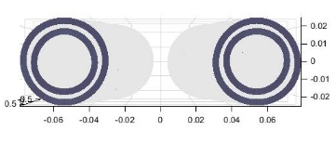
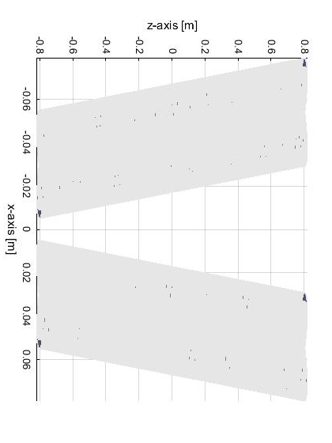
layout
1.6m long, 1.5cm inner bore – would need two of them per side per beam to achieve the 320T integral field

Slide 26
Size of inner bore
We need a study as to what the heat loads would be in the vicinity of the final focus quadrupoles (from SR and impedance)
I have used a minimum bore size of 15mm radius. There is space to increase this to 20-25cm.

Slide 28
Field quality @2/3 aperture (1cm)
With no wire positioning errors, field quality is excellent – the two edges have anti-symmetric fields. Largest component is B1 and A4
Highest component after integration is A1 with a value of 0.1 units
One side of the coil

Slide 29
Harmonics integrals – one quad
B1 [T] | B2 [T] | B3 [T] | B4 [T] | B5 [T] | B6 [T] | B7 [T] | B8 [T] | B9 [T] | B10 [T]
2.19E-08 | -1.54E+00 | -2.31E-09 | -2.86E-07 | -4.00E-09 | -1.24E-06 | 4.22E-09 | 1.09E-08 | 1.70E-09 | 1.83E-06
A1 [T] | A2 [T] | A3 [T] | A4 [T] | A5 [T] | A6 [T] | A7 [T] | A8 [T] | A9 [T] | A10 [T]
1.27E-05 | 2.44E-08 | -1.13E-08 | 9.70E-08 | -8.80E-09 | -7.12E-08 | -5.14E-09 | -7.26E-08 | 3.49E-09 | -1.64E-08
In this work, current leads have been ignored. Current leads will introduce harmonics, so they should be taken into account at a later stage
Highest component is, curiously, A1 with 0.13 units of 10⁻⁴
The aim (K. Oide): all components below 10⁻⁴

Slide 30
Harmonics integrals – two quads
B1 [T] | B2 [T] | B3 [T] | B4 [T] | B5 [T] | B6 [T] | B7 [T] | B8 [T] | B9 [T] | B10 [T]
1.22E-03 | 1.56E+00 | -8.22E-05 | -1.30E-03 | 5.15E-06 | 5.79E-05 | -3.40E-07 | -1.97E-06 | 2.69E-09 | -1.80E-06
A1 [T] | A2 [T] | A3 [T] | A4 [T] | A5 [T] | A6 [T] | A7 [T] | A8 [T] | A9 [T] | A10 [T]
-5.11E-02 | 3.39E-04 | 5.59E-03 | -2.01E-05 | -2.79E-04 | 1.37E-06 | 1.11E-05 | -1.47E-07 | -3.71E-07 | 2.95E-08
Highest components are B4, A3 with ~10 -50 units of 10⁻⁴
Crosstalk should be designed out!

Slide 31
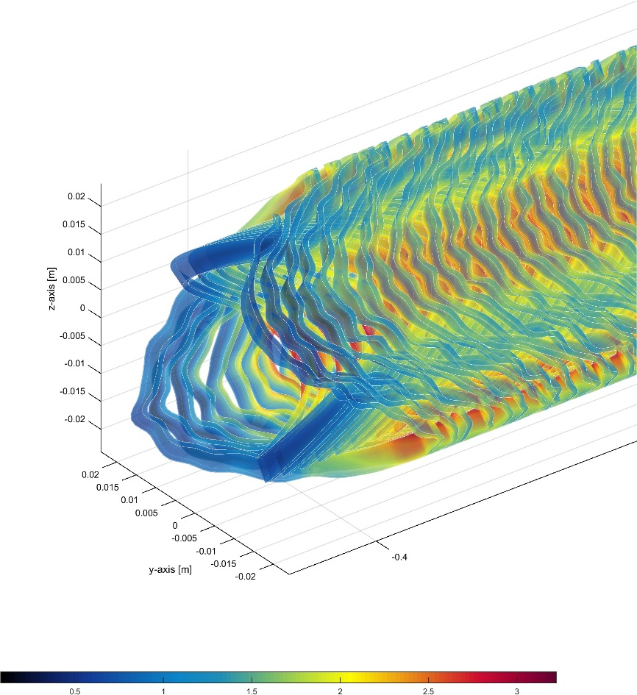
Imperfect coil study
This analysis still to be done – first results show that winding errors need to be larger than 100um to have an effect
exaggerated winding errors
Very preliminary; only a single seed

Slide 32
Experience from SuperB
The idea of designing the compensation out has been thought about at SuperB

Slide 37
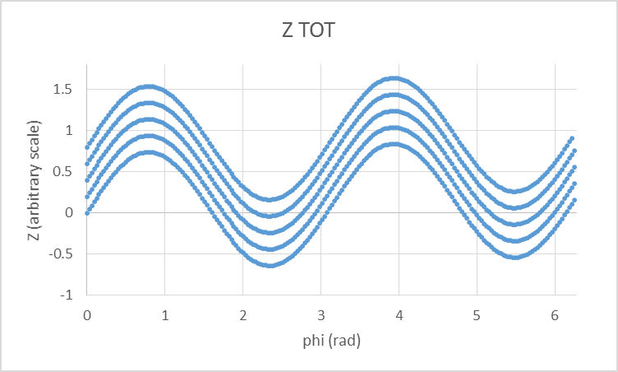
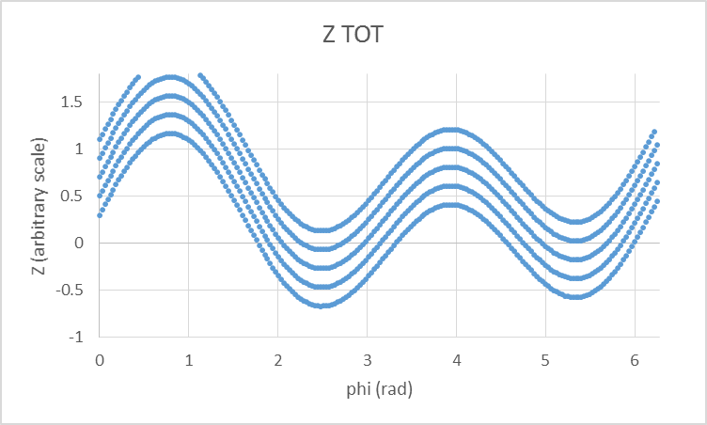
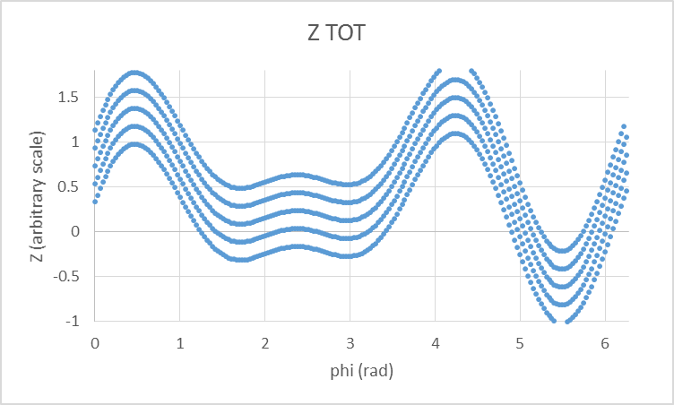
How to design quads with no xtalk
Since we are using no iron, it is very easy to use the principle of field superposition.
It is easy to design helical groves for any superposition of multipoles
Pure quad
Quad strength 1
+
Dipole strength 0.3, phase pi/4
Quad strength 1
+
Sextupole strength 1, phase pi/4

Slide 38
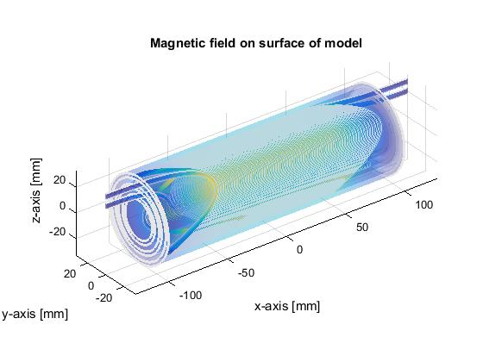
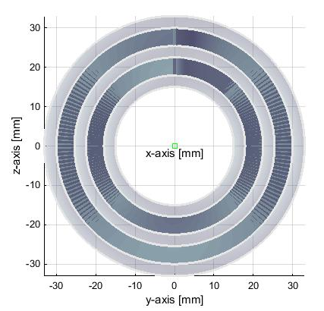
A possible prototype for FCC-ee
A short version of the proposed quad (20cm) with slightly relaxed parameters (thicker walls, less packing

Slide 39
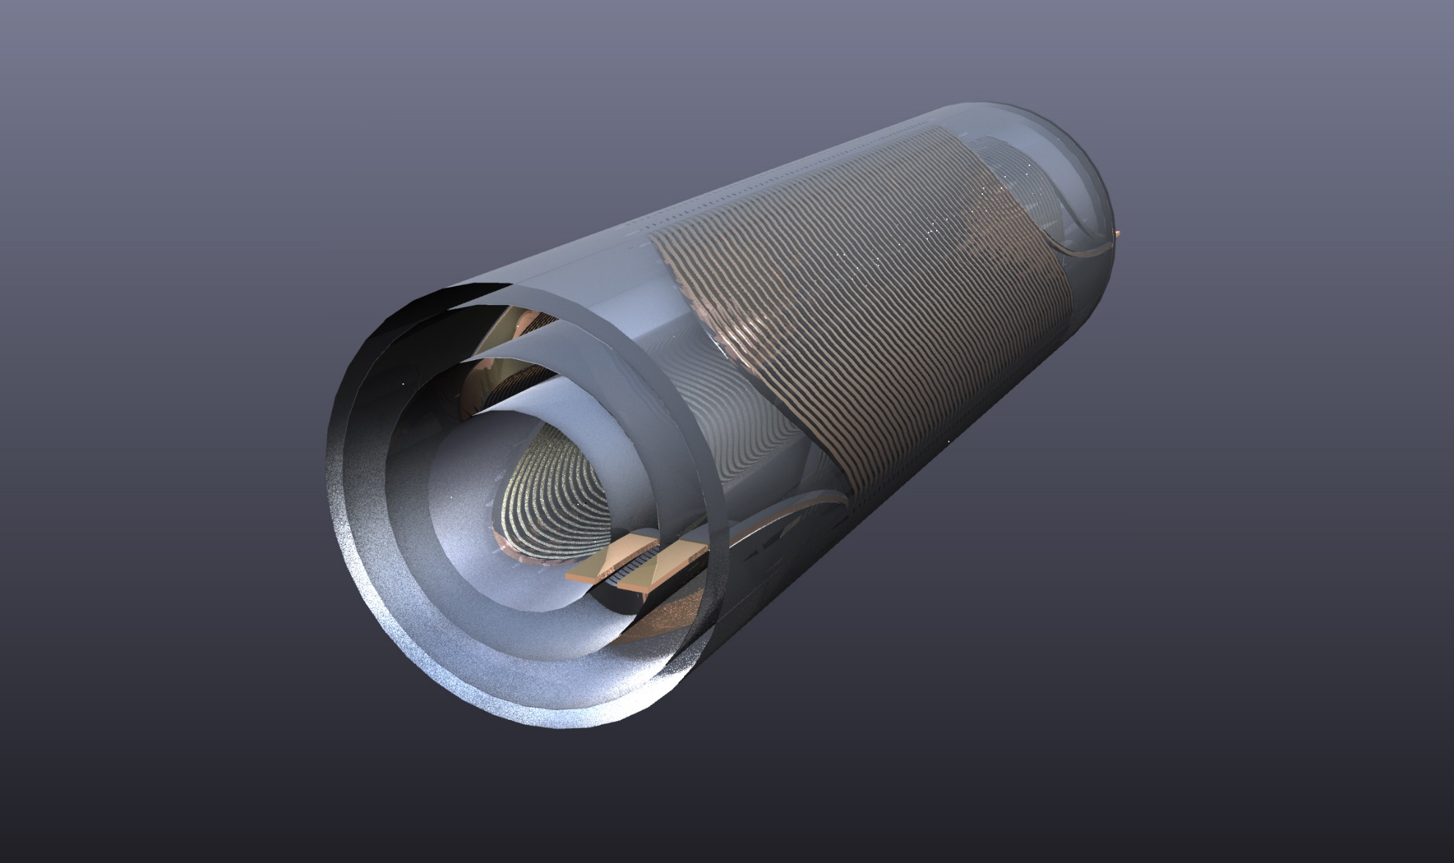
Rapid prototyping
The advantage of this approach is that one can do rapid prototyping. This is a fully engineered CAD drawing with a .STEP file ready

Slide 40
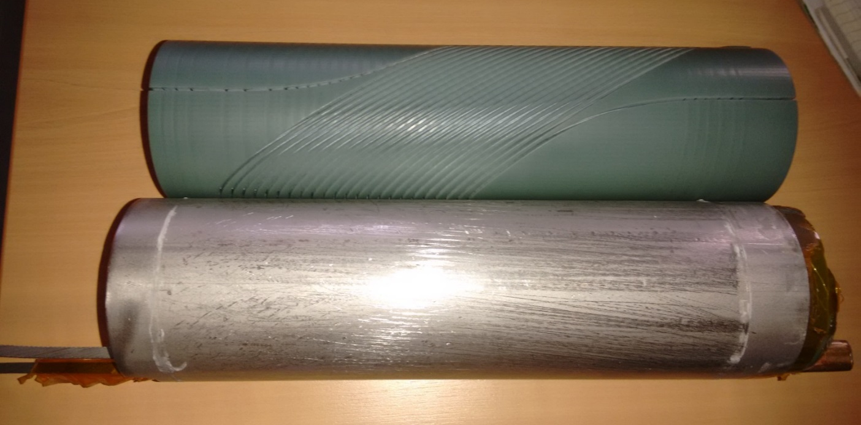
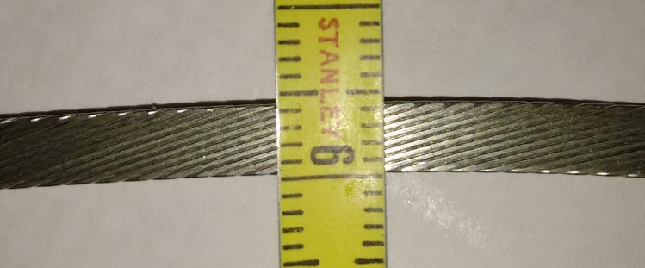
…one they did earlier
In Glyn’s office: a 3D printed version of a CCT dipole printed in bluestone (hard plastic which is cryogenically stable). Wound by hand
Suitable cable: NbTi, already existing, 4.3mmX0.9mm, slightly keystoned

Slide 42
A word on timescales
This work started 15 October 2015
With the right tools and colleagues one can make fast progress
It is possible to have a prototype before Xmas
This will be the first piece of hardware done at CERN for the FCC-ee project

Slide 43
Work plan
Emittance blow up:
already done:
  initial work on emittance blow-up. Target o emittance blow-up reached.
To do:
  Verify, optimise, look into tapered solenoids
  Look into a possible engineering design for the solenoids
CCTs:
Already done:
  Initial design
  Fully engineered prototype
To do:
  Finish prototype
  Test prototype at warm for field quality
  Test prototype at cold, determine gradient limits
  Export to Opera – verify Field2015 calculations
  Design crosstalk elimination
  Design second prototype

