Slide 1
Overview, Herman’s 7 questions
FCC Hadron Detector Meeting
Nov., 3rd, 2015
W. Riegler

Slide 2
Dates for Next Meetings
We have defined the dates for all FCC hadron detector meetings, leading up to the next FCC week in Rome (April 11-15, 2016).
Nov. 03, 2015
Dec. 09, 2015
Jan. 21, 2016
Mar. 03, 2016
Apr. 06, 2016
https://indico.cern.ch/category/6069/

Slide 3
FCC Software
In the last meeting we have defined a baseline parametrization for a DELPHES card that should be ready for physics studies.
There is quite some activity on FCC simulation and software tools. As a next step we have to define clear goals for this effort (fast, full simulation, reconstruction …)
FCC-hh, FCC-ee, FCC-eh studies use the same FCC software framework.
The overall FCC software coordination is done by Benedikt Hegner.
The items related to FCC-ee software are coordinated by Colin Bernet.
For the FCC-hh issues, Clement Helsens agreed to take up this task.
See presentation by Clement.

Slide 4
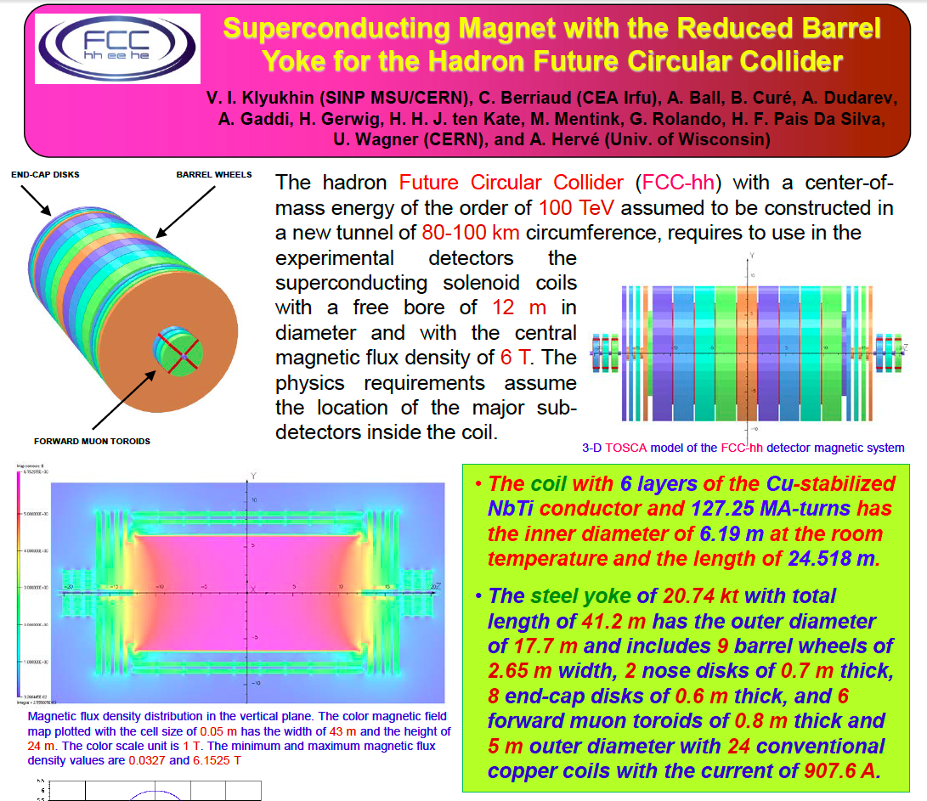
→ Presentation in the next meeting, detector concept t.b.d.

Slide 5
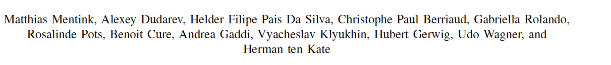
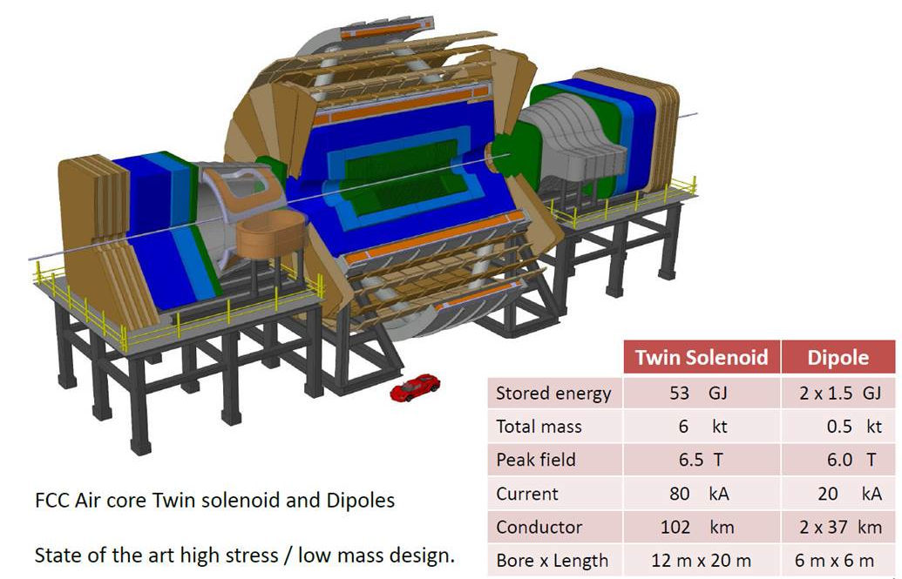
Twin Solenoid + Dipole Magnet System as Present Baseline

Slide 6
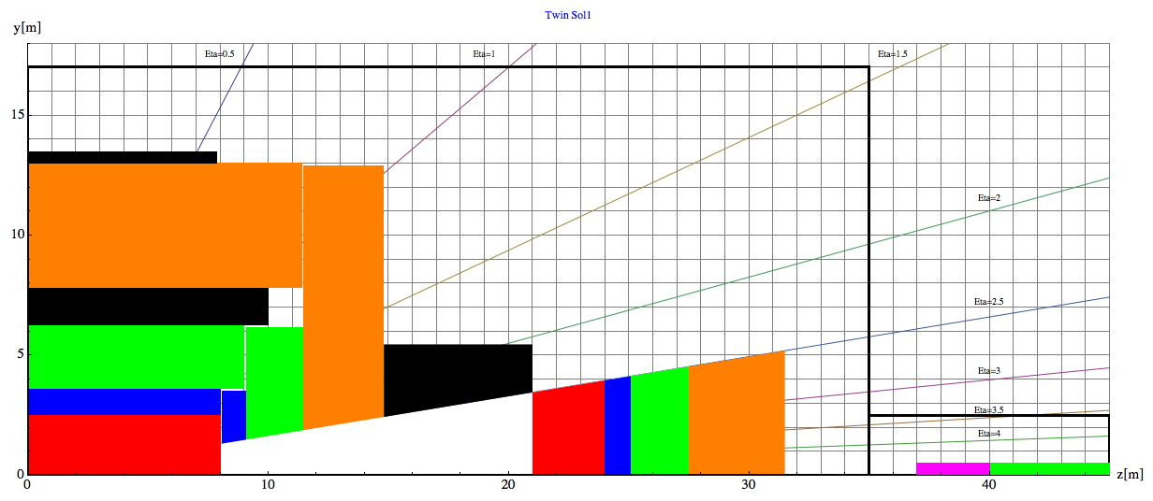
Baseline Geometry, Twin Solenoid
Barrel:
Tracker available space:
R=2.1cm to R=2.5m, L=8m
EMCAL available space:
R=2.5m to R= 3.6m → dR= 1.1m
HCAL available space:
R= 3.6m to R=6.0m → dR=2.4m
Coil+Cryostat:
R= 6m to R= 7.825 → dR = 1.575m, L=10.1m
Muon available space:
R= 7.825m to R= 13m → dR = 5.175m
Coil2:
R=13m to R=13.47m → dR=0.475m, L=7.6m
Endcap:
EMCAL available space:
z=8m to z= 9.1m → dz= 1.1m
HCAL available space:
z= 9.1m to z=11.5m → dz=2.4m
Muon available space:
z= 11.5m to z= 14.8m → dz = 3.3m
Forward:
Dipole:
z= 14.8m to z= 21m → dz=6.2m
FTracker available space:
z=21m to R=24m, L=3m
FEMCAL available space:
Z=24m to z= 25.1m → dz= 1.1m
FHCAL available space:
z= 25.1m to z=27.5m → dz=2.4m
FMuon available space:
z= 27.5m to z=31.5m → dz=4m

Slide 7
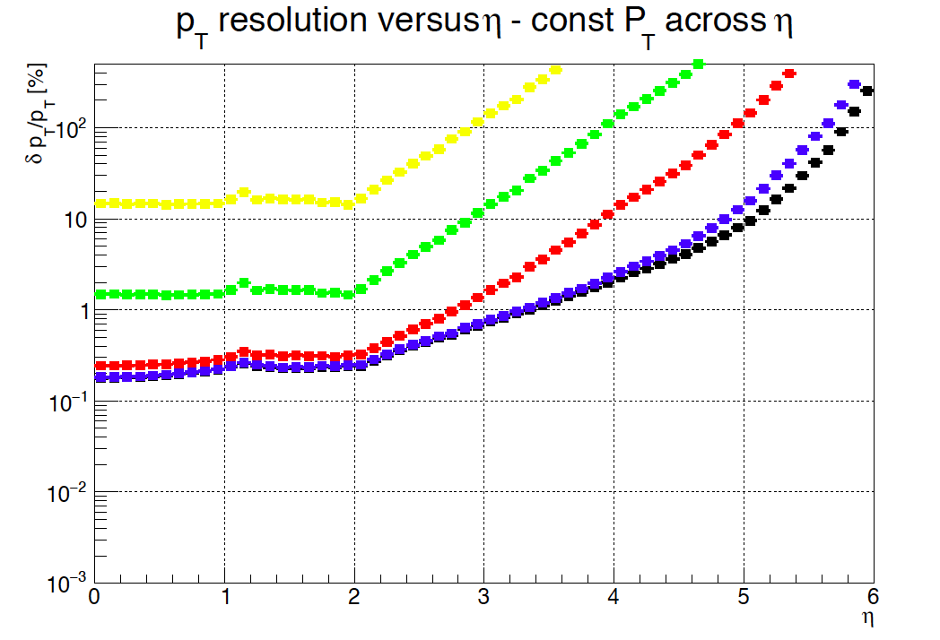
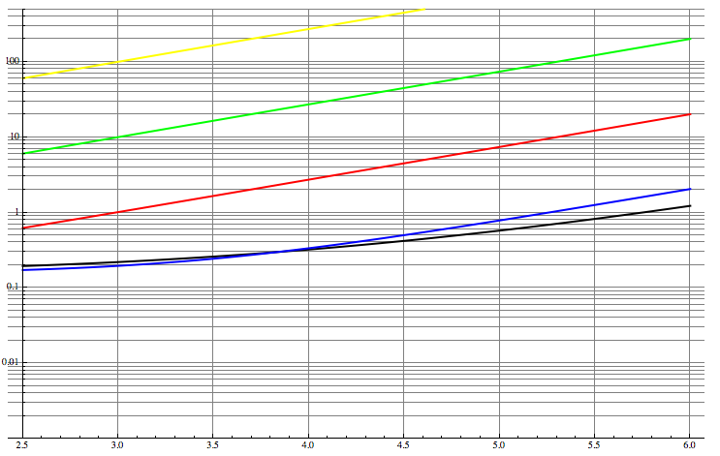
10 000GeV, 1000GeV, 100GeV, 10GeV, 5GeV
Solid lines show the performance of the forward dipole

Slide 8
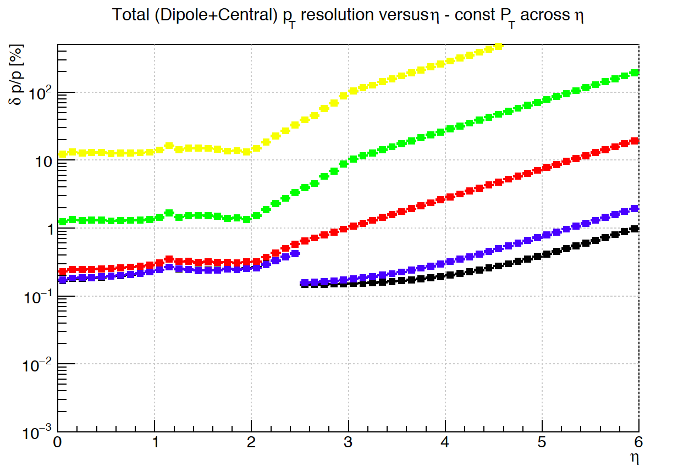
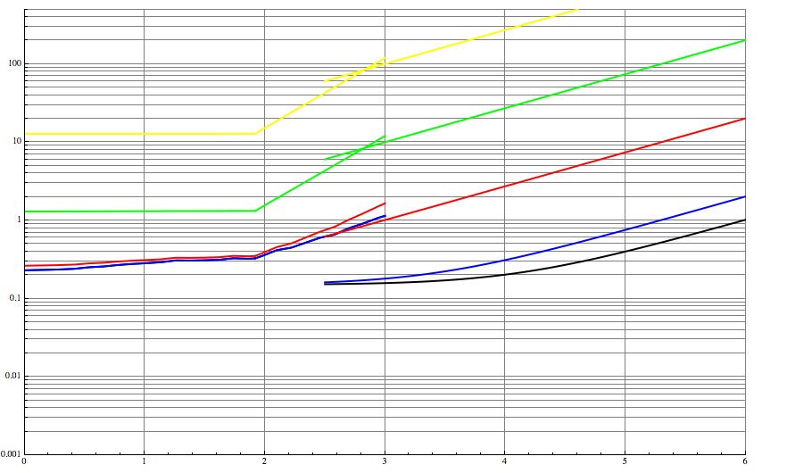
Forward Tracker Resolution
This is the baseline parametrization used for DELPHES
10 000GeV, 1000GeV, 100GeV, 10GeV, 5GeV

Slide 9
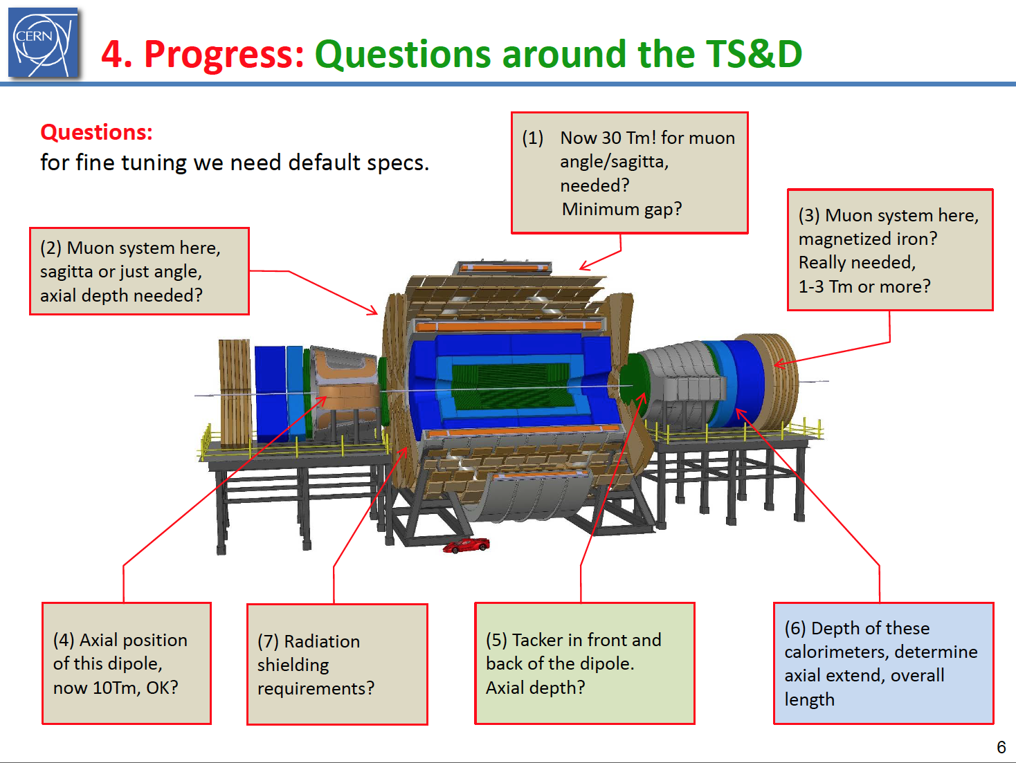
Herman’s 7 Questions

Slide 10
As discussed in the last meeting, the angular measurement of the muon at the entrance of the spectrometer will give a very precise momentum measurement (order 3%). This only needs approximately 2-2.5m of space.
A ‘standalone’ system with 3 stations for sagitta measurement will have a very hard time to compete with this angular measurement and the combined measurement with the inner tracker (→ see today’s talk by Sotiris)
→ Since the overall dimension of the object is a critical parameter for the installation and realization of the object, a version with a minimum gap is clearly very interesting and might represent the optimum configuration.

Slide 11
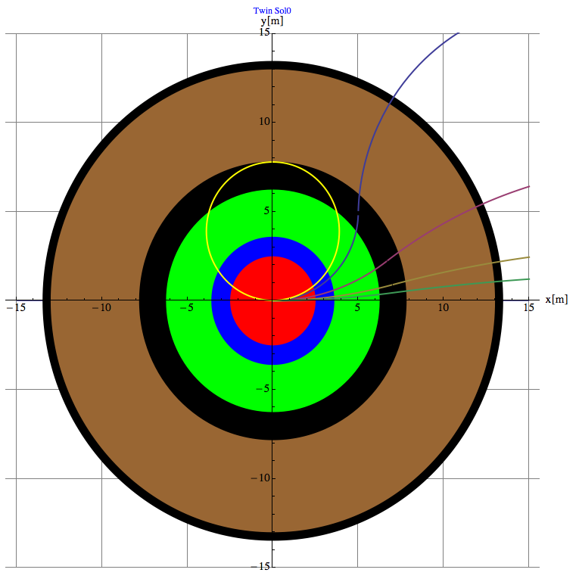
Muon Momentum can be measured by
The inner tracker
2) The track angle at the entrance of the muon system → Trigger
3) A sagitta measurement in the muon system (no iron → precise !)
4) The combined fit of inner tracker and outer layers of the muon system.
R₀
R₁

Slide 12
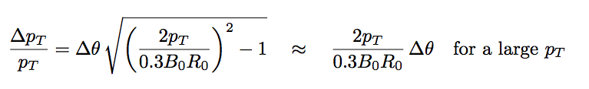

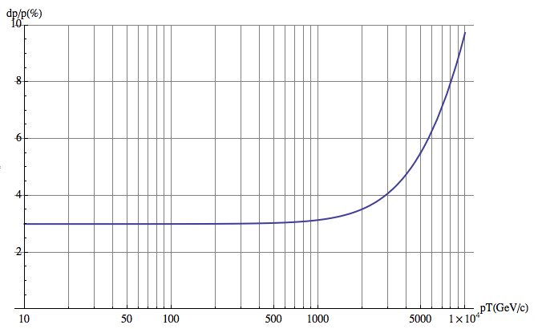
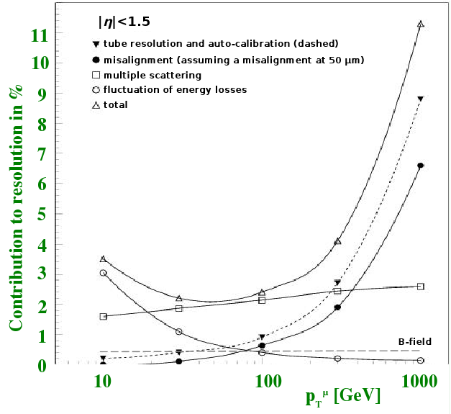
2) Track angle at the entrance of the muon system
θ
10% at 10TeV, B₀=6T, R₀=6m
Δθ=50μRad
2 stations at 1.5m distance with 50um position resolution
For low momentum, limit due to multiple scattering in the calorimeters and coil:
Calorimeter+Cryostat: 35X₀
HCAL: 110X₀
Coil: 5X₀
→ x_{tot}/X₀ ≈150
B₀=6T, R₀=6m
dp/p=3% !!!
(CMS 9% because B₀R₀=1/3 of FCC value)
At eta=0 ATLAS type standalone Muon Performance up to 10TeV !!!

Slide 13
3) Sagitta measurement in the muon system
The return field is 2.45T
Measuring over the 5m lever arm with stations of sig=50um resolution we have
dp_{T}/p_{T}= sig*p_{T}/(0.3*B*L²)*8
= 20% @ 10TeV
with possibly excellent performance at low p_{T} due to the absence of iron (vs. CMS) .
but very hard to beat the angular measurement at high p_{T} and the inner tracker at low p_{T}.
Surface > 5000 m²
CMS sagitta measurement in the muon system is limited to dp_{T}/p_{T} = 20% due to multiple scattering alone.

Slide 14

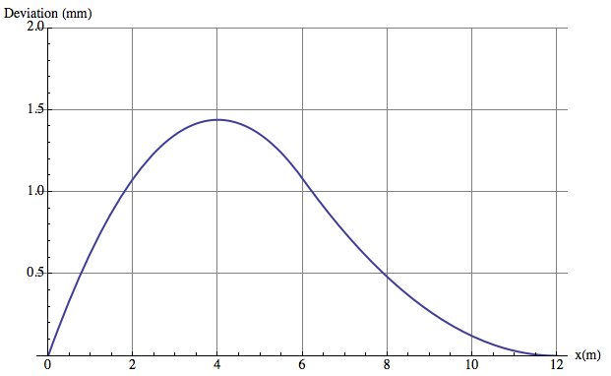
Combined Measurement
If the full flux is returned trough the muon system, the muon trajectory at the exit of the system points exactly to the IP !
The maximum excursion y_{t}(x₀) is always at the same radial distance of x₀
For values below: x₀=4m, y_{t}(x0)=1.44mm
Ideal measurement point is at the peak, but y_{t}(2.4m)= 1.24mm still good !
B₀=6T, R₀=6m, R₁=12m, p_{T}=10000GeV
σ₁
σ²=σ₁²+(x/R₁σ₂)²
x=2.4m,R₁=12m, σ₁=50μm, σ₁=250μm,
σ=64μm, dp_{T}/p_{T}=5% at 10TeV !
Measuring just in the last tracker layer and in the outermost muon station already beats the full inner tracker performance (14 layers, 23um).
σ₂

Slide 15
This question needs to be quantified.
Again, the present thinking is that the angular measurement (for possible triggering) together with the the inner tracker measurement will be sufficient.
A muon station at z-larger distance might be needed for the end cap region.
Calculations on ‘field closure’ for the questions have been started by M. Mentink, multiple scattering questions →see talk of Sotiris.
→ Quantified endcap muon performance for the next meeting.

Slide 16
Like in LHCb this system will act as muon trigger and muon identifier and the final precision measurement of the muons will be done with the forward tracker.
→ Magnetization is not needed.

Slide 17
The present dipole layout and dipole strength are a good baseline.
We assume tracking stations in front and behind the dipole.
The field inhomogeneity due to the superposition of solenoid and dipole field needs B-field maps and calibration, which is ‘standard’ in present LHC operation.
→ See next slides

Slide 18
At present we assume two stations in front of the dipole (z=12m, z=14m) and two stations behind the dipole magnet (z=22m, z=24m) .
Having the stations outside the dipole has many practical advantages: (installation, secondaries …)
The key advantage is that the stations can be made ‘larger’ than the dipole opening, so one can use the entire dipole acceptance and has space for mechanics and electronics.
The exact position and radial extent of the upstream forward tracker has to be defined by the shielding of the end cap muon stations → see today’s talk by Ilaria Besana.
The exact position has to be optimized with respect to the field integrals (see next slide).
→ For the moment the available space for the forward tracker seems sufficient.

Slide 19
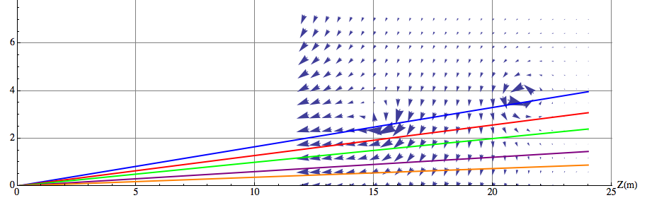
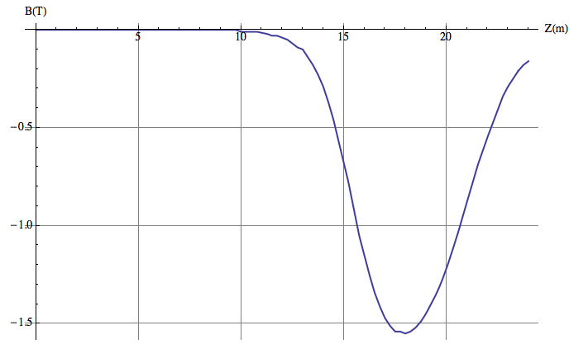
η=2.5
η=2.75
η=3
η=3.5
η=4
at x=y=0
Placing the tracking stations
z=12,14m
z=22,24m
we lose some of the bending power.
Optimization of the position and tracker layout (e.g. 3 instead of two layers)

Slide 20
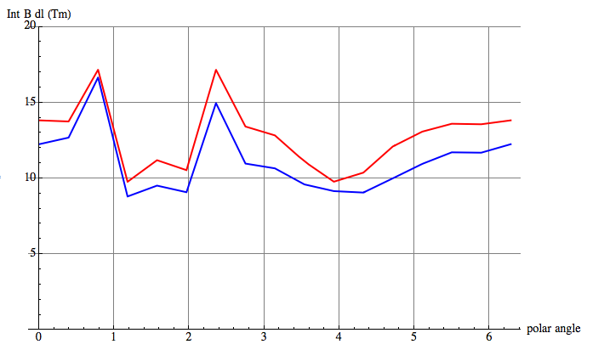
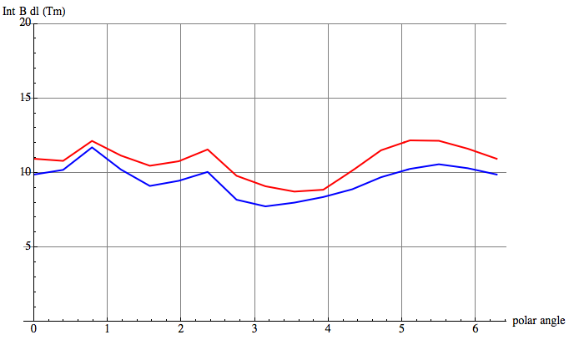
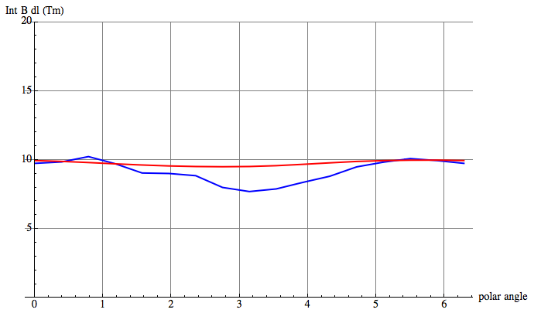
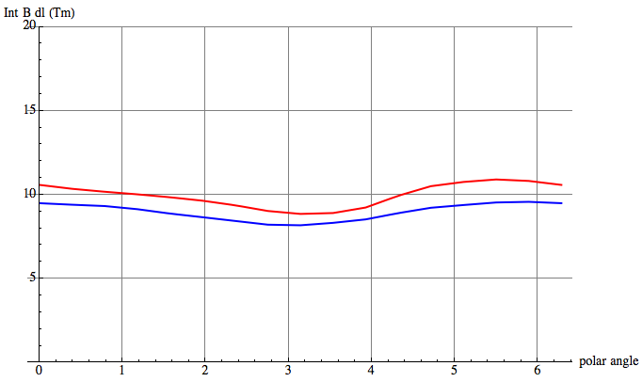
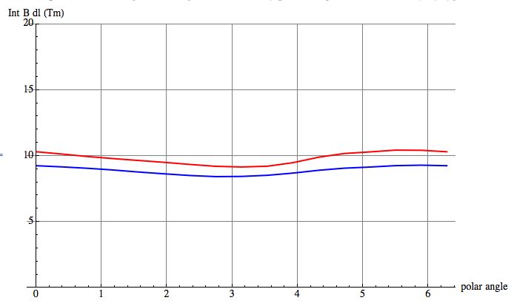
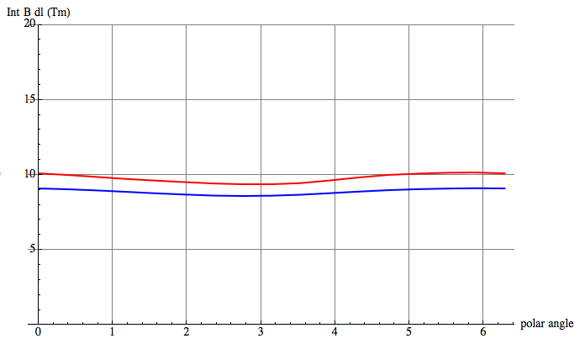
η=2.5
η=2.75
η=3.0
Int_14m^22mBdl
Int_12m^24mBdl
η=3.5
η=4
The tracker position must be optimized.
η=4.5

Slide 21
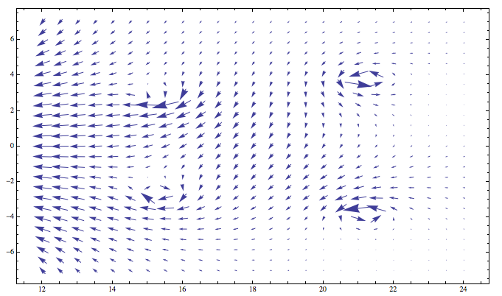
The superposition of the vertical dipole field and the solenoid field results in some ‘inhomogeneity’ of the dipole field.
Effect on radiation → see today’s talk by Ilara Besana

Slide 22
→ See today’s presentation by Ilaria Besana

Slide 23
Conclusions
Baseline detector layout for Twin Solenoid + Dipole exists
Parametrized performance in DELPHES card exists
FCC detector simulation goals must be defined (→ Clement)
Muon performance must be studies (→ Sotiris)
Radiation studies for baseline detector (→ Ilaria)
More magnet systems coming (→ next meeting)

