Slide 1
Mechanics and granularity considerations of a Tile hadronic calorimeter for FCC hh barrel
Nikolay Topilin/Dubna+ Sergey Kolesnikov/Dubna
Ana Henriques/CERN

Slide 2
- The ATLAS Tile barrel had. Calorimeter concept using Si-PMTs as readout was presented in the February 2015 FCC-hh detector Workshop : https://indico.cern.ch/event/358198/session/2/contribution/1/3/attachments/713312/979278/ANA_TALK_FCC_scint-1.pdf
- For FCC-hh optimisations are needed at the level of mechanics, optics, electronics readout, …
- Today will discuss barrel HCAL mechanics and granularity matters

Slide 3
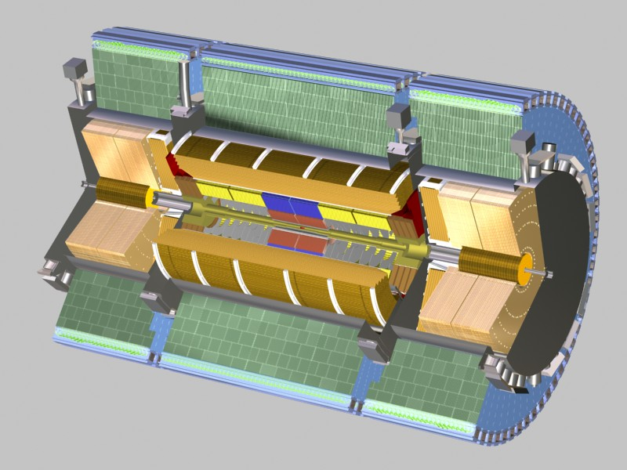
ATLAS Tile hadron calorimeter (|η|<1.7)
Scint. Tiles; fibres ‖ to incoming particles at η=0
Steel/Tiles: = 4.7 : 1 (λ = 20.7 cm)
Active cells volume: ~ 372m3
~ 620k fibres ; 40k Tiles
10 k channels
7.7 λ at |η|=0 ; (9.7 λ with the em LAr calo)
Transversal granularity ΔηxΔφ=0.1x0.1
Longitudinal segmentation: 3 layers
e/h = 1.33
Pion resolution (test beam):
  σ_{E}/E~52%/√E ⊕ 5.7 % (7.9 λ)
  σ_{E}/E~45%/√E ⊕ 2 % ( 9.2 λ)
target (with e.m. LAR) at ATLAS/LHC:
  Jet σ_{E}/E~50-60%/√E ⊕ 3%
  Containment ~ 98% TeV hadrons, jets
12 m
Tilecal
8.5m
2900 tons

Slide 4
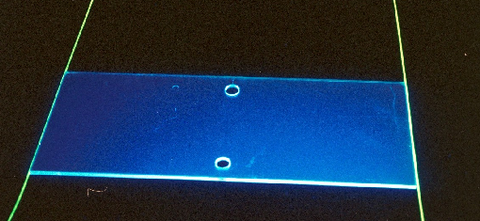
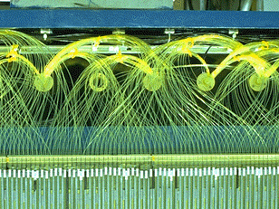
Today’s ATLAS Tilecal optics granularity (but merged at readout…)
PMT
PMT
3mm thick
10-17cm
Φ
~20-40cm
R
(Tiles by injection molding)
steel
Fibres start at different R and go radially out =>
No φ cracks
R segmentation
PMTS out Radius
4 mm
Fibre bundles
(at outer radius)
R, depth
Tile
(no grooves)
3mm
steel
Fibres
Φ
p
p
Z, η
Δη: 3mm tiles every 9-18mm in Z->0.0007<Δη<0.008
ΔR: 11 tiles and 8 fibres in R -> 8-11 layers with 1λ<ΔR<0.5 λ
ΔΦ: 20 cm tiles-> Δφ=0.1 (with dual fibre readout)
In total ~ 620k fibres and 40k tiles ; but ~80-300 Tile-fibres couplings in 1PMT =>
10 k channels ; ΔηxΔφ=0.1x0.1 ; 3 longitudinal layers in LHC
Cost/performance compromise in electronics costs (~730CHF/channel in 1998)
Minimal changes needed in optics/mechanics to exploit full granularity at FCC-hh
Steel
R
Tile
Z, η

Slide 5
Main R&D/improvements needed in Mechanics vs ATLAS
Stainless Steel (ok) for faster showers, less μ tails, non magnetic for solenoid compatibility
Increase cells thickness to at least 10λ (assuming 2λ e.m. calo + tracker (?) )
Redesign outer support/girder:
- reduce girder thickness (ATLAS ~30 cm; 1.5λ )
      - optimize electronics location/space (no need to shield Si-PMT)
      - Optimize fibres to Si-Pmts coupling (not yet studied)
Improve φ granularity to Δφ= 0.05= 120 modules; (64 modules;Δφ= 0.1 in ATLAS). Could study also 180 modules and implications on girder design if needed)
  Mechanics granularity in Z:
    Propose central barrel in 3 cylinders of ~ 6m each (ATLAS Tilecal barrel=5.6m)
    Minimize cracks in the Z between 3 cylinders (not yet studied)
  Optimize supports/interface with solenoid (not yet studied)
ATLAS
Tilecal
Z ~ 18m in ~3 cylinders
Redesign support
Increase depth,
Increase number modules in cylinder
Reduce φ dimensions
Rin
φ

Slide 6
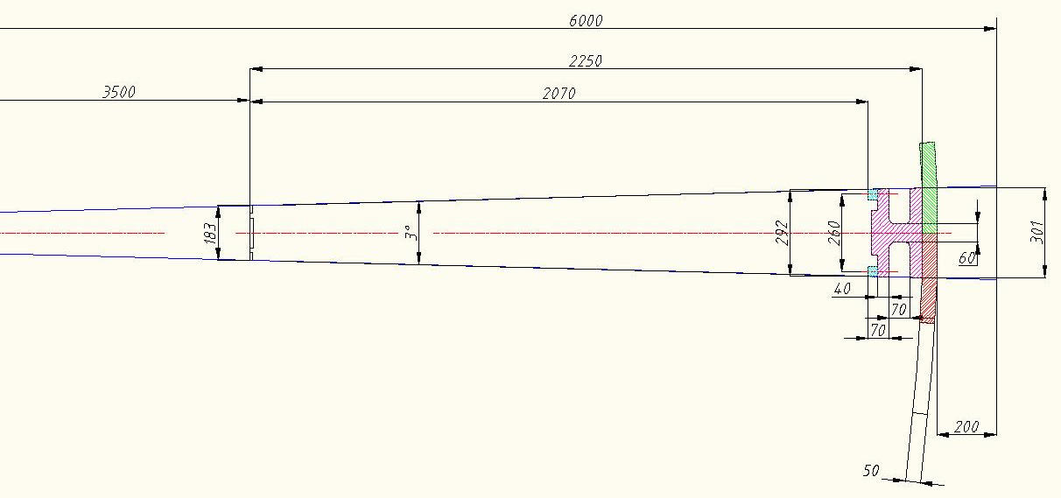
FCC Tile Had. Calo module Dimensions (version 120 modules in a cylinder)
girder
Xbar
φ
1 Module
Space for electronics
120 modules in φ , 6m long in Z is ok => Δφ =0.05, 2 times better than ATLAS
Rmin=3.5m (OR 3.4m IF em calo+tracker <2λ). Need to keep 12λ in total…
Rout =5.8m (with supports and Xbars). Need 20cm for cables before solenoid…
Depth active cells = 207 cm = 10λ (+29% than ATLAS; λ_{tilecal}=20.7cm ).
Depth Outer Supports=20cm (15cm girder+5cm Xbars);~1.5 shorter than ATLAS !
20 tons each module of 6 m long in Z + 0.7 tons Xbars per module
Total FCC Tilecal barrel weight of 18m long = 7500 tons (3x2500)

Slide 7
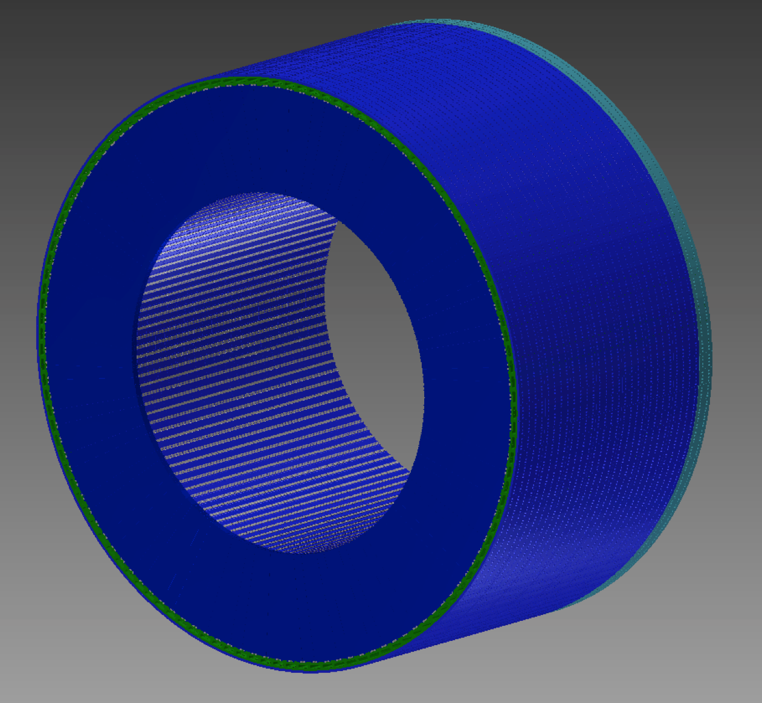
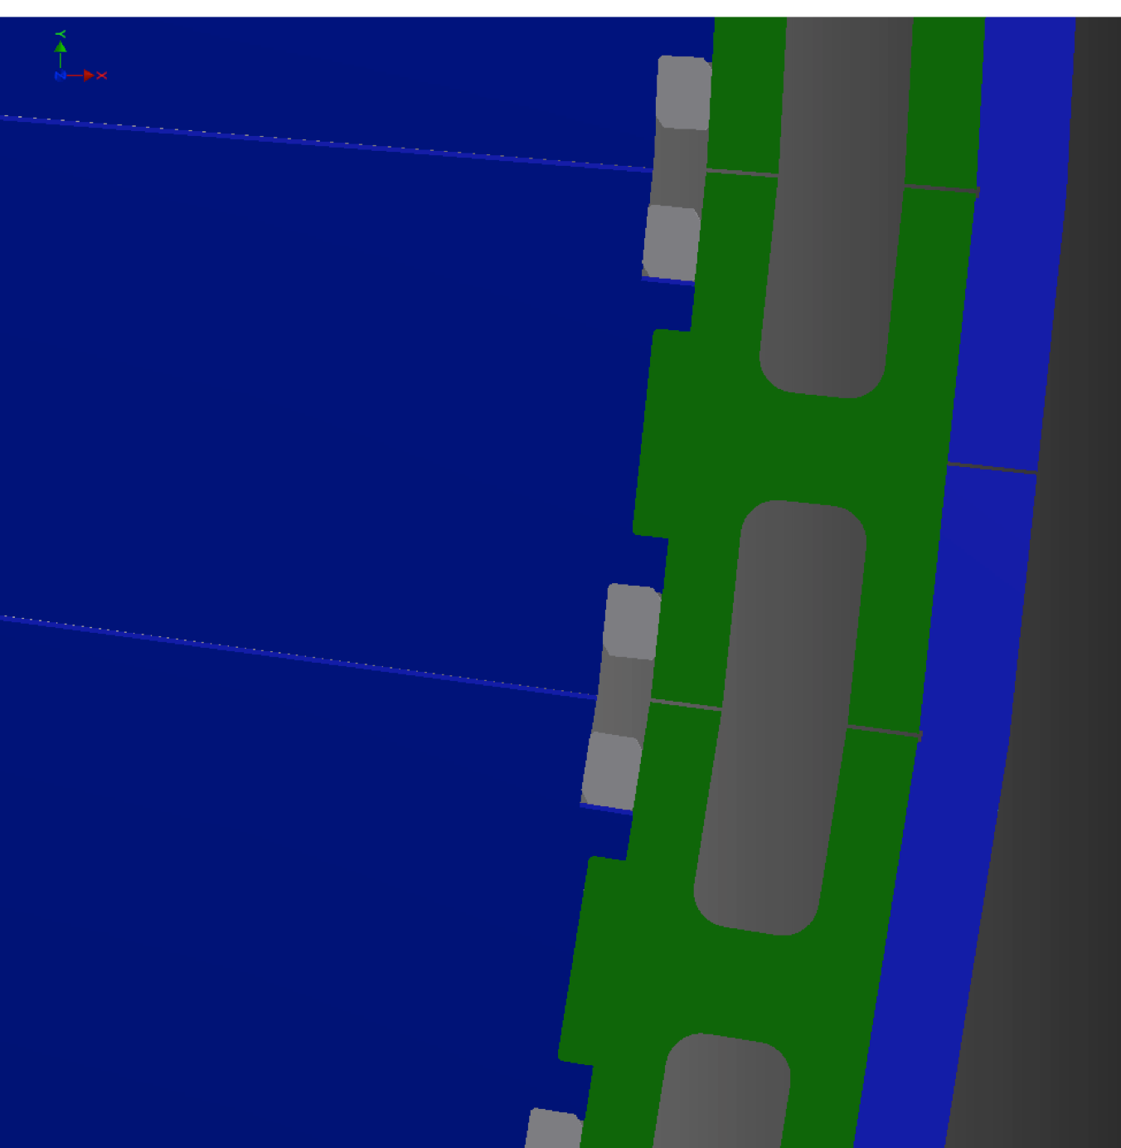
1/3 FCC Tile Had. Calorimeter barrel (version 120 modules and 6m length)
1/3 barrel=2500 tons
Z~6m (1/3 barrel)
20cm
- Barrel made of 3 cylinders of ~ 6m long each (need to minimize cracks in Z between 3 cylinders, not yet studied)
- Reduced support radius/space for drawers electronics (Si-PMTS+FE electronics)
- Need carefully design to access electronics in shutdowns, moveable in Z, with good alignment between fibres-Si-PMTS along 18m overall cylinder…(not yet studied)

Slide 10
Summary
It is feasible φ granularity=0.05 (120 modules /cylinder; Rin=3.5m ; Rout = 5.8m ; Tilecal effective depth =10λ=2.07m= (assuming 2λ in em calorimeter). If Δφ=0.025 is needed can be “easily” achieved using half trapezoidal tiles and single fibre readout.
Outer support reduced to ~ 20cm (~1λ)
Propose divide barrrel in 3 cylinders (~6m max each in Z), but need to minimize cracks in Z…
Need to optimize interface fibres-Si-PMTS, new location of electronics and it’s access during maintenance
Need to look at supports and interface with solenoid and em calo not studied
etc, etc,….

Slide 11
Back-up slides

Slide 12
Main R&D/improvements needed for an “ATLAS-Tile layout using si-PMTS” in the central HCAL FCC-hh detector (η~<1.5) (cont.)
  Optics:
  R&D on more radiation hard scintillators/fibres (> safety factors)
  Improve φ granularity. Possible cumulative actions
  Example Δφ =0.1-> 0.025:
  Move outer radius; R_{min} =2.2 m (ATLAS-tilecal) -> 3.0m => Δφ =0.1 -> 0.07 (64 ->87 modules in cylinder).
  Half trapezoidal tiles read by fibres in 1 side (Δφ =0.07-> 0.035) ; 87 modules; loose light and uniformity
  Modules/tiles with smaller φ dimensions (Δφ =0.035 -> 0.025 (87 -> 122 modules/cylinder)
  Optimize depth granularity with the best match tiles-fibres and Tile depth dimensions (depends on real needs)
  ….

Slide 13
ATLAS Tile calorimeter characteristics
Characteristics | ATLAS |η|<1.7
Absorber Absorber/scintillator ratio Geometry Tiles-Fe periodicity in Z | Steel 4.7∶1 Tiles & fibres ⊥ to pp beam axis 18 mm (3mm Tiles+14mm Fe)
Tiles characteristics: - Tile dimensions (ηxφxR): - Inner radius - Outer radius - WLS Fibres | Polystyrene+1.5%PTP+0.04%POPOP by injection molding, no grooves ; ~ 70 tons 11 trapezoidal sizes in depth/R ; ~ 40105 tiles 3 mm x ~22 cm x ~10 cm ; 3 mm x ~35 cm x ~19 cm Kurary Y11 ; 1mm diameter ; ~1062 Km ; ~620 000 fibres
3 cylinders (Barrel+2 Ext B): Length in Z Outer radius(w/supports+elect.) Outer active radius Inner active radius Active depth ΔR at η=0 Volume (inner-outer active R) Weight | 12m 4.2 m 3.9 m 2.3 m 1.6m; 7.7 λ 372m3 2900 T
Longitudinal Segmentation | 3 layers
Transversal granularity (ΔηxΔφ) | 0.1x0.1 inner and middle layers ; 0.2x0.1 outer layer
# channels/PMTs | 10 000 channels
Gain-dynamic range | 10⁵ ; 2 gain 10 bits ADCs
Xo ; λ_{p} ; Moliere Radius | 22.4 mm ; 20.7 cm ; 20.5 mm

Slide 14
ATLAS Tile calorimeter Performance
Characteristics | ATLAS |η|<1.7
Light yield | 70 phe/GeV
σ_{E}/E (tbeam standalone) | 52%/√E+ 5.7% (7.7 λ) 45%/√E+2 % ( if 9.2 λ)
Jet resolution target | ~50-60%/VE ⊕ 3%
e/h | 1.33
em sampling fraction | 3%
Max dose at HL LHC (3000 fb-1) Max light reduction due to irradiation in run1 Max. light reduction expected at HL LHC | 0.2Mard -2% -15%

