Slide 1
FCC-hh HCAL software goals
Ana Henriques
(thanks for Clement Helsens, Carlos Solans input)

Slide 2
FCC-hh HCAL software goals
Follow the FCC-hh SW recommendations (short term)
  DD4Hep for the detector description
  Gaudi modules for the simulation jobs
  Podio for event data model / analysis interface
Aim for FCC week in April 2016
  Implement stand-alone simulation (that already exists)
  Repeat single particle performance studies (e, π,…)
  Converge on jet performance studies
Longer term
  Contribute to global detector description
  in parametric Geant4
Tile ATLAS geometry
Depth ; Radius
η;
ϕ

Slide 3
Challenges/needed actions
Implementation for the central barrel HCAL is basically settled
  ATLAS-Tilecal based with better η,φ,depth granularity; 10λ active cells (assuming 2λ in the emcalo+tracker). Can extend to extended barrel (if R_{in} is kept constant and end-cap ? (radiation levels considerations)
No ongoing efforts for the end-cap and forwards detectors (yet…)
  More complex (radiation levels and pile-up). Not clear what the best technology choices are (Lar; Si/W;…). For simplicity could implement Lar as in the em calo as a starting point?
Need software, detector and physics inputs/experts to start/continue the development
Detector calibration
Jet reconstruction and resolution in extremely high pileup
Jet reconstruction in forward regions
Jet substructure
Low pT jet reconstruction with high B
Include particle flow calibration
New fellow neeed….

Slide 4
Stand-alone simulation
Geant4 + Tile ATLAS model for single hadron and jet simulation
Focused on calo depth; σ_{E}/E
  ~12 λ for few TeV single hadron
  Jet simulations to be concluded
MC: σ_{E}/E (%)~a/√E ⊕ b %
FCC hh 16th September 2015
https://indico.cern.ch/event/443015/
Simulation ~ compatible with ATLAS test-beam

Slide 5
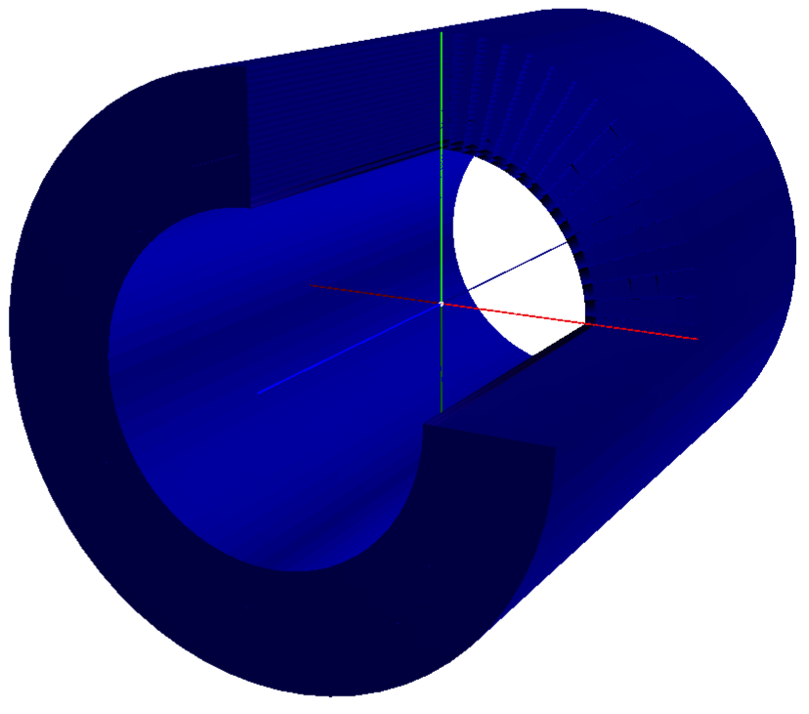
A tile scintillating sampling calorimeter for FCC-hh
Simulated a tile scintillating sampling calorimeter made with plates perpendicular
to the beam pipe (inspired in TileCal)
  Iron master plates Δz = 5 mm
  Iron spacer plates Δz = 4 mm
  Scintillating tiles Δz = 3 mm
  Air gap Δz = 0.5 mm
  Sampling period 18 mm
  Sampling ratio 4.6/1
Double azimuthal granularity (Δϕ) wrt ATLAS
  128 (-> 120) wedges in ϕ: Δϕ = 0.05
  Same size of tiles as in ATLAS
  due to larger distance from i.p.
Radial depth of 15 λ to fully contain multi-TeV particle showers (→10λ in global detector)
  30 layers in ρ: Δρ = 10 cm
Run simulation with cylindrical configuration
  Two alternating patterns along depth (ρ)
Tile ATLAS geometry
ϕ

Slide 6
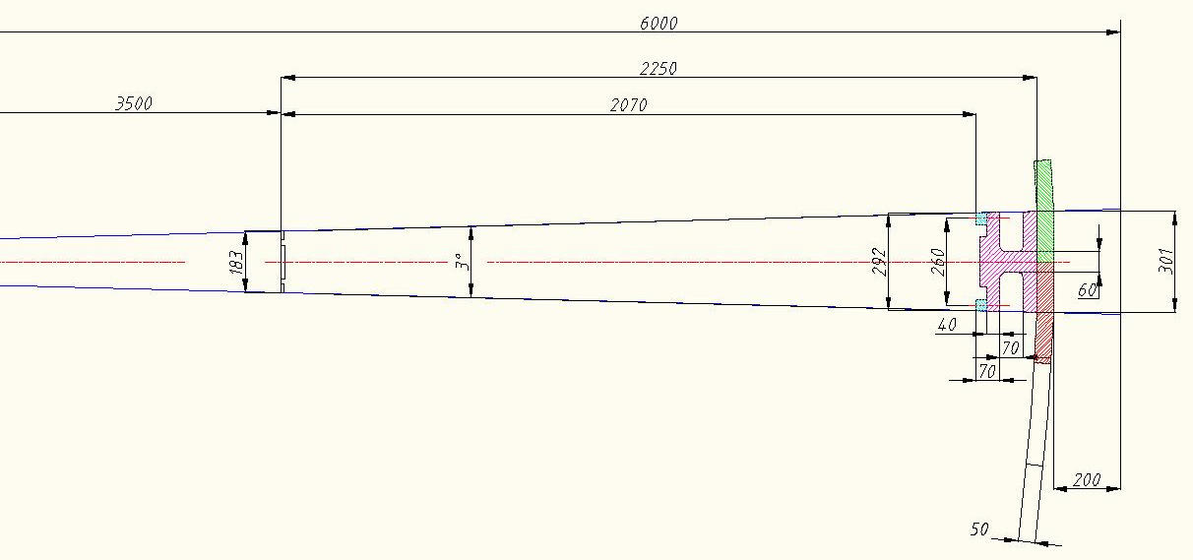
FCC Tile Had. Calo module Dimensions (version 120 modules in a cylinder)
girder
Xbar
φ
1 Module
Space for electronics
120 modules in φ => Δφ =0.05
Rmin=3.5m (OR 3.4m IF em calo+tracker <2λ). Need to keep 12λ in total…
Rout =5.8m (with supports and Xbars). Need 20cm for supports/rails at least…
Depth active cells = 207 cm = 10λ (;1λ=20.7cm ).
Depth Outer Supports=20cm (15cm girder+5cm Xbars)

