Slide 1
Muon System Performance
FCC Hadron Detector Meeting
Dec., 9th 2015
W. Riegler

Slide 2
Dates for Next Meetings
Next hadron detector meetings:
Jan. 21, 2016
Mar. 03, 2016
Apr. 06, 2016
FCC week Rome
Apr. 11-15 2016
https://indico.cern.ch/category/6069/

Slide 3
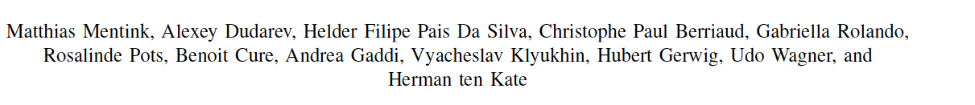
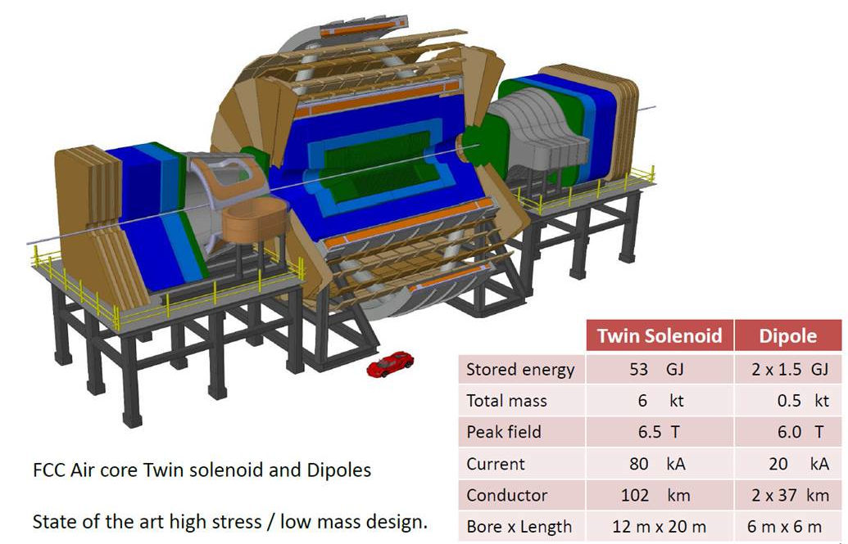
Twin Solenoid + Dipole Magnet System

Slide 4
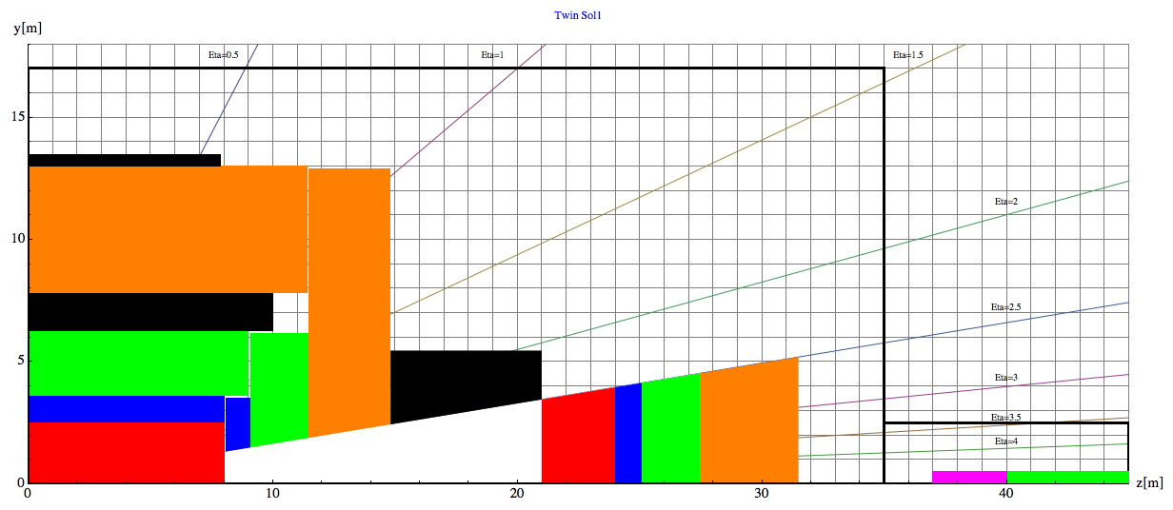
Baseline Geometry, Twin Solenoid
Barrel:
Tracker available space:
R=2.1cm to R=2.5m, L=8m
EMCAL available space:
R=2.5m to R= 3.6m → dR= 1.1m
HCAL available space:
R= 3.6m to R=6.0m → dR=2.4m
Coil+Cryostat:
R= 6m to R= 7.825 → dR = 1.575m, L=10.1m
Muon available space:
R= 7.825m to R= 13m → dR = 5.175m
Coil2:
R=13m to R=13.47m → dR=0.475m, L=7.6m
Endcap:
EMCAL available space:
z=8m to z= 9.1m → dz= 1.1m
HCAL available space:
z= 9.1m to z=11.5m → dz=2.4m
Muon available space:
z= 11.5m to z= 14.8m → dz = 3.3m
Forward:
Dipole:
z= 14.8m to z= 21m → dz=6.2m
FTracker available space:
z=21m to R=24m, L=3m
FEMCAL available space:
Z=24m to z= 25.1m → dz= 1.1m
FHCAL available space:
z= 25.1m to z=27.5m → dz=2.4m
FMuon available space:
z= 27.5m to z=31.5m → dz=4m

Slide 5
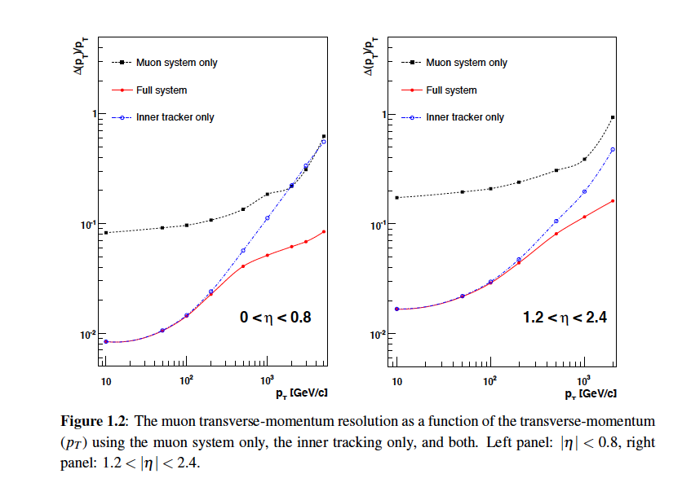
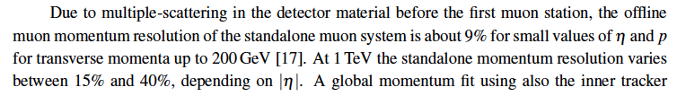
CMS Muon Performance
30%
20%
10%
5%
P_{T}=1TeV/c, 0<eta < 0.8: 20% muon standalone (angle)
10% inner tracker only
5% combined
P_{T}=1TeV/c, eta 0<eta<2.4: 40% muon standalone (angle) 20% inner tracker only
10% combined

Slide 6
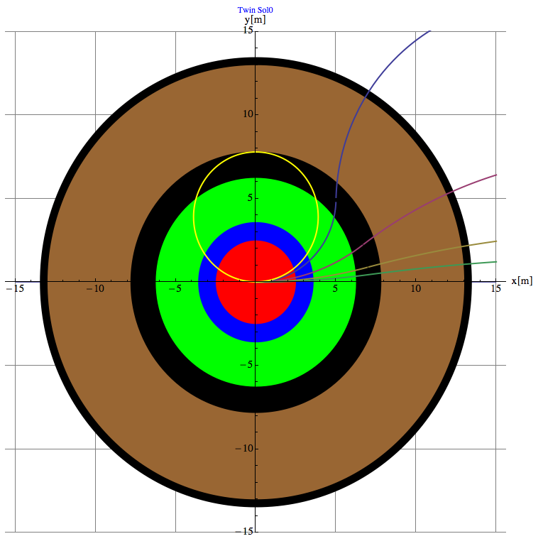
Muon Momentum can be measured by
1) The inner tracker
2) The track angle at the entrance of the muon system → Trigger
3) The combined fit of inner tracker and outer layers of the muon system.
4) A sagitta measurement in the muon system
R₀
R₁

Slide 7
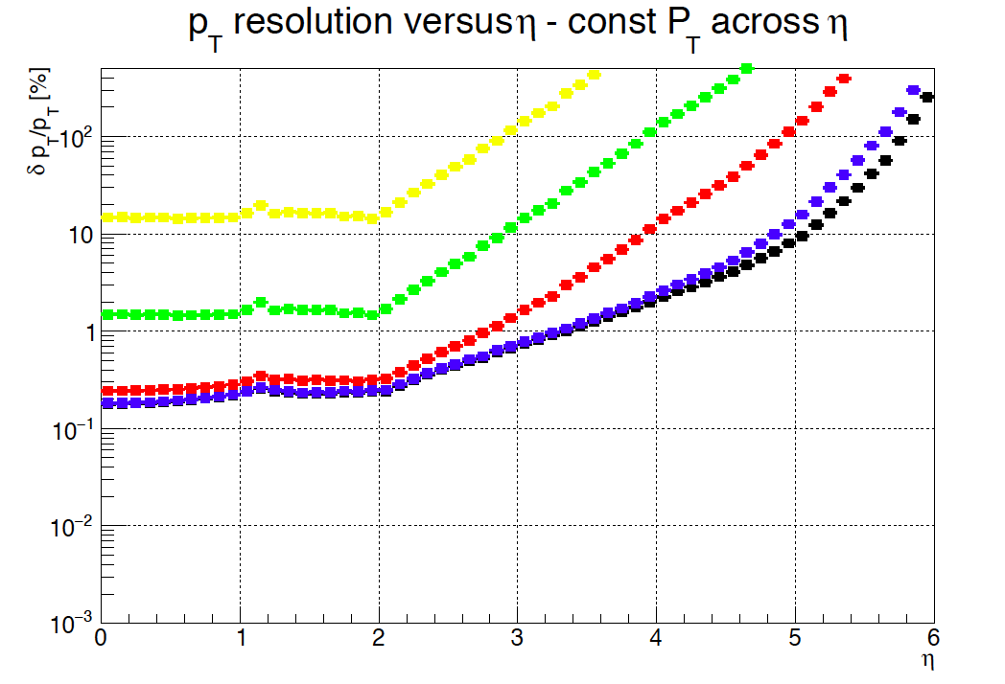
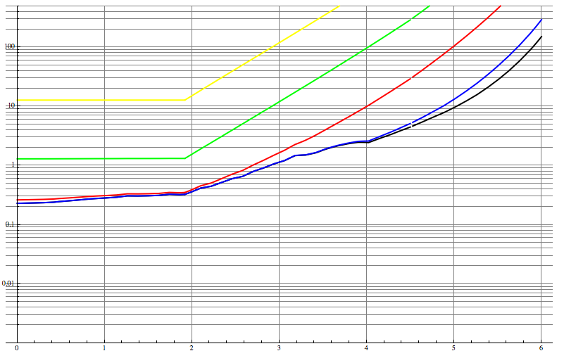
Tracker
Z. Drasal
The points are Zbynek’s results from the TKLayout Tool, the solid lines are the formulas from the previous slide.
10 000GeV, 1000GeV, 100GeV, 10GeV, 5GeV

Slide 8
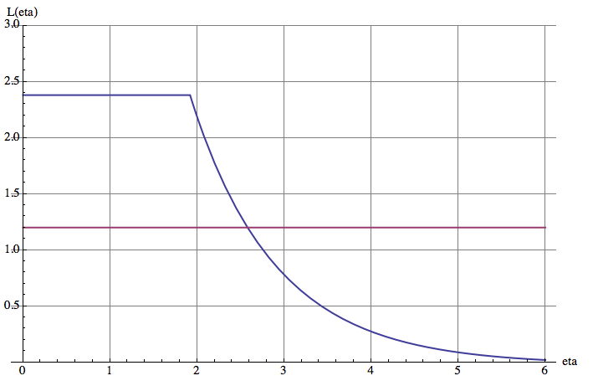
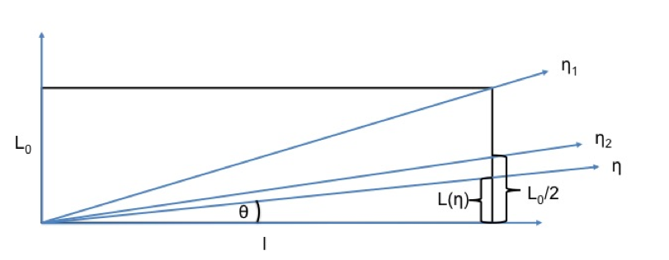
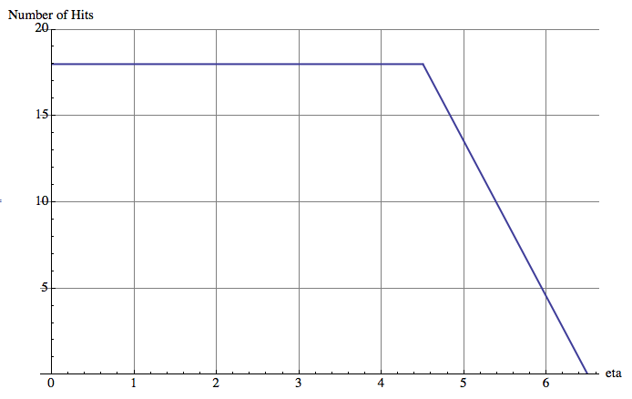



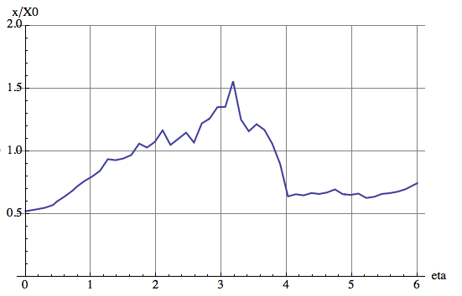

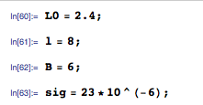
Tracker

Slide 9
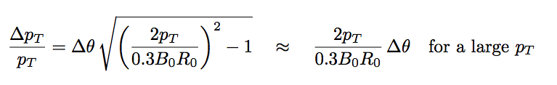

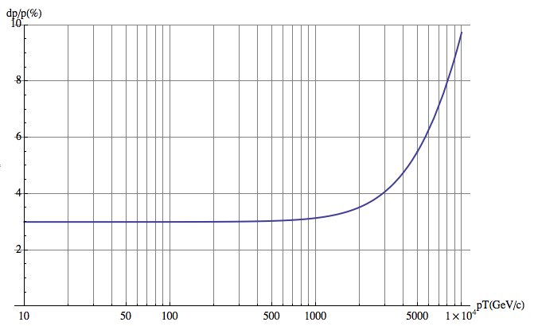
2) Muon measurement by track angle at the entrance of the muon system
θ
If we want 10% at 10TeV for B₀=6T, R₀=6m
We need Δθ=50μRad
2 stations at 1.5m distance with 50um position resolution
For low momentum, limit due to multiple scattering in the calorimeters and coil:
Calorimeter+Cryostat: 35X₀
HCAL: 110X₀
Coil: 5X₀
x_{tot}/X₀ ≈150
Δθ=0.0136/p_{T}*Sqrt(x_{tot}/X₀)
10TeV/c Muon
B₀=6T, R₀=6m → dp_{T}/p_{T} ≈ 3%
This is approximate for an infinitely thin coil and for η=0.

Slide 10

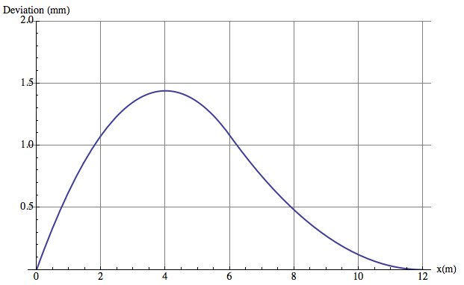
3) Muon Measurement by combined measurement of inner tracker and muon system
If the full flux is returned trough the muon system, the muon trajectory at the exit of the system points exactly to the IP !
The maximum excursion y_{t}(x₀) is always at the same radial distance of x₀
For values below: x₀=4m, y_{t}(x0)=1.44mm
Ideal measurement point is at the peak, but y_{t}(2.4m)= 1.24mm still good !
B₀=6T, R₀=6m, R₁=12m, p_{T}=10000GeV
σ₁
σ²=σ₁²+(x/R₁σ₂)²
x=2.4m,R₁=12m, σ₁=50μm, σ₁=250μm,
σ=64μm, dp_{T}/p_{T}=5% at 10TeV !
Measuring just in the last tracker layer and in the outermost muon station already beats the full inner tracker performance (14 layers, 23um).
σ₂

Slide 11
4) Muon measurement by sagitta measurement in the muon system
The return field is 2.45T
Measuring over the 5m lever arm with stations of sig=50um resolution we have
dp_{T}/p_{T}= sig*p_{T}/(0.3*B*L²)*8
= 20% @ 10TeV
with possibly excellent performance at low p_{T} due to the absence of iron (vs. CMS) .
but very hard to beat the angular measurement at high p_{T} and the inner tracker at low p_{T}.
Surface > 5000 m²
→ Seems not competitive

Slide 12
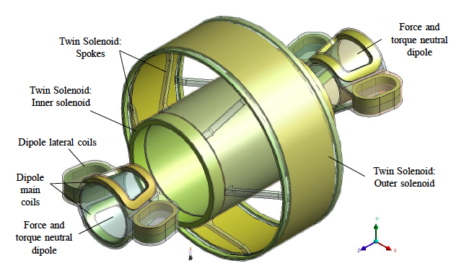
Muon performance versus η using the twin solenoid fieldmap and the
baseline detector layout described in the previous meetings.

Slide 13
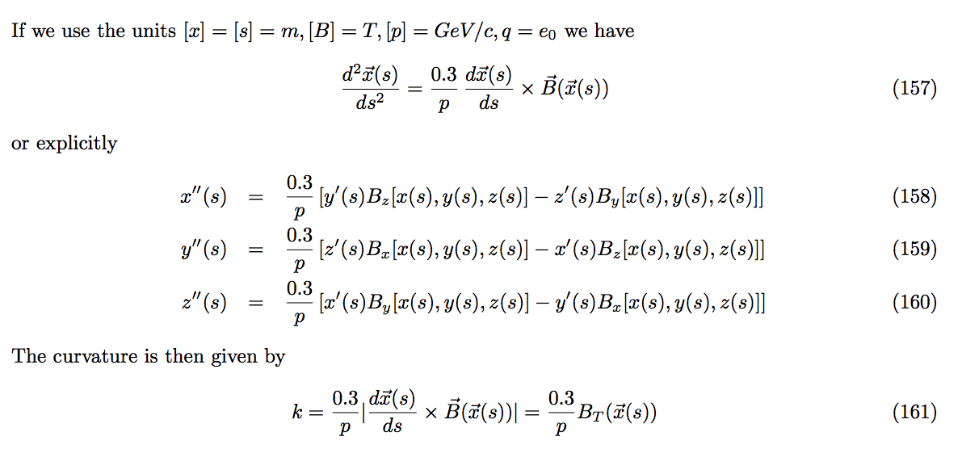
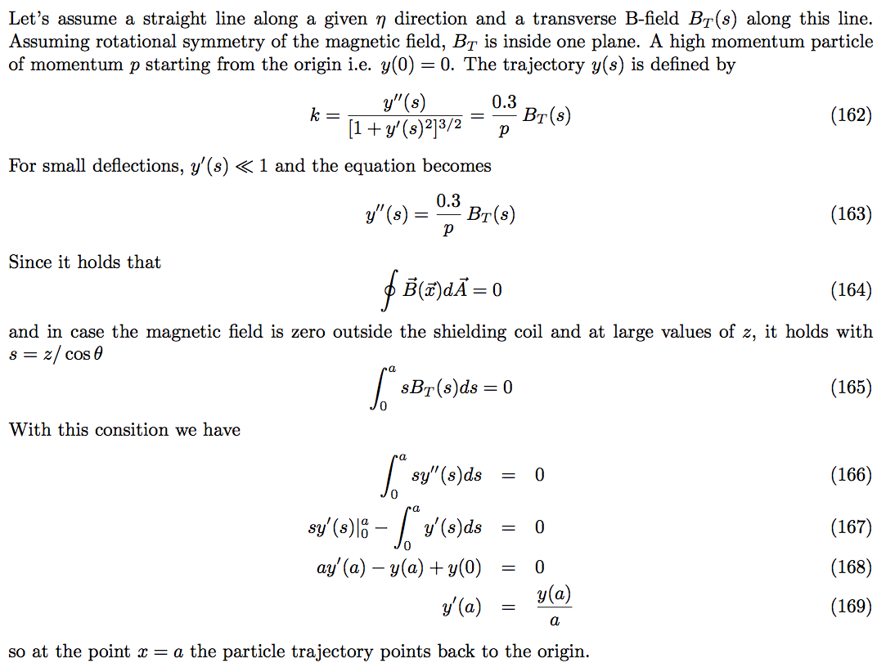
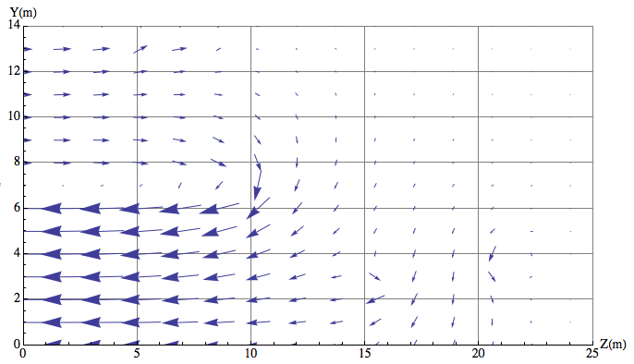
Muon Trajectories in B-fields
a
B_{T}
s

Slide 14
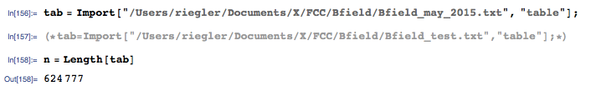
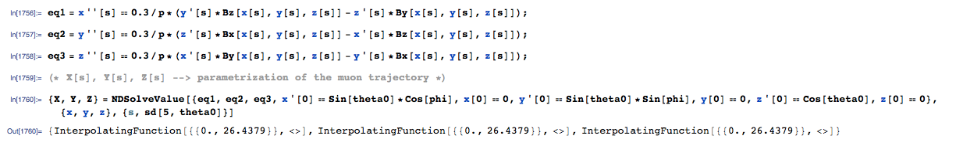
Flux Return and Muon Trajectories

Slide 15
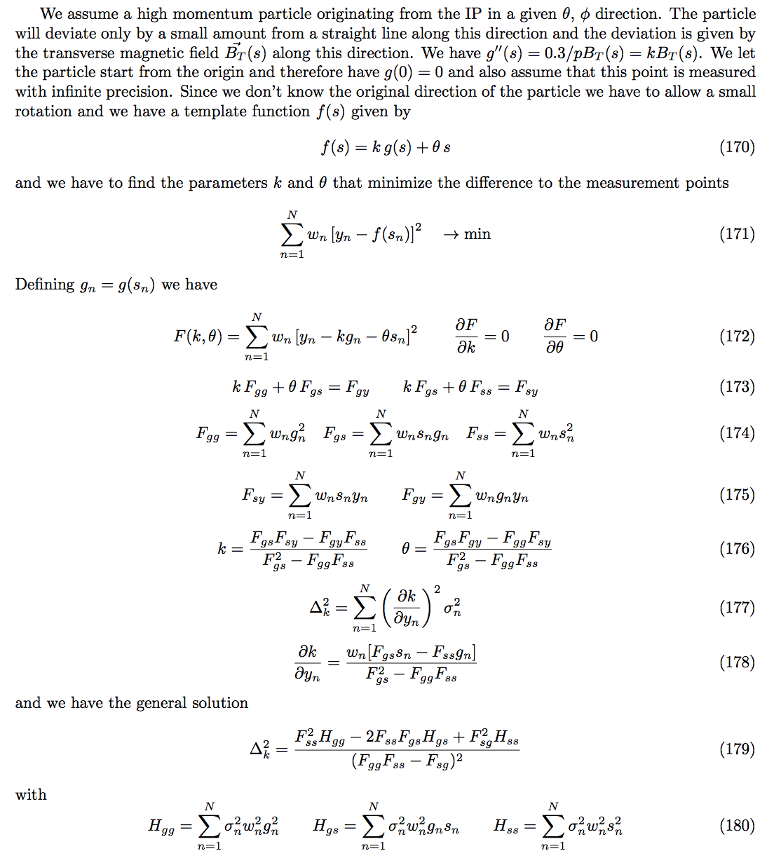
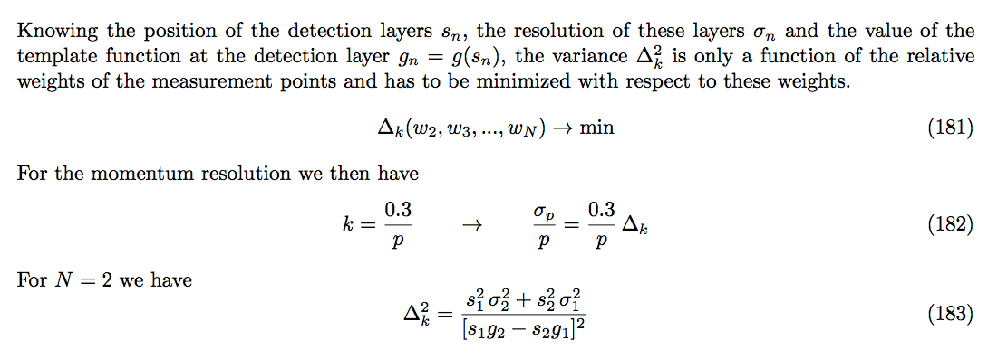
Analytic, back of the envelope, pseudo-precise determination of the muon momentum resolution using the tracker+muon system measurement.
Template function g(s) is calculated with MATHEMATICA based on the correct field map.
14 equally spaced layers of central tracker are assumed with a resolution of 23um per layer.
The layers in the muon system are then added with their respective resolution.
A global minimization of Δ_{k} for the weights w_{n} is performed.
Before assuming specific resolution number for the muon system, a key question is: How is the position measurement in the muon system affected by the multiple scattering the in calorimeters ?

Slide 16
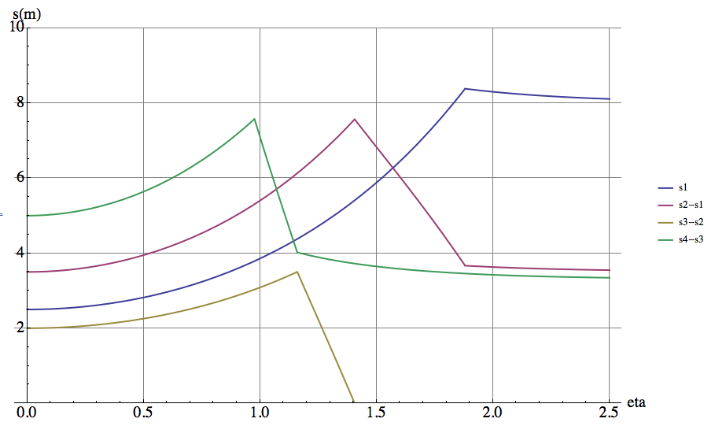
Thickness of different subsystems seen by a high energy muon
s₄
s₃
s₂
s₁

Slide 17
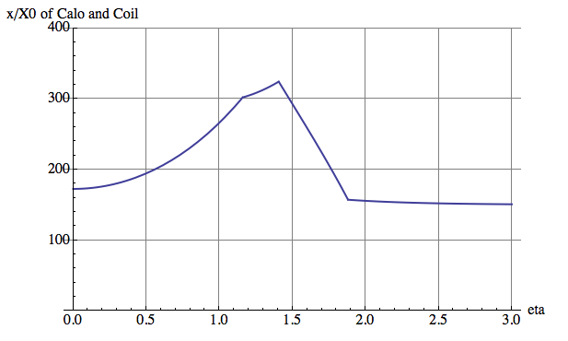
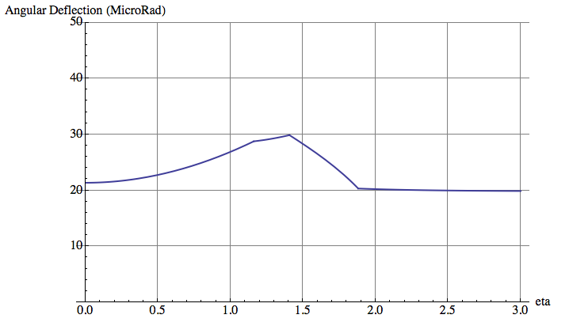
Radiation length and angular deflection of muons in calo+coil
s₄
s₃
s₂
s₁
10 TeV/s

Slide 18
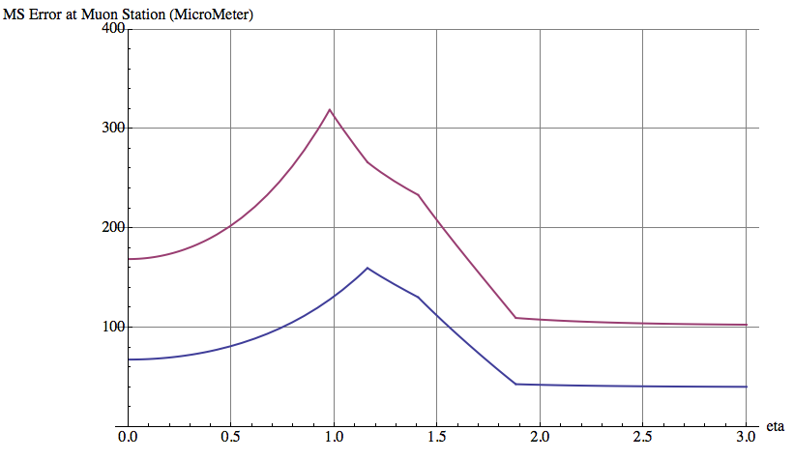
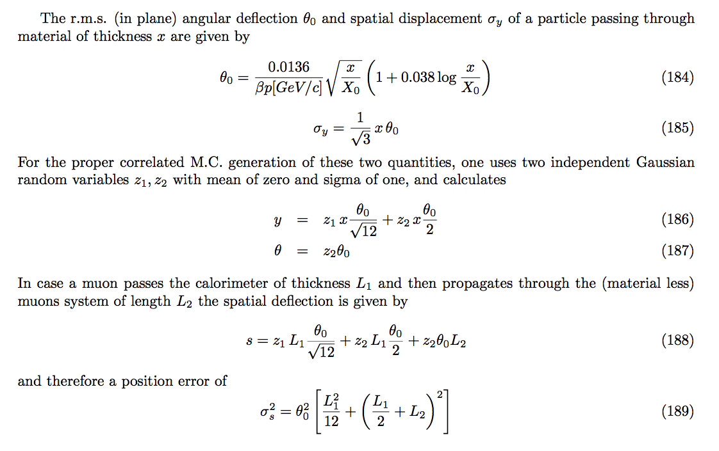
Measurement error in the muon system due to multiple scatering
10 TeV/c

Slide 19
Radiation length and angular deflection of muons in calo+coil
10 TeV/s
s₄
*
*
s₃
s₂
*
s₁
*
*
*
Fit of the template function to 14 measurement points of 23um in the inner tracker and 1 layer in the muon system with a resolution that is much better than the multiple scattering limit.
i.e. assuming the resolution at s4 to be better than 100um and at s3 to be better than 50um and the resolution of the angular measurement better than 20uRad.

Slide 20
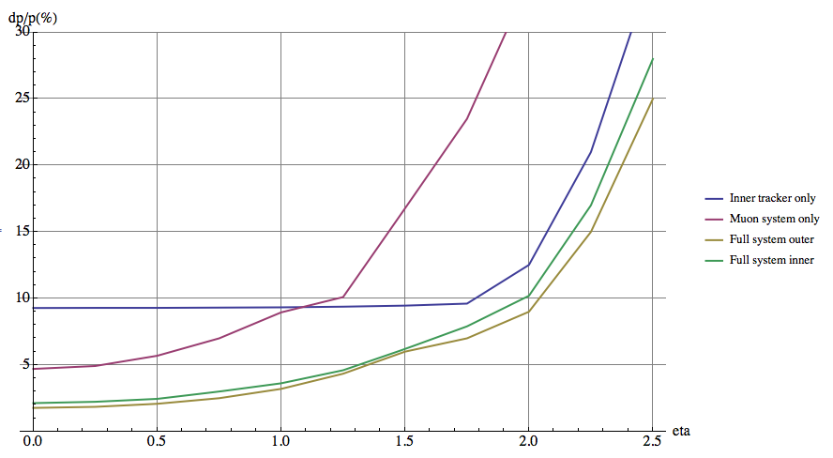
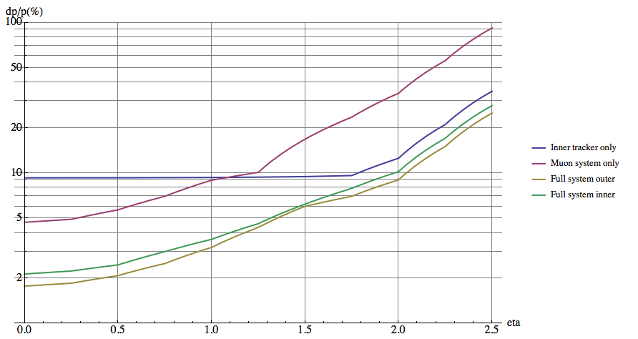
Momentum resolution for a 10 TeV/s muon vs. eta
Twin Solenoid assuminginner tracker with baseline resolution curves and multiple scattering limit in the muons system.
P_{T}=10TeV/c eta = 0: 5% muon standalone (angle)
10% inner tracker only
2% combined
P_{T}=10TeV/c eta=2.: 35% muon standalone (angle) 12.5% inner tracker only
8% combined
Compare to the CMS numbers:
P_{T}=1TeV/c, 0<eta < 0.8: 20% muon standalone (angle)
10% inner tracker only
5% combined
P_{T}=1TeV/c, eta 0<eta<2.4: 40% muon standalone (angle) 20% inner tracker only
10% combined

Slide 21
Summary
First shot at the global muon performance.
What CMS does for 1TeV/c Muons seems feasible for 10TeV/c at FCC.
For now, the ‘global fit’ assumed just one measurement point in the muon system in addition to the 14 points of the inner tracker.
We have to do proper evaluation of the radiation length of the Calo using FLUKA/GEANT.
We have to understand whether the scattering of high energy muons is really approximated well by the given formulas (see todays presentation on Muon scattering in GEANT).
We have to include energy loss.
Another attempt to include all this in the semi-analytical calculation will be done.
A proper track fit in a proper MC simulation will be needed soon to have a solid result.

Slide 22
η₄
s₄
r₄=13
η₃
s₃
η₂
r₃=8
s₂
s₄
r₂=6
s₂=s₃
η₁
s₁
s₁
r₁=2.5
0
z₁=8
z₂=z₃=11.5
z₄=14.8

