Slide 1
Far Detector Overburden
Peter Wilson
15 October 2015

Slide 2
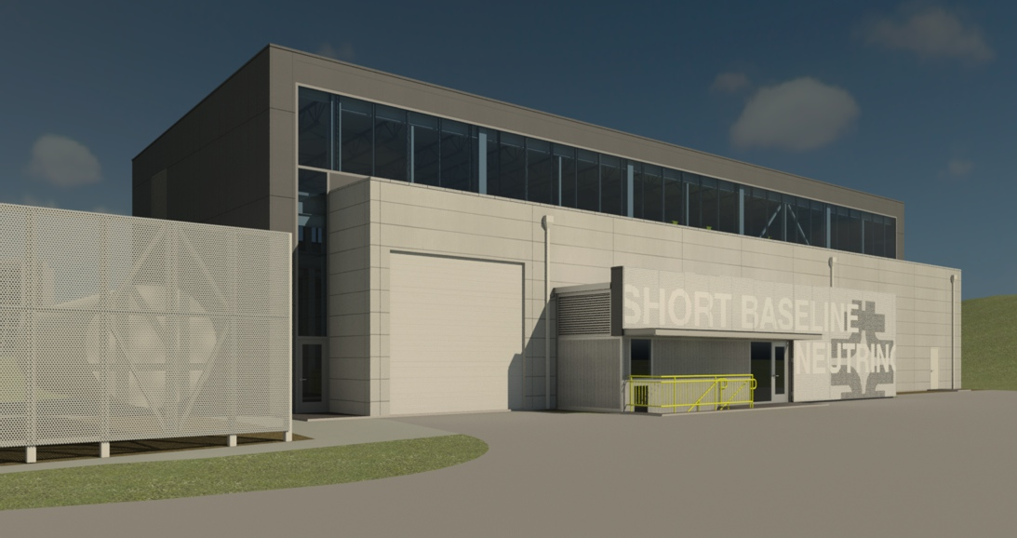
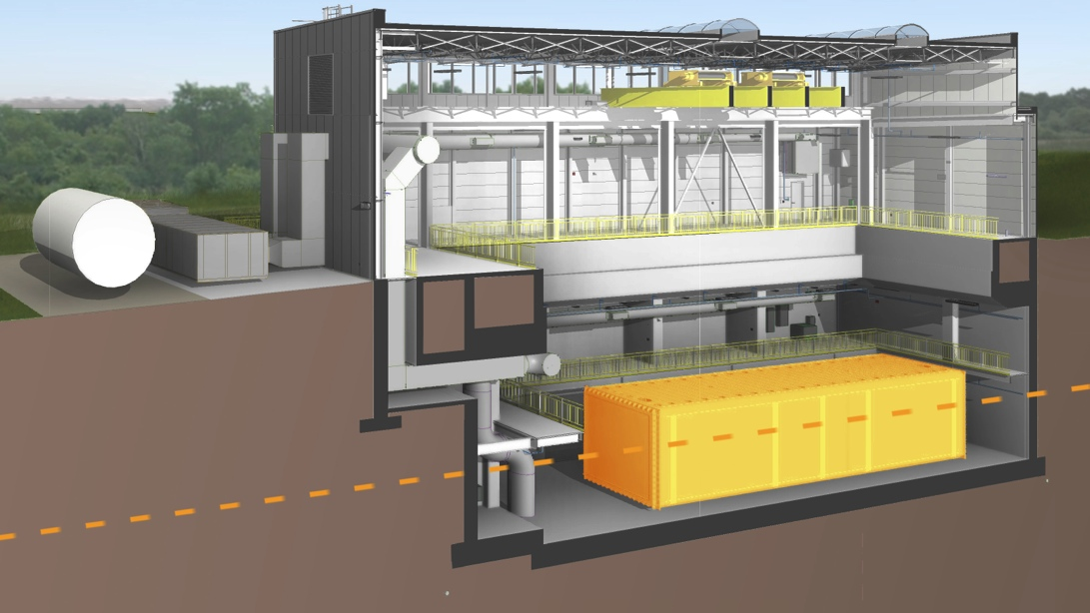
Far Detector Building
Close cooperation between ICARUS, CERN and Fermilab on design requirements and review.
Designed for 3m concrete overburden over detector to mitigate cosmogenic backgrounds for near surface operation
Milestones:
  Aug 2015 – Start preliminary design
  March 2015 - Design complete
  April 2015 - Construction contract bidding
  July 2015 – Construction Start
  Sept 2015 – Excavation complete
  Jan 2016 – Concrete complete
  June 2016 – Building envelope complete
  Oct 2016 - Substantial completion
T600
ν

Slide 3
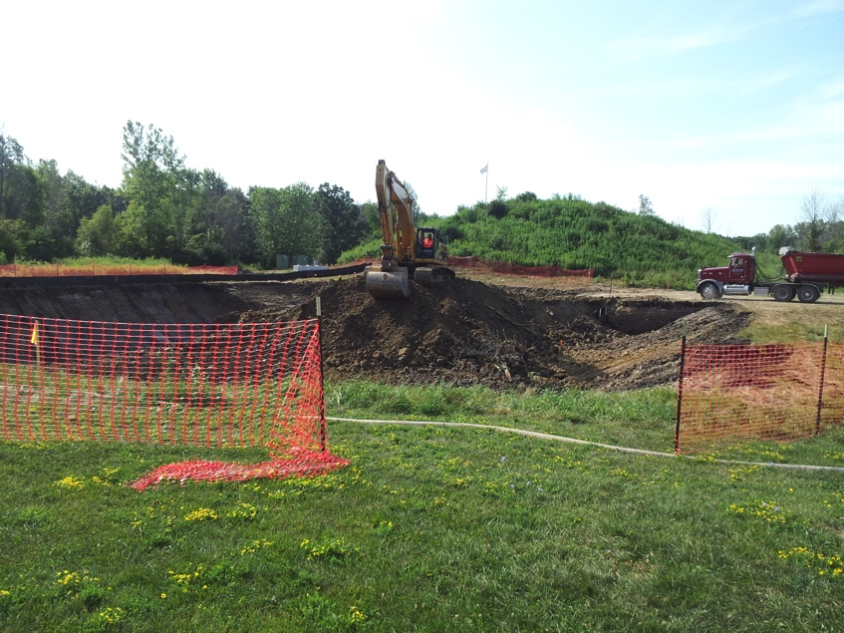
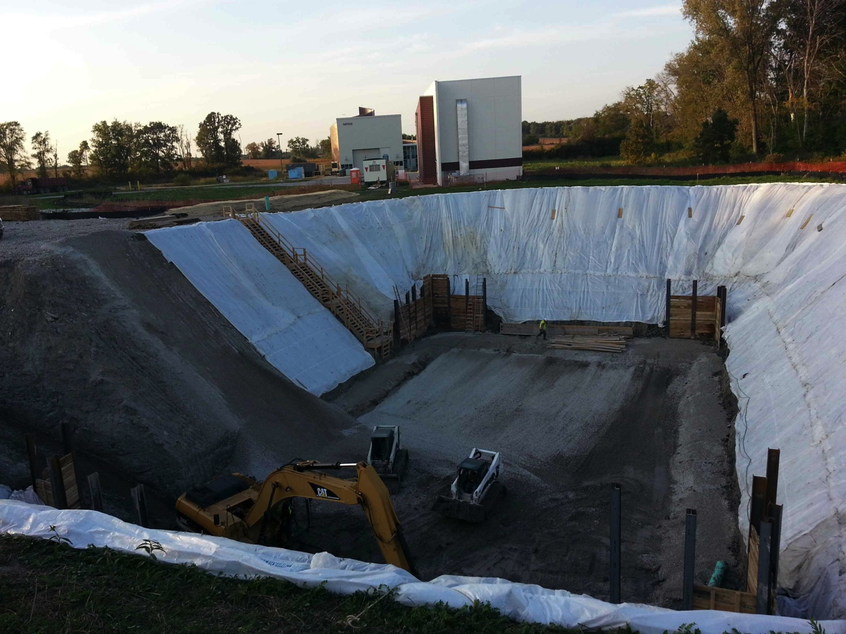
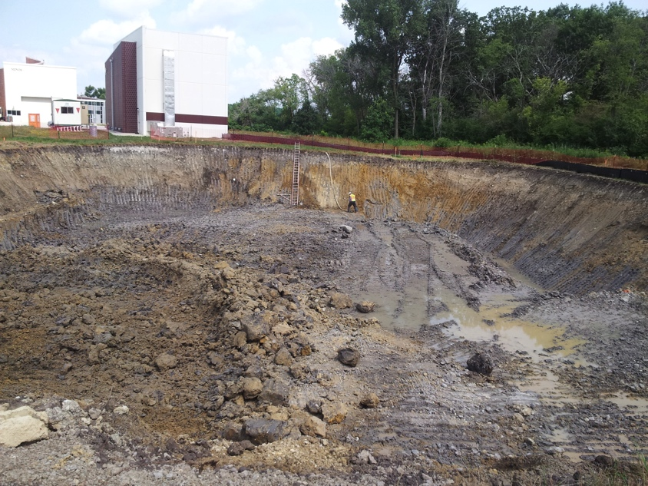
Far Detector Building Progress
Aug 13 looking south
Oct 7 looking north
Aug 17 looking north

Slide 4
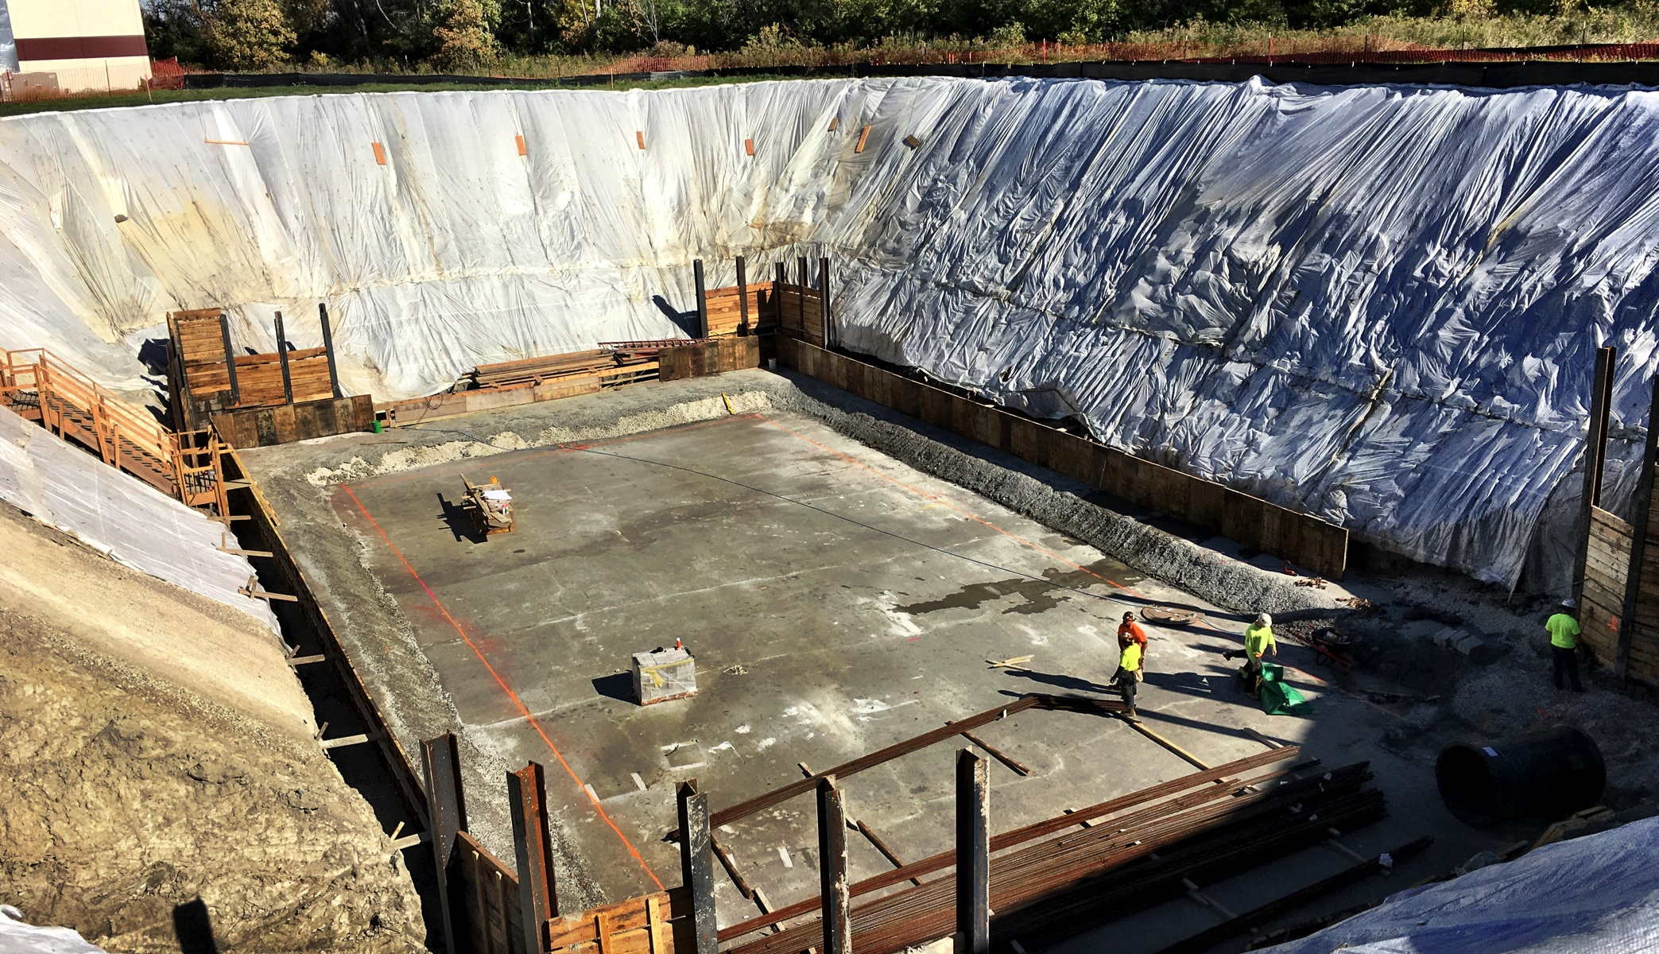
Building Progress – Oct 14

Slide 5
Overburden
Need to cover area 12.2m x 27.4m (334m²)
  3m overburden = 1000m³
Ledge in structure hold concrete blocks 12.2m long
First layer new blocks 12.2m long x 1m high x 0.5m wide
Additional overburden options
  Additional new blocks of same size
  Existing blocks recovered from onsite (inventory in progress)
  Loose material held by a perimeter wall of blocks
Preliminary cost estimate for concrete based on purchase in 2012
  $1500/m³ for precast concrete blocks
  $740k for first meter
  $600k for each additional m

