Slide 1
Status of ICARUS
C. Montanari – CERN / INFN-PV

Slide 2
Activities in progress
  The following main activities are being developed to setup the ICARUS detector for the SBN run at Fermilab:
    New PMTs system deployment;
    Cathode substitution/”planarization”;
    Detector re-cabling;
    New cold vessels construction;
    New thermal insulation;
    Maintenance and partial replacement of cryogenics and purification systems;
    Construction of the Cosmic Rays Tagger.

Slide 3
New PMTs system deployment
    The mechanical design of the new scintillation light collection system has been completed for the chosen configuration; the first prototypes have been built. The full production is in progress. Delivery is expected around half of November.
    The PMTs are being produced by Hamamatsu, that accepted all our technical specifications with slight modifications, including the cold test at the production location. The 20 pre-series samples arrived at CERN at the end of September. One unit was tested in LAr, the other units are being tested at room temperature.
    Design of the new bases has been completed. Prototypes have been realized and tested. Components for the full production have been delivered. The full production has been ordered and a pre-series has been delivered.
    The setup for testing and pre-assembling of the PMTs is functional: two locations, B182 for cold tests and Ideasquare for warm tests and pre-assembly.
    The TPB evaporator is installed in B169, first evaporations are being done.

Slide 4
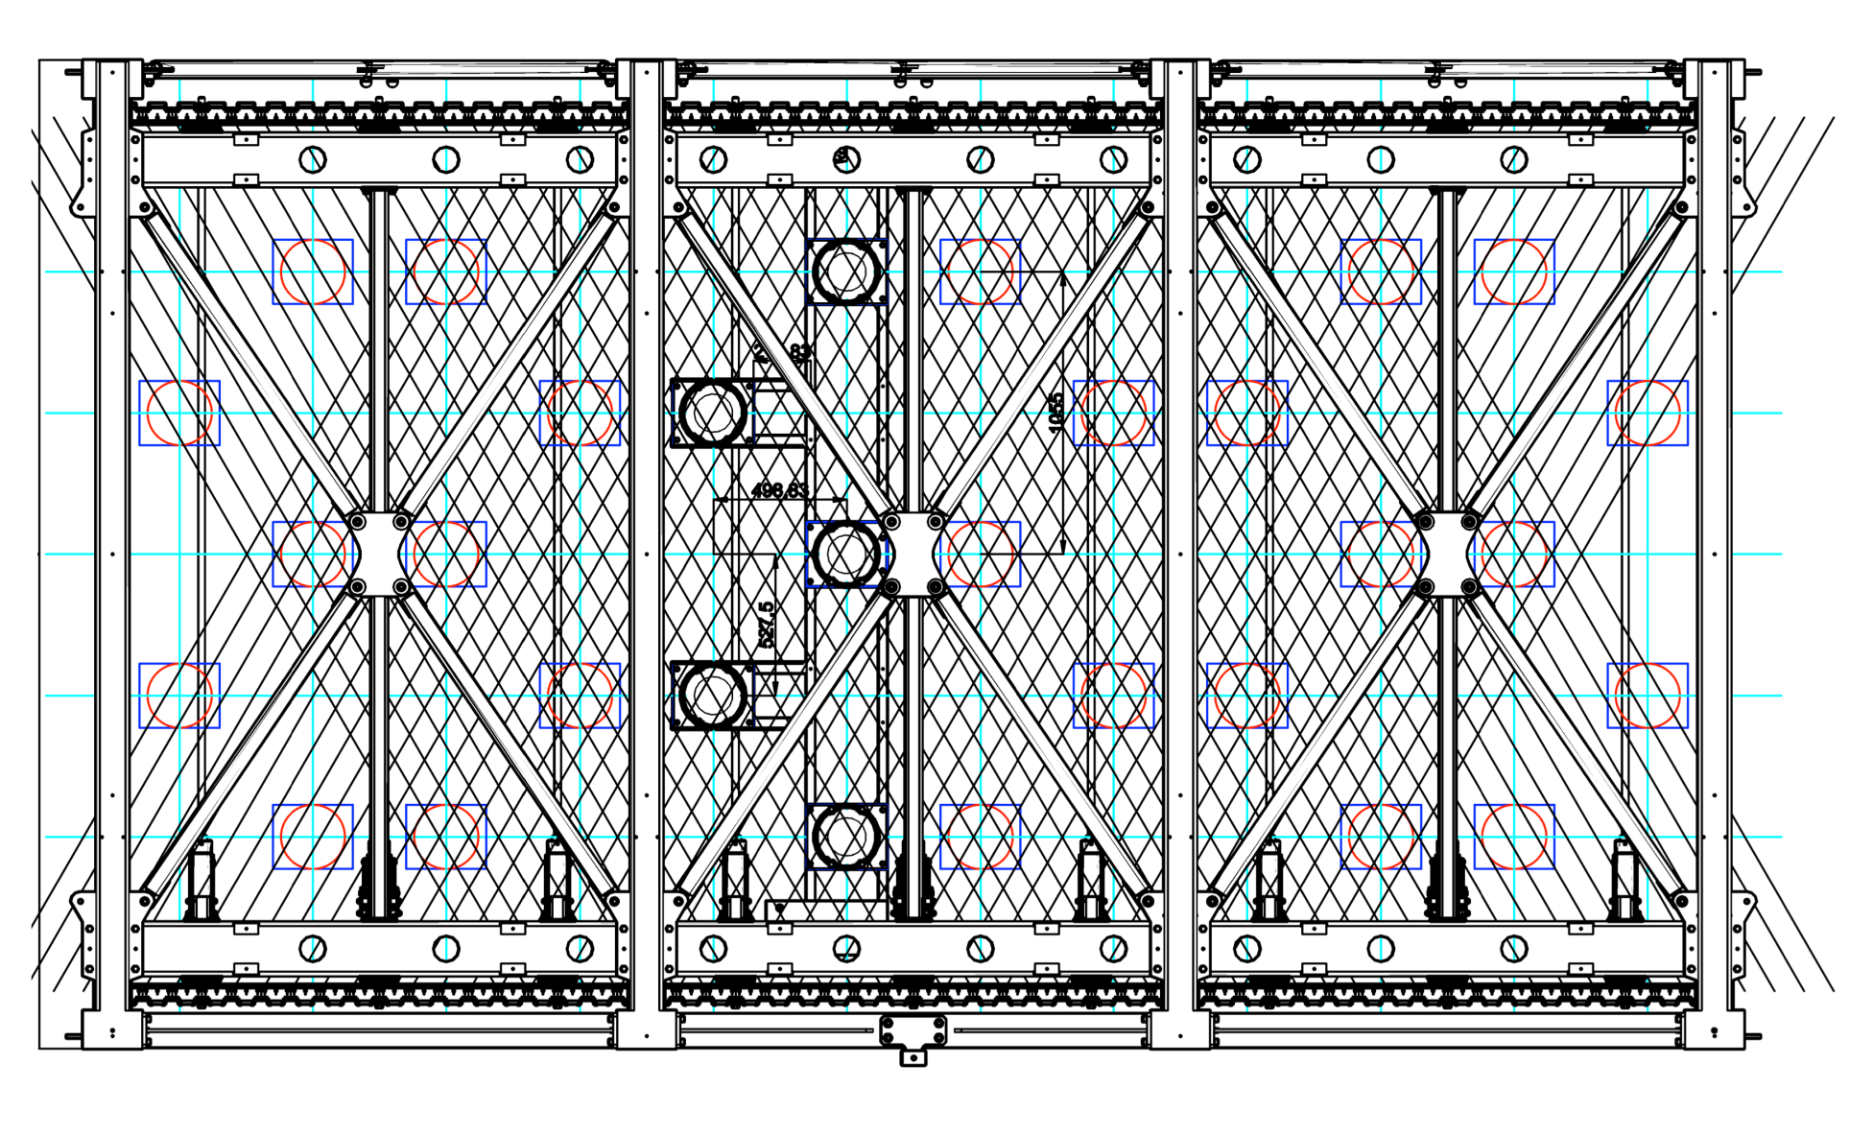
New PMTs system deployment and mechanics

Slide 5
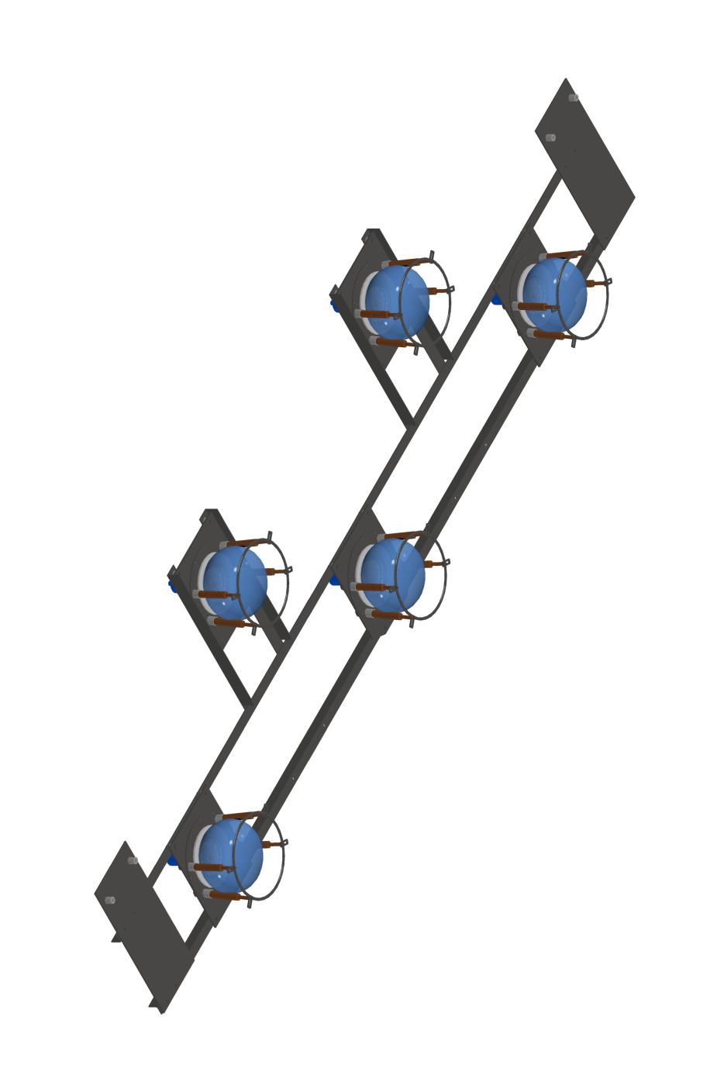
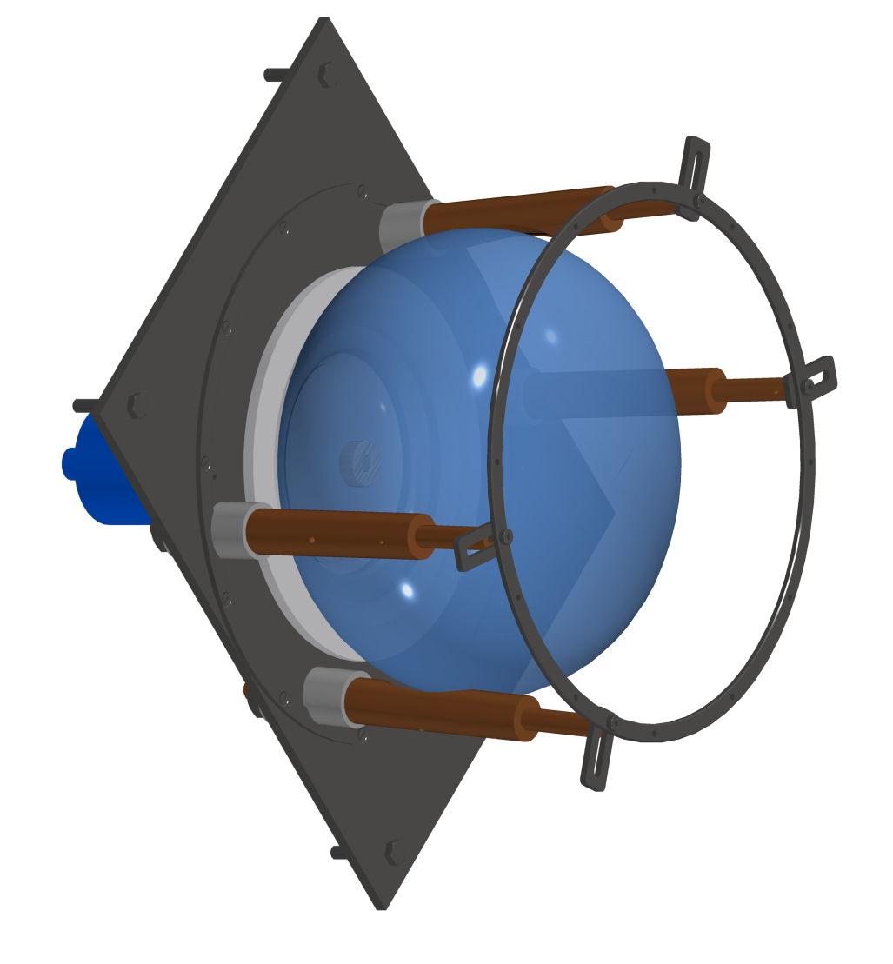
PMTs mechanics
Basic Unit
(36 / T300 module)
Shielding grid

Slide 6
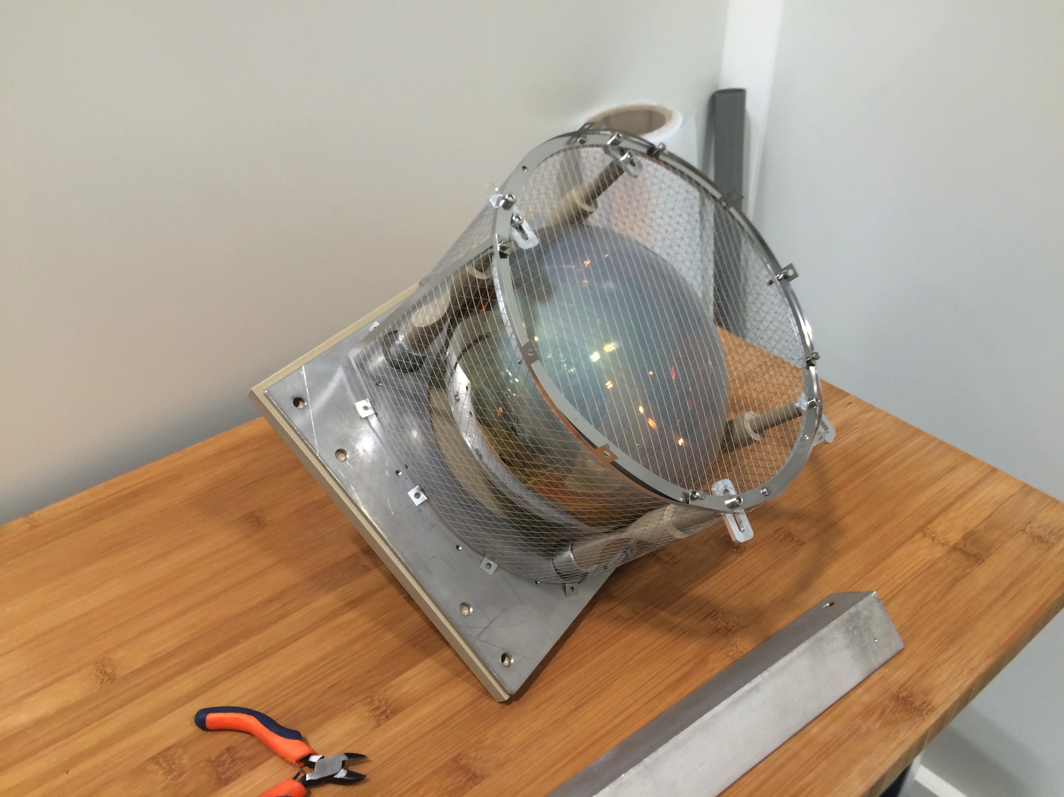
PMTs mechanics
Shielding grid

Slide 7
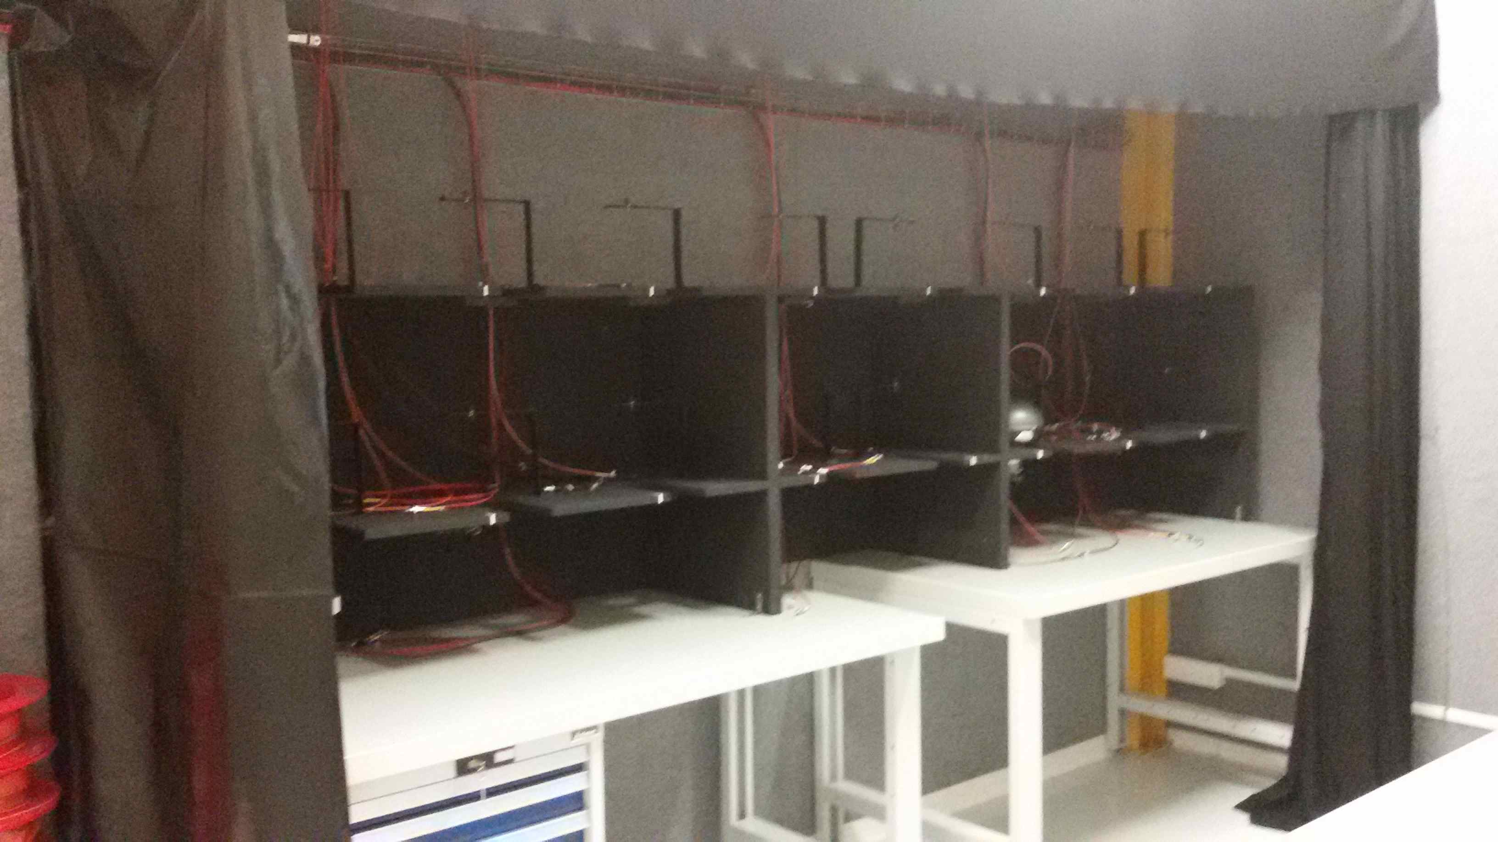
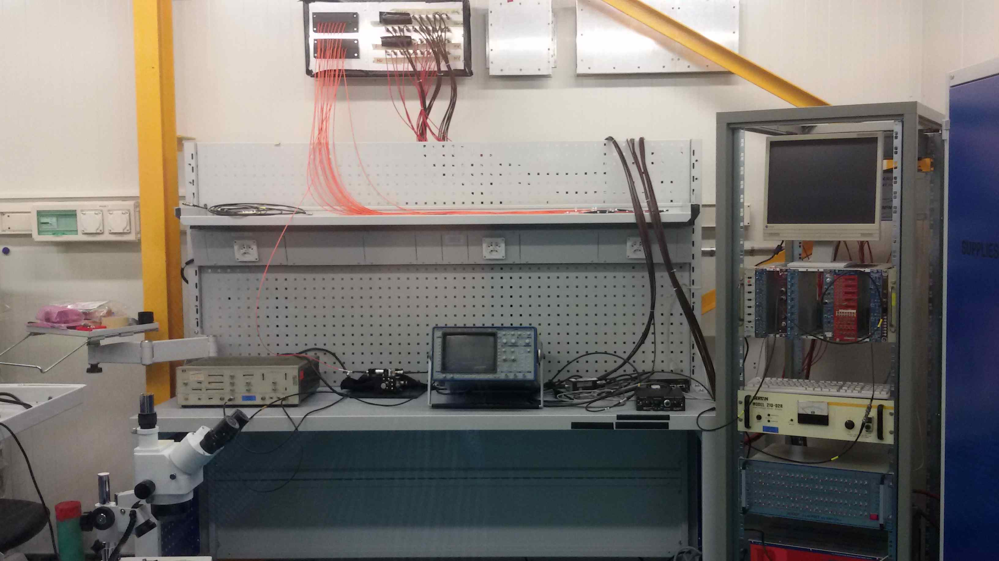
Preparation of the dark room for PMT testing (I)
Test Area
Dark room
Dark room
Control Area
Electronics Lab
Electronics Lab
Ideasquare Lab

Slide 8
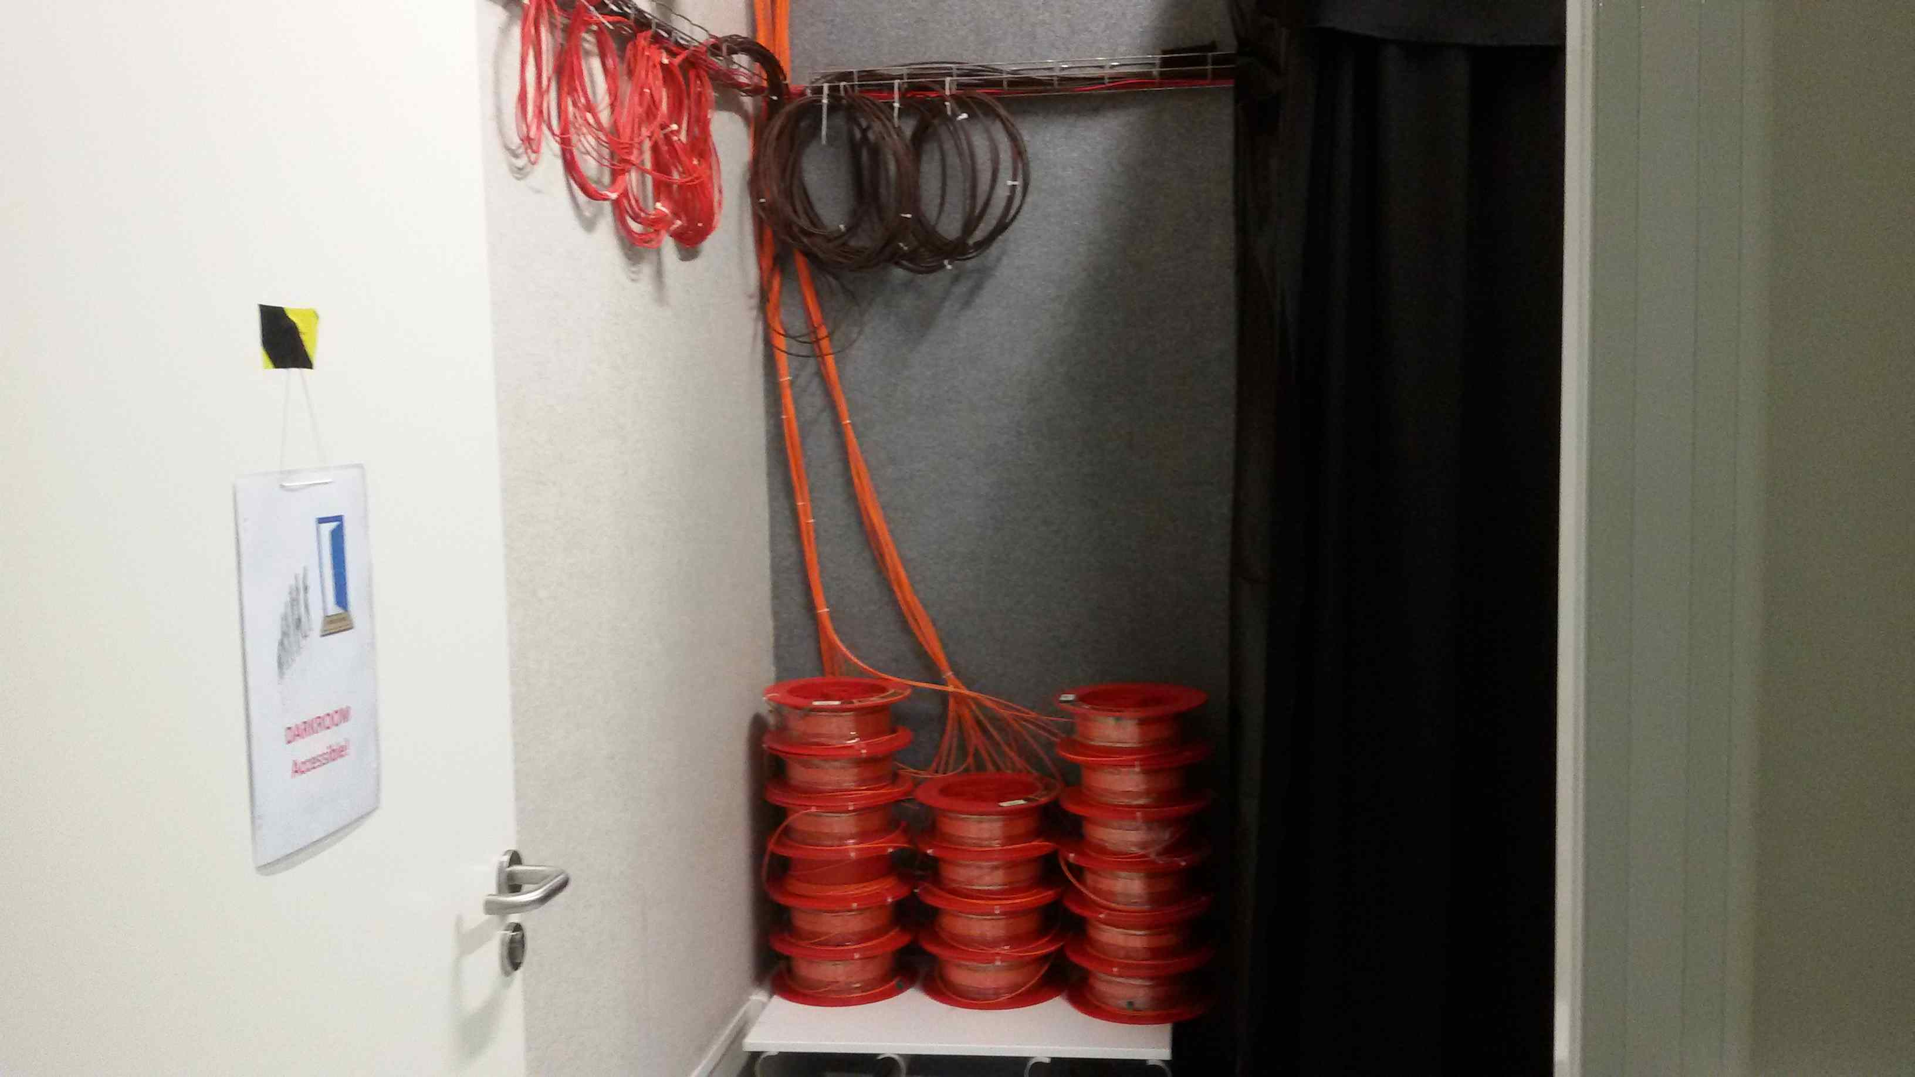
Preparation of the dark room for PMT testing (II)
Equipped for simultaneous testing of 16 PMTs
items | status
Furniture | Installed
Cabling | Installed
Feedthroughs electronics lab to dark room | Installed
Access and environmental monitoring | Being implemented

Slide 9
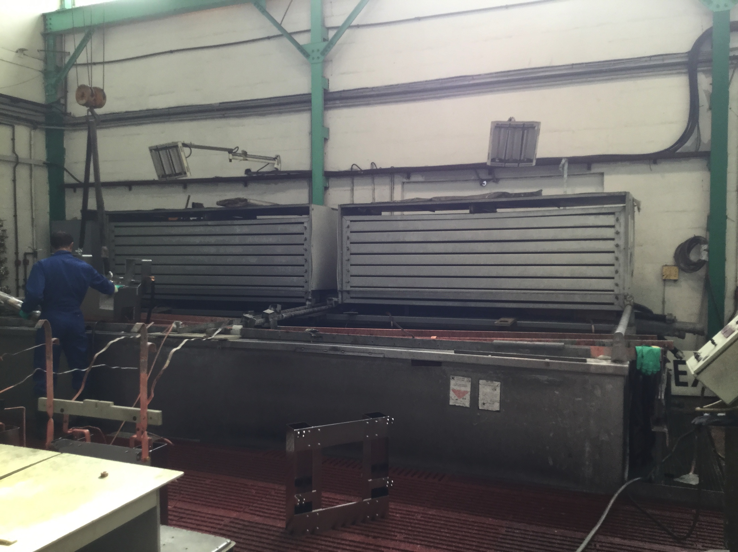
Cathode substitution/”planarization”
    The intervention on the cathode panels of the first T300 module by personnel of the CERN Main Workshop was successful: the residual non-planarity is within few mm.
    The “flattening” operation was completed at the end of September. The panels were taken to an external company for cleaning and electro-polishing. Re-installation in the TPC is scheduled by end of October.
Electro-polishing bath

Slide 10
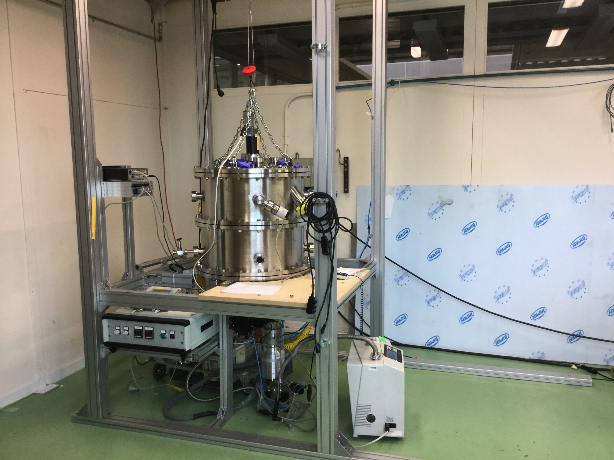
TPB Evaporation – B169
The evaporator is installed in B169.
First evaporations have started.
Production will start at the end of October with the pre-series units.

Slide 11
    Detector re-cabling
    The design of the decoupling boards is complete and the components selection for the biasing chain is also complete.
    Prototypes have been installed in the TPC to check for mechanical interferences and to fix the details of the mechanical supports.
    Pre-series have been delivered; a second batch is being produced.
    New cables have been selected and tested in LAr. Order for the cables procurement and assembly is done.
V1
V2
V3

Slide 12
New readout electronics
The new readout electronics for the wire chambers, all warm, is being tested at our Legnaro Lab with a LAr TPC prototype (ICARINO).
The procurement of the new electronics has been granted by INFN. An addendum to the INFN – CERN MoU is being prepared on this subject.
For fiscal year 2016 CSN2 has granted 530k€. The total cost is foreseen in the order of 1930k€.
See S. Centro presentation for details.
The readout electronics for the PMTs is not yet fully defined, although it is budgeted within the existing CERN – INFN MoU.

Slide 13
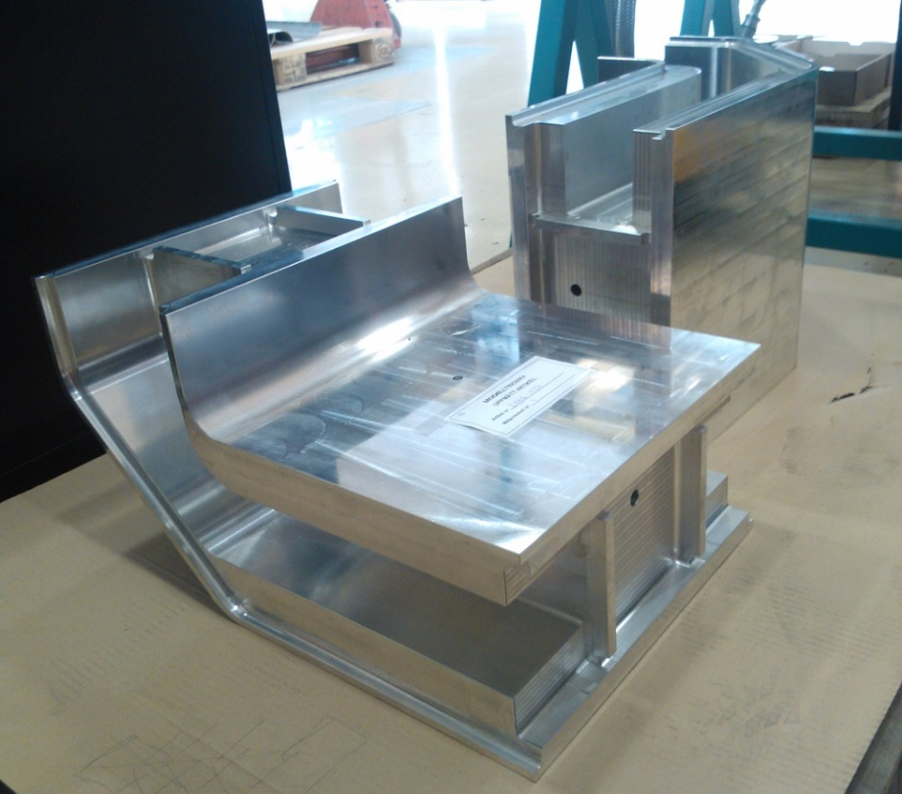
    New cold vessels construction
  First extrusions produced and delivered to CERN for first tests on welding.
  Order for the panels pre-assemblies was sent out to the company, first delivery before end of 2015.
  Order for end-caps being processed.
  The final assembly strategy has been defined; the required tools are being procured.
  CERN Main Workshop is proceeding with the
  assembly of the stiffening frames and with
  the definition of the welding procedures.
  The first two angular profiles of
  the stiffening frames have been delivered
  to CERN, as well as 10 “I” profiles. Samples of the profiles are in the Main
  Workshop.
  Welding procedures have been defined
  according to maximum quality (level B of
  Eurocodes)

Slide 14
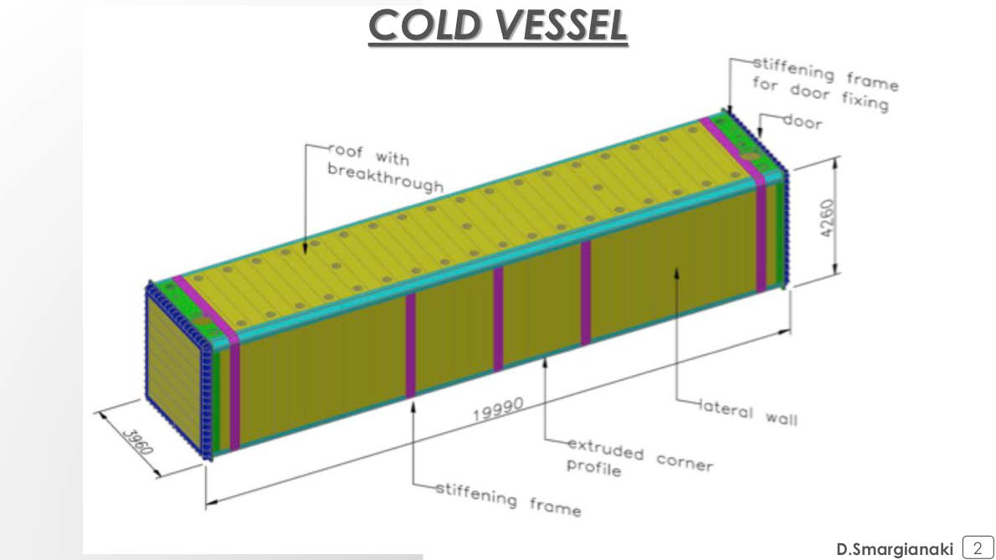
New cold vessels

Slide 15
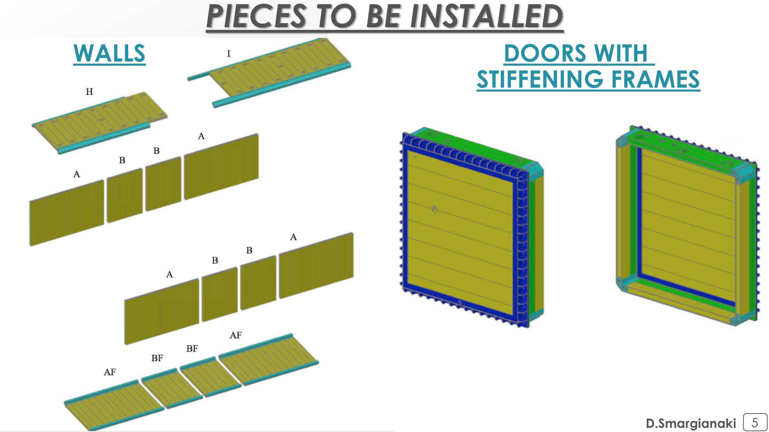
New cold vessels construction – Materials I

Slide 16
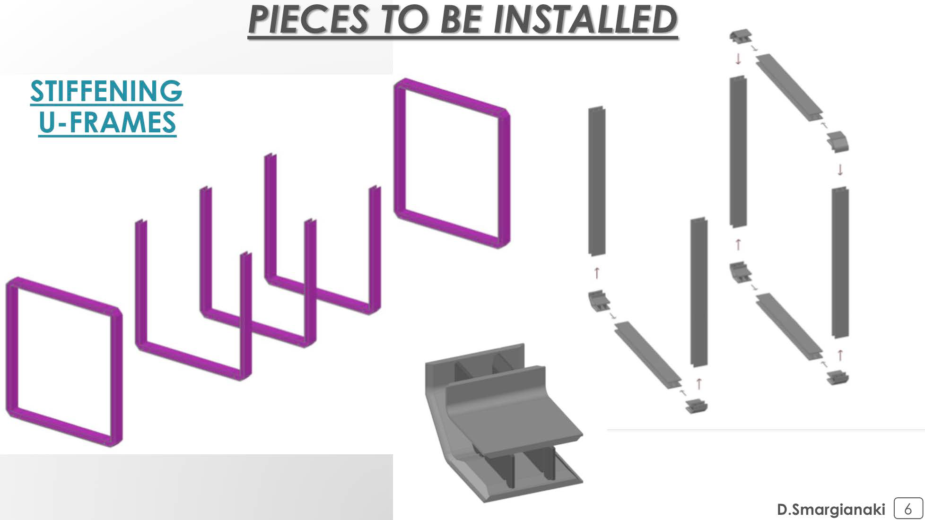
New cold vessels construction – Materials II

Slide 17
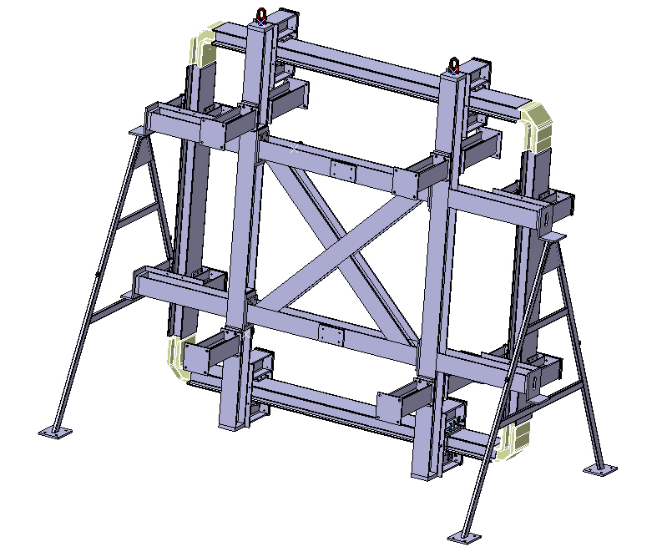
U-frames
Assembly tooling
Design of a specific tooling
  To ensure an appropriate positioning and clamping of the parts in order to achieve the thigh tolerances required
  To allow the welding in flat position which is mandatory to achieve the quality level required
Delivery date foreseen: end October

Slide 18
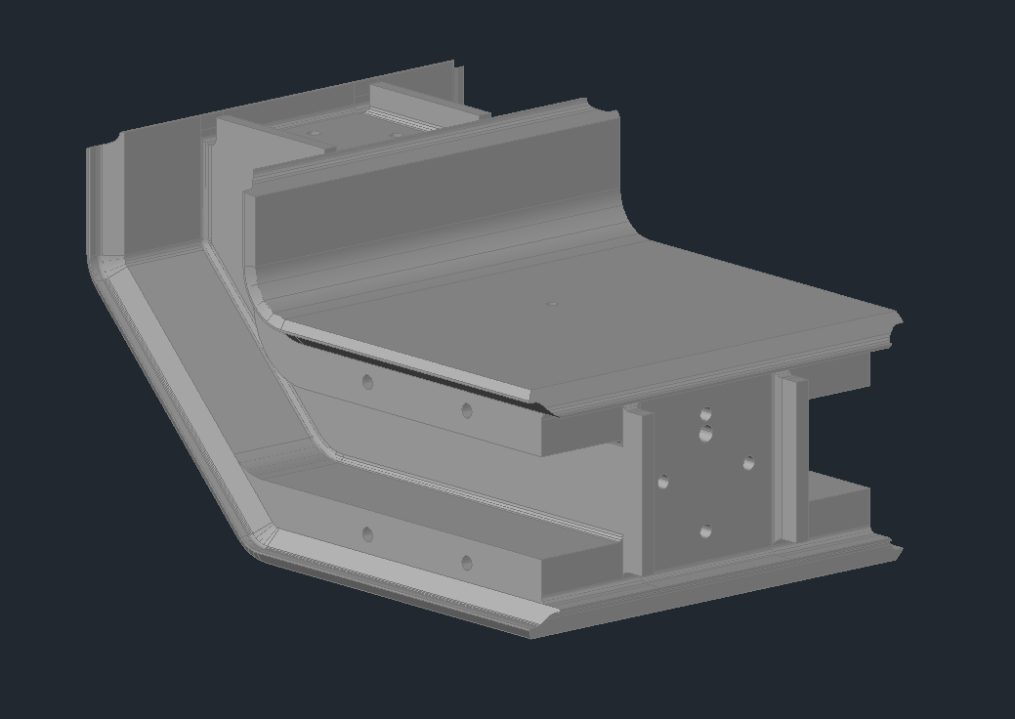
U-frames
Corner design
Design of the chamfers
  A: 20 mm
  B: 10 mm
  C: 8 mm
A
B
C

Slide 19
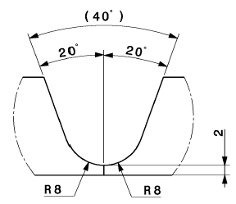
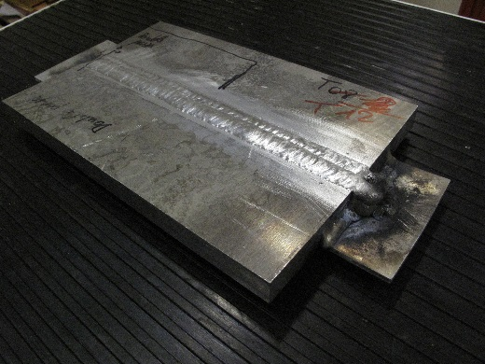
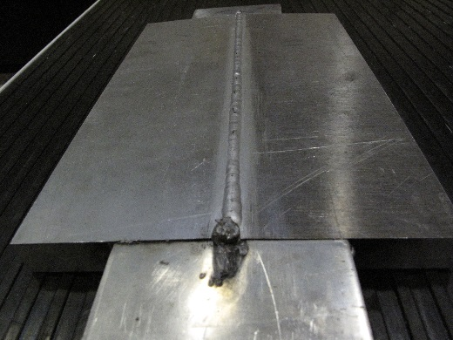
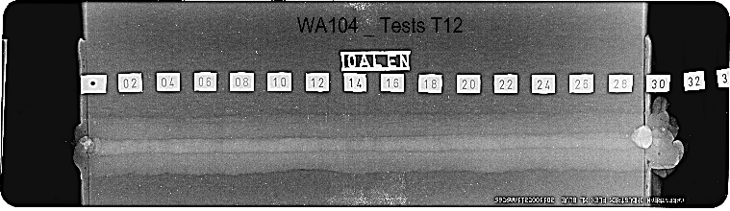
U-frames
Corner design - Welding development
A
Base material: 6082 T6
Filler metal: 5556A
Process: MIG
Number of runs: ≈ 12
Backing support: No
Shrinkage: ≈ 3.5 mm
Quality level achieve: level B (stringent) according to ISO 10042
Next steps:
  Design of the run-in & run-out plates
  Tensile test

Slide 20
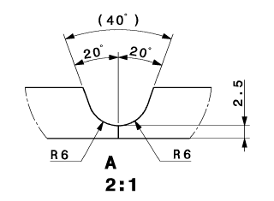
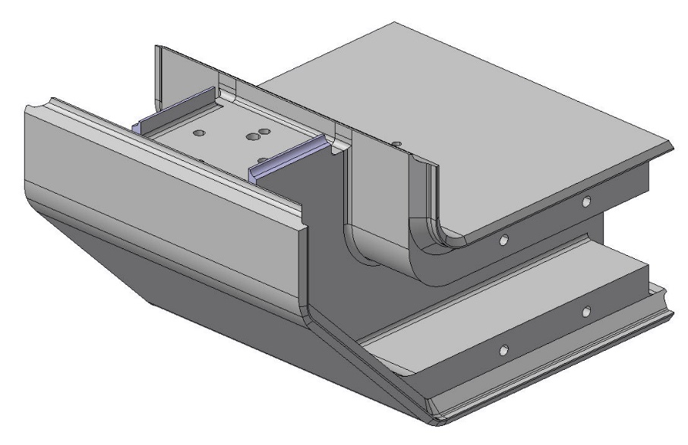
U-frames
Corner design - Welding development
B
Process: TIG
Number of runs: ≈ 3
Backing support: No
Quality level achieve: X-Ray to be done
Length of the weld to be reduced by 10 mm each side to optimize the access (by facilitating the welding operation the risk of imperfections will be reduced)

Slide 21
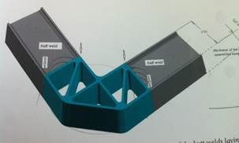
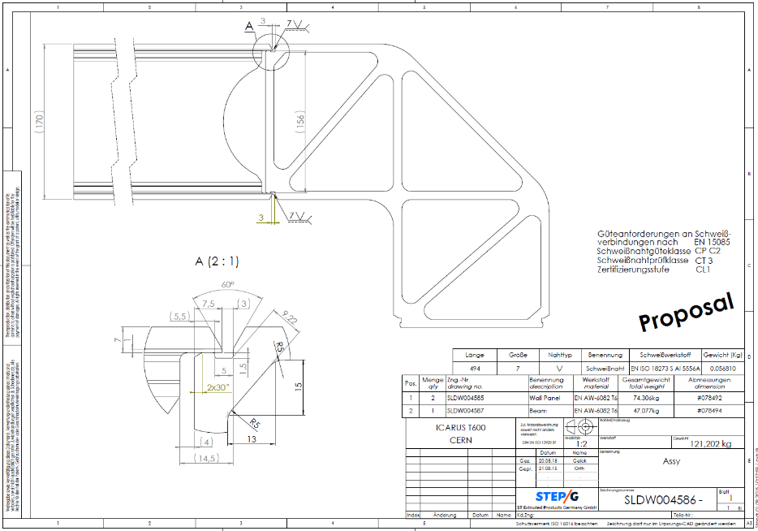
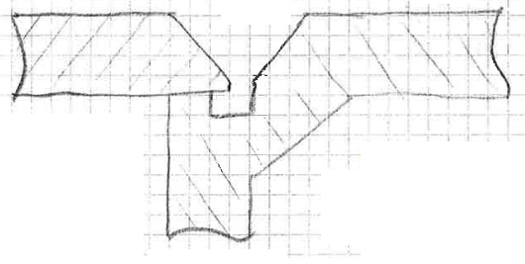
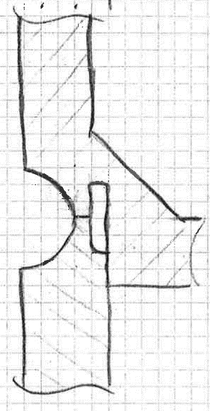
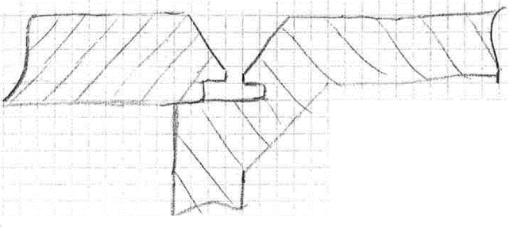
WA104
Corner assembly test piece
Welding tests in progress, 3 configurations will be tested
(1) STEP-G proposal
(2) & (3) CERN proposals
(with and without gap)

Slide 22
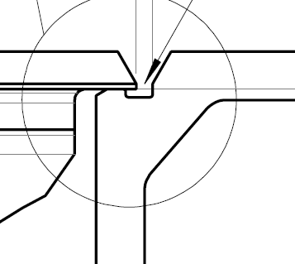
WA104
Welding qualifications
Welding Procedure Qualification (WPQ) & Welder Qualification (WQ)
  3 WPQR will be carried out in the coming weeks (w43 & w44) with the external Body APAVE
  4 welders will be qualified for each WPQ

Slide 23
Assembly strategy - 1

Slide 24
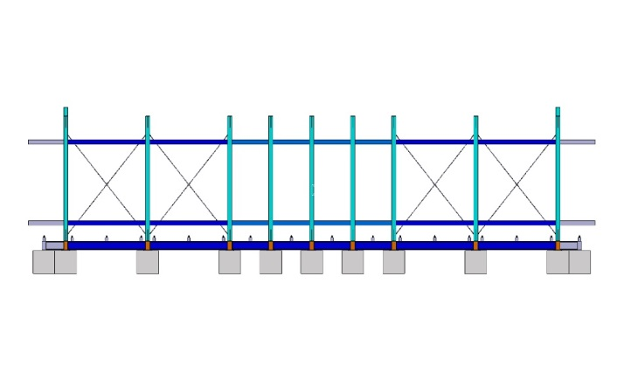
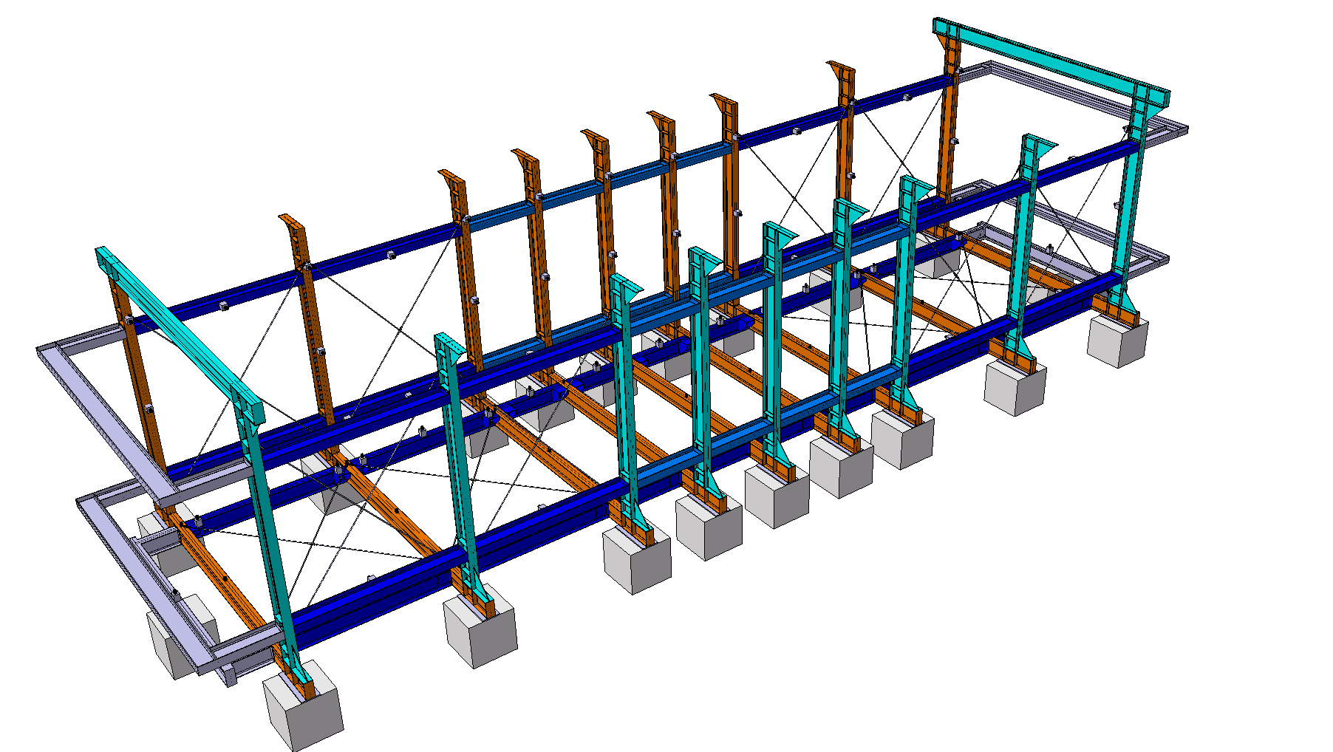
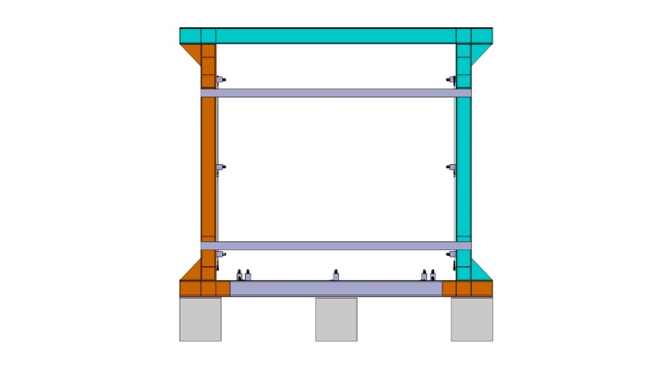
Assembly strategy - 2

Slide 25
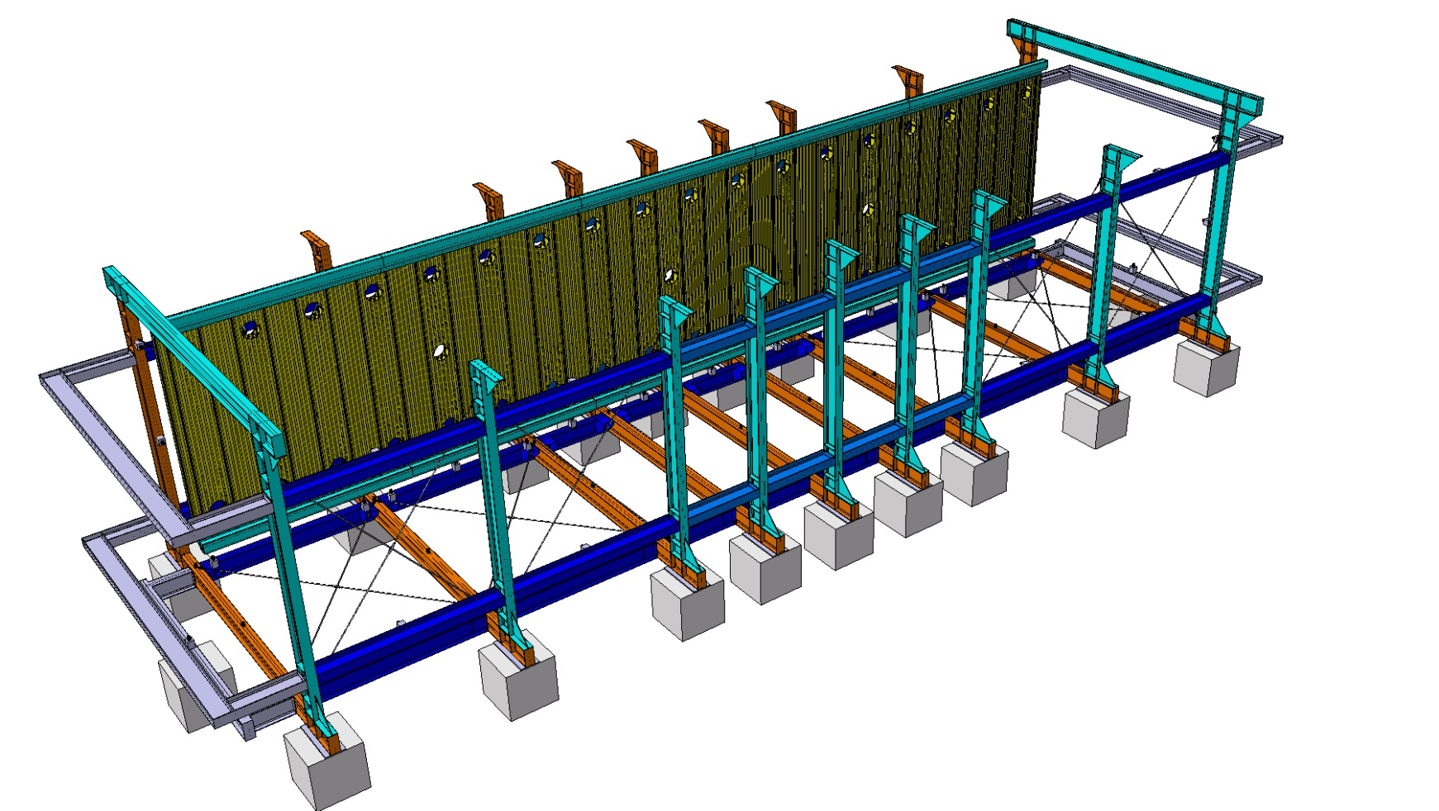
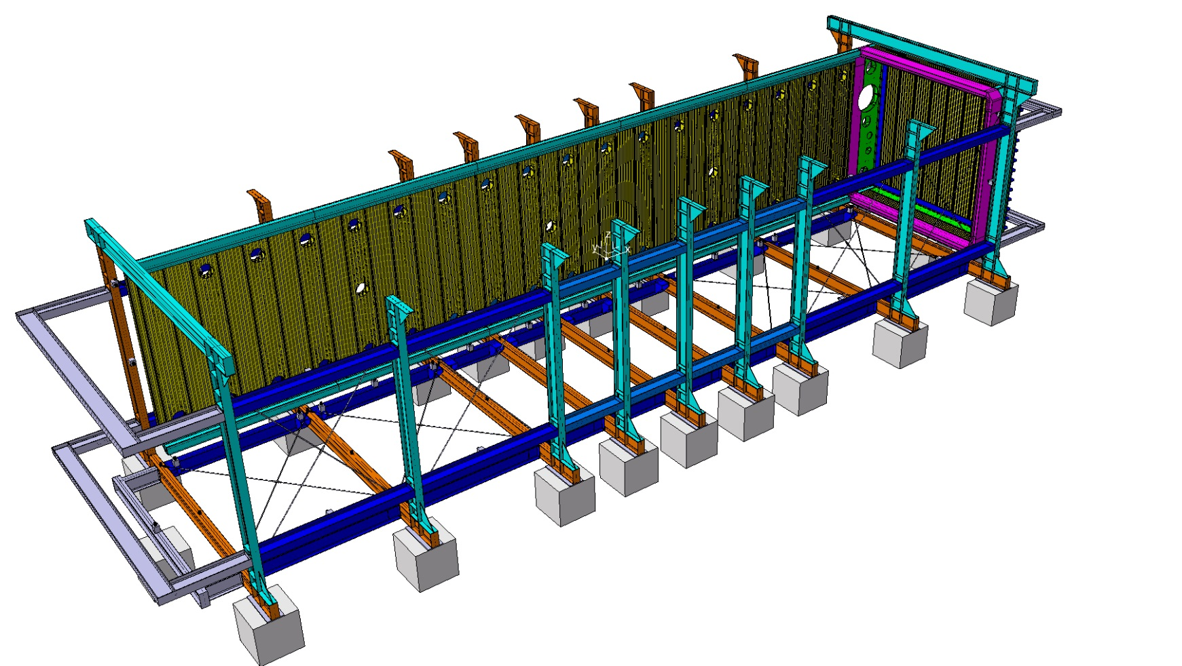
Assembly strategy - 3
Start from the roof
Vessel assembled “on a side”
1
2
Rotation of the whole vessel, in the end, to complete welding.
As many final welds during installation as possible.

Slide 26
Assembly strategy - 4

Slide 27
Assembly strategy - 5

Slide 28
Assembly strategy - 6

Slide 29
Assembly strategy - 7

Slide 30
Assembly strategy - 8

Slide 31
Assembly strategy - 9

Slide 32
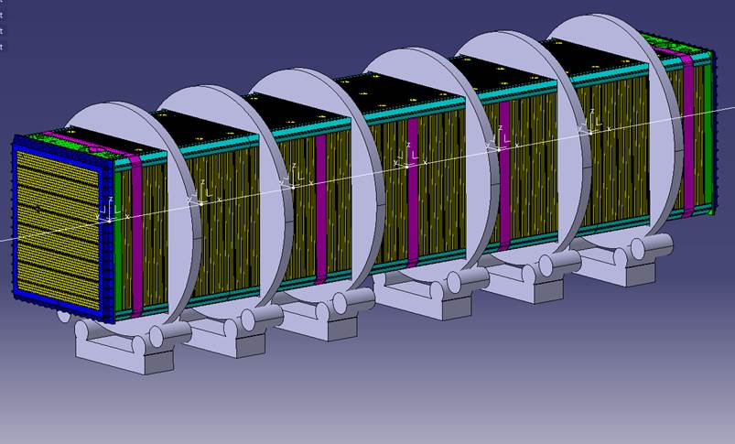
Assembly strategy - 10

Slide 33
Assembly strategy - 11

Slide 34
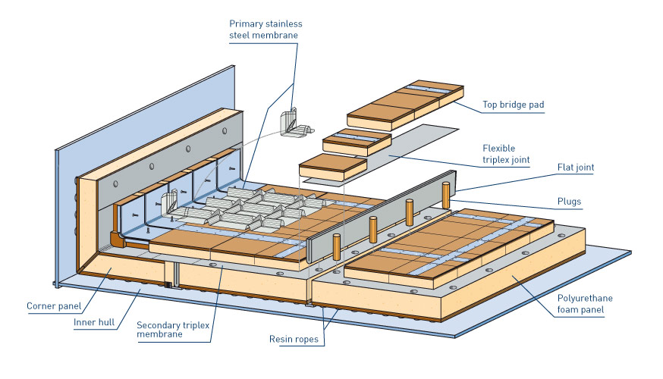
New Thermal Insulation
Purely passive insulation chosen for the installation at CERN, coupled to our standard cooling shield with boiling Nitrogen.
Technique developed for 50 years and widely used for large industrial storage vessels and ships for liquefied natural gas.
Expected heat loss through the insulation:
T600 ≈ 6.6 kW
Preliminary design done by GTT in Jan 2013
No internal membrane is required for our case
Slide 34

Slide 35
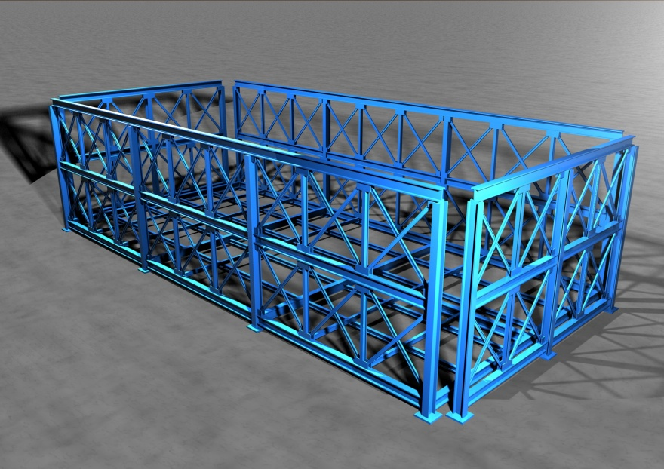
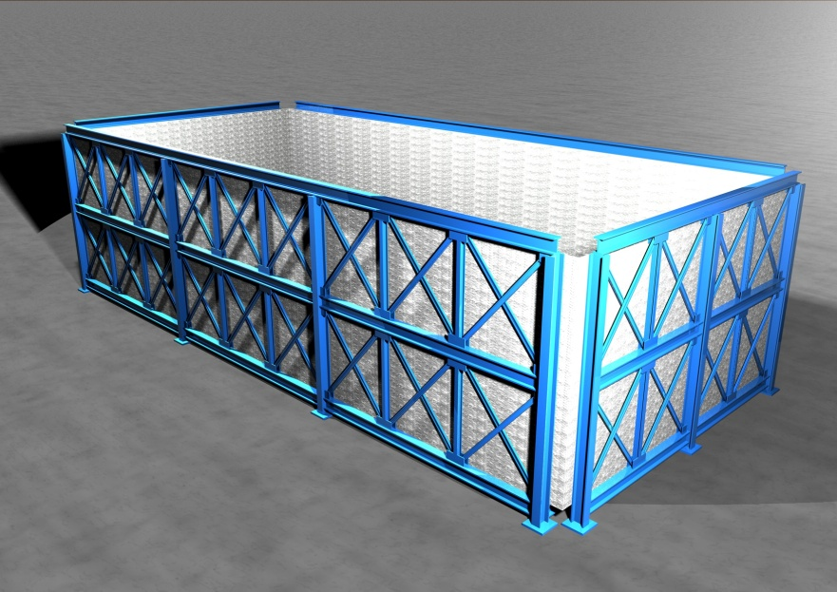
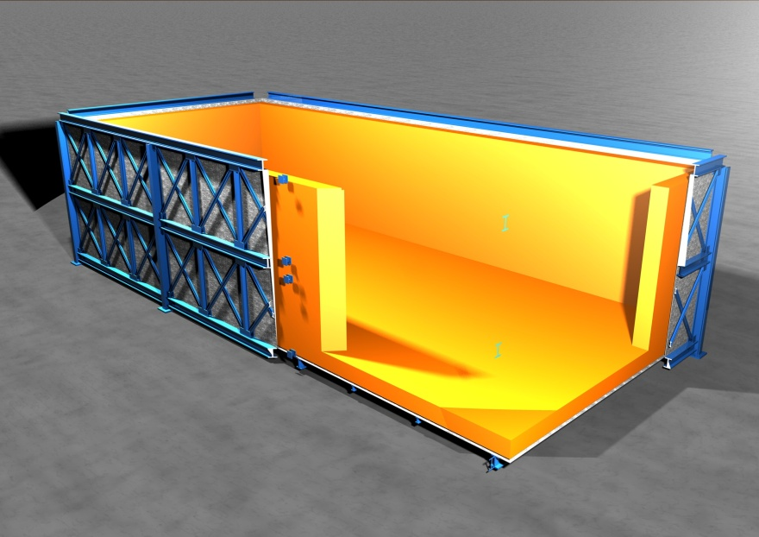
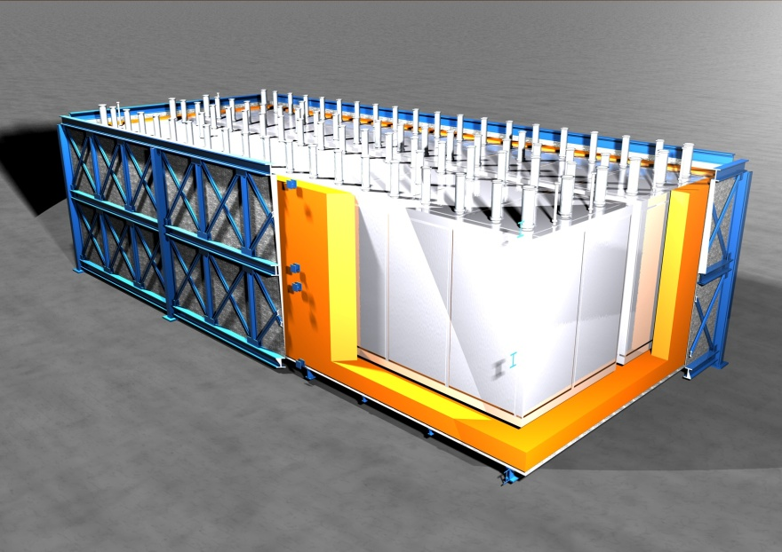
New T600 layout
Warm vessel cage
External skin
Insulation panels
T600 modules

Slide 36
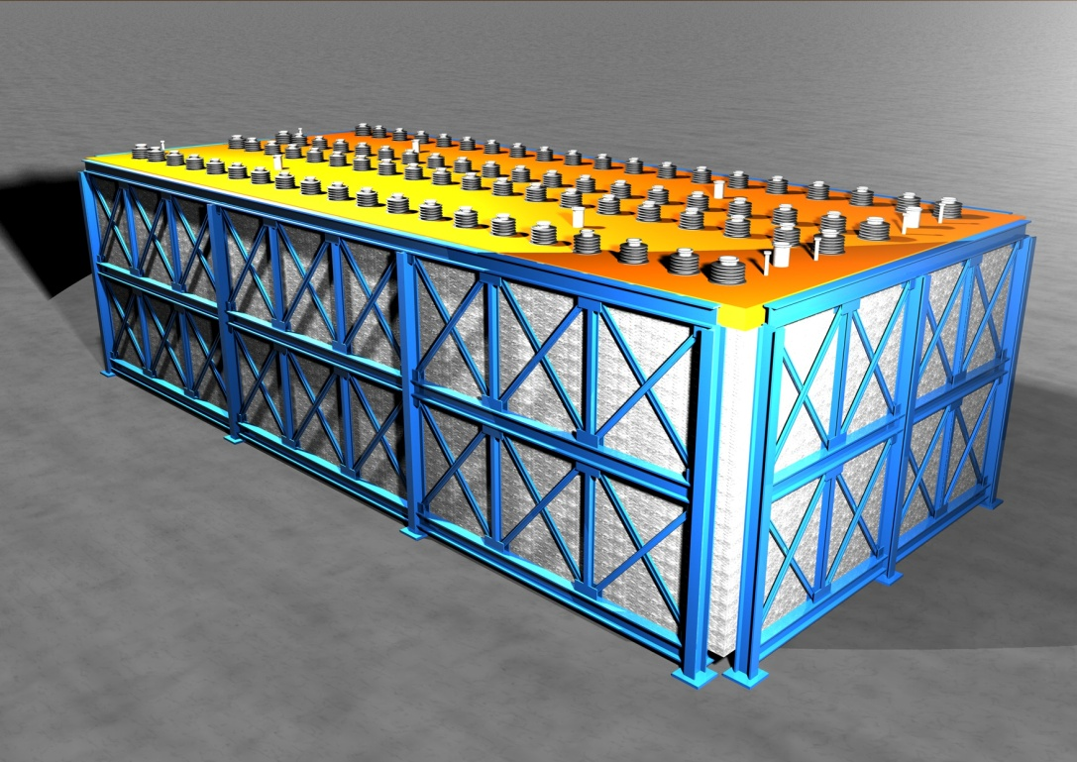
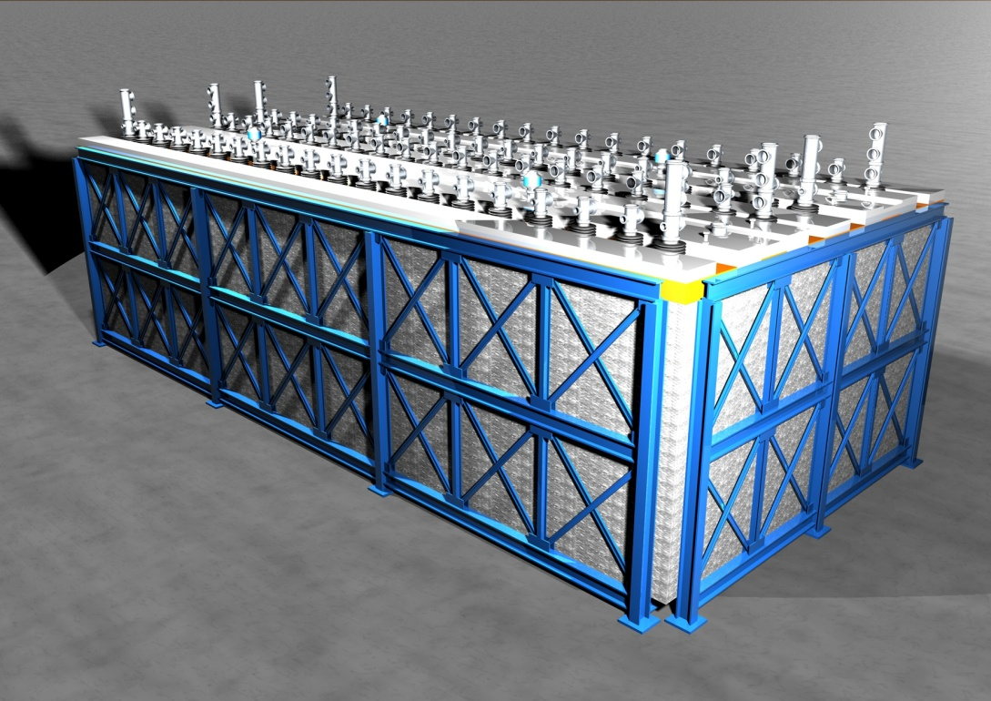
New T600 layout
Insulation top
Top flanges (final layout)

Slide 37
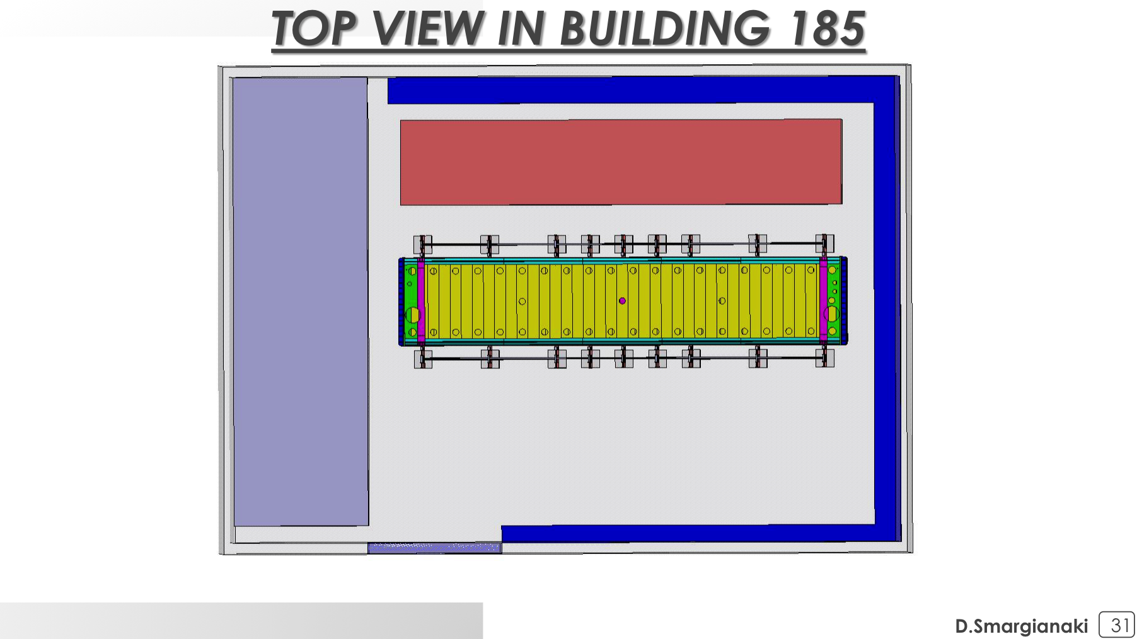
    Installation area
Second T300 module in transport vessel.
Clean room with first T300 module

Slide 38
    Cryogenics and purification systems
    Maintenance of cryogenic pumps and valves from the Gran Sasso installation was started. A setup for a test and qualification of the pumps is being realized (prevalence vs. rotation speed curves).
    Tests of the new cold shield have been done. Measurements confirm the numerical model. A complete report is expected for the next few weeks.
    Tests of the new copper filters are under way at B182 with the 50 liters prototype. First results are expected by end of October 2015.

Slide 39
T600 Warm Vessel and Cryogenics envelope
Preliminary design is complete
Engineering design by end 2015
Procurement and production in 2016
Warm Vessel
Cryogenics and purification equipment

Slide 40
T600 Warm Vessel and Cryogenics envelope
Longitudinal view
Cryo
and purification
Warm Vessel

Slide 41
T600 Warm Vessel and Cryogenics envelope
Detector supports (I beams)

Slide 42
Cosmic Rays Tagger – US contribution

Slide 43
Cosmic Rays Tagger – US contribution

Slide 48
Far Detector Building at FNAL – July 24, 2015
Dear Carlo and Sandro,
On Wednesday July 22nd, Fermilab issued the formal notice to the construction contractor for the SBN far detector building that they may begin work on the project. We expect that the contractor will start on site within the next couple of weeks.
Included in the notice are the construction milestones agreed to by Fermilab and the contractor. Below is a summary of some key dates. As you can see we are on target for being ready for the T600 installation start.
We will make sure to keep you informed regularly as the construction proceeds.
Regards, Peter
SBN Far Detetor Building Milestones
0 Calendar Days - Notice to Proceed Issued (22JUL15)
183 Calendar Days – Concrete Work Complete (21JAN16)
319 Calendar Days – Building Envelope Work Complete (05JUN16)
440 Calendar Days – Substantial Completion (04OCT16)
-----
Peter Wilson - Short Baseline Neutrino Program

Slide 49
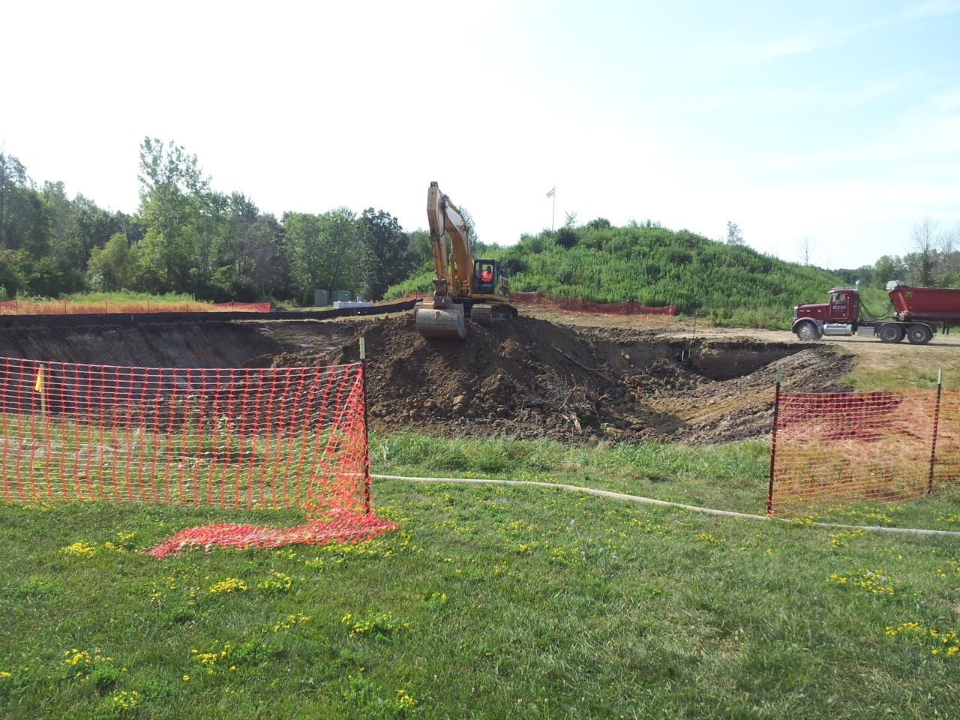
Far Detector Building at FNAL – August 13, 2015

Slide 50
Conclusions
    The overhauling of the T600 is proceeding according to schedule and in line with the budget, with the only exception of the Cosmic Rays Tagger.
    The first T300 module will be ready at the beginning of 2016. The second one will take advantage of all the preparatory work of the first one and will require only six months to be completed. Both modules will be ready for transport in second half 2016, well in advance with respect to the beneficial occupancy of the building at FNAL.
    Aim of the Collaboration is to start data taking with the BNB during 2017.
    Preparation for installation and run at FNAL requires some actions:
      Formal agreements between INFN and FNAL and between CERN and FNAL;
      Exact definition of the onsite work to be done by the Collaboration prior to transportation;
      Identification of the missing resources.
      The active involvement of US teams is essential.

Slide 51
Schedules and future activities
ICARUS Referee Meeting, September 15, 2015
51

Slide 52
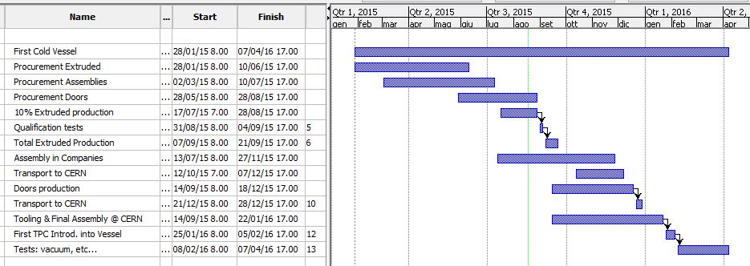
First Cold Vessel

Slide 53
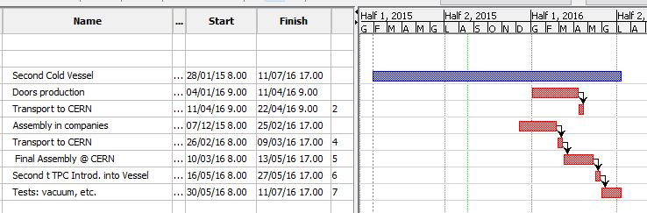
Second Cold Vessel

Slide 54
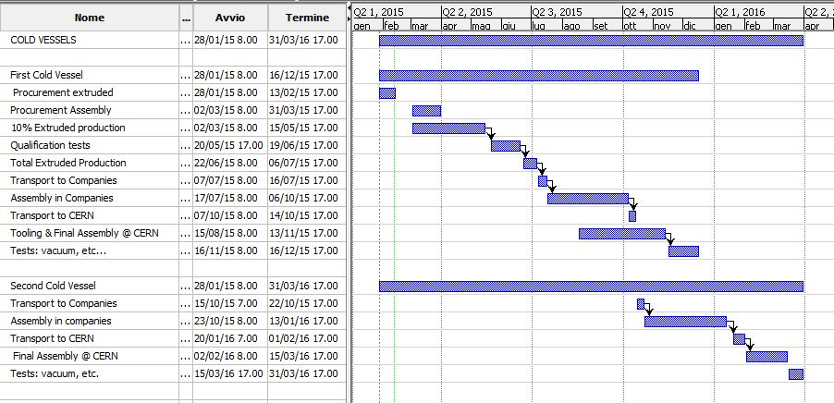
Cold Vessels

Slide 55
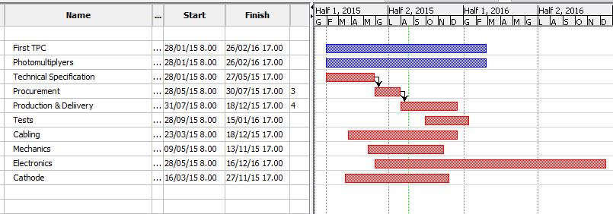
First TPC

Slide 56
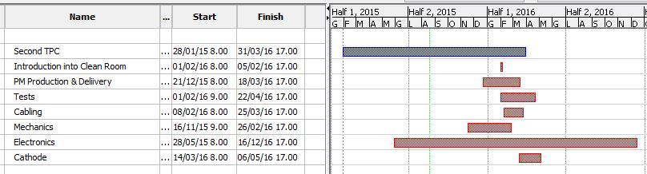
Second TPC

Slide 57
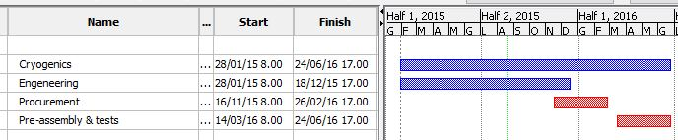
Cryogenics

Slide 58
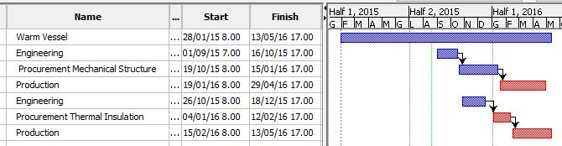
Warm Vessel

Slide 59
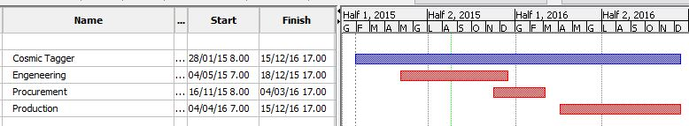
Cosmic Tagger

Slide 60

Transport to FNAL

Slide 61

Assembly at FNAL & Commissioning

Slide 62

All in One

