Slide 1
Cold Cryostat construction
O. Beltramello, F. Cadoux, G.Favre, S. Michal, D. Mladenov, C. Montanari, M. Nessi, D.Perini, A. Scaramelli, D.Smargianaki, A. Zani
E. Bascialla, S.Bonelli, A.Castellani

Slide 2
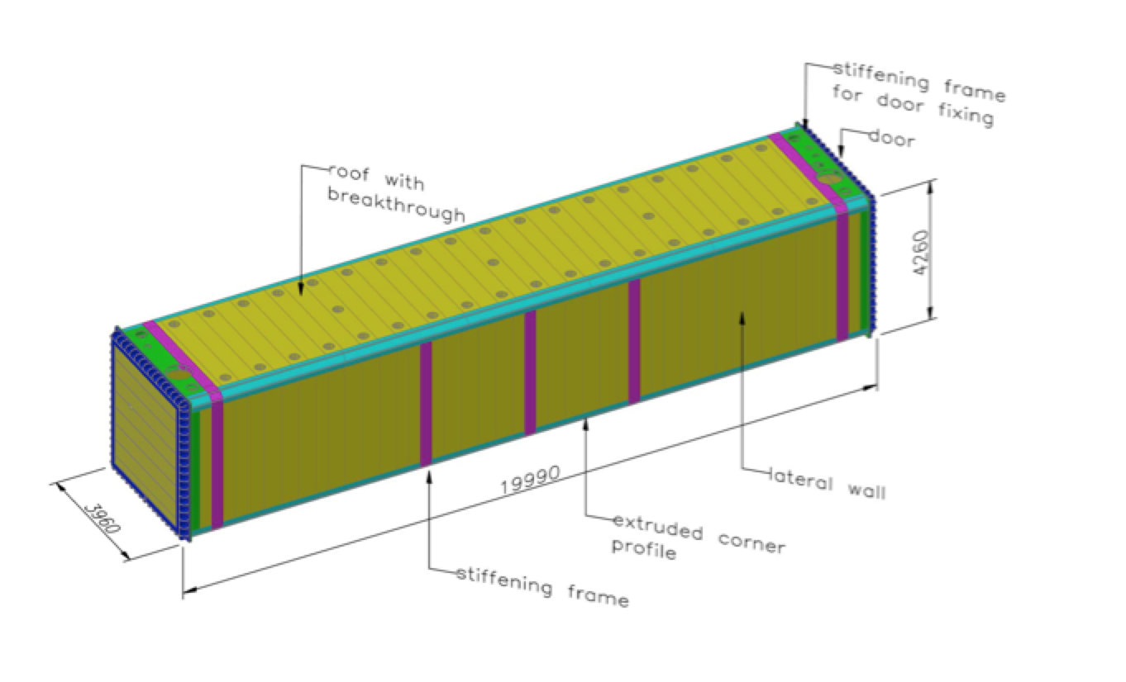

Slide 3
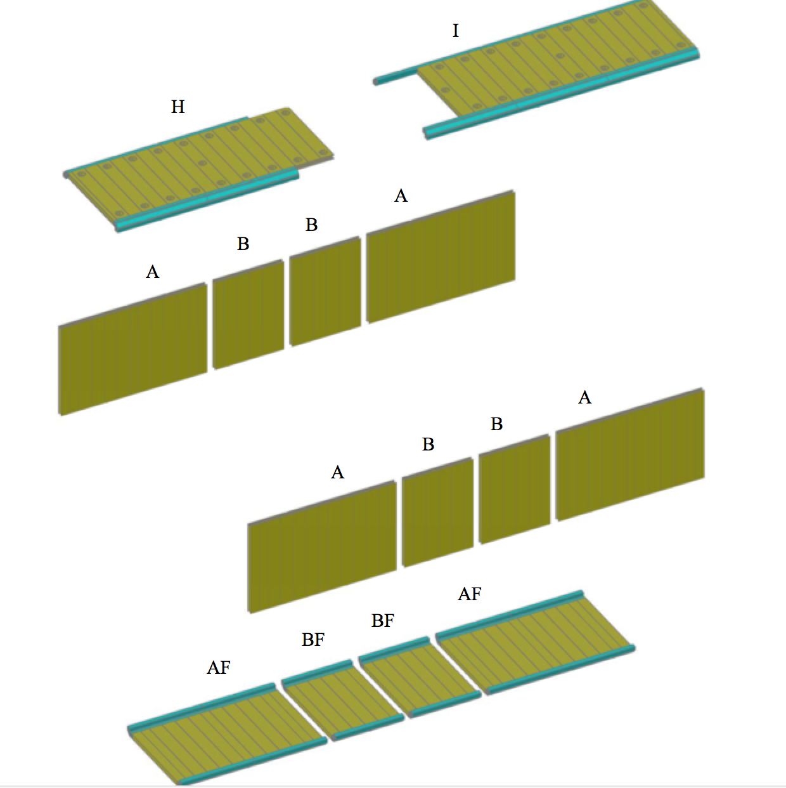
Material and assemblies contracted to a D-Firm

Slide 4
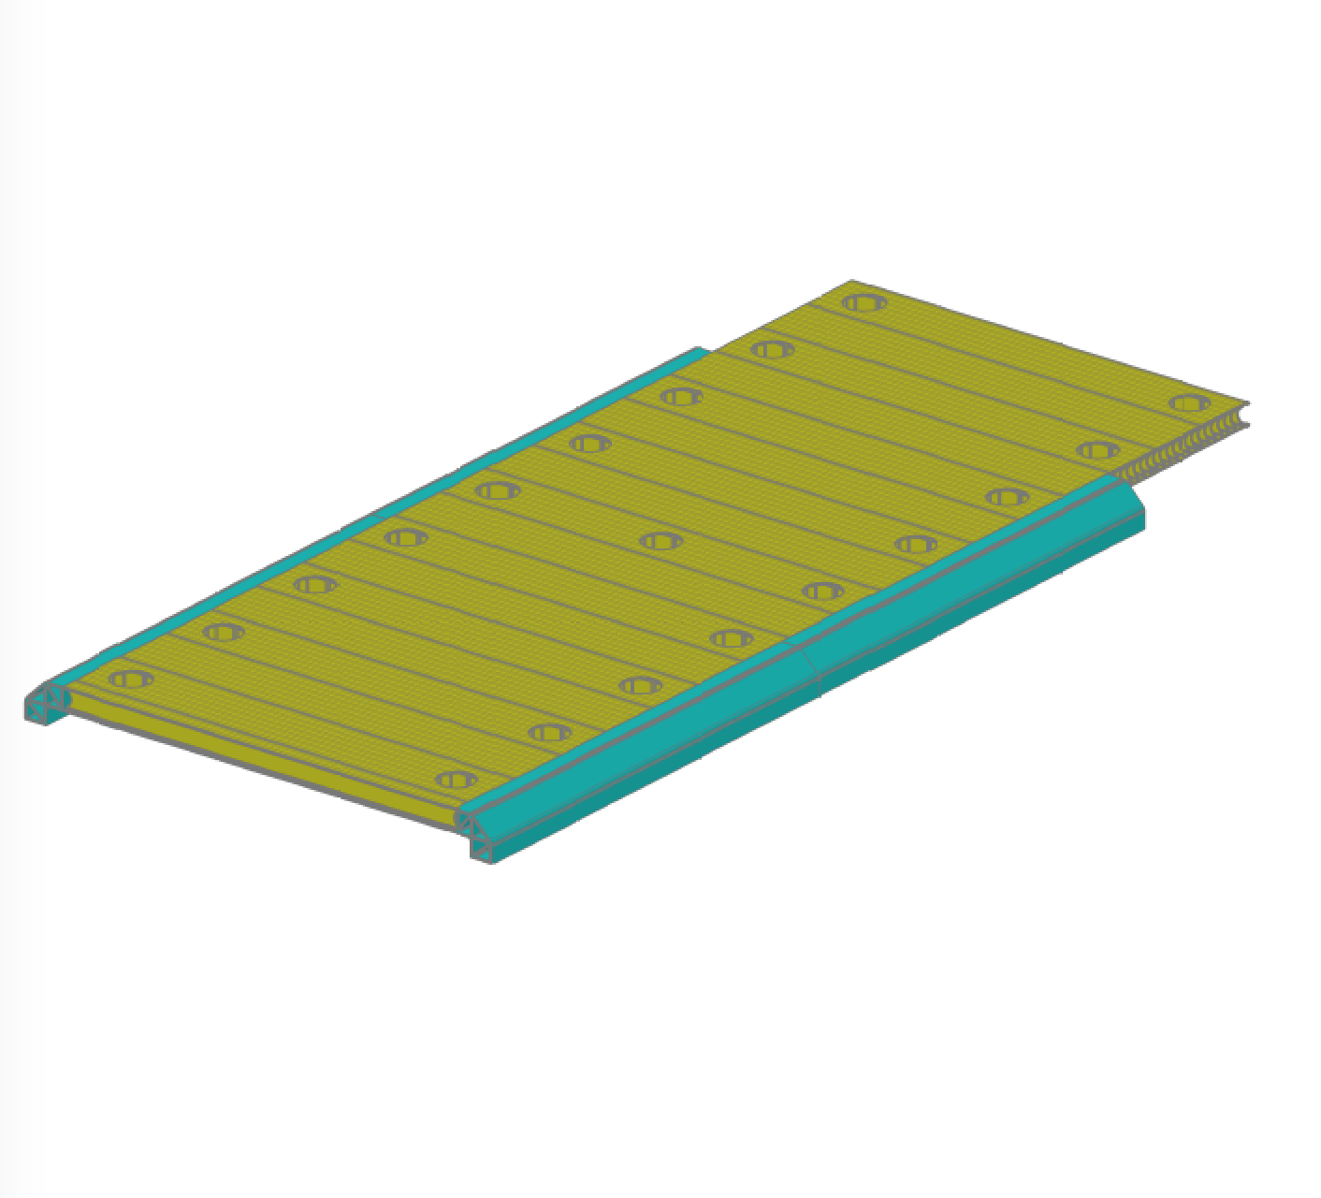
Material and assemblies contracted to a D-Firm

Slide 5
Material produced by extrusion. Production should finish by beginning of November

Slide 6
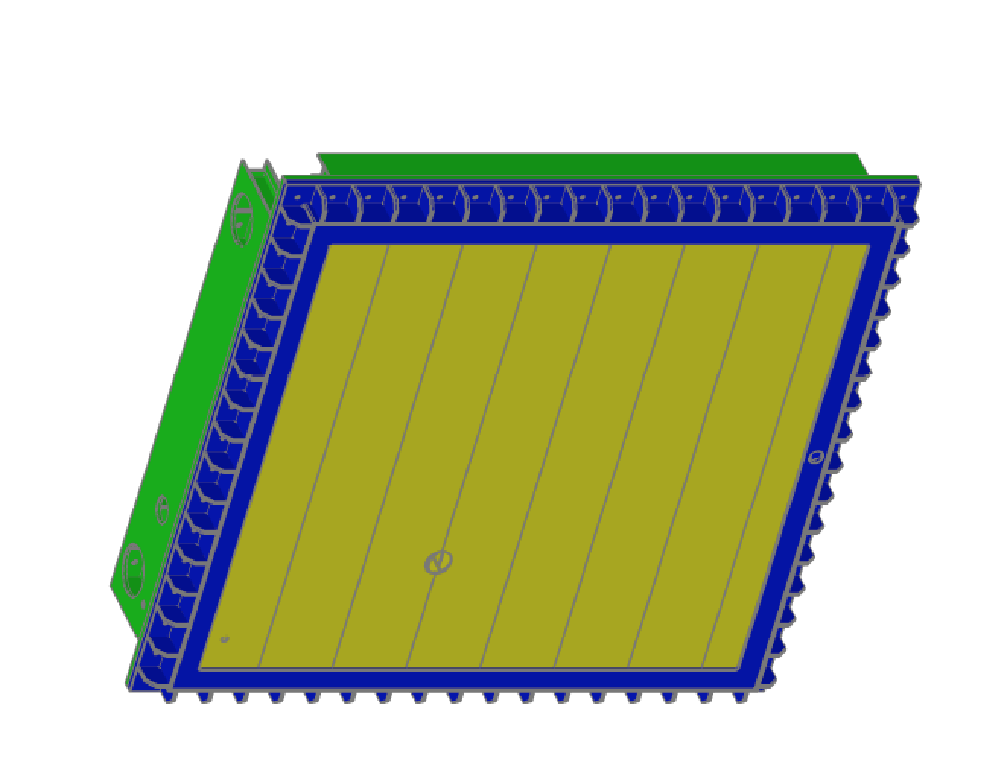
Material and assemblies in the contractual phase : tendering done !
Still under discussion the delivery time!

Slide 7
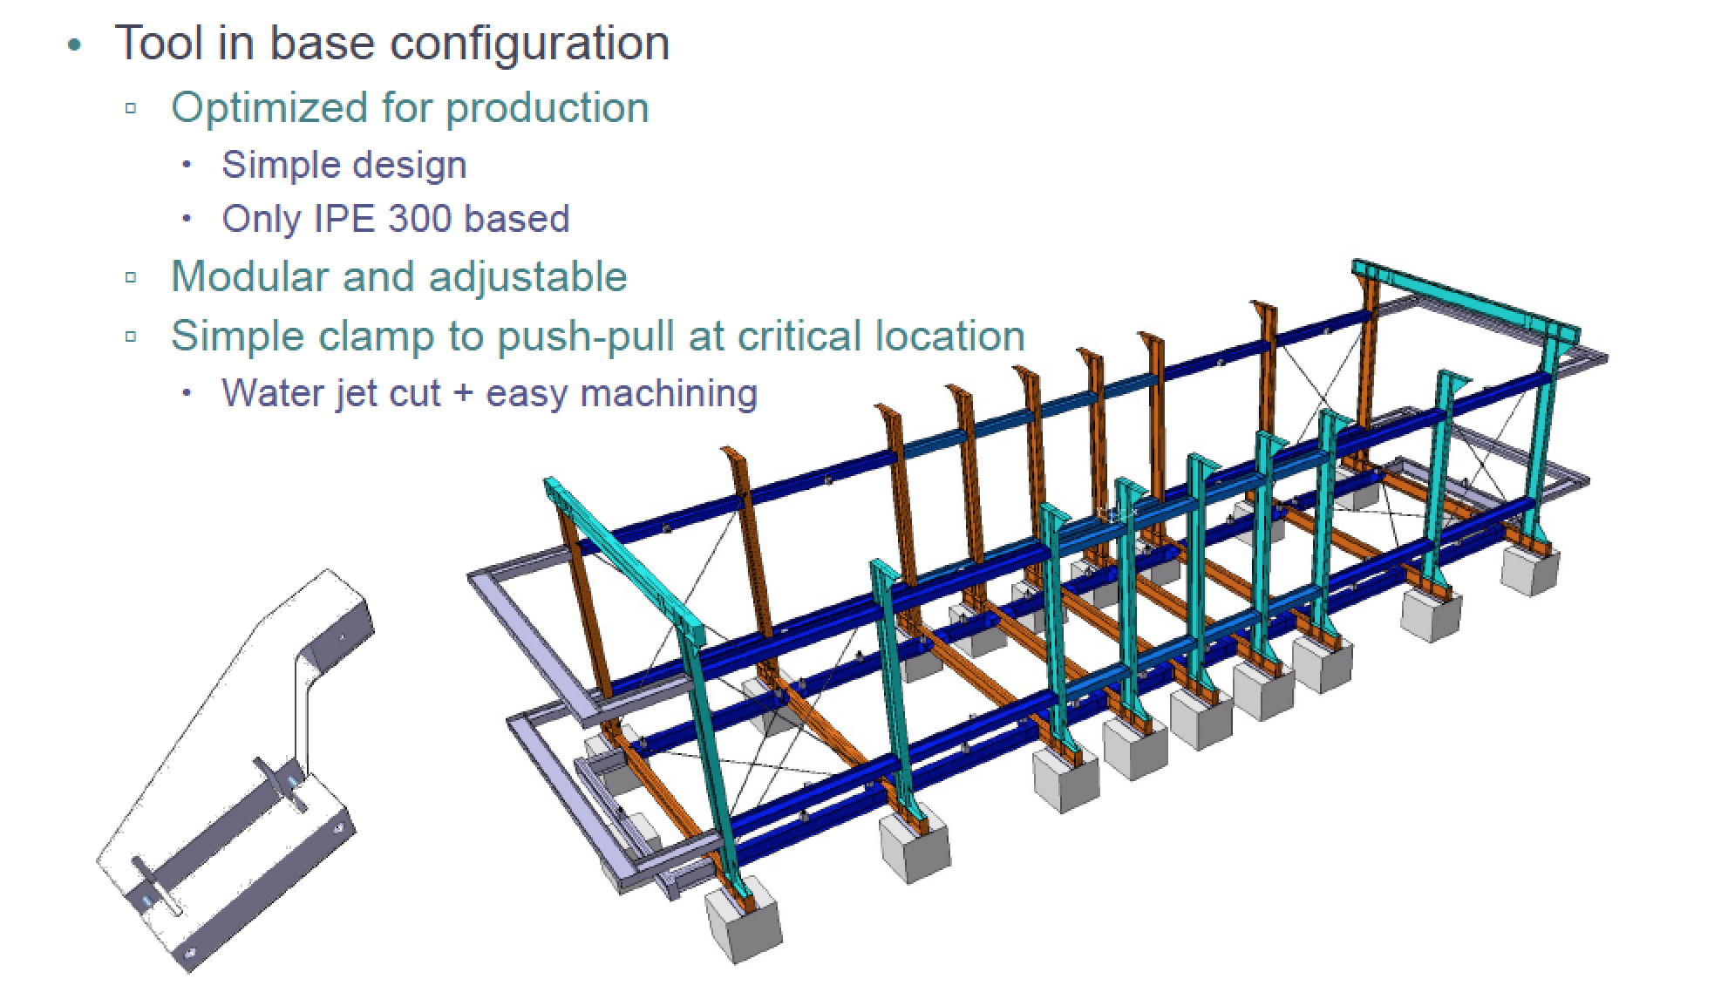
Assembly tool under construction, should be delivered to CERN in the second half of November. Assembly in December

Slide 8
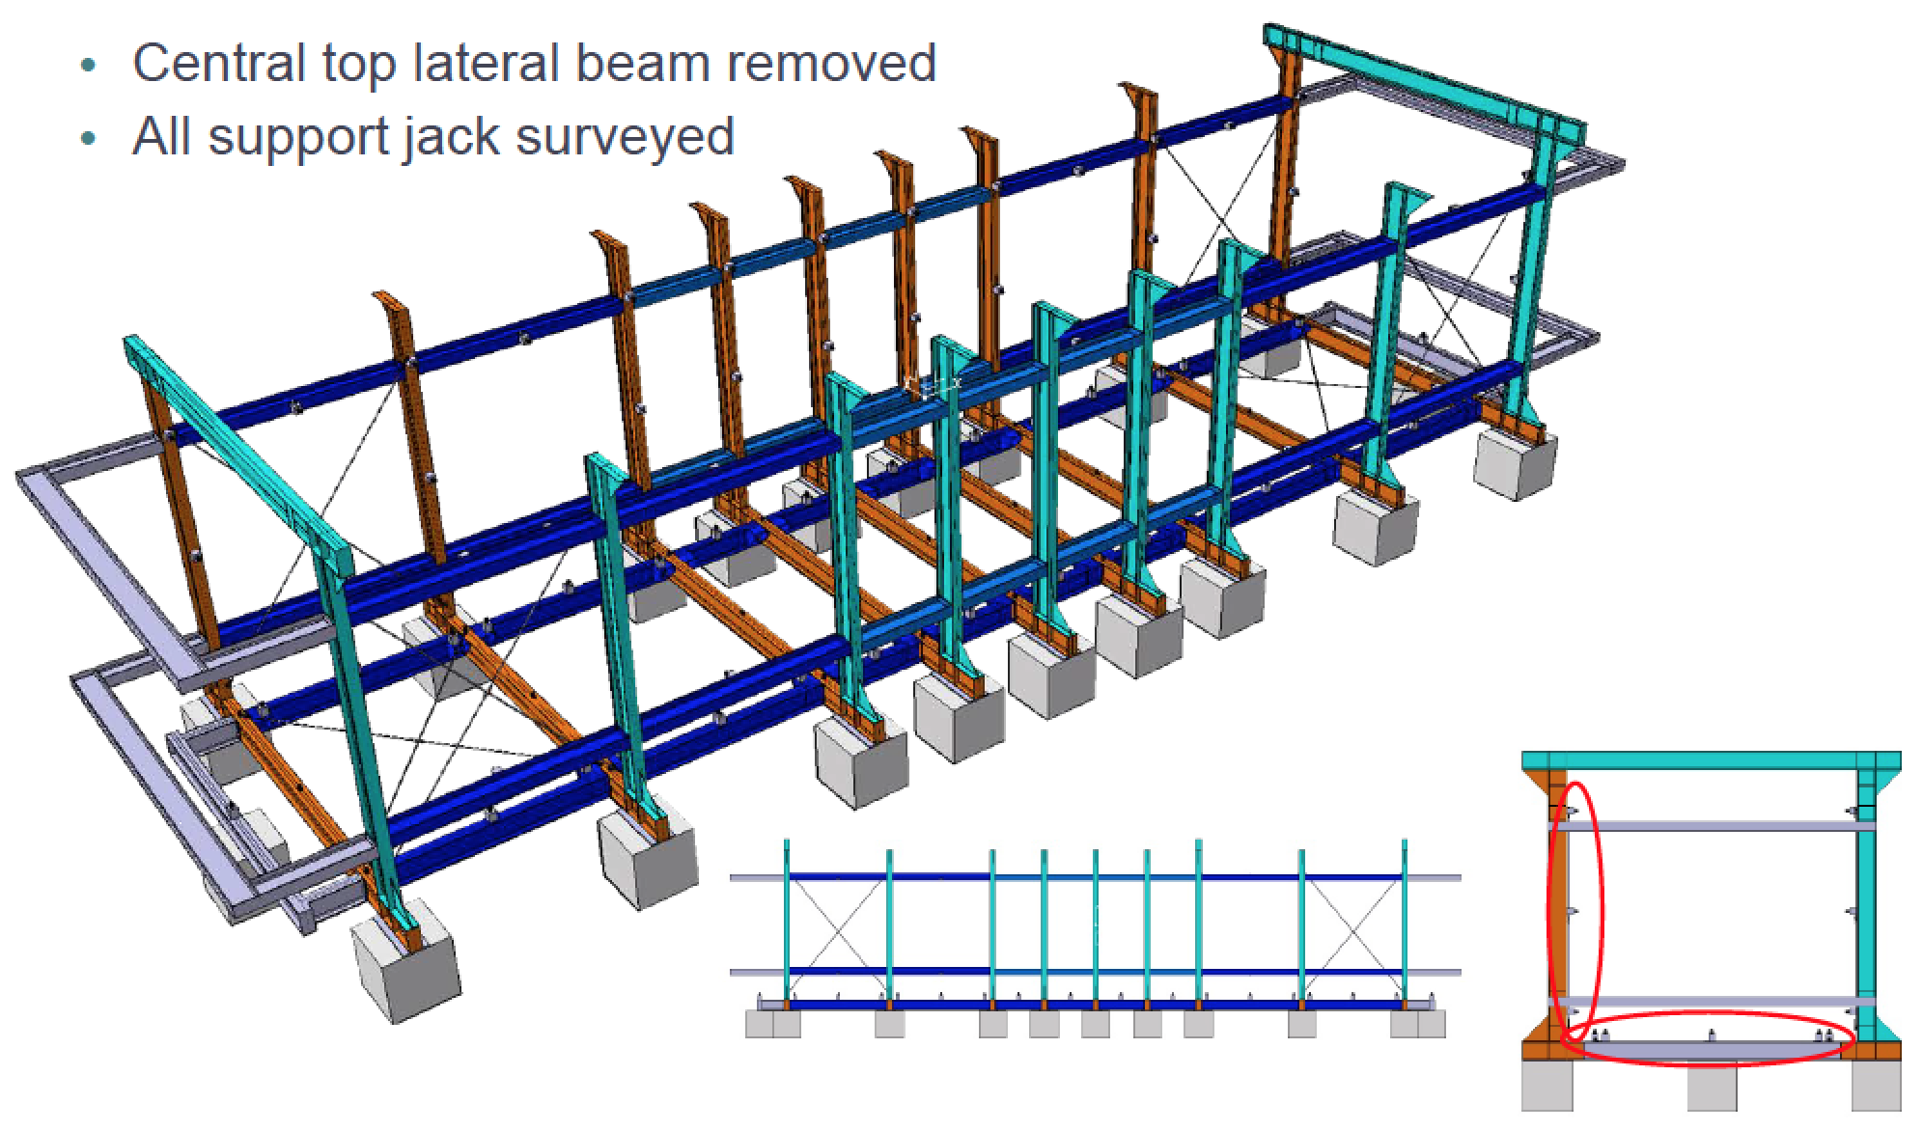

Slide 9

U-frame assembiies ongoing in the main CERN workshop, starting from components delivered and under delivery.
First U frames needed in December.

Slide 10
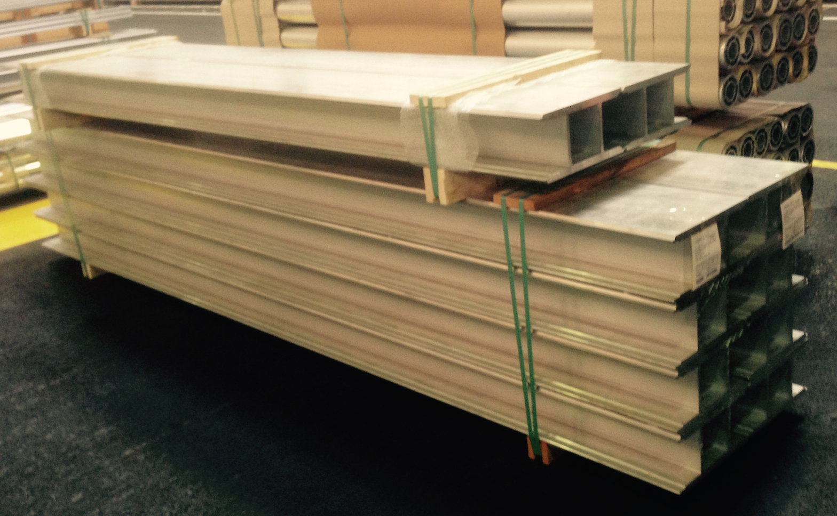
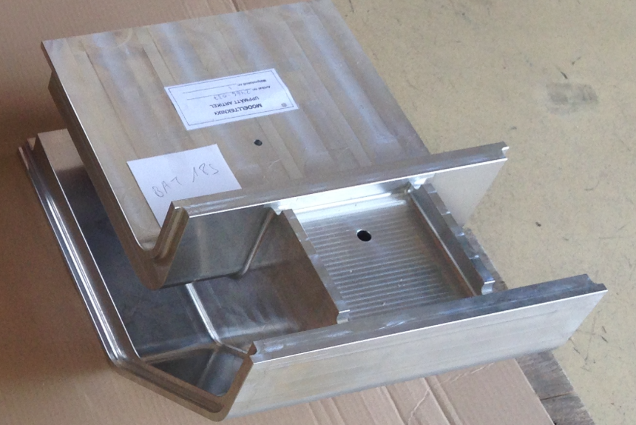
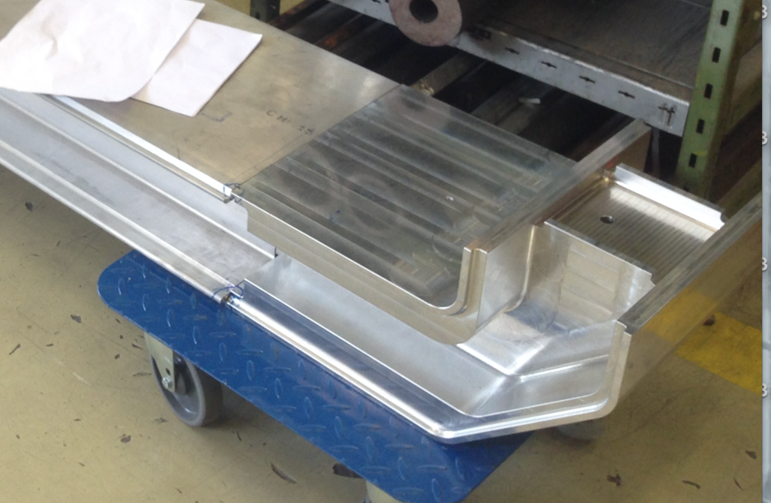
U-frame assembiies ongoing in the main CERN workshop, starting from components delivered and under delivery.
First U frames needed in December.

Slide 11
Sequence of operations

Slide 12
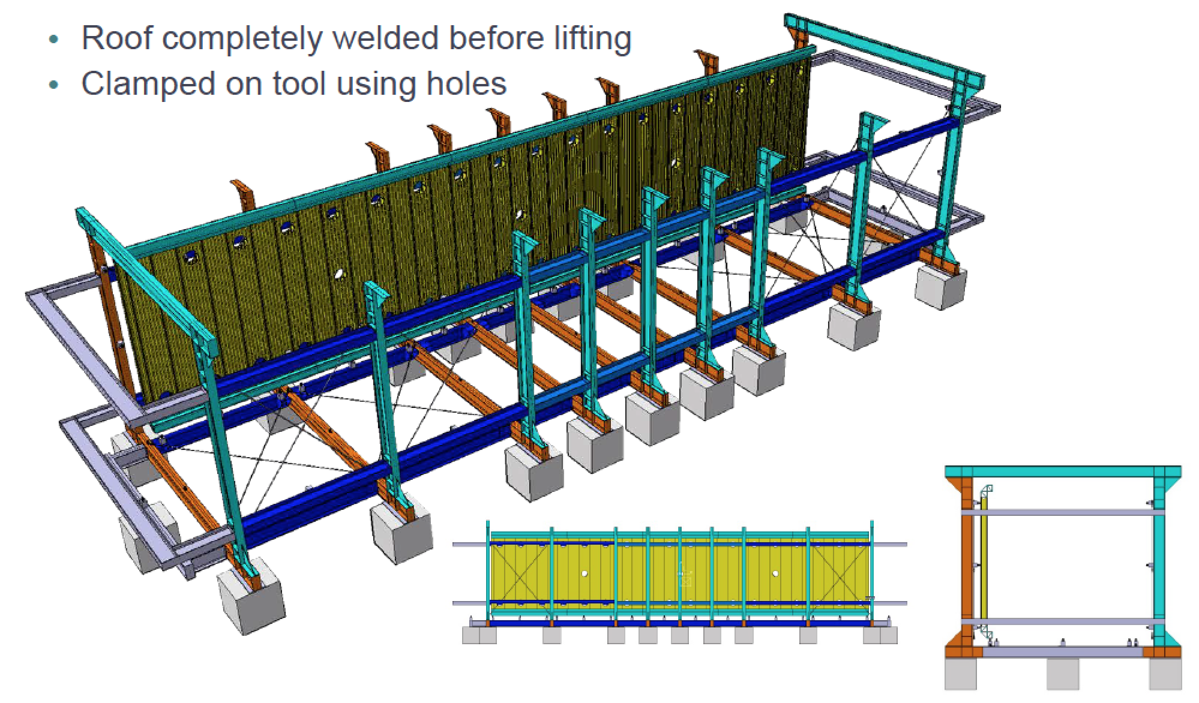

Slide 13
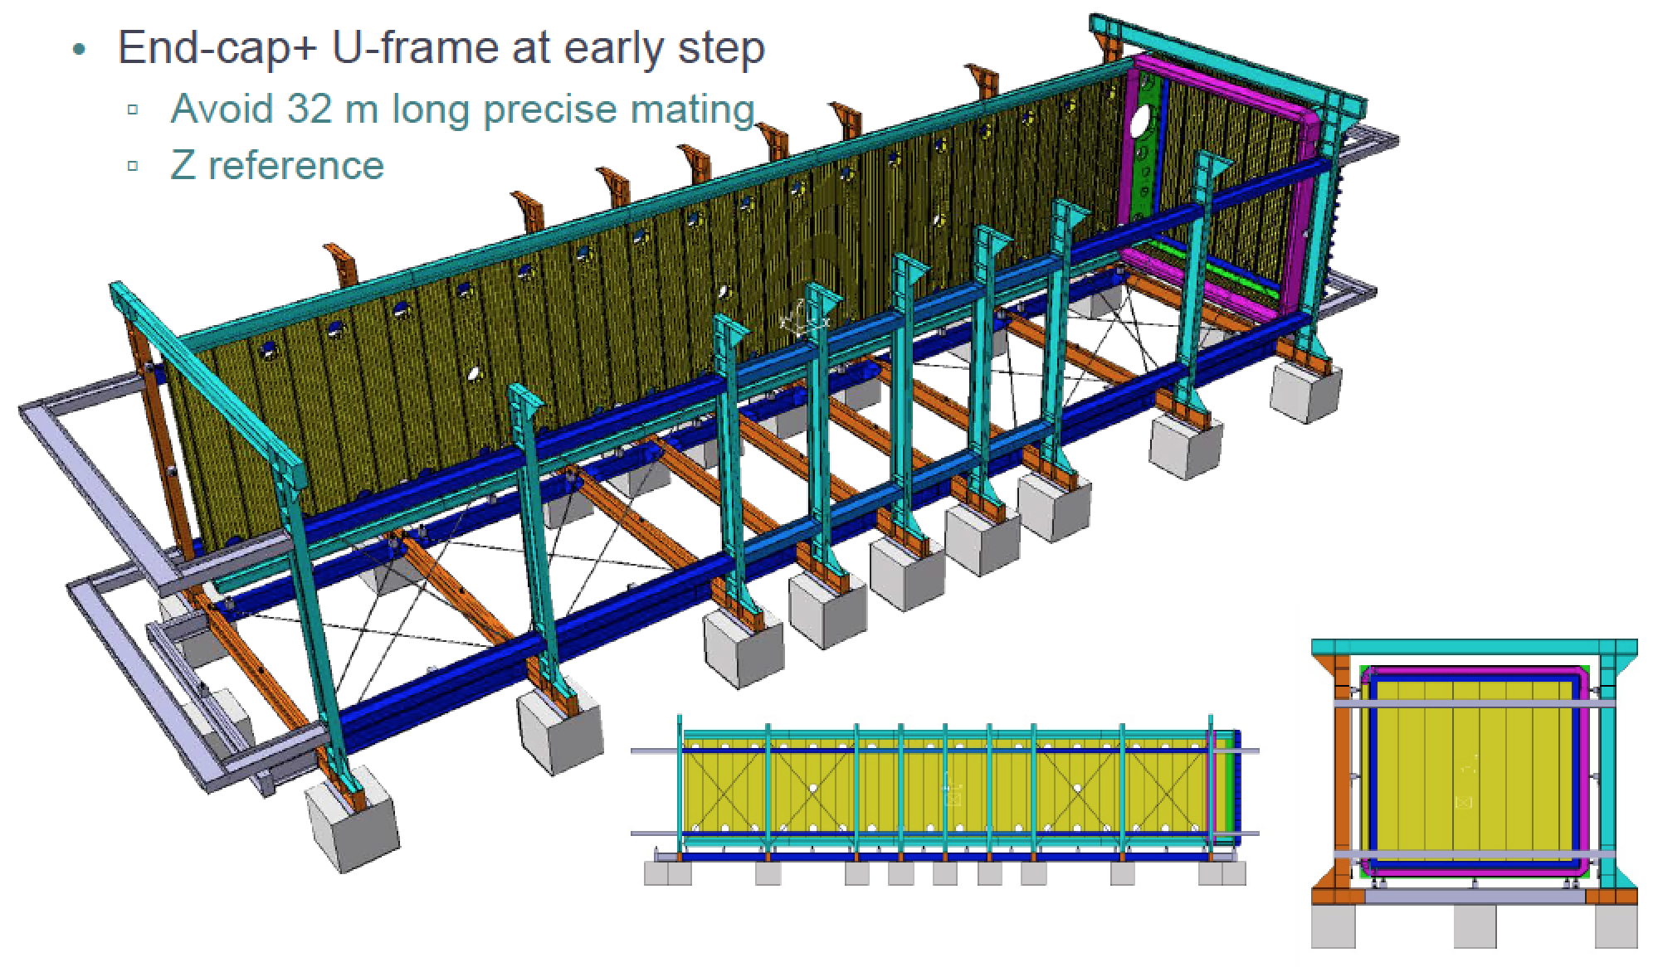

Slide 14
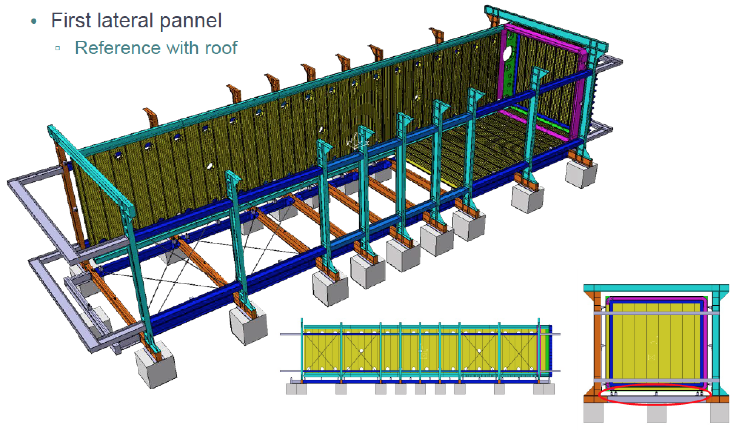

Slide 15
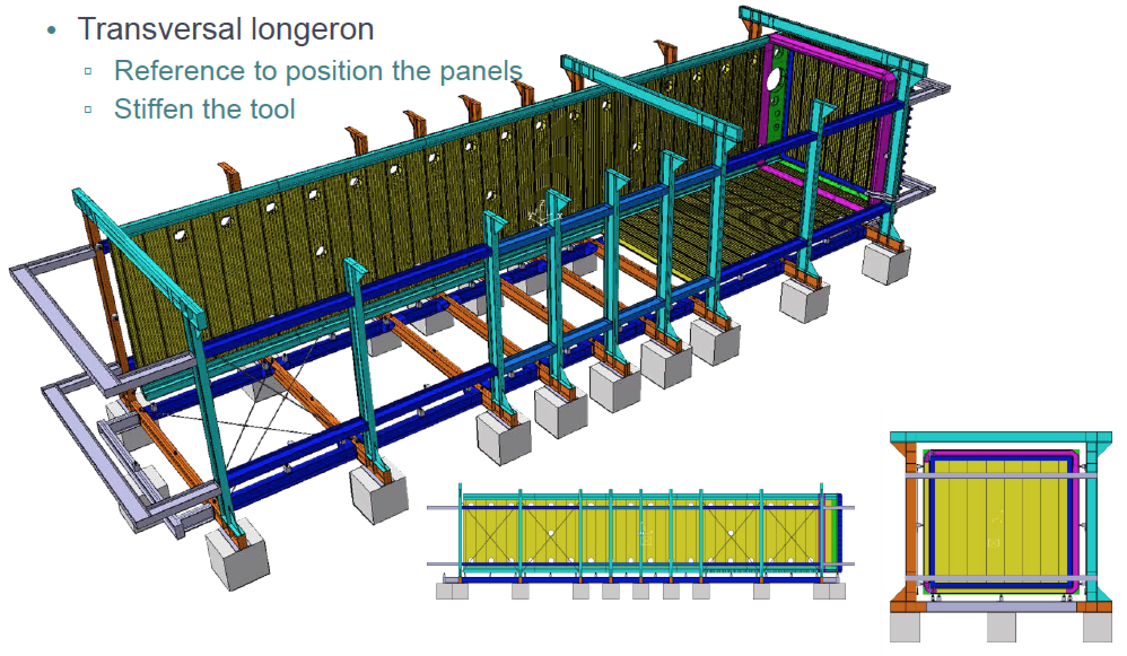

Slide 16
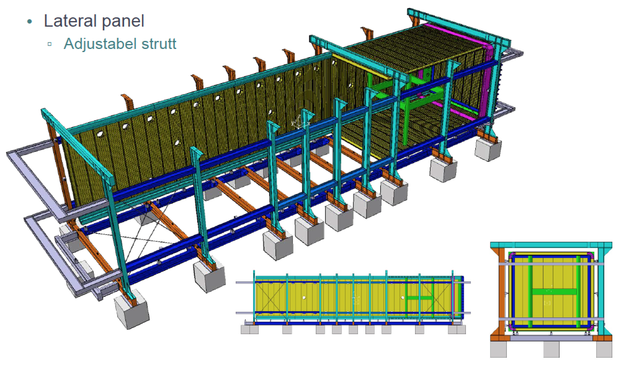

Slide 17
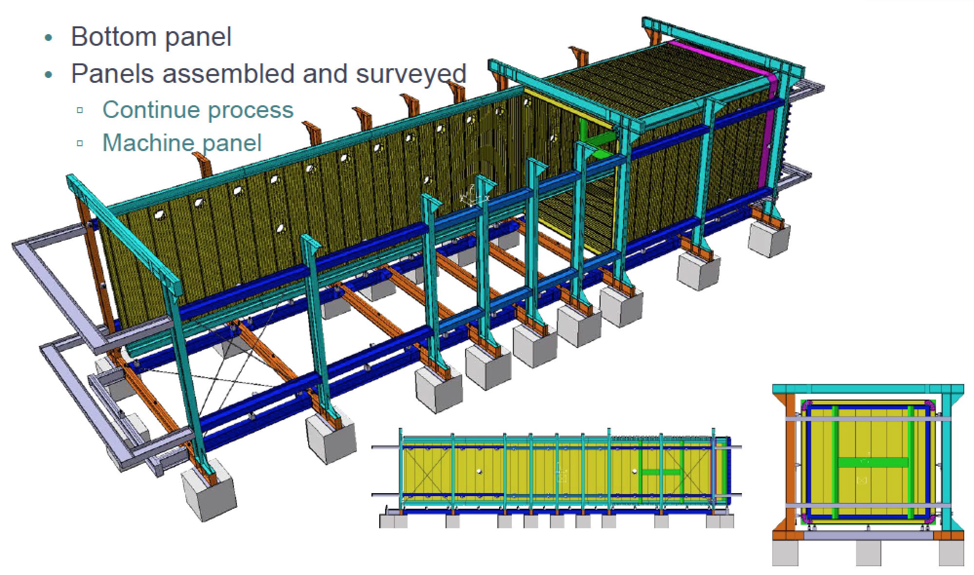

Slide 18
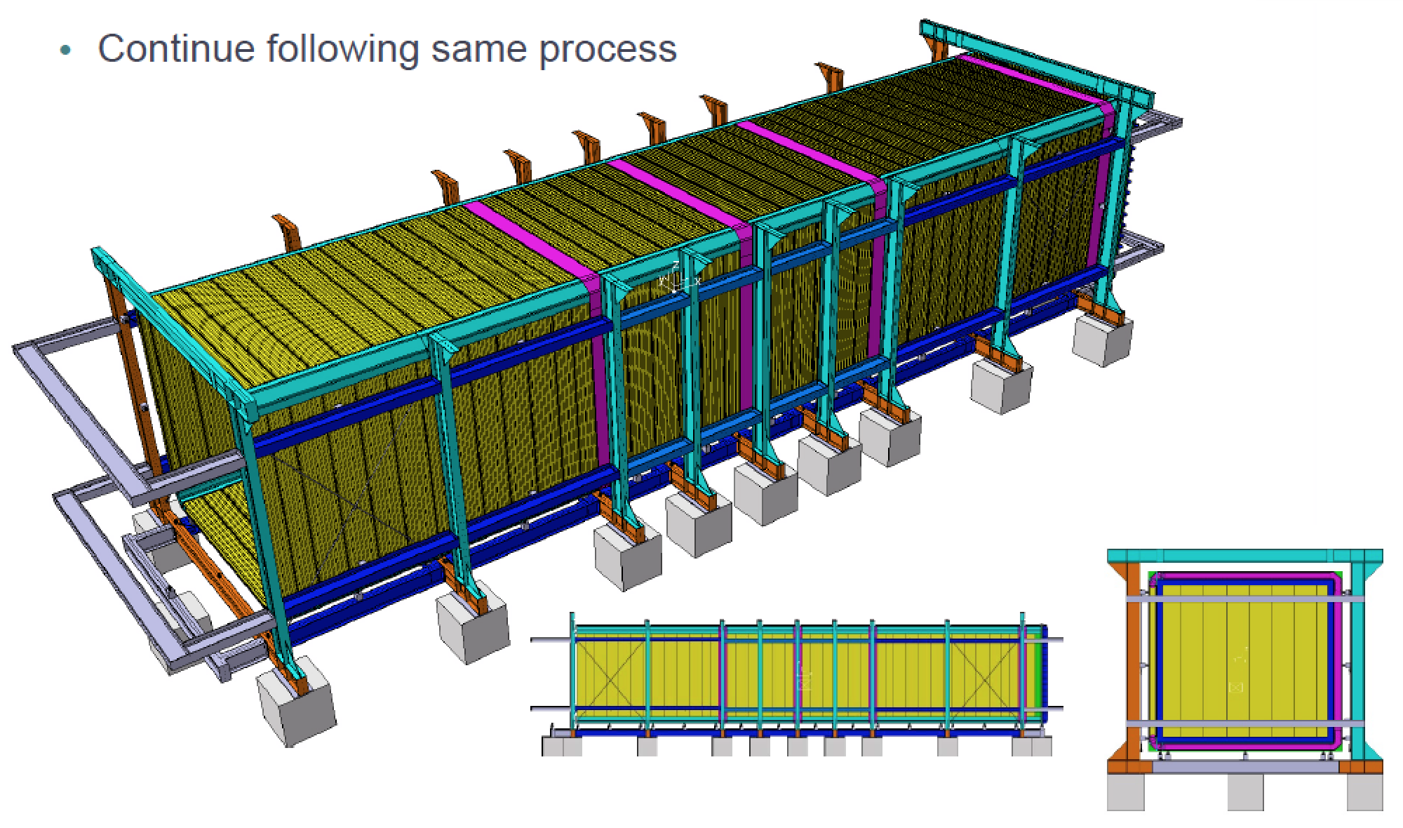

Slide 19
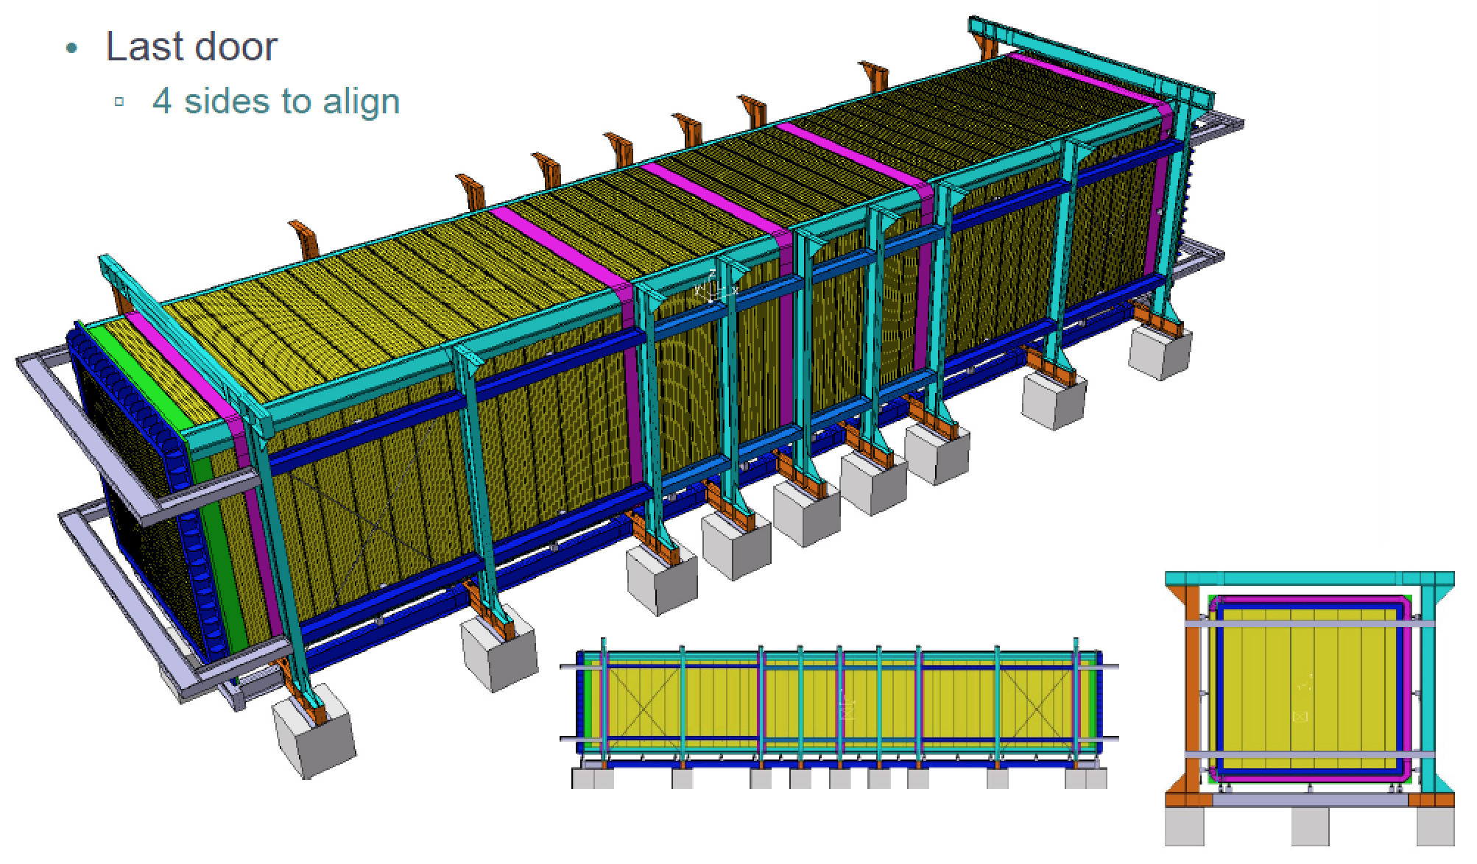

Slide 20
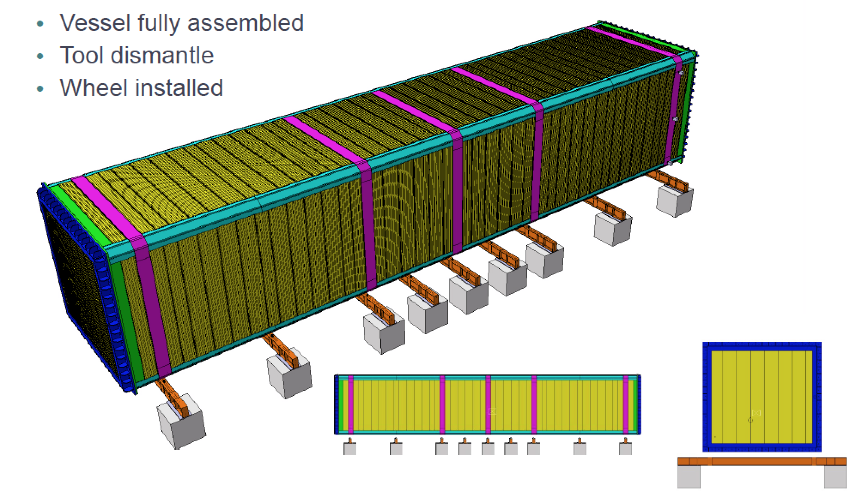

Slide 21
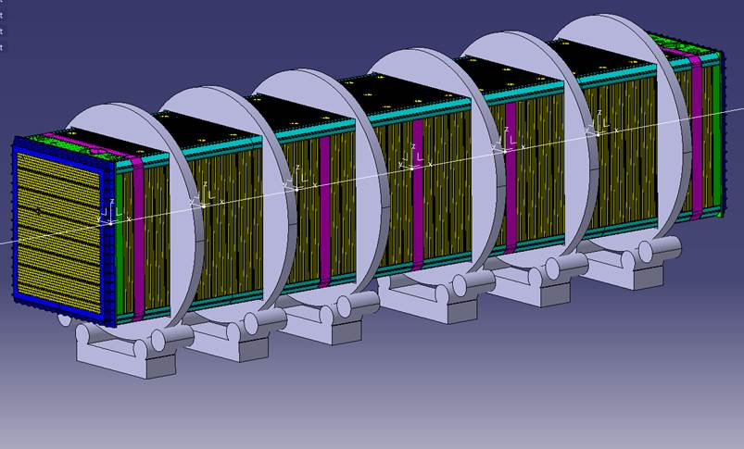

Slide 22
