Slide 1
Warm WA104 Cryostat construction
D. Mladenov, C. Montanari, M. Nessi, A. Scaramelli

Slide 2
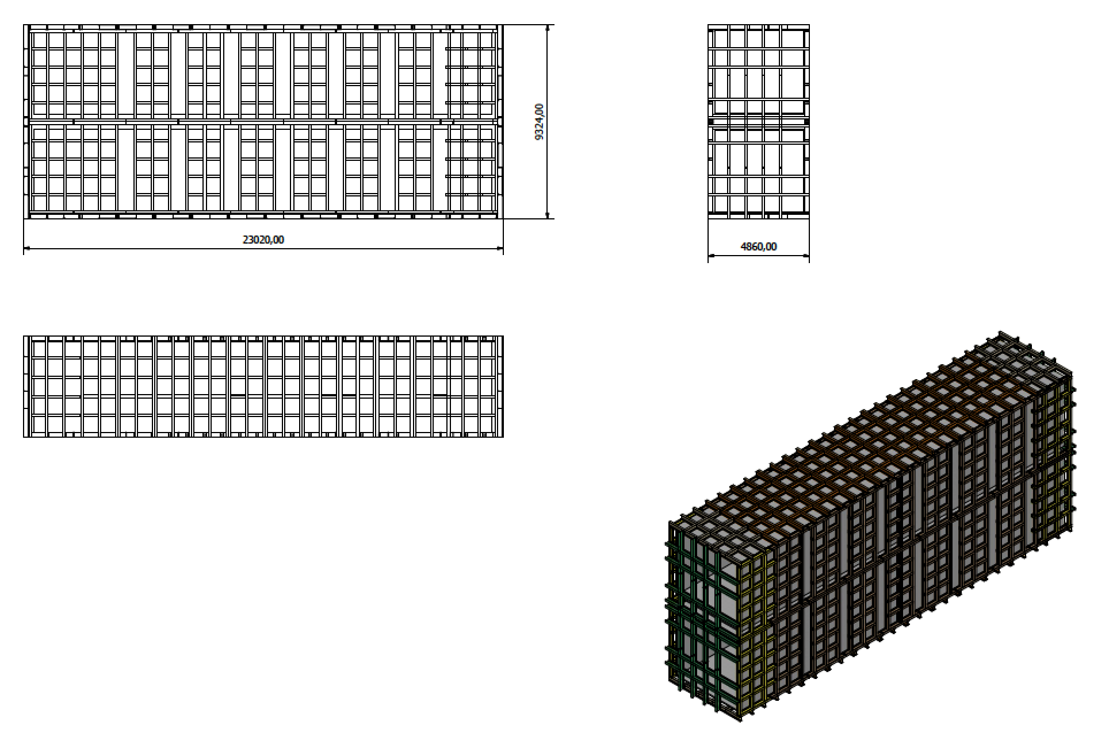
Basic metallic structure designed and calculated
Next : penetrations and installation procedure

Slide 3
