Slide 1
SBND
cryostat support structure design,
fabrication and installation plan
Dimitar MLADENOV

Slide 2
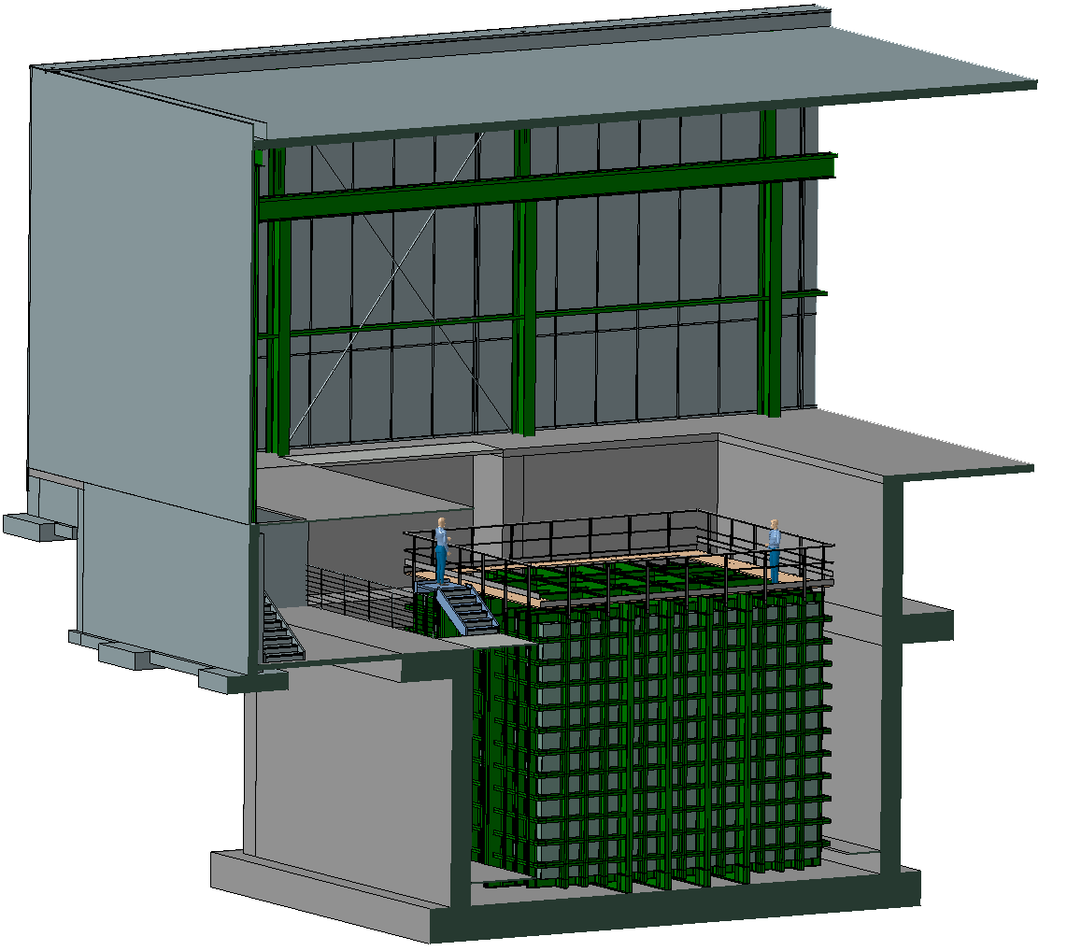
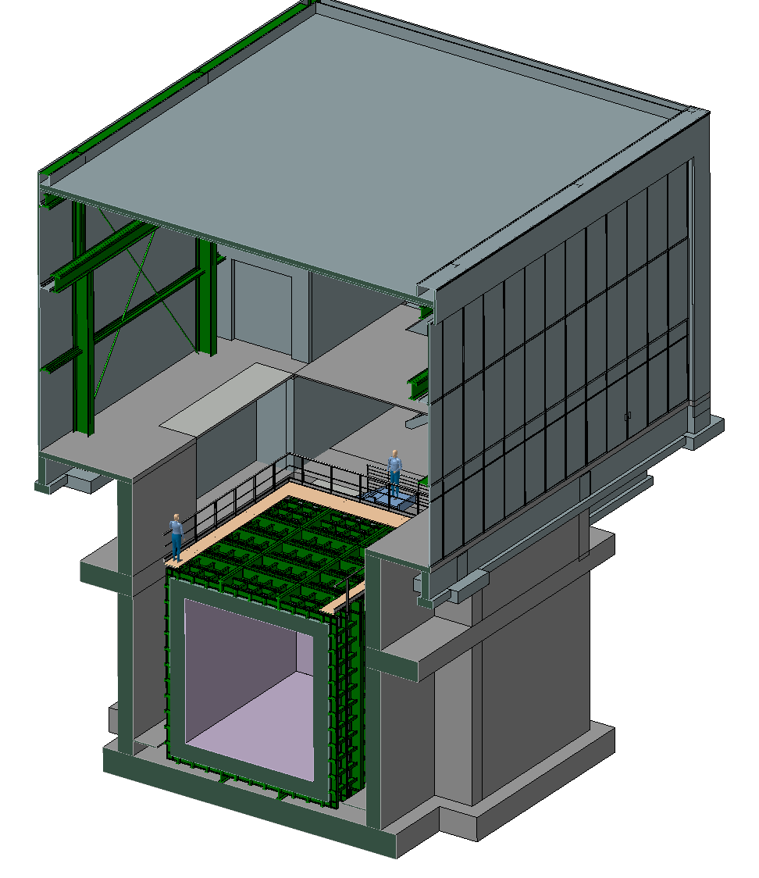
FermiLab- Layout
We have received the model of the experimental building and we integrated the cryostat inside.

Slide 3
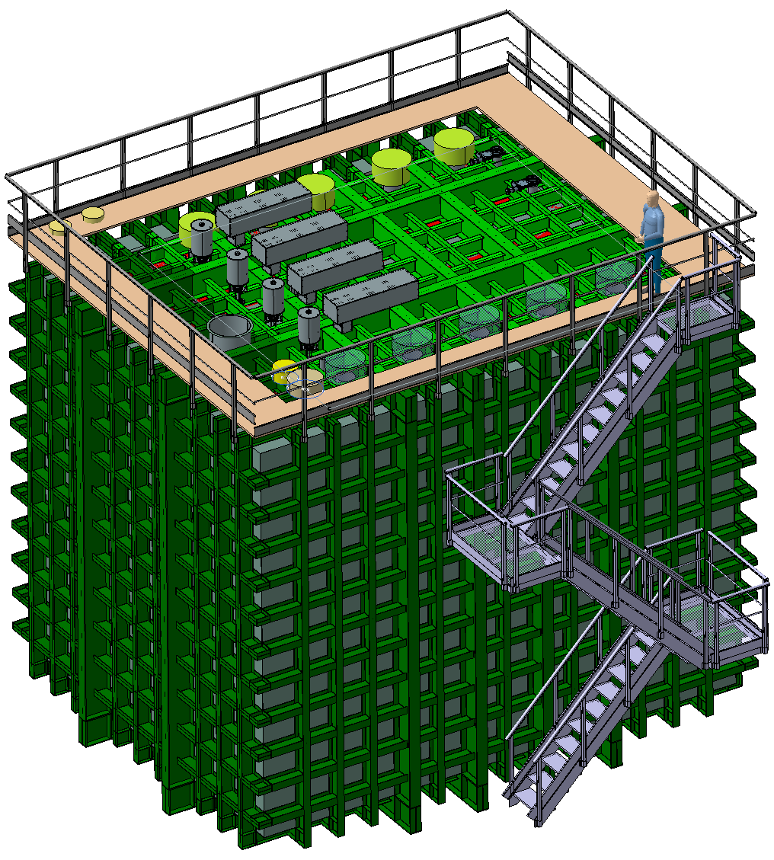
Current Status
We have also received last week the models of the Top-Cap and the detector. This is the most current integration model we have.
Some problems with translations between CAD systems still to be sorted out.
In contact with Joe Howell.

Slide 4
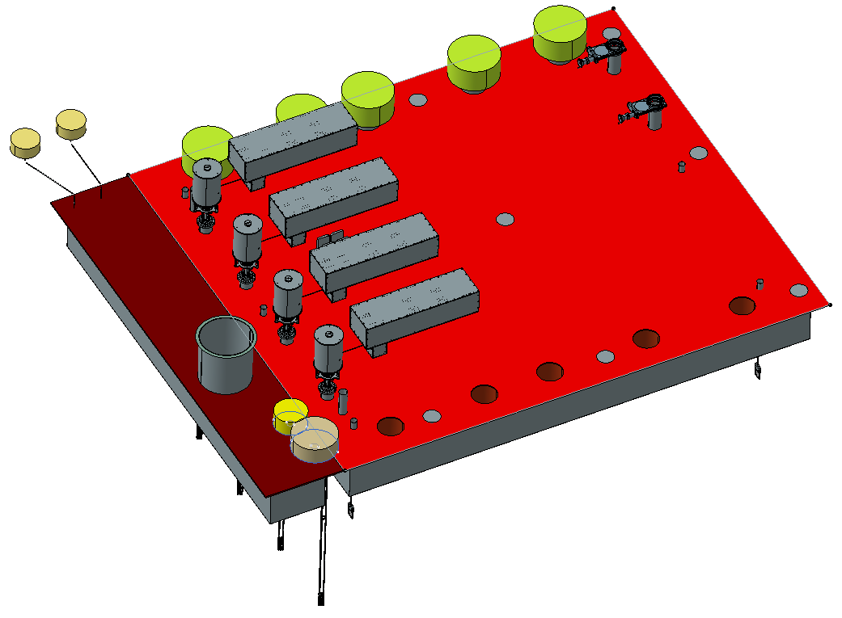
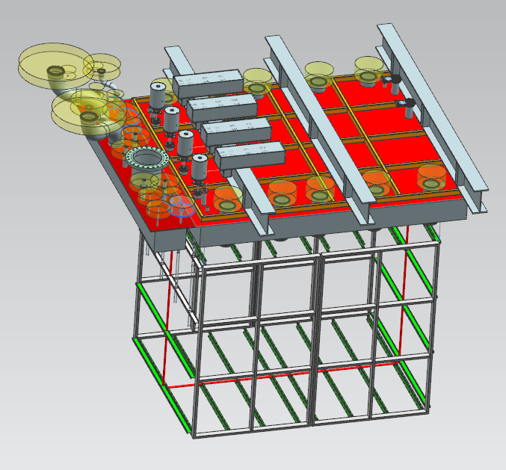
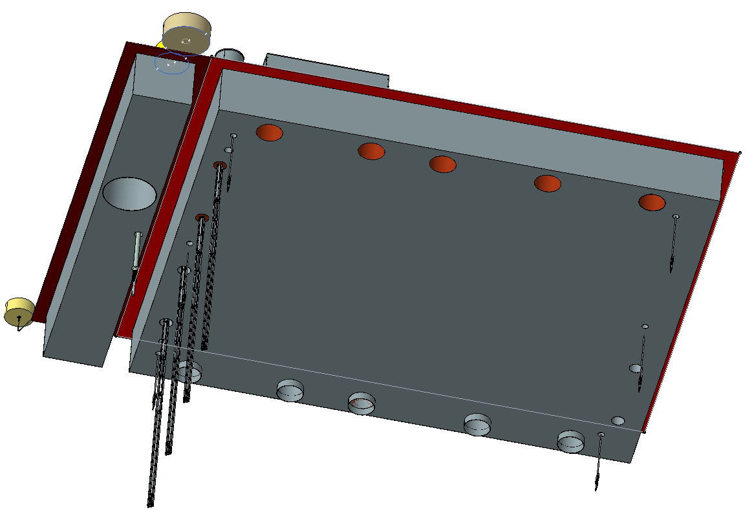
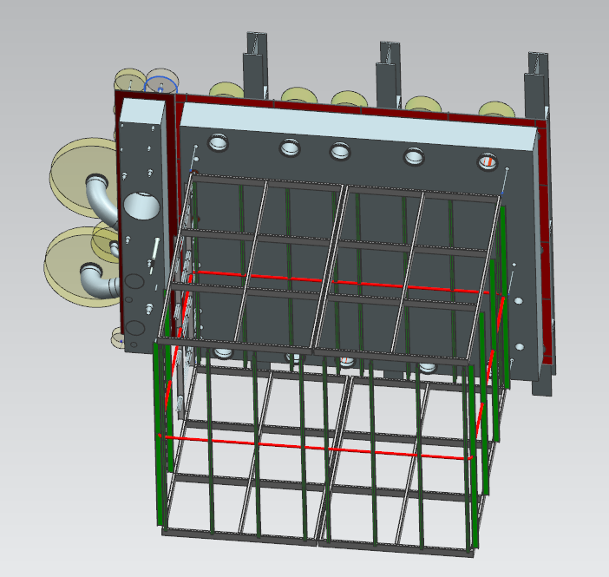
CAD - Translation Problems
On the left is what we are receiving.
On the right is what we should have received.

Slide 5
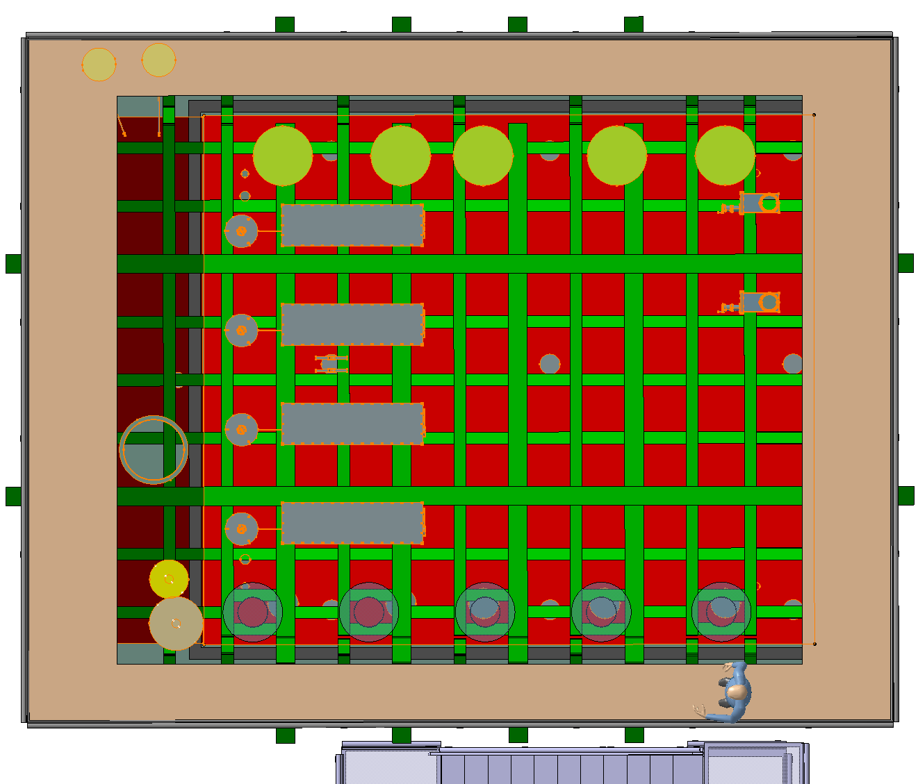
Penetrations List
Penetrations on the removable Top-Cap
TPC Support N. 6, crossing tube diameter 6"
TPC Signal/Power Feedthrough N. 4, crossing tube diameter 14"
LDS Signal/Power Feedthrough N. 6, crossing tube diameter 14"
Laser ports N. 4, crossing tube diameter 8"
Detector monitoring N. 2, crossing tube diameter 6"
Radiation source deployment N. 2, crossing tube diameter 8"
Penetrations on the fixed portion
Argon purge gas N. 4, crossing tube diameter 2"
Argon make up gas N. 1, crossing tube diameter 1.75"
Argon purge gas N. 1, crossing tube diameter 1.75"
Argon gas momentum N. 1, crossing tube diameter 1.25"
Argon gas cooldown N. 1, crossing tube diameter 1.25"
Argon liquid cooldown N. 1, crossing tube diameter 3.75"
Argon liquid distribution N. 1, crossing tube diameter 3.75"
Argon liquid to cold roof N. 1, crossing tube diameter 3.75"
Argon liquid path to condenser N. 1, crossing tube diameter 3.75"
Argon gas boil-off N. 1, crossing tube diameter 4.75"
Liquid level probes N. 2, crossing tube diameter 0.75"
Argon gas vent port N. 12, crossing tube diameter 0.375"
Spare port N. 1, crossing tube diameter 4.75"
Spare port N. 1, crossing tube diameter 4.75"
Argon vacuum relief N. 12, crossing tube diameter 0.375"
Instrumentation port N. 1, crossing tube diameter 0.375"
Instrumentation port N. 1, crossing tube diameter 0.375"
Instrumentation port N. 1, crossing tube diameter 4.25"

Slide 6
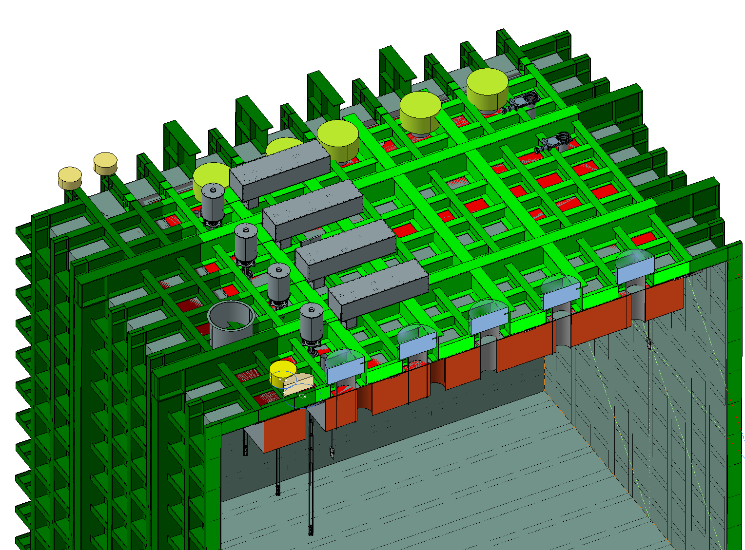
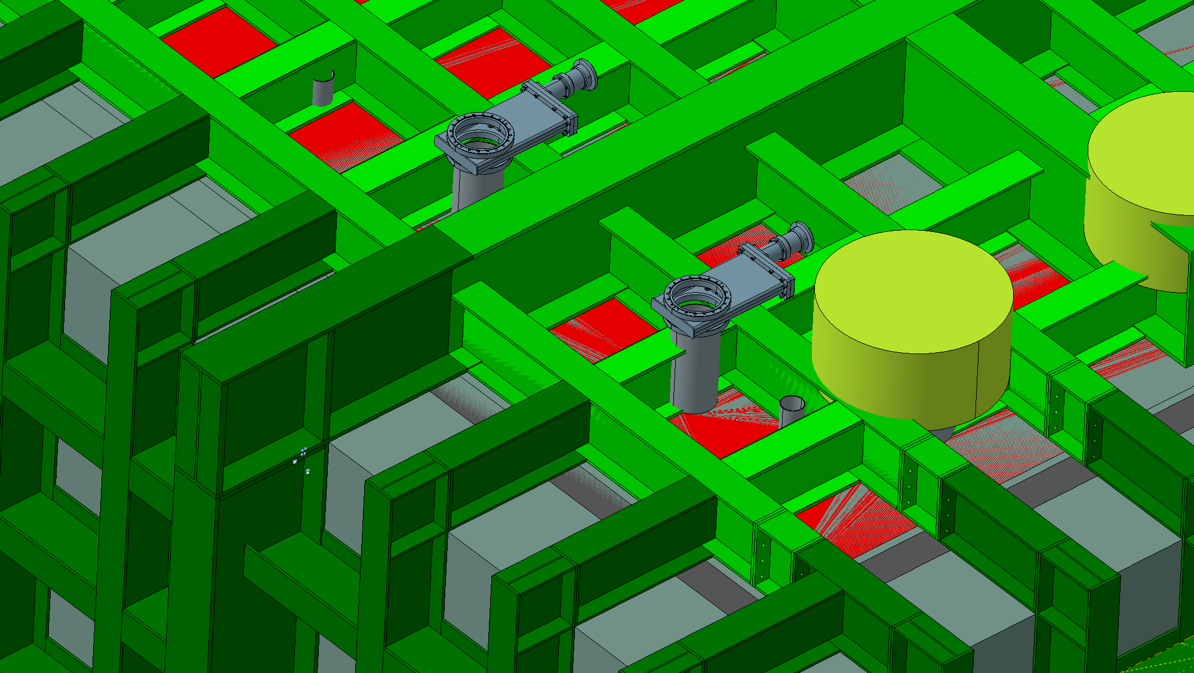
Integration Studies
Trying to find a way how to close (and weld) the Top-Cap with the existing steel structure in place. Currently developing interface pieces.
Trying to find a way how to integrate the steel structure with the penetrations requirements

Slide 7
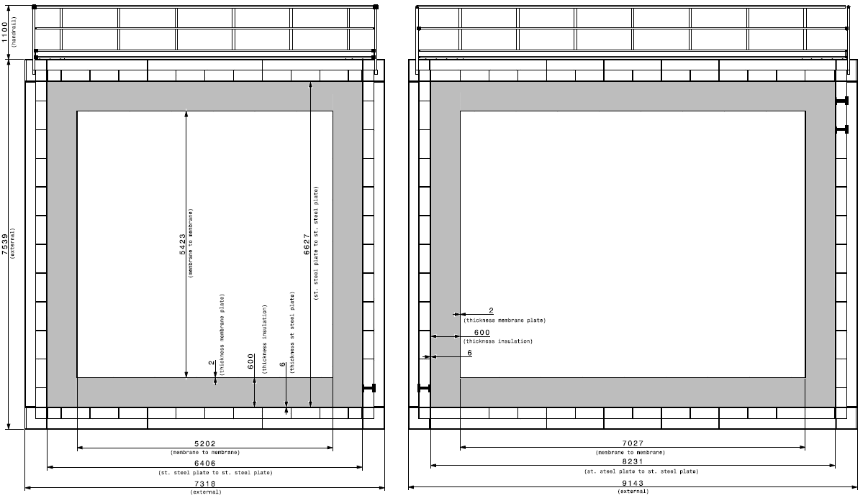
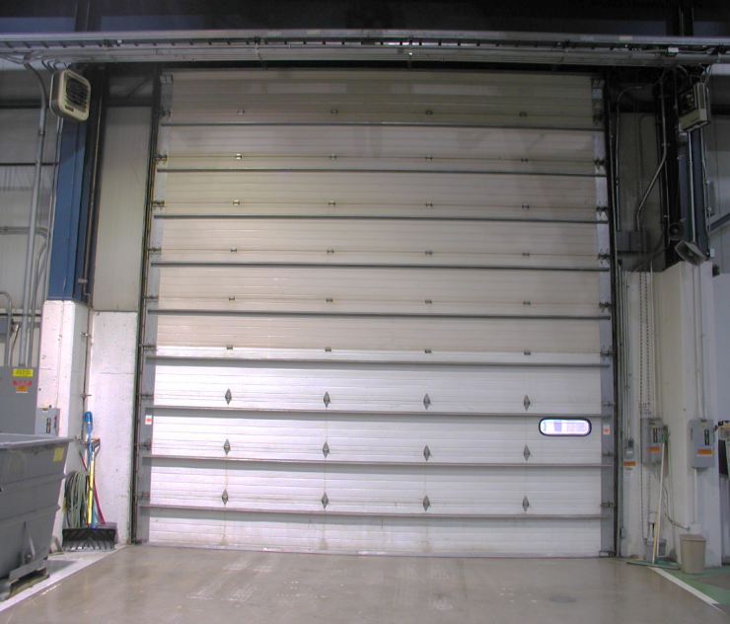
SBND - Dimensions
Door
20’ high
6’096 mm
6’083 mm clearance
7’539mm (height) – 450mm (beam) – 600mm (insulation) – 400mm (detector)

Slide 8
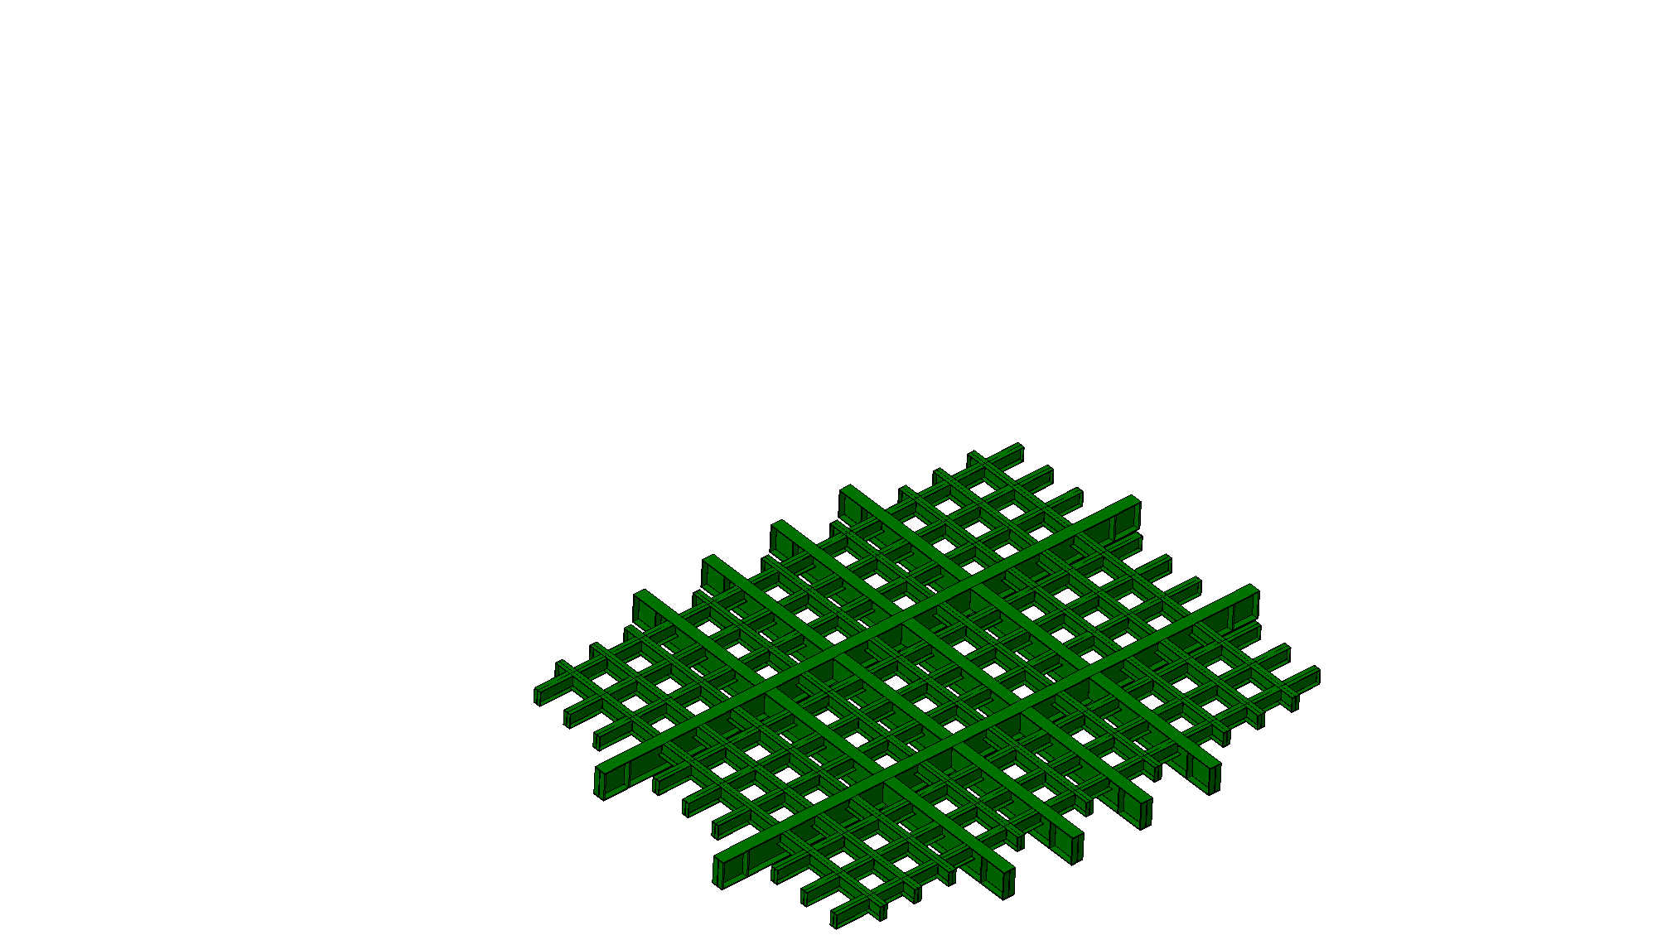
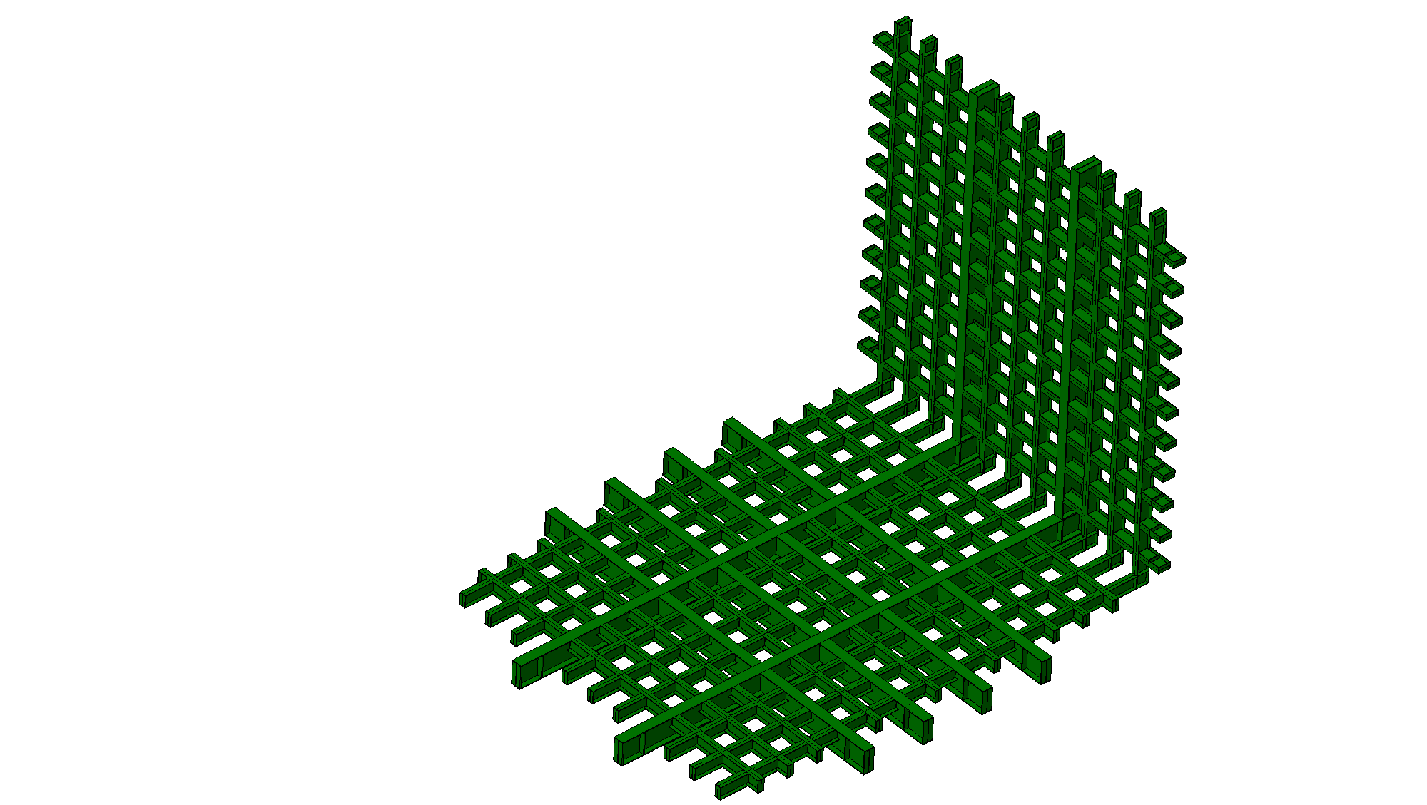
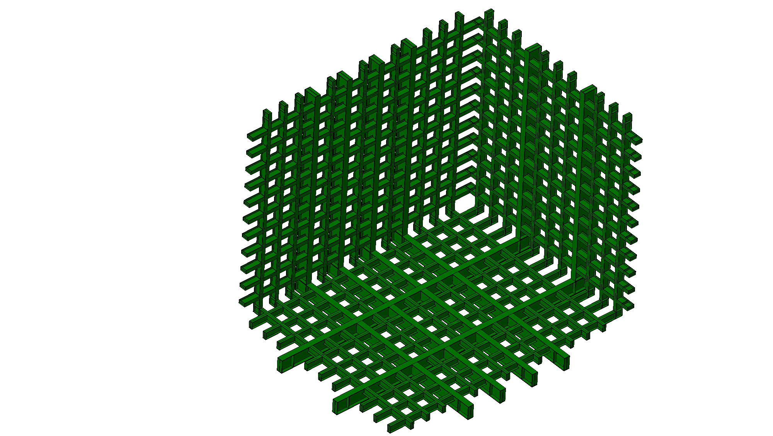
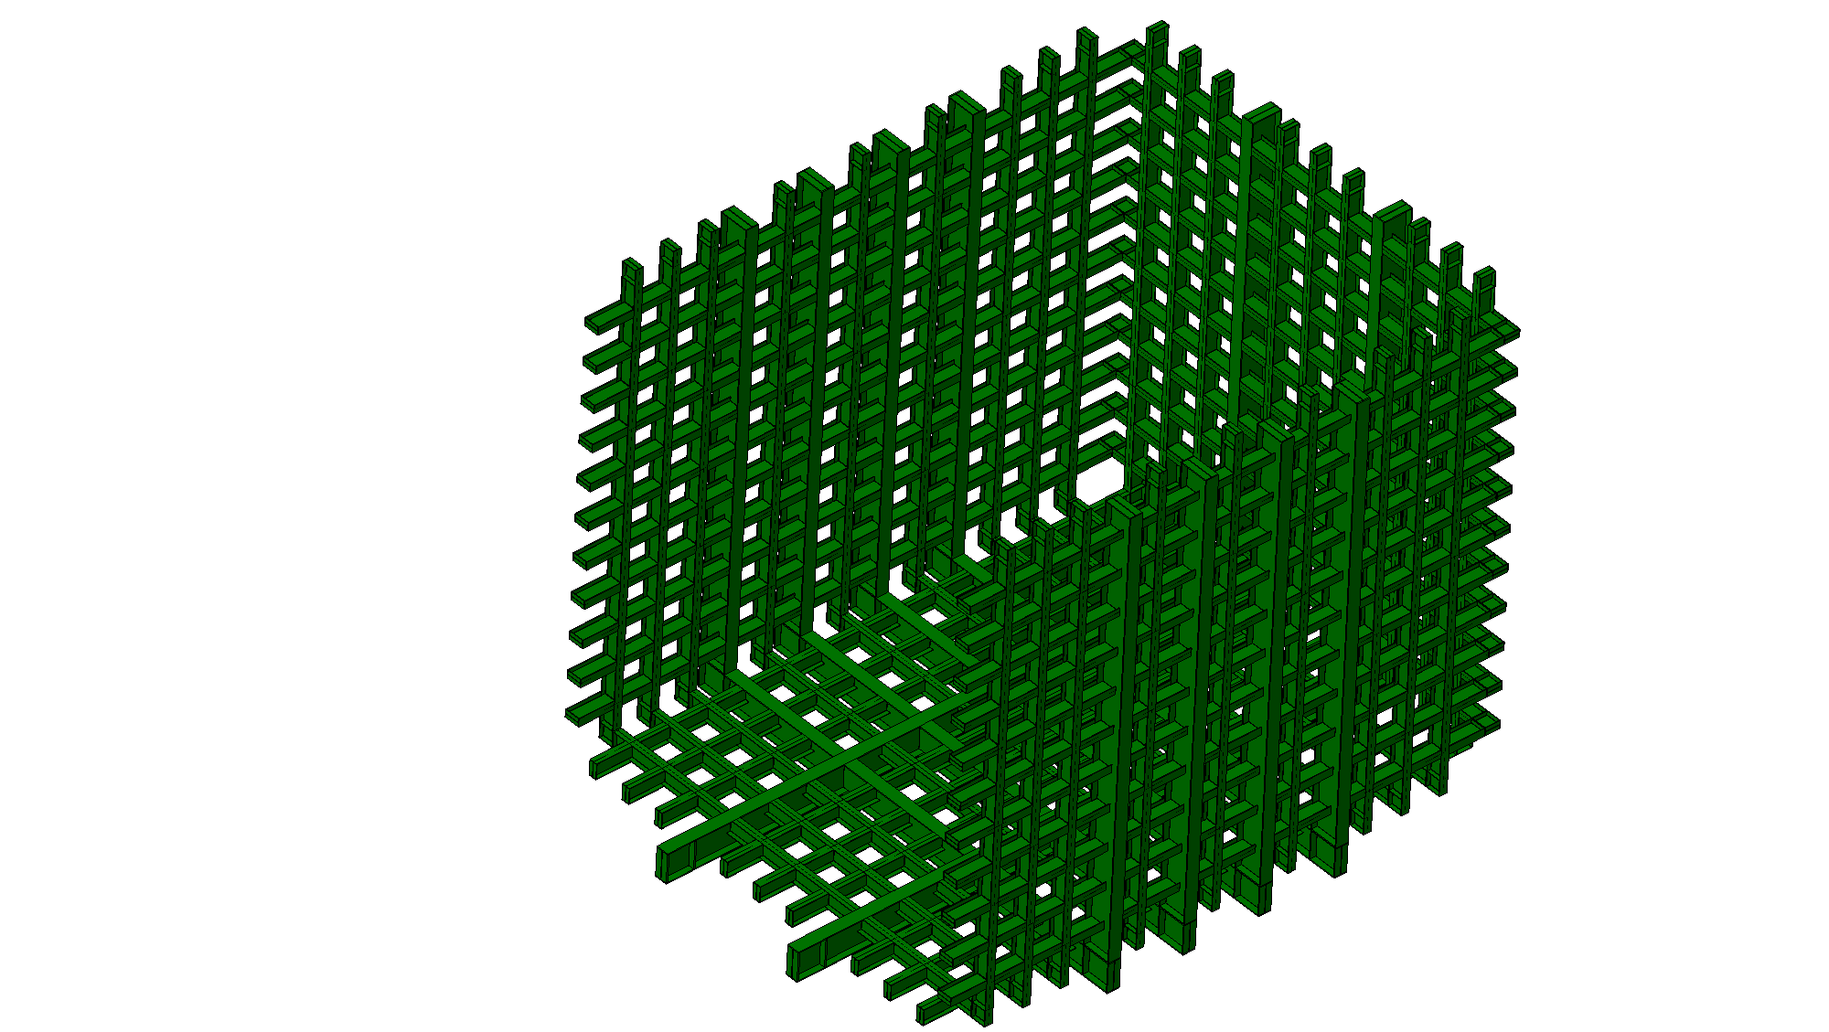
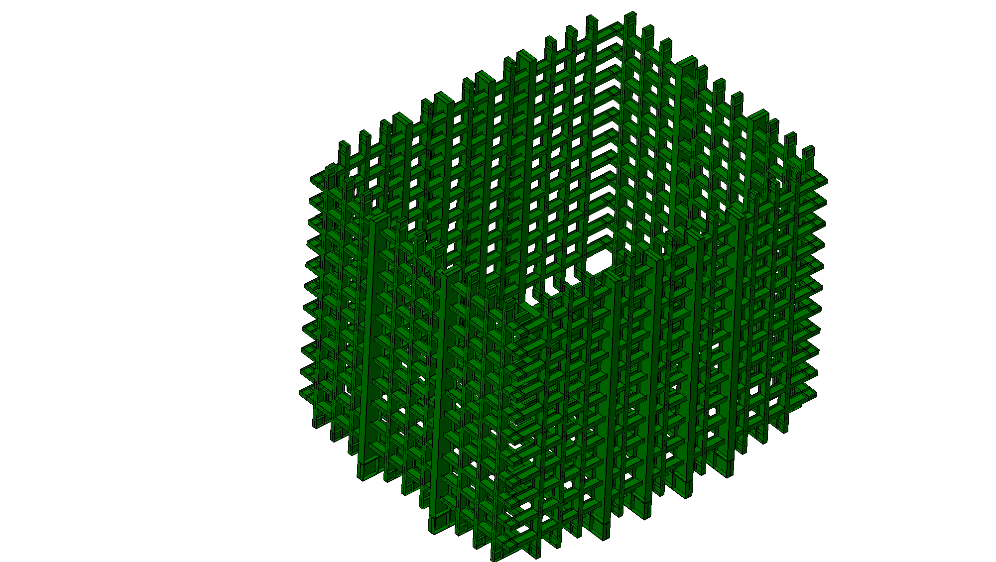
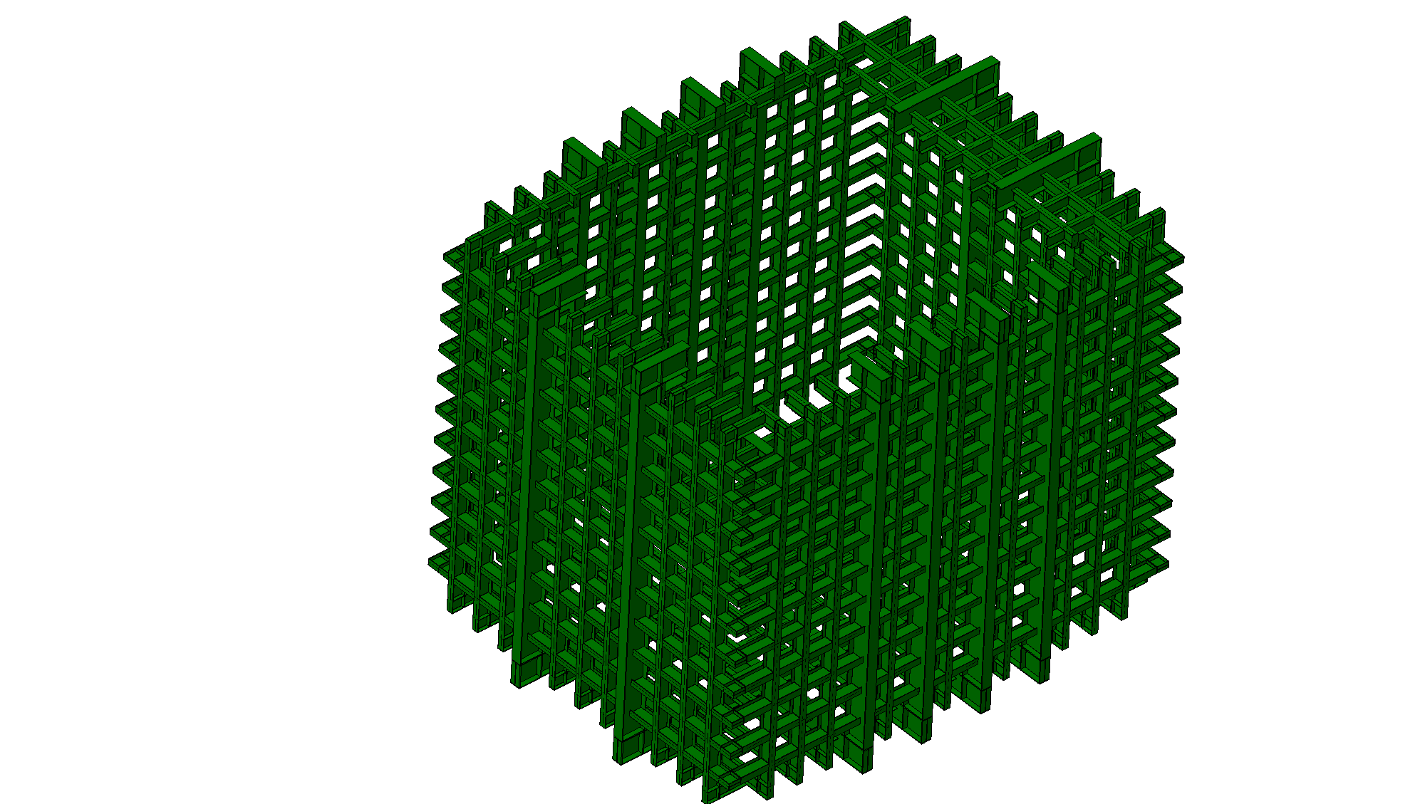
Installation

Slide 9
Thank You!

